Slide 1

Chapter
1
MANAGING THE
DIGITAL FIRM

Slide 2
Management Information Systems 8/e
Chapter 1 Managing the Digital Firm
OBJECTIVES
What is the role of information systems in today’s competitive business environment?
What exactly is an information system? What do managers need to know about information systems?
How are information systems transforming organizations and management?

Slide 3
Management Information Systems 8/e
Chapter 1 Managing the Digital Firm
OBJECTIVES
How has the Internet and Internet technology transformed business?
What are the major management challenges to building and using information systems?

Slide 4
Management Information Systems 8/e
Chapter 1 Managing the Digital Firm
MANAGEMENT CHALLENGES
1. Design competitive and effective systems
2. Understand system requirements of global business environment
3. Create information architecture that supports organization’s goal

Slide 5
Management Information Systems 8/e
Chapter 1 Managing the Digital Firm
MANAGEMENT CHALLENGES
4. Determine business value of information systems
5. Design systems people can control, understand and use in a socially, ethically responsible manner

Slide 6
Management Information Systems 8/e
Chapter 1 Managing the Digital Firm
WHY INFORMATION SYSTEMS?
The Competitive Business Environment and the Emerging Digital Firm
Four powerful worldwide changes that
have altered the business environment:
Emergence of the Global Economy
Transformation of Industrial Economies
Transformation of the Business Enterprise
The Emerging Digital Firm

Slide 7
Management Information Systems 8/e
Chapter 1 Managing the Digital Firm
WHY INFORMATION SYSTEMS?
The Competitive Business Environment and the Emerging Digital Firm
Emergence of the Global Economy
Management and control in a global marketplace
Competition in world markets
Global work groups
Global delivery systems

Slide 8
Management Information Systems 8/e
Chapter 1 Managing the Digital Firm
WHY INFORMATION SYSTEMS?
The Competitive Business Environment and the Emerging Digital Firm
Transformation of Industrial Economies
Knowledge- and information-based economies
Productivity
New products and services
Knowledge: a central productive and strategic asset

Slide 9
Management Information Systems 8/e
Chapter 1 Managing the Digital Firm
WHY INFORMATION SYSTEMS?
The Competitive Business Environment and the Emerging Digital Firm
Transformation of Industrial Economies
Time-based competition
Shorter product life
Turbulent environment
Limited employee knowledge base

Slide 10
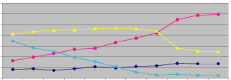
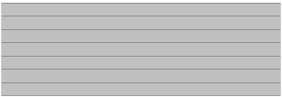

Management Information Systems 8/e
Chapter 1 Managing the Digital Firm
WHY INFORMATION SYSTEMS?
Labor Force Composition 1900-2000
Labor Force Composition 1900-2000
70%
60%
50%
40%
30%
20%
10%
0%
1900
1910
1920
1930
1940
1950
1960
1970
1980
1997
2000
Year
Figure 1-1

Slide 11
Management Information Systems 8/e
Chapter 1 Managing the Digital Firm
WHY INFORMATION SYSTEMS?
The Competitive Business Environment and the Emerging Digital Firm
Transformation of the Business Enterprise
Flattening
Decentralization
Flexibility
Location independence
Low transaction and coordination costs
Empowerment
Collaborative work and teamwork

Slide 12
Management Information Systems 8/e
Chapter 1 Managing the Digital Firm
WHY INFORMATION SYSTEMS?
The Competitive Business Environment and the Emerging Digital Firm
Emergence of the Digital Firm
Digitally-enabled relationships with customers, suppliers, and employees
Core business processes accomplished via digital networks
Digital management of key corporate assets
Rapid sensing and responding to environmental changes

Slide 13
Management Information Systems 8/e
Chapter 1 Managing the Digital Firm
WHY INFORMATION SYSTEMS?
The Competitive Business Environment and the Emerging Digital Firm
4 Major Systems Defining the Digital Firm
Supply chain management systems
Customer relationship management systems
Enterprise systems
Knowledge management systems

Slide 14
Management Information Systems 8/e
Chapter 1 Managing the Digital Firm
WHY INFORMATION SYSTEMS?
What Is an Information System?
A set of interrelated components that collect
(or retrieve), process, store, and distribute
information to support decision making and
control in an organization

Slide 15
Management Information Systems 8/e
Chapter 1 Managing the Digital Firm
WHY INFORMATION SYSTEMS?
What Is an Information System?
Data: Streams of raw facts representing events such as business transactions
Information: Clusters of facts that are meaningful and useful to human beings in the processes such as making decisions

Slide 16
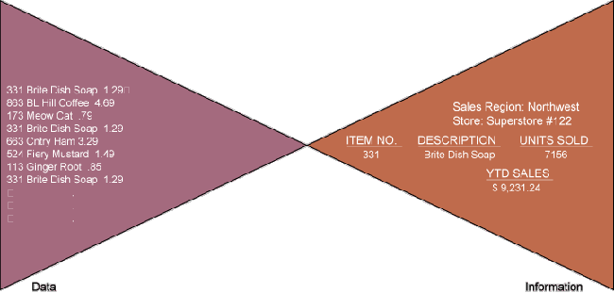
Management Information Systems 8/e
Chapter 1 Managing the Digital Firm
WHY INFORMATION SYSTEMS?
What Is an Information System?
Data and Information
Figure 1-2

Slide 17
Management Information Systems 8/e
Chapter 1 Managing the Digital Firm
WHY INFORMATION SYSTEMS?
Activities in an Information System
INPUT
PROCESS
OUTPUT
FEEDBACK

Slide 18
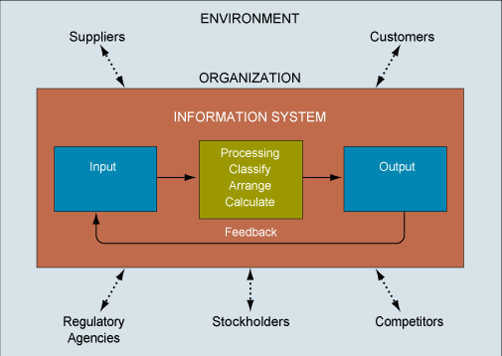
Management Information Systems 8/e
Chapter 1 Managing the Digital Firm
WHY INFORMATION SYSTEMS?
Functions of an Information System
Figure 1-3

Slide 19
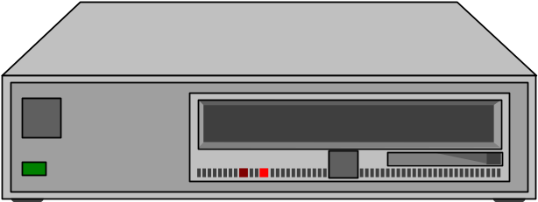
Management Information Systems 8/e
Chapter 1 Managing the Digital Firm
WHY INFORMATION SYSTEMS?
Computer-Based Information System (CBIS)
Rely on computer hardware and software
Processing and disseminating information

Slide 20
Management Information Systems 8/e
Chapter 1 Managing the Digital Firm
WHY INFORMATION SYSTEMS?
Formal Systems
Fixed definitions of data, procedures
Collecting, storing, processing, disseminating, using data

Slide 21
Management Information Systems 8/e
Chapter 1 Managing the Digital Firm
WHY INFORMATION SYSTEMS?
A Business Perspective on Information Systems
An organizational and management solution based on information technology to a challenge posed by the environment
An important instrument for creating value for the organization
Stages in the business information value chain add value to information

Slide 22
Management Information Systems 8/e
Chapter 1 Managing the Digital Firm
WHY INFORMATION SYSTEMS?
Business Processes
Supply
Enterprise
Customer
Knowledge
Chain
Management
Management
Management
Firm
Management
Profitability
and
Strategic
Position
Data
Transformation
Dissemination
Collection
Into
and
Business
Storage
Systems
Planning
Coordinating
Controlling
Modeling and
Decision
Making
Information Processing Activities
Management Activities
Business Value
Figure 1-4

Slide 23
Management Information Systems 8/e
Chapter 1 Managing the Digital Firm
WHY INFORMATION SYSTEMS?
Information Systems
ORGANIZATIONS
TECHNOLOGY
INFORMATION
SYSTEMS
MANAGEMENT
Figure 1-5

Slide 24
Management Information Systems 8/e
Chapter 1 Managing the Digital Firm
WHY INFORMATION SYSTEMS?
A Business Perspective on Information Systems
Information systems literacy: Broad-based understanding of information systems that includes behavioral knowledge about organizations and individuals using information systems and technical knowledge about computers.
Computer literacy: Knowledge about information technology, focusing on
understanding how computer-based technologies work

Slide 25
Management Information Systems 8/e
Chapter 1 Managing the Digital Firm
WHY INFORMATION SYSTEMS?
Major Business Functions
Sales and marketing
Manufacturing
Finance
Accounting
Human resources

Slide 26
Management Information Systems 8/e
Chapter 1 Managing the Digital Firm
WHY INFORMATION SYSTEMS?
Organizations
Key Elements:
People: Managers, knowledge workers, data workers, production or service workers
Structure: Organization chart , groups of specialists, products, geography

Slide 27
Management Information Systems 8/e
Chapter 1 Managing the Digital Firm
WHY INFORMATION SYSTEMS?
Organizations
Operating procedures: Standard operating procedures (SOP, rules for action)
Politics: Power to persuade, get things done
Culture: Customs of behavior

Slide 28
Management Information Systems 8/e
Chapter 1 Managing the Digital Firm
WHY INFORMATION SYSTEMS?
Management
Levels:
Senior managers: make long-range strategic decisions about products and services
Middle managers: Carry out the programs and plans of senior management
Operational managers: monitor the firm’s daily activities

Slide 29

Management Information Systems 8/e
Chapter 1 Managing the Digital Firm
WHY INFORMATION SYSTEMS?
Computer Technology
Tools managers use to cope with change
Hardware: Physical equipment
Software: Detailed preprogrammed instructions
Storage: Physical media for
storing data and the software

Slide 30
Management Information Systems 8/e
Chapter 1 Managing the Digital Firm
WHY INFORMATION SYSTEMS?
Computer Technology
Communications Technology: transfers data from one physical location to another
Networks: link computers to share data or resources

Slide 31

Management Information Systems 8/e
Chapter 1 Managing the Digital Firm
CONTEMPORARY APPROACHES TO INFORMATION SYSTEMS
Technical
Approaches
Computer
Operations
Science
Research
Management
Sociology
Science
Psychology
Economics
Behavioral
Approaches
Figure 1-6

Slide 32
Management Information Systems 8/e
Chapter 1 Managing the Digital Firm
CONTEMPORARY APPROACHES TO INFORMATION SYSTEMS
Socio-Technical Systems
Optimize systems performance:
Technology and organization
Organizations mutually adjust to one another until fit is satisfactory

Slide 33
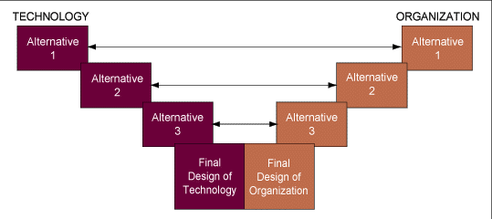
Management Information Systems 8/e
Chapter 1 Managing the Digital Firm
CONTEMPORARY APPROACHES TO INFORMATION SYSTEMS
Socio-technical Systems
Figure 1-7
SOURCE: Liker, et al, 1987

Slide 34
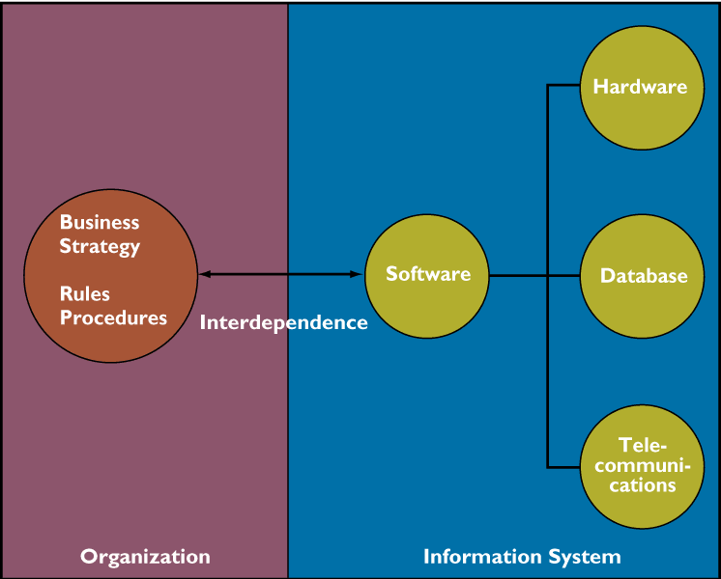
Management Information Systems 8/e
Chapter 1 Managing the Digital Firm
TOWARD THE DIGITAL FIRM
The Interdependence Between Organizations and Information Systems
Figure 1-8

Slide 35
Management Information Systems 8/e
Chapter 1 Managing the Digital Firm
TOWARD THE DIGITAL FIRM
The Widening Scope of Information Systems
1950s: Technical changes
1960s-70s: Managerial controls
1980s-90s: Institutional core activities
Today: Digital information webs extending beyond the enterprise

Slide 36
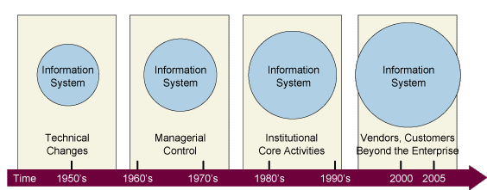
Management Information Systems 8/e
Chapter 1 Managing the Digital Firm
TOWARD THE DIGITAL FIRM
The Widening Scope of Information Systems
Figure 1-9

Slide 37
Management Information Systems 8/e
Chapter 1 Managing the Digital Firm
TOWARD THE DIGITAL FIRM
The Internet
International network of networks
Universal technology platform: Any computer can communicate with any other computer
World Wide Web and Web sites

Slide 38
Management Information Systems 8/e
Chapter 1 Managing the Digital Firm
TOWARD THE DIGITAL FIRM
What You Can Do on the Internet?
Communicate and collaborate
Access information
Participate in discussions
Supply information
Find entertainment
Exchange business transactions

Slide 39
Management Information Systems 8/e
Chapter 1 Managing the Digital Firm
TOWARD THE DIGITAL FIRM
New Options for Organizational Design
Flattening organizations
Separating work from location
Reorganizing work-flows
Increasing flexibility
Redefining organizational boundaries

Slide 40
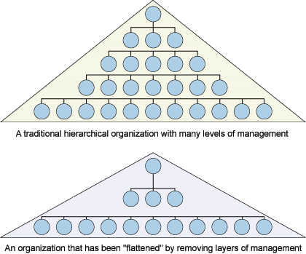
Management Information Systems 8/e
Chapter 1 Managing the Digital Firm
TOWARD THE DIGITAL FIRM
Flattening Organizations & Information Systems
Figure 1-10

Slide 41
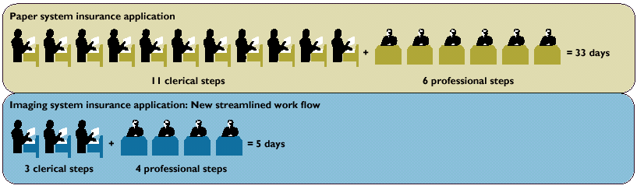
Management Information Systems 8/e
Chapter 1 Managing the Digital Firm
TOWARD THE DIGITAL FIRM
Redesigned Work Flow For Insurance Underwriting
Figure 1-11

Slide 42
Management Information Systems 8/e
Chapter 1 Managing the Digital Firm
TOWARD THE DIGITAL FIRM
The Digital Firm
Electronic commerce
Electronic business
Digital market: Information systems links, buyers and sellers to exchange information, products, services, payments

Slide 43

Management Information Systems 8/e
Chapter 1 Managing the Digital Firm
TOWARD THE DIGITAL FIRM
THE EMERGING DIGITAL FIRM
ELECTRONIC BUSINESS
Electronic Commerce
Factories
Just-in-time production
•
•
Continuous inventory
replenishment
Customers
Production planning
•
On-line marketing
•
•
On-line sales
Built-to-order products
•
•
Customer service
Sales force automation
•
Remote offices and work groups
Communicate plans and policies
•
Group collaboration
•
Electronic communication
•
•
Scheduling
Suppliers
•
Procurement
Supply chain management
•
Business partners
•
Joint design
•
Outsourcing
Figure 1-12

Slide 44
Management Information Systems 8/e
Chapter 1 Managing the Digital Firm
TOWARD THE DIGITAL FIRM
Electronic Commerce
Internet links buyers, sellers
Lower transaction costs
Goods and services advertised, bought, exchanged worldwide
Business-to-business transactions increasing

Slide 45
Management Information Systems 8/e
Chapter 1 Managing the Digital Firm
TOWARD THE DIGITAL FIRM
Electronic Business
Electronic Business: Executing all the firm’s business processes with Internet technology
Intranet: Business builds private, secure network based on Internet technology
Extranet: Extension of intranet to authorized external users

Slide 46
Management Information Systems 8/e
Chapter 1 Managing the Digital Firm
TOWARD THE DIGITAL FIRM
Information Architecture and Information Technology Infrastructure
Figure 1-13

Slide 47
Chapter
1
MANAGING THE
DIGITAL FIRM

