Slide 1

Chapter
2
INFORMATION
SYSTEMS IN THE
ENTERPRISE

Slide 2
Management Information Systems 8/e
Chapter 2 Information Systems in the Enterprise
OBJECTIVES
What are the major types of systems in a business? What role do they play?
How do information systems support the major business functions?
Why should managers pay attention to business processes?

Slide 3
Management Information Systems 8/e
Chapter 2 Information Systems in the Enterprise
OBJECTIVES
What are the benefits and challenges of using enterprise systems?
What are the benefits of using systems to support supply chain management and collaborative commerce?
What are the benefits of using information systems for customer relationship management and knowledge management?

Slide 4
Management Information Systems 8/e
Chapter 2 Information Systems in the Enterprise
MANAGEMENT CHALLENGES
Integration: Different systems serve variety of functions, connecting organizational levels difficult, costly
Enlarging scope of management thinking: Huge system investments, long development time must be guided by common objectives

Slide 5
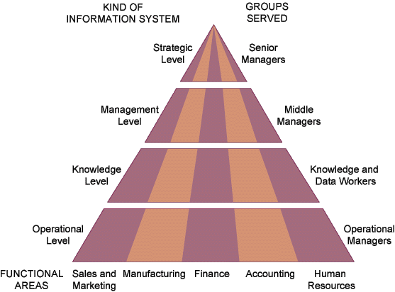
Management Information Systems 8/e
Chapter 2 Information Systems in the Enterprise
KEY SYSTEM APPLICATIONS IN THE ORGANIZATION
Types of Information Systems
Figure 2-1

Slide 6
Management Information Systems 8/e
Chapter 2 Information Systems in the Enterprise
MAJOR TYPES OF SYSTEMS IN ORGANIZATIONS
Major Types of Systems
Executive Support Systems (ESS)
Decision Support Systems (DSS)
Management Information Systems (MIS)
Knowledge Work Systems (KWS)
Office Systems
Transaction Processing Systems (TPS)

Slide 7
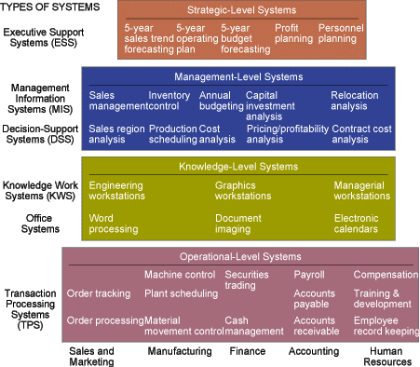
Management Information Systems 8/e
Chapter 2 Information Systems in the Enterprise
MAJOR TYPES OF SYSTEMS IN ORGANIZATIONS
Figure 2-2

Slide 8
Management Information Systems 8/e
Chapter 2 Information Systems in the Enterprise
MAJOR TYPES OF SYSTEMS IN ORGANIZATIONS
Transaction Processing Systems (TPS):
Basic business systems that serve the operational level
A computerized system that performs and records the daily routine transactions necessary to the conduct of the business

Slide 9
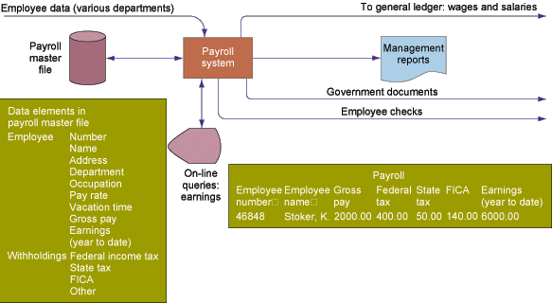
Management Information Systems 8/e
Chapter 2 Information Systems in the Enterprise
MAJOR TYPES OF SYSTEMS IN ORGANIZATIONS
Payroll TPS
Figure 2-3

Slide 10
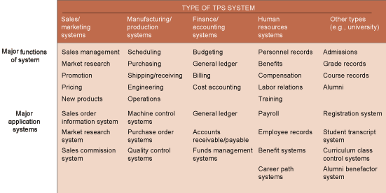
Management Information Systems 8/e
Chapter 2 Information Systems in the Enterprise
MAJOR TYPES OF SYSTEMS IN ORGANIZATIONS
Types of TPS Systems
Figure 2-4

Slide 11
Management Information Systems 8/e
Chapter 2 Information Systems in the Enterprise
MAJOR TYPES OF SYSTEMS IN ORGANIZATIONS
Knowledge Work Systems (KWS):
Knowledge level
Inputs: Design specs
Processing: Modeling
Outputs: Designs, graphics
Users: Technical staff and professionals
Example: Engineering work station

Slide 12
Management Information Systems 8/e
Chapter 2 Information Systems in the Enterprise
MAJOR TYPES OF SYSTEMS IN ORGANIZATIONS
Management Information System (MIS):
Management level
Inputs: High volume data
Processing: Simple models
Outputs: Summary reports
Users: Middle managers
Example: Annual budgeting

Slide 13
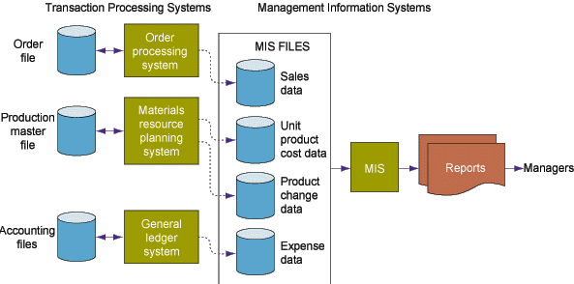
Management Information Systems 8/e
Chapter 2 Information Systems in the Enterprise
MAJOR TYPES OF SYSTEMS IN ORGANIZATIONS
Management Information System (MIS)
Figure 2-5

Slide 14
Management Information Systems 8/e
Chapter 2 Information Systems in the Enterprise
MAJOR TYPES OF SYSTEMS IN ORGANIZATIONS
Management Information System (MIS)
Structured and semi-structured decisions
Report control oriented
Past and present data
Internal orientation
Lengthy design process

Slide 15
Management Information Systems 8/e
Chapter 2 Information Systems in the Enterprise
MAJOR TYPES OF SYSTEMS IN ORGANIZATIONS
Decision Support System (DSS):
Management level
Inputs: Low volume data
Processing: Interactive
Outputs: Decision analysis
Users: Professionals, staff
Example: Contract cost analysis

Slide 16
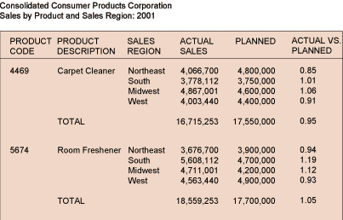
Management Information Systems 8/e
Chapter 2 Information Systems in the Enterprise
MAJOR TYPES OF SYSTEMS IN ORGANIZATIONS
Decision Support System (DSS)
Figure 2-6

Slide 17
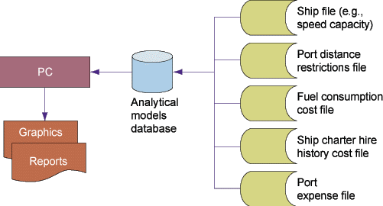
Management Information Systems 8/e
Chapter 2 Information Systems in the Enterprise
MAJOR TYPES OF SYSTEMS IN ORGANIZATIONS
Decision Support System (DSS)
Figure 2-7

Slide 18
Management Information Systems 8/e
Chapter 2 Information Systems in the Enterprise
MAJOR TYPES OF SYSTEMS IN ORGANIZATIONS
Executive Support System (ESS):
Strategic level
Inputs: Aggregate data
Processing: Interactive
Outputs: Projections
Users: Senior managers
Example: 5-year operating plan

Slide 19
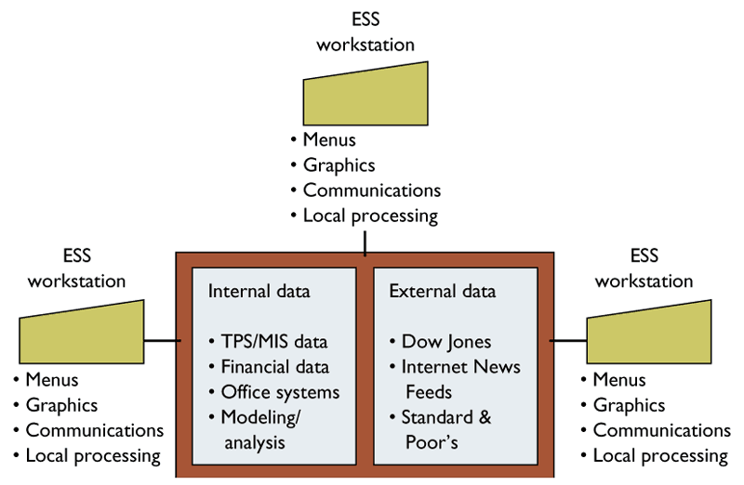
Management Information Systems 8/e
Chapter 2 Information Systems in the Enterprise
MAJOR TYPES OF SYSTEMS IN ORGANIZATIONS
Executive Support System (ESS)
Figure 2-8

Slide 20
Management Information Systems 8/e
Chapter 2 Information Systems in the Enterprise
MAJOR TYPES OF SYSTEMS IN ORGANIZATIONS
Executive support system (ESS)
Top level management
Designed to the individual
Ties CEO to all levels
Very expensive to keep up
Extensive support staff

Slide 21
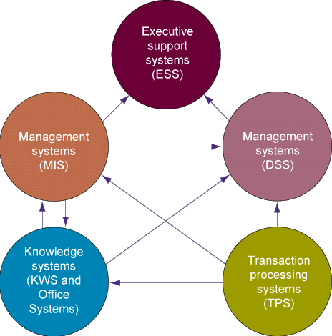
Management Information Systems 8/e
Chapter 2 Information Systems in the Enterprise
INTERRELATIONSHIPS AMONG SYSTEMS
Figure 2-9

Slide 22
Management Information Systems 8/e
Chapter 2 Information Systems in the Enterprise
SYSTEMS FROM A FUNCTIONAL PERSPECTIVE
Sales and Marketing Systems
Major functions of systems:
Sales management, market research, promotion, pricing, new products
Major application systems:
Sales order info system, market research system, pricing system

Slide 23
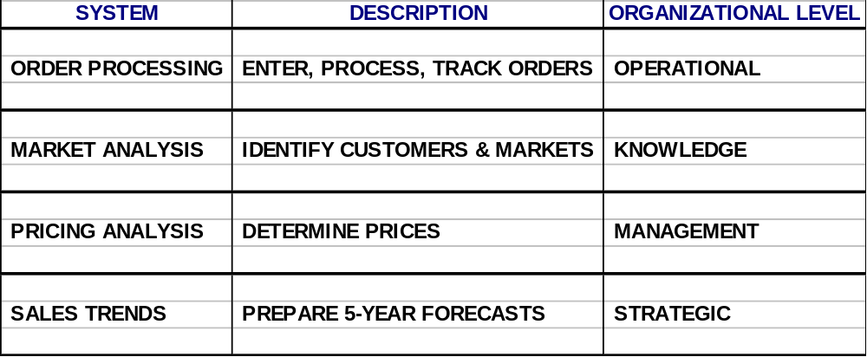
Management Information Systems 8/e
Chapter 2 Information Systems in the Enterprise
SYSTEMS FROM A FUNCTIONAL PERSPECTIVE
Sales and Marketing Systems
Table 2-2

Slide 24
Management Information Systems 8/e
Chapter 2 Information Systems in the Enterprise
SYSTEMS FROM A FUNCTIONAL PERSPECTIVE
Manufacturing and Production Systems
Major functions of systems:
Scheduling, purchasing, shipping, receiving, engineering, operations
Major application systems:
Materials resource planning systems, purchase order control systems, engineering systems, quality control systems

Slide 25
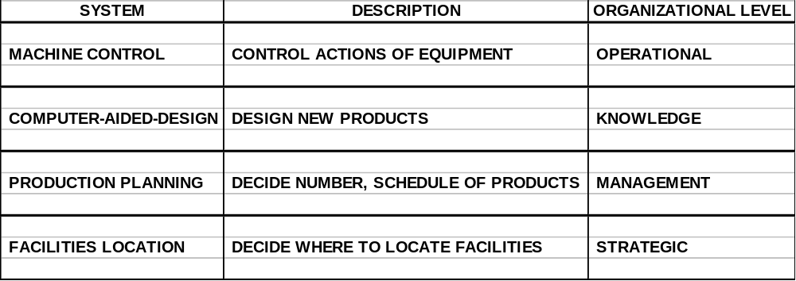
Management Information Systems 8/e
Chapter 2 Information Systems in the Enterprise
SYSTEMS FROM A FUNCTIONAL PERSPECTIVE
Manufacturing and Production Systems
Table 2-3

Slide 26
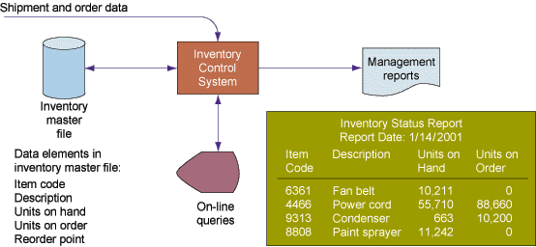
Management Information Systems 8/e
Chapter 2 Information Systems in the Enterprise
SYSTEMS FROM A FUNCTIONAL PERSPECTIVE
Overview of Inventory Systems
Figure 2-10

Slide 27
Management Information Systems 8/e
Chapter 2 Information Systems in the Enterprise
SYSTEMS FROM A FUNCTIONAL PERSPECTIVE
Financing and Accounting Systems
Major functions of systems:
Budgeting, general ledger, billing, cost accounting
Major application systems:
General ledger, accounts receivable, accounts payable, budgeting, funds management systems

Slide 28
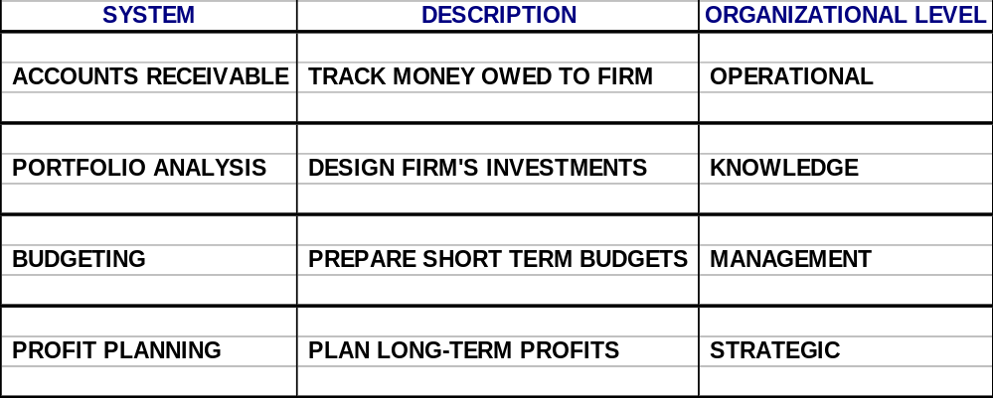
Management Information Systems 8/e
Chapter 2 Information Systems in the Enterprise
SYSTEMS FROM A FUNCTIONAL PERSPECTIVE
Financing and Accounting Systems
Table 2-4

Slide 29
Management Information Systems 8/e
Chapter 2 Information Systems in the Enterprise
SYSTEMS FROM A FUNCTIONAL PERSPECTIVE
Human Resource Systems
Major functions of systems:
Personnel records, benefits, compensation, labor relations, training
Major application systems:
Payroll, employee records, benefit systems, career path systems, personnel training systems

Slide 30
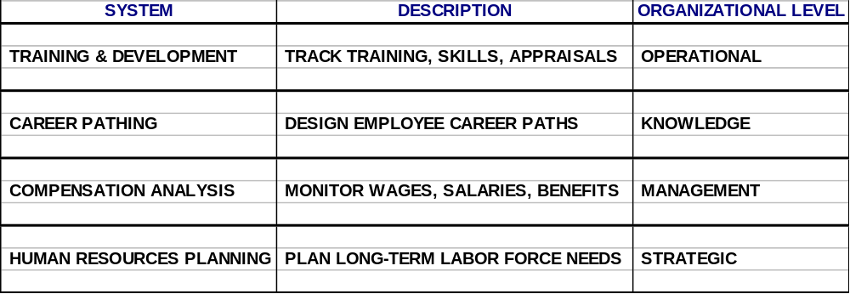
Management Information Systems 8/e
Chapter 2 Information Systems in the Enterprise
SYSTEMS FROM A FUNCTIONAL PERSPECTIVE
Human Resource Systems
Table 2-5

Slide 31
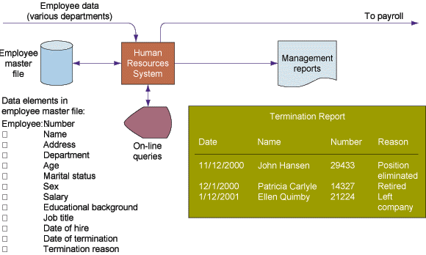
Management Information Systems 8/e
Chapter 2 Information Systems in the Enterprise
SYSTEMS FROM A FUNCTIONAL PERSPECTIVE
Human Resource Systems
Figure 2-11

Slide 32
Management Information Systems 8/e
Chapter 2 Information Systems in the Enterprise
ENTERPRISE APPLICATIONS
Business Processes and Information Systems
Business processes
Manner in which work is organized, coordinated, and focused to produce a valuable product or service
Concrete work flows of material, information, and knowledge—sets of activities

Slide 33
Management Information Systems 8/e
Chapter 2 Information Systems in the Enterprise
ENTERPRISE APPLICATIONS
Business Processes and Information Systems
Unique ways to coordinate work,
information, and knowledge
Ways in which management chooses
to coordinate work

Slide 34
Management Information Systems 8/e
Chapter 2 Information Systems in the Enterprise
ENTERPRISE APPLICATIONS
Business Processes and Information Systems
Information systems help organizations
Achieve great efficiencies by automating parts of processes
Rethink and streamline processes

Slide 35
Management Information Systems 8/e
Chapter 2 Information Systems in the Enterprise
ENTERPRISE APPLICATIONS
Examples of Business Processes
Manufacturing and production: Assembling product, checking quality, producing bills of materials
Sales and marketing: Identifying customers, creating customer awareness, selling

Slide 36
Management Information Systems 8/e
Chapter 2 Information Systems in the Enterprise
ENTERPRISE APPLICATIONS
Examples of Business Processes
Finance and accounting: Paying creditors, creating financial statements, managing cash accounts
Human Resources: Hiring employees, evaluating performance, enrolling employees in benefits plans

Slide 37
Management Information Systems 8/e
Chapter 2 Information Systems in the Enterprise
ENTERPRISE APPLICATIONS
Business Processes and Information Systems
Cross-Functional Business Processes
Transcend boundary between sales, marketing, manufacturing, and research and development
Group employees from different functional specialties to a complete piece of work
Example: Order Fulfillment Process

Slide 38
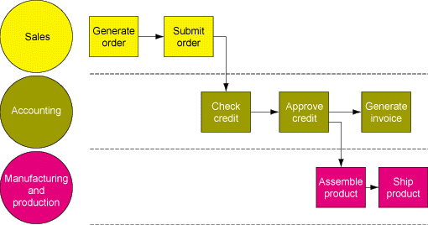
Management Information Systems 8/e
Chapter 2 Information Systems in the Enterprise
ENTERPRISE APPLICATIONS
The Order Fulfillment Process
Figure 2-12

Slide 39
Management Information Systems 8/e
Chapter 2 Information Systems in the Enterprise
ENTERPRISE APPLICATIONS
Enterprise Applications
Enterprise systems
Supply chain management systems
Customer relationship management systems
Knowledge management systems

Slide 40
Management Information Systems 8/e
Chapter 2 Information Systems in the Enterprise
ENTERPRISE APPLICATIONS
Traditional View of the Systems
Within the business: There are functions, each having its uses of information systems
Outside the organization’s boundaries: There are customers and vendors
Functions tend to work in isolation

Slide 41
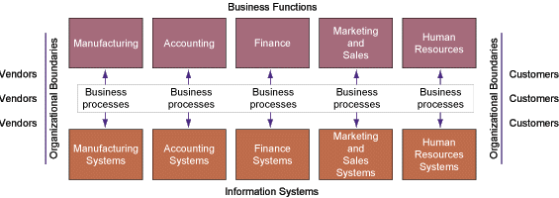
Management Information Systems 8/e
Chapter 2 Information Systems in the Enterprise
ENTERPRISE APPLICATIONS
Traditional View of the Systems
Figure 2-13

Slide 42
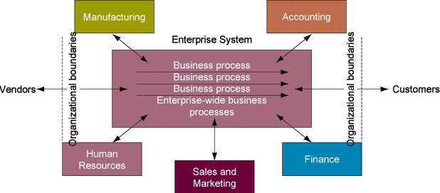
Management Information Systems 8/e
Chapter 2 Information Systems in the Enterprise
ENTERPRISE APPLICATIONS
Enterprise Systems
Figure 2-14

Slide 43
Management Information Systems 8/e
Chapter 2 Information Systems in the Enterprise
ENTERPRISE APPLICATIONS
Benefits of Enterprise Systems
Firm structure and organization: One organization
Management: Firm-wide knowledge-based management processes
Technology: Unified platform
Business: More efficient operations and customer-driven business processes

Slide 44
Management Information Systems 8/e
Chapter 2 Information Systems in the Enterprise
ENTERPRISE APPLICATIONS
Challenges of Enterprise Systems
Difficult to build: Require fundamental changes in the way the business operates
Technology: Require complex pieces of software and large investments of time, money, and expertise
Centralized organizational coordination and decision making: Not the best way for the firms to operate

Slide 45
Management Information Systems 8/e
Chapter 2 Information Systems in the Enterprise
ENTERPRISE APPLICATIONS
Supply Chain Management (SCM)
Supply Chain Management (SCM)
Close linkage and coordination of activities involved in buying, making, and moving a product
Integrates supplier, manufacturer, distributor, and customer logistics time
Reduces time, redundant effort, and inventory costs

Slide 46
Management Information Systems 8/e
Chapter 2 Information Systems in the Enterprise
ENTERPRISE APPLICATIONS
Supply Chain Management (SCM)
Supply Chain
Network of organizations and business processes
Helps in procurement of materials, transformation of raw materials into intermediate and finished products

Slide 47
Management Information Systems 8/e
Chapter 2 Information Systems in the Enterprise
ENTERPRISE APPLICATIONS
Supply Chain Management (SCM)
Limitations:
Inefficiencies can waste as much as 25% of company’s operating costs
Bullwhip Effect: Information about the demand for the product gets distorted as it passes from one entity to next

Slide 48
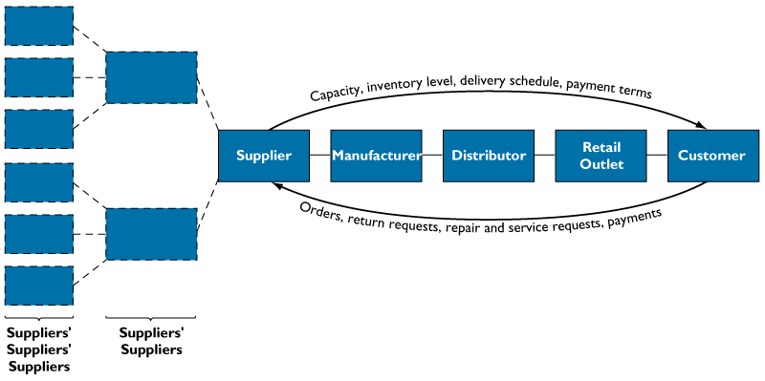
Management Information Systems 8/e
Chapter 2 Information Systems in the Enterprise
ENTERPRISE APPLICATIONS
Supply Chain Management
Figure 2-15

Slide 49
Management Information Systems 8/e
Chapter 2 Information Systems in the Enterprise
ENTERPRISE APPLICATIONS
Supply Chain Management (SCM)
Helps in distribution of the finished products to customers
Includes reverse logistics - returned items flow in the reverse direction from the buyer back to the seller

Slide 50
Management Information Systems 8/e
Chapter 2 Information Systems in the Enterprise
ENTERPRISE APPLICATIONS
How Information Systems Facilitate Supply Chain Management
Decide when, what to produce, store, move
Rapidly communicate orders
Communicate orders, track order status
Check inventory availability, monitor levels
Track shipments
Plan production based on actual demand
Rapidly communicate product design change
Provide product specifications
Share information about defect rates, returns

Slide 51
Management Information Systems 8/e
Chapter 2 Information Systems in the Enterprise
ENTERPRISE APPLICATIONS
Supply Chain Management (SCM)
Supply chain planning system: Enables firm to generate forecasts for a product and to develop sourcing and a manufacturing plan for the product
Supply chain execution system: Manages flow of products through distribution centers and warehouses

Slide 52
Management Information Systems 8/e
Chapter 2 Information Systems in the Enterprise
ENTERPRISE APPLICATIONS
Collaborative Commerce
Uses digital technologies to enable multiple organizations to collaboratively design, develop, build, move, and manage products
Increases efficiencies in reducing product design life cycles, minimizing excess inventory, forecasting demand, and keeping partners and customers informed

Slide 53
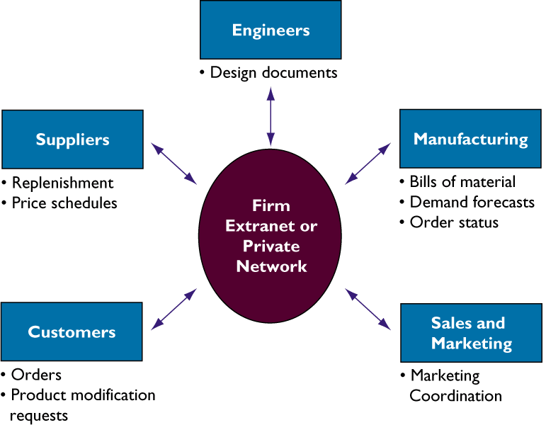
Management Information Systems 8/e
Chapter 2 Information Systems in the Enterprise
ENTERPRISE APPLICATIONS
Collaborative Commerce
Figure 2-16

Slide 54
Management Information Systems 8/e
Chapter 2 Information Systems in the Enterprise
ENTERPRISE APPLICATIONS
Industrial Networks
Private Industrial Networks
Web-enabled networks
Link systems of multiple firms in an industry
Coordinate transorganizational business processes

Slide 55
Management Information Systems 8/e
Chapter 2 Information Systems in the Enterprise
ENTERPRISE APPLICATIONS
Customer Relationship Management (CRM)
Customer Relationship Management (CRM)
Manages all ways used by firms to deal with existing and potential new customers
Business and Technology discipline
Uses information system to coordinate entire business processes of a firm

Slide 56
Management Information Systems 8/e
Chapter 2 Information Systems in the Enterprise
ENTERPRISE APPLICATIONS
Customer Relationship Management (CRM)
Provides end-to-end customer care
Provides a unified view of customer across the company
Consolidates customer data from multiple sources and provides analytical tools for answering questions

Slide 57
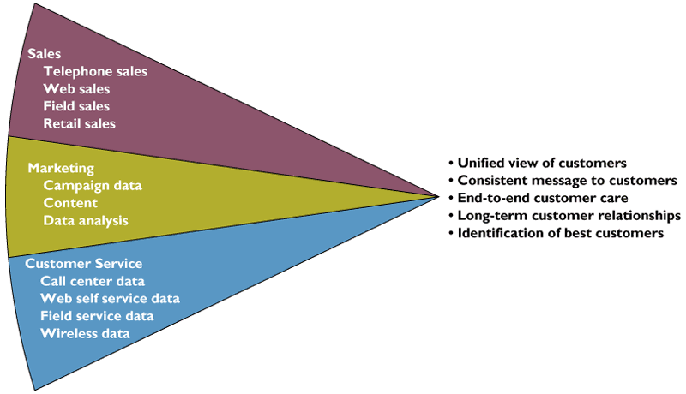
Management Information Systems 8/e
Chapter 2 Information Systems in the Enterprise
ENTERPRISE APPLICATIONS
Customer Relationship Management (CRM)
Figure 2-17

Slide 58
Management Information Systems 8/e
Chapter 2 Information Systems in the Enterprise
Knowledge Management Systems
Creating knowledge
Discovering and codifying knowledge
Sharing knowledge
Distributing knowledge

Slide 59
Chapter
2
INFORMATION
SYSTEMS IN THE
ENTERPRISE

