Slide 1

Chapter
4
THE DIGITAL FIRM: ELECTRONIC BUSINESS AND ELECTRONIC COMMERCE

Slide 2
OBJECTIVES
How has Internet technology changed value propositions and business models?
What is electronic commerce? How has electronic commerce changed consumer retailing and business-to-business transactions?
What are the principal payment systems for electronic commerce?

Slide 3
OBJECTIVES
How can Internet technology support management and coordination of internal business processes and supply chain management?
What are the major managerial and organizational challenges posed by electronic business and electronic commerce?

Slide 4
MANAGEMENT CHALLENGES
Emerging digital firm
Electronic commerce
Electronic business
Challenges and opportunities

Slide 5
MANAGEMENT CHALLENGES
Digitally enabling the enterprise requires a new mind set
Finding a successful Internet business model

Slide 6
ELECTRONIC BUSINESS, ELECTRONIC COMMERCE, AND THE EMERGING DIGITAL FIRM
Internet Technology and The Digital Firm
Information technology infrastructure: Provides a universal and easy-to-use set of technologies and technology standards that can be adopted by all organizations
Direct communication between trading partners: Disintermediation removes intermediate layers, streamlines process

Slide 7
ELECTRONIC BUSINESS, ELECTRONIC COMMERCE, AND THE EMERGING DIGITAL FIRM
Internet Technology and the Digital Firm
Round-the-clock service: Web sites available to consumers 24 hours a day
Extended distribution channels:
Outlets created for attracting customers who otherwise would not patronize
Reduced transaction costs: Costs of searching for buyers, sellers, etc. reduced

Slide 8
ELECTRONIC BUSINESS, ELECTRONIC COMMERCE, AND THE EMERGING DIGITAL FIRM
New Business Models and Value Propositions
Business Model:
Defines an enterprise
Describes how the enterprise delivers a product or service
Shows how the enterprise creates wealth

Slide 9
ELECTRONIC BUSINESS, ELECTRONIC COMMERCE, AND THE EMERGING DIGITAL FIRM
The Changing Economics of Information
Information asymmetry: One party in a transaction has more information than the other
Increases richness: Depth and detail of information
Increases reach: Number of people contacted

Slide 10
ELECTRONIC BUSINESS, ELECTRONIC COMMERCE, AND THE EMERGING DIGITAL FIRM
The Changing Economics of Information
New levels of richness and reach attainable
_{Richness}
_{ENABLERS}
_{Explosion of connectivity}
_{Dissemination of standards}
_{Reach}
Figure 4-1

Slide 11
ELECTRONIC BUSINESS, ELECTRONIC COMMERCE, AND THE EMERGING DIGITAL FIRM
Internet Business Models
Virtual storefront: Sells goods, services on-line
Information broker: Provide info on products, pricing, etc.
Transaction broker: Buyers view rates, terms from various sources

Slide 12
ELECTRONIC BUSINESS, ELECTRONIC COMMERCE, AND THE EMERGING DIGITAL FIRM
Internet Business Models
Online Marketplace: Concentrates information from several providers
Content provider: Creates revenue through providing client for a fee, and advertising

Slide 13
EELECTRONIC BUSINESS, ELECTRONIC COMMERCE, AND THE EMERGING DIGITAL FIRM
Internet Business Models
On-line service provider: Provides service, support for hardware, software products
Virtual community: Chat room, on-line meeting place
Portal: Initial point of entry to Web, specialized content, services

Slide 14
ELECTRONIC BUSINESS, ELECTRONIC COMMERCE, AND THE EMERGING DIGITAL FIRM
Internet Business Models
Syndicator: Online content provider that aggregates information from several sources sold to other companies
Auction: Products, prices, change in response to demand. Used in online marketplaces

Slide 15
ELECTRONIC COMMERCE
Internet Business Models
Dynamic pricing: real-time interactions between buyers and sellers determine worth of items
Banner ad: Graphic display used for advertising, linked to the advertiser’s Web site

Slide 16
ELECTRONIC COMMERCE
Categories of Electronic Commerce
Business-to-customer (B2C): Retailing of products and services directly to individual customers
Business-to-business (B2B): Sales of goods and services among businesses
Consumer-to-consumer (C2C): Individuals use Web for private sales or exchange

Slide 17
ELECTRONIC COMMERCE
Business-To-Consumer
Customer-centered retailing: Closer, yet more cost-effective relationship with customers
Web sites: Provide information on products, services, prices, orders

Slide 18
ELECTRONIC COMMERCE
Business-To-Consumer
Disintermediation: The removal of organizations or business process layers responsible for certain intermediary steps in a value chain
Reintermediation: The shifting of the intermediary role in a value chain to a new source

Slide 19
ELECTRONIC COMMERCE
Benefits of Disintermediation to the Consumer
_{Cost/}
_{Sweater}
_{Manufacturer}
_{Distributor}
_{Retailer}
_{Customer}
_{$48.50}
_{Manufacturer}
_{Retailer}
_{Customer}
_{$40.34}
_{Manufacturer}
_{Customer}
_{$20.45}
Figure 4-2

Slide 20
ELECTRONIC COMMERCE
Interactive Marketing and Personalization
Web personalization:
Benefits of using individual sales people
Dramatically lower costs

Slide 21
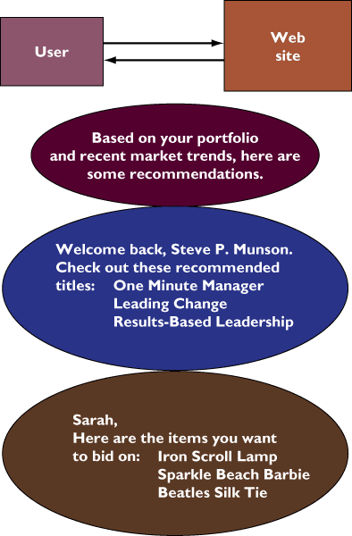
ELECTRONIC COMMERCE
Web Site Personalization
Figure 4-3

Slide 22
ELECTRONIC COMMERCE
M-Commerce and Next Generation Marketing
Mobile commerce (m-commerce):
Wireless devices used to conduct both business-to-consumer and business-to-business e-commerce transactions over the Internet
Extend personalization by delivering new value-added services directly to customers at any time and place

Slide 23
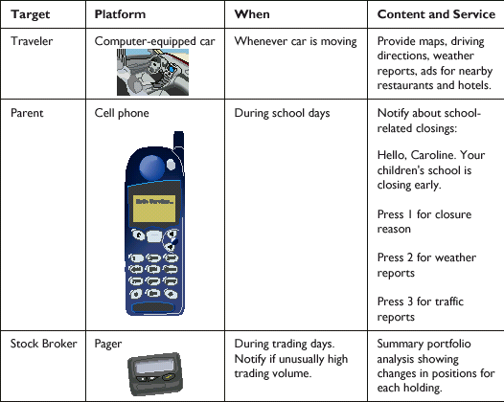
ELECTRONIC COMMERCE
Customer Personalization
Figure 4-4

Slide 24
ELECTRONIC COMMERCE
Business-To-Business Electronic Commerce
Automation of purchase, sale transactions
from business to business
Private industrial networks (private exchanges): Coordination between companies for efficient supply chain management and collaborative activities
Net marketplaces: On-line marketplaces, point-to-point connections, integrated information
Notes:
Ritu, plz check the content

Slide 25
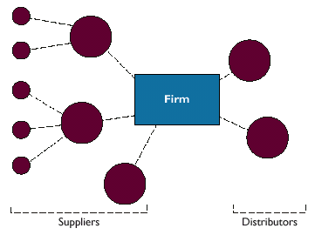
ELECTRONIC COMMERCE
A Private Industrial Network
Figure 4-5

Slide 26
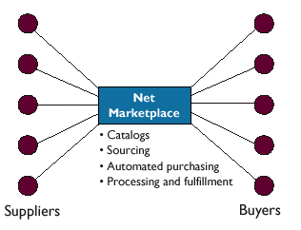
ELECTRONIC COMMERCE
A Net Marketplace
Figure 4-6

Slide 27
ELECTRONIC COMMERCE
Exchanges: Third-party net marketplace
Primarily transaction oriented
Connects buyers and suppliers for spot purchasing

Slide 28
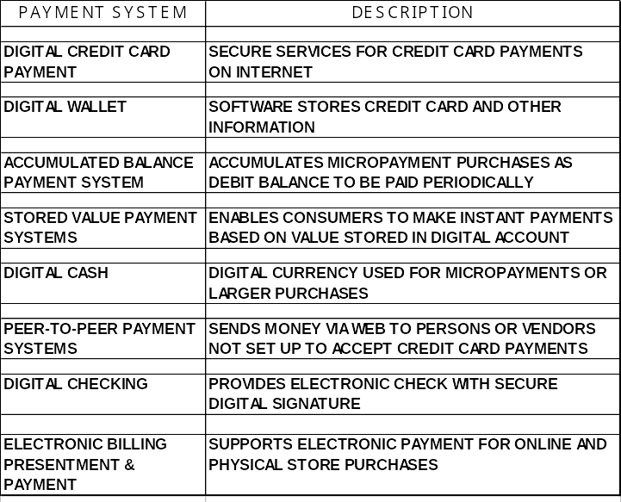
ELECTRONIC COMMERCE
Electronic Commerce Payment Systems

Slide 29
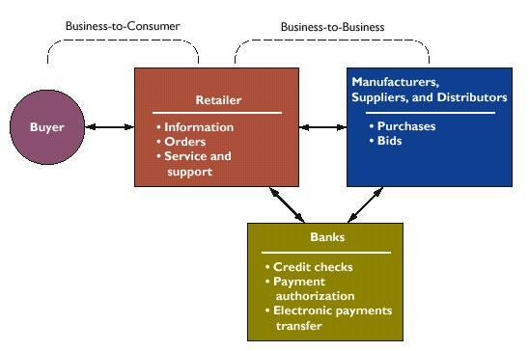
ELECTRONIC COMMERCE
Electronic Commerce Information Flows
Figure 4-7

Slide 30
ELECTRONIC BUSINESS AND THE DIGITAL FIRM
How Intranets Support Electronic Business
Benefits
Group collaboration
Functional applications
Supply chain management

Slide 31
ELECTRONIC BUSINESS AND THE DIGITAL FIRM
Benefits of Intranets
Connectivity: accessible from most
computing platforms
Can be tied to internal corporate systems
and core transaction databases
Can create interactive applications
Scalable to larger or smaller computing platforms

Slide 32
ELECTRONIC BUSINESS AND THE DIGITAL FIRM
Benefits of Intranets
Easy-to-use, universal Web interface
Low start-up costs
Richer, more responsive information environment
Reduced information distribution costs

Slide 33
ELECTRONIC BUSINESS AND THE DIGITAL FIRM
Functional Applications of Intranet
Finance and accounting
Human resources
Sales and marketing
Manufacturing and production

Slide 34
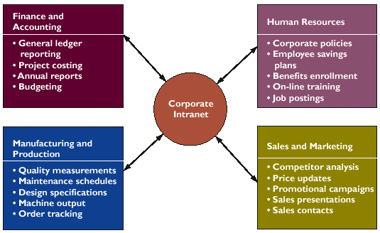
ELECTRONIC BUSINESS AND THE DIGITAL FIRM
Functional Applications of Intranets
Figure 4-8

Slide 35
ELECTRONIC BUSINESS AND THE DIGITAL FIRM
Finance and Accounting
General ledger reporting
Project costing
Annual reports
Budgeting

Slide 36
ELECTRONIC BUSINESS AND THE DIGITAL FIRM
Human Resources
Company
On-line publishing of corporate policy
Job postings and internal job transfers
Company telephone directories, and training
Employees
Healthcare
Employee savings
Competency tests

Slide 37
ELECTRONIC BUSINESS AND THE DIGITAL FIRM
Sales and Marketing
Competitor analysis
Price updates
Promotional campaigns
Sales presentations
Sales contracts

Slide 38
ELECTRONIC BUSINESS AND THE DIGITAL FIRM
Manufacturing and Production
Quality measurements
Maintenance schedules
Design specifications
Machine outputs
Order tracking

Slide 39
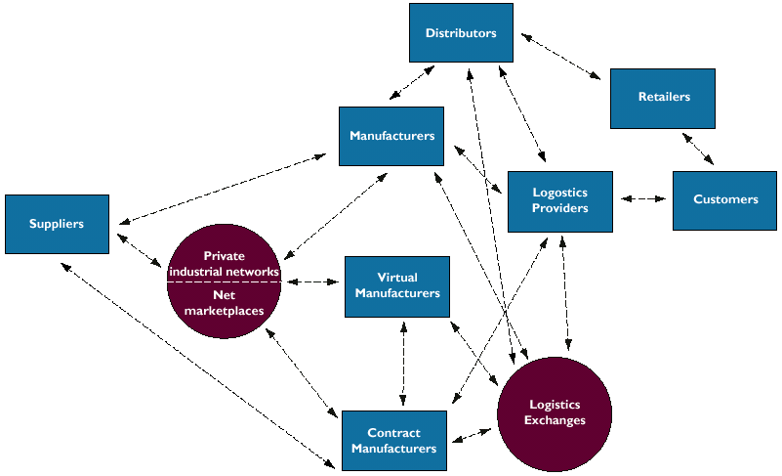
ELECTRONIC BUSINESS AND THE DIGITAL FIRM
The Future Internet-Driven Supply Chain
Figure 4-9

Slide 40
MANAGEMENT CHALLENGES & OPPORTUNITIES
Unproven business models
Business process change requirements
Channel conflicts
Legal issues
Security and privacy

Slide 41
Chapter
4
THE DIGITAL FIRM: ELECTRONIC BUSINESS AND ELECTRONIC COMMERCE

