Slide 1


Chapter
5
ETHICAL AND
SOCIAL ISSUES
IN THE DIGITAL FIRM

Slide 2
OBJECTIVES
What ethical, social, and political issues are raised by information systems?
Are there specific principles for conduct that can be used to guide decisions about ethical dilemmas?
Why does contemporary information systems technology pose challenges to the protection of individual privacy and intellectual property?

Slide 3
OBJECTIVES
How have information systems affected everyday life?
How can organizations develop corporate policies for ethical conduct?

Slide 4
MANAGEMENT CHALLENGES
Understanding the moral risks of new technology
Establishing corporate ethics policies that include information systems issues

Slide 5
UNDERSTANDING ETHICAL AND SOCIAL ISSUES RELATED TO SYSTEMS
Ethics
Principles of right and wrong
Can be used by individuals acting as free moral agents to make choices to guide their behavior

Slide 6
UNDERSTANDING ETHICAL AND SOCIAL ISSUES RELATED TO SYSTEMS
A Model for Thinking about Ethical, Social, and Political Issues
Illustrates the dynamics connecting ethical, social, and political issues
Identifies the moral dimensions of the “information society,” across individual, social, and political levels of action

Slide 7
UNDERSTANDING ETHICAL AND SOCIAL ISSUES RELATED TO SYSTEMS
Moral Dimensions of the Information Age
Information rights and obligations
Property rights
Accountability and control
System quality
Quality of life

Slide 8
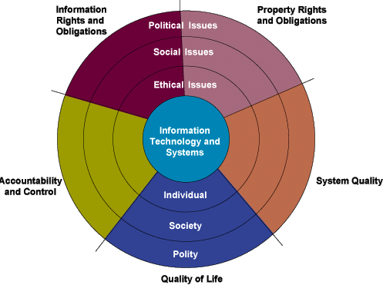
UNDERSTANDING ETHICAL AND SOCIAL ISSUES RELATED TO SYSTEMS
The Relationship between Ethical, Social, and Political Issues in an Information Society
Figure 5-1

Slide 9
UNDERSTANDING ETHICAL AND SOCIAL ISSUES RELATED TO SYSTEMS
Key Technology Trends that Raise Ethical Issues
Computing power doubles every 18 months: Dependence on computer systems
Rapidly declining data storage costs: Easy maintenance of individual database

Slide 10
UNDERSTANDING ETHICAL AND SOCIAL ISSUES RELATED TO SYSTEMS
Key Technology Trends that Raise Ethical Issues
Datamining advances: Analysis of vast quantities of data
Networking advances and the Internet: Remotely accessing personal data

Slide 11




UNDERSTANDING ETHICAL AND SOCIAL ISSUES RELATED TO SYSTEMS
NORA Technology
Customer
Human
Incident
"Bad guy"
transaction
resources
and arrest
lists
systems
systems
systems
Name standardization
Address hygiene
Data quality/enhancement
Match/merge
From data capture to
relationship identification
in less than 8 seconds
NORA alerts
Figure 5-2

Slide 12
ETHICS IN AN INFORMATION SOCIETY
Basic Concepts: Responsibility, Accountability, and Liability
Responsibility: Accepting the potential costs, duties, and obligations for decisions
Accountability: Assessing responsibility for decisions made and actions taken

Slide 13
ETHICS IN AN INFORMATION SOCIETY
Basic Concepts: Responsibility, Accountability, and Liability
Liability: Permits individuals to recover damages
Due process: Laws are well-known and understood, with an ability to appeal to higher authorities

Slide 14
ETHICS IN AN INFORMATION SOCIETY
Candidate Ethical Principles
Golden rule: Do unto others as you would have them do unto you
Immanuel Kant’s categorical imperative: If an action is not right for everyone to take, then it is not right for anyone

Slide 15
ETHICS IN AN INFORMATION SOCIETY
Candidate Ethical Principles
Descartes’ rule of change: If an action cannot be taken repeatedly, then it is not right to be taken at any time
Utilitarian principle: Put values in rank order and understand consequences of various courses of action

Slide 16
ETHICS IN AN INFORMATION SOCIETY
Candidate Ethical Principles
Risk aversion principle: Take the action that produces the least harm or incurs the least cost
Ethical “no free lunch” rule: All tangible and intangible objects are owned by creator who wants compensation for the work

Slide 17
ETHICS IN AN INFORMATION SOCIETY
Professional Codes of Conduct
Promises by professions to regulate themselves in the general interest of society
Promulgated by associations such as the American Medical Association (AMA) and the American Bar Association (ABA)

Slide 18
ETHICS IN AN INFORMATION SOCIETY
Some Real-World Ethical Dilemmas
Information system being used by
organizations to:
Minimize drains on productivity by reducing jobs
Prevent wastage of resources for non-business activities by employee monitoring

Slide 19
THE MORAL DIMENSIONS OF INFORMATION SYSTEMS
Information Rights: Privacy and Freedom in the Internet Age
Privacy: Claim of individuals to be left alone, free from surveillance or interference from other individuals, organizations, or the state
Fair Information Practices: Set of principles governing the collection and use of information on the basis of U.S. and European privacy laws

Slide 20
THE MORAL DIMENSIONS OF INFORMATION SYSTEMS
U.S. Federal Privacy Laws
General Federal Privacy Laws
Freedom of Information Act, 1966
Privacy Act of 1974
Electronic Communications Privacy Act of 1986
Computer Matching and Privacy Protection Act of 1988
Computer Security Act of 1987
Federal Managers Financial Integrity Act of 1982

Slide 21
THE MORAL DIMENSIONS OF INFORMATION SYSTEMS
The European Directive on Data Protection
Informed consent
Consent given with knowledge of all facts needed to make a rational decision

Slide 22
THE MORAL DIMENSIONS OF INFORMATION SYSTEMS
Internet Challenges to Privacy
Cookies
Tiny files deposited on a hard drive
Used to identify the visitor and track visits
to the Web site

Slide 23
THE MORAL DIMENSIONS OF INFORMATION SYSTEMS
Cookies? I Didn't
How Cookies Can Identify Web Visitors
Order Any Cookies
Here is how a cookie works:
1.
A user opens
a Web browser
W
W
W
and selects a
Web site to visit.
2.
The user's
computer sends
a request for
information to
the computer
running the
Web site.
3.
The Web site
computer, called
a server, sends
the information
that allows the
user's computer
to display the
Web site. It also
sends a cookie
—
a data file
that contains
information like
an encrypted
user ID and
information
about when the
user visited and
what he did on
WWW
the site.
4.
The user's
computer
receives the
cookie and
places it in a
file on the
hard drive.
5.
Whenever the
user goes back
to the Web site,
the server
running the
site retrieves the
cookie to help it
Figure 5-3
identify the user.
WWW

Slide 24
THE MORAL DIMENSIONS OF INFORMATION SYSTEMS
Internet Challenges to Privacy
Web bugs
Tiny graphic files embedded in e-mail messages and Web pages
Designed to monitor on-line Internet user behavior

Slide 25
THE MORAL DIMENSIONS OF INFORMATION SYSTEMS
Internet Challenges to Privacy
Opt-out model
Informed consent permitting the collection
of personal information
Consumer specifically requests for the data not to be collected

Slide 26
THE MORAL DIMENSIONS OF INFORMATION SYSTEMS
Internet Challenges to Privacy
Opt-in model
Informed consent prohibiting an organization from collecting any personal information
Individual has to approve information collection and use

Slide 27
THE MORAL DIMENSIONS OF INFORMATION SYSTEMS
Technical Solutions
P3P
Platform for Privacy Preferences Project
Industry standard designed to give users more control over personal information

Slide 28
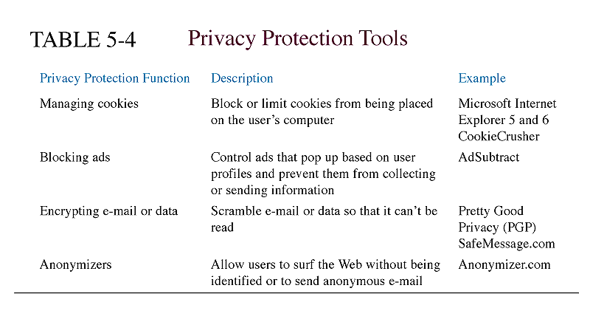
THE MORAL DIMENSIONS OF INFORMATION SYSTEMS
Technical Solutions

Slide 29
THE MORAL DIMENSIONS OF INFORMATION SYSTEMS
Ethical Issues
Under what conditions should the privacy of others be invaded?
What legitimates intruding into others’ lives through unobtrusive surveillance, through market research, or by whatever means?

Slide 30
THE MORAL DIMENSIONS OF INFORMATION SYSTEMS
Ethical Issues
Do we have to inform people that we are eavesdropping?
Do we have to inform people that we are using credit history information for employment screening purposes?

Slide 31
THE MORAL DIMENSIONS OF INFORMATION SYSTEMS
Social Issues
Concerns the development of “expectations of privacy” or privacy norms, as well as public attitudes

Slide 32
THE MORAL DIMENSIONS OF INFORMATION SYSTEMS
Political Issues
Concern the development of statutes
Govern the relations between record keepers and individuals

Slide 33
THE MORAL DIMENSIONS OF INFORMATION SYSTEMS
Property Rights: Intellectual Property
Intellectual property: Intangible creations protected by law
Trade secret: Intellectual work or product belonging to business, not in public domain

Slide 34
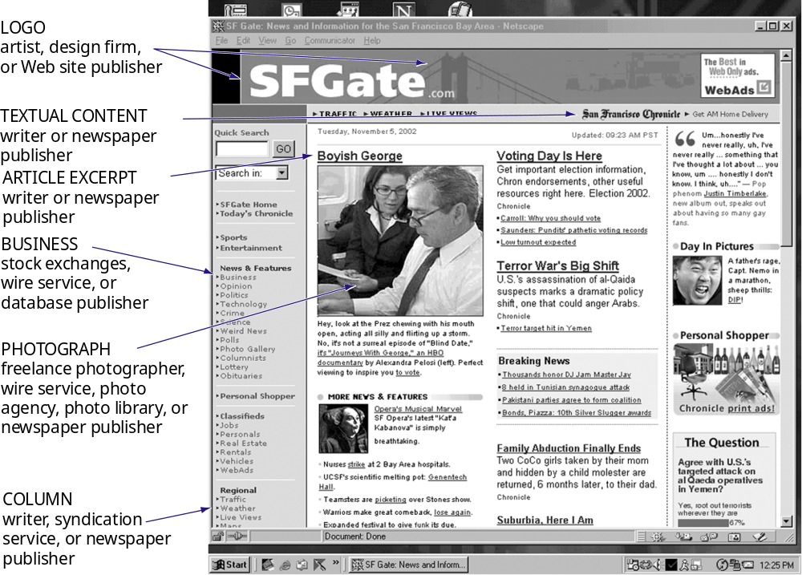
THE MORAL DIMENSIONS OF INFORMATION SYSTEMS
Framing: Displaying One Web Site Inside Another
Figure 5-4

Slide 35
THE MORAL DIMENSIONS OF INFORMATION SYSTEMS
Property Rights: Intellectual Property
Copyright: Statutory grant protecting intellectual property from getting copied for minimum of 70 years
Patents: Legal document granting the owner an exclusive monopoly on the ideas behind an invention for 20 years

Slide 36
THE MORAL DIMENSIONS OF INFORMATION SYSTEMS
Challenges to Intellectual Property Rights
Ethical issues: Production of intellectual property
Social issues: Current intellectual property laws breaking down
Political issues: Creation of new property protection measures

Slide 37
THE MORAL DIMENSIONS OF INFORMATION SYSTEMS
Accountability, Liability and Control
Ethical issues: Who is morally responsible for consequences of use?
Social issues: What should society expect and allow?
Political issues: To what extent should government intervene, protect?

Slide 38
THE MORAL DIMENSIONS OF INFORMATION SYSTEMS
System Quality: Data Quality and System Errors
Ethical issues: At what point to release the software/services for consumption?
Social issues: Should people be encouraged to believe systems are infallible?
Political Issues: Laws of responsibility and accountability

Slide 39
THE MORAL DIMENSIONS OF INFORMATION SYSTEMS
Quality of Life: Equity, Access, and Boundaries
Balancing power center versus periphery: Key policy decisions centralized as in the past
Rapidity of change- Reduced response time to competition: Reduced normal social buffers

Slide 40
THE MORAL DIMENSIONS OF INFORMATION SYSTEMS
Quality of Life: Equity, Access, and Boundaries
Maintaining boundaries: Family, work, and leisure: “Do anything anywhere” environment blurring boundaries between work and family time
Dependence and vulnerability: No regulatory or standard-setting forces

Slide 41
THE MORAL DIMENSIONS OF INFORMATION SYSTEMS
Quality of Life: Equity, Access, and Boundaries
Computer crime: Commission of illegal acts through the use of a computer or against a computer system
Computer abuse: Commission of acts involving a computer that may not be illegal but are considered unethical

Slide 42
THE MORAL DIMENSIONS OF INFORMATION SYSTEMS
Quality of Life: Equity, Access, and Boundaries
Employment- Trickle-down technology and reengineering job loss: Causes millions of middle-level managers and clerical workers to lose their jobs
Equity and access- Increasing racial and social class cleavages: Society of computer literate and skilled, versus computer illiterate and unskilled

Slide 43
THE MORAL DIMENSIONS OF INFORMATION SYSTEMS
Health Risks: RSI, CVS, and Technostress
Repetitive stress injury (RSI)
Occupational disease
Muscle groups are forced through repetitive actions with high-impact loads or thousands of repetitions with low impact loads

Slide 44
THE MORAL DIMENSIONS OF INFORMATION SYSTEMS
Health Risks: RSI, CVS, and Technostress
Carpal tunnel syndrome (CTS)
Type of RSI
Pressure on the median nerve through the wrist’s bony carpal tunnel structure produces pain

Slide 45
THE MORAL DIMENSIONS OF INFORMATION SYSTEMS
Health Risks: RSI, CVS, and Technostress
Computer vision syndrome (CVS)
Eyestrain condition
Related to computer display screen usage
Symptoms include headaches, blurred vision, and dry and irritated eyes

Slide 46
THE MORAL DIMENSIONS OF INFORMATION SYSTEMS
Health Risks: RSI, CVS, and Technostress
Technostress
Stress induced by computer use
Symptoms include aggravation, hostility toward humans, impatience, and enervation

Slide 47
THE MORAL DIMENSIONS OF INFORMATION SYSTEMS
Management Actions: A Corporate Code of Ethics
Information rights and obligations
Property rights and obligations
Accountability and control
System quality
Quality of life

Slide 48
Chapter
5
ETHICAL AND
SOCIAL ISSUES
IN THE DIGITAL FIRM

