Slide 1

Chapter
6
MANAGING
HARDWARE AND
SOFTWARE
ASSETS

Slide 2
OBJECTIVES
What computer processing and storage capability does our organization need to handle its information and business transactions?
What arrangement of computers and computer processing would best benefit our organization?
What kinds of software and software tools do we need to run our business? What criteria should we use to select our software technology?
Notes:
Nidhi-Too congested! Can we shorten it ?

Slide 3
OBJECTIVES
Of what new software technologies should we be aware? How would they benefit our organization?
How should we acquire and manage the firm’s hardware and software assets?

Slide 4
MANAGEMENT CHALLENGES
The centralization versus decentralization debate
The application backlog

Slide 5
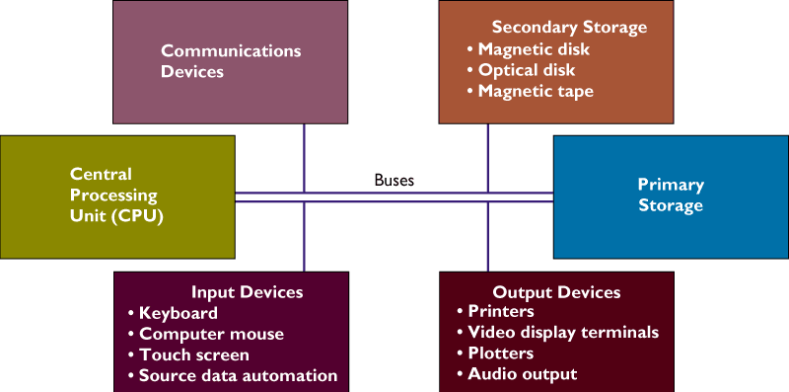
COMPUTER HARDWARE AND INFORMATION TECHNOLOGY INFRASTRUCTURE
Hardware Components of a Computer System
Figure 6-1

Slide 6
COMPUTER HARDWARE AND INFORMATION TECHNOLOGY INFRASTRUCTURE
The Computer System
Bit
Binary digit
Represents smallest unit of data in the form of either 0 or 1
Byte
String of bits, usually eight
Stores one number or character

Slide 7
COMPUTER HARDWARE AND INFORMATION TECHNOLOGY INFRASTRUCTURE
Bits and Bytes
0
or
1
One bit
Characters are
represented by one
byte for each letter.
0
1
0
0
0
0
0
1
One byte for character A
Figure 6-2

Slide 8
COMPUTER HARDWARE AND INFORMATION TECHNOLOGY INFRASTRUCTURE
The CPU and Primary Storage
Central Processing Unit (CPU)
Manipulates symbols, numbers, and letters
Controls other parts of the computer system

Slide 9
COMPUTER HARDWARE AND INFORMATION TECHNOLOGY INFRASTRUCTURE
The CPU and Primary Storage
Primary Storage
Temporarily stores program instructions
Data being used by the instructions

Slide 10
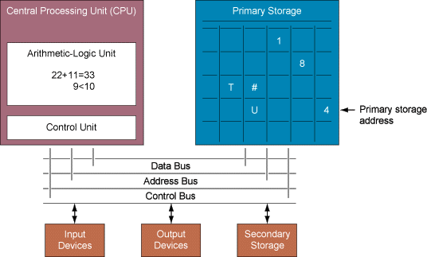
COMPUTER HARDWARE AND INFORMATION TECHNOLOGY INFRASTRUCTURE
The CPU and Primary Storage
Figure 6-3

Slide 11
COMPUTER HARDWARE AND INFORMATION TECHNOLOGY INFRASTRUCTURE
Primary Storage
Stores
Software program being executed
Operating system programs
Data being used by program

Slide 12
COMPUTER HARDWARE AND INFORMATION TECHNOLOGY INFRASTRUCTURE
CPU
Arithmetic-logic unit (ALU): performs the computer’s principal logic and arithmetic operations
Control Unit: coordinates and controls the other parts of the computer system

Slide 13
COMPUTER HARDWARE AND INFORMATION TECHNOLOGY INFRASTRUCTURE
Primary Storage
RAM: Directly accesses any randomly chosen location in the same amount of time
ROM: Semiconductor memory chips with program instructions, cannot be written to

Slide 14
COMPUTER HARDWARE AND INFORMATION TECHNOLOGY INFRASTRUCTURE
Computer Processing
Microprocessors and Processing Power
Integrated circuit technology
Integrates the computer’s memory, logic, and control on a single chip

Slide 15
COMPUTER HARDWARE AND INFORMATION TECHNOLOGY INFRASTRUCTURE
Computer Processing
Parallel Processing
Problem broken down into smaller parts
Multiple instructions processed simultaneously with multiple processors

Slide 16
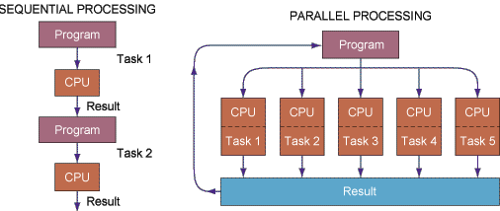
COMPUTER HARDWARE AND INFORMATION TECHNOLOGY INFRASTRUCTURE
Sequential and Parallel Processing
Figure 6-4

Slide 17
COMPUTER HARDWARE AND INFORMATION TECHNOLOGY INFRASTRUCTURE
Secondary Storage Technology
Magnetic disk: Floppy disk, Hard disk
Optical disks: CD-ROM, DVDs
Magnetic tape: Inexpensive, older secondary-storage medium
New storage alternatives: Storage Area Networks (SANs)

Slide 18
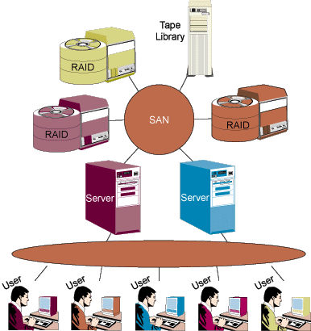
COMPUTER HARDWARE AND INFORMATION TECHNOLOGY INFRASTRUCTURE
A Storage Area Network (SAN)
Figure 6-5

Slide 19
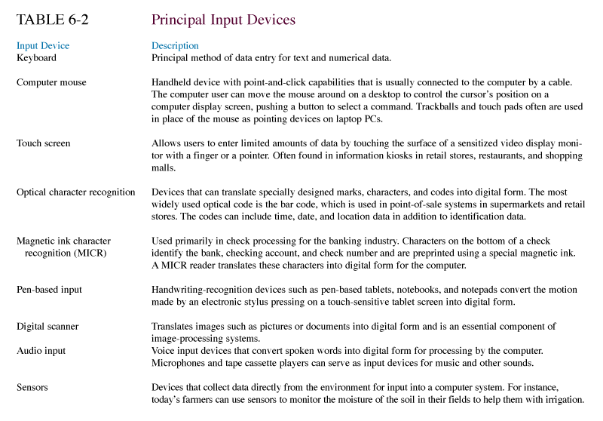
COMPUTER HARDWARE AND INFORMATION TECHNOLOGY INFRASTRUCTURE
Input and Output Devices

Slide 20
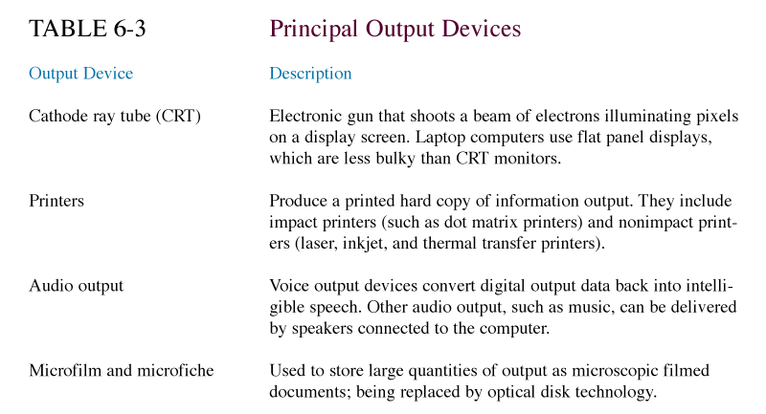
COMPUTER HARDWARE AND INFORMATION TECHNOLOGY INFRASTRUCTURE
Input and Output Devices

Slide 21
COMPUTER HARDWARE AND INFORMATION TECHNOLOGY INFRASTRUCTURE
Batch and On-Line Input and Processing
Batch processing
Transactions accumulated and stored until processing
On-line processing
Transactions are entered directly into computer and processed immediately

Slide 22
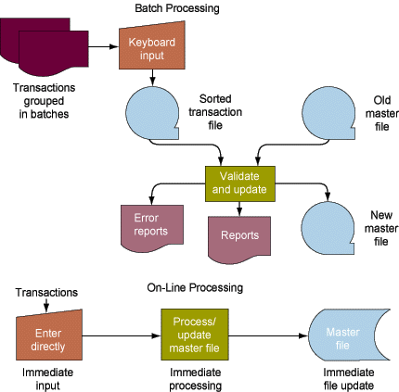
COMPUTER HARDWARE AND INFORMATION TECHNOLOGY INFRASTRUCTURE
A Comparison of Batch and On-line Processing
Figure 6-6

Slide 23
COMPUTER HARDWARE AND INFORMATION TECHNOLOGY INFRASTRUCTURE
Interactive Multimedia
Integrates two or more types of media into a computer-based application
Used in interactive Web pages with graphics, sound, animation, video

Slide 24
CATEGORIES OF COMPUTERS AND COMPUTER SYSTEMS
Classifying Computers
Mainframes: Largest computer, massive memory, rapid processing power
Midrange computers: Less powerful, less expensive, and smaller than a mainframe
Server: Provides software and other resources to computers over a network

Slide 25
CATEGORIES OF COMPUTERS AND COMPUTER SYSTEMS
Classifying Computers
Minicomputers: Middle-range computer, used in universities, factories, or research laboratories
Server Farm: Large group of servers maintained by a commercial vendor, available for electronic commerce and other activities

Slide 26
CATEGORIES OF COMPUTERS AND COMPUTER SYSTEMS
Classifying Computers
Personal Computer (PC): Small desktop or portable computer
Workstation: Desktop computer with powerful graphics and mathematical capabilities
Supercomputer: Highly sophisticated and powerful, performs complex computations

Slide 27
CATEGORIES OF COMPUTERS AND COMPUTER SYSTEMS
Computer Networks and Client/Server Computing
Distributed processing: Distribution of processing work among multiple computers
Centralized processing: Accomplished by one large central computer
Client/server computing: Splits processing between “clients” and “servers” on network

Slide 28
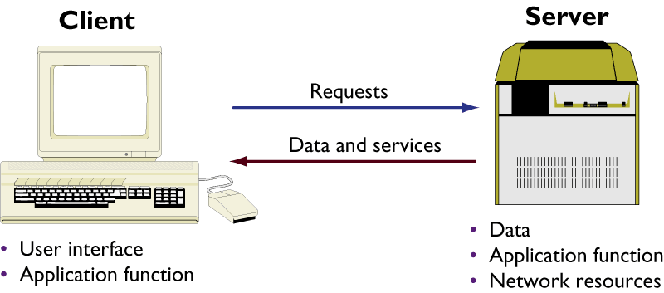
CATEGORIES OF COMPUTERS AND COMPUTER SYSTEMS
Client/Server Computing
Figure 6-7

Slide 29
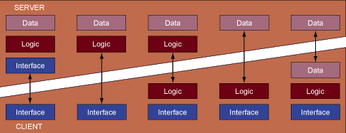
CATEGORIES OF COMPUTERS AND COMPUTER SYSTEMS
Types of Client/Server Computing
Figure 6-8

Slide 30
CATEGORIES OF COMPUTERS AND COMPUTER SYSTEMS
Network Computers and Peer-to-Peer Computing
Network computer (NC): Simplified desktop computer, does not store data permanently
Peer-to-peer computing: Distributed processing that links computers through Internet or private networks
Grid computing: Applies computational resources of many networked computers to solve a large, complex problem

Slide 31
TYPES OF SOFTWARE
The Major Types of Software
Software program: Series of statements or instructions to the computer
System software: Generalized programs, manages computer’s resources
Application software: Programs written to perform functions specified by end users

Slide 32
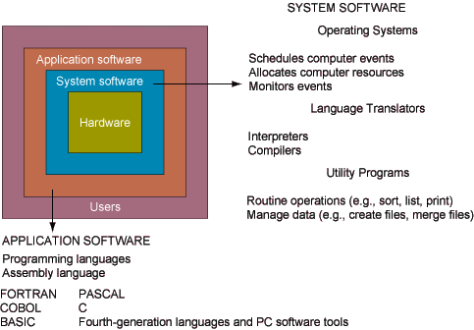
TYPES OF SOFTWARE
The Major Types of Software
Figure 6-9

Slide 33
TYPES OF SOFTWARE
System Software and PC Operating Systems
Operating system
System software
Manages and controls computer

Slide 34
TYPES OF SOFTWARE
System Software and PC Operating Systems
Functions of the operating system
Allocates and assigns system resources
Schedules use of computer resources
Monitors computer system activities
Provides locations in primary memory for data and programs
Controls the input and output devices

Slide 35
TYPES OF SOFTWARE
System Software and PC Operating Systems
Multiprogramming
Executes two or more programs concurrently using the same computer
CPU executes only one program but services the input/output needs of others

Slide 36
TYPES OF SOFTWARE
System Software and PC Operating Systems
Multitasking
Multiprogramming capability of single-user operating systems
Virtual Storage
Handles programs more efficiently by dividing the programs into small fixed or variable length

Slide 37
TYPES OF SOFTWARE
System Software and PC Operating Systems
Time Sharing
Sharing of computer resources by many users simultaneously
Multiprocessing
Executing two or more instructions simultaneously in a single computer using multiple central processing units

Slide 38
TYPES OF SOFTWARE
System Software and PC Operating Systems
Language translation and utility
software
Translates high-level language programs into machine language

Slide 39
TYPES OF SOFTWARE
PC Operating Systems and Graphical User Interfaces
GUIs in contemporary PC operating systems
Windows XP
Microsoft’s Windows 98 and Me
Windows 2000

Slide 40
TYPES OF SOFTWARE
PC Operating Systems and Graphical User Interfaces
Windows .NET server
UNIX
Linux: open-source software

Slide 41
TYPES OF SOFTWARE
Application Software and Programming Languages
Programming languages: evolved from machine language to high-level languages for business and scientific work
Important programming languages for business today: COBOL, C, C++, and Visual Basic

Slide 42
TYPES OF SOFTWARE
Fourth-Generation Languages
Fourth-generation language: Can help end users develop software with little or no assistance from IS specialists
Natural languages: Close to human language
Query languages: Provide immediate on-line answers to requests

Slide 43
CONTEMPORARY TOOLS FOR SOFTWARE DEVELOPMENT
Object-Oriented Programming
Object-oriented programming
Approach to software development that combines data and procedures into a single object
Visual programming
Construction of software programs by selecting and arranging programming objects

Slide 44
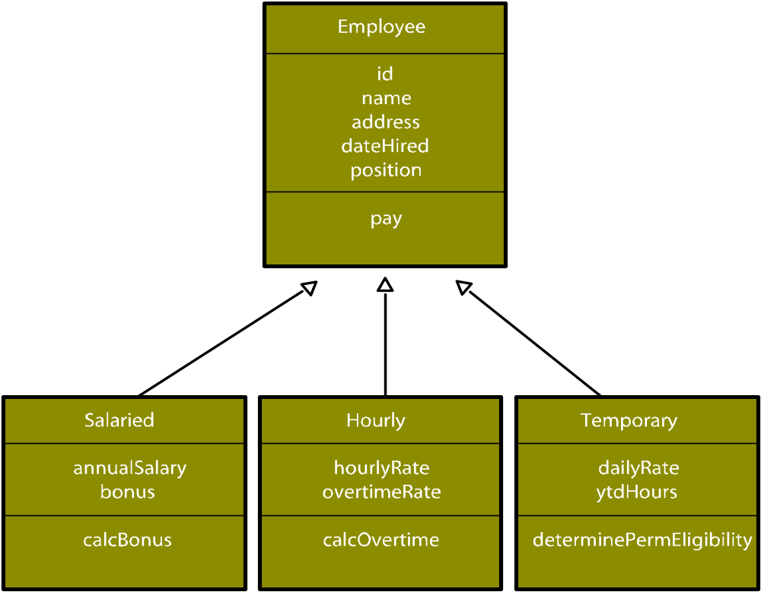
Class and inheritance
Figure 6-10

Slide 45
CONTEMPORARY TOOLS FOR SOFTWARE DEVELOPMENT
Java
Programming language
Delivers the software functionality needed for a particular task
Runs on any computer and operating system

Slide 46
CONTEMPORARY TOOLS FOR SOFTWARE DEVELOPMENT
Hypertext Markup Language (HTML) and XML
Hypertext Markup Language (HTML): Page description language, creates Web pages and other hypermedia documents
XML (eXtensible Markup Language): Describes the structure of a document, supports links to multiple documents, allowing data to be manipulated by the computer

Slide 47
TYPES OF SOFTWARE
Application Software Packages and Productivity Software
PC software tools: Word Processing Software, Spreadsheets, Data Management Software, Presentation Graphics
Other productivity software: e-mail, groupware, Web browsers

Slide 48
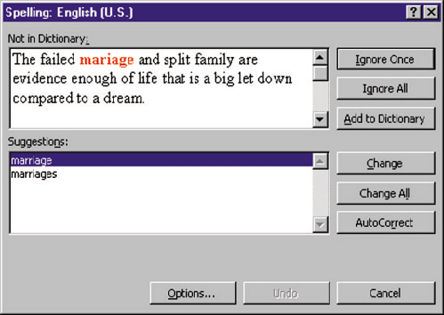
TYPES OF SOFTWARE
Word Processing Software
Figure 6-11

Slide 49
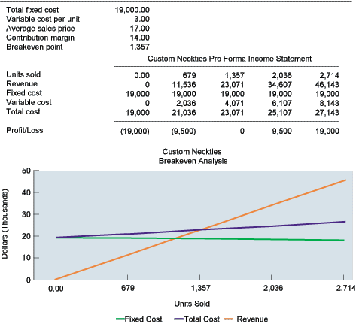
TYPES OF SOFTWARE
Spreadsheet Software
Figure 6-12

Slide 50
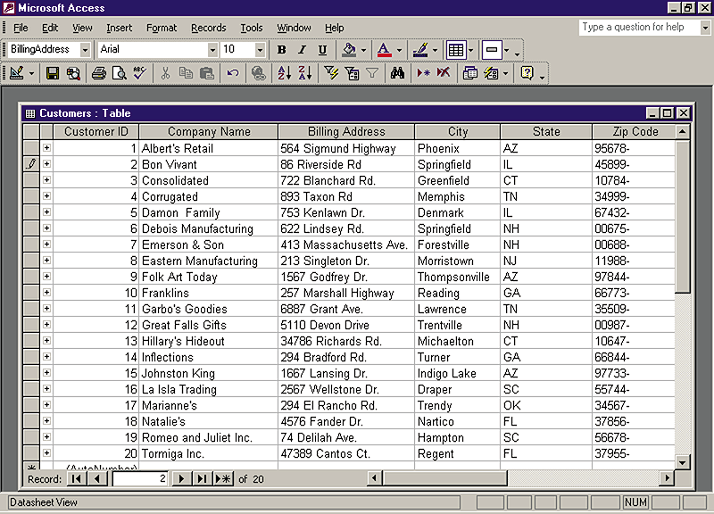
TYPES OF SOFTWARE
Data Management Software
Figure 6-13

Slide 51
TYPES OF SOFTWARE
Software for Enterprise Integration
Enterprise software
Set of integrated modules for major business functions
Allows data to be used by multiple functions and business processes

Slide 52
TYPES OF SOFTWARE
Software for Enterprise Integration
Middleware
Allows two disparate applications to communicate to exchange data
Web server
Manages requests for Web pages on the computer where they are stored

Slide 53
TYPES OF SOFTWARE
Software for Enterprise Integration
Enterprise application integration
software
Ties together multiple applications to support enterprise integration

Slide 54

TYPES OF SOFTWARE
Middleware
Figure 6-14

Slide 55
MANAGING HARDWARE AND SOFTWARE ASSETS
Hardware Technology Requirements for Electronic Commerce and Digital Firm
Capacity planning: Process of predicting the computing power
Scalability: Ability of a computer, product, or system to expand and to serve without breaking down

Slide 56
MANAGING HARDWARE AND SOFTWARE ASSETS
Total Cost of Ownership (TCO) of Technology Assets
Designates the total cost of owning technology resources
Includes initial purchase costs, cost of hardware and software upgrades, maintenance, technical support, and training

Slide 57
MANAGING HARDWARE AND SOFTWARE ASSETS
Rent or Build Decisions: Using Technology Service Providers
On-line storage service providers
Third-party providers that rent out storage space to subscribers over the Web
Allow customers to store and access data
Application service providers (ASPs)
Provide software that can be rented by other companies

Slide 58
MANAGING HARDWARE AND SOFTWARE ASSETS
Rent or Build Decisions: Using Technology Service Providers
Other types of service providers
Management service providers and business continuity service providers
Utility computing
“Pay as you go” model” where firms pay only for the information technology resources they actually use during a specified period

Slide 59

MANAGING HARDWARE AND SOFTWARE ASSETS
VENDOR
CUSTOMER PREMISES
OPS. CENTER
Vendor-supplied portal
software
gives a customer
the same view as the vendor
operations center.
Using
proprietary
Firewall
software,
vendor employees
monitor and
manage a customer's
storage.
Vendor's
on-site
hardware
device
Storage
infrastructure
SECURE NETWORK CONNECTION
(may be
The customer's actual data never passes
direct-attached
through the firewall;
rather, metadata
storage, SANs
needed to manage storage flows across a
or NAS)
Figure 6-15
secure network connection.

Slide 60
Chapter
6
MANAGING
HARDWARE AND
SOFTWARE
ASSETS

