Slide 1

Chapter
7
MANAGING
DATA
RESOURCES

Slide 2
OBJECTIVES
Why do businesses have trouble finding the information they need in their information systems?
How does a database management system help businesses improve the organization of their information?

Slide 3
OBJECTIVES
How do the principal types of database models affect the way businesses can access and use information?
What are the managerial and organizational requirements of a data-base environment?
What new tools and technologies can make databases more accessible and useful?

Slide 4
MANAGEMENT CHALLENGES
Organizational obstacles to a database environment
Integrating data and ensuring quality

Slide 5
ORGANIZING DATA IN A TRADITIONAL FILE ENVIRONMENT
File Organization Terms and Concepts
Bit: Smallest unit of data; binary digit (0,1)
Byte: Group of bits that represents a single character
Field: Group of words or a complete number

Slide 6
ORGANIZING DATA IN A TRADITIONAL FILE ENVIRONMENT
File Organization Terms and Concepts
Record: Group of related fields
File: Group of records of same type
Database: Group of related files

Slide 7
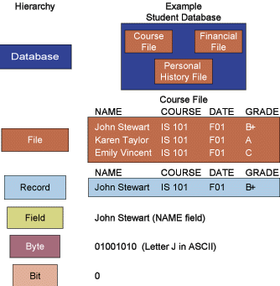
ORGANIZING DATA IN A TRADITIONAL FILE ENVIRONMENT
Data Hierarchy in a Computer System
Figure 7-1

Slide 8
ORGANIZING DATA IN A TRADITIONAL FILE ENVIRONMENT
File Organization Terms and Concepts
Entity: Person, place, thing, event about which information is maintained
Attribute: Description of a particular entity
Key field: Identifier field used to retrieve, update, sort a record

Slide 9
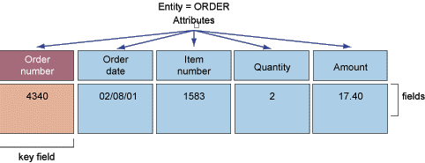
ORGANIZING DATA IN A TRADITIONAL FILE ENVIRONMENT
Entitities and Attributes
Figure 7-2

Slide 10
ORGANIZING DATA IN A TRADITIONAL FILE ENVIRONMENT
Problems with the Traditional File Environment
Data redundancy
Program-Data dependence
Lack of flexibility
Poor security
Lack of data-sharing and availability

Slide 11
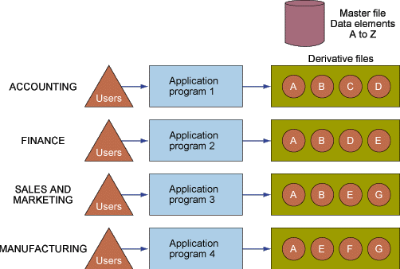
ORGANIZING DATA IN A TRADITIONAL FILE ENVIRONMENT
Traditional File Processing
Figure 7-3

Slide 12
THE DATABASE APPROACH TO DATA MANAGEMENT
Database Management System (DBMS)
Creates and maintains databases
Eliminates requirement for data definition statements
Acts as interface between application programs and physical data files
Separates logical and physical views of data

Slide 13
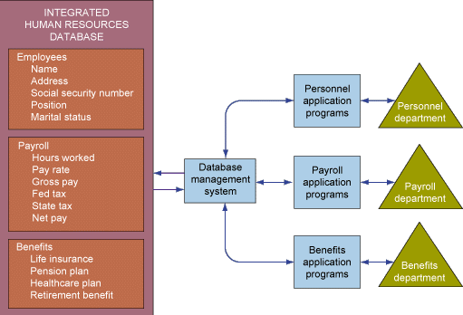
THE DATABASE APPROACH TO DATA MANAGEMENT
The Contemporary Database Environment
Figure 7-4

Slide 14
THE DATABASE APPROACH TO DATA MANAGEMENT
Components of DBMS
Data definition language: Specifies content and structure of database and defines each data element
Data manipulation language:
Manipulates data in a database
Data dictionary: Stores definitions of data elements, and data characteristics

Slide 15
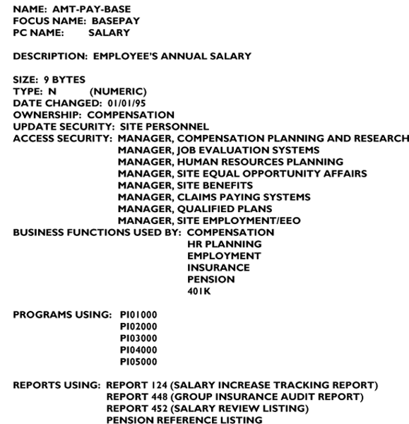
THE DATABASE APPROACH TO DATA MANAGEMENT
Sample Data Dictionary Report
Figure 7-5

Slide 16
THE DATABASE APPROACH TO DATA MANAGEMENT
Types of Databases
Relational DBMS
Hierarchical and Network DBMS
Object-Oriented Databases

Slide 17
THE DATABASE APPROACH TO DATA MANAGEMENT
Relational DBMS
Represents data as two-dimensional tables called relations
Relates data across tables based on common data element
Examples: DB2, Oracle, MS SQL Server

Slide 18
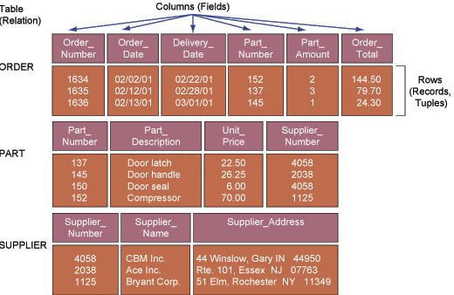
THE DATABASE APPROACH TO DATA MANAGEMENT
Relational Data Model
Figure 7-6

Slide 19
THE DATABASE APPROACH TO DATA MANAGEMENT
Three Basic Operations in a Relational Database
Select: Creates subset of rows that meet specific criteria
Join: Combines relational tables to provide users with information
Project: Enables users to create new tables containing only relevant information

Slide 20
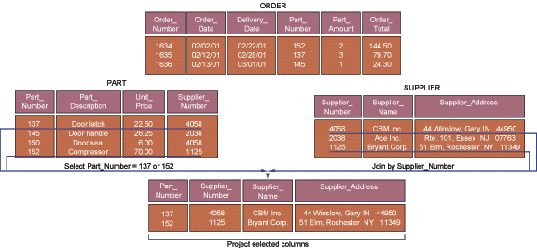
THE DATABASE APPROACH TO DATA MANAGEMENT
Three Basic Operations in a Relational Database
Figure 7-7

Slide 21
THE DATABASE APPROACH TO DATA MANAGEMENT
Hierarchical and Network DBMS
Hierarchical DBMS
Organizes data in a tree-like structure
Supports one-to-many parent-child relationships
Prevalent in large legacy systems

Slide 22
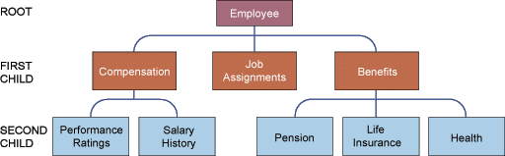
THE DATABASE APPROACH TO DATA MANAGEMENT
Hierarchical DBMS
Figure 7-8

Slide 23
THE DATABASE APPROACH TO DATA MANAGEMENT
Hierarchical and Network DBMS
Network DBMS
Depicts data logically as many-to-many relationships

Slide 24

THE DATABASE APPROACH TO DATA MANAGEMENT
Network DBMS
Figure 7-9

Slide 25
THE DATABASE APPROACH TO DATA MANAGEMENT
Hierarchical and Network DBMS
Disadvantages
Outdated
Less flexible compared to RDBMS
Lack support for ad-hoc and English language-like queries

Slide 26
THE DATABASE APPROACH TO DATA MANAGEMENT
Object-Oriented Databases
Object-oriented DBMS: Stores data and procedures as objects that can be retrieved and shared automatically
Object-relational DBMS: Provides capabilities of both object-oriented and relational DBMS

Slide 27
THE DATABASE APPROACH TO DATA MANAGEMENT
Querying Databases: Elements of SQL
Basic SQL Commands
SELECT: Specifies columns
FROM: Identifies tables or views
WHERE: Specifies conditions

Slide 28
THE DATABASE APPROACH TO DATA MANAGEMENT
Results of SELECT Statement
Figure 7-10

Slide 29
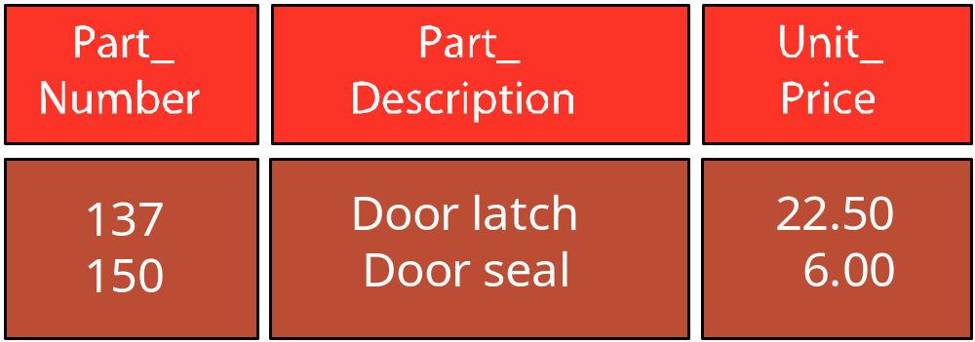
THE DATABASE APPROACH TO DATA MANAGEMENT
C
Results of Conditional Selection
Figure 7-11

Slide 30
THE DATABASE APPROACH TO DATA MANAGEMENT
Projection from Joining PART and SUPPLIER Tables
Figure 7-12

Slide 31
CREATING A DATABASE ENVIRONMENT
Designing Databases
Conceptual design: Abstract model of database from a business perspective
Physical design: Detailed description of business information needs

Slide 32
CREATING A DATABASE ENVIRONMENT
Designing Databases
Entity-relationship diagram: Methodology for documenting databases illustrating relationships between database entities
Normalization: Process of creating small stable data structures from complex groups of data

Slide 33
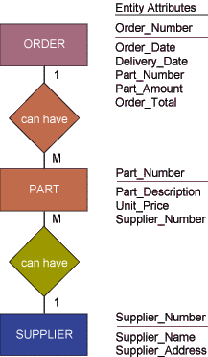
CREATING A DATABASE ENVIRONMENT
Figure 7-13

Slide 34
CREATING A DATABASE ENVIRONMENT
Figure 7-14

Slide 35
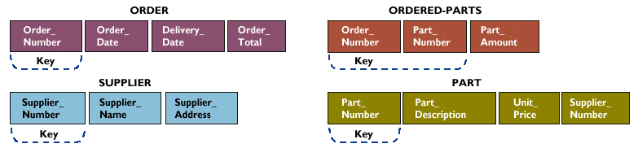
CREATING A DATABASE ENVIRONMENT
An Normalized Relation of ORDER
Figure 7-15

Slide 36
CREATING A DATABASE ENVIRONMENT
Distributing Databases
Centralized database
Used by single central processor or multiple processors in client/server network

Slide 37
CREATING A DATABASE ENVIRONMENT
Distributing Databases
Distributed database
Stored in more than one physical location
Partitioned database
Duplicated database

Slide 38
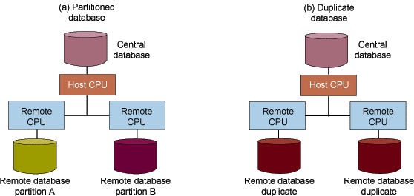
CREATING A DATABASE ENVIRONMENT
Distributed Databases
Figure 7-16

Slide 39
CREATING A DATABASE ENVIRONMENT
Management Requirements for Database Systems
Key elements in a database environment:
Data Administration
Data Planning and Modeling Methodology
Database Technology and Management
Users

Slide 40
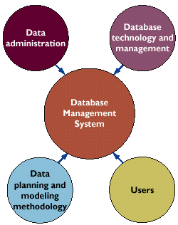
CREATING A DATABASE ENVIRONMENT
Management Requirements for Database Systems
Figure 7-17

Slide 41
DATABASE TRENDS
Multidimensional Data Analysis
On-line analytical processing (OLAP)
Multidimensional data analysis
Supports manipulation and analysis of large volumes of data from multiple dimensions/perspectives

Slide 42
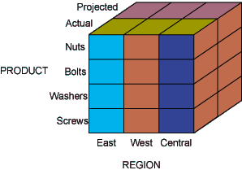
DATABASE TRENDS
Multidimensional Data Model
Figure 7-18

Slide 43
DATABASE TRENDS
Data Warehousing and Datamining
Data warehouse
Supports reporting and query tools
Stores current and historical data
Consolidates data for management analysis and decision making

Slide 44
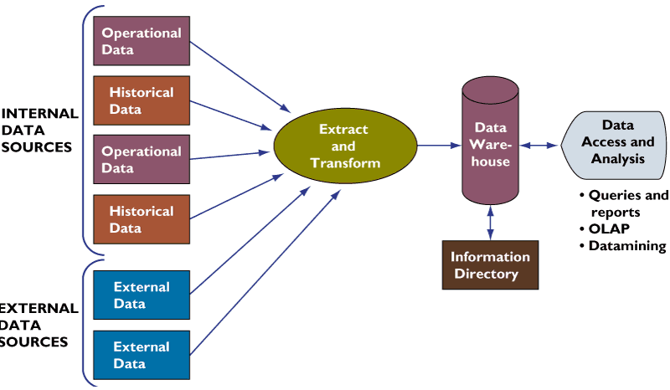
DATABASE TRENDS
Components of a Data Warehouse
Figure 7-19

Slide 45
DATABASE TRENDS
Data Warehousing and Datamining
Data mart
Subset of data warehouse
Contains summarized or highly focused portion of data for a specified function or group of users

Slide 46
DATABASE TRENDS
Data Warehousing and Datamining
Datamining
Tools for analyzing large pools of data
Find hidden patterns and infer rules to predict trends

Slide 47
DATABASE TRENDS
Benefits of Data Warehouses
Improved and easy accessibility to information
Ability to model and remodel the data

Slide 48
DATABASE TRENDS
Databases and the Web
Hypermedia database
Organizes data as network of nodes
Links nodes in pattern specified by user
Supports text, graphic, sound, video and executable programs

Slide 49
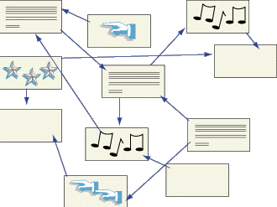
DATABASE TRENDS
A Hypermedia Database
Figure 7-20

Slide 50
DATABASE TRENDS
Databases and the Web
Database server
Computer in a client/server environment runs a DBMS to process SQL statements and perform database management tasks
Application server
Software handling all application operations

Slide 51
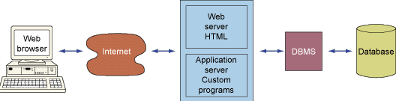
DATABASE TRENDS
Linking Internal Databases to the Web
Figure 7-21

Slide 52
Chapter
7
MANAGING
DATA
RESOURCES

