Slide 1

Chapter
8
TELECOMMUNICATIONS
AND
NETWORKS

Slide 2
OBJECTIVES
What technologies are used in telecommunications systems?
What telecommunications transmission media should our organization use?
How should our organization design its networks?

Slide 3
OBJECTIVES
What alternative network services are available to our organization?
What telecommunications applications can be used for electronic commerce and electronic business?

Slide 4
MANAGEMENT CHALLENGES
Managing LANs
Managing bandwidth

Slide 5
COMPONENTS AND FUNCTIONS OF A TELECOMMUNICATIONS SYSTEM
Telecommunications:
Communication of information by electronic means
Includes digital data transmission as well as voice transmission

Slide 6
COMPONENTS AND FUNCTIONS OF A TELECOMMUNICATIONS SYSTEM
Telecommunications System Components
Computers to process information
Terminals or any input/output devices that send or receive data
Communications processors
Communications software

Slide 7
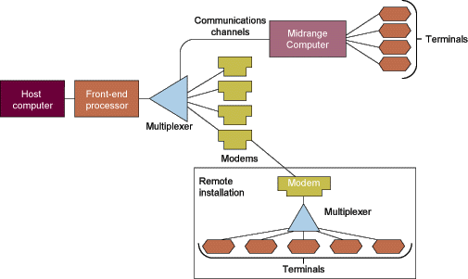
COMPONENTS AND FUNCTIONS OF A TELECOMMUNICATIONS SYSTEM
Components of a Telecommunications System
Figure 8-1

Slide 8
COMPONENTS AND FUNCTIONS OF A TELECOMMUNICATIONS SYSTEM
Functions of Telecommunications Systems
Transmit information
Establish interface between sender and the receiver
Route messages along most efficient paths

Slide 9
COMPONENTS AND FUNCTIONS OF A TELECOMMUNICATIONS SYSTEM
Functions of Telecommunications Systems
Perform elementary processing of information
Perform editorial tasks on data
Convert message speed or format
Control flow of information

Slide 10
COMPONENTS AND FUNCTIONS OF A TELECOMMUNICATIONS SYSTEM
Types of Signals: Analog and Digital
Analog signal
Continuous waveform
Passes through communications medium
Used for voice communications

Slide 11
COMPONENTS AND FUNCTIONS OF A TELECOMMUNICATIONS SYSTEM
Types of Signals: Analog and Digital
Digital signal
Discrete waveform
Transmits data coded into two discrete states as 1-bits and 0-bits
Used for data communications
Modem
Translates computer’s digital signals into analog and vice versa

Slide 12

COMPONENTS AND FUNCTIONS OF A TELECOMMUNICATIONS SYSTEM
Functions of the Modem
Figure 8-2

Slide 13
COMPONENTS AND FUNCTIONS OF A TELECOMMUNICATIONS SYSTEM
Communications Channels
Twisted wire: Telephone systems
Coaxial cable: Cable television
Fiber optics and optical networks: Dense wave division multiplexing (DWDM)

Slide 14
COMPONENTS AND FUNCTIONS OF A TELECOMMUNICATIONS SYSTEM
Communications Channels
Wireless transmission: Microwave, Satellites, Paging systems, Cellular telephones, Personal communication Services, Personal digital assistants, Mobile data networks
Transmission speed: Baud, bandwidth

Slide 15
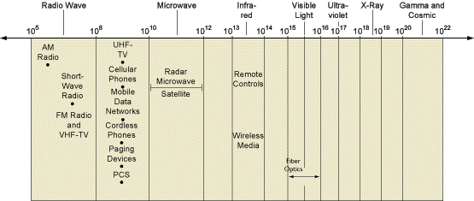
COMPONENTS AND FUNCTIONS OF A TELECOMMUNICATIONS SYSTEM
Frequency Ranges for Communications Media and Devices
Figure 8-3

Slide 16
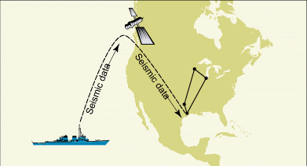
COMPONENTS AND FUNCTIONS OF A TELECOMMUNICATIONS SYSTEM
Amoco’s Satellite Transmission System
Figure 8-4

Slide 17
COMPONENTS AND FUNCTIONS OF A TELECOMMUNICATIONS SYSTEM
Communications Processors and Software
Front-end processor: Manages communications for the host computer
Concentrator: Collects and temporarily stores messages
Controller: Supervises communication traffic
Multiplexer: Enables single communication channel to carry data transmissions

Slide 18
COMMUNICATIONS NETWORKS
Network Topologies
Star Network: All computers and other devices are connected to a central host computer
Bus Network: Links a number of computers by a single circuit
Ring Network: All computers are linked by a closed loop

Slide 19
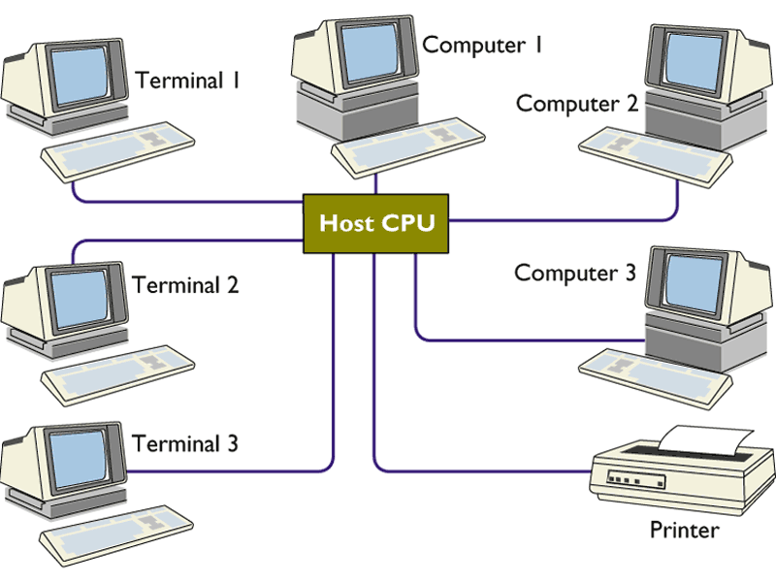
COMMUNICATIONS NETWORKS
A Star Network Topology
Figure 8-5

Slide 20
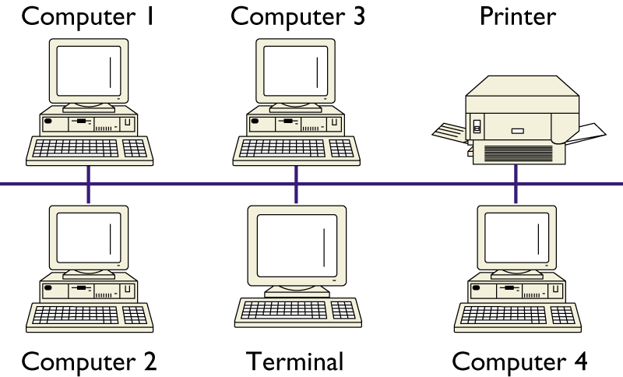
COMMUNICATIONS NETWORKS
A Bus Network Topology
Figure 8-6

Slide 21
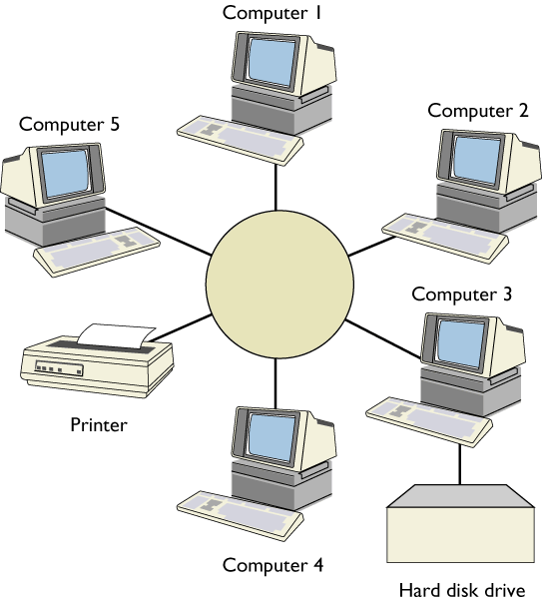
COMMUNICATIONS NETWORKS
A Ring Network Topology
Figure 8-7

Slide 22
COMMUNICATIONS NETWORKS
Private Branch Exchanges, Local Area Networks (LANs),
and Wide Area Networks (WANs)
Private Branch Exchanges
Central switching system
Handle firm’s voice and digital communications

Slide 23
COMMUNICATIONS NETWORKS
Private Branch Exchanges, Local Area Networks (LANs),
and Wide Area Networks (WANs)
Local Area Networks
Require their own dedicated channels
Encompass a limited distance
Gateway, router, Network Operating System (NOS), peer-to-peer

Slide 24
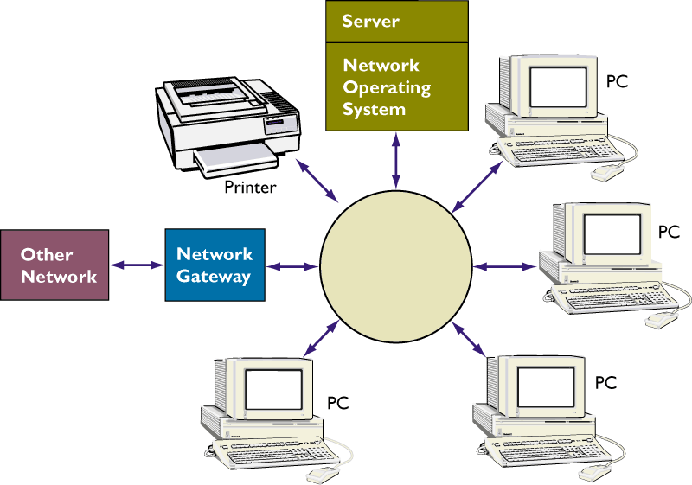
COMMUNICATIONS NETWORKS
A Local Area Network (LAN)
Figure 8-8

Slide 25
COMMUNICATIONS NETWORKS
Private Branch Exchanges, Local Area Networks (LANs),
and Wide Area Networks (WANs)
Wireless LANs
Wi-Fi (802.11b) standard: Up to 11 Mbps, low cost, high-speed mobile Internet access, links work groups
Bluetooth standard: Up to 720 Kbps, small personal area networks

Slide 26
COMMUNICATIONS NETWORKS
Private Branch Exchanges, Local Area Networks (LANs),
and Wide Area Networks (WANs)
Wide Area Networks (WANs)
Span large geographical distance
Consist of variety of cable, satellite, and microwave technologies
Switched lines, dedicated lines

Slide 27
COMMUNICATIONS NETWORKS
Network Services and Broadband Technologies
Value-Added Networks (VANs)
Private, multipath, data-only, third-party-managed network
Other Network Services
Packet switching, Frame Relay, Asynchronous transfer mode (ATM)
Integrated Services Digital Network (ISDN), Digital subscriber line (DSL), Cable modems, T1 line - Broadband

Slide 28
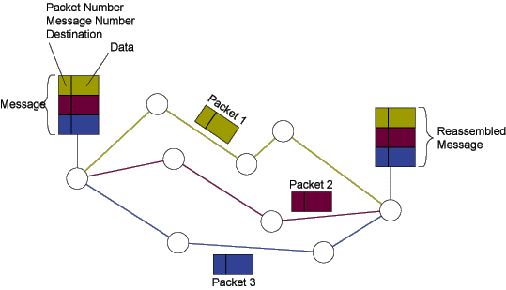
COMMUNICATIONS NETWORKS
Packed-Switched Networks and Packet Communications
Figure 8-9

Slide 29
COMMUNICATIONS NETWORKS
Network Convergence
Converged network
Enables voice, video and data to run over a single network
Unified messaging
System combining voice messages, email, and fax

Slide 30
ELECTRONIC COMMERCE AND ELECTRONIC BUSINESS TECHNOLOGIES
Electronic Commerce and Electronic Business Technologies
Electronic Mail and Groupware
E-mail: Eliminates telephone tag and costly long-distance telephone charges
Groupware: Enables work groups at different locations to participate in discussion forums and work on shared documents and projects

Slide 31
ELECTRONIC COMMERCE AND ELECTRONIC BUSINESS TECHNOLOGIES
Electronic Commerce and Electronic Business Technologies
Voice Mail and Fax
Voice mail: Digitizes spoken message and transmits it over a network
Fax: Digitizes and transmits documents over telephone lines

Slide 32
ELECTRONIC COMMERCE AND ELECTRONIC BUSINESS TECHNOLOGIES
Electronic Commerce and Electronic Business Technologies
Teleconferencing, data conferencing,
and videoconferencing
Teleconferencing: Ability to confer with a group of people simultaneously
Data conferencing: Two or more users can edit and modify data files simultaneously
Videoconferencing: Participants are able to see each other over video screens

Slide 33
ELECTRONIC COMMERCE AND ELECTRONIC BUSINESS TECHNOLOGIES
Electronic Commerce and Electronic Business Technologies
Digital information services, distance
learning and E-Learning
Distance learning: Education or training delivered over a distance to individuals in one or more locations
E-learning: Instruction delivered online using the Internet or private networks

Slide 34
ELECTRONIC COMMERCE AND ELECTRONIC BUSINESS TECHNOLOGIES
Electronic Data Interchange (EDI)
Direct computer-to-computer exchange between two organizations of standard business transaction documents

Slide 35
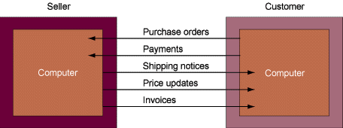
ELECTRONIC COMMERCE AND ELECTRONIC BUSINESS TECHNOLOGIES
Electronic Data Interchange (EDI)
Figure 8-10

Slide 36
Chapter
8
TELECOMMUNICATIONS
AND
NETWORKS

