Slide 1

Chapter
9
THE INTERNET AND THE
NEW INFORMATION
TECHNOLOGY
INFRASTRUCTURE

Slide 2
OBJECTIVES
What is the new information technology (IT) infrastructure for business? Why is connectivity so important in this infrastructure?
How does the Internet work? What are its major capabilities?
How can businesses benefit from using the World Wide Web and Web technology? How can businesses benefit from the Wireless Web?

Slide 3
OBJECTIVES
What are the principal technologies for supporting electronic commerce and electronic business?
What management problems are raised by the new information technology (IT) infrastructure? How can businesses solve these problems?

Slide 4
MANAGEMENT CHALLENGES
Taking a broader perspective on infrastructure development
Selecting technologies for the new information technology (IT) infrastructure

Slide 5
THE NEW INFORMATION TECHNOLOGY (IT) INFRASTRUCTURE
FOR THE DIGITAL FIRM
Enterprise Networking and Internetworking
Enterprise Networking
Arrangement of organization’s hardware, software, network, and data resources
Creates a company-wide network linking many smaller networks
Internetworking
Links separate networks into an interconnected network

Slide 6
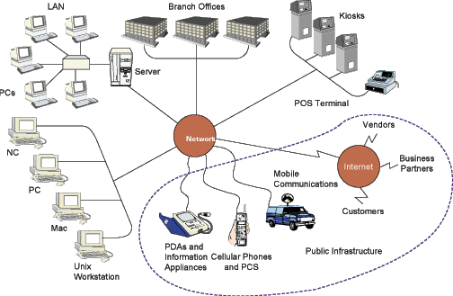
THE NEW INFORMATION TECHNOLOGY (IT) INFRASTRUCTURE
FOR THE DIGITAL FIRM
The New Information Technology (IT) Infrastructure
Figure 9-1

Slide 7
THE NEW INFORMATION TECHNOLOGY (IT) INFRASTRUCTURE
FOR THE DIGITAL FIRM
Standards and Connectivity for Digital Integration
Connectivity
Measures how well computers and computer-based devices communicate
Open System
Software systems
Operate on different hardware platforms

Slide 8
THE NEW INFORMATION TECHNOLOGY (IT) INFRASTRUCTURE
FOR THE DIGITAL FIRM
Standards and Connectivity for Digital Integration
Models of Connectivity for Networks
Transmission Control Protocol/Internet Protocol (TCP/IP)
Open Systems Interconnect (OSI)

Slide 9
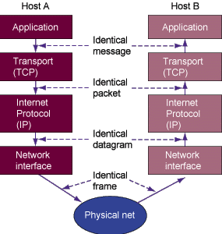
THE NEW INFORMATION TECHNOLOGY (IT) INFRASTRUCTURE
FOR THE DIGITAL FIRM
(TCP/IP) Reference Model
Figure 9-2

Slide 10
THE NEW INFORMATION TECHNOLOGY (IT) INFRASTRUCTURE
FOR THE DIGITAL FIRM
What is the Internet?
Internet Service Provider (ISP)
Commercial organization with a permanent connection to Internet
Sells temporary connections to subscribers

Slide 11
THE INTERNET: INFORMATION TECHNOLOGY (IT) INFRASTRUCTURE
FOR THE DIGITAL FIRM
Internet Technology and Services
Information appliance
Device customized to perform few specialized computing tasks with minimal user effort

Slide 12
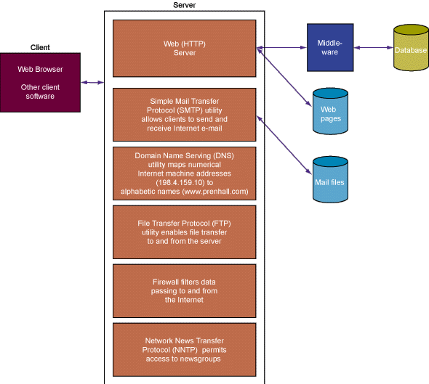
THE INTERNET: INFORMATION TECHNOLOGY (IT) INFRASTRUCTURE
FOR THE DIGITAL FIRM
Client/Server Computing on the Internet
Figure 9-3

Slide 13
THE INTERNET: INFORMATION TECHNOLOGY (IT) INFRASTRUCTURE
FOR THE DIGITAL FIRM
Internet Tools for Communication
Electronic Mail (E-Mail)
Connects people worldwide
Creates productivity gain
Usenet Newsgroups
On-line discussion groups using electronic bulletin boards

Slide 14
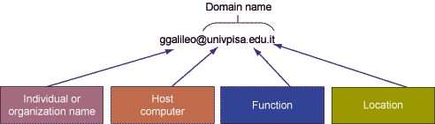
THE INTERNET: INFORMATION TECHNOLOGY (IT) INFRASTRUCTURE
FOR THE DIGITAL FIRM
Analysis of an Internet Address
Figure 9-4

Slide 15
THE INTERNET: INFORMATION TECHNOLOGY (IT) INFRASTRUCTURE
FOR THE DIGITAL FIRM
Internet Tools for Communication
LISTSERV
E-mail broadcast from mailing list servers
Chatting
Live, interactive conversations over public network

Slide 16
THE INTERNET: INFORMATION TECHNOLOGY (IT) INFRASTRUCTURE
FOR THE DIGITAL FIRM
Internet Tools for Communication
Instant messaging
Service that allows participants to create their own private chat channels
Internet telephony
Two-way voice transmission over the Internet

Slide 17
THE INTERNET: INFORMATION TECHNOLOGY (IT) INFRASTRUCTURE
FOR THE DIGITAL FIRM
SERVERS
How are you?
How are you?
( )
( )
A
B
C
A
B
C
Z
GATEWAY
A
B
C
B
C
A
GATEWAY
A
B
Y
Y
Z
X
X
Y
Z
X
Fine, thank you!
C
Fine, thank you!
( )
X
Y
Z
( )
X
Y
Z
Figure 9-5

Slide 18
THE INTERNET: INFORMATION TECHNOLOGY (IT) INFRASTRUCTURE
FOR THE DIGITAL FIRM
Internet Tools for Communication
Telnet
Allows users to log on to one computer system while working on another
File Transfer Protocol (FTP)
Tool for retrieving and transferring files from a remote computer

Slide 19
THE INTERNET: INFORMATION TECHNOLOGY (IT) INFRASTRUCTURE
FOR THE DIGITAL FIRM
Next Generation Networks and Internet 2
Internet2 and Next Generation Networks
Research networks with new protocols and transmission speeds
Provide infrastructures for supporting high bandwidth Internet applications

Slide 20
THE WORLD WIDE WEB
Overview
Based on a standard hypertext language called hypertext markup language (HTML)
Combines text, hypermedia, graphics, and sound
Handles all types of digital communication
Uses graphical user interfaces for easy viewing

Slide 21
THE WORLD WIDE WEB
Searching for Information on the Web
Search Engine
Locates specific sites or information on Internet
Shopping Bot
Software with varying levels of built-in intelligence
Helps electronic commerce shoppers locate and evaluate products or services

Slide 22
THE WORLD WIDE WEB
Searching for Information on the Web
“Push” technology
Information broadcast directly to user based on pre-specified interests
Multicasting
Transmission of data to a selected group of recipients

Slide 23
THE WORLD WIDE WEB
Intranets and Extranets
Firewall
Hardware or software placed between an organization’s internal network and external network
Prevents outsiders from invading private networks
Extranets
Private intranets extended to authorized users outside company

Slide 24
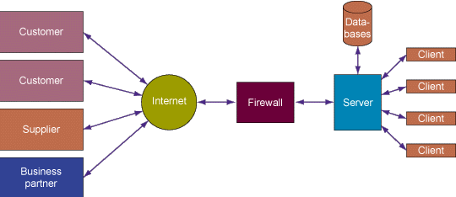
THE WORLD WIDE WEB
Model of an Extranet
Figure 9-6

Slide 25
THE WORLD WIDE WEB
The Wireless Web
Web-based applications
Enables users to access digital information from the Internet
Wireless Web Standards:
  Wireless Application Protocol (WAP)
  WML (Wireless Markup Language)
  Microbrowser
  I-mode
  M-Commerce Challenges
  Voice portals

Slide 26
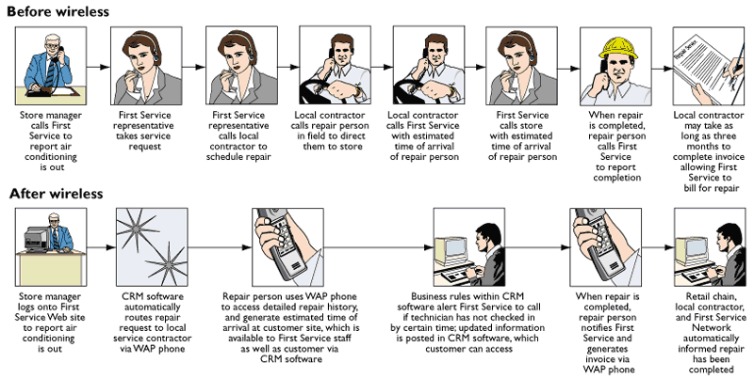
THE WORLD WIDE WEB
Figure 9-7

Slide 27
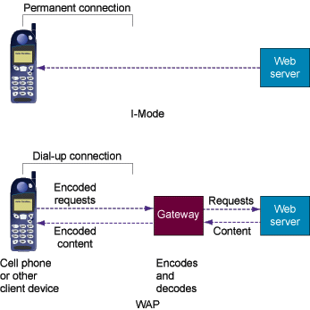
THE WORLD WIDE WEB
WAP Versus I-Mode
Figure 9-8

Slide 28
THE WORLD WIDE WEB
M-Commerce Challenges
Keyboards and screens of cell phones tiny and awkward to use
Very slow data transfer speeds
Minimal memory and limited power supplies in Internet-enabled phones
Web content primarily in text with very little graphics
Incompatible technologies

Slide 29
SUPPORT TECHNOLOGY FOR ELECTRONIC COMMERECE AND ELECTRONIC BUSINESS
Web Servers and Electronic Commerce Servers
Hit
Entry into Web server’s log file
Generated by each request to the server for a file
Electronic commerce server software
Provides functions essential for running
e-commerce Web sites

Slide 30
SUPPORT TECHNOLOGY FOR ELECTRONIC COMMERECE AND ELECTRONIC BUSINESS
Customer Tracking and Personalization Tools
Collecting and storing data
Combining data with already stored data
Analyzing the data
Identifying customer preferences and trends

Slide 31
SUPPORT TECHNOLOGY FOR ELECTRONIC COMMERECE AND ELECTRONIC BUSINESS
Web Content Management Tool
Software to facilitate collection, assembly, and management of content on Web site, intranet, or extranet

Slide 32
SUPPORT TECHNOLOGY FOR ELECTRONIC COMMERECE AND ELECTRONIC BUSINESS
Web Site Performance Monitoring Tool
Monitors time taken for downloading Web pages
Identifies broken links between Web pages, Web site problems, and bottlenecks

Slide 33
SUPPORT TECHNOLOGY FOR ELECTRONIC COMMERECE AND ELECTRONIC BUSINESS
Web Hosting Services
Company with large Web server computers
Maintain Web sites of fee-paying subscribers

Slide 34
MANAGEMENT ISSUES AND DECISIONS
The Challenge of Managing the New Information Technology Infrastructure
Loss of management control
Connectivity and application integration challenges
Organizational change requirements
Hidden costs of enterprise computing
Scalability, reliability, and security
downtime

Slide 35
MANAGEMENT ISSUES AND DECISIONS
Some Solutions
Change management
Education and training
Data administration disciplines
Planning for connectivity and application integration

Slide 36
Chapter
9
THE INTERNET AND THE
NEW INFORMATION
TECHNOLOGY
INFRASTRUCTURE

