Slide 1

Chapter
10
MANAGING
KNOWLEDGE FOR
THE DIGITAL
FIRM

Slide 2
OBJECTIVES
Why do businesses today need knowledge management programs and systems for knowledge management?
Which information system applications are most useful for distributing, creating, and sharing knowledge in the firm?
What are the business benefits of using artificial intelligence technology for knowledge management?

Slide 3
OBJECTIVES
How can businesses use expert systems and case-based reasoning to capture knowledge?
How can organizations benefit from using use neural networks and other intelligent techniques?

Slide 4
MANAGEMENT CHALLENGES
Designing knowledge systems that genuinely enhance organizational performance
Identifying and implementing appropriate organizational applications for artificial intelligence

Slide 5
KNOWLEDGE MANAGEMENT IN THE ORGANIZATION
Organizational Learning and Knowledge Management
Organizational learning
Creation of new standard operating procedures and business processes reflecting experience
Knowledge management
Set of processes
Creates, gathers, stores, maintains, and disseminates knowledge

Slide 6
KNOWLEDGE MANAGEMENT IN THE ORGANIZATION
Organizational Learning and Knowledge Management
Knowledge Assets
Organizational knowledge enabling the business to create value
Chief Knowledge Officer (CKO)
Senior executive in charge of organization’s knowledge management program

Slide 7
KNOWLEDGE MANAGEMENT IN THE ORGANIZATION
Systems and Infrastructure for Knowledge Management
Tacit Knowledge
Expertise and experience not formally documented
Best Practices
Successful solutions or problem-solving methods developed by specific organization or industry

Slide 8
KNOWLEDGE MANAGEMENT IN THE ORGANIZATION
Systems and Infrastructure for Knowledge Management
Organizational Memory
Stored learning from organization’s history
Used for decision making and other purposes

Slide 9
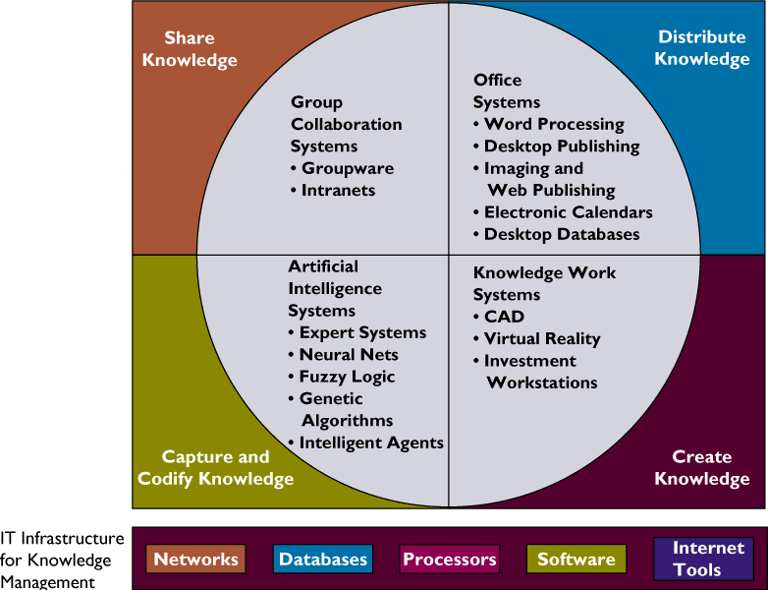
KNOWLEDGE MANAGEMENT IN THE ORGANIZATION
IT Infrastructure for Knowledge Management
Figure 10-1

Slide 10
INFORMATION AND KNOWLEDGE WORK SYSTEMS
Information Work
Consists of creating or processing information
Divided into knowledge workers and data workers

Slide 11
INFORMATION AND KNOWLEDGE WORK SYSTEMS
Distributing Knowledge: Office and Document Management Systems
Office systems
Manage and coordinate work of data and knowledge workers
Connect work of local information workers with all levels and functions of organization
Connect organization to external world
Example: Word processing, voice mail, and imaging

Slide 12
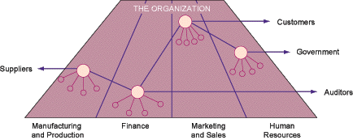
INFORMATION AND KNOWLEDGE WORK SYSTEMS
The Three Major Roles of Offices
Figure 10-2

Slide 13
INFORMATION AND KNOWLEDGE WORK SYSTEMS
Typical Office Systems
Document imaging systems
Convert documents and images into digital form
Can be stored and accessed by the computer
Knowledge repository
Documented knowledge in a single location

Slide 14
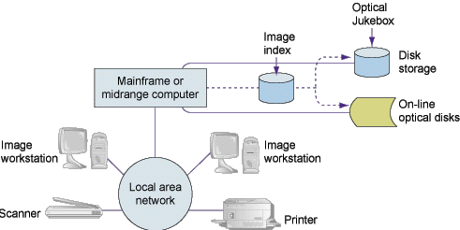
INFORMATION AND KNOWLEDGE WORK SYSTEMS
Components of an Imaging System
Figure 10-3

Slide 15
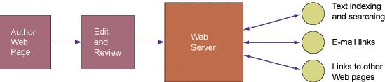
INFORMATION AND KNOWLEDGE WORK SYSTEMS
Web Publishing and Document Management
Figure 10-4

Slide 16
INFORMATION AND KNOWLEDGE WORK SYSTEMS
Creating Knowledge: Knowledge Work Systems
Knowledge Work Systems (KWS)
Aid knowledge workers in creation and integration of new knowledge
Specialized tools for specific types of knowledge work
User-friendly interface

Slide 17
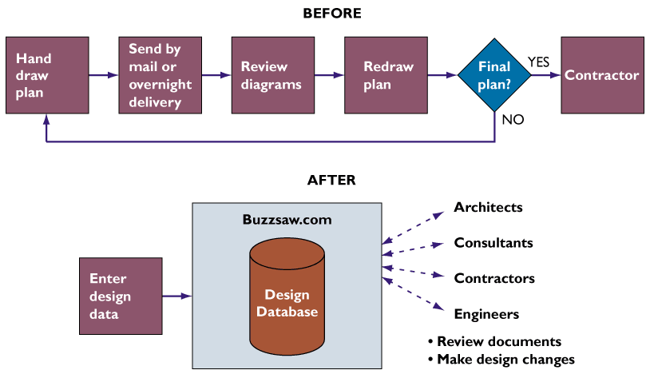
INFORMATION AND KNOWLEDGE WORK SYSTEMS
Changes in the Construction Project Management Process
Figure 10-5

Slide 18
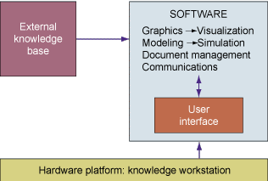
INFORMATION AND KNOWLEDGE WORK SYSTEMS
Requirements of Knowledge Work Systems
Figure 10-6

Slide 19
INFORMATION AND KNOWLEDGE WORK SYSTEMS
Examples of Knowledge Work Systems
Computer-aided design (CAD)
Virtual reality systems
Virtual Reality Modeling Language (VRML)
Investment workstations

Slide 20
INFORMATION AND KNOWLEDGE WORK SYSTEMS
Sharing Knowledge: Group Collaboration Systems and Enterprise Knowledge Environments
Groupware
Intranets and Enterprise Knowledge Environments
Enterprise information portals
Teamware

Slide 21
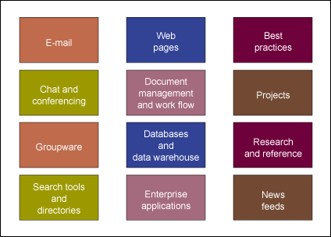
INFORMATION AND KNOWLEDGE WORK SYSTEMS
An Enterprise Information Portal
Figure 10-7

Slide 22
ARTIFICIAL INTELLIGENCE
What is Artificial Intelligence?
Effort to develop computer-based systems that behave as humans
Includes natural language, robotics, perceptive systems, expert systems, and intelligent machines

Slide 23
ARTIFICIAL INTELLIGENCE
Why Business is Interested in Artificial Intelligence
Artificial Intelligence:
  Stores information in active form
  Creates mechanism not subjected to human feelings
  Eliminates routine and unsatisfying jobs
  Enhances organization’s knowledge base
  Generates solution to specific problems

Slide 24
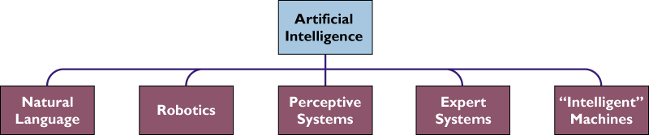
ARTIFICIAL INTELLIGENCE
The Artificial Intelligence Family
Figure 10-8

Slide 25
ARTIFICIAL INTELLIGENCE
Capturing Knowledge: Expert Systems
Knowledge Base
Rule-based Expert System
Rule Base
Knowledge Frames

Slide 26
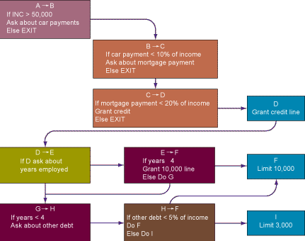
ARTIFICIAL INTELLIGENCE
Rules in an AI Program
Figure 10-9

Slide 27
ARTIFICIAL INTELLIGENCE
Capturing Knowledge: Expert Systems
AI shell
Inference Engine
Forward Chaining
Backward Chaining

Slide 28
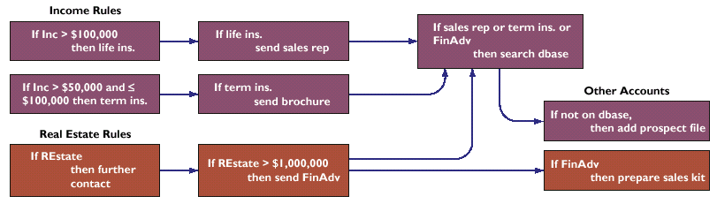
ARTIFICIAL INTELLIGENCE
Figure 10-10

Slide 29
ARTIFICIAL INTELLIGENCE
Building an Expert System
Knowledge engineer
Specialist eliciting information and expertise from other professionals
Translates information into set of rules for an expert system

Slide 30
ARTIFICIAL INTELLIGENCE
Examples of Successful Expert Systems
Galeria Kaufhof
Countrywide Funding Corp.

Slide 31
ARTIFICIAL INTELLIGENCE
Organizational Intelligence: Case-Based Reasoning
Case-based Reasoning (CBR)
Captures and stores collective knowledge
Represents knowledge as database of cases and solutions

Slide 32
ARTIFICIAL INTELLIGENCE
1.
User describes the
problem
System searches
2.
database for similar
cases
Case
System asks user
database
3.
additional questions to
narrow the search
System finds closest
4.
fit and retrieves
solution
System stores
5.
System modifies the
6.
problem and
solution to better fit
successful solution
the problem
in the database
Successful?
NO
YES
Figure 10-11

Slide 33
OTHER INTELLIGENT TECHNIQUES
Neural Networks
Hardware or software emulating processing patterns of biological brain
Put intelligence into hardware in form of a generalized capability to learn

Slide 34
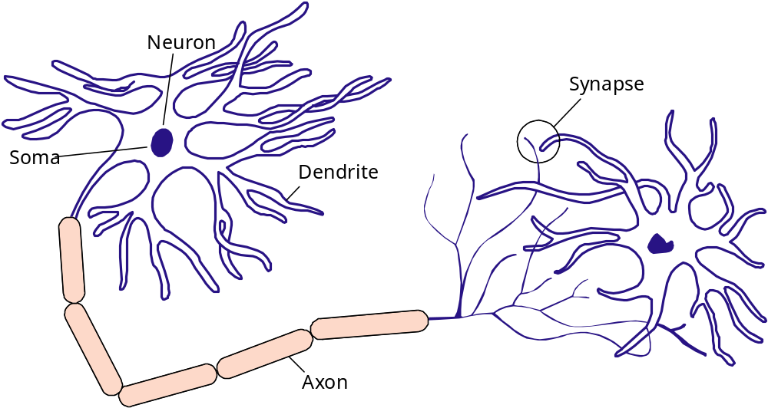
ARTIFICIAL INTELLIGENCE
Inference Engines in Expert Systems
Figure 10-12

Slide 35
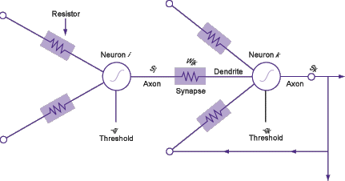
ARTIFICIAL INTELLIGENCE
Figure 10-13

Slide 36
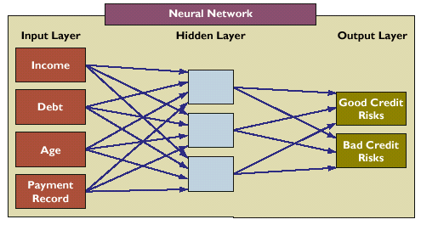
OTHER INTELLIGENT TECHNIQUES
Biological Neurons of a Leech
Figure 10-14

Slide 37
OTHER INTELLIGENT TECHNIQUES
Fuzzy Logic
Rule-based AI
Tolerates imprecision
Uses nonspecific terms called membership functions to solve problems

Slide 38
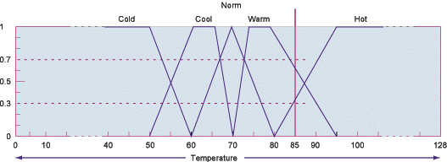
OTHER INTELLIGENT TECHNIQUES
Implementing Fuzzy Logic Rules in Hardware
Figure 10-15

Slide 39
OTHER INTELLIGENT TECHNIQUES
Genetic Algorithms
Problem-solving methods
Promote evolution of solutions to specified problems
Use a model of living organisms adapting to their environment

Slide 40
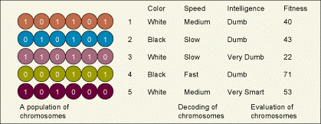
OTHER INTELLIGENT TECHNIQUES
The Components of a Genetic Algorithm
Figure 10-16

Slide 41
OTHER INTELLIGENT TECHNIQUES
Hybrid AI Systems
Integration of multiple AI technologies into a single application
Takes advantage of best features of technologies

Slide 42
OTHER INTELLIGENT TECHNIQUES
Intelligent Agents
Software programs
Use built-in or learned knowledge base to carry out specific, repetitive, and predictable tasks

Slide 43
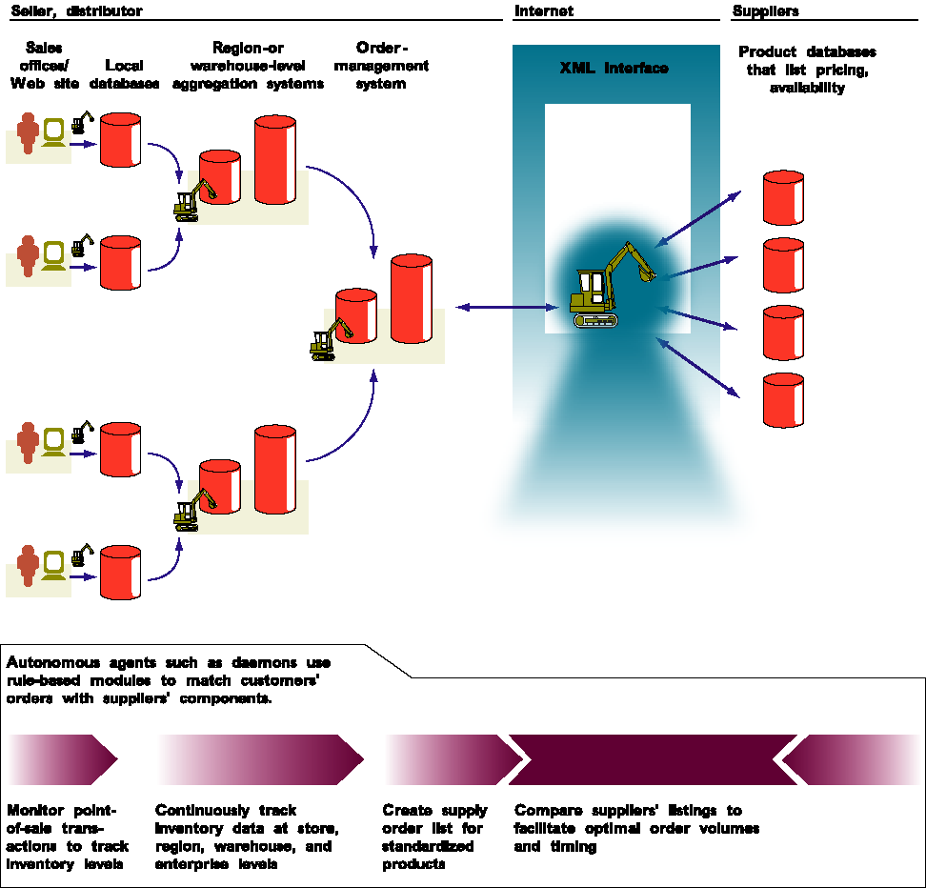
OTHER INTELLIGENT TECHNIQUES
Figure 10-17

Slide 44
Chapter
10
MANAGING
KNOWLEDGE FOR
THE DIGITAL
FIRM

