Slide 1

Chapter
11
ENHANCING
MANAGEMENT
DECISION-MAKING
FOR THE DIGITAL FIRM

Slide 2
OBJECTIVES
How can information systems help individual managers make better decisions when the problems are non-routine and constantly changing?
How can information systems help people working in a group make decisions more efficiently?

Slide 3
OBJECTIVES
Are there any special systems that can facilitate decision-making among senior managers? Exactly what can these systems do to help high-level management?
What benefits can systems that support management decision-making provide for the organization as a whole?

Slide 4
MANAGEMENT CHALLENGES
Building information systems that can actually fulfill executive information requirements
Create meaningful reporting and management decision-making processes

Slide 5
DECISION-SUPPORT SYSTEMS (DSS)
Computer system at the management level of an organization
Combines data, analytical tools, and models
Supports semi-structured and unstructured decision-making

Slide 6
DECISION-SUPPORT SYSTEMS (DSS)
MIS and DSS
MIS
Provides reports based on routine flow
of data
Assists in general control of the organization

Slide 7
DECISION-SUPPORT SYSTEMS (DSS)
MIS and DSS
DSS
Emphasizes change, flexibility, rapid response, models, assumptions, ad hoc queries, and display graphics

Slide 8
DECISION-SUPPORT SYSTEMS (DSS)
Types of Decision-Support Systems
Model-driven DSS
Primarily stand-alone
Uses model to perform “what-if” and other kinds of analysis

Slide 9
DECISION-SUPPORT SYSTEMS (DSS)
Types of Decision-Support Systems
Data-driven DSS
Allows users to extract and analyze useful information from large databases
Datamining
Finds hidden patterns and relationships in large databases to infer rules
Knowledge discovery

Slide 10
DECISION-SUPPORT SYSTEMS (DSS)
CARGO
2
Cargo
1
RESERVATION
Booking
Request
SYSTEM
Agent
Confirm/
xxx
Reject
Cargo Size,
Availability/
Rate Data
3
CARGOPROF
Minimum Price
REVENUE
MANAGEMENT SYSTEM
Cargo
Availability
FLIGHT
5
Forecast
SCHEDULE
SERVER
Passenger
Passenger
PASSENGER
4
Forecast Data
Booking
RESERVATION
Agent
SYSTEM
Figure 11-1

Slide 11
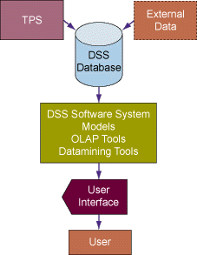
DECISION-SUPPORT SYSTEMS (DSS)
Overview of a Decision-Support System (DSS)
Figure 11-2

Slide 12
DECISION-SUPPORT SYSTEMS (DSS)
Components of Decision-Support Systems
DSS database: collection of current or historical data
DSS software system: collection of software tools/mathematical and analytical models
User interface: easy interaction

Slide 13
DECISION-SUPPORT SYSTEMS (DSS)
Components of Decision-Support Systems
Model
Abstract representation illustrating components or relationships
Sensitivity analysis
Asks “what-if” questions repeatedly to determine the impact of change

Slide 14
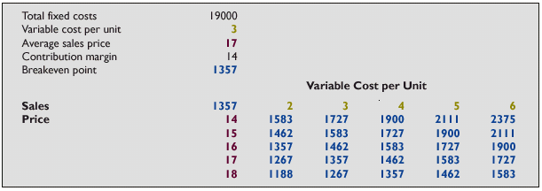
DECISION-SUPPORT SYSTEMS (DSS)
Sensitivity Analysis
Figure 11-3

Slide 15
DECISION-SUPPORT SYSTEMS (DSS)
DSS Applications and the Digital Firm
General Accident Insurance: Customer buying patterns and fraud detection
Bank of America: Customer profiles
Frito-Lay, Inc.: Price, advertising, and promotion selection

Slide 16
DECISION-SUPPORT SYSTEMS (DSS)
DSS Applications and the Digital Firm
Burlington Coat Factory: Store location and inventory mix
Keycorp: Targeting direct mail marketing customers
National Gypsum: Corporate planning and forecasting

Slide 17
DECISION-SUPPORT SYSTEMS (DSS)
DSS Applications and the Digital Firm
Southern Railway: Train dispatching and routing
Texas Oil and Gas Corporation: Evaluation of potential drilling sites
United Airlines: Flight scheduling, passenger demand forecasting

Slide 18
DECISION-SUPPORT SYSTEMS (DSS)
DSS Applications and the Digital Firm
U.S. Department of Defense: Defense contract analysis

Slide 19
DECISION-SUPPORT SYSTEMS (DSS)
DSS for Supply Chain Management
Comprehensive examination of supply management chain
Searches for most efficient and cost-effective combination
Reduces overall costs
Increases speed and accuracy of filling customer orders

Slide 20
DECISION-SUPPORT SYSTEMS (DSS)
DSS for Customer Relationship Management
Uses data mining to guide decisions
Consolidates customer information into massive data warehouses
Uses various analytical tools to slice information into small segments

Slide 21
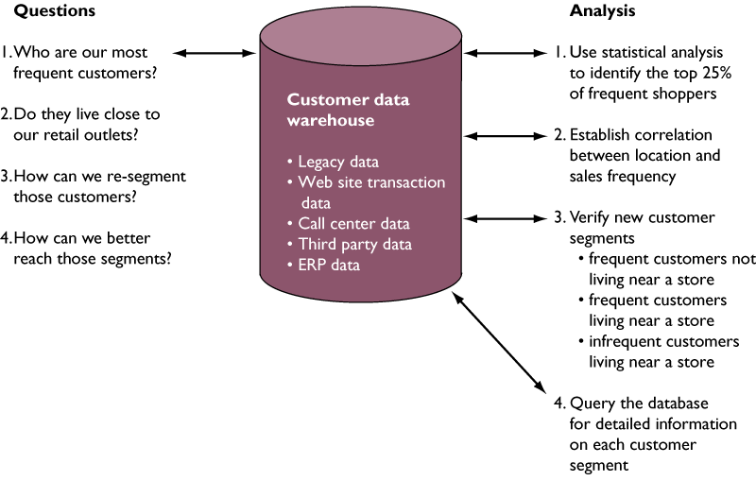
DECISION-SUPPORT SYSTEMS (DSS)
DSS for Customer Analysis and Segmentation
Figure 11-4

Slide 22
DECISION-SUPPORT SYSTEMS (DSS)
DSS for Simulating Business Scenarios
Geographic Information Systems (GIS)
Software for analyzing and displaying data using digitized maps
Enhances planning and decision-making
Use data visualization technology

Slide 23
DECISION-SUPPORT SYSTEMS (DSS)
Web-Based Customer Decision-Support Systems
Customer Decision-Support Systems (CDSS)
Support decision-making process of an existing or potential customer

Slide 24
GROUP DECISION-SUPPORT SYSTEMS (GDSS)
What Is a GDSS?
Interactive computer-based system
Facilitates solution to unstructured problems
Set of decision makers working together as a group

Slide 25
GROUP DECISION-SUPPORT SYSTEMS (GDSS)
Characteristics of GDSS
Hardware: Conference facility, electronic hardware
Software tools: Tools for organizing ideas, gathering information, and ranking and seeking priorities
People: Participants, trained facilitator, staff supporting hardware and software

Slide 26
GROUP DECISION-SUPPORT SYSTEMS (GDSS)
GDSS Software Tools
Electronic questionnaires
Electronic brainstorming tools
Idea organizers
Questionnaire tools

Slide 27
GROUP DECISION-SUPPORT SYSTEMS (GDSS)
GDSS Software Tools
Tools for voting or setting priorities
Stakeholder identification and analysis tools

Slide 28
DECISION-SUPPORT SYSTEMS (DSS)
Group Interaction
Idea
Brainstorming
Generation
Topic Commenter
Group Outliner
Idea
Idea Organizer
Organization
Issue Analyzer
Group Writer
Session
Planning
Vote Selection
Prioritizing
Alternative Eval.
Questionnaire
Group Matrix
Session
Manager
Policy
Policy Formation
Development
Stakeholder ID.
Enterprise Analyzer
Graphical Browser
Organizational Memory
Group Dictionary
Brief Case
•
Access to information
•
Personal productivity
Figure 11-5

Slide 29
GROUP DECISION-SUPPORT SYSTEMS (GDSS)
How GDSS can Enhance Group Decision-Making
Improved preplanning
Increased participation
Open, collaborative meeting atmosphere
Criticism-free idea generation
Evaluation objectivity

Slide 30
EXECUTIVE SUPPORT IN THE ENTERPRISE
Executive Support Systems (ESS):
Information system at strategic level of an organization
Addresses unstructured decision-making through advanced graphics and communications

Slide 31
GROUP DECISION-SUPPORT SYSTEMS (GDSS)
The Role of Executive Support Systems in the Organization
Brings together data from the entire organization
Allows managers to select, access, and tailor data
Enables executive and any subordinates to look at the same data in the same way

Slide 32
GROUP DECISION-SUPPORT SYSTEMS (GDSS)
The Role of Executive Support Systems in the Organization
Developing ESS:
Ease of use
Facility for environmental scanning
External and internal sources of information to be used for environmental scanning

Slide 33
GROUP DECISION-SUPPORT SYSTEMS (GDSS)
Benefits of Executive Support Systems
Analyzes, compares, and highlights trends
Provides greater clarity and insight into data
Speeds up decision-making

Slide 34
GROUP DECISION-SUPPORT SYSTEMS (GDSS)
Benefits of Executive Support Systems
Improves management performance
Increases management’s span of control
Better monitoring of activities

Slide 35
GROUP DECISION-SUPPORT SYSTEMS (GDSS)
Executive Support Systems and the Digital Firm
ESS for business intelligence:
Identifies changing market conditions
Formulates responses
Tracks implementation efforts
Learns from feedback

Slide 36
GROUP DECISION-SUPPORT SYSTEMS (GDSS)
Executive Support Systems and the Digital Firm
Monitoring corporate performance:
balanced scorecard systems
Model for analyzing firm performance
Supplements traditional financial measures with measurements from additional business perspectives

Slide 37
GROUP DECISION-SUPPORT SYSTEMS (GDSS)
Enterprise Wide Reporting and Analysis
Strategic performance management tools
for enterprise systems
SAP: Web-enabled mySAP.com™, Management Cockpit
PeopleSoft: Web-enabled Enterprise Performance Management (EPM)
Oracle: Strategic Enterprise Management

Slide 38
Chapter
11
ENHANCING
MANAGEMENT
DECISION-MAKING
FOR THE DIGITAL FIRM

