Slide 1

Chapter
12
REDESIGNING THE
ORGANIZATION
WITH
INFORMATION
SYSTEMS

Slide 2
OBJECTIVES
How could building a new system change the way an organization works?
How can a company make sure that the new information systems it builds fit its business plan?
What are the steps required to build a new information system?

Slide 3
OBJECTIVES
What alternative methods for building information systems are available?
Are there any techniques or system-building approaches to help us build
e-commerce and e-business applications more rapidly?

Slide 4
MANAGEMENT CHALLENGES
Major risks and uncertainties in systems development
Determining when new systems and business processes can have the greatest strategic impact

Slide 5
SYSTEMS AS PLANNED ORGANIZATIONAL CHANGE
Linking Information Systems to the Business Plan
Information systems plan
Road map indicating direction of systems development

Slide 6
SYSTEMS AS PLANNED ORGANIZATIONAL CHANGE
Establishing Organizational Information Requirements
Enterprise Analysis (Business Systems
Planning)
Analysis of organization-wide information requirements
Identifies key entities and attributes

Slide 7
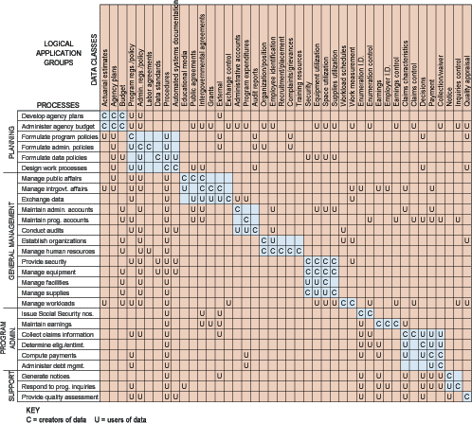
SYSTEMS AS PLANNED ORGANIZATIONAL CHANGE
Process/Data Class Matrix
Figure 12-1

Slide 8
SYSTEMS AS PLANNED ORGANIZATIONAL CHANGE
Establishing Organizational Information Requirements
Strategic Analysis or Critical Success
Factors
Small number of easily identifiable operational goals
Shaped by industry, firm, manager, and broader environment
Used to determine information requirements of organization

Slide 9
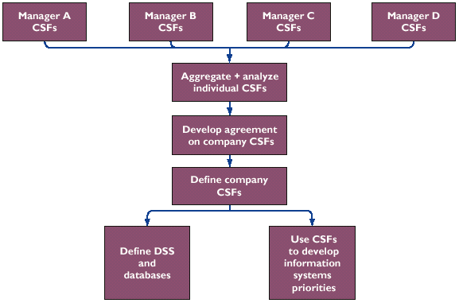
SYSTEMS AS PLANNED ORGANIZATIONAL CHANGE
Using CSFs to Develop Systems
Figure 12-2

Slide 10
SYSTEMS AS PLANNED ORGANIZATIONAL CHANGE
Systems Development and Organizational Change
Automation: Speeding up performance
Rationalization of procedures: Streamlining of operating procedures
Business process reengineering: Radical design of business processes
Paradigm shift: Radical reconceptualization

Slide 11
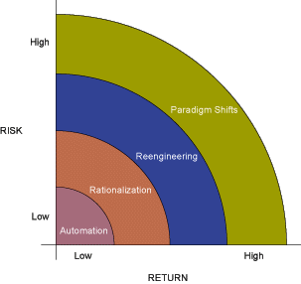
SYSTEMS AS PLANNED ORGANIZATIONAL CHANGE
Organizational Change Carries Risks and Rewards
Figure 12-3

Slide 12
BUSINESS PROCESS REENGINEERING AND PROCESS IMPROVEMENT
Business Process Reengineering
Business Process Reengineering
Reorganizes work flows, combining steps to eliminate redundant paper-intensive tasks
Large payoff from IT investment if processes are redesigned before applying technology

Slide 13
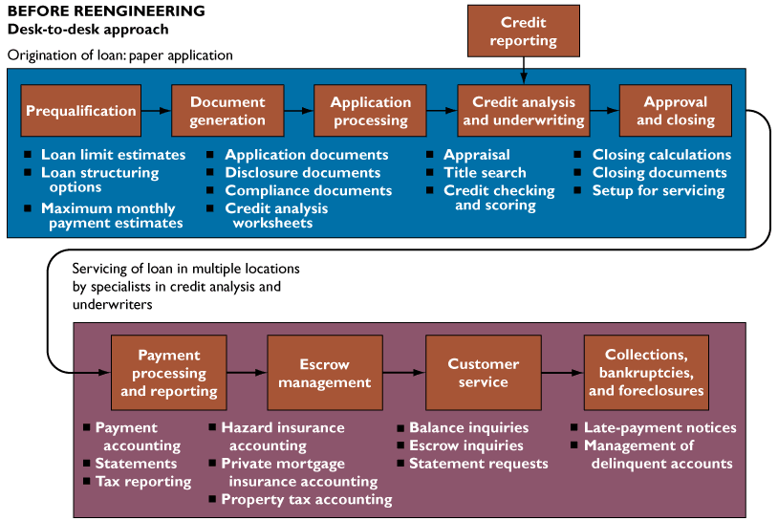
BUSINESS PROCESS REENGINEERING AND PROCESS IMPROVEMENT
Redesigning Mortgage Processing in the United States
Figure 12-4a

Slide 14
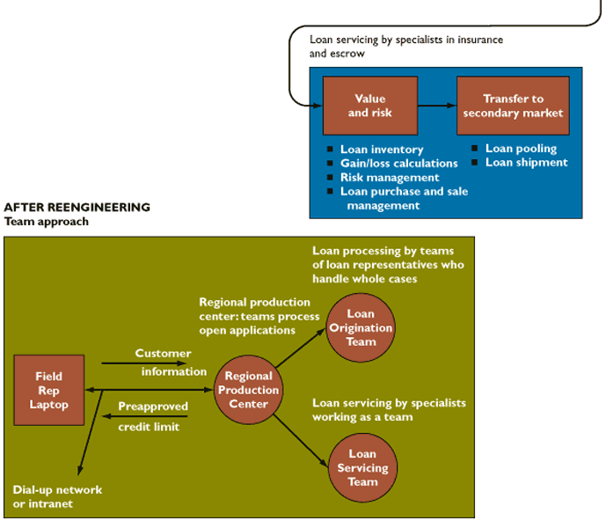
BUSINESS PROCESS REENGINEERING AND PROCESS IMPROVEMENT
Redesigning Mortgage Processing in the United States
Figure 12-4b

Slide 15
BUSINESS PROCESS REENGINEERING AND PROCESS IMPROVEMENT
Steps in Effective Reengineering
Senior management needs to develop broad strategic vision
Management must understand and measure performance of existing processes as baseline
Information technology should be allowed to influence process design from start
IT infrastructure should be able to support business process changes

Slide 16
BUSINESS PROCESS REENGINEERING AND PROCESS IMPROVEMENT
Process Total Quality Management (TQM) and Six Sigma
How information systems contribute
to Total Quality Management
Simplify product or production process
Enable benchmarking
Use customer demands as guide to improve products and services
Reduce cycle time

Slide 17
OVERVIEW OF SYSTEMS DEVELOPMENT
Overview
Systems development
Activities that go into producing information systems solution
Systems analysis
Analysis of problems that organization aims to resolve using information systems

Slide 18
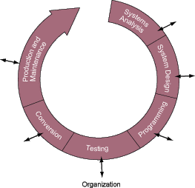
OVERVIEW OF SYSTEMS DEVELOPMENT
The Systems Development Process
Figure 12-5

Slide 19
OVERVIEW OF SYSTEMS DEVELOPMENT
Overview
Feasibility study
Determining achievability of solution
Establishing information requirements
Stating information needs that new system must satisfy
Identifying who, when, where and how components of information

Slide 20
OVERVIEW OF SYSTEMS DEVELOPMENT
Systems Design
Details how system will meet information requirements as determined by systems analysis
Specifications for the system solution
Should reflect user business priorities and information needs

Slide 21
OVERVIEW OF SYSTEMS DEVELOPMENT
Completing the Systems Development Process
Programming
Process of translating system specifications into program code
Testing
Checks whether the system produces desired results under known conditions
Unit testing, system testing, acceptance testing, test plan

Slide 22
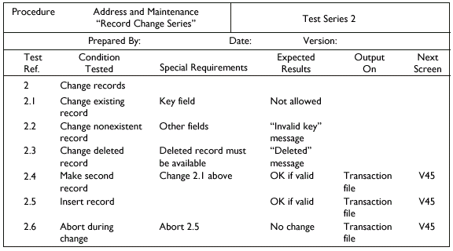
OVERVIEW OF SYSTEMS DEVELOPMENT
A Sample Test Plan to Test a Record Change
Figure 12-6

Slide 23
OVERVIEW OF SYSTEMS DEVELOPMENT
Completing the Systems Development Process
Conversion
Process of changing from old system to new system
Strategies:
  Parallel
  Direct cutover
  Pilot study
  Phased approach
  Documentation

Slide 24
OVERVIEW OF SYSTEMS DEVELOPMENT
Completing the Systems Development Process
Production and maintenance
Production is stage after new system is installed and the conversion is complete
Maintenance is changes in hardware, software, documentation, or procedures of production system to correct errors

Slide 25
ALTERNATIVE SYSTEM-BUILDING APPROACHES
Traditional Systems Lifecycle
Systems lifecycle
Traditional methodology for developing information system
Partitions systems development process into formal stages that must be completed sequentially

Slide 26
ALTERNATIVE SYSTEM-BUILDING APPROACHES
Prototyping
Prototyping
Process of building experimental system quickly and inexpensively for demonstration and evaluation
Prototype
Preliminary working version of information system for demonstration and evaluation

Slide 27
ALTERNATIVE SYSTEM-BUILDING APPROACHES
Prototyping
Iterative
A process of repeating over and over again the steps to build system

Slide 28
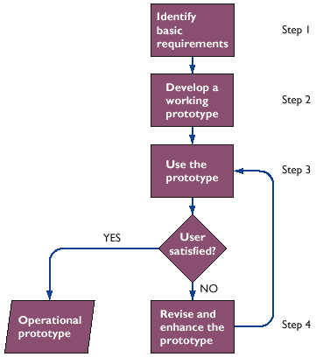
ALTERNATIVE SYSTEM-BUILDING APPROACHES
The Prototyping Processes
Figure 12-7

Slide 29
ALTERNATIVE SYSTEM-BUILDING APPROACHES
Steps in Prototyping
Identifying user’s basic requirements
Developing initial prototype
Using prototype
Revising and enhancing prototype

Slide 30
ALTERNATIVE SYSTEM-BUILDING APPROACHES
Advantages and Disadvantages of Prototyping
Advantage
Useful in designing information system’s end-user interface
Disadvantage
Rapid prototyping can gloss over essential steps in systems development

Slide 31
ALTERNATIVE SYSTEM-BUILDING APPROACHES
Application Software Packages
Application software packages
Set of prewritten, precoded application software programs commercially available for sale or lease
Customization
Modification of software package to meet organization’s unique requirements without destroying the software’s integrity

Slide 32
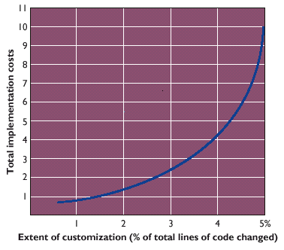
ALTERNATIVE SYSTEM-BUILDING APPROACHES
The Effects of Customizing a Software Package on Total Implementation Costs
Figure 12-8

Slide 33
ALTERNATIVE SYSTEM-BUILDING APPROACHES
Application Software Packages
Request for Proposal (RFP)
Detailed list of questions submitted to vendors of software or other services
Determines how well vendor’s product can meet organization’s specific requirements

Slide 34
ALTERNATIVE SYSTEM-BUILDING APPROACHES
End-User Development
Development of information systems by end users with little or no formal assistance from technical specialists
Allows users to specify their own business needs

Slide 35
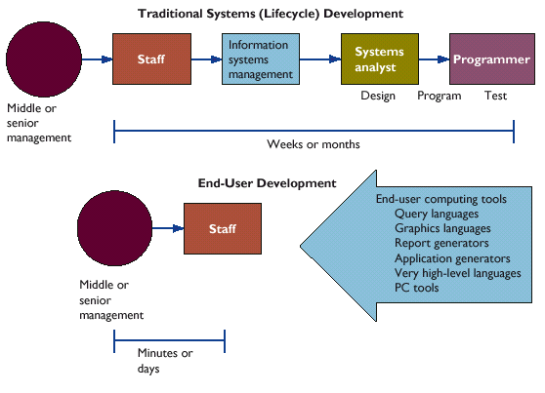
ALTERNATIVE SYSTEM-BUILDING APPROACHES
End-User Versus System Lifecycle Development
Figure 12-9

Slide 36
ALTERNATIVE SYSTEM-BUILDING APPROACHES
End-User Development
Improves requirements gathering leading to higher level of user involvement and satisfaction
Cannot easily handle processing of large numbers of transactions or applications

Slide 37
ALTERNATIVE SYSTEM-BUILDING APPROACHES
Outsourcing
Practice of contracting computer center operations, telecommunications networks, or applications development to external vendors

Slide 38
APPLICATION DEVELOPMENT FOR THE DIGITAL FIRM
Object-Oriented Software Development
System modeled as a collection of objects and relationships between them
Iterative and incremental
Shifts focus from modeling business processes and data to combining data and procedures to create objects

Slide 39
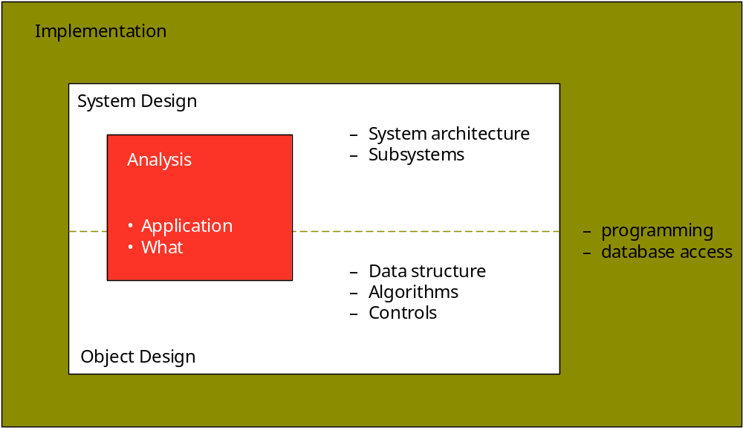
ALTERNATIVE SYSTEM-BUILDING APPROACHES
Figure 12-10

Slide 40
APPLICATION DEVELOPMENT FOR THE DIGITAL FIRM
Rapid Application Development (RAD)
Process for developing systems in short time period
Uses prototyping, fourth-generation tools, and close teamwork

Slide 41
APPLICATION DEVELOPMENT FOR THE DIGITAL FIRM
Web Services
Software components deliverable over Internet
Enable one application to communicate with another with no translation required
Standards and protocols: XML, SOAP, WSDL, UDDI

Slide 42
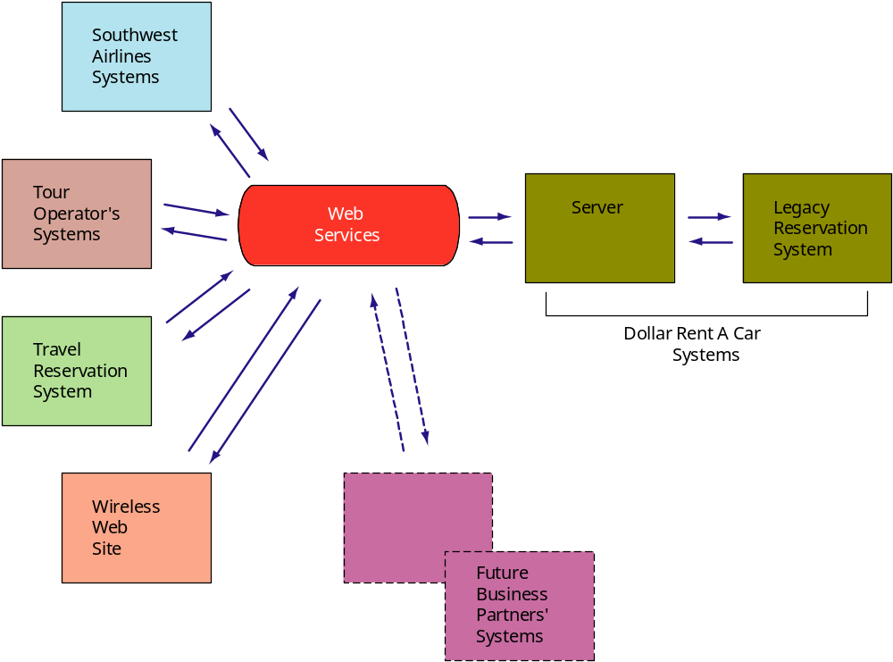
ALTERNATIVE SYSTEM-BUILDING APPROACHES
Figure 12-11

Slide 43
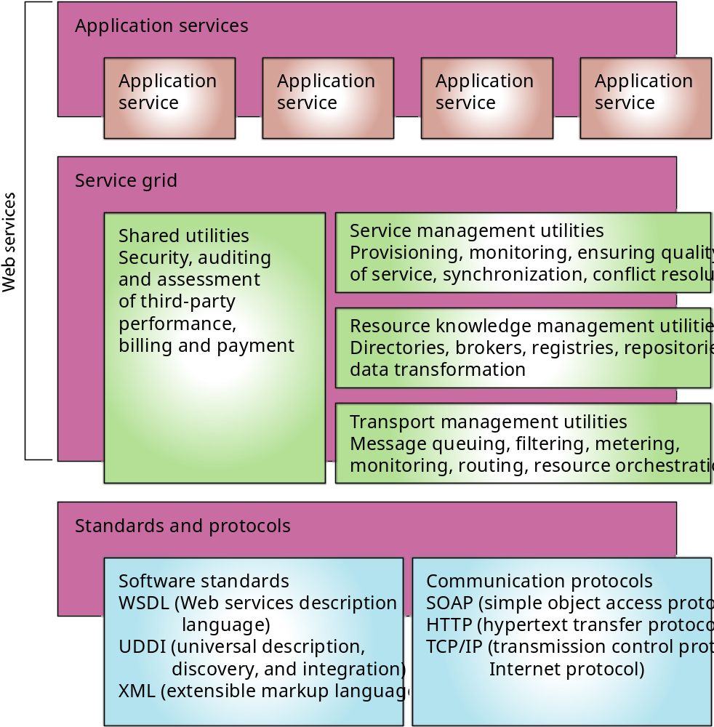
ALTERNATIVE SYSTEM-BUILDING APPROACHES
Figure 12-12

Slide 44
APPLICATION DEVELOPMENT FOR THE DIGITAL FIRM
Looking Beyond the Organization
E-commerce and e-business require systems planning and systems analysis based on a broader view of organization

Slide 45
Chapter
12
REDESIGNING THE
ORGANIZATION
WITH
INFORMATION
SYSTEMS

