Slide 1

Chapter
13
UNDERSTANDING
THE BUSINESS
VALUE OF SYSTEMS
AND MANAGING
CHANGE

Slide 2
OBJECTIVES
How can our company measure the business benefits of our information systems? What models should be used to measure that business value?
Why do so many system projects fail? What are the principal reasons for system failures?

Slide 3
OBJECTIVES
How should the organizational change surrounding a new system be managed to ensure success?
What strategies can our organization use to manage the system implementation process more effectively?

Slide 4
MANAGEMENT CHALLENGES
Determining benefits and costs of a system when they are difficult to quantify
Dealing with the complexity of large-scale systems projects

Slide 5
UNDERSTANDING THE BUSINESS VALUE OF INFORMATION SYSTEMS
Traditional Capital Budgeting Models
Capital budgeting
Process of analyzing and selecting various proposals for capital expenditures

Slide 6
UNDERSTANDING THE BUSINESS VALUE OF INFORMATION SYSTEMS
Limitations of Financial Models
Do not express the risks and uncertainty of own cost and benefits estimates

Slide 7
UNDERSTANDING THE BUSINESS VALUE OF INFORMATION SYSTEMS
Case Example: Primrose, Mendelson, and Hansen
The Problem
No automated way of tracking billable hours
No secure method for communication
No client database
No system to track costs

Slide 8
UNDERSTANDING THE BUSINESS VALUE OF INFORMATION SYSTEMS
Case Example: Primrose, Mendelson, and Hansen
The Solution
Local area network
Lotus Notes to handle client accounting, document management, group collaboration, and e-mail

Slide 9
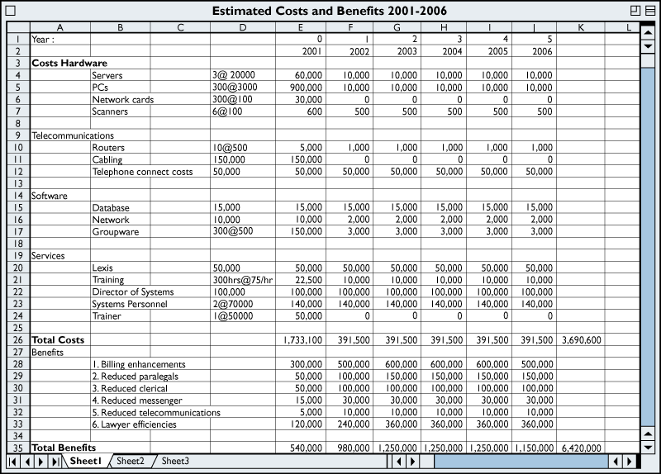
UNDERSTANDING THE BUSINESS VALUE OF INFORMATION SYSTEMS
Costs and Benefits of the Legal Information System
Figure 13-1

Slide 10
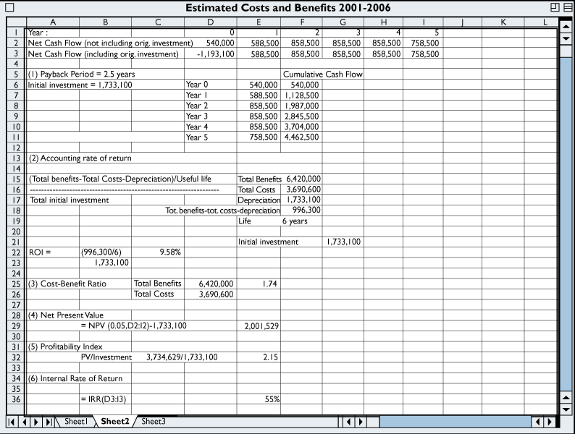
UNDERSTANDING THE BUSINESS VALUE OF INFORMATION SYSTEMS
Financial Models
Figure 13-2

Slide 11
UNDERSTANDING THE BUSINESS VALUE OF INFORMATION SYSTEMS
Case Example: Primrose, Mendelson, and Hansen
The Payback Method
Measure of time required to pay back the initial investment on a project
Accounting Rate of Return on Investment
(ROI)
Approximates the accounting income earned by the investment

Slide 12
UNDERSTANDING THE BUSINESS VALUE OF INFORMATION SYSTEMS
Case Example: Primrose, Mendelson, and Hansen
Present value
Value in current dollars of a payment or stream of payments to be received in the future
Net present value
Amount of money an investment is worth after considering its cost, earnings and the time value of money

Slide 13
UNDERSTANDING THE BUSINESS VALUE OF INFORMATION SYSTEMS
Case Example: Primrose, Mendelson, and Hansen
Cost-benefit ratio
Divides total benefits by total costs
Profitability index
Compares profitability of alternative investments by dividing the present value of total cash inflow by initial cost

Slide 14
UNDERSTANDING THE BUSINESS VALUE OF INFORMATION SYSTEMS
Case Example: Primrose, Mendelson, and Hansen
Internal Rate of Return (IRR)
Rate of return or profit an investment is expected to earn

Slide 15
UNDERSTANDING THE BUSINESS VALUE OF INFORMATION SYSTEMS
Strategic Considerations
Portfolio Analysis
Analysis of portfolio of potential applications within a firm
Determines risks and benefits
Selects among alternatives for information systems

Slide 16
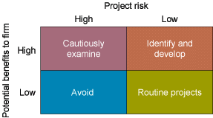
UNDERSTANDING THE BUSINESS VALUE OF INFORMATION SYSTEMS
A System Portfolio
Figure 13-3

Slide 17
UNDERSTANDING THE BUSINESS VALUE OF INFORMATION SYSTEMS
Strategic Considerations
Scoring Models
Method for deciding among alternative systems based on a system of ratings
Real Options Pricing Models
Models using techniques for valuing financial options to evaluate information technology investments with uncertain returns

Slide 18
UNDERSTANDING THE BUSINESS VALUE OF INFORMATION SYSTEMS
Strategic Considerations
Knowledge Value–Added Approach
Focuses on knowledge input into a business process
Determines costs and benefits of changes in business processes from new information systems

Slide 19
UNDERSTANDING THE BUSINESS VALUE OF INFORMATION SYSTEMS
Information Technology Investments and Productivity
Productivity
Measure of firm’s efficiency in converting inputs to outputs
Information Technology
Contribution to productivity difficult to measure

Slide 20
IMPORTANCE OF CHANGE MANAGEMENT IN INFORMATION SYSTEM
SUCCESS AND FAILURE
Information System Problem Areas
System failure
Information system does not perform as expected, is not operational at a specified time
Problem areas: Poor design, inaccurate data, excessive expenditure, breakdown in operations

Slide 21
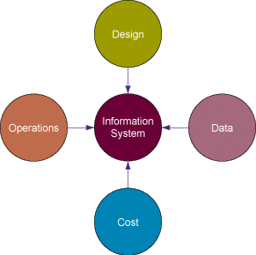
IMPORTANCE OF CHANGE MANAGEMENT IN INFORMATION SYSTEM
SUCCESS AND FAILURE
Information System Problem Areas
Figure 13-4

Slide 22
IMPORTANCE OF CHANGE MANAGEMENT IN INFORMATION SYSTEM
SUCCESS AND FAILURE
Change Management and the Concept of Implementation
Implementation
Organizational activities working towards adoption, management, and routinization of innovation
Change agent
Individual acting as catalyst to ensure successful organizational adaptation to a new system or innovation

Slide 23
IMPORTANCE OF CHANGE MANAGEMENT IN INFORMATION SYSTEM
SUCCESS AND FAILURE
Causes of Implementation Success and Failure
Role of users in implementation process
Degree of management support for implementation effort
Level of complexity and risk of implementation project
Quality of management of implementation process

Slide 24
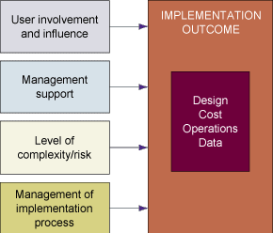
IMPORTANCE OF CHANGE MANAGEMENT IN INFORMATION SYSTEM
SUCCESS AND FAILURE
Factors in Information System Success or Failure
Figure 13-5

Slide 25
IMPORTANCE OF CHANGE MANAGEMENT IN INFORMATION SYSTEM
SUCCESS AND FAILURE
User Involvement and Influence
User–designer communications gap
Different backgrounds, interests, and priorities
Impedes communication and problem solving among end users and information systems specialists

Slide 26
IMPORTANCE OF CHANGE MANAGEMENT IN INFORMATION SYSTEM
SUCCESS AND FAILURE
Management Support and Commitment
Project requires backing and commitment of management at various levels
Helps project to be perceived positively by both users and technical information services staff

Slide 27
IMPORTANCE OF CHANGE MANAGEMENT IN INFORMATION SYSTEM
SUCCESS AND FAILURE
Level of Complexity and Risk
Project size: Larger project has greater risk
Project structure: Clear and straightforward requirements help define outputs and processes
Experience with technology: Project risk rises if project team and information system staff lack required technical expertise

Slide 28
IMPORTANCE OF CHANGE MANAGEMENT IN INFORMATION SYSTEM
SUCCESS AND FAILURE
Management of the Implementation Process
Improper management leads to:
Cost overruns
Unexpected time slippage
Technical shortfalls
Failure to obtain anticipated benefits

Slide 29

IMPORTANCE OF CHANGE MANAGEMENT IN INFORMATION SYSTEM
SUCCESS AND FAILURE
Consequences of Poor Project Management
Figure 13-6

Slide 30
IMPORTANCE OF CHANGE MANAGEMENT IN INFORMATION SYSTEM
SUCCESS AND FAILURE
Change Management Challenges
System Challenges of Mergers and
Acquisitions
Integrating systems
Organizational characteristics
Information technology infrastructures

Slide 31
IMPORTANCE OF CHANGE MANAGEMENT IN INFORMATION SYSTEM
SUCCESS AND FAILURE
Change Management Challenges
High failure rates: enterprise system, BPR, CRM, and SCM implementations
Hurdles: Extensive change required in organizational culture and business processes

Slide 32
MANAGING IMPLEMENTATION
Controlling Risk Factors
Managing Technical Complexity: Usage of internal integration tools to ensure operation of implementation team
Formal Planning and Control Tools: Structures and sequences tasks, monitors progress towards fulfillment of goals

Slide 33
MANAGING IMPLEMENTATION
Controlling Risk Factors
Increasing User Involvement and Overcoming User Resistance: External integration tools linking work of implementation team to that of users at all organizational levels
Counterimplementation: Deliberate strategy to thwart an implementation effort

Slide 34
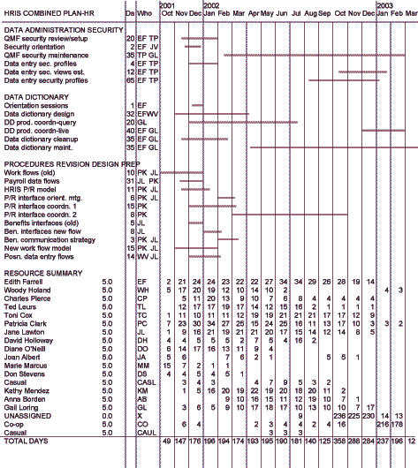
MANAGING IMPLEMENTATION
Formal planning and control tools help to manage information systems projects successfully
Figure 13-7

Slide 35
MANAGING IMPLEMENTATION
Designing for the Organization
Allowing for the Human Factor
Ergonomics: interaction of people and machines in work environment
Sociotechnical Design
Produces information system blending technical efficiency with sensitivity to organizational and human needs

Slide 36
MANAGING IMPLEMENTATION
Fourth-Generation Project Management
Project planning is an enterprise-wide focus
Managers focus on solving problems as they arise and meeting challenges

Slide 37
Chapter
13
UNDERSTANDING
THE BUSINESS
VALUE OF SYSTEMS
AND MANAGING
CHANGE

