Slide 1

Chapter
15
MANAGING
INTERNATIONAL
INFORMATION
SYSTEMS

Slide 2
OBJECTIVES
What are the major factors driving the internationalization of business?
What strategies are available for developing international businesses?
How can information systems support the various international business strategies?
What issues should managers address when developing international information systems?
What technical alternatives are available for developing global systems?

Slide 3
MANAGEMENT CHALLENGES
Lines of business and global strategy
The difficulties of managing change in a multicultural environment

Slide 4
THE GROWTH OF INTERNATIONAL INFORMATION SYSTEMS
Developing an International Information Systems Architecture
An international information systems architecture consists of basic information systems required by organizations to coordinate worldwide trade and other tasks
A business driver is an environmental force to which businesses must respond and that influence a business’s direction

Slide 5
THE GROWTH OF INTERNATIONAL INFORMATION SYSTEMS
Global Environment:
Business Drivers and Challenges
Corporate Global Strategies
Organization Structure
Management and Business
Processes
Technology Platform
International Information Systems Architecture
Figure 15-1

Slide 6
THE GROWTH OF INTERNATIONAL INFORMATION SYSTEMS
The Global Environment: Business Drivers and Challenges
Global business drivers are [a] general cultural factors and [b] specific business factors
Global culture, created by TV and other global media (e.g., movies) permit cultures to develop common expectations about right and wrong, desirable and undesirable, heroic and cowardly
A global knowledge base--strengthened by educational advances in Latin America, China, southern Asia, and eastern Europe--also affects growth

Slide 7
THE GROWTH OF INTERNATIONAL INFORMATION SYSTEMS
Business Challenges
Particularism, making judgments and taking action based on narrow or personal features, rejects the concept of shared global culture
Transborder data flow is the movement of information across international boundaries in any form
National laws and traditions create disparate accounting practices in various countries, impacting how profits and losses are analyzed
Additional factors: cultural differences about technology, different languages, and currency fluctuations

Slide 8
THE GROWTH OF INTERNATIONAL INFORMATION SYSTEMS
State of the Art
Despite business challenges, many firms still do not have rationally developed IT systems
Most companies inherited patchwork international systems from the past
Significant difficulties still exist in building proper international architectures

Slide 9
ORGANIZING INTERNATIONAL INFORMATION SYSTEMS
Global Strategies and Business Organization
Domestic exporter – characterized by heavy centralization of corporate activities in home country of origin
Multinational – concentrates financial management and control out of a home base, but decentralizes production, sales, and marketing
Franchisers – involve creating, designing, and financing in the home country, then rely on foreign personnel for further production, marketing, and human resources (e.g., McDonald’s)
Transnational – may or may not have a world headquarters, but will have many regional headquarters

Slide 10
ORGANIZING INTERNATIONAL INFORMATION SYSTEMS
Global Systems to Fit the Strategy
Global Systems
Information technology and improved global telecommunications - give international firms more flexibility to shape global strategies
Domestic exporters - tend to have highly centralized systems in which one domestic systems development staff develops worldwide applications

Slide 11
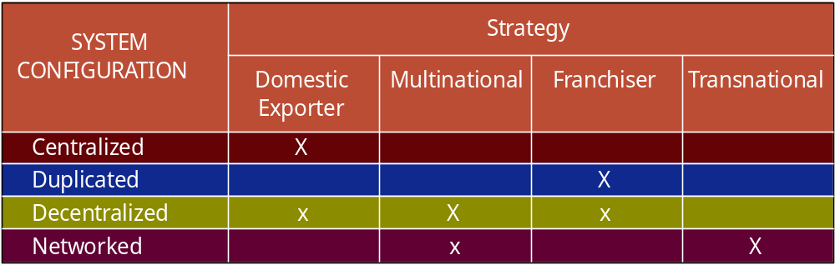
THE GROWTH OF INTERNATIONAL INFORMATION SYSTEMS
Figure 15-2

Slide 12
ORGANIZING INTERNATIONAL INFORMATION SYSTEMS
Global Systems, Reorganizing the Business
Reorganizing the Business
Organize value-adding services along lines of comparative advantage
Develop and operate systems units at each level of corporate activity – regional, national, and international
Establish a world headquarters at one office responsible for developing international systems

Slide 13
MANAGING GLOBAL SYSTEMS
A Typical Scenario: Disorganization on a Global Scale
A traditional U.S. multi-national consumer-goods company, also operating in Europe, wants to expand into Asia
It knows it must develop a transnational strategy and supportive IT system structure
It has dispersed production and marketing to regional and national centers while maintaining a world headquarters and strategic management in the U.S.
The result: a hodgepodge of hardware, software, and communications (e.g., incompatible e-mail systems, different manufacturing resources planning, different marketing / sales / human resources systems)

Slide 14
MANAGING GLOBAL SYSTEMS
Strategy: Divide, Conquer, Appease
Not all systems need be coordinated on a transnational basis; only some core systems are truly worth sharing from a cost and feasibility basis
  Define the Core Business Processes
  Identify the Core Systems to Coordinate Centrally
  Choose an Approach: Incremental, Grand Design, Evolutionary
  Make the Benefits Clear

Slide 15
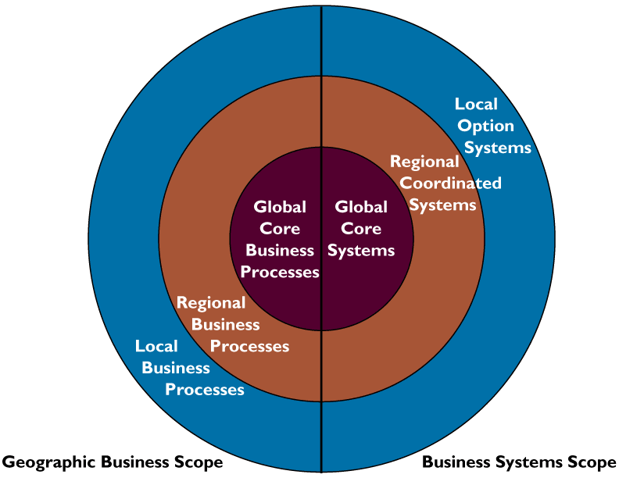
MANAGING GLOBAL SYSTEMS
Figure 15-3

Slide 16
OBJECTIVES
Implementation Tactics and The Management Solution
Implementation Tactics: Cooptation - bringing the opposition into design and implementation
of solution without surrendering control over direction
and nature of change
The Management Solution
  Agree on common user requirements
  Introduce changes in business processes
  Coordinate applications development
  Coordinate software releases
  Encourage local users to support global systems

Slide 17
TECHNOLOGY ISSUES AND OPPORTUNITIES FOR GLOBAL VALUE CHAINS
Main Technical Issues
Hardware and Systems Integration
  Developing global systems based on core systems raises questions about how new cores systems will fit within existing applications
Connectivity
  Telecommunications is heart of international systems, linking systems and people in global firm into single, integrated network
  Potential solutions including putting together leased private network, building one’s own network, or creating global intranets over Intranet
Software
  Developing new core systems poses unique challenges for software, involves problems of human interface design and system functionality
  Many firms increasingly turn to supply chain management and enterprise systems to standardize business processes globally

Slide 18
TECHNOLOGY ISSUES AND OPPORTUNITIES FOR GLOBAL VALUE CHAINS
Table 15-5: Problems of International Networks
  Costs and tariffs
  Network management
  Installation delays
  Poor international service quality
  Regulatory constraints
  Changing user requirements
  Disparate standards
  Network capacity

Slide 19
TECHNOLOGY ISSUES AND OPPORTUNITIES FOR GLOBAL VALUE CHAINS
New Technical Opportunities and the Internet
  Communicate and compute anytime, anywhere networks based on satellites, cell phones, and personal communications systems will facilitate work
  Companies use the Internet to construct virtual private networks (VPNs) to reduce networking costs and staff
  As Internet technology spreads outside the USA, it will expand opportunities for electronic commerce and international trade

Slide 20
Chapter
15
MANAGING
INTERNATIONAL
INFORMATION
SYSTEMS

