Slide 1

Chapter
14
INFORMATION
SYSTEMS
SECURITY AND
CONTROL

Slide 2
OBJECTIVES
Why are information systems so vulnerable to destruction, error, abuse, and system quality problems?
What types of controls are available for information systems?
What special measures must be taken to ensure the reliability, availability and security of electronic commerce and digital business processes?

Slide 3
OBJECTIVES
What are the most important software quality assurance techniques?
Why are auditing information systems and safeguarding data quality so important?

Slide 4
MANAGEMENT CHALLENGES
Designing systems that are neither over-controlled nor under-controlled
Applying quality assurance standards in large systems projects

Slide 5
SYSTEM VULNERABILITY AND ABUSE
Why Systems are Vulnerable
Advances in telecommunications and computer software
Unauthorized access, abuse, or fraud
Hackers
Denial of service attack
Computer viruses

Slide 6
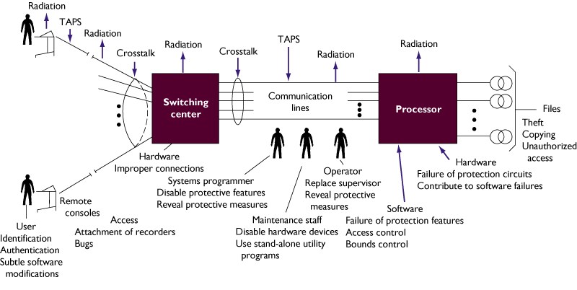
SYSTEM VULNERABILITY AND ABUSE
Telecommunication Network Vulnerabilities
Figure 14-1

Slide 7
SYSTEM VULNERABILITY AND ABUSE
Concerns for System Builders and Users
Disaster
Destroys computer hardware, programs, data files, and other equipment
Security
Prevents unauthorized access, alteration, theft, or physical damage

Slide 8
SYSTEM VULNERABILITY AND ABUSE
Concerns for System Builders and Users
Errors
Cause computers to disrupt or destroy organization’s record-keeping and operations

Slide 9
SYSTEM VULNERABILITY AND ABUSE
System Quality Problems: Software and Data
Bugs
Program code defects or errors
Maintenance Nightmare
Maintenance costs high due to organizational change, software complexity, and faulty system analysis and design

Slide 10
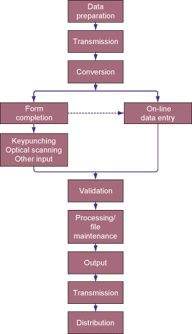
SYSTEM VULNERABILITY AND ABUSE
Points in the Processing Cycle where Errors Can Occur
Figure 14-2

Slide 11
SYSTEM VULNERABILITY AND ABUSE
System Quality Problems: Software and Data
Data Quality Problems
Caused due to errors during data input or faulty information system and database design

Slide 12
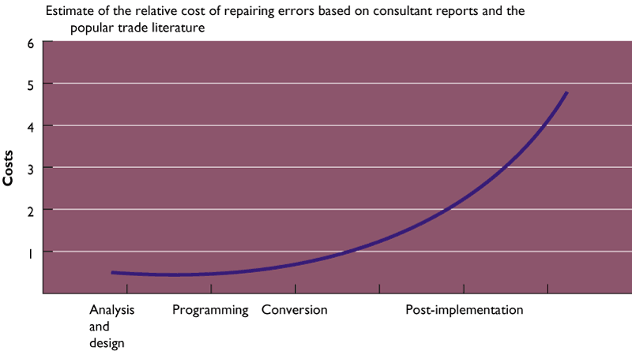
SYSTEM VULNERABILITY AND ABUSE
The Cost of Errors over the Systems Development Cycle
Figure 14-3

Slide 13
CREATING A CONTROL ENVIRONMENT
Overview
Controls
Methods, policies, and procedures that ensure protection of organization’s assets
Ensure accuracy and reliability of records, and operational adherence to management standards

Slide 14
CREATING A CONTROL ENVIRONMENT
General Controls and Application Controls
General controls
Establish framework for controlling design, security, and use of computer programs
Include software, hardware, computer operations, data security, implementation, and administrative controls

Slide 15
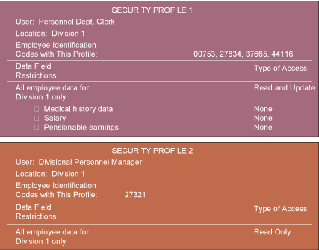
CREATING A CONTROL ENVIRONMENT
Security Profiles for a Personnel System
Figure 14-4

Slide 16
CREATING A CONTROL ENVIRONMENT
General Controls and Application Controls
Application controls
Unique to each computerized application
Include input, processing, and output controls

Slide 17
CREATING A CONTROL ENVIRONMENT
Protecting the Digital Firm
On-line transaction processing: Transactions entered online are immediately processed by computer
Fault-tolerant computer systems: Contain extra hardware, software, and power supply components to provide continuous uninterrupted service

Slide 18
CREATING A CONTROL ENVIRONMENT
Protecting the Digital Firm
High-availability computing: Tools and technologies enabling system to recover quickly from a crash
Disaster recovery plan: Runs business in event of computer outage
Load balancing: Distributes large number of requests for access among multiple servers

Slide 19
CREATING A CONTROL ENVIRONMENT
Protecting the Digital Firm
Mirroring: Duplicating all processes and transactions of server on backup server to prevent any interruption in service
Clustering: Linking two computers together so that a second computer can act as a backup to the primary computer or speed up processing

Slide 20
CREATING A CONTROL ENVIRONMENT
Internet Security Challenges
Firewalls
Prevent unauthorized users from accessing private networks
Two types: proxies and stateful inspection
Intrusion Detection System
Monitors vulnerable points in network to detect and deter unauthorized intruders

Slide 21
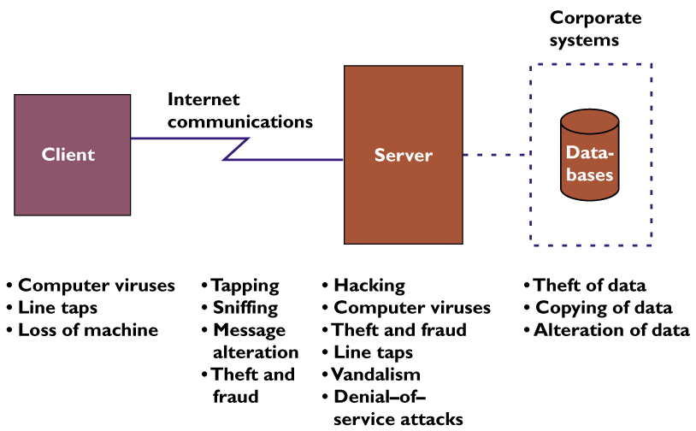
CREATING A CONTROL ENVIRONMENT
Internet Security Challenges
Figure 14-5

Slide 22
CREATING A CONTROL ENVIRONMENT
Security and Electronic Commerce
Encryption: Coding and scrambling of messages to prevent their access without authorization
Authentication: Ability of each party in a transaction to ascertain identity of other party
Message integrity: Ability to ascertain that transmitted message has not been copied or altered

Slide 23
CREATING A CONTROL ENVIRONMENT
Security and Electronic Commerce
Digital signature: Digital code attached to electronically transmitted message to uniquely identify contents and sender
Digital certificate: Attachment to electronic message to verify the sender and to provide receiver with means to encode reply

Slide 24

CREATING A CONTROL ENVIRONMENT
Public Key Encryption
Figure 14-6

Slide 25
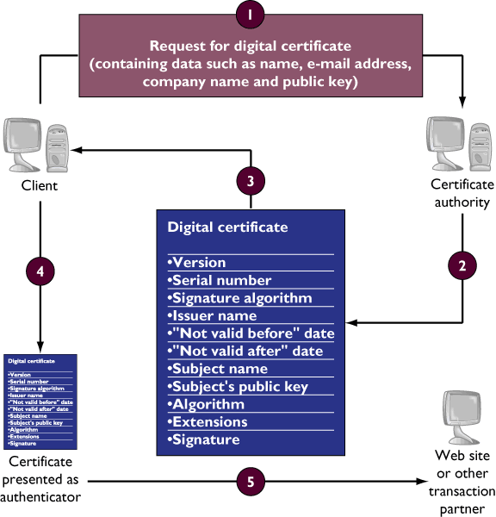
CREATING A CONTROL ENVIRONMENT
Digital Certificates
Figure 14-7

Slide 26
CREATING A CONTROL ENVIRONMENT
Developing a Control Structure: Costs and Benefits
Criteria for determining control
structure
Importance of data
Efficiency, complexity, and expense of each control technique
Level of risk if a specific activity or process is not properly controlled

Slide 27
CREATING A CONTROL ENVIRONMENT
The Role of Auditing in the Control Process
MIS audit
Identifies all controls that govern individual information systems and assesses their effectiveness

Slide 28
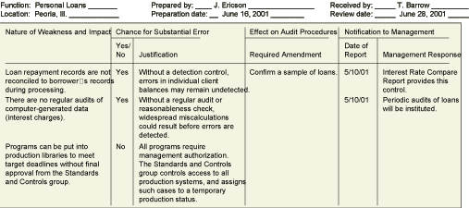
CREATING A CONTROL ENVIRONMENT
Sample Auditor’s List of Control Weaknesses
Figure 14-8

Slide 29
ENSURING SYSTEM QUALITY
Software Quality Assurance Methodologies and Tools
Development methodology: Collection of methods, for every activity within every phase of development project
Structured: Refers to fact that techniques are carefully drawn up, step-by-step, with each step building on a previous one

Slide 30
ENSURING SYSTEM QUALITY
Software Quality Assurance Methodologies and Tools
Structured analysis: Method for defining system inputs, processes, and outputs, for partitioning systems into subsystems or modules
Data Flow Diagram (DFD): Graphically illustrates system’s component processes and flow of data

Slide 31
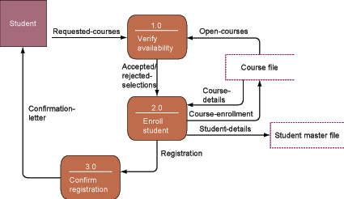
ENSURING SYSTEM QUALITY
Data Flow Diagram for Mail-in University Registration System
Figure 14-9

Slide 32
ENSURING SYSTEM QUALITY
Software Quality Assurance Methodologies and Tools
Structured design: Encompasses set of design rules and techniques for designing systems from top down
Structured programming: Organizing and coding programs that simplify control paths

Slide 33
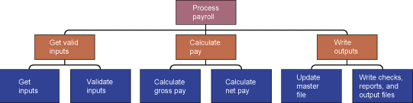
ENSURING SYSTEM QUALITY
High-Level Structure Chart For a Payroll System
Figure 14-10

Slide 34
ENSURING SYSTEM QUALITY
Limitation of Traditional Methods
Inflexible
Time-consuming

Slide 35
ENSURING SYSTEM QUALITY
Tools and Methodologies for Object-Oriented Development
Unified Modeling Language (UML) has become industry standard for analyzing and designing object-oriented systems.
Structural diagrams describe the relation between classes.
Behavioral diagrams describe interactions in an object-oriented system.

Slide 36
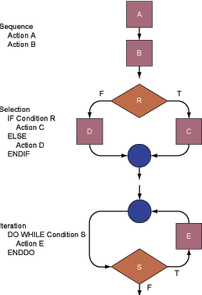
ENSURING SYSTEM QUALITY
Basic Program Control Constructs
Figure 14-11

Slide 37
ENSURING SYSTEM QUALITY
Computer-Aided Software Engineering (CASE)
Automation of step-by-step methodologies for software and systems development
Reduces repetitive work
Enforces standard development methodology and design discipline
Improves communication between users and technical specialists

Slide 38
ENSURING SYSTEM QUALITY
Computer-Aided Software Engineering (CASE)
Organizes and correlates design components
Automates tedious and error-prone portion of analysis and design, code generation, testing, and control rollout

Slide 39
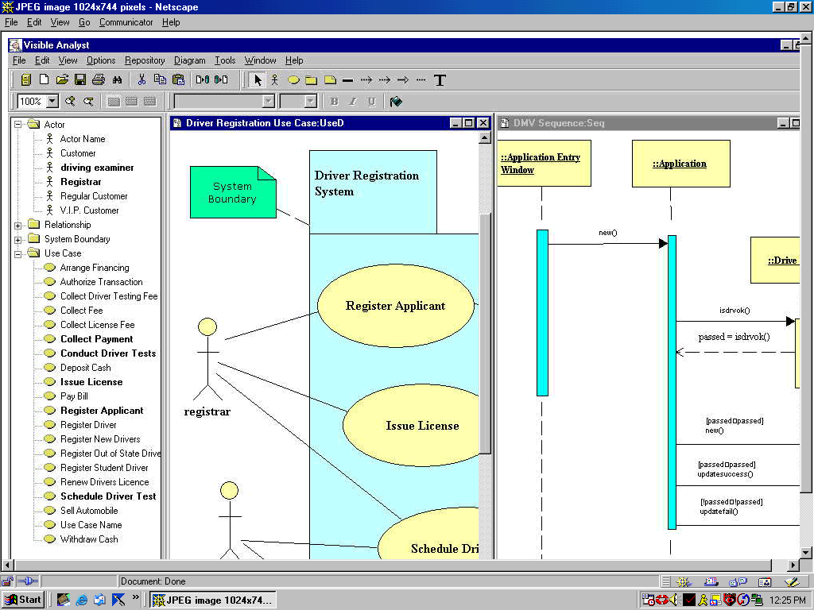
ENSURING SYSTEM QUALITY
Visible Analyst: A Tool to Automate Object-Oriented Analysis and Design
Figure 14-12

Slide 40
ENSURING SYSTEM QUALITY
Resource Allocation During Systems Development
Resource allocation
Determines how costs, time, and personnel are assigned to different phases of systems development project

Slide 41
ENSURING SYSTEM QUALITY
Software Metrics
Objective assessment of software used in the system in form of quantified measurements

Slide 42
ENSURING SYSTEM QUALITY
Testing
Walkthrough: Review of specification or design document by small group of people
Debugging: Process of discovering and eliminating errors and defects in program code

Slide 43
ENSURING SYSTEM QUALITY
Data Quality Audit and Data Cleansing
Data quality audit
Survey and/or sample of files
Determines accuracy and completeness of data
Data cleansing
Correcting errors and inconsistencies in data to increase accuracy

Slide 44
Chapter
14
INFORMATION
SYSTEMS
SECURITY AND
CONTROL

