Slide 1
Paper Title : AI-Driven Academic Risk & Dropout Early-Warning System Using Digital Twin
Authors Details
P. Agnes Alex Rathy (Asst. Prof. / IT)
A. Altrin Benser, J. Jerish Rethna,
J. John Jins, S. Mukhilan (UG - IT)
St. Xavier’s Catholic College of Engineering,
Chunkankadai, Tamil Nadu, India
Paper Id : 2610079
Presenter Category : UG (Information Technology)
Presented by
A. Altrin Benser, J. Jerish Rethna,
J. John Jins, S. Mukhilan
Student - UG (Dept. of IT)
St. Xavier’s Catholic College of Engineering,
Chunkankadai, Tamil Nadu, India

Slide 2
Key talking points
PRESENTATION FRAMEWORK
Abstract & Outline of Abstract
Introduction & Problem Statement
Literature Review & Research Gap
Proposed Methodology Flowchart
AI Model Performance & Feature Importance
Prototype Implementation & Multi-Role Dashboards
Results, Discussion & Conclusion

Slide 3
ABSTRACT
Academic Risk & Dropout Challenge: Academic under-performance and student dropout remain critical challenges in higher education, caused by delays in identifying struggling students when relying on manual records and fragmented spreadsheets.
Dynamic Digital Class Twin: Our AI-driven early-warning system integrates lecture attendance, Continuous Internal Assessment (CIA) marks, laboratory performance, and behavioral indicators into a real-time digital representation of each student's academic journey.
Predictive ML & Risk Classification: Employs Dual Ridge Regression to forecast SGPA/CGPA trends (R² > 0.99) and a Random Forest Classifier (98.6% accuracy) to categorize students into four risk states: Stable, Warning, Critical, and Recovering.
Explainable AI & What-If Simulation: Tree-based factor attribution identifies the exact drivers behind risk scores, while an in-memory What-If simulator models hypothetical attendance and mark recovery targets without altering production records.
Full-Stack Proactive Support Platform: Developed using Python, FastAPI, SQLite, and React 18, the platform dispatches automated role-based alerts to faculty mentors, students, and parents to drive timely interventions and student retention.

Slide 4
Outline of Abstract :
➤ Problem:
Delayed identification of academically at-risk students due to manual records, fragmented spreadsheets, and static end-of-semester reviews.
➤ Scope:
Continuous multi-factor academic telemetry integrating lecture attendance, CIA/IAT marks, laboratory evaluations, and behavioral conduct.
➤ Strategy:
Maintain a dynamic Digital Class Twin per student over a 30-day sliding window with a 3.0-point anti-flicker hysteresis state machine.
➤ Plan:
Combine deterministic health scoring with Ridge Regression (GPA forecasting) and Random Forest (4-state risk classification + Explainable AI).
➤ Solution:
Full-stack FastAPI + React early-warning platform classifying students into Stable, Warning, Critical & Recovering with What-If simulation.
➤ Benefits:
Proactive faculty mentoring, transparent parent-student alerts, 98.6% ML accuracy, 26.12 ms ingestion latency, and higher student retention.

Slide 5
Introduction
Delayed Academic Risk Detection: Conventional university monitoring identifies struggling students only after semester-end examinations, when remedial counseling can no longer prevent course failure or detention.
Fragmented & Static Spreadsheets: Attendance registers, CIA test marks, and laboratory evaluations are stored in disconnected silos, hiding temporal performance trends and inter-assessment volatility.
Limitations of Rigid Cutoff Rules: Single-threshold rules (such as the mandatory 75% university attendance cutoff) fail to capture compound academic risks across internal marks and classroom behavior.
Core Project Objectives: (1) Maintain a live Digital Class Twin per student over a 30-day rolling window; (2) Forecast GPA via Ridge Regression and classify 4 risk states via Random Forest; (3) Provide XAI attribution and an interactive What-If recovery simulator across role-based dashboards.

Slide 6
Literature Review
Machine Learning for Dropout Prediction (Tamada et al., 2022; Yağcı, 2022): Demonstrated that Random Forest, SVM, and ensemble classifiers accurately predict academic failure from past grades and LMS logs, but rely on static, retrospective batch datasets.
Multi-Factor Early Warning Systems (Plak et al., 2022; Qin et al., 2023): Integrated objective test scores with attendance and behavioral elements to support student counseling, yet lacked event-driven state synchronization and anti-flicker alert stability.
Explainable AI in Learning Analytics (Nagy & Molontay, 2023; Tiukhova et al., 2024; Miranda et al., 2024): Applied SHAP and tree-based feature attribution to dropout prediction, proving that interpretable risk breakdowns are essential for actionable, personalized faculty interventions.
Identified Research Gap & Proposed Contribution: Prior studies treat risk prediction as a one-time batch classification without continuous state tracking or intervention testing. Digital Class Twin bridges this gap by combining synchronous event ingestion (26.12 ms), 30-day rolling volatility analysis, a 3.0-point hysteresis buffer, and an in-memory What-If recovery simulator.

Slide 7
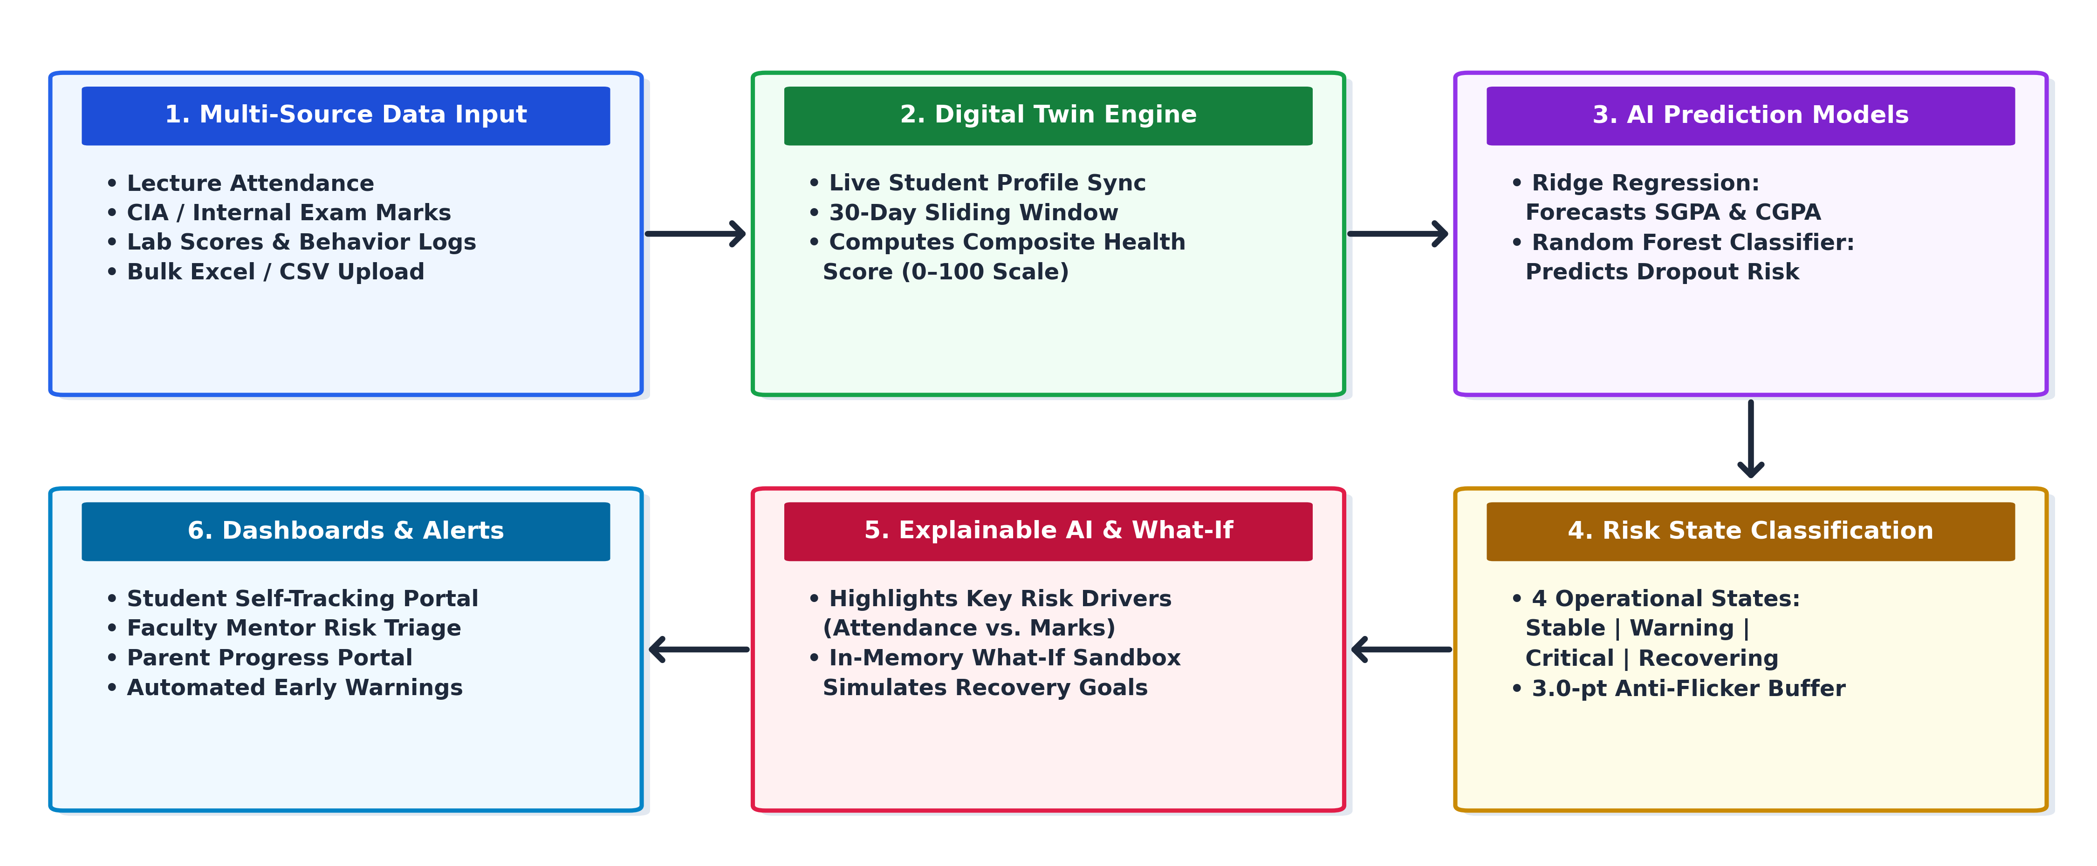
Methodology

Slide 8
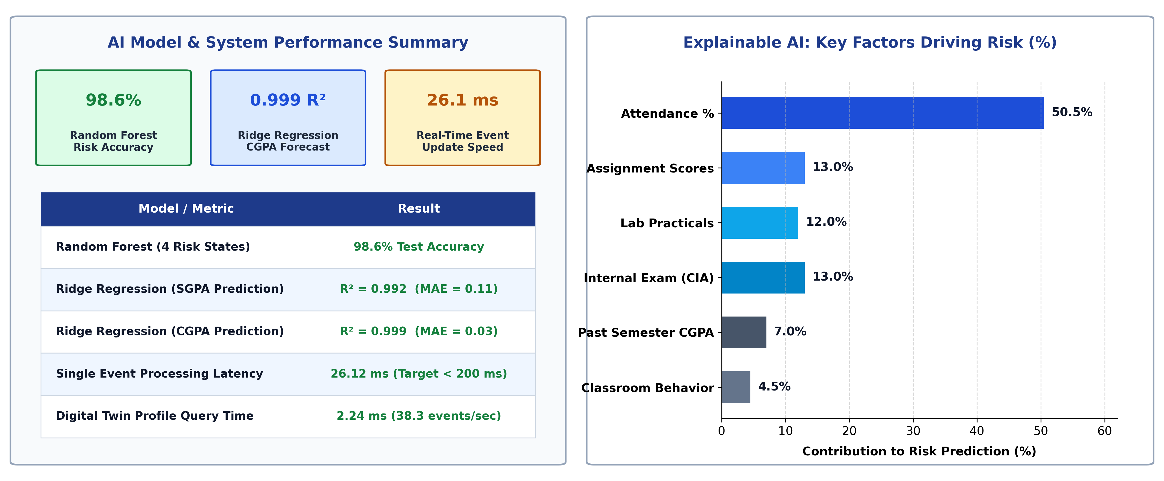
GRAPHS / TABLES / ANALYSIS

Slide 9
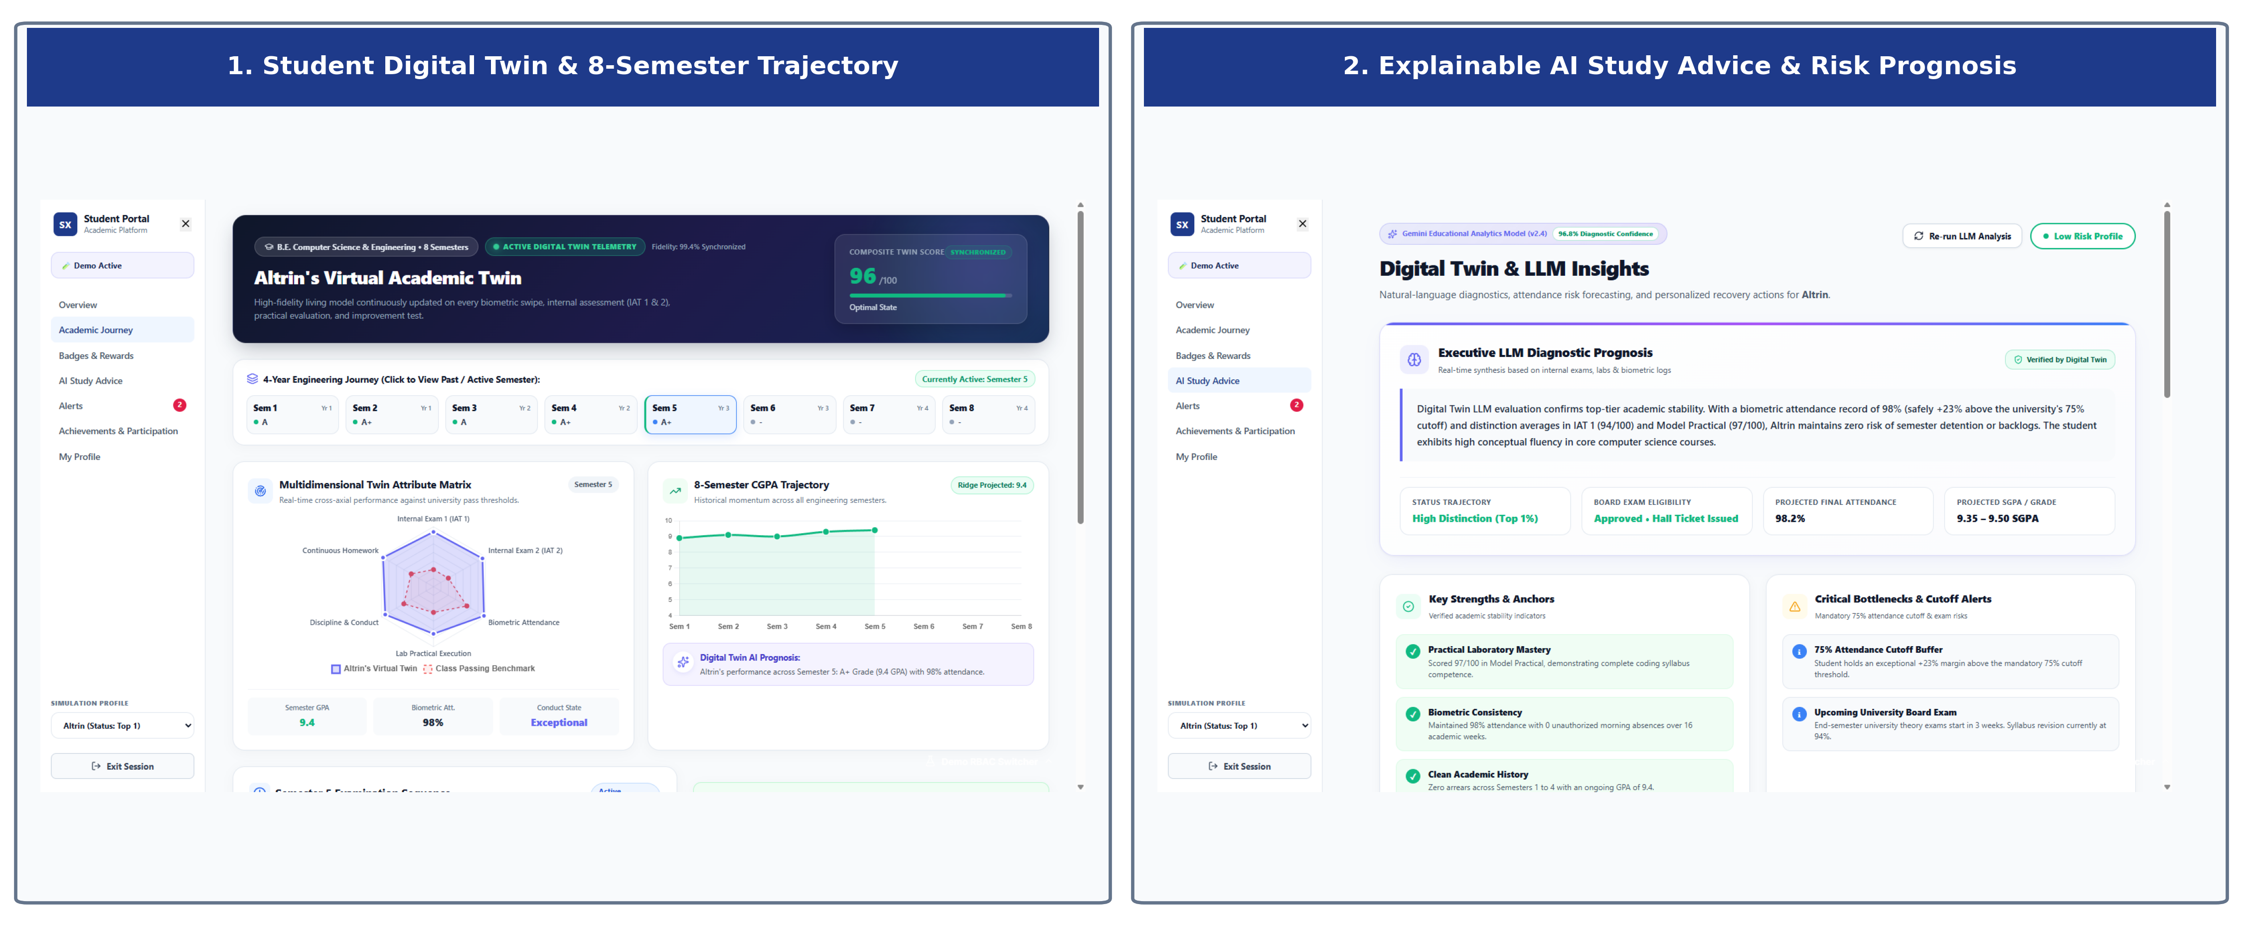
Prototype Dashboards & Simulation (1/2)

Slide 10
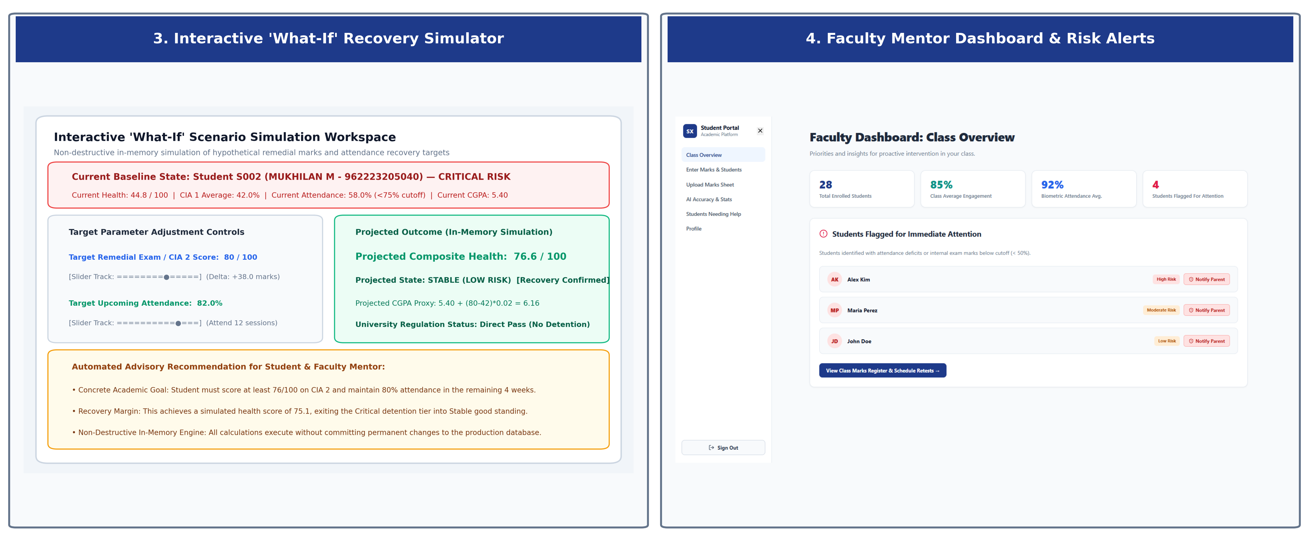
Prototype Dashboards & Simulation (2/2)

Slide 11
Results,
Discussion &
Conclusion
1. High AI Accuracy: Random Forest predicts student risk with 98.6% accuracy, and Ridge Regression accurately forecasts GPA trends (R² = 0.99).
2. Real-Time Early Warning: Detects attendance and internal mark drops weeks before final exams with fast 26 ms real-time updates.
3. Explainable & Actionable: Clearly shows the key factors behind each risk alert and lets mentors plan recovery targets using the What-If Simulator.
4. Conclusion: Digital Class Twin shifts colleges from reactive grading to proactive student support, improving academic outcomes and retention.

Slide 12
REFERENCES
[1] C. R. Tamada, R. Giusti, and J. F. de Magalhães Netto, "Predicting Students at Risk of Dropout in Technical Course Using LMS Logs," IEEE Revista Iberoamericana de Tecnologias del Aprendizaje, vol. 17, no. 2, pp. 159–167, 2022.
[2] M. Yağcı, "Educational Data Mining: Prediction of Students' Academic Performance Using Machine Learning Algorithms," Smart Learning Environments, vol. 9, no. 1, Art. no. 11, 2022.
[3] S. Plak, C. Cornelisz, M. Meeter, and M. van Klaveren, "Early Warning Systems for More Effective Student Counselling in Higher Education," Higher Education Research & Development, vol. 41, no. 7, pp. 2300–2317, 2022.
[4] M. Nagy and R. Molontay, "Interpretable Dropout Prediction: Towards XAI-Based Personalized Intervention," International Journal of Artificial Intelligence in Education, vol. 33, pp. 874–900, 2023.
[5] E. Tiukhova et al., "Explainable Learning Analytics: Assessing the Stability of Student Success Prediction Models by Means of Explainable AI," Decision Support Systems, vol. 178, Art. no. 114129, 2024.
[6] K. Alalawi, R. Athauda, and R. Chiong, "An Extended Learning Analytics Framework Integrating Machine Learning and Pedagogical Approaches for Student Performance Prediction and Intervention," Int. J. Educ. Technol. High. Educ., vol. 21, Art. no. 42, 2024.

Slide 13
THANK YOU

