Slide 1
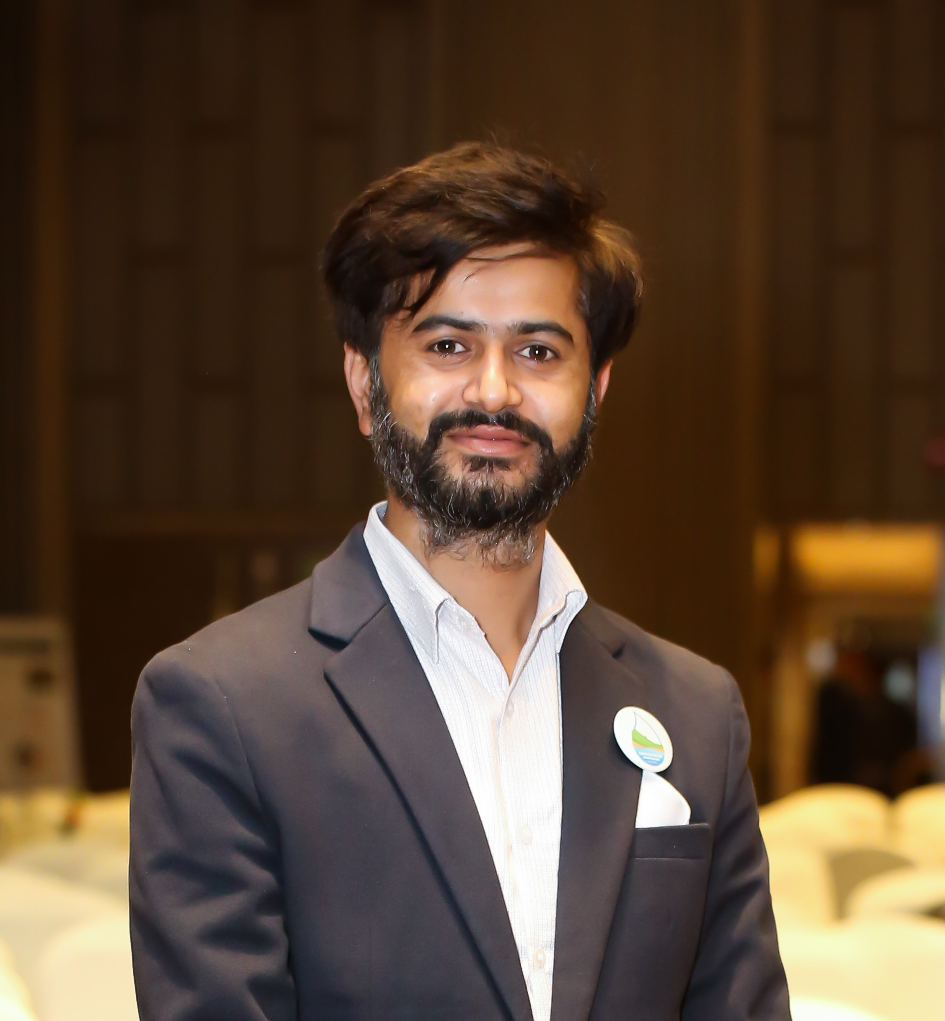
Lalit Pathak
Environmental Science Scholar | Spatial Analytics Professional
Passionate about creating resilient communities through environmental research and data-driven solutions
mail@lalitpathak.com.np | lalit@creew.org.np

