Slide 1
>>>
Chapter 19: Time, Scheduling and Launching Programs
Keeping time, scheduling tasks and launching programs: the time and datetime modules, subprocess, cron
18
6
36
code examples that run on the chapter page
true stories with who, what, when, where, why and how
distinct chapter concepts, each with an everyday picture
SEN0414 Advanced Programming, Fall 2026. Yusuf Altunel, İstanbul Kültür Üniversitesi
1 / 42
Notes:
Welcome. Chapter 19 is about time and about other programs. Every example runs on the chapter page, in the order of this deck. Clocks and sleeps use a stand-in clock where waiting would be slow; the slide says so.

Slide 2
>>>
Today's route
5 parts; every range is a run of slides you can jump to
Part | Slides | Code examples | You will run
Time as a number (the time module) | 4 - 11 | 4 | epoch, clocks, sleep, a stopwatch
Dates and times of day (the datetime module) | 12 - 21 | 5 | durations, text both ways, zones, DST
Launching other programs (subprocess) | 22 - 28 | 4 | run, Popen, exit codes, shell safety
Scheduling tasks | 29 - 34 | 2 | sched, cron fields, system schedulers
Practice programs | 35 - 40 | 3 | countdown, stopwatch, Friday the 13th
Summary and links | 41 - 42 | - | what to remember, where next
Open the chapter-code tab of the page: the same 18 examples, in this order.
2 / 42
Notes:
Five parts. Time as a number, dates and times of day, launching other programs, scheduling, and three practice programs. The table gives the slides and the number of examples in each part.

Slide 3
>>>
Two questions this chapter answers
Carry them through every part; the answers come back at the end
1
How does a program measure, store and print a moment without being wrong about clocks, zones and calendars?
The five points come back on slide 41.
2
How does a program start other programs, and run its own jobs later, without a shell surprise?
Check yourself with the questions on slide 40.
Every example runs on the chapter page; read its printed result first.
3 / 42
Notes:
Two questions to carry through. How does a program measure and print a moment without being wrong? And how does it start other programs and run jobs later, safely? The summary and the practice questions return to them.

Slide 4
Part 1: Time as a number (the time module)
A moment is a count of seconds from one agreed starting point
epoch
The starting point every timestamp counts from
Slide | In this part
5 | Everyday pictures: the time module
6 | Story: Unix chose its 1970 epoch after tw...
7 | Returning the epoch timestamp: the number...
8 | Clocks and what each measures: time(), mo...
9 | Story: A counter that wraps on 19 January...
10 | Pausing programs: time.sleep() and what i...
11 | Project 14: a first stopwatch with laps
clocks
time() can be set by hand; monotonic() cannot
sleep
Pauses a program; promises only 'at least'
stopwatch
Laps from one clock, printed as they happen
4 / 42
Notes:
Part one. A timestamp is a count of seconds from the epoch. time() can be set by hand, monotonic() cannot, sleep() promises only at least, and a stopwatch needs one clock.

Slide 5
>>>
Everyday pictures: the time module
ANALOGY A kilometre-zero stone is the epoch: every distance on the road is counted from it.
Chapter concept | Everyday picture
The time Module | A wall clock and a stopwatch in one drawer.
Returning the Epoch Timestamp | Reading the distance from the stone: one number, whatever the city.
Pausing Programs | An alarm clock that wakes you after at least that long, never sooner.
time | The drawer itself: clocks, a stopwatch and a pause button.
Step 1: Set Up the Program to Track Times | Pressing the stopwatch and writing down the start.
Step 2: Track and Print Lap Times | Pressing lap each time a runner passes, and printing the split.
stopwatch.py | The finished stopwatch, ready to run from a file.
Ideas for Similar Programs (stopwatch) | The same stopwatch timing a kettle, a typing test or a download.
5 / 42
Notes:
A kilometre-zero stone is the epoch, the timestamp is the distance, and perf_counter is the stopwatch. Sleep wakes you after at least that long. The stopwatch needs one clock for every lap.

Slide 6
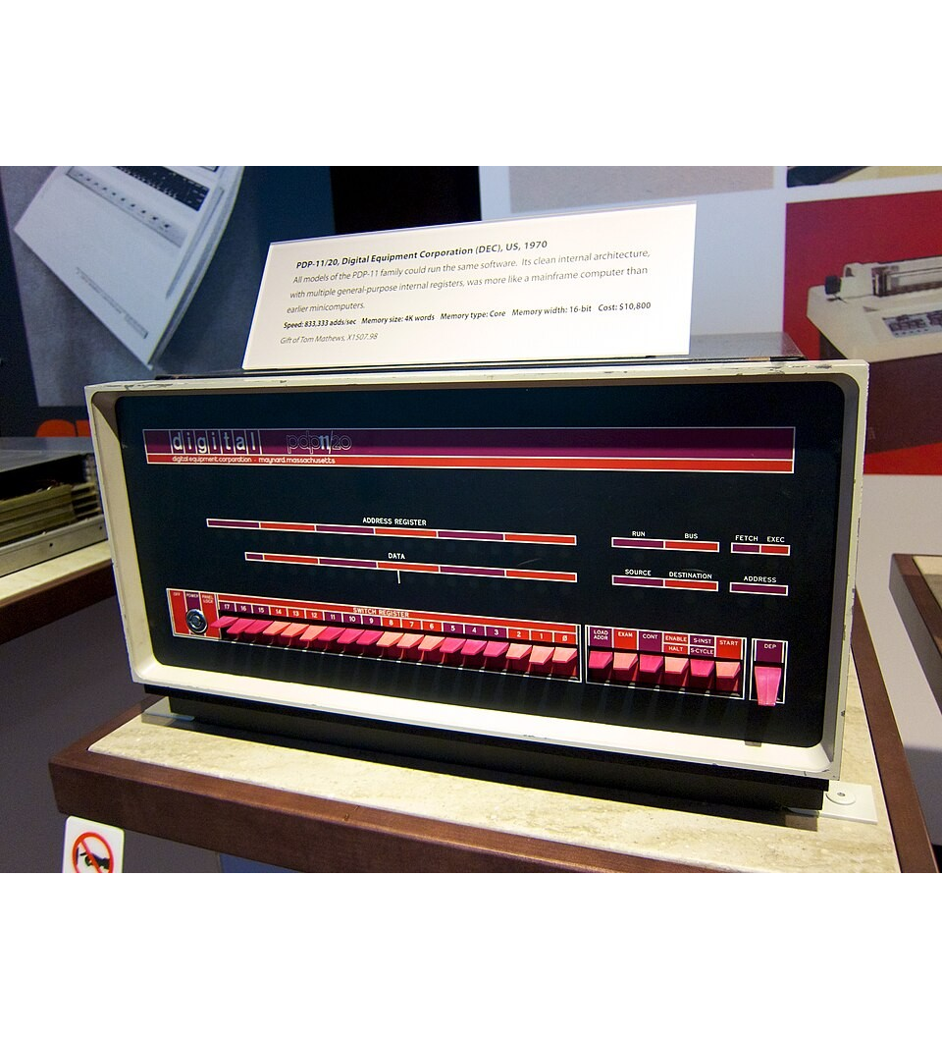
>>>
Story: Unix chose its 1970 epoch after two earlier ones
WHO The Unix engineers at Bell Labs, whose Programmer's Manual described the time call.
WHAT Time counted in sixtieths of a second from 1971, then from 1972; 1970 came later.
WHEN First edition 3 November 1971, third edition 15 March 1972; the 1970 epoch afterwards.
WHERE In the Unix Programmer's Manual; the third edition says the time is stored in 32 bits.
WHY Sixtieths of a second in 32 bits last about 2.3 years, so the unit became seconds.
HOW gmtime(0) gives 1970-01-01 00:00:00 and timegm of it gives 0: the epoch is a convention.
A DEC PDP-11/20 in the Computer History Museum: the machine family Unix first ran on. Photo: Don DeBold, CC BY 2.0, Wikimedia Commons.
READ Unix time (Wikipedia)
6 / 42
Notes:
The Unix manuals counted time from 1971, then 1972, in sixtieths of a second; 1970 and seconds came afterwards. The picture shows a PDP-11, the kind of machine Unix ran on, in a museum. Lesson: an epoch is a convention engineers chose.

Slide 7
>>>
Returning the epoch timestamp: the number behind a date
>>> import calendar
>>> from datetime import datetime, UTC
>>> t = calendar.timegm((2026, 3, 18, 6, 4, 35))
>>> print('timestamp:', t)
timegm() turns a UTC date into the epoch count: seconds since 1 January 1970, 00:00 UTC.
>>> print('zero:', datetime.fromtimestamp(0, UTC).isoformat())
>>> print('last:', datetime.fromtimestamp(2**31 - 1, UTC).isoformat())
Zero is the epoch. 2**31 - 1 is the last second a signed 32-bit counter can hold: the 2038 problem.
>>> print('wrapped:', datetime.fromtimestamp(-2**31, UTC).isoformat())
One second later a 32-bit counter wraps to the most negative number: December 1901.
What the run printed (Python 3.13.18)
Moment (UTC) | Seconds since the epoch | Printed by the program
a day in March 2026 (calendar.timegm) | 1773813875 | 1773813875
second 0: the epoch itself | 0 | 1970-01-01T00:00:00+00:00
2**31 - 1: the last second of 32 signed bits | 2147483647 | 2038-01-19T03:14:07+00:00
2**31 stored in 32 bits, read back as signed | -2147483648 | 1901-12-13T20:45:52+00:00
A timestamp is a count of seconds from one agreed moment.
7 / 42
Notes:
calendar.timegm turns a date into seconds since 1 January 1970 UTC. Second 0 is the epoch; 2**31 - 1 is the last second a signed 32-bit number holds, and the next one reads as 1901.

Slide 8
>>>
Clocks and what each measures: time(), monotonic(), perf_counter()
>>> import time
>>> for name in ('time', 'monotonic', 'perf_counter'):
>>> info = time.get_clock_info(name)
>>> print(name, info.monotonic, info.adjustable)
get_clock_info() tells whether a clock only moves forward (monotonic) and whether the system can set it (adjustable).
>>> wall, mono = [1000.0, 990.0], [50.0, 60.0]
>>> print('wall clock set back 10 s:', wall[1] - wall[0])
>>> print('monotonic clock:', mono[1] - mono[0])
EMULATED: two lists stand in for clocks. When someone sets the wall clock back, the difference of two readings goes negative.
>>> start = time.monotonic()
>>> time.sleep(0.2)
>>> print('lasted at least 0.2:', time.monotonic() - start >= 0.2)
To time a duration use a monotonic clock; the check compares with a bound, not with an exact number.
What the run printed (Python 3.13.18)
Clock | Never goes back | Can be set by hand
time() | False | True
monotonic() | True | False
perf_counter() | True | False
wall clock set back 10 s:
the difference is -10.0
monotonic clock, same 10 s:
the difference is 10.0
monotonic() for how long; time() for what time it is.
8 / 42
Notes:
time() follows the wall clock, which can be set back. monotonic() and perf_counter() never go back. Use monotonic() for how long, time() for what time. The set-back numbers are a stand-in, not a real change.

Slide 9
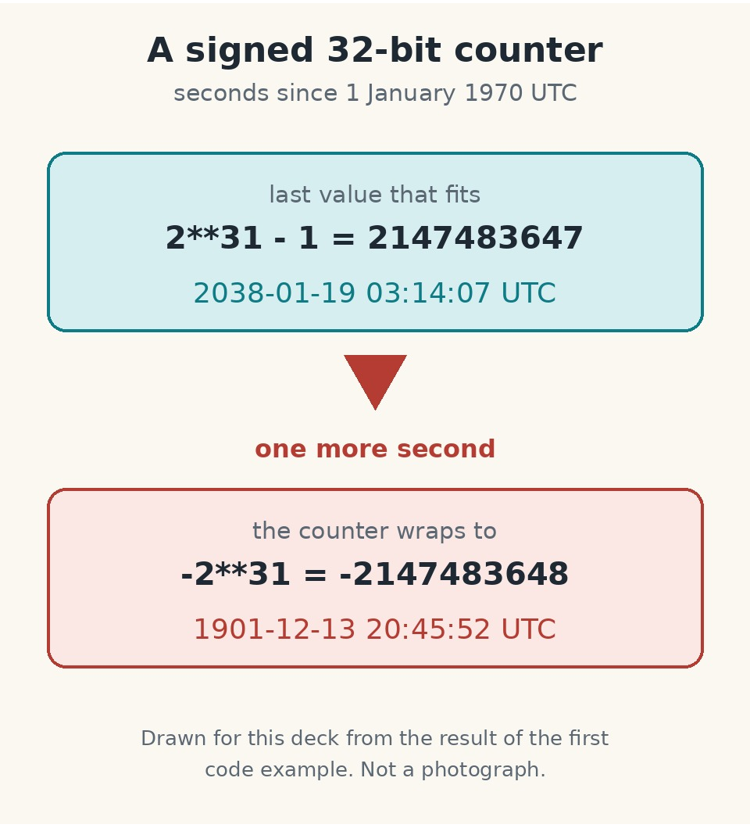
>>>
Story: A counter that wraps on 19 January 2038
WHO Programs and devices that keep Unix time in a signed 32-bit integer.
WHAT The second after 03:14:07 UTC on 19 January 2038 does not fit; the counter becomes negative.
WHEN On 19 January 2038, with warnings long before.
WHERE In any system with a 32-bit time; this study's machine used 8 bytes, datetime reaches year 9999.
WHY A signed 32-bit number has no room for the next value, so it reads as a date in December 1901.
HOW Example 1 shows 2**31 - 1 as 2038-01-19T03:14:07 and -2**31 as 1901-12-13T20:45:52.
Drawn for this deck from the result of the first example; not a photograph.
READ Year 2038 problem (Wikipedia)
9 / 42
Notes:
A signed 32-bit counter runs out at 03:14:07 UTC on 19 January 2038 and wraps to December 1901. The picture is a diagram of that wrap. Lesson: know how many bits your timestamp has.

Slide 10
>>>
Pausing programs: time.sleep() and what it does not promise
>>> import time
>>> start = time.monotonic()
>>> result = time.sleep(0.2)
>>> print('returns', result, '| at least 0.2:', time.monotonic() - start >= 0.2)
sleep() pauses at least the time asked and returns None: it promises a minimum, not an exact time.
>>> work, rounds = 0.02, 3600
>>> print('sleep after work:', round((rounds - 1) * (work + 1.0), 2))
>>> print('fixed tick:', round((rounds - 1) * 1.0, 2))
A loop that sleeps one second after its work adds the work to every round; a fixed tick does not.
What the run printed (Python 3.13.18)
3600 rounds of 'work, then sleep(1)'
late by 71.98 seconds
sleep() itself returns None.
sleep() waits at least that long; a loop that sleeps after its work drifts.
10 / 42
Notes:
sleep returns None and promises at least that long. Sleeping a second after each piece of work drifts: three thousand six hundred rounds end 72 seconds late. A fixed tick does not drift.

Slide 11
>>>
Project 14: a first stopwatch with laps
>>> now = [1000.0]
>>> def clock():
>>> return now[0]
>>> start_time = last_time = clock()
>>> lap_number = 1
EMULATED: a list holds the time, so the user's key presses can be simulated. The real program calls time.time().
>>> for gap in (3.56, 5.07, 9.05, 1.43):
>>> now[0] += gap
>>> lap_time = round(clock() - last_time, 2)
>>> total_time = round(clock() - start_time, 2)
Each press adds the gap to the clock. The lap time is the clock minus the last lap; the total is the clock minus the start.
>>> print(f'Lap #{lap_number}: {total_time} ({lap_time})')
>>> lap_number += 1
>>> last_time = clock()
Print the lap, count it, and remember when it ended.
What the run printed (Python 3.13.18)
Printed line | Total | Lap
Lap #1 | 3.56 | 3.56
Lap #2 | 8.63 | 5.07
Lap #3 | 17.68 | 9.05
Lap #4 | 19.11 | 1.43
Each lap is the clock now minus the clock at the last lap.
11 / 42
Notes:
A stand-in clock moves by given gaps, so the laps are exact. Each lap is the clock now minus the last lap; the total is the clock now minus the start. The real program waits for the Enter key.

Slide 12
Part 2: Dates and times of day (the datetime module)
A date, a time of day, and the length of time between two of them
timedelta
A length of time: days, seconds, never months
Slide | In this part
13 | Everyday pictures: the datetime module
14 | Story: In October 1582 ten days did not h...
15 | datetime: dates, times and timedelta arit...
16 | datetime to string: strftime() and its di...
17 | String to datetime: strptime() and its er...
18 | Story: Twenty-seven leap seconds since 1972
19 | Time zones with zoneinfo
20 | Daylight saving time: a day with 23 hours...
21 | Story: A lawsuit shut down the tz databas...
strftime
Turns a datetime into text with directives
strptime
Turns text into a datetime, or raises ValueError
zoneinfo
Time zone rules, so that a day can have 23 hours
12 / 42
Notes:
Part two. datetime holds dates, times and durations. strftime writes text, strptime reads it. A time zone turns a moment into a clock reading, and a day can have 23 hours.

Slide 13
>>>
Everyday pictures: the datetime module
ANALOGY A boarding pass shows a date, a time and the city whose clock it uses.
Chapter concept | Everyday picture
The datetime Module | A calendar page and a clock face on the same card.
datetime | That card: year, month, day, hour, minute and second together.
Representing Duration | A flight's length: hours and minutes, not a date.
Pausing Until a Specific Date | Setting an alarm for tomorrow's seven o'clock, not for in 600 minutes.
Converting datetime Objects into Strings | Writing the boarding pass out in the format the airport wants.
Converting Strings into datetime Objects | Reading a handwritten date and refusing it if the format is wrong.
Table 19-1: strftime() directives | The key to the airport's format codes: %Y is the year, %d the day.
13 / 42
Notes:
A boarding pass holds a date, a time and a city's clock. A flight's length is a timedelta. Writing and reading the pass use format codes; a wrong code is refused.

Slide 14
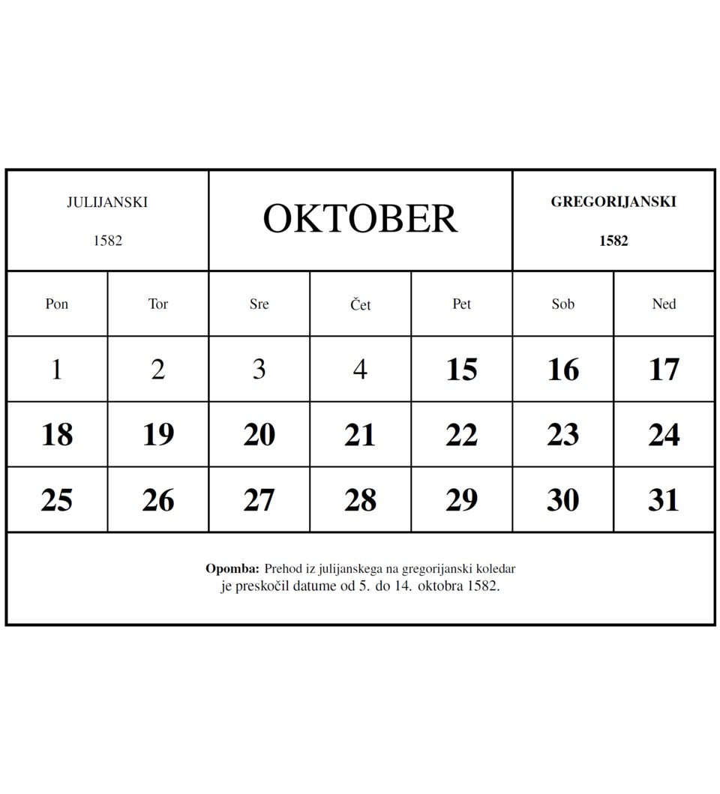
>>>
Story: In October 1582 ten days did not happen
WHO Pope Gregory XIII, who issued the bull Inter gravissimas.
WHAT A calendar reform that advanced the date by 10 days to bring Easter back to its season.
WHEN Bull dated 24 February 1582; Thursday 4 October 1582 was followed by Friday 15 October.
WHERE In the Gregorian calendar, which is named after him.
WHY The calendar had drifted from the seasons, and Easter drifted with it.
HOW Python dates are proleptic: date(1582, 10, 5) exists and is a Tuesday, as if the reform never happened.
The calendar of October 1582: 4 October is followed by 15 October. Image: Andrej Jakobčič, CC BY-SA 4.0, Wikimedia Commons.
READ Gregorian calendar (Wikipedia)
14 / 42
Notes:
After 4 October 1582 came 15 October. The picture is a calendar of October 1582 with the days missing. Python's date is proleptic: it applies today's calendar backwards. Lesson: before 1582 Python dates are not the dates people used.

Slide 15
>>>
datetime: dates, times and timedelta arithmetic
>>> from datetime import datetime, timedelta
>>> d = timedelta(days=11, hours=10, minutes=9, seconds=8)
>>> print(d.days, d.seconds, d.total_seconds())
A timedelta stores days, seconds and microseconds, so 10 hours 9 minutes 8 seconds become 36548 seconds.
>>> try:
>>> timedelta(months=1)
>>> except TypeError:
>>> print('TypeError: timedelta has no months')
There is no month or year: their lengths vary.
>>> start = datetime(2026, 10, 21, 16, 29)
>>> back = start - timedelta(days=365 * 30)
>>> print(back.date(), start.replace(year=1996).date())
Thirty years of 365 days are 7 leap days short of thirty calendar years.
What the run printed (Python 3.13.18)
What the program built | Result
timedelta(days=11, hours=10, minutes=9, seconds=8): .days | 11
the same timedelta: .seconds (the part left over, not a total) | 36548
the same timedelta: .total_seconds() | 986948.0
timedelta(months=1) | TypeError: no such unit
2026-10-21 minus 365 * 30 days, then the year set to 1996 | 1996-10-28 and 1996-10-21
A timedelta has days and seconds; months are not a unit.
15 / 42
Notes:
A timedelta keeps days, seconds and microseconds, never months. days and seconds are parts; total_seconds is the whole. Subtract 365 times 30 days and you land a week away from the same date in 1996.

Slide 16
>>>
datetime to string: strftime() and its directives
>>> from datetime import datetime
>>> dt = datetime(2026, 11, 3, 16, 29, 7)
>>> print(dt.strftime('%Y/%m/%d %H:%M:%S'))
strftime() writes a moment as text; each % directive stands for a part of it.
>>> print(dt.strftime('%I:%M %p'))
>>> print(dt.strftime('%A, %B %d'))
>>> print(dt.strftime('%j %w'))
12-hour clock with AM or PM, the weekday and month names, and the day of the year with the weekday number.
>>> print(dt.isoformat())
>>> print(datetime.fromisoformat('2026-11-03T16:29:07'))
isoformat() and fromisoformat() are the standard pair to store a moment as text and read it back.
What the run printed (Python 3.13.18)
Directives | Printed
%Y/%m/%d %H:%M:%S | 2026/11/03 16:29:07
%I:%M %p | 04:29 PM
%A, %B %d | Tuesday, November 03
Directives | Printed
%j %w | 307 2
isoformat() | 2026-11-03T16:29:07
fromisoformat() | 2026-11-03 16:29:07
%j is the day of the year (307), %w the weekday with Sunday as 0 (2).
Directives such as %Y and %d write the text you ask for.
16 / 42
Notes:
strftime writes a datetime as text from directives: %Y year, %m month, %d day, %H hour, %I and %p twelve-hour time, %A and %B names, %j day of the year. isoformat is the standard text.

Slide 17
>>>
String to datetime: strptime() and its errors
>>> from datetime import datetime
>>> print(datetime.strptime('October 21, 2026', '%B %d, %Y'))
strptime() reads text with a format; the format must match the text exactly.
>>> for text in ('2026-10-21', 'Oct 21, 2026'):
>>> try: datetime.strptime(text, '%B %d, %Y')
>>> except ValueError as e: print('ValueError:', e)
A wrong separator, or Oct where %B wants October, gives a ValueError that quotes the text and the format.
>>> for text in ('00', '26', '68', '69', '99'):
>>> print(text, datetime.strptime(text, '%y').year)
A two-digit year reads 00 to 68 as 2000 to 2068 and 69 to 99 as 1969 to 1999.
What the run printed (Python 3.13.18)
Text | Format | Result
October 21, 2026 | %B %d, %Y | a datetime
2026-10-21 | %B %d, %Y | ValueError
Oct 21, 2026 | %B %d, %Y | ValueError
%y | 00 | 26 | 68 | 69 | 99
year | 2000 | 2026 | 2068 | 1969 | 1999
Two-digit years: 69 to 99 are 1969 to 1999, 00 to 68 are 2000 to 2068.
The format must match the text exactly, or ValueError.
17 / 42
Notes:
strptime reads text with a format and raises ValueError when they differ. A two-digit year is read with a pivot: 69 to 99 are 1969 to 1999, and 00 to 68 are 2000 to 2068.

Slide 18
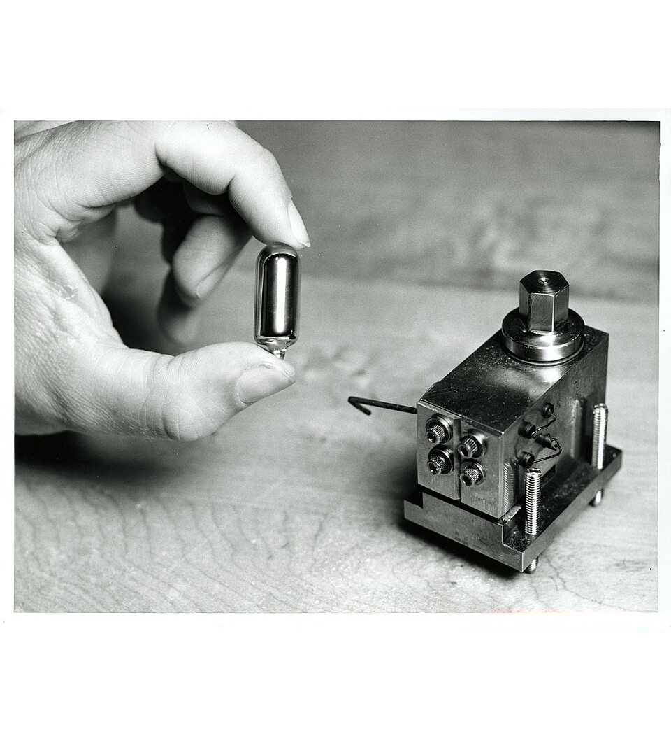
>>>
Story: Twenty-seven leap seconds since 1972
WHO The timekeepers of the BIPM and the General Conference on Weights and Measures.
WHAT Leap seconds: 27 added since 1972, the last on 31 December 2016; UTC and TAI differ by 37 seconds.
WHEN From 1972 to 31 December 2016; a 2022 resolution looks ahead to 2035.
WHERE Resolution 4 of the 27th General Conference, 2022: the allowed UT1-UTC difference will grow.
WHY UTC is kept close to the Earth's rotation, and the rotation is not steady.
HOW POSIX gives every day 86400 seconds, so 23:59:60 has no timestamp; datetime refuses a 60th second.
Cesium, the heart of an atomic clock, in its capsule. Photo: National Institute of Standards and Technology, public domain, Wikimedia Commons.
READ Leap second (Wikipedia)
18 / 42
Notes:
Twenty-seven leap seconds were added from 1972 to 2016, and POSIX time skips them. The picture shows an atomic clock, the kind that keeps the seconds. Lesson: epoch seconds are not SI seconds.

Slide 19
>>>
Time zones with zoneinfo
>>> from datetime import datetime, UTC
>>> from zoneinfo import ZoneInfo
>>> naive = datetime(2026, 10, 21, 16, 29)
>>> aware = naive.replace(tzinfo=UTC)
>>> print(naive == aware)
A naive moment has no zone and an aware one has. They are never equal.
>>> try: naive - aware
>>> except TypeError as e: print('TypeError:', e)
Subtracting a naive from an aware moment is refused.
>>> for zone in ('America/Los_Angeles', 'UTC', 'Europe/Istanbul'):
>>> print(zone, datetime.fromtimestamp(1000000, ZoneInfo(zone)).isoformat())
One timestamp, three zones: the same instant is written with three local clocks.
What the run printed (Python 3.13.18)
Question | Answer
naive == aware (same fields) | False
naive - aware | TypeError
Zone | Second 1,000,000 of the epoch there
America/Los_Angeles | 1970-01-12T05:46:40-08:00
UTC | 1970-01-12T13:46:40+00:00
Europe/Istanbul | 1970-01-12T15:46:40+02:00
Name the zone; a naive and an aware time cannot be compared.
19 / 42
Notes:
A naive datetime has no zone; an aware one has. They cannot be compared or subtracted. ZoneInfo turns one moment into the clock reading of any zone: second one million shows three readings.

Slide 20
>>>
Daylight saving time: a day with 23 hours and an hour that happens twice
>>> from datetime import datetime, timedelta, UTC
>>> from zoneinfo import ZoneInfo
>>> ny = ZoneInfo('America/New_York')
>>> x = datetime(2026, 3, 7, 12, tzinfo=ny)
>>> y = x + timedelta(days=1)
Adding one day to noon in New York on 7 March crosses the night the clocks go forward.
>>> print('wall:', y - x)
>>> print('real:', y.astimezone(UTC) - x.astimezone(UTC))
On the wall clock one day passed; in real time only 23 hours did.
>>> first = datetime(2026, 11, 1, 1, 30, tzinfo=ny)
>>> second = first.replace(fold=1)
>>> a, b = first.astimezone(UTC), second.astimezone(UTC)
>>> print(a.hour, b.hour, first == second)
On 1 November 01:30 happens twice; fold=1 picks the second. They print equal but are an hour apart.
What the run printed (Python 3.13.18)
one clock reading,
two moments
first == second: True
A day can have 23 hours; compare moments in UTC.
20 / 42
Notes:
Adding one day to noon in New York on 7 March gives noon the next day, but only 23 hours passed. At the autumn change 01:30 happens twice; fold tells which. Compare moments in UTC.

Slide 21
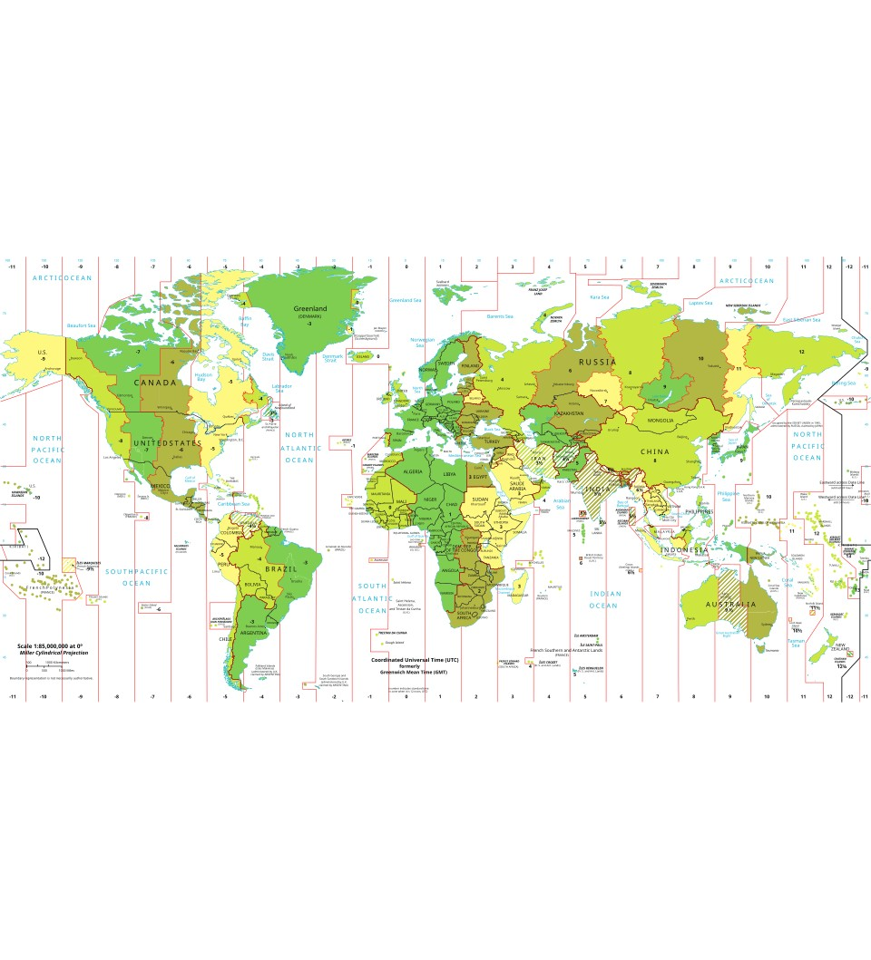
>>>
Story: A lawsuit shut down the tz database in 2011
WHO Arthur David Olson, its founder; Paul Eggert, who designed the names; ICANN and the EFF.
WHAT A lawsuit over atlas data closed the database's mailing list and FTP site.
WHEN Filed 30 September 2011; closed 6 October; ICANN took over 14 October; resolved 22 February 2012.
WHERE The tz database, with roots in 1986 or earlier; Python's zoneinfo reads it.
WHY Astrolabe sued Olson and others over copyright in atlas data.
HOW Here tzdata is 2026.5 and the system copy 2026c; Istanbul was +02:00 in January 1970, +03:00 in 2026.
Time zones of the world, 2012. Map: Poulpy, CC BY-SA 3.0, Wikimedia Commons.
READ Tz database (Wikipedia)
21 / 42
Notes:
The time zone rules are data that people maintain, and a lawsuit once shut the database down. The picture is a map of the world's time zones. Lesson: keep tzdata up to date.

Slide 22
Part 3: Launching other programs (subprocess)
Ask another program to do a job, then read what it says
run()
Launch, wait, collect the output
Slide | In this part
23 | Everyday pictures: subprocess
24 | subprocess.run(): launch a program and re...
25 | subprocess.Popen(): start now, wait later
26 | Exit codes and signals
27 | Shell safety: a list of arguments, not a ...
28 | Opening files and web pages with the defa...
Popen()
Launch now and carry on; wait for it later
exit code
0 is success; a negative number is a signal
arguments
A list of arguments, not one string for a shell
22 / 42
Notes:
Part three. subprocess asks another program to do a job. run waits, Popen does not, the exit code says how it went, and a list of arguments is safer than a string for a shell.

Slide 23
>>>
Everyday pictures: subprocess
ANALOGY run() is asking a colleague to do a job and bring back the result.
Chapter concept | Everyday picture
Launching Other Programs from Python | Asking a colleague to do a job instead of doing it yourself.
subprocess | The internal phone that reaches every colleague.
Passing Command Line Arguments to Processes | Handing over the job as a list of items, not one spoken sentence.
Receiving Output Text from Launched Commands | The colleague's note back: what was said, and whether it worked.
Opening Files with Default Applications | Handing a letter to the person at the desk who always opens letters.
webbrowser | A courier who only ever goes to web addresses.
hello.txt | A small note left on the desk for the application to open.
Figure 19-1: a screenshot of six overlapping calculator programs | Six colleagues all started at once: six windows open on the desk.
23 / 42
Notes:
run is asking a colleague to do a job and bring back the result. Popen hands over the job and carries on. The exit code is the colleague's reply. A list of items is safer than a spoken sentence.

Slide 24
>>>
subprocess.run(): launch a program and read its output
>>> import subprocess, sys
>>> child = 'import sys; print("out"); print("err", file=sys.stderr)'
>>> command = [sys.executable, '-c', child]
The program to launch is a list: the program, then its arguments. Here the program is Python itself.
>>> done = subprocess.run(command, capture_output=True)
>>> print(done.returncode, done.stdout, done.stderr)
run() waits for the program to end and returns a CompletedProcess. The output arrives as bytes.
>>> done = subprocess.run(command, capture_output=True, text=True)
>>> print(type(done.stdout).__name__, repr(done.stdout))
text=True gives text instead of bytes.
What the run printed (Python 3.13.18)
Call | returncode | stdout | stderr
run(command, capture_output=True) | 0 | b'out\n' | b'err\n'
run(command, capture_output=True, text=True) | 0 | str 'out\n' | str
Without text=True the output arrives as bytes; with it, as str.
capture_output=True and text=True give you the output as a string.
24 / 42
Notes:
run launches a program, waits and returns a result. capture_output collects stdout and stderr as bytes; text=True gives str. returncode 0 means success. The child here is Python itself, so the example runs anywhere.

Slide 25
>>>
subprocess.Popen(): start now, wait later
>>> import subprocess
>>> p = subprocess.Popen(['sleep', '0.4'])
>>> print('poll():', p.poll())
Popen() returns at once. poll() answers None while the program is still running.
>>> print('wait():', p.wait())
>>> print('poll():', p.poll())
wait() blocks until the program ends and returns its exit code; poll() then returns the same code.
>>> for call in (['nosuch'], ['false']):
>>> try:
>>> subprocess.run(call, check=True)
>>> except Exception as e:
>>> print(type(e).__name__, e)
A missing program raises FileNotFoundError. With check=True a failing program raises CalledProcessError.
What the run printed (Python 3.13.18)
Popen(['sleep', '0.4'])
starts at once
poll(): None
wait() blocks
wait(): 0
poll(): 0
Call that fails | Exception | Message
a program that does not exist | FileNotFoundError | [Errno 2] No such file or directory: 'nosuch'
check=True and exit status 1 | CalledProcessError | Command '['false']' returned non-zero exit status 1.
Popen returns at once; poll() looks, wait() waits.
25 / 42
Notes:
Popen starts the program and returns at once. poll returns None while it runs; wait blocks and returns the exit code. A missing program raises FileNotFoundError; check=True raises CalledProcessError for a non-zero code.

Slide 26
>>>
Exit codes and signals
>>> import subprocess, sys
>>> def code_of(source):
>>> return subprocess.run([sys.executable, '-c', source], stderr=subprocess.DEVNULL).returncode
A small helper runs a Python program given as text and returns its exit code, hiding its error text.
>>> kill = 'import os, signal; os.kill(os.getpid(), signal.SIG%s)'
>>> print(code_of('pass'), code_of('import sys; sys.exit(3)'), code_of('raise ValueError'))
0 means success; sys.exit(3) gives 3; an uncaught exception gives 1.
>>> print(code_of(kill % 'KILL'), code_of(kill % 'TERM'))
A program ended by a signal returns the negative of the signal number: -9 for KILL and -15 for TERM.
What the run printed (Python 3.13.18)
0 means success;
anything else means failure
a negative number is the
signal that ended the child
0 means success; a negative code is the signal that ended the child.
26 / 42
Notes:
0 is success, any other number a failure. An uncaught exception ends with 1. On Linux and macOS a negative return code is the signal that ended the child: minus 9 for KILL, minus 15 for TERM.

Slide 27
>>>
Shell safety: a list of arguments, not a string
>>> import subprocess, shlex
>>> def sh(args, **kw):
>>> return subprocess.run(args, capture_output=True, text=True, **kw).stdout
>>> name = 'x; echo INJECTED'
A helper runs a command and returns its text. The file name contains a semicolon, as a hostile file name could.
>>> print(repr(sh(f'echo opening {name}', shell=True)))
>>> print(repr(sh(f'echo opening {shlex.quote(name)}', shell=True)))
Built into a string for the shell, the name runs a second command. shlex.quote() makes it one harmless word.
>>> print(repr(sh(['echo', 'opening', name])))
The safest way needs no quoting: pass a list, and the name stays one argument.
What the run printed (Python 3.13.18)
Call | What the shell ran | Printed
shell=True, f-string with the name | two commands: echo, then echo INJECTED | 'opening x\nINJECTED\n'
shell=True, shlex.quote(name) | one command with one argument | 'opening x; echo INJECTED\n'
a list of arguments, no shell | one program, one argument | 'opening x; echo INJECTED\n'
Pass a list of arguments and no shell, and nothing is read as a command.
27 / 42
Notes:
A string given to a shell can carry a second command. shlex.quote protects one value. A list of arguments with no shell is safest, because nothing is parsed as commands.

Slide 28
>>>
Opening files and web pages with the default program
A short slide: three jobs, three calls, and where each works
The job | The call | Where it works
Open a web page | webbrowser.open(url) | Windows, macOS and Linux; True if a browser started
Open a file in its default application | os.startfile(path) | Windows only
Open a file in its default application | subprocess.run(['open', path]) | macOS
Open a file in its default application | subprocess.run(['xdg-open', path]) | Linux desktops
Run a program and wait for it | subprocess.run([program, argument]) | everywhere; see the earlier slides
Not run here: a machine without a screen has no default application to open.
28 / 42
Notes:
Opening a file in its default program differs by system. webbrowser.open works everywhere. os.startfile is Windows only. open on macOS and xdg-open on Linux are programs you launch with subprocess. Not run here.

Slide 29
Part 4: Scheduling tasks
Work that happens later, or again and again
sched
An in-process list of jobs ordered by time
Slide | In this part
30 | Everyday pictures: scheduling
31 | Story: Cron woke every minute until Purdu...
32 | In-process scheduling: the sched module
33 | Cron fields: when does a job next run?
34 | Running Task Scheduler, launchd and cron
priority
Equal times: the lower number goes first
cron
Five fields say when a job runs
native tools
Task Scheduler, launchd and cron start jobs for you
29 / 42
Notes:
Part four. Scheduling means later or again. sched keeps a list of jobs in order, cron fields say when a job runs, and the system schedulers start your program for you.

Slide 30
>>>
Everyday pictures: scheduling
ANALOGY A caretaker who checks a list every minute is cron; a repeating alarm is a schedule.
Chapter concept | Everyday picture
Running Task Scheduler, launchd, and cron | The building's caretaker: told once, then comes back at the set times.
calcProd.py | A small job written on the caretaker's list.
pyperclip | A clipboard that every program in the building can read and write.
calcProd.py (online materials) | The same job, supplied as a file.
30 / 42
Notes:
A caretaker who checks a list every minute is cron. Told once, it comes back at the set times. calcProd and pyperclip are the small job and the shared clipboard from the chapter.

Slide 31
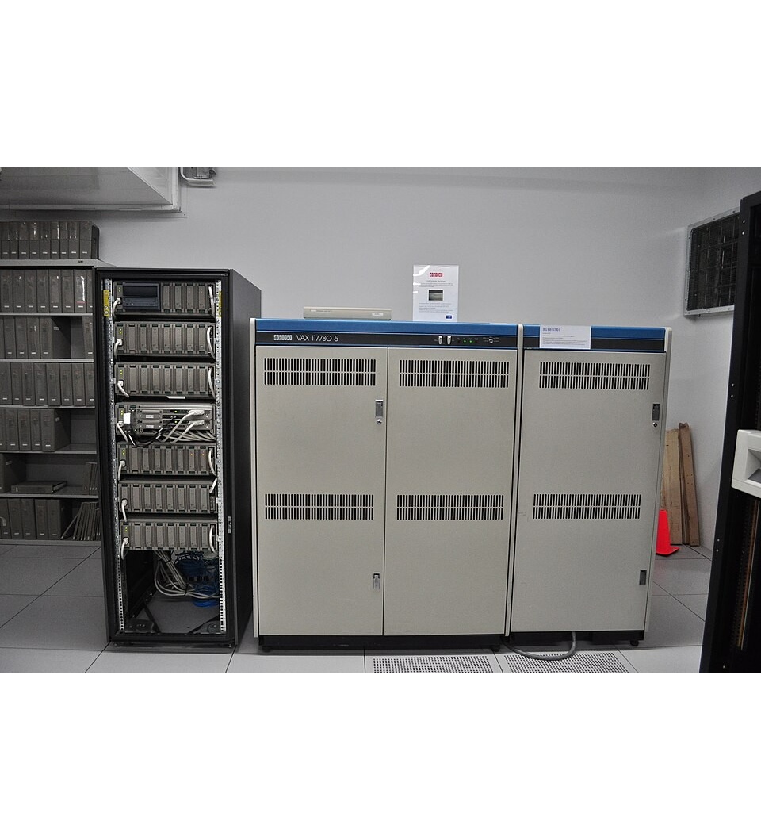
>>>
Story: Cron woke every minute until Purdue's event list
WHO Robert Brown, a Purdue graduate student, who read the paper of Franta and Maly.
WHAT An event-list cron that sleeps until the next job; the old one woke every minute.
WHEN In the late 1970s, after the 1977 paper.
WHERE At Purdue University, on a time-shared VAX with 100 users.
WHY Version 7 cron used resources with or without work and overloaded the machine when shared.
HOW Cron 3.0pl1 here started a job with PATH=/usr/bin:/bin, in /root, with no terminal.
A DEC VAX 11/780 at the Living Computer Museum, Seattle. Photo: Joe Mabel, CC BY-SA 3.0, Wikimedia Commons.
READ Cron (Wikipedia)
31 / 42
Notes:
Version 7 cron woke every minute; the Purdue version kept an event list. The picture shows a VAX computer of the kind the story is about. Lesson: a scheduler is a daemon, and the job does not inherit your shell.

Slide 32
>>>
In-process scheduling: the sched module
>>> import sched
>>> now, log = [0.0], []
>>> def clock(): return now[0]
>>> def advance(seconds): now[0] += seconds
>>> s = sched.scheduler(clock, advance)
EMULATED: a list holds the time, and advance() moves it instead of sleeping, so the run is instant.
>>> jobs = ((5, 1, 'five'), (2, 1, 'two'), (5, 0, 'five-0'), (0, 9, 'now'))
>>> for delay, priority, name in jobs:
>>> s.enter(delay, priority, log.append, (name,))
Each job has a delay, a priority and an action. enter() adds it to the list.
>>> s.run()
>>> print(log, now[0])
run() takes the jobs soonest first; equal times go by priority, and the clock ends at 5.
What the run printed (Python 3.13.18)
run() starts
now
two
five-0
five
clock: 5.0 s
Soonest first. 'five-0' and 'five' are both due at 5 seconds: the lower priority number (0) goes first.
sched runs jobs soonest first; equal times go by priority.
32 / 42
Notes:
sched keeps events in order of time, then priority. The stand-in clock is advanced instead of sleeping, so run finishes at once and shows the order. The real clock would sleep until each job is due.

Slide 33
>>>
Cron fields: when does a job next run?
>>> from datetime import datetime, timedelta
>>> def matches(text, value):
>>> return text == '*' or str(value) in text.split(',')
A cron field is * (any) or a list of numbers. This small matcher knows only those two forms.
>>> def next_run(fields, t):
>>> while True:
>>> t += timedelta(minutes=1)
>>> now = (t.minute, t.hour, t.isoweekday() % 7)
>>> if all(map(matches, fields, now)):
>>> return t
Step forward a minute at a time until every field matches. Cron counts Sunday as 0.
>>> start = datetime(2026, 10, 13, 9, 30)
>>> fmt = '%Y-%m-%d %H:%M %a'
>>> print(next_run(('30', '9', '1,2,3,4,5'), start).strftime(fmt))
>>> print(next_run(('0', '0', '5'), start).strftime(fmt))
'30 9 * * 1-5' is 09:30 on weekdays; '0 0 * * 5' is midnight on Fridays.
What the run printed (Python 3.13.18)
Cron fields: minute hour weekday | Meaning | Next run after 2026-10-13 09:30 Tue
30 9 1-5 | 09:30 on weekdays | 2026-10-14 09:30 Wed
0 0 5 | midnight on Fridays | 2026-10-16 00:00 Fri
Five fields say when: minute, hour, day of month, month, weekday.
33 / 42
Notes:
A cron entry has five fields: minute, hour, day of month, month, weekday. This small matcher knows only a star and lists, and counts Sunday as 0. It steps a minute at a time until every field matches.

Slide 34
>>>
Running Task Scheduler, launchd and cron
Each system starts your program for you; the program does not wait in memory
 | Task Scheduler | launchd | cron
Runs on | Windows | macOS | Linux and other Unix
Where the schedule lives | the Task Scheduler app, or the schtasks command | property-list files, loaded with launchctl | a crontab file, edited with crontab -e
How you say when | triggers: a time, a logon, an event | keys such as StartCalendarInterval | five fields: minute hour day month weekday
Shown in this deck | - | - | the cron-fields slide
One schedule format per system; the cron slide reads the five fields.
34 / 42
Notes:
Each system has its own scheduler. Task Scheduler on Windows, launchd on macOS, cron on Linux. They start your program at set times, so it does not have to wait in memory.

Slide 35
Part 5: Practice programs
Three small programs that combine the parts
countdown
Count down, then sound an alarm
Slide | In this part
36 | Everyday pictures: the practice programs
37 | Project 15: a countdown timer
38 | Practice program: a prettified stopwatch
39 | Practice program: the Friday the 13th fin...
40 | Practice questions
stopwatch
Laps again, with columns that line up
Friday the 13th
Step through the days with a date and a timedelta
35 / 42
Notes:
Part five. Three small programs: a countdown, a prettified stopwatch and a Friday the 13th finder. Each one uses calls from the earlier parts.

Slide 36
>>>
Everyday pictures: the practice programs
ANALOGY A kitchen timer counts down and rings; a stopwatch counts up and notes the laps.
Chapter concept | Everyday picture
Practice Programs | Three small recipes that use everything from the earlier parts.
Step 1: Count Down | Turning the kitchen timer's dial and watching the numbers fall.
Step 2: Play the Sound File | The bell at the end of the countdown.
Ideas for Similar Programs (countdown) | The same timer for tea, for a talk, for a break.
simplecountdown.py | The timer recipe as a file.
playsound3 | The bell: one call that plays a sound file.
alarm.wav | The sound of the bell, stored as a file.
Prettified Stopwatch | The stopwatch with its laps written in neat columns.
Friday the 13th Finder | Turning calendar pages one day at a time, looking for a pattern.
36 / 42
Notes:
A kitchen timer counts down and rings. A stopwatch counts up and notes laps. A Friday the 13th finder turns calendar pages one day at a time.

Slide 37
>>>
Project 15: a countdown timer
>>> now = [0.0]
>>> time_left = 5
EMULATED: a number stands in for the clock that time.sleep(1) would move; the real program sleeps one second per count.
>>> while time_left > 0:
>>> print(time_left, end=' ')
>>> now[0] += 1
>>> time_left = time_left - 1
Print the count, let one second pass, count down. The loop ends at 0.
>>> print()
>>> print('counted', now[0], 'seconds; the alarm needs a sound card')
The real program then plays alarm.wav with playsound3; there is no sound card here.
What the run printed (Python 3.13.18)
5
4
3
2
1
alarm
counted 5.0 seconds; the alarm needs a sound card.
Count down in a loop, then play the sound.
37 / 42
Notes:
Project 15 counts down and then plays a sound. A number stands in for the clock, so the run is instant. The real program sleeps one second per count and calls playsound3 for the alarm.

Slide 38
>>>
Practice program: a prettified stopwatch
>>> rows = [(1, 3.56, 3.56), (2, 8.63, 5.07), (3, 17.68, 9.05), (4, 19.11, 1.43)]
Four laps as (number, total time, lap time), the numbers of the first stopwatch.
>>> for number, total, lap in rows:
>>> print('Lap #' + str(number).rjust(2) + ': ' + str(total).rjust(6) + ' (' + str(lap).rjust(6) + ')')
rjust() pads on the left so the columns line up.
What the run printed (Python 3.13.18)
Lap | Total | Lap time | Printed line
1 | 3.56 | 3.56 | Lap # 1: 3.56 ( 3.56)
2 | 8.63 | 5.07 | Lap # 2: 8.63 ( 5.07)
3 | 17.68 | 9.05 | Lap # 3: 17.68 ( 9.05)
4 | 19.11 | 1.43 | Lap # 4: 19.11 ( 1.43)
rjust() makes the columns line up.
38 / 42
Notes:
rjust pads each number to a fixed width so the columns line up. The same laps as the first stopwatch, now in neat columns.

Slide 39
>>>
Practice program: the Friday the 13th finder
>>> from datetime import date, timedelta
>>> day = date(2026, 10, 13)
>>> found = []
Start on a fixed day, so the result never changes.
>>> while len(found) < 10:
>>> if day.day == 13 and day.weekday() == 4:
>>> found.append(day.isoformat())
>>> day += timedelta(days=1)
Walk forward a day at a time; weekday() is 4 for Friday.
>>> print(found[0], '...', found[-1])
>>> print(len(found), 'dates')
The first and the tenth Friday the 13th after that day.
What the run printed (Python 3.13.18)
2026-11-13 | 2027-08-13 | 2028-10-13 | 2029-04-13 | 2029-07-13
2030-09-13 | 2030-12-13 | 2031-06-13 | 2032-02-13 | 2032-08-13
First and last: 2026-11-13 ... 2032-08-13 - 10 dates. Every one is a day 13 that weekday() numbers 4.
weekday() is 4 for Friday; step with a timedelta.
39 / 42
Notes:
Step one day at a time from a start date with a timedelta. A date is a Friday the 13th when day is 13 and weekday is 4, because Monday is 0. Ten dates are collected.

Slide 40
>>>
Practice Questions
Use the slide of the part named in each question
ANALOGY Predict first, as you would guess the weather before you look out of the window.
1
What does time.sleep() return, and why does 'work, then sleep(1)' in a loop drift? Use the sleep slide.
2
Why can you not subtract a naive datetime from an aware one, and how long is the day the clocks change?
3
What do strptime() and strftime() do, and what happens when the format does not match?
4
What does run() return, and what do a returncode of 0 and of -9 tell you? Use the exit-codes slide.
5
Which five fields does a cron entry have, and which day of the week is 0?
Run the examples on the chapter page to check each answer.
40 / 42
Notes:
Predict first, then run what you can on the chapter page. Each question points to the part where the idea was shown.

Slide 41
>>>
Summary
ANALOGY A day's plan: a clock to read, a calendar to write in, colleagues to call, a caretaker to remind you.
A timestamp counts seconds from the epoch; 32 bits run out in 2038.
code examples in each part of this deck
1
2
Use monotonic() for how long; sleep() promises only 'at least'.
3
datetime holds dates and durations; strftime and strptime convert text.
4
A moment needs a zone, and a day can have 23 hours.
5
subprocess takes a list of arguments; the exit code says how it went.
Two questions of slide 3: measure a moment correctly, and start jobs safely.
41 / 42
Notes:
Five sentences. A timestamp counts seconds from the epoch. datetime holds dates and durations. A moment needs a zone. subprocess takes a list of arguments. A scheduler starts your program for you.

Slide 42
>>>
Resources: where to go next
The chapter, the documentation, and the pages behind the stories
Gregorian calendar (Wikipedia)
https://en.wikipedia.org/wiki/Gregorian_calendar
The crontab manual (Debian)
manpages.debian.org
Book: Automate the Boring Stuff, 3rd edition, chapter 19
https://automatetheboringstuff.com/3e/chapter19.html
Unix time (Wikipedia)
https://en.wikipedia.org/wiki/Unix_time
Python documentation: time
https://docs.python.org/3.14/library/time.html
Year 2038 problem (Wikipedia)
https://en.wikipedia.org/wiki/Year_2038_problem
Python documentation: datetime
https://docs.python.org/3.14/library/datetime.html
Cron (Wikipedia)
https://en.wikipedia.org/wiki/Cron
Python documentation: zoneinfo
https://docs.python.org/3.14/library/zoneinfo.html
Tz database (Wikipedia)
https://en.wikipedia.org/wiki/Tz_database
Python documentation: subprocess
https://docs.python.org/3.14/library/subprocess.html
schedule on PyPI
https://pypi.org/pypi/schedule/json
POSIX: seconds since the epoch
pubs.opengroup.org
tzdata on PyPI
https://pypi.org/pypi/tzdata/json
Every link was opened on 2026-11-12 and answered.
42 / 42
Notes:
Links to read next: the chapter, the documentation of the modules, the POSIX definition of epoch seconds, the crontab manual and the pages behind the stories.

