Slide 1
>>>
PDF and Word Documents
Chapter 17 of Automate the Boring Stuff with Python, 3rd edition, for an advanced course
28
5
84
code examples that run on the chapter page
true stories with who, what, when, where, why and how
distinct chapter concepts, each with an everyday picture
SEN0414 Advanced Programming, Fall 2026. Yusuf Altunel, İstanbul Kültür Üniversitesi
1 / 58
Notes:
Welcome. Chapter 17 reads and writes PDF and Word files with pypdf and python-docx. Every example builds its own files in memory or in a temporary folder, and the same examples stand in the chapter-code tab of the page, in this order.

Slide 2
>>>
Today's route
Five parts; every range is a run of slides you can jump to
Part | Slides | Code examples | You will run
What a PDF holds | 4 - 13 | 5 | a small PDF, reader, text, mending, images
New PDFs from pages | 14 - 27 | 9 | page copies, merge, rotate, stamp, locks, Project 12
Reading Word documents | 28 - 39 | 6 | ZIP and XML, runs, full text, styles, attributes
Writing Word documents | 40 - 47 | 4 | write, headings, breaks, pictures
Practice programs | 48 - 53 | 4 | PDF Paranoia, invitations, password breaker
Tools, changes, summary, practice, resources | 54 - 58 | - | which call does what, and what differs today
Open the chapter-code tab of the page: the same 28 examples, in this order.
2 / 58
Notes:
Five parts. Part one is what a PDF holds. Part two builds new PDFs from pages. Parts three and four are Word files, reading and writing. Part five is the three practice programs and Project 12. The table gives the slides of each part.

Slide 3
>>>
Two questions this chapter answers
Carry them through every part; the answers come back at the end
1
What can a program do with a PDF or a Word file, and what can it not recover from them?
Answer on slide 54: the calls, and what each one needs.
2
Which printed outputs, programs and statements of the book differ in current pypdf and python-docx?
Answer on slide 55: the changes, from the chapter research.
A page description can be copied and locked; lost structure cannot be recovered.
3 / 58
Notes:
Two questions to carry through. What can a program do with a PDF or a Word file, and what can it not recover? And which statements of the book differ in current pypdf and python-docx? The last slides answer both.

Slide 4
Part 1: What a PDF holds
A page description: objects, a table, drawing commands, pictures
PdfReader
Opens a PDF and lists its pages.
Slide | In this part
5 | Everyday pictures: a PDF and its reader
6 | Story: A 1991 memo called Camelot started...
7 | Inside a small PDF: header, objects, tabl...
8 | PdfReader: pages, their size and whether ...
9 | Extracting text: what comes out, and what...
10 | Everyday pictures: text and images
11 | Post-processing: mend the text before any...
12 | Extracting images: a scanned page is a pi...
13 | Story: In July 2008 PDF became an interna...
extract_text
Returns the words in drawing order.
images
Lists the pictures that a page holds.
Post-processing
Mends extracted text before it is used.
4 / 58
Notes:
Part one. A PDF is a page description: drawing commands, numbered objects and a table at the end. Text comes out in drawing order, a scan has no text, and a black box hides nothing.

Slide 5
>>>
Everyday pictures: a PDF and its reader
ANALOGY A PDF is like a printed photo of a page; the look is kept, the sentences are not.
Chapter concept | Everyday picture
PDF Documents | A printed photo of a page: it looks the same on every screen, but the words are no longer sentences you can move.
PDF | One printed page kept as a file, with the look of the paper.
pypdf | A pair of scissors, glue and a paper clip for PDF pages.
PdfReader | A reader at a library desk: it opens the book and looks at its pages, and writes nothing.
Page object | One sheet taken out of the book, so that you can turn it, stamp it or copy it.
pages | The numbered sheets in the binder, counted from zero.
is_encrypted | A lock sign on the binder: look at it before you try to open the binder.
io | A notepad in your pocket: a file that lives in memory and never goes into the cabinet.
5 / 58
Notes:
The printed photograph of a page carries the look but not the sentences. pypdf is scissors and glue. A reader looks at the sheets; the lock sign is is_encrypted. The notepad in your pocket is a file in memory.

Slide 6
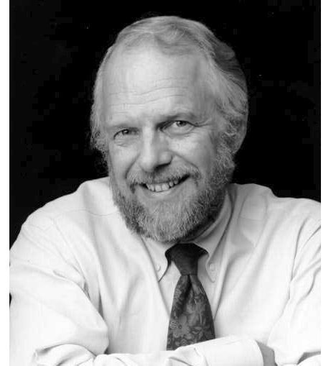
>>>
Story: A 1991 memo called Camelot started the PDF
WHO John Warnock, co-founder of Adobe Systems.
WHAT He outlined a system called Camelot, which began the Portable Document Format, PDF.
WHEN In the spring of 1991; the first Acrobat was released on 15 June 1993.
WHERE At Adobe Systems, in a design document.
WHY The goal: capture documents from any application, send them anywhere, and view and print them on any machine.
HOW A PDF stores each page as drawing commands with a table at the end, so a page looks the same everywhere.
John Warnock. Photo: Marvalous, CC BY-SA 3.0, Wikimedia Commons.
READ John Warnock (Wikipedia)
6 / 58
Notes:
John Warnock outlined Camelot in the spring of 1991. The photograph shows him in 2008. A PDF is a page description made to look the same everywhere; chapter 17 reads and rewrites exactly such files.

Slide 7
>>>
Inside a small PDF: header, objects, table, trailer
>>> import base64, zlib
>>> blob = ('eNq1kF9PgzAUxd/5FPdliT5oW6DAzMLD/sVEjcvAp2UP3SjIgtS0nW5+etsNRx'
>>> 'BfLUlJT8+95/46WEznN+TWdwhgEJudMxqh9PjO0YRpVokCLVjBFbjmdhnHDq8z'
>>> 'a3J/mU8m9FBmauVbJwR2X6OJ2Nca3LbQ+1U4F7VGyX6j7cEqBI2Z4if5nlcfXJ'
>>> 'db1pb7f+SaTXKbYiPRE89KNhaHFTZHD2OI8BotuRJ7ueXK1NnW9kfAOzPFsRmz'
>>> '1qaFAtrFpG3cI68L/QqhZVFacvbmjFOwbUgEaQ6EYvAxpBlcfQpZZdeQ7mCWQs'
>>> 'fkXjyGrRKNx6Y1LZvc4J8xwy5m2MekfUy/S5CwisnjHRAXmwUvyfQHGZ8+WZg3'
>>> 'MaOB69oJQXLI+6QHyXPHTO/gy4KAUo9CDq02hPNN3WrU72mEkL4W9n1uRHuaj/'
>>> 'saJUGracnKikv7Rkn5xSFCSyE0kOYllWZSn2ACb+gMBrPnufMNU9nkUQ==')
A two-page PDF squeezed into text so that it fits a slide; the book's sample files are not needed.
>>> data = zlib.decompress(base64.b64decode(blob))
>>> print(data[:8], data.rstrip().endswith(b'%%EOF'))
>>> text = data.decode()
>>> start = text.split('startxref')[1].split()[0]
>>> print(text.count(' obj'), 'objects; table at byte', start)
The file starts with a version line, ends with an EOF marker, and startxref names the byte where the table begins.
What the run printed (Python 3.13.16)
header
%PDF-1.4
7 numbered objects
catalog, pages, font, 2 pages, 2 streams
cross-reference table
begins at byte 639
trailer
startxref 639, then %%EOF
the file is 859 bytes; a reader starts at its end
startxref says where to jump: byte 639
A PDF is numbered objects and a table at the end.
7 / 58
Notes:
The sample travels inside the code as compressed text. Unpacked, it is a file that begins with a version line, holds numbered objects, and ends with a table whose position the last lines name. PdfReader follows that table to the pages.

Slide 8
>>>
PdfReader: pages, their size and whether the file is locked
>>> import io, pypdf
>>> writer = pypdf.PdfWriter()
>>> for width in (100, 200, 300): writer.add_blank_page(width, 100)
A PdfWriter starts empty. Three blank pages of different widths stand in for a real document.
>>> buf = io.BytesIO()
>>> writer.write(buf)
>>> reader = pypdf.PdfReader(buf)
>>> print(len(reader.pages), 'pages; locked:', reader.is_encrypted)
write() saves into memory; PdfReader reads it back. pages is a list, and is_encrypted says whether a password is needed.
>>> widths = [float(p.mediabox.width) for p in reader.pages]
>>> print('width of each page in points:', widths)
Page numbers count from 0 in code. The media box is the page's size in points; 72 points make an inch.
What the run printed (Python 3.13.16)
Question | Answer
how many pages | 3
is_encrypted | False
page 3 width (points) | 300.0
A reader gives pages, their size and the lock state.
8 / 58
Notes:
Pages are blank here so that they can be told apart by width. pages is a list, counted from zero. The media box gives a page's size in points. is_encrypted says whether a password is needed.

Slide 9
>>>
Extracting text: what comes out, and what a black box hides
>>> import base64, io, zlib, pypdf
>>> blob = ('eNq1kF9PgzAUxd/5FPdliT5oW6DAzMLD/sVEjcvAp2UP3SjIgtS0nW5+etsNRx'
>>> 'BfLUlJT8+95/46WEznN+TWdwhgEJudMxqh9PjO0YRpVokCLVjBFbjmdhnHDq8z'
>>> 'a3J/mU8m9FBmauVbJwR2X6OJ2Nca3LbQ+1U4F7VGyX6j7cEqBI2Z4if5nlcfXJ'
>>> 'db1pb7f+SaTXKbYiPRE89KNhaHFTZHD2OI8BotuRJ7ueXK1NnW9kfAOzPFsRmz'
>>> '1qaFAtrFpG3cI68L/QqhZVFacvbmjFOwbUgEaQ6EYvAxpBlcfQpZZdeQ7mCWQs'
>>> 'fkXjyGrRKNx6Y1LZvc4J8xwy5m2MekfUy/S5CwisnjHRAXmwUvyfQHGZ8+WZg3'
>>> 'MaOB69oJQXLI+6QHyXPHTO/gy4KAUo9CDq02hPNN3WrU72mEkL4W9n1uRHuaj/'
>>> 'saJUGracnKikv7Rkn5xSFCSyE0kOYllWZSn2ACb+gMBrPnufMNU9nkUQ==')
The same sample. Page 1 draws world, then Hello; page 2 draws a salary line, then a black box over it.
>>> pdf = zlib.decompress(base64.b64decode(blob))
>>> reader = pypdf.PdfReader(io.BytesIO(pdf))
>>> print('stream order:', repr(reader.pages[0].extract_text()))
>>> layout = reader.pages[0].extract_text(extraction_mode='layout')
>>> print('layout mode:', layout.split())
>>> print('under the black box:', reader.pages[1].extract_text())
Stream order is the order of drawing: worldHello. Layout mode sorts by position. The black box only covers the text.
What the run printed (Python 3.13.16)
page 1 draws, in this order
page 2 draws a text line, then a black box
1st: world
2nd: Hello
stream order: 'worldHello'
layout: Hello world
still returned: Salary: 120000 USD
Text comes out in drawing order; a black box hides nothing.
9 / 58
Notes:
A PDF stores drawing commands. Page one draws world before Hello, so stream order gives worldHello; layout mode sorts by position. Page two draws a black box over text: the text is still in the file.

Slide 10
>>>
Everyday pictures: text and images
ANALOGY Extracting text is like tracing a poster letter by letter, in the order the printer laid the ink.
Chapter concept | Everyday picture
Extracting Text | Reading a poster aloud letter by letter, in the order the printer drew it.
extract_text | The reading aloud itself: one call that returns what it read as one string.
Post-Processing with AI | A proofreader who tidies a rough dictation: line breaks, hyphens and odd letters.
Extracting Images | Peeling the photographs off a magazine page into a shoebox.
images | The shoebox: the list of pictures found on one page.
extractpdftext.py | A copy-machine program: a PDF goes in, its text comes out as a text file.
extractpdfimages.py | A photo-lifting program that empties the pictures of every page into a folder.
open | A door to a file: open it, use it, close it.
10 / 58
Notes:
Text extraction is tracing letters in the order they were drawn. The shoebox holds the pictures of a page. Post-processing tidies the rough result; the chapter hands that to a language model.

Slide 11
>>>
Post-processing: mend the text before anyone reads it
>>> import re
>>> raw = 'The ﬁrst chap-\nter was long.\nIt had two\nlines.'
>>> print(repr(raw))
Extracted text often has a ligature, a hyphen at a line end and breaks inside sentences. This line imitates that.
>>> text = raw.replace('ﬁ', 'fi')
>>> text = re.sub(r'-\n', '', text)
>>> text = re.sub(r'(?<!\.)\n', ' ', text)
>>> print(repr(text))
Three repairs: swap the ligature, join the hyphenated word, and turn a break into a space unless a sentence ended.
>>> prompt = 'Fix the line breaks of this text:\n' + raw
>>> n = len(prompt.split())
>>> print(len(raw.split()), 'words in; a prompt of', n, 'words')
The chapter hands such repairs to a language model. These lines only build the request; no model is called.
What the run printed (Python 3.13.16)
raw: 'The ﬁrst chap-\nter was long.\nIt had two\nlines.'
ligature to letters
clean: 'The first chapter was long.\nIt had two lines.'
join the hyphen
a model would get 17 words to fix
line break to space
no model is called here; the lines only count the request
Mend extracted text before anyone reads it.
11 / 58
Notes:
Extracted text often needs mending: a ligature, a hyphen at a line end, line breaks inside sentences. Three regular expressions do it. The chapter lets a language model do it; this example only builds the request.

Slide 12
>>>
Extracting images: a scanned page is a picture without text
>>> import io, os, tempfile, pypdf
>>> from PIL import Image
>>> buf = io.BytesIO()
>>> Image.new('RGB', (60, 40), 'red').save(buf, 'PDF')
Pillow saves a small red picture as a one-page PDF. A scan is such a page: a picture and no text.
>>> page = pypdf.PdfReader(buf).pages[0]
>>> print('text found:', repr(page.extract_text()))
>>> print('images found:', len(page.images))
There is no text, so extract_text() returns an empty string. The picture is there: page.images lists it.
>>> os.chdir(tempfile.mkdtemp())
>>> for i, image in enumerate(page.images, 1):
>>> open('page1_%d.bin' % i, 'wb').write(image.data)
>>> size = Image.open(io.BytesIO(page.images[0].data)).size
>>> print(os.listdir('.'), size)
The chapter's loop writes each image's bytes to a file. The bytes open as a picture of 60 by 40 pixels.
What the run printed (Python 3.13.16)
on the page | result
extract_text() | ''
len(page.images) | 1
files written | ['page1_1.bin']
60 x 40 pixels
A scan is a picture without text.
12 / 58
Notes:
A scanned page is a picture with no text: extract_text gives an empty string and images lists the picture. The loop writes each image's bytes to a file, as the chapter's image script does.

Slide 13
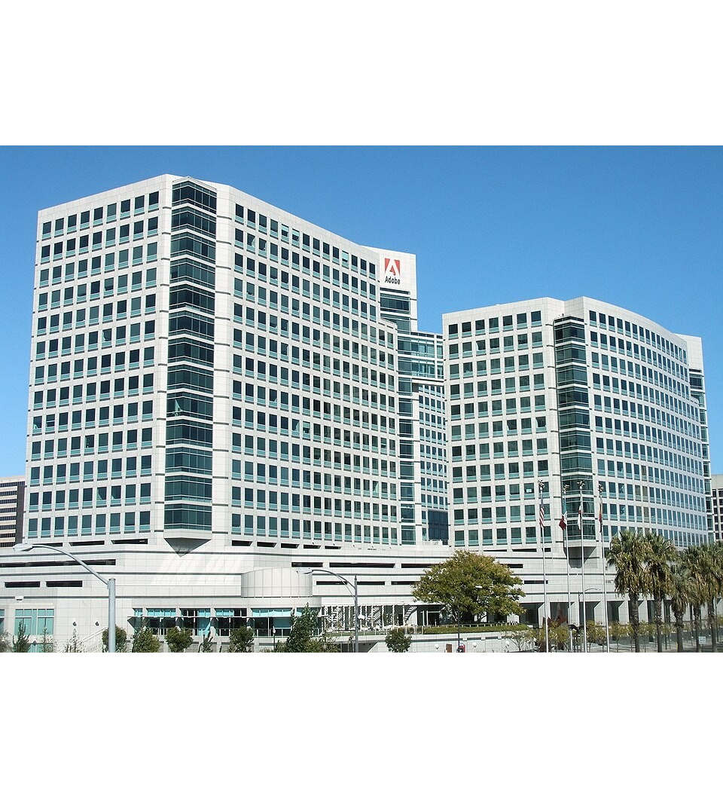
>>>
Story: In July 2008 PDF became an international standard
WHO Adobe Systems, which began the format, and the ISO committee TC 171/SC 2.
WHAT PDF 1.7 was published as the standard ISO 32000-1.
WHEN Released in November 2006; Adobe announced in January 2007 that it sought standardization; published in July 2008.
WHERE ISO, the International Organization for Standardization; the Library of Congress describes the format.
WHY A public standard lets other programs, such as pypdf, read and write PDF from the same rules.
HOW The standard defines the header, numbered objects, cross-reference table and trailer that the first example opened.
Adobe's headquarters towers, San Jose. Photo: Coolcaesar, CC BY-SA 3.0, Wikimedia Commons.
READ PDF 1.7, ISO 32000-1 (Library of Congress)
13 / 58
Notes:
PDF 1.7 became ISO 32000-1 in July 2008. The photograph shows the Adobe headquarters towers in San Jose. The standard describes the pieces of the first example: header, objects, table, trailer.

Slide 14
Part 2: New PDFs from pages
Copy, turn, stamp and lock pages, and combine many files
PdfWriter
An empty binder that you fill with pages.
Slide | In this part
15 | Everyday pictures: building a new PDF
16 | Copying pages into a new file: a tuple is...
17 | merge() puts pages inside; blank pages fi...
18 | Rotating pages: angles add up and must be...
19 | Everyday pictures: stamps and padlocks
20 | Watermarks and overlays: merge_page lays ...
21 | Encrypt, then decrypt: a locked file refu...
22 | Everyday pictures: two keys, and Project 12
23 | Two passwords: the user opens, the owner ...
24 | Which lock was used: RC4 by default, AES ...
25 | Everyday pictures: folders and the program
26 | Project 12, step 1: find all PDF files an...
27 | Project 12, steps 2 and 3: open each PDF,...
append and merge
Copy pages to the end or inside.
merge_page
Lays one page on another as a stamp.
encrypt, decrypt
Lock a file; a password unlocks it.
14 / 58
Notes:
Part two. A PdfWriter is an empty binder. Append and merge copy pages in, rotate turns them, merge_page stamps one on another, encrypt locks the file, and Project 12 combines many files.

Slide 15
>>>
Everyday pictures: building a new PDF
ANALOGY A new PDF from old pages is like a new binder made from other binders: you choose sheets and clip them in.
Chapter concept | Everyday picture
Creating PDFs from Other Pages | Photocopying chosen sheets from other binders into a new one.
PdfWriter | An empty binder with a hole punch: only what you add is in the new file.
append | Clipping sheets onto the end of the binder.
merge | Slipping sheets in at a chosen place inside the binder.
Inserting Blank Pages | Adding clean sheets to separate one chapter from the next.
add_blank_page | A clean sheet put at the back of the binder.
insert_blank_page | A clean sheet slid in at page number n.
Rotating Pages | Turning a sheet a quarter turn, so that a wide table can be read.
15 / 58
Notes:
A writer is an empty binder. Append clips sheets at the end, merge slips them in, and blank pages separate chapters. A rotation turns a sheet by quarter turns.

Slide 16
>>>
Copying pages into a new file: a tuple is a range, a list is exact
>>> import io, pypdf
>>> src = pypdf.PdfWriter()
>>> for n in range(1, 7): src.add_blank_page(100 * n, 100)
>>> buf = io.BytesIO()
>>> src.write(buf)
A six-page source. Page n is n hundred points wide, so a width tells which page it was.
>>> def pick(pages):
>>> w = pypdf.PdfWriter()
>>> w.append(io.BytesIO(buf.getvalue()), pages)
>>> return [int(p.mediabox.width) // 100 for p in w.pages]
pick() copies chosen pages into a new writer and reports which source pages arrived.
>>> for pages in ((0, 5), (0, 5, 2), [0, 5]):
>>> print(pages, '->', pick(pages))
A tuple is a range like range(): start, stop, step. A list names the pages exactly.
What the run printed (Python 3.13.16)
(0, 5)
1
2
3
4
5
6
copies 5 pages: a range, stop before 5
(0, 5, 2)
1
2
3
4
5
6
copies 3 pages: every second page
[0, 5]
1
2
3
4
5
6
copies 2 pages: exactly pages 1 and 6
A tuple is a range; a list is exact.
16 / 58
Notes:
The width of a page tells which page it was. A tuple is a range with a start, a stop and a step; a list names pages exactly. So (0, 5) copies pages one to five, and [0, 5] copies pages one and six.

Slide 17
>>>
merge() puts pages inside; blank pages fill gaps
>>> import io, pypdf
>>> w = pypdf.PdfWriter()
>>> for n in (1, 2, 3): w.add_blank_page(100 * n, 100)
Three pages 100, 200 and 300 points wide. add_blank_page() adds a page at the end.
>>> other = pypdf.PdfWriter()
>>> for n in (7, 8): other.add_blank_page(100 * n, 100)
>>> buf = io.BytesIO()
>>> other.write(buf)
A second file of two pages, 700 and 800 points wide, kept in memory.
>>> def sizes(): return [int(p.mediabox.width) for p in w.pages]
>>> w.merge(1, buf, pages=(0, 2))
>>> print('after merge at 1:', sizes())
>>> w.insert_blank_page(index=2)
>>> print('after insert_blank_page:', sizes())
merge() inserts pages at position 1; write pages=, or a tuple is read as a bookmark title. A blank page copies its neighbour's size.
What the run printed (Python 3.13.16)
start
100
200
300
merge(1, ..., pages=(0, 2))
100
700
800
200
300
insert_blank_page(index=2)
100
700
800
800
200
300
each box is one page, named by its width; amber pages came from the other file, teal is the blank page
Name pages= in merge(); a blank page copies its neighbour.
17 / 58
Notes:
merge puts another file's pages inside this one at an index. Write pages= by name: the third position is a bookmark title, and a tuple there is wrong. insert_blank_page copies the size of the page before it.

Slide 18
>>>
Rotating pages: angles add up and must be multiples of 90
>>> import pypdf
>>> page = pypdf.PdfWriter().add_blank_page(100, 100)
>>> print('start:', page.rotation)
A fresh page has rotation 0. add_blank_page() returns the new Page object.
>>> seen = [page.rotate(angle).rotation for angle in (90, 270, -90, 180)]
>>> print('rotation after each turn:', seen)
rotate() turns the page clockwise and adds the angle to the total already there. The total is not wrapped at 360.
>>> try:
>>> page.rotate(45)
>>> except ValueError:
>>> print('45 degrees refused: use multiples of 90')
Only quarter turns are allowed. Any other angle raises a ValueError, caught here.
What the run printed (Python 3.13.16)
totals: 90, 360, 270, 450
the total is not wrapped at 360, so 450 means a quarter turn past a full one
Angles add up, in quarter turns.
18 / 58
Notes:
rotate adds the angle to the total already there, and the total is not wrapped at 360. Only multiples of 90 are accepted; anything else raises a ValueError.

Slide 19
>>>
Everyday pictures: stamps and padlocks
ANALOGY A watermark is like a rubber stamp, and a password is like a padlock on the binder.
Chapter concept | Everyday picture
rotate | Turning the sheet by quarter turns, adding to how far it is already turned.
Adding Watermarks and Overlays | Pressing a stamp on a printed sheet, or laying a see-through sheet over it.
Watermark | A faint stamp behind the words, such as DRAFT.
Overlay | A see-through sheet laid on top of the page.
merge_page | Laying one sheet on another so that both show.
Encrypting and Decrypting PDFs | Locking the binder with a padlock, and opening it again with the key.
encrypt | Snapping the padlock shut and choosing its key.
decrypt | Trying a key in the padlock; the padlock tells you whether it fits.
19 / 58
Notes:
Rotation adds up. A watermark is a stamp, an overlay a see-through sheet, and merge_page lays one sheet on another. Encrypt snaps the padlock shut; decrypt tries a key.

Slide 20
>>>
Watermarks and overlays: merge_page lays one page on another
>>> import io, pypdf
>>> from PIL import Image
>>> def page_with(size, color):
>>> buf = io.BytesIO()
>>> Image.new('RGB', size, color).save(buf, 'PDF')
>>> return pypdf.PdfReader(buf).pages[0]
A helper that makes a one-page PDF holding a picture of one size and colour.
>>> base = page_with((60, 40), 'blue')
>>> top = page_with((30, 20), 'red')
>>> before = len(base.images)
>>> base.merge_page(top)
A big blue page stands for the document, a small red one for the stamp. merge_page() copies the stamp onto the base page.
>>> print('images:', before, '->', len(base.images))
>>> print('drawn first to last:', [im.image.size for im in base.images])
The page now draws two pictures. The later one lies on top: by default the stamp goes over the page.
What the run printed (Python 3.13.16)
drawn | picture size
1st (the document) | 60 x 40
2nd (the stamp) | 30 x 20
images before -> after | 1 -> 2
the later a picture is drawn, the higher it lies: the stamp lies on top
merge_page draws the stamp on top.
20 / 58
Notes:
merge_page lays the stamp page on the base page. The page then draws both pictures, the later one on top. Without Pillow the images list would not work.

Slide 21
>>>
Encrypt, then decrypt: a locked file refuses its pages
>>> import io, pypdf
>>> writer = pypdf.PdfWriter()
>>> writer.add_blank_page(100, 100)
>>> writer.encrypt('userpw', algorithm='AES-256')
>>> buf = io.BytesIO()
>>> writer.write(buf)
encrypt() locks the file with a password. AES-256 is the strong algorithm; the default form is weaker.
>>> reader = pypdf.PdfReader(buf)
>>> print('locked:', reader.is_encrypted)
>>> try: reader.pages[0]
>>> except Exception as e: print('refused:', type(e).__name__)
A reader opens a locked file but refuses its pages. The refusal is an error, caught here to go on.
>>> for guess in ('wrong', 'userpw'):
>>> print(repr(guess), '->', reader.decrypt(guess).name)
>>> print(len(reader.pages), 'page after decrypt')
decrypt() answers with a PasswordType. One password serves as user and owner password, so a match says OWNER_PASSWORD.
What the run printed (Python 3.13.16)
encrypt('userpw',
AES-256)
locked: True
pages[0] refused
FileNotDecryptedError
decrypt('wrong')
NOT_DECRYPTED
decrypt('userpw')
OWNER_PASSWORD
1 page after decrypt
red: the pages stay closed; green: a match opens them
A locked file refuses its pages until decrypt() fits.
21 / 58
Notes:
encrypt locks the file; a reader opens it but refuses its pages until decrypt matches. decrypt answers with a PasswordType. When one password is given it serves as both user and owner password.

Slide 22
>>>
Everyday pictures: two keys, and Project 12
ANALOGY There are two keys: the guest key opens the door, and the owner key also changes the locks.
Chapter concept | Everyday picture
PasswordType | The padlock's answer: no fit, the guest key, or the owner key.
User password | The guest key: it lets you in to read.
Owner password | The owner's key: it lets you in and also sets the house rules.
Project 12: Combine Select Pages from Many PDFs | Making one handout from a drawer of reports, taking everything but the cover sheet of each.
Step 1: Find All PDF Files | Looking through the drawer and pulling out only the reports.
Step 2: Open Each PDF | Taking each report out in turn and leaving its cover sheet behind.
Step 3: Save the Results | Binding the pile and putting the handout back in the drawer.
22 / 58
Notes:
A file can have two keys: the guest key reads, the owner key sets the rules. decrypt reports which key fitted. Project 12 has three steps: find the files, open each, save the result.

Slide 23
>>>
Two passwords: the user opens, the owner may do more
>>> import io, pypdf
>>> writer = pypdf.PdfWriter()
>>> writer.add_blank_page(100, 100)
>>> writer.encrypt(user_password='open-me', owner_password='boss',
>>> algorithm='AES-256')
One file, two passwords. The user password is for reading; the owner password is for whoever controls the file.
>>> buf = io.BytesIO()
>>> writer.write(buf)
>>> for pw in ('open-me', 'boss', 'guess'):
>>> reader = pypdf.PdfReader(io.BytesIO(buf.getvalue()))
>>> print(pw, '->', reader.decrypt(pw).name)
decrypt() tells which password matched: USER_PASSWORD, OWNER_PASSWORD or NOT_DECRYPTED. Each try uses a fresh reader.
What the run printed (Python 3.13.16)
decrypt(...) with | answer
open-me | USER_PASSWORD
boss | OWNER_PASSWORD
guess | NOT_DECRYPTED
user password: opens the file and shows its pages
owner password: also controls what the file allows
The answer names the key that fitted.
23 / 58
Notes:
Two passwords give two answers. The user password opens the file; the owner password also controls what the file allows. decrypt reports which one fitted: USER_PASSWORD, OWNER_PASSWORD or NOT_DECRYPTED.

Slide 24
>>>
Which lock was used: RC4 by default, AES when asked
>>> import io, pypdf
>>> def lock(**options):
>>> w = pypdf.PdfWriter()
>>> w.add_blank_page(100, 100)
>>> w.encrypt('pw', **options)
>>> b = io.BytesIO()
>>> w.write(b)
>>> return pypdf.PdfReader(b).trailer['/Encrypt']
A helper that locks a one-page file with the options given and returns the record of the lock that the file keeps.
>>> for algo in (None, 'AES-128', 'AES-256'):
>>> e = lock(algorithm=algo)
>>> v, r, bits = e['/V'], e['/R'], e['/Length']
>>> print('%s: V=%d R=%d bits=%d' % (algo, v, r, bits))
None asks for the default, the old RC4. V and R name the scheme; AES needs the cryptography package.
What the run printed (Python 3.13.16)
lock | V | R | key bits
None (default) | 2 | 3 | 128
AES-128 | 4 | 4 | 128
AES-256 | 5 | 6 | 256
The file records its lock: RC4 by default, AES when asked.
24 / 58
Notes:
The file records its lock. The default algorithm is the old RC4: version 2, revision 3, 128-bit key. AES-128 records 4 and 4, AES-256 records 5 and 6 with a 256-bit key. AES needs the cryptography package.

Slide 25
>>>
Everyday pictures: folders and the program
ANALOGY A program that handles many files is like a mail sorter: it walks the shelves and treats every item alike.
Chapter concept | Everyday picture
os | The building's directory board: it says where things are kept.
os.listdir | A glance at one shelf: the names of what lies on it.
os.walk | A walk through the whole building, room by room and shelf by shelf.
sort | Putting the folders in alphabetical order before they are bound.
combine_pdfs.py | The mail sorter's finished routine for Project 12.
Ideas for Similar Programs | The same sorter on new jobs: stamp every page, split a book into chapters, number the sheets.
25 / 58
Notes:
A folder program is a mail sorter. os names the building, listdir looks at one shelf, walk visits all of them. Sort the names before binding. Similar programs follow the same plan.

Slide 26
>>>
Project 12, step 1: find all PDF files and sort them
>>> import os, tempfile
>>> os.chdir(tempfile.mkdtemp())
>>> for name in ('b.pdf', 'A.pdf', 'c.PDF', 'notes.txt'):
>>> open(name, 'w').close()
A folder with three PDF names and a text file, all empty: step 1 only needs names. One PDF has a capital extension.
>>> pdf_filenames = []
>>> for filename in os.listdir('.'):
>>> if filename.lower().endswith('.pdf'):
>>> pdf_filenames.append(filename)
>>> pdf_filenames.sort(key=str.lower)
>>> print(pdf_filenames)
listdir() names everything in the folder. lower() lets the test see c.PDF too, and the sort ignores case.
What the run printed (Python 3.13.16)
b.pdf
A.pdf
lower() and endswith('.pdf')
keeps 3 of 4 names
sorted, ignoring case:
A.pdf, b.pdf, c.PDF
c.PDF
notes.txt
green: kept; grey: left out (a text file)
Find the PDFs; ignore case when sorting.
26 / 58
Notes:
Project 12, step one: find the PDF files and sort them. lower() lets the test see c.PDF too, and sorting ignores case. The files are empty because only their names matter here.

Slide 27
>>>
Project 12, steps 2 and 3: open each PDF, copy, save
>>> import os, tempfile, pypdf
>>> os.chdir(tempfile.mkdtemp())
>>> w = pypdf.PdfWriter()
>>> w.add_blank_page(100, 100)
>>> for name in ('b.pdf', 'A.pdf', 'c.PDF'):
>>> w.add_blank_page(100, 100)
>>> w.write(name)
Three PDFs of 2, 3 and 4 pages stand in for the folder's files: one writer is saved after each added page.
>>> pdf_filenames = ['A.pdf', 'b.pdf', 'c.PDF']
>>> writer = pypdf.PdfWriter()
>>> for name in pdf_filenames:
>>> writer.append(name, (1, len(pypdf.PdfReader(name).pages)))
Step 2: open each file in the sorted order and copy the range (1, number of pages): the first page of each file is skipped.
>>> writer.write('combined.pdf')
>>> sizes = [len(pypdf.PdfReader(n).pages) for n in pdf_filenames]
>>> print(sizes, 'pages ->', len(pypdf.PdfReader('combined.pdf').pages))
Step 3: save the result, then read back the sizes of the three files and of the new file.
What the run printed (Python 3.13.16)
A.pdf
1
2
3
order of the names: A.pdf, b.pdf, c.PDF
grey: first page of each file skipped
2 + 1 + 3 = 6
b.pdf
1
2
combined.pdf
6 pages
c.PDF
1
2
3
4
Copy all but the first page of each file, then save.
27 / 58
Notes:
Project 12, steps two and three: open each PDF, copy every page but the first, save. The chapter's loop uses a name that does not exist; the list is pdf_filenames. A second run would also read combined.pdf.

Slide 28
Part 3: Reading Word documents
A .docx file is a ZIP of XML; paragraphs hold runs
ZIP and XML
A .docx file is an archive of parts.
Slide | In this part
29 | Everyday pictures: a Word file
30 | Story: The ZIP format of 1989 is the box ...
31 | A .docx file is a ZIP archive of XML parts
32 | Reading a Word file: paragraphs hold runs
33 | Getting the full text from a .docx file
34 | Everyday pictures: paragraphs, runs and s...
35 | Styles: a paragraph style and a run style
36 | Styles: the right kind and the exact name
37 | Everyday pictures: bold, italic and under...
38 | Run attributes: bold, italic and underlin...
39 | Story: Word's .docx format became a stand...
Paragraph and run
A card in the box, and its pen strokes.
Style
A named rule for a paragraph or a run.
Run attributes
Bold, italic and underline have three states.
28 / 58
Notes:
Part three. A .docx file is a ZIP of XML. A document holds paragraphs, a paragraph holds runs, and styles must fit the object and match by exact name.

Slide 29
>>>
Everyday pictures: a Word file
ANALOGY A Word file is like a recipe box: it holds cards, each card holds short stretches of words, each with its own pen.
Chapter concept | Everyday picture
Word Documents | A recipe box you can still rewrite: the words, the fonts and the pictures are kept apart.
docx | The label on the box: you install python-docx but you write import docx.
Document object | The whole recipe box.
Paragraph object | One card in the box.
Run object | A stretch of words on the card written with one pen.
Reading Word Documents | Flipping through the box and reading the cards.
Getting the Full Text from a .docx File | Copying the words of every card onto one long list.
readDocx.py | The little program that copies the words of every card for you.
29 / 58
Notes:
A Word file is a recipe box. The Document is the box, a Paragraph is a card, a Run is a stretch of words in one pen. Install python-docx, import docx. readDocx joins the cards.

Slide 30
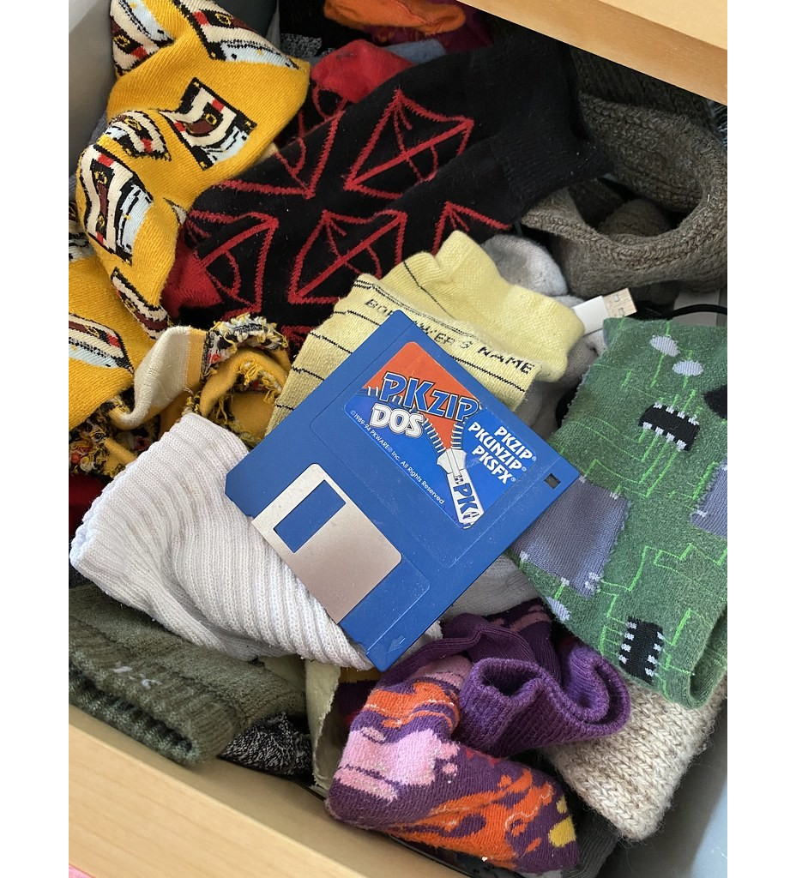
>>>
Story: The ZIP format of 1989 is the box every .docx comes in
WHO Phil Katz of PKWARE and Gary Conway of Infinity Design Concepts.
WHAT They designed the ZIP file format; its first two bytes are usually PK, the initials of Phil Katz.
WHEN The format was first released on 14 February 1989.
WHERE At PKWARE, Inc., after a lawsuit by Systems Enhancement Associates (SEA) over the ARC archive format.
WHY SEA claimed that PKWARE's PKARC products were derived from its ARC system, so a new format was needed.
HOW Office Open XML is extended from ZIP: a .docx file is a ZIP archive that the zipfile module opens.
A PKZIP floppy disk, label of PKWARE. Photo: blakespot, CC BY 2.0, Flickr.
READ ZIP (file format) (Wikipedia)
30 / 58
Notes:
ZIP dates from 14 February 1989. The photograph shows a PKZIP floppy disk. Every .docx file is a ZIP archive of XML parts, which is why the zipfile module can open one.

Slide 31
>>>
A .docx file is a ZIP archive of XML parts
>>> import io, zipfile, docx
>>> doc = docx.Document()
>>> doc.add_paragraph('Hello, world!')
>>> buf = io.BytesIO()
>>> doc.save(buf)
A new document with one paragraph, saved into memory. python-docx is installed as python-docx and imported as docx.
>>> print(buf.getvalue()[:2], 'starts every ZIP file')
>>> z = zipfile.ZipFile(buf)
>>> names = z.namelist()
>>> part = 'word/document.xml'
>>> print(len(names), 'parts;', part, 'in names:', part in names)
The first two bytes are PK, the mark of a ZIP file. The zipfile module lists the parts inside.
>>> body = z.read(part).decode().split('<w:body>')[1]
>>> print(body[:46])
The text lives in word/document.xml, in XML tags: a paragraph, a run, the text.
What the run printed (Python 3.13.16)
[Content_Types].xml | word/_rels/document.xml.rels | word/fontTable.xml | word/numbering.xml
_rels/.rels | word/styles.xml | word/theme/theme1.xml | docProps/thumbnail.jpeg
docProps/core.xml | word/stylesWithEffects.xml | customXml/item1.xml
docProps/app.xml | word/settings.xml | customXml/_rels/item1.xml.rels
word/document.xml | word/webSettings.xml | customXml/itemProps1.xml
A .docx file is a ZIP archive of XML parts.
31 / 58
Notes:
A .docx file begins with PK because it is a ZIP archive. It holds seventeen parts; the text is in word/document.xml, inside paragraph, run and text tags.

Slide 32
>>>
Reading a Word file: paragraphs hold runs
>>> import docx
>>> doc = docx.Document()
>>> p = doc.add_paragraph('A plain ')
>>> p.add_run('bold').bold = True
>>> p.add_run(' word.')
A stand-in for demo.docx: one paragraph of three runs. A run is a stretch of text with one look.
>>> table = doc.add_table(rows=1, cols=1)
>>> table.cell(0, 0).text = 'in a table'
A table with one cell. Its text is part of the document, but not of any paragraph in it.
>>> print([x.text for x in doc.paragraphs])
>>> print([(r.text, r.bold) for r in p.runs])
>>> print('table text is kept apart:', doc.tables[0].cell(0, 0).text)
doc.paragraphs lists Paragraph objects, and each has runs. Table text is not in that list; it sits in doc.tables.
What the run printed (Python 3.13.16)
paragraphs[0]
run 1
'A plain ' bold=None
run 2
'bold' bold=True
run 3
' word.' bold=None
Document
tables[0].cell(0, 0)
table text: in a table - not in the paragraphs list
Paragraphs hold runs; tables stand apart.
32 / 58
Notes:
A document holds paragraphs, a paragraph holds runs. A table's text is not in the paragraphs list; it is in tables. The same holds for headers.

Slide 33
>>>
Getting the full text from a .docx file
>>> import io, docx
>>> doc = docx.Document()
>>> for line in ('Title line', 'First paragraph.', 'Second paragraph.'):
>>> doc.add_paragraph(line)
>>> buf = io.BytesIO()
>>> doc.save(buf)
A three-paragraph document saved in memory. The buffer stands in for a file name.
>>> def get_text(source):
>>> doc = docx.Document(source)
>>> return '\n'.join(p.text for p in doc.paragraphs)
>>> text = get_text(io.BytesIO(buf.getvalue()))
>>> print(text)
>>> print(len(text.split('\n')), 'lines,', len(text.split()), 'words')
The idea of readDocx.py: open the file, join each paragraph's text with a line break. Document() takes a name or a file object.
What the run printed (Python 3.13.16)
paragraph | text
0 | Title line
1 | First paragraph.
2 | Second paragraph.
joined | 3 lines, 6 words
Join the paragraphs' text with line breaks.
33 / 58
Notes:
The readDocx idea: open the file, join each paragraph's text with a line break. Document accepts a file name or a file object.

Slide 34
>>>
Everyday pictures: paragraphs, runs and styles
ANALOGY A style is like a house rule for a card: headings are big and bold, quotes lean.
Chapter concept | Everyday picture
paragraphs | The cards of the box, in order.
runs | The places inside a card where the pen changes.
Styling Paragraph and Run Objects | Choosing a house rule for a whole card, or for only a few words.
Paragraph style | A rule for the whole card: margins, spacing and the size of the letters.
Character style | A rule for a few words, such as emphasis.
style | The name of the rule; it must match exactly, like a key cut for one lock.
34 / 58
Notes:
Paragraphs are the cards in order; runs are the places where the pen changes. A paragraph style rules a card, a character style a few words. A style name must match exactly.

Slide 35
>>>
Styles: a paragraph style and a run style
>>> import docx
>>> doc = docx.Document()
>>> p = doc.add_paragraph('Quoted words')
>>> p.style = 'Quote'
>>> print('paragraph style:', p.style.name)
A paragraph style shapes the whole paragraph. Quote is a paragraph style of the default template.
>>> run = p.add_run(' and a run')
>>> run.style = 'Quote Char'
>>> print('run style:', run.style.name)
>>> print(len(doc.styles), 'styles in a new document')
A character style shapes a run. Quote Char matches Quote. The template holds 164 styles of four kinds.
What the run printed (Python 3.13.16)
object | style set | style name read back
paragraph | Quote | Quote
run | Quote Char | Quote Char
164 styles in a new document
four kinds: paragraph, character, list, table
A paragraph takes a paragraph style, a run a character style.
35 / 58
Notes:
A paragraph takes a paragraph style, a run a character style. Quote is the first, Quote Char the second. A new document holds 164 styles; the chapter prints 34.

Slide 36
>>>
Styles: the right kind and the exact name
>>> import docx
>>> doc = docx.Document()
>>> p = doc.add_paragraph('Quoted words')
>>> try: p.style = 'Quote Char'
>>> except ValueError: print('a paragraph refuses a character style')
The kind must fit the object: a character style on a paragraph raises a ValueError, caught here.
>>> try: doc.add_paragraph('x', 'List Number ')
>>> except KeyError: print('style not found: names match exactly')
>>> doc.add_paragraph('x', 'List Number')
>>> print('List Number found:', doc.paragraphs[-1].style.name)
The name must match letter for letter. One trailing space, as the book's printed list shows, and the style is not found.
What the run printed (Python 3.13.16)
object | style asked | result
paragraph | Quote Char | refused: ValueError (wrong kind)
paragraph | List Number | not found: KeyError (trailing space)
paragraph | List Number | accepted: List Number
ValueError for the wrong kind, KeyError for the wrong name
The kind must fit and the name must match exactly.
36 / 58
Notes:
The kind must fit the object: a character style on a paragraph raises ValueError. The name must match exactly: a trailing space raises KeyError, as the book's printed list would.

Slide 37
>>>
Everyday pictures: bold, italic and underline
ANALOGY A run attribute is like a light switch with three positions: on, off, or follow the house rule.
Chapter concept | Everyday picture
Applying Run Attributes | Flipping the switches for a few words.
bold | A thick pen.
italic | A pen that leans.
underline | A ruler line drawn under the words.
37 / 58
Notes:
Bold, italic and underline are switches with three positions: on, off, and follow the style. The next slide shows all three states.

Slide 38
>>>
Run attributes: bold, italic and underline have three states
>>> import docx
>>> doc = docx.Document()
>>> run = doc.add_paragraph().add_run('text')
>>> for value in (True, False, None):
>>> run.bold = value
>>> print('bold =', value, '-> reads back', run.bold)
True turns bold on, False turns it off, None means the style decides. The run reads back what was set.
>>> run.italic, run.underline = True, True
>>> print('italic:', run.italic, '| underline:', run.underline)
Italic and underline work like bold. These three are real attributes of a run.
>>> run.strike = True
>>> print('run.strike ->', run.font.strike)
>>> run.font.strike = True
>>> print('run.font.strike ->', run.font.strike)
Strike is not an attribute of a run: setting it does nothing and raises no error. It lives in run.font.
What the run printed (Python 3.13.16)
you set | run.bold reads back
bold = True | True
bold = False | False
bold = None | None
attribute | read back
run.italic | True
run.underline | True
run.strike = True | None
run.font.strike = True | True
Three states; strike lives in run.font.
38 / 58
Notes:
Bold, italic and underline are real attributes of a run. True, False and None are three states. Strike is not: set it and nothing happens; use run.font.strike.

Slide 39
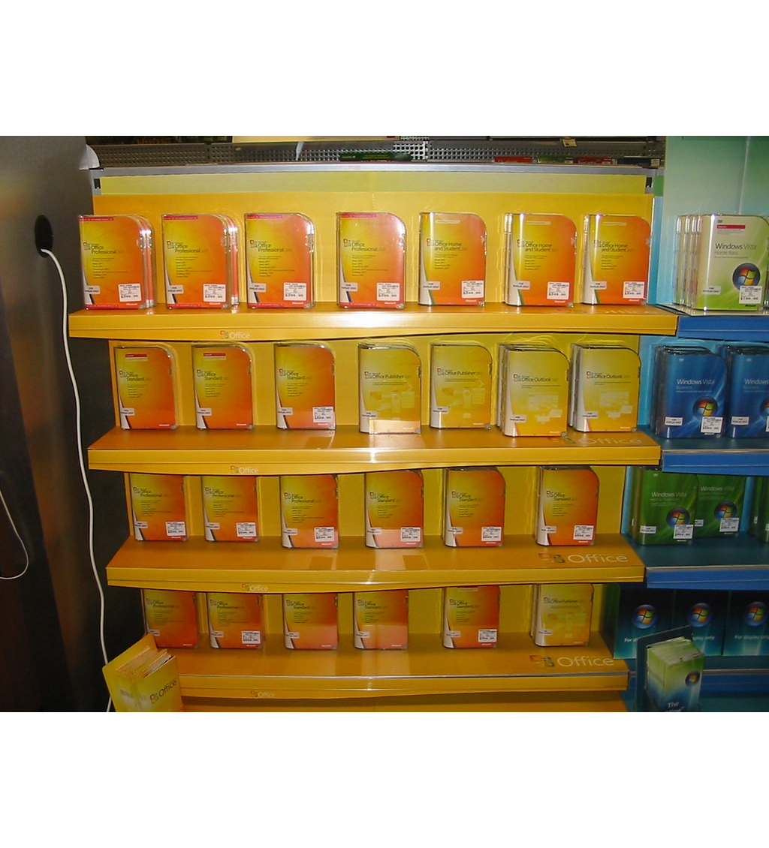
>>>
Story: Word's .docx format became a standard in 2006 and 2008
WHO Microsoft, Ecma International, and the ISO and IEC joint committee JTC 1.
WHAT Office Open XML, the format of .docx files, became the standards ECMA-376 and ISO/IEC 29500.
WHEN ECMA-376 was first released on 7 December 2006; ISO/IEC 29500:2008 was published in November 2008.
WHERE Ecma technical committee TC45, then the fast-track process of ISO and IEC.
WHY A published standard lets programs other than Word, such as python-docx, read and write the files.
HOW Since Office 2007 these formats are Word's default. A first ISO vote failed; an amended version passed in April 2008.
Boxes of Microsoft Office 2007 on a shop shelf. Photo: Stephen Edgar (@netweb), CC BY-SA 2.0, Flickr.
READ Office Open XML (Wikipedia)
39 / 58
Notes:
The format of .docx files is a published standard: Ecma first, ISO in 2008. Office 2007 made it the default. The photograph shows Office 2007 boxes on a shop shelf, not the committees. A standard is why python-docx can write files Word opens.

Slide 40
Part 4: Writing Word documents
Paragraphs, runs, headings, breaks and pictures
add_paragraph
Adds a card and returns it to you.
Slide | In this part
41 | Everyday pictures: writing a Word file
42 | Writing a Word file: add_paragraph and ad...
43 | Adding headings: levels 0 to 9
44 | Adding line breaks and page breaks
45 | Everyday pictures: pictures and sizes
46 | Adding pictures: width and height in inch...
47 | Story: pip install docx has not worked si...
add_heading
Adds a title or a heading, level 0 to 9.
Breaks
A line break sits in a run; a page break is a call.
add_picture
Pins a picture; width or height is enough.
40 / 58
Notes:
Part four. Writing a Word file: paragraphs and runs, headings from level 0 to 9, line and page breaks, and pictures sized by width or height.

Slide 41
>>>
Everyday pictures: writing a Word file
ANALOGY Writing a Word file is like filling a new recipe box: add a card, add words to it, then save the box.
Chapter concept | Everyday picture
Writing Word Documents | Filling a new recipe box from the first card to the last.
add_paragraph | Putting a new card into the box.
add_run | Writing a few more words on the same card, with another pen.
Adding Headings | Writing a title across the top of a card.
add_heading | The heading pen: level 0 is the title, levels 1 to 9 are headings.
Adding Line and Page Breaks | Starting a new line, or a new sheet.
add_break | A mark that says: break here.
Page break | The tear line between two sheets.
41 / 58
Notes:
Writing is filling a new box. add_paragraph adds a card, add_run more words on it, add_heading a title. A break is a mark inside a run, a page break is a tear line.

Slide 42
>>>
Writing a Word file: add_paragraph and add_run
>>> import io, docx
>>> doc = docx.Document()
>>> p = doc.add_paragraph('Hello world!')
>>> r = p.add_run(' A second run.')
>>> r.italic = True
>>> print(type(p).__name__, type(r).__name__)
add_paragraph() returns the new Paragraph; add_run() returns the new Run. Keep them to change them.
>>> buf = io.BytesIO()
>>> doc.save(buf)
>>> again = docx.Document(buf)
>>> texts = [r.text for r in again.paragraphs[0].runs]
>>> print(len(again.paragraphs), 'paragraph; runs:', texts)
save() writes the file; opening it again shows one paragraph whose two runs kept their text.
What the run printed (Python 3.13.16)
run 1: 'Hello world!'
italic = None
Document (saved, then opened again)
1 paragraph
add_run(...) kept each run
run 2: ' A second run.'
italic = True
add_paragraph and add_run return what you keep.
42 / 58
Notes:
add_paragraph returns the new Paragraph and add_run the new Run. Save, open again, and the two runs kept their text.

Slide 43
>>>
Adding headings: levels 0 to 9
>>> import docx
>>> doc = docx.Document()
>>> for level in (0, 1, 9):
>>> h = doc.add_heading('Heading %d' % level, level)
>>> print('level', level, '->', h.style.name)
add_heading() takes a level. Level 0 is the Title style; levels 1 to 9 are Heading 1 to Heading 9.
>>> try: doc.add_heading('Too deep', 10)
>>> except ValueError: print('level 10 refused: levels are 0 to 9')
Outside 0 to 9 the call raises a ValueError. The chapter says 0 to 4 in one place and 1 to 9 in another.
What the run printed (Python 3.13.16)
level 0: Title
add_heading(text, level): level 0 is the Title style; 1 to 9 are Heading 1 to Heading 9
level 1: Heading 1
level 9: Heading 9
level 10 refused: ValueError
Levels 0 to 9; the Title is level 0.
43 / 58
Notes:
add_heading takes levels 0 to 9: level 0 is the Title style. Level 10 raises a ValueError. The chapter's text says 0 to 4 in one place and 1 to 9 in another.

Slide 44
>>>
Adding line breaks and page breaks
>>> import docx
>>> from docx.enum.text import WD_BREAK
>>> doc = docx.Document()
>>> p = doc.add_paragraph('First line')
>>> p.add_run().add_break(WD_BREAK.LINE)
>>> p.add_run('second line, same paragraph')
A break is an item inside a run. WD_BREAK.LINE starts a new line without starting a new paragraph.
>>> doc.add_page_break()
>>> doc.add_paragraph('Second page')
>>> xml = doc.element.xml
>>> pages = xml.count('w:type="page"')
>>> print(pages, 'page break;', xml.count('<w:br'), 'breaks in all')
add_page_break() adds a paragraph that holds a page break. Counting tags in the XML shows one page break among two breaks.
What the run printed (Python 3.13.16)
page 1
First line [line break]
second line, same paragraph
[page break]
page 2
Second page
counted in the XML: 1 page break; 2 breaks in all
A line break lives in a run; a page break has its own call.
44 / 58
Notes:
A line break is an item inside a run; a page break is added by add_page_break. Counting tags in the XML shows what was written.

Slide 45
>>>
Everyday pictures: pictures and sizes
ANALOGY A picture in a Word file is like a photo pinned to a card: you choose the width and the height follows.
Chapter concept | Everyday picture
Adding Pictures | Pinning a photograph to a card.
add_picture | The pin itself, and the photo it holds.
Inches | A ruler in inches.
Cm | A ruler in centimetres.
docx.shared | The drawer of rulers and pen sizes that the package shares.
docx.enum.text | The drawer of named choices, such as LINE or PAGE.
45 / 58
Notes:
A picture is pinned to a card. Give a width or a height and the other follows. Inches and Cm are the rulers, and they come from docx.shared.

Slide 46
>>>
Adding pictures: width and height in inches or centimetres
>>> import io, docx
>>> from PIL import Image
>>> from docx.shared import Cm, Inches
>>> png = io.BytesIO()
>>> Image.new('RGB', (60, 80), 'red').save(png, 'PNG')
>>> doc = docx.Document()
Pillow makes a stand-in for zophie.png: 60 by 80 pixels, kept in memory.
>>> sizes = {'as is': {}, '1 inch wide': {'width': Inches(1)},
>>> '2 cm high': {'height': Cm(2)}}
Three ways to place it: as it is, one inch wide, or two centimetres high.
>>> for label, kw in sizes.items():
>>> shape = doc.add_picture(io.BytesIO(png.getvalue()), **kw)
>>> print(label, '->', int(shape.width), 'x', int(shape.height), 'EMU')
Give a width or a height and the other follows. Sizes are stored in EMU: 914400 to the inch.
What the run printed (Python 3.13.16)
call | width (EMU) | height (EMU) | width in inches
as is | 762000 | 1016000 | 0.83
1 inch wide | 914400 | 1219200 | 1.00
2 cm high | 540000 | 720000 | 0.59
Give a width or a height; the other follows.
46 / 58
Notes:
A picture's size is stored in EMU, 914400 to the inch. Give width or height and the other follows from the picture's shape.

Slide 47
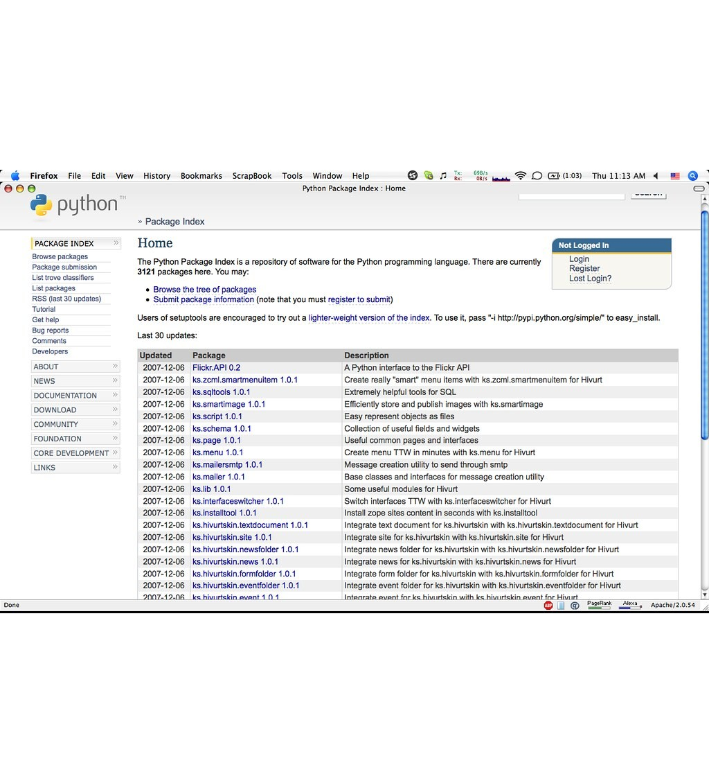
>>>
Story: pip install docx has not worked since 2014
WHO Steve Canny, author of python-docx, and the old package docx.
WHAT The name docx on PyPI is another package: its last release is 0.2.4, not the library of this chapter.
WHEN Release 0.2.4 is dated 6 February 2014; python-docx 1.2.0 came out on 16 June 2025.
WHERE The Python Package Index, PyPI: the projects docx and python-docx.
WHY Both are imported as docx, but only python-docx is maintained. The chapter says: install python-docx.
HOW In the research, importing docx 0.2.4 under Python 3.14.6 failed, because it needs a module of Python 2.
The Python Package Index home page, 6 December 2007 (screenshot). Photo: Vurter, CC BY-SA 2.0, Flickr.
READ docx 0.2.4 (PyPI)
47 / 58
Notes:
Two packages share the import name docx. Only python-docx is maintained. Install python-docx and write import docx. The picture is a screenshot of the Python Package Index home page from December 2007.

Slide 48
Part 5: Practice programs
Three small programs, each on stand-in files
PDF Paranoia
Locks every PDF of a folder tree.
Slide | In this part
49 | Everyday pictures: the practice programs
50 | Practice program 1, part 1: walk a folder...
51 | Practice program 1, part 2: lock a copy, ...
52 | Practice program 2: Custom Invitations
53 | Practice program 3: PDF Password Breaker
Custom Invitations
One styled card per guest, one per page.
Password Breaker
Tries a word list against a locked file.
Brute force
Cost grows with the list; length defeats it.
48 / 58
Notes:
Part five. The practice programs: PDF Paranoia, Custom Invitations and the Password Breaker. Each runs on small stand-in data, and each shows a limit of the method.

Slide 49
>>>
Everyday pictures: the practice programs
ANALOGY A brute-force attack is like trying every key on a ring until one fits.
Chapter concept | Everyday picture
Practice Programs | Small recital pieces after the finger exercises.
PDF Paranoia | Locking every report in a vault, checking that the lock works, then shredding the paper copy.
Custom Invitations | A card printer: one personal card for each guest.
PDF Password Breaker | A locksmith with a list of likely keys, who tries each one in turn.
Brute-force attack | Trying every key on the ring; a long random key makes the ring far too big.
pdfminer.high_level | A second pair of eyes: another library that also reads the text of PDFs.
49 / 58
Notes:
The practice programs. PDF Paranoia is a vault, Custom Invitations a card printer, the Password Breaker a locksmith with a list. Brute force grows with the size of the list.

Slide 50
>>>
Practice program 1, part 1: walk a folder tree for PDFs
>>> import os, tempfile
>>> os.chdir(tempfile.mkdtemp())
>>> os.makedirs('tree/sub')
>>> for path in ('tree/a.pdf', 'tree/sub/B.PDF', 'tree/c.txt'):
>>> open(path, 'w').close()
A folder tree of two PDF names and a text file stands in for the reader's files. One extension is in capitals.
>>> found = []
>>> for folder, dirs, names in os.walk('tree'):
>>> for name in names:
>>> if name.lower().endswith('.pdf'):
>>> found.append(os.path.join(folder, name))
>>> print(sorted(found))
os.walk visits every folder of the tree. Each name ending in .pdf, in any case, becomes a full path.
What the run printed (Python 3.13.16)
tree/a.pdf
os.walk visits every folder;
lower().endswith('.pdf')
2 PDF paths found:
tree/a.pdf, tree/sub/B.PDF
tree/sub/B.PDF
tree/c.txt
green: found; grey: left out (a text file)
os.walk visits every folder; test each extension.
50 / 58
Notes:
PDF Paranoia, part one: os.walk visits every folder of a tree. Each name that ends in .pdf, in any case, becomes a full path. The tree here holds empty files; only the names matter.

Slide 51
>>>
Practice program 1, part 2: lock a copy, check it, remove the original
>>> import os, tempfile, pypdf
>>> os.chdir(tempfile.mkdtemp())
>>> w = pypdf.PdfWriter()
>>> w.add_blank_page(100, 100)
>>> w.write('a.pdf')
One small PDF stands in for a file the program found.
>>> w = pypdf.PdfWriter(clone_from='a.pdf')
>>> w.encrypt('swordfish', algorithm='AES-256')
>>> w.write('a_encrypted.pdf')
>>> r = pypdf.PdfReader('a_encrypted.pdf')
>>> ok = r.is_encrypted and r.decrypt('swordfish').name != 'NOT_DECRYPTED'
>>> if ok: os.remove('a.pdf')
>>> print(ok, os.listdir('.'))
Copy, lock, save under a new name, test the copy with the password, and only then remove the original.
What the run printed (Python 3.13.16)
a.pdf
(the original)
clone, then encrypt
AES-256, save as
a_encrypted.pdf
test the copy:
is_encrypted and
decrypt matched: True
original removed
folder now: ['a_encrypted.pdf']
the original is removed only after the copy passed the test
Lock a copy, test it, then remove the original.
51 / 58
Notes:
PDF Paranoia, part two: copy the PDF, lock the copy with AES-256, test it with the password, and only then remove the original. Real use never passes the password on the command line.

Slide 52
>>>
Practice program 2: Custom Invitations
>>> import docx
>>> doc = docx.Document()
>>> guests = ['Prof. Plum', 'Miss Scarlet', 'Col. Mustard']
Three guests. The book's invitations use styles from a template file; the built-in Title style stands in for them.
>>> for i, guest in enumerate(guests):
>>> doc.add_paragraph('You are invited,')
>>> doc.add_paragraph(guest, 'Title')
>>> if i < len(guests) - 1:
>>> doc.add_page_break()
One card per guest: a line, then the name in the big style. A page break follows every card but the last.
>>> names = [p.text for p in doc.paragraphs if p.style.name == 'Title']
>>> xml = doc.element.xml
>>> print(len(names), 'guests;', xml.count('w:type="page"'), 'page breaks')
>>> print(names)
Three cards need two page breaks. Filtering by style name finds the names again.
What the run printed (Python 3.13.16)
page 1
You are invited,
Prof. Plum
page 2
You are invited,
Miss Scarlet
page 3
You are invited,
Col. Mustard
red arrow: a page break
3 guests; 2 page breaks
One card per guest; no break after the last.
52 / 58
Notes:
Custom Invitations: one card per guest, the name in a big built-in style, a page break after every card but the last. Three guests need two page breaks.

Slide 53
>>>
Practice program 3: PDF Password Breaker
>>> import io, pypdf
>>> words = ['apple', 'banana', 'cherry', 'dragonfruit']
>>> w = pypdf.PdfWriter()
>>> w.add_blank_page(100, 100)
>>> w.encrypt('CHERRY', algorithm='AES-256')
>>> buf = io.BytesIO()
>>> w.write(buf)
A locked file whose password is a dictionary word in capitals. Four words stand in for the book's dictionary.txt.
>>> reader = pypdf.PdfReader(buf)
>>> tries = [g for x in words for g in (x, x.upper())]
>>> for attempts, guess in enumerate(tries, 1):
>>> if reader.decrypt(guess).name != 'NOT_DECRYPTED': break
Try every word in lower case, then in capitals, until decrypt() stops answering NOT_DECRYPTED.
>>> print('found', guess, 'after', attempts, 'of at most', len(tries))
Attempts grow with the dictionary and the cases tried. A long random password is in no dictionary.
What the run printed (Python 3.13.16)
1
apple
2
APPLE
3
banana
4
BANANA
5
cherry
6
CHERRY
7
dragonfruit
8
DRAGONFRUIT
red: tried, no match; green: decrypt() matched; grey: never tried because the search stopped
found CHERRY after 6 of at most 8
Attempts grow with the list; length defeats the list.
53 / 58
Notes:
The Password Breaker tries every word in two cases until decrypt stops answering NOT_DECRYPTED. Four words give at most eight attempts; a long random password is in no dictionary.

Slide 54
>>>
Which call does what, and what it needs
From the chapter research; each call has its code slide
Call | What it does | What to know | See slide
PdfReader(file) | opens a PDF to read | pages, is_encrypted; changes nothing | 8
page.extract_text() | returns the text of a page | drawing order; empty for a scan | 9
page.images | lists the pictures of a page | needs the Pillow package | 12
writer.append(file, pages) | copies pages to the end | a tuple is a range, a list is exact | 16
writer.merge(i, file, pages=) | copies pages inside | name pages=; a tuple is a title | 17
page.rotate(angle) | turns a page | multiples of 90; angles add up | 18
page.merge_page(other) | stamps one page on another | the later page lies on top | 20
writer.encrypt / reader.decrypt | locks and unlocks a file | AES needs the cryptography package | 21
docx.Document(file) | opens or starts a Word file | paragraphs, runs, tables are apart | 32
A read changes nothing; a write makes a new file; a lock needs the right package.
54 / 58
Notes:
The calls of the chapter in one table, each with its code slide. Reads change nothing; writes make a new file; locks need the cryptography package.

Slide 55
>>>
What differs from the book today
Research of 12 October 2026: Python 3.14.6, pypdf 6.20.1, python-docx 1.2.0
What the book says | Today | See slide
merge(2, 'Recursion_Chapter1.pdf', (0, 5)) inserts five pages | The tuple becomes a bookmark title and all 18 pages go in; write pages=(0, 5) | 17
Project 12 loop appends to pdf_files | NameError: the list is pdf_filenames; a second run also reads combined.pdf | 27
Table 17-1: strike, all_caps and more are run attributes | Only bold, italic, underline are; run.strike = True silently does nothing | 38
Heading levels 0 to 4, and 1 to 9 | add_heading accepts 0 to 9; anything else raises ValueError | 43
The style 'List Number ' with a trailing space; 34 style names | KeyError: names match exactly; a new document holds 164 styles | 36
encrypt() shown with AES-256 only | The default is RC4 (V 2, R 3); AES needs the cryptography package | 24
page.images used without a note | It needs Pillow; ImportError without it | 12
PdfFileReader and PdfMerger of older tutorials | Removed: pypdf 6.20.1 has PdfReader and PdfWriter only | 8
The password breaker needs about 88,000 attempts | The shipped dictionary gives 699,800; AES-256 took 1467.5 s, RC4 241.7 s | 53
Run what the book printed; then check what changed.
55 / 58
Notes:
What differs from the book today, from the chapter research. Run the book's lines first; then compare with these rows. Each row names the slide that shows it.

Slide 56
>>>
Summary
ANALOGY A summary is a packing list: only what you really need goes into the bag.
A PDF is a page description: drawing commands, objects and a table.
code examples in each part of this deck
1
2
pypdf copies, turns, stamps and locks pages; it cannot recover lost structure.
3
A .docx file is a ZIP of XML: documents hold paragraphs, paragraphs hold runs.
4
A style must fit its object and match by exact name.
5
A password is only as strong as it is long and random.
A document is a file with a structure; know what that structure keeps.
56 / 58
Notes:
Five sentences. A PDF is a page description. pypdf copies, turns, stamps and locks pages. A .docx file is ZIP and XML. Styles fit the object. Passwords are only as strong as their length.

Slide 57
>>>
Practice Questions
Predict first, then run what you can on the chapter page
ANALOGY Practice questions are finger scales for a pianist; the practice programs are the small recital pieces.
1
A page draws the word world before Hello. What does extract_text() return, and what does layout mode return? Use the extraction slide.
2
Which call keeps pages 1 and 6 of a six-page file: a tuple (0, 5) or a list [0, 5]? Say why. Use the page-copy slide.
3
A paragraph has three runs. How do you find out whether the middle one is bold, and what does None mean?
4
Why is a black rectangle drawn over text not a safe way to hide the text in a PDF?
5
A dictionary holds 50,000 words and the program tries each in two cases. How many attempts are needed at most?
Each answer fits in a few lines you can run.
57 / 58
Notes:
Predict first, then run what you can on the chapter page. Each question points to a slide.

Slide 58
>>>
Resources: where to go next
Reading and watching, chosen for this chapter; every link is live
Book: Automate the Boring Stuff, 3rd edition, chapter 17
https://automatetheboringstuff.com/3e/chapter17.html
python-docx documentation
https://python-docx.readthedocs.io/en/latest/
pypdf documentation
https://pypdf.readthedocs.io/en/stable/
python-docx: working with styles
python-docx.readthedocs.io
pypdf: extract text
pypdf.readthedocs.io
python-docx: quickstart
python-docx.readthedocs.io
pypdf: merging PDF files
pypdf.readthedocs.io
PDF 1.7, ISO 32000-1 (Library of Congress)
loc.gov
pypdf: encryption and decryption
pypdf.readthedocs.io
Office Open XML (Library of Congress)
loc.gov
pypdf: adding a watermark
pypdf.readthedocs.io
Python documentation: zipfile
https://docs.python.org/3/library/zipfile.html
pypdf: history of the library
https://pypdf.readthedocs.io/en/stable/meta/history.html
Wikipedia: John Warnock
https://en.wikipedia.org/wiki/John_Warnock
Pick one link and read it before the next class.
58 / 58
Notes:
Links to read and watch next: the chapter, the two packages' documentation, the PDF and Office standards, and the pages behind the stories.

