Slide 1
>>>
Command Line Programs
Chapter 12 of Automate the Boring Stuff with Python, 3rd edition, for an advanced course
23
4
23
code examples that run on the chapter page
true stories with who, what, when, where, why and how
distinct chapter concepts, each with an everyday picture
SEN0414 Advanced Programming, Fall 2026. Yusuf Altunel, İstanbul Kültür Üniversitesi
1 / 48
Notes:
Welcome. This chapter follows a typed command to a running program: the terminal, PATH, a virtual environment, the arguments, the look of the output, and the launcher. Every code slide shows the code, a plain explanation and the result drawn as a table, chart or diagram.

Slide 2
>>>
Today's route
Five parts; every range is a run of slides you can jump to
Part | Slides | Code examples | You will run
Starting a program | 4 - 10 | 4 | cd, pwd, ls as os calls; PATH and which
Isolating a program | 11 - 16 | 3 | pyvenv.cfg, activate, pip pins
Programs that look around | 17 - 23 | 5 | os.name, version, sys.argv, argparse
Designing the terminal output | 24 - 32 | 4 | quiet mode, chr, escape codes, snowstorm
Deploying a program | 33 - 44 | 7 | launcher, ccwd, recorder, PyInstaller
Changes, summary, practice, resources | 45 - 48 | - | what current Python adds
Open the chapter-code tab of the page: the same 23 examples, in this order.
2 / 48
Notes:
Five parts: starting a program, isolating it, letting it read its surroundings, designing its text output, and deploying it. Each code slide has its place in the chapter-code tab of the page, in this same order.

Slide 3
>>>
Two questions this chapter answers
Carry them through every part; the answers come back at the end
1
How does a typed command become a running program, and how does the program learn what it was given?
Answer on slides 9 to 23: PATH, the launcher, sys.argv and argparse.
2
Which printed outputs and launchers of the book differ in current Python or on a current system?
Answer on slide 45: the changes, from the chapter research.
The terminal searches PATH; the program reads its arguments.
3 / 48
Notes:
Two questions to carry through the chapter. How does a typed command become a running program, and how does the program learn what it was given? And which outputs and launchers of the book differ in current Python?

Slide 4
Part 1: Starting a program
From a typed word to a running program: names, the terminal and PATH
Program names
Script, command and app name nearly the same thing.
Slide | In this part
5 | Everyday pictures: starting a program
6 | A program by any other name
7 | The terminal: cd and pwd as Python calls
8 | The terminal: ls and dir *.exe as Pyth...
9 | PATH: a text of folders, searched in o...
10 | which: the first folder that holds the...
Terminal
A text window where you type short commands.
cd, pwd, ls
Move, show the place, and list what is there.
PATH
The list of folders searched, in order, for a program.
4 / 48
Notes:
Part one. Programs have many names. The terminal finds a program by searching the folders of PATH, from left to right. Predict which folder wins before you read the result.

Slide 5
>>>
Everyday pictures: starting a program
ANALOGY The terminal is a drive-through window: you say a short order and the kitchen answers in text.
Chapter concept | Everyday picture
A Program by Any Other Name | One dish on many menus: dish, plate, course. Program, script and app name nearly the same thing.
Using the Terminal | Speaking into the drive-through speaker: short orders, and the answer comes back as text.
Command line program | A vending-machine button: you name the item and its options, and it does one job.
5 / 48
Notes:
A drive-through is a good picture for the terminal: short orders, text answers. A command line program is a button on a vending machine. Ask students to add one more everyday picture of their own.

Slide 6
>>>
A Program by Any Other Name
Seven words for nearly the same thing
ANALOGY One dish on many menus: dish, plate, course. The words differ by how the program is started.
Word | What it means | Starts how
program | Instructions a computer runs | any of the ways below
script | A program an interpreter runs from its source | python yourScript.py
command | A program started from a terminal, set by arguments | ls, dir, cd, cp
shell script | A text file of terminal commands | a launcher file
application | A program with a window of its own | a double click
app | An application on a phone or tablet | a tap
web app | A program that runs on a server, used in a browser | an address
A script is run from source; a command is started from a terminal.
6 / 48
Notes:
Seven words for nearly the same thing. A script is run from source by an interpreter. A command is a program you start from a terminal. Ask students which word fits their last project.

Slide 7
>>>
The terminal: cd and pwd as Python calls
>>> import os, tempfile
>>> start = os.getcwd()
>>> with tempfile.TemporaryDirectory() as lab:
>>> os.chdir(lab)
>>> os.mkdir('Desktop')
Work in a throw-away folder, so nothing stays behind. os.mkdir makes a folder called Desktop.
>>> os.chdir('Desktop') # cd Desktop
>>> where = os.path.basename(os.getcwd()) # pwd
>>> os.chdir('..') # cd ..
os.chdir is the cd command and os.getcwd is pwd. The program goes down into Desktop and back up.
>>> os.chdir(start)
>>> print('pwd ->', where)
Go back to the starting folder, then print what pwd showed inside Desktop.
What the run printed (Python 3.13.16)
Terminal | Python call | What it gave
cd Desktop | os.chdir('Desktop') | moved down into the new folder
pwd | os.getcwd() | 'Desktop'
cd .. | os.chdir('..') | moved back up one folder
the walk, folder by folder
start
lab
Desktop
pwd printed 'Desktop'; the cleanup removed the lab.
cd and pwd have twins in os.
7 / 48
Notes:
The terminal commands cd and pwd have Python twins: os.chdir and os.getcwd. We run them in a throw-away folder. Predict what pwd prints inside Desktop.

Slide 8
>>>
The terminal: ls and dir *.exe as Python calls
>>> import os, tempfile
>>> with tempfile.TemporaryDirectory() as lab:
>>> for name in ('spam.exe', 'eggs.exe', 'notes.txt'):
>>> open(os.path.join(lab, name), 'w').close()
Make three empty files in a throw-away folder: two programs and a note.
>>> listing = sorted(os.listdir(lab)) # ls
>>> programs = [n for n in listing if n.endswith('.exe')] # dir *.exe
>>> print('ls ->', listing)
>>> print('dir *.exe ->', programs)
os.listdir lists the names like ls. The filter keeps only the names ending in .exe, like dir *.exe.
What the run printed (Python 3.13.16)
Terminal | Python | Names it showed
ls | os.listdir(lab) | eggs.exe, notes.txt, spam.exe
dir *.exe | names ending in .exe | eggs.exe, spam.exe
names each command shows
ls and dir have one twin: os.listdir.
8 / 48
Notes:
Ls and dir have one twin: os.listdir. The filter keeps names that end in dot exe, like dir star dot exe. Predict how many names each command shows.

Slide 9
>>>
PATH: a text of folders, searched in order
>>> PATH = '/home/al/bin:/usr/local/bin:/usr/bin:/bin'
>>> folders = PATH.split(':')
PATH is one text of folders, separated by colons. split turns it into a list in search order.
>>> print(len(folders), 'folders')
>>> print('/usr/bin is number', folders.index('/usr/bin') + 1)
>>> print(':'.join(['/home/al/Scripts'] + folders[:2]))
The terminal tries the folders from left to right. A folder put first, like /home/al/Scripts, wins.
What the run printed (Python 3.13.16)
PATH as it is (searched from the left)
1 /home/al/bin
2 /usr/local/bin
3 /usr/bin
4 /bin
with /home/al/Scripts put first (searched from the left)
1 /home/al/Scripts
2 /home/al/bin
3 /usr/local/bin
PATH is text; the first folder with the name wins.
9 / 48
Notes:
PATH is just text. The terminal splits it at the colons and tries the folders in order. A folder put first wins. Predict the number of folders before you run it.

Slide 10
>>>
which: the first folder that holds the program
>>> import os, shutil, tempfile
>>> with tempfile.TemporaryDirectory() as lab:
>>> for d in ('a', 'b'):
>>> os.mkdir(lab + '/' + d)
Make two folders, a and b, inside a throw-away folder.
>>> prog = lab + '/' + d + '/spam'
>>> open(prog, 'w').close()
>>> os.chmod(prog, 0o744)
Each folder gets a program called spam. chmod gives the owner the right to run it.
>>> path = lab + '/a:' + lab + '/b'
>>> where = os.path.relpath(shutil.which('spam', path=path), lab)
>>> print('first spam is in', where)
>>> print('eggs found:', shutil.which('eggs', path=path))
shutil.which does what the which command does: it walks the folders in order and returns the first match, or None.
What the run printed (Python 3.13.16)
shutil.which('spam', path='a:b') over the two lab folders
a holds spam (first)
found: a/spam
which('eggs') -> None
b holds spam (never reached)
None means: no folder of the path holds it
shutil.which walks PATH like the terminal.
10 / 48
Notes:
Shutil.which does the same walk the terminal does and returns the first hit. Who wins when two folders hold spam? And what does it return when nothing matches?

Slide 11
Part 2: Isolating a program
A virtual environment keeps one project's packages apart; pip fills it
Virtual environment
A folder that keeps one project's packages apart.
Slide | In this part
12 | Everyday pictures: environments and pa...
13 | Virtual environments: a folder and a s...
14 | activate puts the environment first on...
15 | pip: pin a version, find a module
16 | Story: pip began as pyinstall, Septemb...
activate
Puts the environment's folder first on PATH.
pip
Installs packages into exactly the Python you name.
Version pin
Two equals signs fix the version that is installed.
11 / 48
Notes:
Part two. A virtual environment keeps one project's packages apart from the rest. pip installs into exactly the Python you name. Notice how little a venv really is: a folder and a file.

Slide 12
>>>
Everyday pictures: environments and packages
ANALOGY A virtual environment is a lunch box with its own compartments: what you pack stays apart from the shared kitchen.
Chapter concept | Everyday picture
Virtual Environments | A lunch box: your own compartments, so the shared kitchen stays untouched.
Installing Python Packages with pip | An order form at the library: name the book and its edition, and it arrives on your shelf.
12 / 48
Notes:
A lunch box keeps your food apart from the shared kitchen, just as a virtual environment keeps your packages apart. Pip is the order form for new packages.

Slide 13
>>>
Virtual environments: a folder and a settings file
>>> cfg = 'home = /usr/bin\ninclude-system-site-packages = false'
>>> settings = dict(line.split(' = ') for line in cfg.splitlines())
>>> print(settings)
A virtual environment is a folder with a small pyvenv.cfg file. Every line is one setting, so a dictionary can hold it.
What the run printed (Python 3.13.16)
pyvenv.cfg setting | value
home | /usr/bin
include-system-site-packages | false
.venv (a folder)
bin/ (activate, python, pip)
pyvenv.cfg (the settings)
lib/ (the packages)
A venv is a folder and a settings file.
13 / 48
Notes:
A virtual environment is a folder with a small settings file and three parts: bin, lib and pyvenv.cfg. Each line of the file is one setting, so a dictionary can read it.

Slide 14
>>>
activate puts the environment first on PATH
>>> import sys
>>> bin_dir = '/home/al/Scripts/.venv/bin'
>>> PATH = '/usr/local/bin:/usr/bin:/bin'
>>> print('after activate:', bin_dir + ':' + PATH)
activate puts the environment's bin folder first on PATH. Its python and pip are now found before the system ones.
>>> print('inside a virtual environment:', sys.prefix != sys.base_prefix)
Outside an environment prefix and base_prefix are equal, so this test prints False. Inside one it prints True.
What the run printed (Python 3.13.16)
PATH before activate
/usr/local/bin
/usr/bin
/bin
inside a venv: False
PATH after activate
.venv/bin
/usr/local/bin
/usr/bin
/bin
activate edits PATH for one terminal.
14 / 48
Notes:
Activate only changes PATH, for one terminal window. The test sys.prefix not equal to sys.base_prefix tells a program whether it runs inside an environment.

Slide 15
>>>
pip: pin a version, find a module
>>> requirement = 'package_name==1.17.4'
>>> name, sep, version = requirement.partition('==')
>>> print(name, sep, version)
pip pins a version with two equals signs. partition cuts the text into name, separator and version.
>>> import importlib.util, json
>>> print(type(json).__name__)
>>> print('pyperclip missing:', importlib.util.find_spec('pyperclip') is None)
A package is a module you import. find_spec asks whether Python can find one before the import fails.
What the run printed (Python 3.13.16)
requirement.partition('==')
Command in the terminal | Does
python -m pip install package_name | newest
python -m pip install package_name==1.17.4 | this version
python -m pip list | lists all
python -m pip uninstall package_name | removes
'package_name'
'=='
'1.17.4'
package name
separator
version
Pin with ==; ask find_spec before you import.
15 / 48
Notes:
Pip pins a version with two equals signs. Run pip as python dash m pip, so it installs into the Python you mean. Find_spec asks whether a module can be imported before you try.

Slide 16
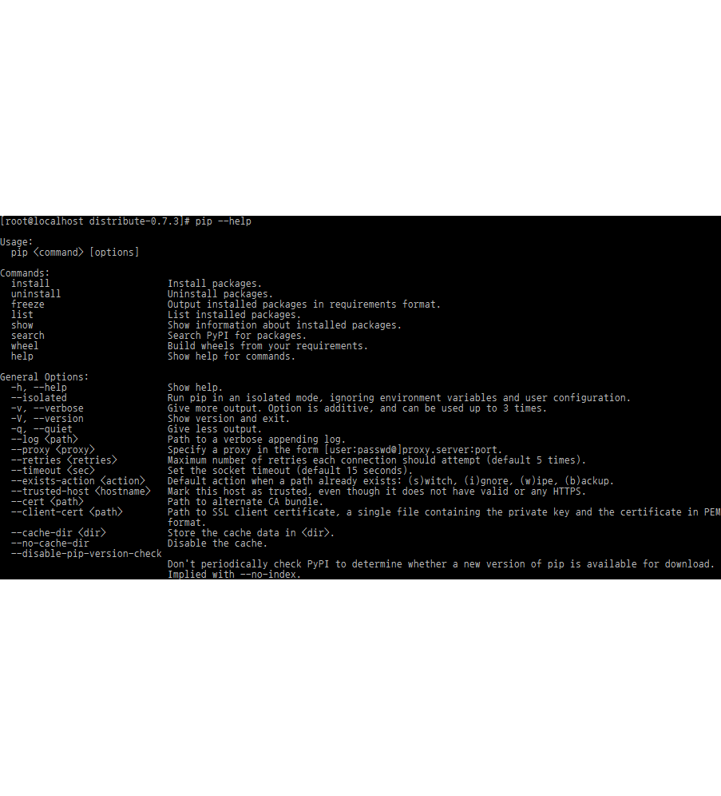
>>>
Story: pip began as pyinstall, September 2008
WHO Ian Bicking, the author of virtualenv; later Carl Meyer wrote PEP 405.
WHAT An installer called pyinstall, renamed pip, and then venv in the standard library.
WHEN Announced 24 September 2008, renamed pip on 28 October 2008; PEP 405 created 13 June 2011.
WHERE Ian Bicking's blog, then the Python Enhancement Proposals on python.org.
WHY He wanted a better installer than easy_install, and isolated environments for every project.
pip in a terminal, screenshot. Image: Cedar101, CC BY-SA 3.0, Wikimedia Commons.
HOW PEP 405 credits virtualenv and put isolated environments into Python 3.3 as the venv module.
READ pip (package manager) (Wikipedia)
16 / 48
Notes:
Ian Bicking announced pyinstall on 24 September 2008 and renamed it pip a month later. PEP 405 then made virtual environments part of Python 3.3. The two commands of this part are his two ideas side by side.

Slide 17
Part 3: Programs that look around
A program asks about its system and reads the words it was given
os.name
Tells which family of operating system runs the program.
Slide | In this part
18 | Everyday pictures: programs that know ...
19 | Self-aware programs: system, version, ...
20 | Missing modules and sys.exit with a me...
21 | Command line arguments: sys.argv
22 | argparse: declare the arguments once
23 | argparse: a wrong word is refused
sys.version_info
Lets the program refuse a Python that is too old.
sys.argv
The words typed after the name of the program.
argparse
Declares the arguments once and checks them.
17 / 48
Notes:
Part three. A program can ask about its system, its version and its file, and it can read the words after its name. argparse does that reading for you and refuses wrong input.

Slide 18
>>>
Everyday pictures: programs that know themselves
ANALOGY A self-aware program is a traveller who checks the weather and the passport before acting.
Chapter concept | Everyday picture
Self-Aware Python Programs | A traveller who reads the weather, the language and the passport before packing.
sys.argv | The order slip: the words you wrote on it, in the order you wrote them.
argparse | A form with labelled boxes: it fills in the blanks and refuses a wrong entry politely.
sys.exit | A note on the door that says why the shop is closed, instead of a locked door and silence.
18 / 48
Notes:
Four small ideas. The program checks its surroundings, reads the words it was given, lets argparse fill the form, and leaves a clear note when it must stop.

Slide 19
>>>
Self-aware programs: system, version, file
>>> import os, sys
>>> KINDS = {'nt': 'Windows', 'posix': 'macOS or Linux'}
>>> print('os.name is', os.name, '->', KINDS[os.name])
os.name tells the family of the operating system. sys.platform is finer: win32, darwin or linux.
>>> print('Python 3.9 or newer:', sys.version_info >= (3, 9))
>>> print('version fields:', len(sys.version_info))
>>> print('started from a file:', '__file__' in globals())
sys.version_info compares like a tuple. A script started from a file has __file__; this listing has none, so it prints False.
What the run printed (Python 3.13.16)
The program asks | Python expression | Answer | It can then
Which kind of system? | os.name | 'posix' | run macOS or Linux code
A new enough Python? | sys.version_info >= (3, 9) | True | refuse an old Python
How detailed is the version? | len(sys.version_info) | 5 | compare it like a tuple
Started from a file? | '__file__' in globals() | False | find files beside itself
A program can ask where and on what it runs.
19 / 48
Notes:
A program can ask which family of system, which Python version and whether it came from a file. Dunder file is an absolute path since Python 3.9. Predict each answer.

Slide 20
>>>
Missing modules and sys.exit with a message
>>> import sys
>>> try:
>>> import nonexistentModule
>>> except ModuleNotFoundError as err:
>>> print('Result: no module called', err.name)
Catch ModuleNotFoundError to say in your own words what is missing, instead of showing a traceback.
>>> try:
>>> sys.exit('This program needs nonexistentModule.')
>>> except SystemExit as stop:
>>> print('exit message:', stop.code)
sys.exit with a text raises SystemExit. In a real run Python prints the text to standard error and ends with exit code 1.
What the run printed (Python 3.13.16)
import nonexistentModule
ModuleNotFoundError
name = 'nonexistentModule'
sys.exit(message)
SystemExit
code = 'This program needs no...'
A real run prints the message to standard error and ends the program with exit code 1.
Say what is missing; leave with a message.
20 / 48
Notes:
Catch ModuleNotFoundError and explain in your own words. Sys.exit with a text ends the program, prints the text to standard error and gives exit code 1. Here we catch it to show the value.

Slide 21
>>>
Command line arguments: sys.argv
>>> import shlex
>>> typed = ['python3 yourScript.py hello world',
>>> 'python3 yourScript.py "hello world"',
>>> 'python3 yourScript.py']
Three ways to start the same script. The shell cuts each typed line into words before Python sees it.
>>> for line in typed:
>>> argv = shlex.split(line)[1:]
>>> print(len(argv), argv)
shlex.split cuts a line the way a Unix shell does. Quotation marks keep two words together as one argument.
What the run printed (Python 3.13.16)
Typed in the terminal | sys.argv inside the script | Items
python3 yourScript.py hello world | ['yourScript.py', 'hello', 'world'] | 3
python3 yourScript.py "hello world" | ['yourScript.py', 'hello world'] | 2
python3 yourScript.py | ['yourScript.py'] | 1
The shell cuts the words; argv keeps them.
21 / 48
Notes:
The shell splits the line into words, and quotation marks keep two words together. Sys.argv holds the words, with the script name first. Predict the length of each list.

Slide 22
>>>
argparse: declare the arguments once
>>> import argparse
>>> p = argparse.ArgumentParser(prog='snowstorm', exit_on_error=False)
>>> p.add_argument('density', type=int, nargs='?', default=4)
>>> p.add_argument('-v', '--verbose', action='store_true')
Declare each argument once: an optional number that defaults to 4, and a -v switch. argparse does the parsing.
>>> for argv in ([], ['20', '-v']):
>>> print(argv, '->', vars(p.parse_args(argv)))
parse_args turns the list of words into named values and fills in the defaults.
What the run printed (Python 3.13.16)
Words typed after snowstorm | density | verbose
(nothing) | 4 | False
20 -v | 20 | True
density the program receives
Declare once; argparse parses and fills defaults.
22 / 48
Notes:
Once arguments multiply, declare them once with argparse. It converts types and fills in defaults. Predict the density for the second run.

Slide 23
>>>
argparse: a wrong word is refused
>>> import argparse
>>> p = argparse.ArgumentParser(prog='snowstorm', exit_on_error=False)
>>> p.add_argument('density', type=int)
The same parser, now with a required number. The declaration says the density must be an int.
>>> try:
>>> p.parse_args(['lots'])
>>> except argparse.ArgumentError as err:
>>> print('Result: refused,', err)
A word that is not a number is refused with a clear message. In a terminal the program would also stop with exit code 2.
What the run printed (Python 3.13.16)
snowstorm lots
type=int:
int('lots') fails
ArgumentError
argument density: invalid int value: 'l...
argparse writes the usage message and, in a terminal, the program stops with exit code 2.
A wrong word is refused with a clear message.
23 / 48
Notes:
A word that is not a number is refused by the int conversion. Argparse turns that into one clear message. In a terminal the exit code would be 2.

Slide 24
Part 4: Designing the terminal output
Quiet by default, characters for pictures, escape codes for colour
Quiet default
Print little, so that another program can read it.
Slide | In this part
25 | Everyday pictures: how a program looks...
26 | Text-based design: quiet by default
27 | Story: the pipe and the quiet command,...
28 | Story: a text screen that felt like a ...
29 | Terminal presentation: chr and os.system
30 | Colour in the terminal: what bext.fg a...
31 | Pop-ups, sound and colour: helpers
32 | Snowstorm: one frame of the animation
chr and ord
Convert between numbers and characters.
Escape codes
Numbered signals that colour the text.
Snowstorm
A flip-book animation drawn with block characters.
24 / 48
Notes:
Part four. A text program is designed for being typed and read. Quiet by default, colour by escape code, block characters for pictures. The snowstorm puts them together.

Slide 25
>>>
Everyday pictures: how a program looks and sounds
ANALOGY A text program is a shop window drawn in chalk: only characters, arranged to attract.
Chapter concept | Everyday picture
Text-Based Program Design | A road sign: short, readable at a glance, silent unless it matters.
Terminal presentation | A chalk drawing on a pavement: only strokes, but colour and layout carry the message.
A Short Program: Snowstorm | A flip book: clear the page, draw one frame, flip, and repeat.
os.system | Passing a note through the kitchen hatch: Python writes the order, the shell cooks it.
chr | A typewriter key: a number goes in, a character comes out.
bext.fg | A coloured pen for the letters.
bext.bg | A coloured sheet of paper behind the letters.
Pop-up Message Boxes with PyMsgBox | A doorbell: it interrupts the person, so ring it only for what needs an answer.
playsound | A kitchen timer: it announces the end with a sound instead of words.
25 / 48
Notes:
Text design in nine pictures. Notice that the pop-up and the sound are the two ways to interrupt a person. Use them only when you must.

Slide 26
>>>
Text-based design: quiet by default
>>> import argparse
>>> p = argparse.ArgumentParser(prog='backup', exit_on_error=False)
>>> p.add_argument('-v', '--verbose', action='store_true')
>>> p.add_argument('-q', '--quiet', action='store_true')
Two switches: -v asks for more output and -q for none. Without either, the command stays short.
>>> steps = ['reading 3 files', 'zipping', 'saved backup.zip']
>>> report = lambda a: [] if a.quiet else steps if a.verbose else steps[-1:]
Quiet prints nothing, verbose every step, and the default only the last line, the result.
>>> for argv in ([], ['-v'], ['-q']):
>>> print(argv, '->', report(p.parse_args(argv)))
Run it three ways. Short default output is easy for another program to read.
What the run printed (Python 3.13.16)
Switch | Lines | What the user sees
default | 1 | saved backup.zip
-v | 3 | reading 3 files / zipping / saved backup.zip
-q | 0 | nothing
lines printed per switch
Quiet by default; -v for more, -q for none.
26 / 48
Notes:
Quiet by default is the Unix habit. The minus v switch asks for more and minus q for none. The bars show how many lines each mode prints.

Slide 27
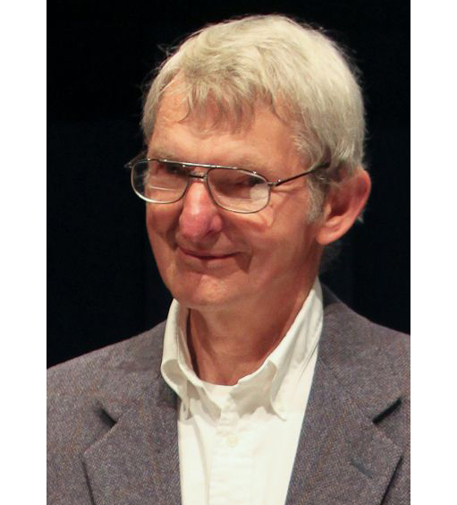
>>>
Story: the pipe and the quiet command, 1973
WHO Doug McIlroy, head of the Computing Techniques Research Department at Bell Labs, and Ken Thompson.
WHAT The pipe: the output of one program becomes the input of the next.
WHEN McIlroy proposed it in a 1964 memo; Thompson added pipes to Version 3 Unix in 1973.
WHERE Bell Labs, the birthplace of Unix.
WHY Each program should do one thing well and feed another, as yet unknown, program.
Douglas McIlroy. Image: Denise Panyik-Dale, CC BY 2.0, Wikimedia Commons.
HOW The 1978 maxims add: do not clutter output. So a command stays quiet unless --verbose asks.
READ Pipeline (Unix) (Wikipedia)
27 / 48
Notes:
Doug McIlroy proposed the pipe in 1964 and Ken Thompson built it in one night in 1973. The 1978 maxims say: do not clutter output. That is why a command is quiet by default. Ask: who reads your program's output?

Slide 28
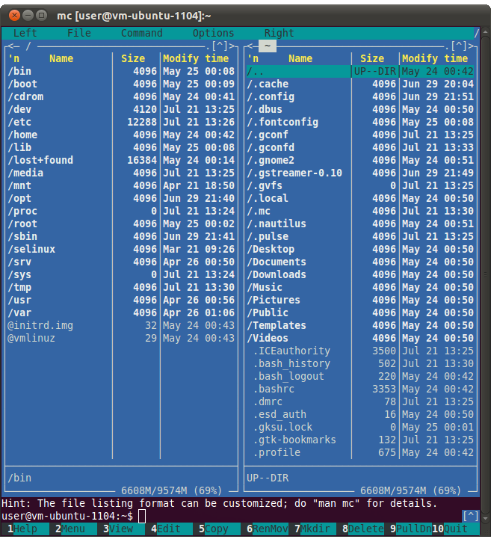
>>>
Story: a text screen that felt like a desktop, 1986
WHO John Socha wrote it; Peter Norton Computing released it.
WHAT Norton Commander, a file manager with two panels drawn with text characters.
WHEN Begun in 1984 as Visual DOS; released in 1986; last MS-DOS version 5.51 on 1 July 1998.
WHERE On MS-DOS, a plain text screen. The chapter shows it as Figure 12-1.
WHY A text interface can offer panels, menus, a viewer and an editor, and is simpler to program than a graphical one.
Midnight Commander, screenshot. Image: Creator: Miguel de Icaza
Uploader: Rprpr, GPL, Wikimedia Commons.
HOW Two file lists side by side, a command bar below, a viewer on F3 and an editor on F4.
READ Norton Commander (Wikipedia)
28 / 48
Notes:
Norton Commander shipped in 1986 with two panels drawn only with characters. The chapter's Figure 12-1 shows it. Our snowstorm is the same idea with block characters. Ask students what else a text screen could show.

Slide 29
>>>
Terminal presentation: chr and os.system
>>> import os
>>> clear_command = 'cls' if os.name == 'nt' else 'clear'
>>> print('os.system would run:', clear_command)
os.system hands a text to the shell. Programs use it to clear the screen: cls on Windows, clear elsewhere. Here only the text is built.
>>> TOP, BOTTOM, FULL = chr(9600), chr(9604), chr(9608)
>>> print([ord(c) for c in (TOP, BOTTOM, FULL)])
>>> print(TOP * 10 + BOTTOM * 10 + FULL * 10)
chr turns a number into a character and ord turns it back. Three block characters draw the snow and the ground.
What the run printed (Python 3.13.16)
Constant | chr(...) | Character | ord(...) | Unicode name
TOP | chr(9600) | ▀▀▀ | 9600 | upper half block
BOTTOM | chr(9604) | ▄▄▄ | 9604 | lower half block
FULL | chr(9608) | ███ | 9608 | full block
os.system('clear')
the text handed to the shell on this system
chr: number to character; os.system: text to the shell.
29 / 48
Notes:
Os.system hands a text to the shell. Cls on Windows, clear elsewhere. Chr turns a number into a character. The three block characters are the snow and the ground.

Slide 30
>>>
Colour in the terminal: what bext.fg and bext.bg send
>>> COLORS = ['black', 'red', 'green', 'yellow',
>>> 'blue', 'purple', 'cyan', 'white']
The eight colour names of Bext, in the order of the numbers 0 to 7.
>>> fg = lambda name: '\x1b[%dm' % (30 + COLORS.index(name))
>>> bg = lambda name: '\x1b[%dm' % (40 + COLORS.index(name))
bext.fg and bext.bg pick a colour by name. Underneath, the terminal receives numbered escape codes: 30 to 37 and 40 to 47.
>>> print(repr(fg('red') + bg('blue') + 'hi' + '\x1b[0m'))
>>> print([fg(c)[2:-1] for c in COLORS])
The terminal reads the code and switches colour; the reset code 0 switches back. This is a stand-in; the real Bext is not installed here.
What the run printed (Python 3.13.16)
Name | fg | bg | Looks like
black | '\x1b[30m' | '\x1b[40m'
red | '\x1b[31m' | '\x1b[41m'
green | '\x1b[32m' | '\x1b[42m'
yellow | '\x1b[33m' | '\x1b[43m'
Name | fg | bg | Looks like
blue | '\x1b[34m' | '\x1b[44m'
purple | '\x1b[35m' | '\x1b[45m'
cyan | '\x1b[36m' | '\x1b[46m'
white | '\x1b[37m' | '\x1b[47m'
A colour name becomes an escape code.
30 / 48
Notes:
Bext sets colours with names, but the terminal receives escape codes: 30 to 37 for text, 40 to 47 for background. This stand-in builds the same codes. Zero resets.

Slide 31
>>>
Pop-ups, sound and colour: the helpers
Most are third-party packages; the page does not run them
Helper | What it does | Comes with Python?
os.system | Hands a text to the shell, such as clear | Yes: the os module
chr | Turns a number into a character | Yes: a built-in
bext.fg and bext.bg | Set the text and the background colour | No: pip install bext
Pop-up Message Boxes with PyMsgBox | alert, confirm, prompt and password dialogs | No: needs Tkinter
playsound | Plays an MP3 or WAV file and waits for the end | No: playsound3
PyMsgBox offers alert, confirm, prompt and password. Bext offers fg, bg, clear, goto and get_key.
Check the package name before you install: the chapter and PyPI differ.
31 / 48
Notes:
Three of these helpers are not in the standard library. Pymsgbox needs Tkinter, bext needs a terminal and playsound needs a sound system. That is why the page does not run them.

Slide 32
>>>
Snowstorm: one frame of the animation
>>> import random
>>> TOP, BOTTOM = chr(9600), chr(9604)
>>> argv = ['snowstorm.py', '20']
>>> DENSITY = int(argv[1]) if len(argv) > 1 else 4
>>> random.seed(12)
The argument, as in python snowstorm.py 20, sets the density: the percent of cells that hold snow. The default is 4. The seed fixes one frame.
>>> def cell():
>>> snow = random.randint(0, 99) < DENSITY
>>> return random.choice([TOP, BOTTOM]) if snow else ' '
A cell holds snow when a random number from 0 to 99 is below the density.
>>> rows = [''.join(cell() for x in range(40)) for y in range(5)]
>>> print('flakes per row:', [len(r) - r.count(' ') for r in rows])
>>> print('\n'.join(rows))
Five rows of 40 cells. The book clears the screen and repeats the frame forever.
What the run printed (Python 3.13.16)
snowflakes in each of the 5 rows (40 cells)
density 20 percent
expected 8 of 40 per row
drawn: 38 in 200 cells
Cell by cell: snow or space.
32 / 48
Notes:
The snowstorm decides cell by cell whether there is snow. The density comes from the argument. The book clears the screen and repeats the frame; we print one seeded frame and count the flakes.

Slide 33
Part 5: Deploying a program
A launcher in a PATH folder, two small system programs, and a bundle
Launcher
A script in a PATH folder that starts the program.
Slide | In this part
34 | Everyday pictures: deploying
35 | Launcher files on three systems
36 | Deploying on Ubuntu: the launcher script
37 | Deploying on Ubuntu: chmod u+x
38 | Story: the #! line, announced by email...
39 | Deploying on Ubuntu: the .desktop entry
40 | ccwd: copying the current working dire...
41 | Clipboard Recorder: print what changed
42 | PyInstaller: one file, a whole interpr...
43 | PyInstaller: what the file costs
44 | Practice program: make your programs d...
chmod u+x
Gives the owner the right to run the file.
ccwd, recorder
Two small programs that touch the system.
PyInstaller
Packs the interpreter and the script into one file.
33 / 48
Notes:
Part five. A program becomes a command when a launcher sits in a PATH folder. We build the Ubuntu launcher, two small programs that touch the system, and a bundle with PyInstaller.

Slide 34
>>>
Everyday pictures: deploying
ANALOGY Deploying is hanging a key on the hook by the door: anyone can reach the program by its name.
Chapter concept | Everyday picture
Deploying Python Programs | A key on a hook by the door: found by name, used with one move.
Deployment | Moving a recipe into a food truck: the same dish, ready to serve at one tap.
A Short Program: Copying the Current Working Directory | A courier who copies the address on the envelope: he moves, the sender stays at home.
A Short Program: Clipboard Recorder | A security camera that logs a picture only when the scene changes.
Compiling Python Programs with PyInstaller | A camping set that packs the stove with the food: heavier, but it needs nothing from the host.
Practice Program: Make Your Programs Deployable | A tool belt: each tool you made earlier gets a loop, so you can grab it anywhere.
34 / 48
Notes:
Deploying means reachable by name. Ccwd and the recorder are two tiny programs that touch the system. PyInstaller packs the interpreter along, so the file is large.

Slide 35
>>>
Launcher files on three systems
One idea in three spellings
ANALOGY A launcher is a taxi dispatcher: you say where, it activates the environment and drives the program there.
System | Launcher file | Forwards the arguments with
Windows | yourScript.bat in a PATH folder: @call activate.bat, @python script, @pause | %*
macOS | yourScript.command: a shell script, made executable with chmod u+x | "$@"
Ubuntu | yourScript: a shell script with #!/usr/bin/env bash, plus a .desktop entry | "$@"
Forward the arguments, or the script never receives them.
35 / 48
Notes:
One idea, three spellings. Windows uses a bat file and percent star. macOS and Linux use a shell script and dollar at in quotes. Forward the arguments, or the script never sees them.

Slide 36
>>>
Deploying on Ubuntu: the launcher script
>>> launcher = '#!/usr/bin/env bash\nsource ~/Scripts/.venv/bin/activate\n'
>>> launcher += 'python3 ~/Scripts/yourScript.py "$@"\n'
The launcher is a three-line shell script. Its first line names the interpreter; "$@" passes the arguments on.
>>> for number, line in enumerate(launcher.splitlines(), 1):
>>> print(number, line)
>>> print('interpreter:', launcher.splitlines()[0][2:].split())
Number the lines. Line 1 starts #!, which tells the system which program runs the file; env then finds bash on PATH.
What the run printed (Python 3.13.16)
1
#!/usr/bin/env bash
names the interpreter
2
source ~/Scripts/.venv/bin/activate
enters the environment
3
python3 ~/Scripts/yourScript.py "$@"
runs the script, forwards the arguments
Three lines: interpreter, environment, program.
36 / 48
Notes:
The launcher starts with the hash-bang line, activates the environment and runs the script with all its arguments. Three lines, three jobs.

Slide 37
>>>
Deploying on Ubuntu: chmod u+x
>>> import os, shutil, stat, tempfile
>>> from pathlib import Path
>>> with tempfile.TemporaryDirectory() as scripts:
>>> path = Path(scripts, 'yourScript')
A throw-away Scripts folder holds the launcher file.
>>> path.write_text('#!/usr/bin/env bash\n')
>>> path.chmod(0o644)
>>> before = stat.filemode(path.stat().st_mode)
Write the launcher. A new file can be read but not run.
>>> path.chmod(path.stat().st_mode | stat.S_IXUSR) # chmod u+x
>>> after = stat.filemode(path.stat().st_mode)
>>> on_path = shutil.which('yourScript', path=scripts) == str(path)
>>> print(before, '->', after, '| found on PATH:', on_path)
chmod u+x gives the owner the right to run it. Then which finds the launcher by its bare name on PATH.
What the run printed (Python 3.13.16)
before chmod u+x
-
r
w
-
r
-
-
r
-
-
found by name on PATH: True
after chmod u+x
-
r
w
x
r
-
-
r
-
-
type
owner
group
other
chmod u+x turns a file into a command.
37 / 48
Notes:
Chmod u plus x is what makes the file a command: the owner gets the x bit. Which then finds it by its bare name on PATH.

Slide 38
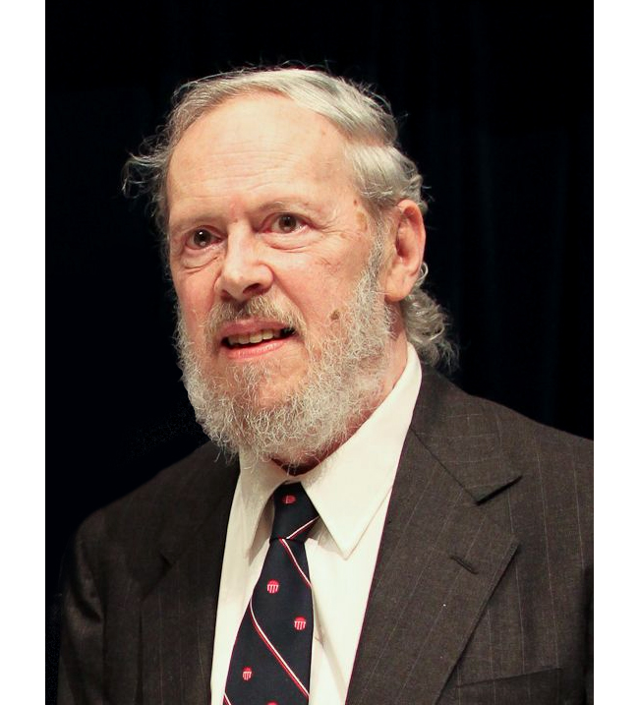
>>>
Story: the #! line, announced by email, 1980
WHO Dennis Ritchie of Bell Laboratories.
WHAT The #! line: if a file starts with these two characters, the rest of the line names the interpreter.
WHEN In an email dated Thursday, 10 January 1980.
WHERE Bell Laboratories, between Edition 7 and Edition 8 Unix; it reached users through Berkeley BSD.
WHY Scripts could then be run by name, like any program. His advice: put #! /bin/sh first.
HOW The kernel reads the line and starts the named program. The launcher's #!/usr/bin/env bash adds a PATH search.
Dennis Ritchie, 2011. Image: Denise Panyik-Dale, CC BY 2.0, Wikimedia Commons.
READ Shebang (Unix) (Wikipedia)
38 / 48
Notes:
Dennis Ritchie announced the hash-bang line by email on 10 January 1980. Our Ubuntu launcher starts with it. Ask students why the file needs no dot sh ending.

Slide 39
>>>
Deploying on Ubuntu: the .desktop entry
>>> import configparser
>>> entry = ('[Desktop Entry]\n'
>>> 'Name=yourScript\n'
>>> 'Exec=gnome-terminal -- /home/al/Scripts/yourScript\n'
>>> 'Type=Application\n')
A .desktop file is a small settings file that puts a program in the Ubuntu menu. Its Exec line says what to run.
>>> c = configparser.ConfigParser()
>>> c.read_string(entry)
>>> print(dict(c['Desktop Entry']))
configparser reads this kind of file. Every key becomes an item of a dictionary.
What the run printed (Python 3.13.16)
Key | Value | Meaning
Name | yourScript | the label in the menu
Exec | gnome-terminal -- /home/al/Scripts/yourScript | what a click runs, in a terminal window
Type | Application | an entry that starts a program
A .desktop file puts the launcher in the menu.
39 / 48
Notes:
A desktop file is a small settings file. Configparser reads it. The Exec line is the launcher, wrapped in a terminal window so that the user sees the output.

Slide 40
>>>
ccwd: copying the current working directory
>>> import os
>>> clipboard = []
>>> def ccwd(argv):
>>> if len(argv) > 1:
>>> os.chdir(argv[1])
>>> clipboard.append(os.getcwd())
ccwd changes folder when it gets an argument, then copies the working directory. A list stands in for the clipboard.
>>> start = os.getcwd()
>>> os.chdir('/tmp')
>>> terminal = os.getcwd() # where the terminal stands
>>> ccwd(['ccwd.py', '..'])
>>> print('clipboard', clipboard[-1], '| terminal', terminal)
>>> os.chdir(start)
os.chdir moves only the running program. After ccwd .. the terminal itself has not moved.
What the run printed (Python 3.13.16)
terminal
working directory /tmp
starts
ccwd .. (a running program)
working directory /
copies
clipboard
/
After the program has changed folder, the terminal has not: it still stands in /tmp.
os.chdir moves only the program.
40 / 48
Notes:
Os.chdir changes the folder of the running program only. The terminal that started it stays where it was. That is the chapter's point, and why ccwd copies the folder instead of moving there.

Slide 41
>>>
Clipboard Recorder: print what changed
>>> texts = ['ch11', 'ch11', 'ch12', 'ch12', 'ch13']
>>> previous_content, recorded = '', []
>>> try:
>>> for content in texts: # the book calls paste()
The real program calls pyperclip.paste again and again. Here a list of copied texts plays the clipboard.
>>> if content != previous_content:
>>> print(content)
>>> recorded.append(content)
>>> previous_content = content
It prints a text only when it is new, and remembers the last one.
>>> raise KeyboardInterrupt # the user presses CTRL-C
>>> except KeyboardInterrupt:
>>> print('Result: stopped quietly;', len(recorded), 'recorded')
CTRL-C raises KeyboardInterrupt. The except clause catches it, so the program ends quietly.
What the run printed (Python 3.13.16)
Read | Clipboard holds | New?
1 | ch11 | yes: printed
2 | ch11 | no: skipped
3 | ch12 | yes: printed
4 | ch12 | no: skipped
5 | ch13 | yes: printed
reads against texts recorded
Poll, print what changed, stop on CTRL-C.
41 / 48
Notes:
The recorder polls again and again and prints only what changed. Control-C raises KeyboardInterrupt, which is not an Exception, so the except clause names it. It ends quietly.

Slide 42
>>>
PyInstaller: one file, a whole interpreter
>>> import shlex
>>> command = 'python -m PyInstaller --onefile yourScript.py'
>>> words = shlex.split(command)
>>> print(len(words), 'words:', words)
The module name needs its two capital letters and --onefile its two dashes. shlex.split shows the words PyInstaller receives.
>>> roles = {'-m': 'run a module', '--onefile': 'bundle into one file'}
>>> print({w: roles[w] for w in words if w in roles})
-m runs PyInstaller as a module and --onefile asks for one executable.
>>> left = ['build/', 'dist/', 'yourScript.spec']
>>> print('the build leaves:', left)
The build leaves a build folder, a dist folder and a spec file.
What the run printed (Python 3.13.16)
python
-m
PyInstaller
--onefile
yourScript.py
starts the interpreter
run a module
the module to run
bundle into one file
the script to pack
the build leaves
build/
dist/
yourScript.spec
-m and --onefile; the build leaves three things.
42 / 48
Notes:
Pyinstaller needs its capital letters and two dashes. Python dash m Pyinstaller dash dash onefile builds one executable. It leaves build, dist and a spec file.

Slide 43
>>>
PyInstaller: what the one file costs
Measured in the chapter research with PyInstaller 6.22.3 and Python 3.14.6
size of the Hello, world executable, in megabytes
Fact | Value
Source file | 23 bytes
Executable (Ubuntu) | 12,950,120 bytes
Build time | about 15 seconds
Leaves | build, dist, a spec file
Works on | one system, one Python
PyInstaller packs a copy of the interpreter with your script.
43 / 48
Notes:
Pyinstaller packs a copy of the interpreter with the script, so even Hello world is megabytes. The output belongs to one operating system and one Python version. Mail providers may block it.

Slide 44
>>>
Practice program: make your programs deployable
>>> LINE = 'python3 ~/Scripts/{name}.py "$@"' # third line of a launcher
>>> projects = {'zipBackup': 11, 'extractContacts': 9, 'wikiBullets': 8, 'chessboard': 7}
The practice program asks for four earlier projects to become commands. One template line serves them all.
>>> for name, chapter in projects.items():
>>> print(name.ljust(16), 'chapter', chapter, '|', LINE.format(name=name))
format fills the project name into the line. Each project then runs from any folder.
What the run printed (Python 3.13.16)
Project | From chapter | Third line of its launcher
zipBackup | 11 | python3 ~/Scripts/zipBackup.py "$@"
extractContacts | 9 | python3 ~/Scripts/extractContacts.py "$@"
wikiBullets | 8 | python3 ~/Scripts/wikiBullets.py "$@"
chessboard | 7 | python3 ~/Scripts/chessboard.py "$@"
One template, four commands.
44 / 48
Notes:
The practice program turns four old projects into commands. One template serves all. The only change per project is its name in the third line.

Slide 45
>>>
Current Python and systems change more
What differs from the book, from the chapter research
What changed | Since | What it means for the chapter
__file__ of a script is an absolute path | 3.9 | Path(__file__).parent finds files beside the program
setuptools is no longer pre-installed in a venv | 3.12 | pip list shows only pip in a fresh environment
A new venv holds a .gitignore file | 3.13 | The environment folder is not committed by mistake
argparse colours its help text and can suggest a choice | 3.14 | Usage messages are easier to read
System Python is marked externally managed (PEP 668) | Ubuntu 24.04 | pip install there stops with an error: use a venv
Bext hides the cursor with hide_cursor and show_cursor | Bext 0.1.1 | The chapter lists hide and show
automateboringstuff3 requires playsound 1.3.0 | 2024.10.1 | The chapter's prose names playsound3
Run what the book printed; then check what changed.
45 / 48
Notes:
Python moves on. Dunder file is absolute since 3.9. No setuptools in new environments since 3.12. Python 3.13 adds a gitignore file. Python 3.14 colours argparse help. PEP 668 blocks pip in system Python.

Slide 46
>>>
Summary
ANALOGY A summary is a packing list: only what you really need goes into the bag.
A program is started by a terminal that searches PATH.
code examples in each part of this deck
1
2
A virtual environment keeps the packages of one project apart.
3
The program reads sys.argv; argparse parses it for you.
4
Text design: quiet by default, colour by escape code.
5
A launcher in a PATH folder, or PyInstaller, deploys it.
The terminal searches PATH; the program reads its arguments.
46 / 48
Notes:
Five sentences to keep. The chart counts the code examples in each part of this deck.

Slide 47
>>>
Practice Questions
Predict first, then run what you can on the chapter page
ANALOGY Practice questions are finger scales for a pianist: short drills before the performance.
1
Add /home/al/Scripts to the front of PATH. Which folder does shutil.which search first?
2
What does shlex.split give for 'python3 snow.py "big storm" 20'? How long is argv?
3
Add a --density option to the argparse example with a default of 4 and a type of int.
4
Write the launcher line that forwards arguments, and say why the chapter's own line forwards none.
Each answer fits in a few lines you can run.
47 / 48
Notes:
Four drills. Predict first, then run what you can on the page. Ask students to explain each answer in one sentence.

Slide 48
>>>
Resources: where to go next
Reading and watching, chosen for this chapter; every link is live
Book: Automate the Boring Stuff, 3rd edition, chapter 12
https://automatetheboringstuff.com/3e/chapter12.html
PEP 668: externally managed environments
https://peps.python.org/pep-0668/
Python documentation: sys, system-specific parameters
https://docs.python.org/3/library/sys.html
pip user guide: running pip as python -m pip
https://pip.pypa.io/en/stable/user_guide/
Python documentation: os, operating system interfaces
https://docs.python.org/3/library/os.html
PyInstaller manual: using PyInstaller
https://pyinstaller.org/en/stable/usage.html
Python documentation: argparse
https://docs.python.org/3/library/argparse.html
Bext on the Python Package Index
https://pypi.org/project/Bext/
Python documentation: venv
https://docs.python.org/3/library/venv.html
PyMsgBox on the Python Package Index
https://pypi.org/project/PyMsgBox/
Python documentation: shutil.which and shlex.split
https://docs.python.org/3/library/shutil.html
Video: AT&T Archives, The UNIX Operating System (1982)
https://www.youtube.com/watch?v=tc4ROCJYbm0
PEP 405: Python Virtual Environments
https://peps.python.org/pep-0405/
Pipeline (Unix) on Wikipedia
https://en.wikipedia.org/wiki/Pipeline_(Unix)
Pick one link and read it before the next class.
48 / 48
Notes:
Start with the book chapter, then the Python documentation, the two PEPs and the pip and PyInstaller manuals. The stories link to first-hand sources. Choose one link and read it before the next class.

