Slide 1

Chapter 10: Debugging
CSE0408 Programming III
IKU Department of Computer Engineering
Yusuf Altunel, PhD

Slide 2


Content
Headlines
Raising Exceptions
Getting the Traceback as a String
Assertions
Logging
IDLE’S Debugger
Automate the Boring Stuff with Python
Practical Programming for Total Beginners
Chapter 10: Debugging

Slide 3
Organizing file
Python can be used to automate boring stuff
File Copies
File Name Correction
Backup with Compression
Create Copies of Files
All .PDF files on a drive
doc & docx files in any of Homework subfolder in Courses folder
Modify files names
Removing the leading zeros
in the filenames
for every file in a folder
Compress folders
Compressing several folders
into one ZIP file

Slide 4



Chapter 10: Debugging
Raising Exceptions

Slide 5
The shutil Module
shell utilities for file and folder operations
Copy and Move
Rename
Delete
Create copies of
Files
Folders
Move
Files
Folders
Rename
Files
Folders
Delete
Files
Folders

Slide 6



Copying Files and Folders
(\) (/): Separators between folder names
shutil.copy()
copy(source, destination)
return
Copy
files
entire folders
source
location of source file
is a path
type string
destination
location to make a copy
is a path
type string
returns
a string
the path of the copied file.

Slide 7

shutil.copy()
  waffles = 'C:\\delicious\\walnut\\waffles\\'
  >>> os.chdir(waffles)
  >>> os.getcwd()
  'C:\\delicious\\walnut\\waffles’
  >>> shutil.copy('Hello.txt', 'HelloBeSafe.txt')
  'HelloBeSafe.txt’
  >>> os.listdir()
  ['bacon.txt', 'Hello.txt', 'HelloBeSafe.txt', 'HelloWellcome.txt', 'myCats.py', 'mydata.bak', 'mydata.dat', 'mydata.dir', 'sonnet29.txt', '__pycache__']
  >>> os.chdir('c:\\')
  >>> os.getcwd()
  'c:\\’
  >>> delicious = 'C:\\delicious\\'
  >>> shutil.copy(waffles + 'hello.txt', delicious)
  'C:\\delicious\\hello.txt’
  >>> os.listdir(delicious)
  ['hello.txt', 'walnut’]
  >>> shutil.copy(waffles + 'HelloWellcome.txt ', delicious + 'HelloBeSafe.txt ')
  'C:\\delicious\\HelloBeSafe.txt ‘
  >>> os.listdir(delicious)
  ['hello.txt', 'HelloBeSafe.txt', 'walnut']
Notes:
come back to make corrections

Slide 8
Copying Files and Folders
copy entire folder tree
shutil.copytree()
copytree(source, destination))
return
Copy
every folder
every file in the folder
source
location of source directory
is a path
type string
destination
destination folder
is a path
type string
a string
the path
of the copied folder

Slide 9
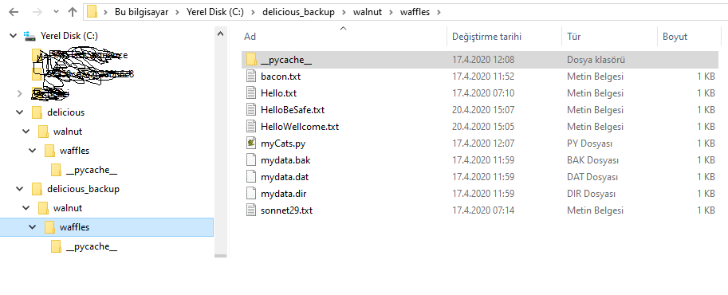
shutil.copytree()
  >>> import shutil, os
  >>> os.chdir('C:\\’)
  >>> shutil.copytree('C:\\delicious', 'C:\\delicious_backup')
  'C:\\delicious_backup'
Notes:
come back to make corrections

Slide 10



shutil.copytree()
copy everything
copy every folder
all subfolders
every file file in the folders
get a full copy
creates a new folder
with the same content
of the original folder
Backup
now safely backed up
the folder and its content

Slide 11
Moving and Renaming Files and Folders
shutil.move(source, destination)
shutil.move()
shutil.move(source, destination)
return
Move
move the file or folder
to the destination
source
location of source path
file or folder
destination
destination path
file or folder
a string
absolute path of
the new location

Slide 12
Move file to a Directory
Source: file
Destination: a folder
the source file gets moved
into destination folder
file name preserved
, in such a case
file
keeps its current filename.
use to move a file
used
to move a file
to another folders

Slide 13
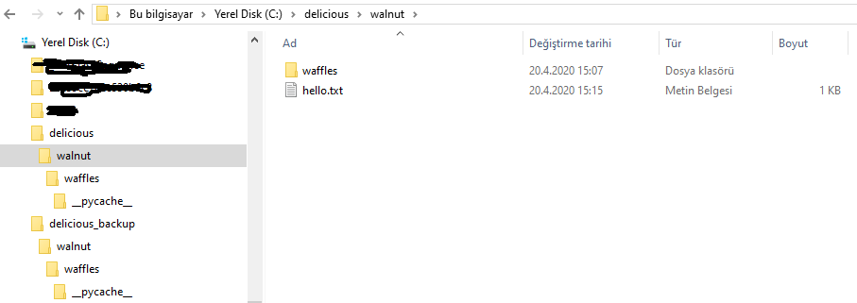
shutil.move()
  >>> import shutil
  >>> shutil.move('C:\\delicious\\hello.txt', 'C:\\delicious\\walnut')
  'C:\\delicious\\walnut\\hello.txt'
Notes:
come back to make corrections

Slide 14

shutil.move()
File is in the destination folder
  destination folder already contain the file
  with the same name
File is Replaced
  the file is replaced
  with the source file
take care not to accidentally overwrite files in this way

Slide 15
Move & Rename
File name in destination
destination path
specify a filename
file name in source
the source file
is moved
and renamed
one command
double functions
move
rename

Slide 16
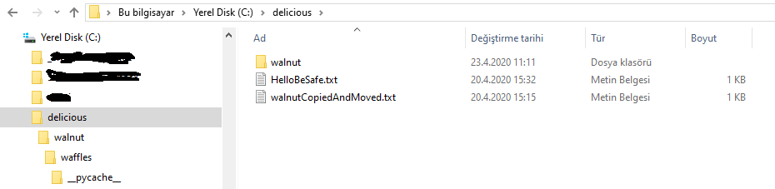
shutil.move()
  >>> import shutil
  >>> shutil.move('C:\\delicious\\walnut\\hello.txt', 'C:\\delicious\\walnutCopiedAndMoved.txt')
  'C:\\delicious\\walnutCopiedAndMoved.txt'
Notes:
come back to make corrections

Slide 17
Destination folder not existing
destination folder
confusing case
if the destination folder
is not existing
rename the file
the move command
renames the file
with the destination folder name
confusing
source of bugs
this is a cause of buggy code
hard to locate

Slide 18
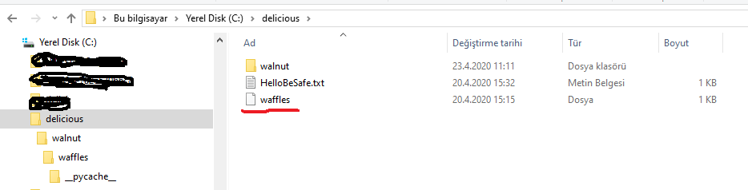
shutil.move()
  >>> import shutil
  >>> shutil.move('C:\\delicious\\walnutCopiedAndMoved.txt', 'C:\\delicious\\waffles')
  'C:\\delicious\\waffles'
Notes:
come back to make corrections

Slide 19
shutil.move()
Source files and folders should exist
  Python throws exception otherwise
Exception
  FileNotFoundError
take care not to accidentally overwrite files in this way

Slide 20
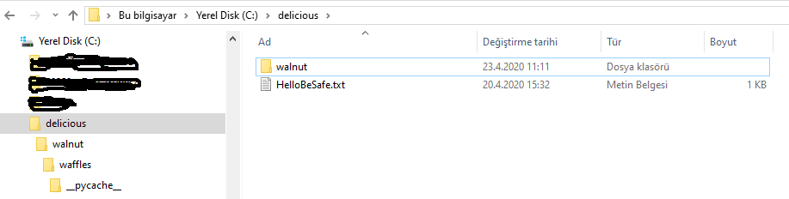
os.unlink(path)
  >>> import shutil
  >>> shutil.move('C:\\delicious\\walnutCopiedAndMoved.txt', 'C:\\delicious\\waffles')
  'C:\\delicious\\waffles'
Notes:
come back to make corrections

Slide 21
Permanently Deleting Files and Folders
os.unlink, rmdir, rmtree: delete file, directory or whole path
os.unlink(path)
os.rmdir(path)
shutil.rmtree(path)
delete file
delete the file
at path
delete empty folder
delete the folder at path
folder should be empty
remove whole path
removes the folder
with whole path
Note
all files and folders
in the path are also removed

Slide 22
permenant deletion mistakes
be careful about typos!
  if filename.endswith('.rxt’): #rxt instead of txt
  os.unlink(filename)
Try it first
  if filename.endswith('.rxt’):
  #os.unlink(filename) # don’t delete it directly
  print(filename) # list to see if it is correct
try it in simulation mode before actual deletion!

Slide 23
os.unlink(path)
  >>> os.getcwd()
  'C:\\Users\\yusuf.altunel\\AppData\\Local\\Programs\\Python\\Python38-32’
  >>> os.chdir('c:\\delicious')
  >>> os.getcwd()
  'c:\\delicious’
  >>> for filename in os.listdir():
  if filename.endswith('.rxt'):
  #os.unlink(filename)
  print(filename)
  >>> for filename in os.listdir():
  if filename.endswith('.txt'):
  #os.unlink(filename)print(filename)
  print(filename)
  HelloBeSafe.txt
  >>> for filename in os.listdir():
  if filename.endswith('.txt'):
  print(filename +' to be deleted !')
  os.unlink(filename)
  print(filename +' is deleted !')
  HelloBeSafe.txt to be deleted !
  HelloBeSafe.txt is deleted !
Notes:
come back to make corrections

Slide 24
os.rmdir(path)
  >>> os.listdir('c:\\delicious\\walnut\\waffles\\__pycache__')
  ['myCats.cpython-38.pyc']
  >>> os.rmdir('c:\\delicious\\walnut\\waffles\\__pycache__')
  Traceback (most recent call last):
  File "<pyshell#56>", line 1, in <module>
  os.rmdir('c:\\delicious\\walnut\\waffles\\__pycache__')
  OSError: [WinError 145] Dizin boş değil: 'c:\\delicious\\walnut\\waffles\\__pycache__'
  >>> os.unlink('c:\\delicious\\walnut\\waffles\\__pycache__\\myCats.cpython-38.pyc')
  >>> os.listdir('c:\\delicious\\\\walnut\\waffles\\__pycache__')
  []
  >>> os.listdir('c:\\delicious\\\\walnut\\waffles')
  ['bacon.txt', 'Hello.txt', 'HelloBeSafe.txt', 'HelloWellcome.txt', 'myCats.py', 'mydata.bak', 'mydata.dat', 'mydata.dir', 'sonnet29.txt', '__pycache__’]
  >>> os.rmdir('c:\\delicious\\walnut\\waffles\\__pycache__’)
  >>> os.listdir('c:\\delicious\\\\walnut\\waffles')
  ['bacon.txt', 'Hello.txt', 'HelloBeSafe.txt', 'HelloWellcome.txt', 'myCats.py', 'mydata.bak', 'mydata.dat', 'mydata.dir', 'sonnet29.txt']
Notes:
come back to make corrections

Slide 25
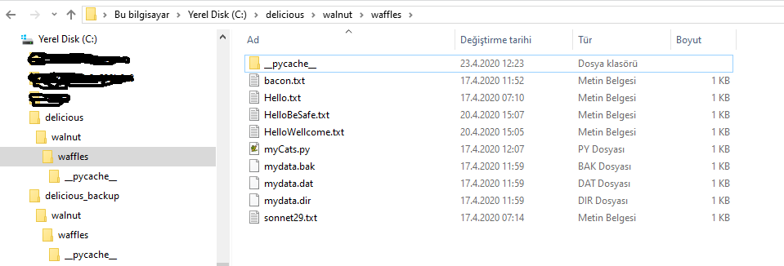
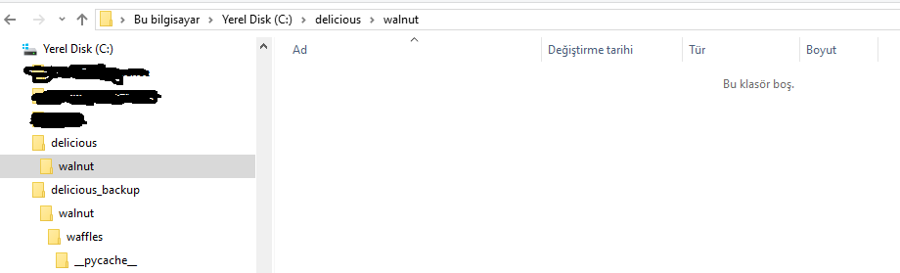
shutil.rmtree(path)
  shutil.rmtree('c:\\delicious\\walnut\\waffles')
Notes:
come back to make corrections

Slide 26
Safe Deletes with the send2trash Module
install third-party send2trash module: pip install send2trash
send to trash
alternative deletion
restore
files and folders
sent to computer’s
trash or recycle bin
moved to trash
instead of permanently deleting them
restore later is possible
restore later
from the recycle bin

Slide 27
send2trash() can’t call back from trash
sent to trash
  function can only send files to the recycle bin
no incarnation
  it cannot pull files out of it.

Slide 28
send2trash.send2trash(path)
  >>> baconFile = open('bacon.txt', 'a') # creates the file
  >>> baconFile.write('Bacon is not a vegetable.')
  25
  >>> baconFile.close()
  >>> os.listdir()
  ['bacon.txt', 'walnut’]
  >>> send2trash.send2trash('bacon.txt')
  >>> os.listdir()
  ['walnut']
Notes:
come back to make corrections

Slide 29
Chapter 10: Debugging
Getting the Traceback as a String

Slide 30
Directory Walk Through with Python
Python provides a function to handle directory walk through
walk through
touche files
os.walk(path)
visiting directories
and subdirectories
in the directory tree
touch files & folders
renaming
deleting
moving
walks through
a whole directory tree
starting from the path

Slide 31

visitDirectoryTree.py
  import os
  def walkThrough(path):
  for folderName, subfolders, filenames in os.walk(path):
  print('The current folder is ' + folderName)
  for subfolder in subfolders:
  print('SUBFOLDER OF ' + folderName + ': ' + subfolder)
  for filename in filenames:
  print('FILE INSIDE ' + folderName + ': '+ filename)
  print('')
  >>> walkThrough('C:\\delicious')
  The current folder is C:\delicious
  SUBFOLDER OF C:\delicious: walnut
  The current folder is C:\delicious\walnut

Slide 32
Chapter 10: Debugging
Assertions
Using an Assertion in a Traffic Light Simulation
Disabling Assertions

Slide 33
Chapter 10: Debugging
Logging
Using the logging Module
Don’t Debug with print()
Logging Levels
Disabling Logging
Logging to a File

Slide 34
Chapter 10: Debugging
IDLE’S Debugger
Go
Step
Over
Out
Quit
Debugging a Number Adding Program
Breakpoints

Slide 35
Compressing Files with the zipfile Module
Compression reduces its size, package files
size reduction
packaging
archive file
useful
transferring over the Internet
keeping on disk
simplification
multiples files
processed as a single entity
archive file is
a single compressed file
contains files and folders

Slide 36
Pythong Abilities about Archive Files
zip module: create and open (or extract) ZIP files
call open()
read() & write()
call close()
to
return a File object
call read() to
read content
call write() to
write into file object
to
Close the file
on the File object

Slide 37
zipfile
zipfile is the name of the Python module to import
import zipfile
zipfile module
examples
import
the zipfile module
has
necessary functions
to process archive files
processes
extract files
creating archive files
adding file to archive file

Slide 38
ZIP File Operations
zipfile is the name of the Python module to import
import zipfile
zipfile module
operations
import
the zipfile module
has
necessary functions
to process archive files
archive file operations
extract files
creating archive files
adding file to archive file

Slide 39
Reading ZIP Files
zipfile is the name of the Python module to import
import zipfile
ZipFile objects
Zipfile.ZipFile()
create
a ZipFile object
conceptually similar
to the File objects
to create a ZipFile Object
call Zipfile.ZipFile(fileName)

Slide 40
namelist() method
  returns a list of strings for all the files and folders contained in the ZIP file
getinfo()
ZipInfo objects
Usage of ZipInfo
strings can be passed
to return a ZipInfo object
about a particular file.
have their own attributes
file_size
compress_size
holds useful information
about a single file
in the archive

Slide 41

ZipFile & ZipInfoObjects
  >>> import zipfile, os
  >>> os.chdir('C:\\delicious')
  >>> os.listdir()
  ['delicious.zip', 'hello.txt', 'HelloBeSafe.txt', 'walnut']
  >>> exampleZip = zipfile.ZipFile('delicious.zip')
  >>> exampleZip.namelist()
  ['walnut/', 'walnut/waffles/', 'walnut/waffles/bacon.txt', 'walnut/waffles/Hello.txt', 'walnut/waffles/HelloBeSafe.txt', 'walnut/waffles/HelloWellcome.txt', 'walnut/waffles/myCats.py', 'walnut/waffles/mydata.bak', 'walnut/waffles/mydata.dat', 'walnut/waffles/mydata.dir', 'walnut/waffles/sonnet29.txt', 'walnut/waffles/__pycache__/', 'walnut/waffles/__pycache__/myCats.cpython-38.pyc', 'hello.txt', 'HelloBeSafe.txt']
  >>> spamInfo = exampleZip.getinfo('hello.txt')
  >>> spamInfo.file_size
  62
  >>> spamInfo.compress_size
  64
  >>> 'Compressed file is %sx smaller!' % (round(spamInfo.file_size / spamInfo.compress_size, 2))
  'Compressed file is 0.97x smaller!'
  >>> exampleZip.close()

Slide 42
Extracting from ZIP Files
extractall() method for ZipFile objects
extractall()
folder name
Extract to
extract all files & folders
from a ZIP file
into the current working directory
pass a folder name
to extractall()
extract the files
into a folder
other than
the current working directory.

Slide 43

extractall()
  >>> import zipfile, os
  >>> os.getcwd()
  'C:\\Users\\yusuf.altunel\\AppData\\Local\\Programs\\Python\\Python38-32'
  >>> os.chdir("c:\\delicious")
  >>> os.getcwd()
  'c:\\delicious'
  >>> os.listdir()
  ['delicious.zip', 'hello.txt', 'HelloBeSafe.txt', 'walnut']
  >>> exampleZip = zipfile.ZipFile('delicious.zip')
  >>> exampleZip.extractall()
  >>> exampleZip.close()
  >>> exampleZip = zipfile.ZipFile('delicious.zip')
  >>> exampleZip.extractall('c:\\delicious.bak’)
  >>> os.chdir('c:\\delicious.bak’)
  >>> os.listdir()
  ['hello.txt', 'HelloBeSafe.txt', 'walnut']
  >>> exampleZip.close()

Slide 44

Extracting a Single File
ZipFile.extract() method
extract a single file from the ZIP file

Slide 45

Extracting File to a Different Path
  >>> import zipfile, os
  >>> os.chdir("c:\\delicious")
  >>> os.listdir()
  ['delicious.zip', 'hello.txt', 'HelloBeSafe.txt', 'walnut’]
  >>> exampleZip = zipfile.ZipFile('delicious.zip’)
  >>> exampleZip.namelist()
  ['walnut/', 'walnut/waffles/', 'walnut/waffles/bacon.txt', 'walnut/waffles/Hello.txt', 'walnut/waffles/HelloBeSafe.txt', 'walnut/waffles/HelloWellcome.txt', 'walnut/waffles/myCats.py', 'walnut/waffles/mydata.bak', 'walnut/waffles/mydata.dat', 'walnut/waffles/mydata.dir', 'walnut/waffles/sonnet29.txt', 'walnut/waffles/__pycache__/', 'walnut/waffles/__pycache__/myCats.cpython-38.pyc', 'hello.txt', 'HelloBeSafe.txt']
  >>> exampleZip.extract('hello.txt')
  'c:\\delicious\\hello.txt’
  >>> exampleZip.extract('hello.txt', 'c:\\a\\New\\Folder\\helloHello.bak')
  'c:\\a\\New\\Folder\\helloHello.bak\\hello.txt’
  >>> exampleZip.close()

Slide 46
Creating and Adding to ZIP Files
To create new compressed ZIP files, open ZipFile object in write mode
ZipFile in Write Mode
ZipFile.write(path)
write(filenamePath, compressionType)
open the ZipFile object
in write mode
by passing 'w’
as the second argument.
Python compresses the file
at that path
and add it into the ZIP file
Compressiont Type
Second argument
algorithm to compress
zipfile.ZIP_DEFLATED

Slide 47
Extracting File to a Different Path
  >>> import zipfile, os
  >>> os.chdir("c:\\delicious")
  >>> os.getcwd()
  'c:\\delicious’
  >>> os.listdir()
  ['delicious.zip', 'hello.txt', 'HelloBeSafe.txt', 'walnut’]
  >>> newZip = zipfile.ZipFile('new.zip', 'w')
  >>> os.listdir()
  ['delicious.zip', 'hello.txt', 'HelloBeSafe.txt', 'new.zip', 'walnut']
  >>> newZip.write('hello.txt', compress_type=zipfile.ZIP_DEFLATED)
  >>> newZip.filelist
  [<ZipInfo filename='hello.txt' compress_type=deflate filemode='-rw-rw-rw-' file_size=62 compress_size=64>]
  >>> newZip.close()

Slide 48
Add to Zip File
  to simply add files to an existing ZIP file
  open the ZIP file in append mode.
pass 'a' as the second argument
to zipfile.ZipFile()
  >>> newZip = zipfile.ZipFile('new.zip', ‘a')

Slide 49






Thank You
Yusuf Altunel, PhD
https://www.linkedin.com/in/yusuf-altunel-2070a31b/
y.altunel@iku.edu.tr
http://cats.iku.edu.tr/portal/site/0181f2bc-77e3-4a85-ade9-77639d9bcfe7

