Slide 1

Chapter 18: ControllingKeyboard & Mouse with GUI Automation
CSE0408 Programming III
IKU Department of Computer Engineering
Yusuf Altunel, PhD

Slide 2


Content
Headlines
Installing the pyautogui Module
Staying on Track
Controlling Mouse Movement
Controlling Mouse Interaction
Working with the Screen
Image Recognition
Controlling the Keyboard
Review of the PyAutoGUI Functions
Automate the Boring Stuff with Python
Practical Programming for Total Beginners
Chapter 18: ControllingKeyboard & Mouse with GUI Automation

Slide 3



Chapter 10: Debugging
Raising Exceptions

Slide 4

Pauses and Fail-Safes
The webbrowser module’s open() function can launch a new browser to a specified URL.
webbrowser
webbrowser.open()
Open a Page
Comes with Python and opens a browser to a specific page
function to open the web browser
Set the URL to a page address
openBrowser(url)

Slide 5
webbrowser.open(URL)
  import webbrowser
  def openBrowser(pageURL):
  webbrowser.open(pageURL)
  if __name__ == '__main__':
  url= 'http://inventwithpython.com/'
  openBrowser(url)
Notes:
come back to make corrections

Slide 6
PyAutoGUI Functions
quick summary reference
moveTo(x, y)
moveRel(xOffset, yOffset)
dragTo(x, y)
Moves the mouse cursor to the given x and y coordinates
Moves the mouse cursor relative to its current position
Moves the mouse cursor while the left button is held down.

Slide 7
PyAutoGUI Functions
quick summary reference
dragRel(xOffset, yOffset)
click(x, y, button)
rightClick()
Moves the mouse cursor relative to its current position while the left button is held down.
Simulates a click (left button by default).
Simulates a right-button click.

Slide 8
PyAutoGUI Functions
quick summary reference
middleClick()
doubleClick()
mouseDown(x, y, button)
Simulates a middle-button click.
Simulates a double left-button click.
Simulates pressing down the given button at the position x, y.

Slide 9
PyAutoGUI Functions
quick summary reference
mouseUp(x, y, button)
scroll(units)
typewrite(message)
Simulates releasing the given button at the position x, y.
Simulates the scroll wheel. A positive argument scrolls up; a negative argument scrolls down.
Types the characters in the given message string.

Slide 10
PyAutoGUI Functions
quick summary reference
typewrite([key1, key2, key3])
press(key)
keyDown(key)
Types the given keyboard key strings.
Presses the given keyboard key string.
Simulates pressing down the given keyboard key.

Slide 11
PyAutoGUI Functions
quick summary reference
keyUp(key)
hotkey([key1, key2, key3])
screenshot()
Simulates releasing the given keyboard key.
Simulates pressing the given keyboard key strings down in order and then releasing them in reverse order.
Returns a screenshot as an Image object.
See Chapter 17 for information on Image objects.

Slide 12
shutil.copy()
  waffles = 'C:\\delicious\\walnut\\waffles\\'
  >>> os.chdir(waffles)
  >>> os.getcwd()
  'C:\\delicious\\walnut\\waffles’
  >>> shutil.copy('Hello.txt', 'HelloBeSafe.txt')
  'HelloBeSafe.txt’
  >>> os.listdir()
  ['bacon.txt', 'Hello.txt', 'HelloBeSafe.txt', 'HelloWellcome.txt', 'myCats.py', 'mydata.bak', 'mydata.dat', 'mydata.dir', 'sonnet29.txt', '__pycache__']
  >>> os.chdir('c:\\')
  >>> os.getcwd()
  'c:\\’
  >>> delicious = 'C:\\delicious\\'
  >>> shutil.copy(waffles + 'hello.txt', delicious)
  'C:\\delicious\\hello.txt’
  >>> os.listdir(delicious)
  ['hello.txt', 'walnut’]
  >>> shutil.copy(waffles + 'HelloWellcome.txt ', delicious + 'HelloBeSafe.txt ')
  'C:\\delicious\\HelloBeSafe.txt ‘
  >>> os.listdir(delicious)
  ['hello.txt', 'HelloBeSafe.txt', 'walnut']
Notes:
come back to make corrections

Slide 13



Copying Files and Folders
copy entire folder tree
shutil.copytree()
copytree(source, destination))
return
Copy
every folder
every file in the folder
source
location of source directory
is a path
type string
destination
destination folder
is a path
type string
a string
the path
of the copied folder

Slide 14
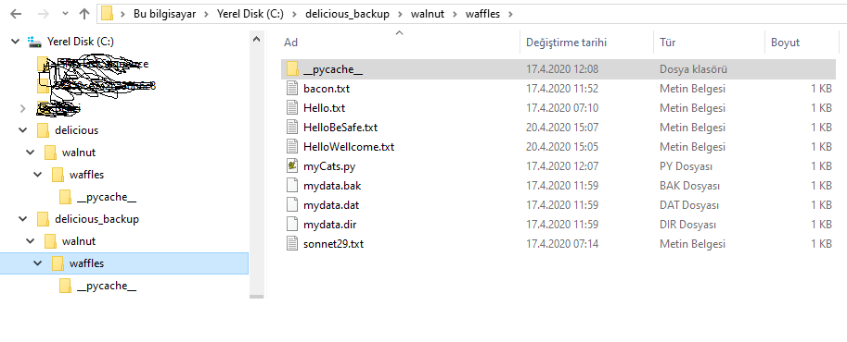
shutil.copytree()
  >>> import shutil, os
  >>> os.chdir('C:\\’)
  >>> shutil.copytree('C:\\delicious', 'C:\\delicious_backup')
  'C:\\delicious_backup'
Notes:
come back to make corrections

Slide 15




shutil.copytree()
copy everything
copy every folder
all subfolders
every file file in the folders
get a full copy
creates a new folder
with the same content
of the original folder
Backup
now safely backed up
the folder and its content

Slide 16
Moving and Renaming Files and Folders
shutil.move(source, destination)
shutil.move()
shutil.move(source, destination)
return
Move
move the file or folder
to the destination
source
location of source path
file or folder
destination
destination path
file or folder
a string
absolute path of
the new location

Slide 17
Move file to a Directory
Source: file
Destination: a folder
the source file gets moved
into destination folder
file name preserved
, in such a case
file
keeps its current filename.
use to move a file
used
to move a file
to another folders

Slide 18

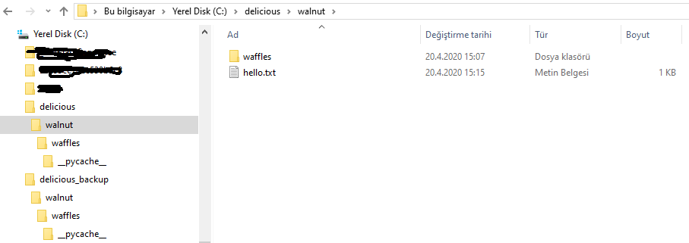
shutil.move()
  >>> import shutil
  >>> shutil.move('C:\\delicious\\hello.txt', 'C:\\delicious\\walnut')
  'C:\\delicious\\walnut\\hello.txt'
Notes:
come back to make corrections

Slide 19
shutil.move()
File is in the destination folder
  destination folder already contain the file
  with the same name
File is Replaced
  the file is replaced
  with the source file
take care not to accidentally overwrite files in this way

Slide 20



Self Assessment
Asses what you got so far!
Noticible issues
Interesting Details
Unclarified issues
Installing the pyautogui Module
Staying on Track
Controlling Mouse Movement
Controlling Mouse Interaction
Working with the Screen
Image Recognition
Controlling the Keyboard
Review of the PyAutoGUI Functions
What is the most interesting details in this chapter?
What are the points need further explanations?

Slide 21






Thank You
Yusuf Altunel, PhD
https://www.linkedin.com/in/yusuf-altunel-2070a31b/
y.altunel@iku.edu.tr
http://cats.iku.edu.tr/portal/site/0181f2bc-77e3-4a85-ade9-77639d9bcfe7

