Slide 1

Chapter 1: Python Basics
CSE0408 Programming III
IKU Department of Computer Engineering
Yusuf Altunel, PhD

Slide 2


Content
Headlines
What is Python?
Entering Expressions into the Interactive Shell
The Integer, Floating-Point, and String Data Types
String Concatenation and Replication
Storing Values in Variables
Your First Program
Automate the Boring Stuff with Python
Practical Programming for Total Beginners
Chapter-1 Python Basics

Slide 3





What is Python
Python programming language
Interpreter
Download
OS
Python comes from
syntax rules
the Python interpreter
Software
reads source code
Performs its instructions
free to download from
http://python.org
Linux
OS X
Windows
the surreal British comedy group Monty Python
not from the snake!

Slide 4

Chapter-1 Python Basics
Entering Expressions

Slide 5
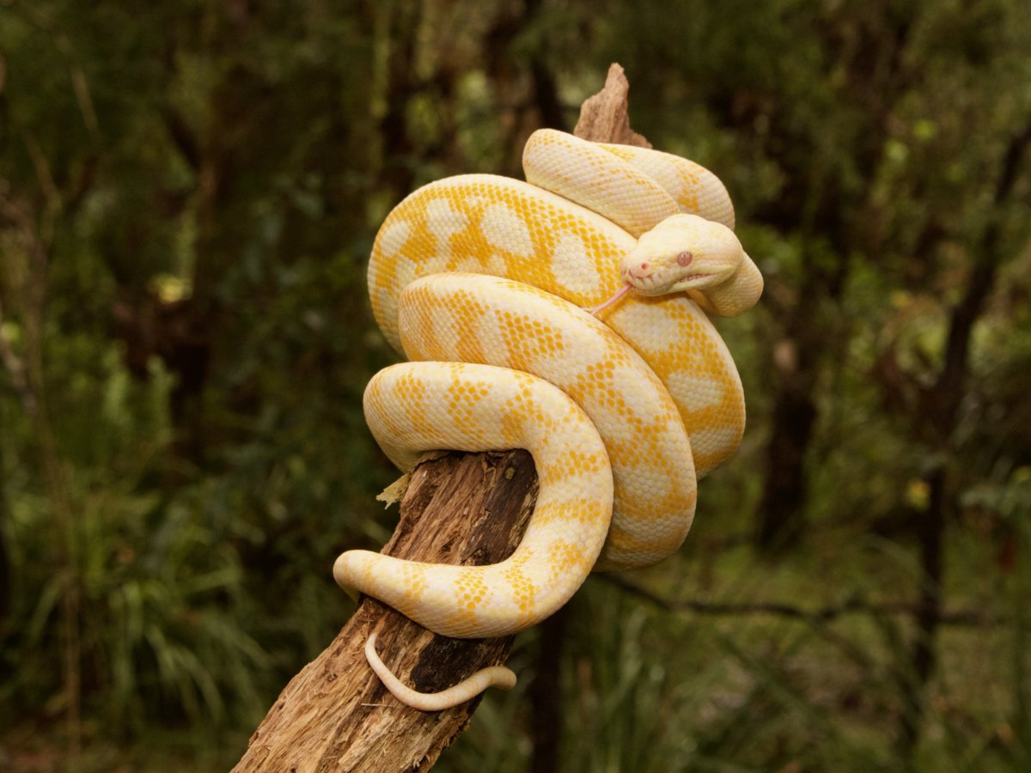
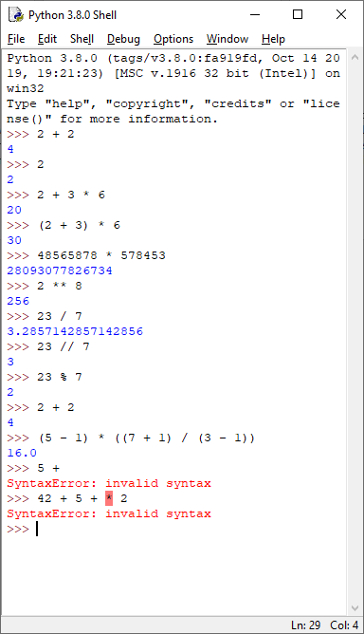




Python Expressions
Expression
Value
Operator
2+2
2
+

Slide 6
Expressions on Python 3.8.0 Shell
Python 3.8.0 (tags/v3.8.0:fa919fd, Oct 14 2019, 19:21:23) [MSC v.1916 32 bit (Intel)] on win32
Type "help", "copyright", "credits" or "license()" for more information.
>>> 2 + 2
4
>>> 2
2
>>> 2 + 3 * 6
20
>>> (2 + 3) * 6
30
>>> 48565878 * 578453
28093077826734
>>> 2 ** 8
256
>>> 23 / 7
3.2857142857142856
>>> 23 // 7
3
>>> 23 % 7
2
>>> 2 + 2
4
>>> (5 - 1) * ((7 + 1) / (3 - 1))
16.0
>>> 5 +
SyntaxError: invalid syntax
>>> 42 + 5 + * 2
SyntaxError: invalid syntax
>>>

Slide 7

Expressions
Precedence
Operators, Operations, Evaluations
Any expression in parenthesis ( ) is evaluated first
** is evaluated next
*,/,//,% evaluated later
+,- evaluated last
Evaluation is from left to right

Slide 8
Chapter-1 Python Basics
The Integer, Floating-Point, String Data Types

Slide 9




Expressions vs Data Types
Expressions
are just values combined with operators
always evaluate down to a single value
data type
is a category for values
belongs to exactly one data type
Python data types
Integers
Floating-point numbers
Strings

Slide 10



String Concatenation
string concatenation operator +
is used on two string values
joins the strings
>>> 'Alice' + 'Bob'
'Alice' + 42
'Alice' * 5
'AliceBob'
TypeError: can only concatenate str (not "int") to str
'AliceAliceAliceAliceAlice'

Slide 11

String Multiplication Operator *
'Alice' * 5
'AliceAliceAliceAliceAlice'
'Alice' * 'Bob'
TypeError: can't multiply sequence by non-int of type 'str'
'Alice' * 5.0
TypeError: can't multiply sequence by non-int of type 'float'

Slide 12
Chapter-1 Python Basics
Storing Values in Variables

Slide 13


Assignment Statements
variable
Assignment Statement
is like a box in the computer’s memory
you can store a single value.
If you want to use the result of an evaluated expression later
you can save it inside a variable.
store values in variables
consists of
  a variable name,
  assignment operator : an equal sign =
  the value to be stored

Slide 14
Assignment Statement
The variable spam now has the integer value 40 in it.”
spam = 40
spam & eggs
a variable named spam
will have the integer value 42
stored in it
>>> spam = 40
>>> spam
40
>>> eggs = 2
>>> spam + eggs
42
>>> spam + eggs + spam
82
>>> spam = spam + 2
>>> spam
42

Slide 15
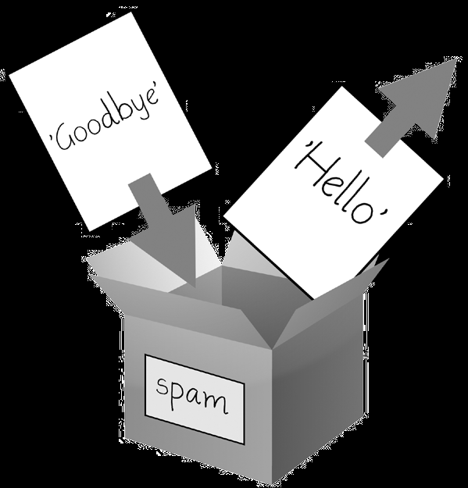
Value of a Variable
Value of the variable can be changed
Initialization
Examples
Using in Expressions
A variable is initialized (or created)
the first time a value is stored in it
When a variable is assigned a new value w,
the old value is forgotten
>>> spam = 'Hello'
>>> spam
'Hello'
>>> spam = 'Goodbye'
>>> spam
'Goodbye'
you can use it in expressions
with other variables and values

Slide 16
Variable Names
Rules on naming the variables
One Word
Use only
Don’t begin with a number
It can be only one word.
Letters
Numbers
underscore _
It can’t begin with a number.

Slide 17
Case Sensitiveness
Variable Names are Case Sensitive
four different variables
Examples
Values
spam
SPAM
Spam
sPaM
>>> spam = 'Happy Valentines Day'
>>> SPAM = 'Today is 14th February 2020'
>>> Spam = 14
>>> sPaM = 2020
>>> spam
'Happy Valentines Day'
>>> SPAM
'Today is 14th February 2020'
>>> Spam
14
>>> sPaM
2020
>>> SPam
NameError: name 'SPam' is not defined

Slide 18
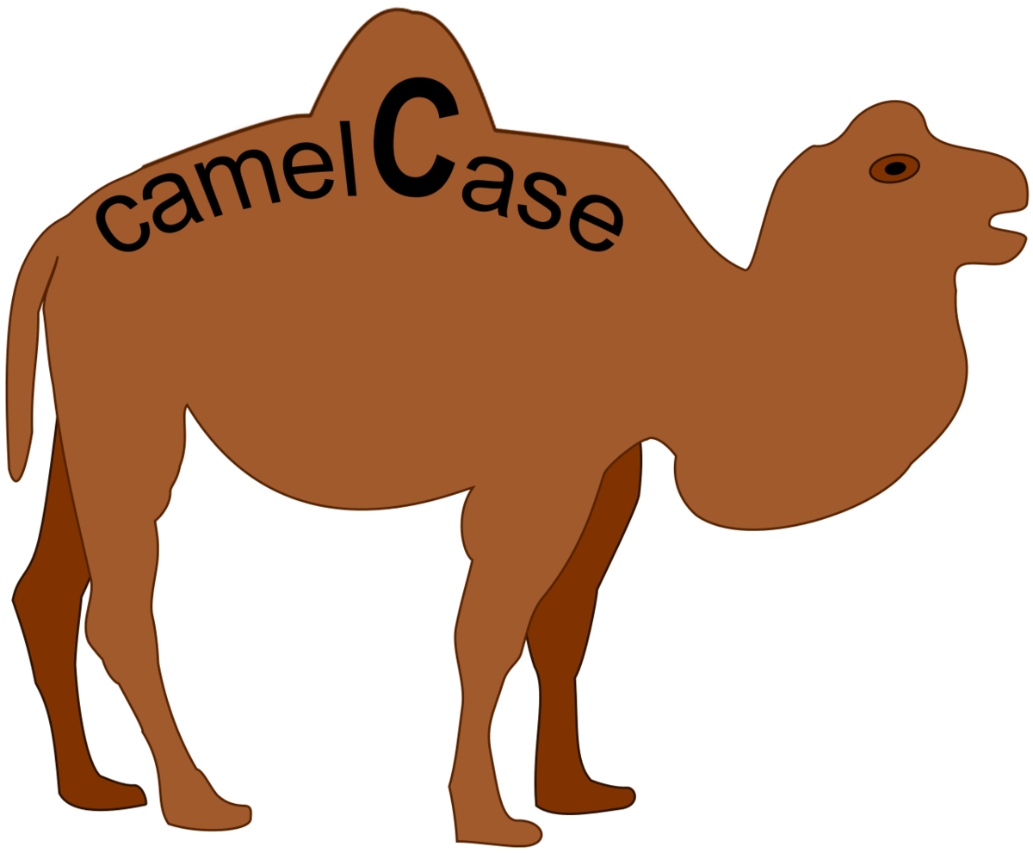
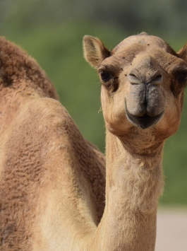
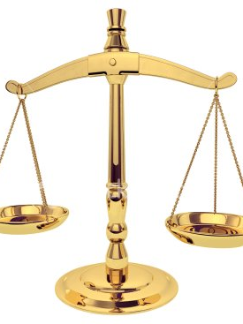
Variable Naming Style
camelCase
variables
Consistency with the style guide
is important
Use camelCase
instead of
underscores
lookLikeThis
instead of
looking_like_this
But most importantly:
know when to be inconsistent
— sometimes the style guide just doesn’t apply.
When in doubt, use your best judgment.

Slide 19
First Program
Writing & Execution of your First Program
Source Code
Store & Run
Execution
#This program says hello and asks for my name.
print('Hello world!')
# ask for their name
print('What is your name?')
myName = input()
print('It is good to meet you, ' + myName)
print('The length of your name is:')
print(len(myName))
print('What is your age?') # ask for their age
myAge = input()
print('You will be ' + str(int(myAge) + 1) + ' in a year.')
Open an editör -Idle
Copy and Paste the code
Save in myFirstProgram.py
File->Open (Ctrl-O)
Run->Run Module (F5)
Hello world!
What is your name?
February
It is good to meet you, February
The length of your name is:
8
What is your age?
2021
You will be 2022 in a year.

Slide 20

Program Explained
Comment
# This program says hello and asks for my name.
The print() Function
Displays the string value inside the parentheses on the screen.
print('Hello world!')
print('What is your name?')
try print() with nothing in between the parentheses.
The input() Function
waits for the user to type some text on the keyboard and press enter.
myName = input()
Printing the User’s Name
print('It is good to meet you, ' + myName)
contains the expression 'It is good to meet you, ' + myName between the parentheses.
The len() Function
the function evaluates to the integer value of the number of characters in that string
print('The length of your name is:')
print(len(myName))
Comment
print()
input()
len()

Slide 21
Program Explained
The str() Funtion
evaluate string form of the value
str(29)
get the value '29', which is the string form of 29
>>> print('I am ' + str(29) + ' years old.')
I am 29 years old.
The int() Function
evaluate integer form of the value.
>>> int('42')
42
>>> int('-99')
-99
>>> int(1.25)
1
The float() Functions
evaluate floating-point form of the value.
float('3.14')
3.14
>>> float(10)
10.0
str()
int()
float()

Slide 22
Using int(), float() with input()
Using int(), float() with input() functions
input() returns string
String to Integer
Treat as Integer
input() function always returns a string
>>> spam = input()
101
>>> spam
'101’
>>> spam = int(spam)
>>> spam
101
>>> spam * 10 / 5
202.0
>>> int(7.7)
7
>>> int(7.7) + 1
8

Slide 23
Self Test
What is expected to happen in following part of the code?
print('What is your age?') # ask for their age
myAge = input()
print('You will be ' + str(int(myAge) + 1) + ' in a year.')
You Got it?

Slide 24



Self Assessment
Asses what you got so far!
Noticible issues
Interesting Details
Unclarified issues
What is Python?
Entering Expressions into the Interactive Shell
The Integer, Floating-Point, and String Data Types
String Concatenation and Replication
Storing Values in Variables
Your First Program
What is the most interesting details in this chapter?
What are the points need further explanations?

Slide 25





Thank You
Yusuf Altunel, PhD
https://www.linkedin.com/in/yusuf-altunel-2070a31b/
y.altunel@iku.edu.tr
https://cats.iku.edu.tr/portal/site/dcaa62f3-f762-43dc-927a-01a09ae33a15

