Slide 1


Chapter 3⁰
Python GUI Programming: PySimpleGUI
Yusuf Altunel, PhD
From: PySimpleGUI: The Simple Way to Create a GUI With Python
by Mike Driscoll Jun 17, 2020

Slide 2


Content
Headlines
Installing PySimpleGUI
Creating Basic UI Elements in PySimpleGUI
Creating Simple Applications
Creating a PySimpleGUI Image Viewer
Integrating Matplotlib With PySimpleGUI
Integrating OpenCV With PySimpleGUI
Packaging Your PySimpleGUI Application for Windows
Conclusion
PySimpleGUI: The Simple Way to Create a GUI With Python
Chapter 3⁰
Python GUI Programming: PySimpleGUI

Slide 3



Chapter 3⁰
Python GUI Programming: PySimpleGUI
Installing PySimpleGUI
Creating Basic UI Elements in PySimpleGUI
Creating Simple Applications
Creating a PySimpleGUI Image Viewer
Integrating Matplotlib With PySimpleGUI
Integrating OpenCV With PySimpleGUI
Packaging Your PySimpleGUI Application for Windows
Conclusion

Slide 4
Installing PySimpleGUI
python -m pip install pysimplegui
pip install pysimplegui
Package Content
PySimpleGUI
Tkinter
Tkinter
PyQt
wxPython
Remi
wraps
the entirety of Tkinter
most of PySide2
only a small portion of wxPython
Default GUI
comes with Python
When you install PySimpleGUI
you get the Tkinter variant
by default

Slide 5
Chapter 3⁰
Python GUI Programming: PySimpleGUI
Installing PySimpleGUI
Creating Basic UI Elements in PySimpleGUI
Creating Simple Applications
Creating a PySimpleGUI Image Viewer
Integrating Matplotlib With PySimpleGUI
Integrating OpenCV With PySimpleGUI
Packaging Your PySimpleGUI Application for Windows
Conclusion

Slide 6
Creating Basic UI Elements in PySimpleGUI
Creating a PySimpleGUI Image Viewer:
to view your own photos or incorporate it to view photos that you download or read from a database
Image()
Pillow
PySimpleGUIQt
for viewing images
PNG
GIF formats
Supported formats
TIFF
JPG
BMP
Qt supports
more image formats
out of the box
than Tkinter

Slide 7
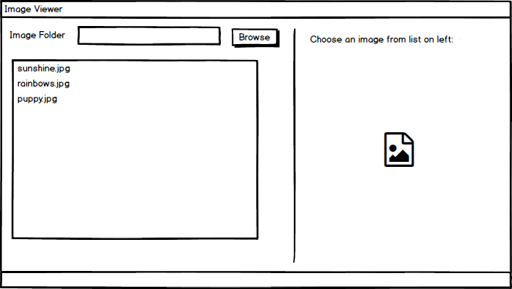
mock-up of the image viewer
Notes:
come back to make corrections

Slide 8
img_viewer.py
  # img_viewer.py
  import PySimpleGUI as sg
  import os.path
  # First the window layout in 2 columns
  file_list_column = [
  [
  sg.Text("Image Folder"),
  sg.In(size=(25, 1), enable_events=True, key="-FOLDER-"),
  sg.FolderBrowse(),
  ],
  [
  sg.Listbox(
  values=[], enable_events=True, size=(40, 20), key="-FILE LIST-"
  )
  ],
  ]
  # Show only the name of the file that was chosen
  image_viewer_column = [
  [sg.Text("Choose an image from list on left:")],
  [sg.Text(size=(40, 1), key="-TOUT-")],
  [sg.Image(key="-IMAGE-")],
  ]
  # ----- Full layout -----
  layout = [
  [
  sg.Column(file_list_column),
  sg.VSeperator(),
  sg.Column(image_viewer_column),
  ]
  ]
  window = sg.Window("Image Viewer", layout)
Notes:
come back to make corrections

Slide 9
img_viewer.py
  # Run the Event Loop
  while True:
  event, values = window.read()
  if event == "Exit" or event == sg.WIN_CLOSED:
  break
  # Folder name was filled in, make a list of files in the folder
  if event == "-FOLDER-":
  folder = values["-FOLDER-"]
  try:
  # Get list of files in folder
  file_list = os.listdir(folder)
  except:
  file_list = []
  fnames = [
  f
  for f in file_list
  if os.path.isfile(os.path.join(folder, f))
  and f.lower().endswith((".png", ".gif"))
  ]
  window["-FILE LIST-"].update(fnames)
  elif event == "-FILE LIST-": # A file was chosen from the listbox
  try:
  filename = os.path.join(
  values["-FOLDER-"], values["-FILE LIST-"][0]
  )
  window["-TOUT-"].update(filename)
  window["-IMAGE-"].update(filename=filename)
  except:
  pass
  window.close()
Notes:
come back to make corrections

Slide 10
Source code part-1
import modules
import PySimpleGUI as sg
import os.path

Slide 11
Source code part-2
turn events on or off for each element via the enable_events parameter.
The key parameter to identify a specific element in the GUI
For the In() input text control, you give it an identity of "-FOLDER-". You’ll use this later to access the contents of the element.
create
a nested list of elements that
represent a vertical column of the user interface
file_list_column = [
[
sg.Text("Image Folder"),
sg.In(size=(25, 1), enable_events=True, key="-FOLDER-"),
sg.FolderBrowse(),
],
[
sg.Listbox(
values=[], enable_events=True, size=(40, 20), key="-FILE LIST-"
)
],
]
The Listbox() element will display a list of paths to the images that you can then choose from to display.
When the first load up the user interface, set the Listbox() to be empty, so pass it an empty list.
prefill the Listbox() with values by passing in a list of strings.
You turn on events for this element
set size of this element
give a unique identifier to this element,

Slide 12
Source code part-3
creates three elements.
# For now will only show the name of the file that was chosen
image_viewer_column = [
[sg.Text("Choose an image from list on left:")],
[sg.Text(size=(40, 1), key="-TOUT-")],
[sg.Image(key="-IMAGE-")],
]
tells the user that they should choose an image to display.
Image() element also has a key set
to refer back to the element later.
displays the name of the selected file.
displays the Image()

Slide 13
Source code part-4
controls how the elements
are laid out on the screen.
# ----- Full layout -----
layout = [
[
sg.Column(file_list_column),
sg.VSeperator(),
sg.Column(image_viewer_column),
]
]
window = sg.Window("Image Viewer", layout)
VSeperator() is an alias for VerticalSeparator().
contains two Column() elements
with a VSeperator() between them.
To add the layout
to the window

Slide 14
Source code part-5
extract the events and values from the window.
the event loop
The values variable contains a Python dictionary
# Run the Event Loop
while True:
event, values = window.read()
if event == "Exit" or event == sg.WIN_CLOSED:
break
The event will be the key string of whichever element the user interacts with.
Dictionary:
that maps the element key to a value.
if the user picks a folder,
then "-FOLDER-" will map to the folder path
If the event equals "Exit" or the user closes the window,
then break out of the loop.

Slide 15
Source code part-6
refers to the In() element
created earlier
Get png & gif file listing
# Folder name was filled in, make a list of files in the folder
if event == "-FOLDER-":
folder = values["-FOLDER-"]
try:
# Get list of files in folder
file_list = os.listdir(folder)
except:
file_list = []
fnames = [
f
for f in file_list
if os.path.isfile(os.path.join(folder, f))
and f.lower().endswith((".png", ".gif"))
]
window["-FILE LIST-"].update(fnames)
check the event against the "-FOLDER-" key
use os.listdir() to get a file listing.
If the event exists, then this means
the user has chosen a folder
filter list down to only the files with the extension ".png" or ".gif".

Slide 16
Source code part-7
If the event equals "-FILE LIST-",
means
the user has chosen a file in the Listbox()
user has chosen a file to update
elif event == "-FILE LIST-": # A file was chosen from the listbox
try:
filename = os.path.join(
values["-FOLDER-"], values["-FILE LIST-"][0]
)
window["-TOUT-"].update(filename)
window["-IMAGE-"].update(filename=filename)
except:
pass
window.close()
shows the selected filename on the right
to update the Image() element as well as the Text() element
shows the selected filename on the right

Slide 17






Thank You
Yusuf Altunel, PhD
https://www.linkedin.com/in/yusuf-altunel-2070a31b/
y.altunel@iku.edu.tr
http://cats.iku.edu.tr/portal/site/0181f2bc-77e3-4a85-ade9-77639d9bcfe7

