Slide 1


Chapter 3⁰
Python GUI Programming: PySimpleGUI
Yusuf Altunel, PhD
From: PySimpleGUI: The Simple Way to Create a GUI With Python
by Mike Driscoll Jun 17, 2020

Slide 2

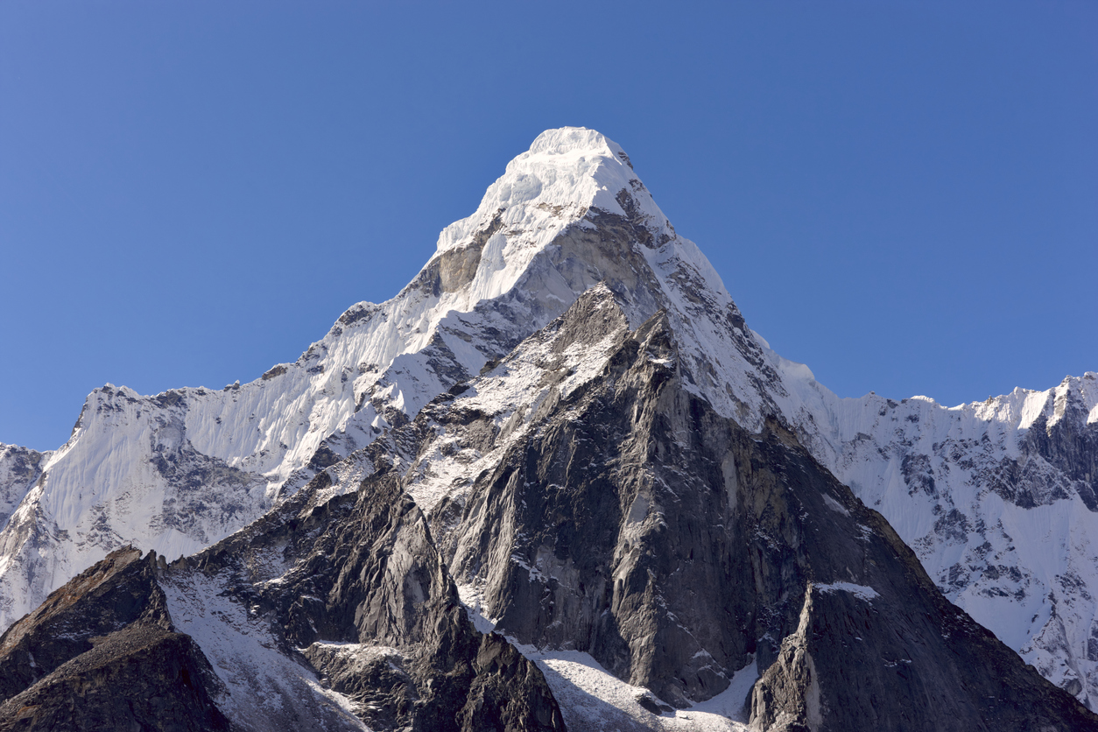
Content
Headlines
create a tkinter app
Button
Canvas
CheckButton
Entry
Frame
Label
Listbox
MenuButton
Menu
Message
RadioButton
Scale
Scrollbar
Text
TopLevel
SpinBox
PannedWindow
Python GUI – tkinter
Chapter 3⁰
Python GUI Programming tkinter

Slide 3


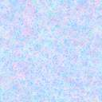
Python GUI – tkinter
Chapter 3⁰
Python GUI Programming tkinter
create a tkinter app
GUI Components

Slide 4
Python Options for GUI Development
Python offers multiple options for developing GUI (Graphical User Interface)
tkinter
Standard of Python
Access
is the most commonly used method
It is a standard Python interface
to the Tk GUI toolkit
shipped with Python

Slide 5
create a tkinter app
Importing the module – tkinter
Create the main window (container)
Add any number of widgets to the main window
Apply the event Trigger on the widgets.

Slide 6
General Structure of Python GUI Application
Importing tkinter
Create the main window
Adding widgets
Applying widget’s event Trigger
mainloop
import tkinter
m = tkinter.Tk()
'''
widgets are added here
'''
m.mainloop()

Slide 7
Steps Creating Python GUI Application
import tkinter
two main methods to remember while creating the Python application with GUI
  1-Tk(screenName=None, baseName=None, className=’Tk’, useTk=1)
  To change the name of the window, you can change the className to the desired one.
  The basic code used to create the main window of the application
    m=tkinter.Tk()
    m is the name of the main window object
  2-mainloop()
  here is a method known by the name mainloop() is used when your application is ready to run.
  mainloop() is an infinite loop used to run the application, wait for an event to occur and process the event as long as the window is not closed.
    m.mainloop()

Slide 8
accessing widgets’ geometric configuration
tkinter also offers access to the geometric configuration of the widgets
  to organize the widgets in the parent windows.
There are mainly three geometry manager classes class.
  pack() method:
  organizes the widgets in blocks before placing in the parent widget.
  grid() method:
  organizes the widgets in grid (table-like structure) before placing in the parent widget.
  place() method:
  organizes the widgets by placing them on specific positions directed by the programmer.

Slide 9
Button
To add a button in the application
The general syntax is:
  w=Button(master, option=value)
Master
  is the parameter used to represent the parent window.
options are used to change the format of the Buttons.
  Number of options can be passed as parameters separated by commas.
activebackground: to set the background color when button is under the cursor.
activeforeground: to set the foreground color when button is under the cursor.
bg: to set the normal background color.
command: to call a function.
font: to set the font on the button label.
image: to set the image on the button.
width: to set the width of the button.
height: to set the height of the button.

Slide 10

Code as Example for Widget: Button
Counting seconds
import tkinter as tk
r = tk.Tk()
r.title('Counting Seconds')
button = tk.Button(r, text='Stop', width=25, command=r.destroy)
button.pack()
r.mainloop()

Slide 11
Canvas
to draw pictures and other complex layout like graphics, text and widgets.
The general syntax is:
w = Canvas(master, option=value)
Options (can be separated with comas
bd: to set the border width in pixels.
bg: to set the normal background color.
cursor: to set the cursor used in the canvas.
highlightcolor: to set the color shown in the focus highlight.
width: to set the width of the widget.
height: to set the height of the widget.

Slide 12

Code as Example for Widget: Canvas
Canvas with one line
from tkinter import *
master = Tk()
w = Canvas(master, width=40, height=60)
w.pack()
canvas_height=100
canvas_width=200
y = int(canvas_height / 2)
w.create_line(0, y, canvas_width, y )
mainloop()

Slide 13
CheckButton
To select any number of options by displaying a number of options to a user as toggle buttons.
The general syntax is:
w = CheckButton(master, option=value)
Options (can be separated with comas
Title: To set the title of the widget.
activebackground: to set the background color when widget is under the cursor.
activeforeground: to set the foreground color when widget is under the cursor.
bg: to set he normal backgrouSteganographyBreak
  Secret Code:
  Attach a File:nd color.
command: to call a function.
font: to set the font on the button label.
image: to set the image on the widget.

Slide 14

Code as Example for Widget: CheckButton
Male & Female check buttons
rom tkinter import *
master = Tk()
var1 = IntVar()
Checkbutton(master, text='male', variable=var1).grid(row=0, sticky=W)
var2 = IntVar()
Checkbutton(master, text='female', variable=var2).grid(row=1, sticky=W)
mainloop()

Slide 15
Entry
to input the single line text entry from the user.. For multi-line text input, Text widget is used.
The general syntax is:
w=Entry(master, option=value)
Options (can be separated with comas
bd: to set the border width in pixels.
bg: to set the normal background color.
cursor: to set the cursor used.
command: to call a function.
highlightcolor: to set the color shown in the focus highlight.
width: to set the width of the button.
height: to set the height of the button.

Slide 16

Code as Example for Widget: Entry
First Name & Last Name Entries
from tkinter import *
master = Tk()
Label(master, text='First Name').grid(row=0)
Label(master, text='Last Name').grid(row=1)
e1 = Entry(master)
e2 = Entry(master)
e1.grid(row=0, column=1)
e2.grid(row=1, column=1)
mainloop()

Slide 17
Frame
acts as a container to hold the widgets. It is used for grouping and organizing the widgets.
The general syntax is:
w = Frame(master, option=value)
master is the parameter used to represent the parent window.
Options (can be separated with comas
highlightcolor: To set the color of the focus highlight when widget has to be focused.
bd: to set the border width in pixels.
bg: to set the normal background color.
cursor: to set the cursor used.
width: to set the width of the widget.
height: to set the height of the widget.

Slide 18

Code as Example for Widget: Frame
Frame of 3 Buttons
from tkinter import *
root = Tk()
frame = Frame(root)
frame.pack()
bottomframe = Frame(root)
bottomframe.pack( side = BOTTOM )
redbutton = Button(frame, text = 'Red', fg ='red')
redbutton.pack( side = LEFT)
greenbutton = Button(frame, text = 'Brown', fg='brown')
greenbutton.pack( side = LEFT )
bluebutton = Button(frame, text ='Blue', fg ='blue')
bluebutton.pack( side = LEFT )
blackbutton = Button(bottomframe, text ='Black', fg ='black')
blackbutton.pack( side = BOTTOM)
root.mainloop()

Slide 19
Label
to the display box where you can put any text or image which can be updated any time as per the code.
The general syntax is:
w=Label(master, option=value)
master is the parameter used to represent the parent window.
Options (can be separated with comas
bg: to set he normal background color.
bg to set he normal background color.
command: to call a function.
font: to set the font on the button label.
image: to set the image on the button.
width: to set the width of the button.
height” to set the height of the button.

Slide 20

Code as Example for Widget: Label
Label to say it is fun to play with GUI widgets
from tkinter import *
root = Tk()
w = Label(root, text="It's fun to play with GUI widgets!")
w.pack()
root.mainloop()

Slide 21
Listbox
offers a list to the user from which the user can accept any number of options..
The general syntax is:
w = Listbox(master, option=value)
master is the parameter used to represent the parent window..
Options (can be separated with comas
highlightcolor: To set the color of the focus highlight when widget has to be focused.
bg: to set he normal background color.
bd: to set the border width in pixels.
font: to set the font on the button label.
image: to set the image on the widget.
width: to set the width of the widget.
height: to set the height of the widget.

Slide 22
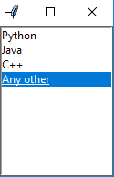
Code as Example for Widget: Listbox
Listbox with 3 programming languages
from tkinter import *
top = Tk()
Lb = Listbox(top)
Lb.insert(1, 'Python')
Lb.insert(2, 'Java')
Lb.insert(3, 'C++')
Lb.insert(4, 'Any other')
Lb.pack()
top.mainloop()

Slide 23
MenuButton
a part of top-down menu which stays on the window all the time. Every menubutton has its own functionality.
The general syntax is:
w = MenuButton(master, option=value)
master is the parameter used to represent the parent window.
Options (can be separated with comas
activebackground: To set the background when mouse is over the widget.
activeforeground: To set the foreground when mouse is over the widget.
bg: to set he normal background color.
bd: to set the size of border around the indicator.
cursor: To appear the cursor when the mouse over the menubutton.
image: to set the image on the widget.
width: to set the width of the widget.
height: to set the height of the widget.
highlightcolor: To set the color of the focus highlight when widget has to be focused.

Slide 24

Code as Example for Widget: MenuButton
Menubuttons contact & about
from tkinter import *
top = Tk()
mb = Menubutton ( top, text = &quot;GfG&quot;)
mb.grid()
mb.menu = Menu ( mb, tearoff = 0 )
mb[&quot;menu&quot;] = mb.menu
cVar = IntVar()
aVar = IntVar()
mb.menu.add_checkbutton ( label ='Contact', variable = cVar )
mb.menu.add_checkbutton ( label = 'About', variable = aVar )
mb.pack()
top.mainloop()

Slide 25
Menu
to create all kinds of menus used by the application
The general syntax is:
w = Menu(master, option=value)
master is the parameter used to represent the parent window.
Options (can be separated with comas
title: To set the title of the widget.
activebackground: to set the background color when widget is under the cursor.
activeforeground: to set the foreground color when widget is under the cursor.
bg: to set he normal background color.
command: to call a function.
font: to set the font on the button label.
image: to set the image on the widget.

Slide 26
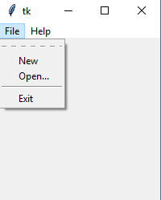
Code as Example for Widget: Menu
Menu with File & Help
from tkinter import *
root = Tk()
menu = Menu(root)
root.config(menu=menu)
filemenu = Menu(menu)
menu.add_cascade(label='File', menu=filemenu)
filemenu.add_command(label='New')
filemenu.add_command(label='Open...')
filemenu.add_separator()
filemenu.add_command(label='Exit', command=root.quit)
helpmenu = Menu(menu)
menu.add_cascade(label='Help', menu=helpmenu)
helpmenu.add_command(label='About')
mainloop()

Slide 27
Message
multi-line and non-editable text. It works same as that of Label
The general syntax is:
w = Message(master, option=value)
master is the parameter used to represent the parent window.
Options (can be separated with comas
bd: to set the border around the indicator.
bg: to set he normal background color.
font: to set the font on the button label.
image: to set the image on the widget.
width: to set the width of the widget.
height: to set the height of the widget.

Slide 28
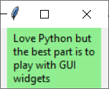
Code as Example for Widget: Message
Message to say the best part is to play with GUI widgets
from tkinter import *
main = Tk()
ourMessage ='Love Python but the best part is to play with GUI widgets'
messageVar = Message(main, text = ourMessage)
messageVar.config(bg='lightgreen')
messageVar.pack( )
main.mainloop( )

Slide 29
RadioButton
to offer multi-choice option to the user. It offers several options to the user and the user has to choose one option.
The general syntax is:
w = RadioButton(master, option=value).
Options (can be separated with comas
activebackground: to set the background color when widget is under the cursor.
activeforeground: to set the foreground color when widget is under the cursor.
bg: to set he normal background color.
command: to call a function.
font: to set the font on the button label.
image: to set the image on the widget.
width: to set the width of the label in characters.
height: to set the height of the label in characters.

Slide 30

Code as Example for Widget: RadioButton
Radio button to make a selection
from tkinter import *
root = Tk()
v = IntVar()
Radiobutton(root, text='GfG', variable=v, value=1).pack(anchor=W)
Radiobutton(root, text='MIT', variable=v, value=2).pack(anchor=W)
mainloop()

Slide 31
Scale
to provide a graphical slider that allows to select any value from that scale.
The general syntax is:
w = Scale(master, option=value)
master is the parameter used to represent the parent window.
Options (can be separated with comas
cursor: To change the cursor pattern when the mouse is over the widget.
activebackground: To set the background of the widget when mouse is over the widget.
bg: to set he normal background color.
orient: Set it to HORIZONTAL or VERTICAL according to the requirement.
from_: To set the value of one end of the scale range.
to: To set the value of the other end of the scale range.
image: to set the image on the widget.
width: to set the width of the widget.

Slide 32
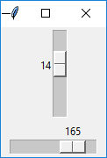
Code as Example for Widget: Scale
Scale to up to 42 X 200
from tkinter import *
master = Tk()
w = Scale(master, from_=0, to=42)
w.pack()
w = Scale(master, from_=0, to=200, orient=HORIZONTAL)
w.pack()
mainloop()

Slide 33
Scrollbar
slide controller which will be used to implement listed widgets.
The general syntax is:
w = Scrollbar(master, option=value)
master is the parameter used to represent the parent window.
Options (can be separated with comas
width: to set the width of the widget.
activebackground: To set the background when mouse is over the widget.
bg: to set he normal background color.
bd: to set the size of border around the indicator.
cursor: To appear the cursor when the mouse over the menubutton.

Slide 34
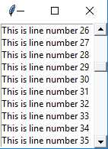
Code as Example for Widget: Scrollbar
Scrollbar to scroll between 200 lines
from tkinter import *
root = Tk()
scrollbar = Scrollbar(root)
scrollbar.pack( side = RIGHT, fill = Y )
mylist = Listbox(root, yscrollcommand = scrollbar.set )
for line in range(100):
mylist.insert(END, 'This is line number' + str(line))
mylist.pack( side = LEFT, fill = BOTH )
scrollbar.config( command = mylist.yview )
mainloop()

Slide 35
Text
To edit a multi-line text and format the way it has to be displayed.
The general syntax is:
w =Text(master, option=value)
Options (can be separated with comas
highlightcolor: To set the color of the focus highlight when widget has to be focused.
insertbackground: To set the background of the widget.
bg: to set he normal background color.
font: to set the font on the button label.
image: to set the image on the widget.
width: to set the width of the widget.
height: to set the height of the widget.

Slide 36
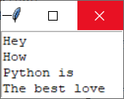
Code as Example for Widget: Text
Text to say Python is the best love!
from tkinter import *
root = Tk()
T = Text(root, height=4, width=15)
T.pack()
T.insert(END, 'Hey\nHow\nPython is\nThe best love')
mainloop()

Slide 37
TopLevel
This widget is directly controlled by the window manager.
It don’t need any parent window to work on.
The general syntax is:
w = TopLevel(master, option=value)
Options (can be separated with comas
bg: to set he normal background color.
bd: to set the size of border around the indicator.
cursor: To appear the cursor when the mouse over the menubutton.
width: to set the width of the widget.
height: to set the height of the widget.

Slide 38
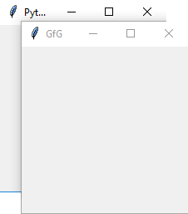
Code as Example for Widget: TopLevel
TopLevel widget for Python and GfG
from tkinter import *
root = Tk()
root.title('GfG')
top = Toplevel()
top.title('Python')
top.mainloop()

Slide 39
SpinBox
an entry of ‘Entry’ widget. Here, value can be input by selecting a fixed value of numbers.
The general syntax is:
w = SpinBox(master, option=value)
Options (can be separated with comas
bg: to set he normal background color.
bd: to set the size of border around the indicator.
cursor: To appear the cursor when the mouse over the menubutton.
command: To call a function.
width: to set the width of the widget.
activebackground: To set the background when mouse is over the widget.
disabledbackground: To disable the background when mouse is over the widget.
from_: To set the value of one end of the range.
to: To set the value of the other end of the range.

Slide 40

Code as Example for Widget: SpinBox
SpinBox widget for 0 to 10
from tkinter import *
master = Tk()
w = Spinbox(master, from_ = 0, to = 10)
w.pack()
mainloop()

Slide 41
PannedWindow
a container widget which is used to handle number of panes arranged in it.
The general syntax is:
w = PannedWindow(master, option=value)
Options (can be separated with comas
bg: to set he normal background color.
bd: to set the size of border around the indicator.
cursor: To appear the cursor when the mouse over the menubutton.
width: to set the width of the widget.
height: to set the height of the widget.

Slide 42

Code as Example for Widget: PannedWindow
PannedWindow widget to enter text and a number
from tkinter import *
m1 = PanedWindow()
m1.pack(fill = BOTH, expand = 1)
left = Entry(m1, bd = 5)
m1.add(left)
m2 = PanedWindow(m1, orient = VERTICAL)
m1.add(m2)
top = Scale( m2, orient = HORIZONTAL)
m2.add(top)
mainloop()
shows the selected filename on the right

Slide 43






Thank You
Yusuf Altunel, PhD
https://www.linkedin.com/in/yusuf-altunel-2070a31b/
y.altunel@iku.edu.tr
http://cats.iku.edu.tr/portal/site/0181f2bc-77e3-4a85-ade9-77639d9bcfe7

