Slide 1
>>>
Reading and Writing Files
Chapter 10 of Automate the Boring Stuff with Python, 3rd edition, for an advanced course
18
4
52
code examples that run on the chapter page
true stories with who, what, when, where, why and how
distinct chapter concepts, each with an everyday picture
SEN0414 Advanced Programming, Fall 2026. Yusuf Altunel, İstanbul Kültür Üniversitesi
1 / 41
Notes:
Welcome. This chapter is about files: where they live, how to name them with a path, and how to read, write and save data. Every code slide shows the code, a plain explanation and what the run printed. The same examples run on the chapter page.

Slide 2
>>>
Today's route
Five parts; every range is a run of slides you can jump to
Part | Slides | Code examples | You will run
Filepaths | 4 - 10 | 3 | Path, slash, cwd, parts of a path
Folders and file facts | 11 - 15 | 3 | makedirs, glob, exists, stat
Reading and writing text | 16 - 25 | 6 | open, read, write, with, modes, encoding
Saving variables | 26 - 31 | 2 | shelve and json
Programs | 32 - 37 | 4 | Mad Libs, Regex Search, Project 4
Changes, summary, practice, resources | 38 - 41 | - | what current Python adds
Open the chapter-code tab of the page: the same 18 examples, in this order.
2 / 41
Notes:
Five parts: paths, folders and file facts, reading and writing text, saving variables, and programs. Each code slide has a place in the chapter-code tab of the page, in this same order.

Slide 3
>>>
Two questions this chapter answers
Carry them through every part; the answers come back at the end
1
Which tools only compute a path, which ask the file system, and which change a file or a folder?
Answer on slide 39: the summary sorts every tool of the chapter.
2
Where do the printed outputs and programs of the book differ in current Python?
Answer on slides 37 and 38: Project 4 and the newer features.
Compute, ask, or change: every file tool is one of the three.
3 / 41
Notes:
Two questions to carry through. Which operations only compute a path, which ask the file system, and which change something? And where does the book differ from current Python?

Slide 4
Part 1: Filepaths
Names, addresses and the parts of a path
Path object
A path is an object, built with Path() or the slash.
Slide | In this part
5 | Everyday pictures: a path is an address
6 | Path objects: joining names into a path
7 | Story: a 2012 proposal made paths obje...
8 | Everyday pictures: where you stand
9 | Where you stand: working directory and...
10 | Taking a path apart
Working directory
The folder that every short path starts from.
Absolute or relative
A full address, or directions from where you stand.
Path parts
Name, stem, suffix and parents of one path.
4 / 41
Notes:
Part one. A path is the address of a file. pathlib makes it an object: you join, you ask where it starts, and you take it apart.

Slide 5
>>>
Everyday pictures: a path is an address
ANALOGY A filepath is a street address for a file: it says in which building, on which floor and in which room to look.
Chapter concept | Everyday picture
Files and Filepaths | A document in a filing cabinet, and the label that says which drawer.
Filepath | The full address of a document: cabinet, drawer, folder, sheet.
Standardizing Path Separators | Some countries write addresses with slashes, some with backslashes; Path writes the local style.
Joining Paths | Gluing address pieces together: city, street, house number.
Absolute path | A full postal address that works from anywhere in the world.
Relative path | Directions such as 'two doors down from here'.
Specifying Absolute vs. Relative Paths | A full address on a parcel, or a note on the desk that says 'next door'.
Handling Absolute and Relative Paths | Turning 'next door' into a full address, and a full address into 'next door'.
5 / 41
Notes:
A filepath is an address. Absolute means the full address, relative means directions from where you stand. Ask students for one more everyday picture of their own.

Slide 6
>>>
Path objects: joining names into a path
>>> from pathlib import Path, PureWindowsPath
>>> p = Path('spam', 'bacon', 'eggs')
>>> print(p)
Path() joins the names it is given with the separator of this computer and returns one path object.
>>> print(Path('spam') / 'bacon' / 'eggs' == p)
>>> print(PureWindowsPath('spam', 'bacon', 'eggs'))
The slash operator joins too. A Windows path object writes the same names with backslashes.
>>> try:
>>> print('spam' / 'bacon')
>>> except TypeError:
>>> print('two strings cannot use the slash')
One side of the slash must be a path object. Two plain strings raise a TypeError.
What the run printed (Python 3.13.16)
Expression | What it printed
Path('spam', 'bacon', 'eggs') | spam/bacon/eggs
Path('spam') / 'bacon' / 'eggs' == p | True
PureWindowsPath('spam', 'bacon', 'eggs') | spam\bacon\eggs
'spam' / 'bacon' | two strings cannot use the slash
spam
bacon
spam/bacon/eggs
eggs
three names, one path object
Path() and the slash join names into one path object.
6 / 41
Notes:
Path joins names with the separator of the computer. The slash does the same. Two plain strings cannot use the slash, because neither one is a path object.

Slide 7
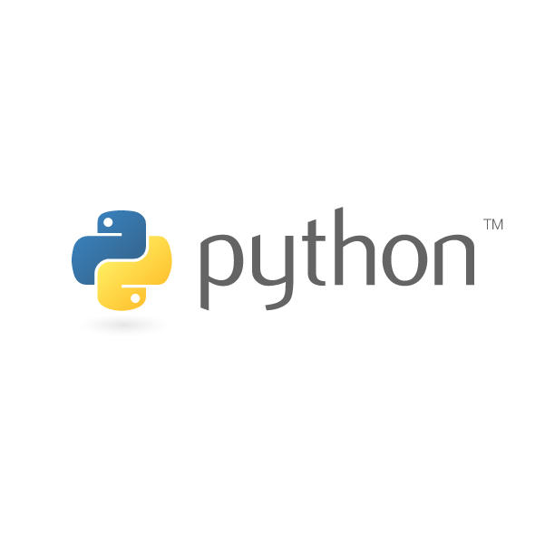
>>>
Story: a 2012 proposal made paths objects
WHO Antoine Pitrou, Python core developer.
WHAT PEP 428: a filesystem path as an object with its own methods, not a plain string.
WHEN Written 30 July 2012; shipped in Python 3.4, March 2014.
WHERE The Python Enhancement Proposals process, python.org.
WHY Separate os.path functions on strings were clumsy and hard to read.
HOW Path('spam', 'bacon', 'eggs') and the slash operator of this chapter come from it.
Python logo. Source: python.org, Python Software Foundation, used under its trademark policy.
READ PEP 428, the pathlib module (peps.python.org)
7 / 41
Notes:
Antoine Pitrou proposed pathlib in PEP 428 on 30 July 2012. A path became an object. Ask students what they gain when a path knows its own parent and suffix.

Slide 8
>>>
Everyday pictures: where you stand
ANALOGY The working directory is the room you are standing in: every short direction starts from there.
Chapter concept | Everyday picture
Accessing the Current Working Directory | Asking the signpost in the hall: 'which room am I in?'
Current working directory | The room you are standing in right now.
os.chdir() | Walking into another room; from now on 'next door' means something else.
Accessing the Home Directory | Finding your own front door, in whatever town you are.
Path() | Writing an address on a card; the card is not the house.
Path.cwd() | A card that already carries the address of the room you stand in.
Path.home() | A card that carries the address of your front door.
is_absolute | Checking whether the card shows a full address or only 'next door'.
Getting the Parts of a Filepath | Reading an address label piece by piece: street, number, flat.
8 / 41
Notes:
The working directory is where you stand. Home is your front door. A path object is a card with an address on it.

Slide 9
>>>
Where you stand: working directory and home
>>> import os, tempfile; os.chdir(tempfile.mkdtemp())
>>> from pathlib import Path
Work in a fresh scratch folder. os.chdir makes it the current working directory of this program.
>>> print(Path.cwd().is_absolute(), Path.home().is_absolute())
>>> print(Path('spam/bacon/eggs').is_absolute())
cwd and home start at the root, so they are absolute. A path that names only its own parts is relative.
>>> print(Path('./spam.txt') == Path('spam.txt'))
>>> print(Path('spam.txt').resolve() == Path.cwd() / 'spam.txt')
A relative path is read from the working directory. The dot means this folder, and resolve adds the full address.
What the run printed (Python 3.13.16)
Question asked | Answer
Path.cwd().is_absolute() | True
Path.home().is_absolute() | True
Path('spam/bacon/eggs').is_absolute() | False
Path('./spam.txt') == Path('spam.txt') | True
resolve() equals cwd / 'spam.txt' | True
/ root
scratch folder (cwd)
spam.txt
relative: spam.txt (from the cwd)
absolute: / scratch folder / spam.txt
Relative paths are read from the working directory.
9 / 41
Notes:
Cwd and home are absolute; a path with only names is relative. A relative path is read from the working directory. Resolve adds the full address.

Slide 10
>>>
Taking a path apart
>>> from pathlib import PureWindowsPath
>>> p = PureWindowsPath('C:/Users/Al/spam.txt')
A pure path only works on the text of a path, so this runs on any computer.
>>> print(p.drive, p.name, p.stem, p.suffix)
>>> print(p.parent)
>>> print(p.parts)
drive is the letter, name the last part, stem the name without its ending, suffix the ending. parts lists every piece.
>>> print(p.parents[1])
>>> print(p.with_suffix('.csv'))
parents climbs up one folder at a time. with_suffix swaps the ending.
What the run printed (Python 3.13.16)
p = PureWindowsPath('C:/Users/Al/spam.txt')
C:\
Users
Al
spam
.txt
Call | Result
p.parents[1] | C:\Users
p.with_suffix('.csv') | C:\Users\Al\spam.csv
drive + root
folder
folder
stem
suffix
parent = C:\Users\Al
name = spam.txt
A path has parts: drive, name, stem, suffix, parents.
10 / 41
Notes:
A pure path works on text only. Name, stem, suffix and drive are its parts. Parents climbs up. With suffix gives a new path.

Slide 11
Part 2: Folders and file facts
Build folders, find files, ask the file system
makedirs and mkdir
Build one folder, or a whole chain of them at once.
Slide | In this part
12 | Everyday pictures: folders and file fa...
13 | Creating folders and listing a tree
14 | glob: find files by a pattern
15 | Does it exist? How big? How old?
glob
Find files by a pattern with a question mark or a star.
exists
Ask whether a path is really there before you use it.
stat
Read the size and the time of a file.
11 / 41
Notes:
Part two. Make folders, find files with patterns, and ask the file system for size, time and existence. Nothing here changes a file yet.

Slide 12
>>>
Everyday pictures: folders and file facts
ANALOGY A folder is a box inside a box; a glob pattern is a search card that says 'every box whose label looks like this'.
Chapter concept | Everyday picture
Creating New Folders | Building the shelves for a new archive before you fill them.
os.makedirs() | Building every missing shelf on the way, from the room down to the box.
mkdir | Adding one new box to a shelf that is already there.
Checking Path Validity | Looking at the shelf to see whether a box is really there before you reach in.
exists | A yes or no question: is this label on any shelf?
Finding File Sizes and Timestamps | Reading the weight and the date stamp on a parcel.
stat | The parcel's information card: weight, date, owner.
Finding Files Using Glob Patterns | A library search card: 'every book whose title starts with project'.
glob | The librarian who walks the shelves with your search card and brings the matches.
12 / 41
Notes:
Folders are boxes in boxes. A glob pattern is a search card. Stat is the information card of a file.

Slide 13
>>>
Creating folders and listing a tree
>>> import os, tempfile; os.chdir(tempfile.mkdtemp())
>>> from pathlib import Path
A fresh scratch folder keeps your own files clean.
>>> os.makedirs('delicious/walnut/waffles')
>>> Path('delicious/walnut/pecan').mkdir()
>>> Path('delicious').mkdir(exist_ok=True)
os.makedirs builds every missing folder on the way. mkdir makes one folder, and exist_ok=True allows that it exists.
>>> for p in sorted(Path('delicious').rglob('*')):
>>> print(p)
rglob walks the whole tree below a folder. The star pattern takes every name.
What the run printed (Python 3.13.16)
pecan
Each line the loop printed is one box of the tree. Teal boxes hold other folders; amber boxes are the deepest folders.
delicious/
walnut/
waffles
makedirs builds all; mkdir builds one.
13 / 41
Notes:
Makedirs builds all missing folders. Mkdir makes one. Rglob lists the tree below a folder; the chart of the slide is drawn from the real listing.

Slide 14
>>>
glob: find files by a pattern
>>> import os, tempfile; os.chdir(tempfile.mkdtemp())
>>> from pathlib import Path
>>> for name in ('project1.txt', 'project2.txt', 'project10.txt', 'notes.csv'):
>>> Path(name).write_text('x')
Four small files to search. write_text creates each one with one letter inside.
>>> print(sorted(p.name for p in Path('.').glob('project?.txt')))
>>> print(sorted(p.name for p in Path('.').glob('*.txt')))
>>> print(sorted(p.name for p in Path('.').glob('*')))
A question mark stands for exactly one character, a star for any number. glob hands back the paths that fit.
What the run printed (Python 3.13.16)
glob pattern | Names found | Count
project?.txt | project1.txt, project2.txt | 2
*.txt | project1.txt, project10.txt, project2.txt | 3
* | notes.csv, project1.txt, project10.txt, project2.txt | 4
? is one character; * is any number.
14 / 41
Notes:
A question mark is exactly one character, a star is any number. Project10 does not fit the question mark pattern. Predict before you run.

Slide 15
>>>
Does it exist? How big? How old?
>>> import os, tempfile, time; os.chdir(tempfile.mkdtemp())
>>> from pathlib import Path
>>> f = Path('f.txt')
>>> print(f.exists())
Before the file is written, exists says False. A missing path is not an error.
>>> f.write_text('Hello, world!')
>>> print(f.exists(), f.is_file(), f.is_dir(), Path('.').is_dir())
After writing, the path exists and is a file. The dot is a folder.
>>> print(f.stat().st_size)
>>> os.utime('f.txt', (1712627129, 1712627129))
>>> print(time.asctime(time.gmtime(f.stat().st_mtime)))
stat reports the size in bytes and the last-modified time. utime sets a fixed time, so the printout never changes.
What the run printed (Python 3.13.16)
Question asked | Answer
f.exists() before writing | False
f.exists() after writing | True
f.is_file() | True
f.is_dir() | False
Path('.').is_dir() | True
st_size = 13 bytes
f.txt
is a file, not a folder
st_mtime = Tue Apr 9 01:45:29 2024
exists asks; stat measures.
15 / 41
Notes:
Exists is False for a missing path, not an error. Stat gives size in bytes and the modified time. We set the time ourselves so the output never changes.

Slide 16
Part 3: Reading and writing text
Open, read, write, close, and say how the letters are stored
open and close
Borrow a file object, use it, give it back.
Slide | In this part
17 | Everyday pictures: reading and writing...
18 | Whole files: write_text and read_text
19 | Story: UTF-8 was drawn on a diner plac...
20 | open(): a file object you must close
21 | Reading: the file cursor moves
22 | Everyday pictures: writing and the wit...
23 | with: the file closes itself
24 | Write modes: w, a and x
25 | encoding: how bytes become characters
read and write
Take the whole text, one line, or a few characters.
with
The block that closes the file for you.
Modes and encoding
w, a and x decide what happens to old text.
16 / 41
Notes:
Part three. Open a file, read it, write it and close it. The with statement closes for you. Modes decide what happens to old text.

Slide 17
>>>
Everyday pictures: reading and writing files
ANALOGY Working with a file is like a library loan: you open the book, you read or write, and you must give it back.
Chapter concept | Everyday picture
The File Reading and Writing Process | Borrow the book, read or write, return the book: three steps, always in this order.
Plaintext file | A note you can read with your own eyes: letters and line breaks.
Binary file | A sealed parcel that only the right machine can open: photos, music, spreadsheets.
Opening Files | Showing your library card and borrowing the book.
open() | The librarian's desk where a loan begins.
File object | The borrowed book in your hands, with a bookmark.
Reading the Contents of Files | Reading the book from the bookmark onward.
read | Reading the whole book in one go, from the bookmark to the last page.
close | Returning the book so the next reader can have it.
17 / 41
Notes:
Reading a file is a loan: open, use, close. A plain text file you can read; a binary file only a program can.

Slide 18
>>>
Whole files: write_text and read_text
>>> import os, tempfile; os.chdir(tempfile.mkdtemp())
>>> from pathlib import Path
>>> spam = Path('spam.txt')
One path object, spam.txt, in a fresh scratch folder.
>>> print(spam.write_text('Hello, world!'))
>>> print(spam.read_text())
>>> print(spam.write_text('café', encoding='utf-8'))
>>> print(spam.stat().st_size)
write_text returns the number of characters, not bytes. The accent takes two bytes, so 4 characters need 5 bytes.
>>> Path('b.bin').write_bytes(bytes([0, 1, 255]))
>>> print(Path('b.bin').read_bytes())
A binary file holds bytes, not text. read_bytes gives them back exactly.
What the run printed (Python 3.13.16)
Call | Result
write_text('Hello, world!') | 13
read_text() | Hello, world!
write_text('café') | 4
stat().st_size | 5
read_bytes() | b'\x00\x01\xff'
write_text counts characters; the file counts bytes.
18 / 41
Notes:
Write text returns characters, not bytes. The accent in cafe takes two bytes in utf-8, so four characters need five bytes. Binary files use write bytes.

Slide 19
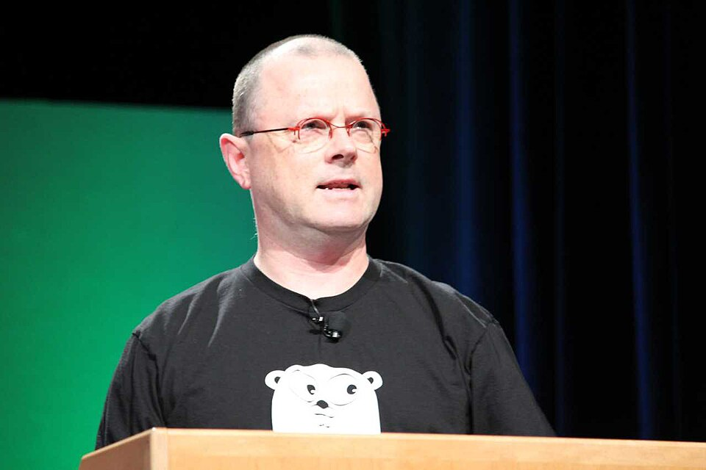
>>>
Story: UTF-8 was drawn on a diner placemat
WHO Ken Thompson and Rob Pike, both of Bell Labs.
WHAT UTF-8, the way of writing every character as one to four bytes.
WHEN September 1992; first working code on 4 September, proposal to X/Open on 8 September.
WHERE A diner in New Jersey, then Bell Labs in Murray Hill.
WHY The rival encoding FSS/UTF could not recover a byte stream picked up mid-character.
HOW The encoding='utf-8' you pass to open() names that format.
Rob Pike at OSCON. Photo: Kevin Shockey, CC BY 2.0, Wikimedia Commons.
READ UTF-8 history, by Rob Pike (doc.cat-v.org)
19 / 41
Notes:
Thompson and Pike designed UTF-8 in September 1992 in a New Jersey diner. Today open() with encoding utf-8 uses it. Ask: what goes wrong when two programs disagree on the encoding?

Slide 20
>>>
open(): a file object you must close
>>> import os, tempfile; os.chdir(tempfile.mkdtemp())
>>> bacon = open('bacon.txt', 'w', encoding='utf-8')
open returns a file object. The mode w means write, and it starts a new empty file.
>>> print(bacon.write('Hello, world!\n'))
>>> print(bacon.write('Bacon is not a vegetable.'))
>>> bacon.close()
Each write returns how many characters it wrote. close finishes the job and frees the file.
>>> reader = open('bacon.txt', encoding='utf-8')
>>> print(reader.read())
>>> reader.close()
>>> print(reader.closed)
Mode r, reading, is the default. read returns the whole text, and closed tells whether the file is shut.
What the run printed (Python 3.13.16)
open(.., 'w')
write(line 1)
write(line 2)
close()
reader.read()
reader.close()
an empty file
14 characters
25 characters
text saved
2 lines read back
closed = True
The program printed: 14, 25, then the two lines 'Hello, world!' and 'Bacon is not a vegetable.', then True.
Open, use, close: always return the file.
20 / 41
Notes:
Open returns a file object. Mode w starts a clean file. Always close it. Reading is the default mode. The closed flag tells the state.

Slide 21
>>>
Reading: the file cursor moves
>>> import os, tempfile; os.chdir(tempfile.mkdtemp())
>>> from pathlib import Path
>>> poem = Path('poem.txt')
>>> poem.write_text('roses\nviolets\nsugar\n', encoding='utf-8')
>>> f = open(poem, encoding='utf-8')
A poem of three lines is written first. Then the file is opened for reading.
>>> print(repr(f.readline()), f.tell())
>>> print(f.readlines(), f.tell())
>>> print(repr(f.read()), f.tell())
>>> f.seek(0)
>>> print(repr(f.read(5)), f.tell())
>>> f.close()
Every read moves the cursor on, and tell shows where it stands. At the end read gives an empty string. seek(0) rewinds.
What the run printed (Python 3.13.16)
r
o
s
e
s
⏎
v
i
o
l
e
t
s
⏎
s
u
g
a
r
⏎
0
1
2
3
4
5
6
7
8
9
10
11
12
13
14
15
16
17
18
19
teal: readline took it amber: readlines took it the cursor then stands at 20, the end
Call | What came back | Cursor after
readline() | 'roses\n' | 6
readlines() | ['violets\n', 'sugar\n'] | 20
read() | '' | 20
seek(0); read(5) | 'roses' | 5
Reading moves the cursor; seek(0) rewinds.
21 / 41
Notes:
A file has a cursor. Readline moves it one line, readlines to the end, read from the cursor. At the end, read gives an empty string. Seek zero rewinds.

Slide 22
>>>
Everyday pictures: writing and the with block
ANALOGY A with block is a borrowing slip that returns the book by itself, even if you drop everything and run.
Chapter concept | Everyday picture
Writing to Files | Writing in a notebook: 'w' brings a clean page, 'a' continues, 'x' refuses to touch a used one.
write | Writing one more line into the notebook.
write_text | Dictating a whole letter to a secretary who files it for you.
read_text | Asking the secretary to read the whole letter back.
readlines | Tearing the letter into strips, one strip per line.
Using with Statements | A borrowing slip that sends the book back by itself.
Context manager | A hotel porter: opens the door for you and shuts it again after you leave.
22 / 41
Notes:
Modes decide what happens to old text: w clears, a continues, x refuses. The with block closes the file by itself.

Slide 23
>>>
with: the file closes itself
>>> import os, tempfile; os.chdir(tempfile.mkdtemp())
>>> with open('data.txt', 'w', encoding='utf-8') as file_obj:
>>> print(file_obj.write('abc'), file_obj.closed)
>>> print(file_obj.closed)
Inside the block the file is open. When the block ends, the with statement closes it for you.
>>> try:
>>> with open('data.txt', 'w', encoding='utf-8') as g: raise RuntimeError('boom')
>>> except RuntimeError:
>>> print(g.closed)
Even when an error leaves the block, the file is closed. That is why with is the safe way.
What the run printed (Python 3.13.16)
with open(...) as file_obj:
block ends
RuntimeError inside with
enter the block
with closes the file
an error leaves the block
closed = False
closed = True
closed = True
with closes the file, even after an error.
23 / 41
Notes:
The with block closes the file when it ends, also after an error. That is why professionals use it. A closed file cannot be written.

Slide 24
>>>
Write modes: w, a and x
>>> import os, tempfile; os.chdir(tempfile.mkdtemp())
>>> from pathlib import Path
>>> log = Path('log.txt')
One file, log.txt, to write to four times.
>>> for mode, text in (('w', 'A\n'), ('a', 'B\n'), ('a', 'C\n'), ('w', 'D\n')):
>>> with open(log, mode, encoding='utf-8') as f:
>>> f.write(text)
>>> print(mode, repr(log.read_text()))
Mode w empties the file first. Mode a adds to the end. The printout shows the whole file after every step.
>>> try: open(log, 'x')
>>> except FileExistsError: print('x refuses: the file exists')
Mode x creates a new file and refuses when the file already exists.
What the run printed (Python 3.13.16)
Step | Mode | File now holds
1 | w | 'A\n'
2 | a | 'A\nB\n'
3 | a | 'A\nB\nC\n'
4 | w | 'D\n'
5 | x | x refuses: the file exists
w clears, a appends, x refuses.
24 / 41
Notes:
W clears the old text. A appends. X refuses when the file exists. The chart shows the file size after every step.

Slide 25
>>>
encoding: how bytes become characters
>>> import os, tempfile; os.chdir(tempfile.mkdtemp())
>>> from pathlib import Path
>>> Path('a.txt').write_text('café', encoding='utf-8')
>>> print(open('a.txt', encoding='utf-8').read())
The same encoding that wrote the file reads it back correctly.
>>> print(open('a.txt', encoding='ascii', errors='replace').read())
>>> try: print(open('a.txt', encoding='ascii').read())
>>> except UnicodeDecodeError: print('ascii cannot read the byte 0xc3')
The wrong encoding either garbles the accent or stops with an error.
>>> for enc in ('utf-8', 'utf-16-le', 'latin-1'):
>>> print(enc, len('café'.encode(enc)))
The same four letters take a different number of bytes in each encoding.
What the run printed (Python 3.13.16)
Reading the file with | What happened
encoding='utf-8' | café
ascii, errors='replace' | caf��
encoding='ascii' | ascii cannot read the byte 0xc3
Say the encoding; utf-8 is the safe choice.
25 / 41
Notes:
Say the encoding every time. The wrong one garbles text or fails. The same word needs a different number of bytes in each encoding.

Slide 26
Part 4: Saving variables
Keep Python values in a file between two runs
shelve
A dictionary that is kept in a file.
Slide | In this part
27 | Everyday pictures: saving variables
28 | shelve: a dictionary that a file can k...
29 | Story: a shelf rests on a 1979 Bell La...
30 | json: a plain format other programs read
31 | Story: JSON was written up in 2001
Shelf trap
A list changed in place is not saved.
json
A plain text format that other programs can read.
pickle warning
Never open a shelf that came from a stranger.
26 / 41
Notes:
Part four. A shelf keeps Python values in a file under a key. Json is the plain alternative that other programs can read.

Slide 27
>>>
Everyday pictures: saving variables
ANALOGY A shelf is a pigeonhole cupboard: every value sits in a slot with a label, and the cupboard stays when you go home.
Chapter concept | Everyday picture
Saving Variables with the shelve Module | Putting your notes into a labelled cupboard before you leave for the night.
Shelf | The cupboard itself: a dictionary that lives in a file.
shelve.open() | Unlocking the cupboard; if there is none, a new one is built.
json | A letter in plain language that any reader in any country can understand.
27 / 41
Notes:
A shelf is a dictionary in a file. Json is plain text that any program understands.

Slide 28
>>>
shelve: a dictionary that a file can keep
>>> import shelve
>>> store = {}
>>> shelf = shelve.Shelf(store)
>>> shelf['cats'] = ['Zophie', 'Pooka', 'Simon']
A Shelf is a dictionary that stores every value pickled. shelve.open('mydata') puts it in a file; here a plain dict plays the file.
>>> print(list(shelf.keys()), shelf['cats'])
>>> print(type(store[b'cats']).__name__)
Keys and values come back as you stored them. Underneath, the dict holds bytes, for the key and for the value.
>>> shelf['cats'].append('Fat-tail')
>>> print(len(shelf['cats']))
>>> cats = shelf['cats']
>>> cats.append('Fat-tail')
>>> shelf['cats'] = cats
>>> print(len(shelf['cats']))
Trap: a list changed in place is not saved, so the length stays 3. Assign the list back to its key and the change is kept.
What the run printed (Python 3.13.16)
shelf['cats'] = [...]
store[b'cats'] = bytes
on disk: shelve.open('mydata') makes it a file
pickled
keys and value: ['cats'] ['Zophie', 'Pooka', 'Simon']
On your computer shelve.open('mydata') keeps it in a file.
28 / 41
Notes:
A shelf is a dictionary that a file can keep; values are pickled, so never open a shelf from a stranger. Here a dict plays the file because the browser has no dbm. Trap: assign a changed list back.

Slide 29
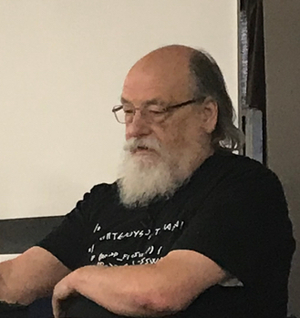
>>>
Story: a shelf rests on a 1979 Bell Labs idea
WHO Ken Thompson, a programmer at AT&T Bell Laboratories.
WHAT The first dbm: a simple store that keeps a value under a text key.
WHEN 1979, released by AT&T as part of Unix.
WHERE Bell Laboratories, Murray Hill, New Jersey.
WHY A program needed to save a value and get it back by one key, with no server.
HOW shelve.open() still gives that one-key-one-value shape; Python's dbm package picks the backend file.
Ken Thompson, 2019. Photo: A.C.Diller, CC BY-SA 4.0, Wikimedia Commons.
READ DBM (computing) on Wikipedia
29 / 41
Notes:
Ken Thompson wrote the first dbm in 1979. A shelf is the same idea: one key, one value, one file. Ask students why a program might want to save values by key.

Slide 30
>>>
json: a plain format other programs read
>>> import json
>>> data = {'cats': ['Zophie', 'Pooka'], 'pair': (1, 2), 5: 'five'}
>>> text = json.dumps(data)
>>> print(text)
dumps turns a Python value into JSON text. JSON keys are always text, and a tuple becomes a list.
>>> print(json.loads(text))
loads reads the text back. The tuple is now a list and the key 5 is now the text '5'.
What the run printed (Python 3.13.16)
Key in Python | Value in Python | Written as JSON | Back in Python
'cats' (str) | list | array | list, key 'cats'
'pair' (str) | tuple | array | list, key 'pair'
5 (int) | str | string | str, key '5'
Red: the value comes back as another type. JSON has no tuples, and every key is text.
json is plain text that other programs read.
30 / 41
Notes:
Json is plain text. Tuples become lists and every key becomes text. Prefer json when another program must read the data.

Slide 31
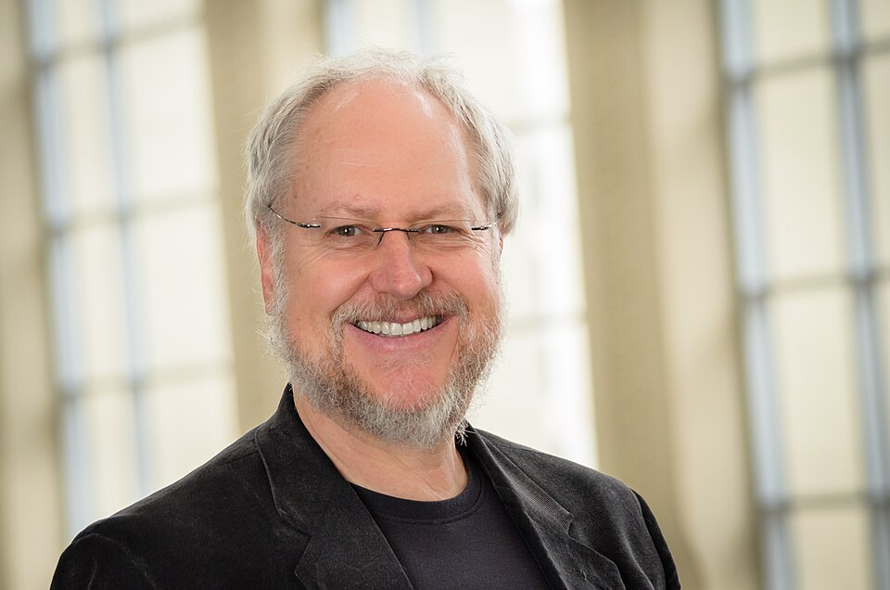
>>>
Story: JSON was written up in 2001
WHO Douglas Crockford and Chip Morningstar.
WHAT JSON, a minimal text format for data, with every key in quotes.
WHEN 2001; Crockford opened json.org on 12 November 2002.
WHERE State Software, a consulting firm in California.
WHY A browser and a server needed to exchange data without reloading the page.
HOW json.dumps() and json.loads() read and write that format for any program or language.
Douglas Crockford, 2013. Photo: Robert Claypool, CC0, Wikimedia Commons.
READ JSON on Wikipedia
31 / 41
Notes:
Crockford and Morningstar wrote up JSON in 2001. It is the plain alternative to a shelf when another program must read the data. Ask which one a web server would use.

Slide 32
Part 5: Programs
Two practice programs and Project 4, the quiz maker
Mad Libs
Fill the blanks of a story file with re.sub.
Slide | In this part
33 | Everyday pictures: programs and review
34 | Practice program: Mad Libs
35 | Practice program: search the text files
36 | Project 4, step 1: one multiple-choice...
37 | Project 4, step 2: write the quiz and ...
Regex Search
Search every text file of a folder for a pattern.
Project 4
Make quiz files and answer keys at random.
Summary
Sort every tool: compute, ask or change.
32 / 41
Notes:
Part five. Two practice programs and Project 4, the random quiz maker. Each uses only what parts one to four taught.

Slide 33
>>>
Everyday pictures: programs and review
ANALOGY A project is a small workshop job: you read the files, you change them, you write a new one.
Chapter concept | Everyday picture
Project 4: Generate Random Quiz Files | A teacher who shuffles the question cards and prints a new test for every student.
Practice Programs | Exercises at the piano: short pieces that make one skill automatic.
Practice Questions | Finger scales before the concert.
Summary | A packing list: only what you really need goes into the bag.
Mad Libs | A party game: blanks in a story that the guests fill in.
Regex Search | A detective with a magnifying glass going through every file in the folder.
33 / 41
Notes:
Practice programs make the parts automatic. Project 4 builds a quiz and its key from a dictionary.

Slide 34
>>>
Practice program: Mad Libs
>>> import os, re, tempfile; os.chdir(tempfile.mkdtemp())
>>> from pathlib import Path
>>> story = 'The ADJECTIVE panda walked to the NOUN and then VERB.'
>>> Path('panda.txt').write_text(story, encoding='utf-8')
A text file holds a story with capital-letter blanks.
>>> answers = iter(['silly', 'chandelier', 'screamed'])
>>> text = Path('panda.txt').read_text(encoding='utf-8')
>>> result = re.sub(r'ADJECTIVE|NOUN|VERB', lambda m: next(answers), text)
re.sub replaces every blank with the next answer. The answers come from a list instead of from typing.
>>> Path('panda_filled.txt').write_text(result, encoding='utf-8')
>>> print(result)
The finished story is saved to a second file and printed.
What the run printed (Python 3.13.16)
Blank in panda.txt | Answer written in
ADJECTIVE | silly
NOUN | chandelier
VERB | screamed
panda.txt
re.sub
panda_filled.txt
The silly panda walked to the chandelier and then screamed.
Read a file, substitute, write a file.
34 / 41
Notes:
Mad Libs reads a file, replaces the blanks with re sub and writes a second file. Answers come from a list so the run repeats.

Slide 35
>>>
Practice program: search the text files
>>> import os, re, tempfile; os.chdir(tempfile.mkdtemp())
>>> from pathlib import Path
>>> put = lambda f, t: Path(f).write_text(t, encoding='utf-8')
put is a small helper that writes a text file in a fresh scratch folder.
>>> put('a.txt', 'spam and eggs\nbacon alone\nSPAM again\n')
>>> put('b.txt', 'nothing here\nspam, glorious spam\n')
>>> put('notes.csv', 'spam,1\n')
Three small files: two text files and one csv file that the search must skip.
>>> for p in sorted(Path('.').glob('*.txt')):
>>> lines = p.read_text(encoding='utf-8').splitlines()
>>> for n, line in enumerate(lines, 1):
>>> if re.search('spam', line): print(f'{p.name}:{n}: {line}')
glob picks the txt files only. Each line is tested with the pattern; a hit prints file, line number and line.
What the run printed (Python 3.13.16)
File | Lines | Printed | Why
a.txt | 3 | 1 | lines with spam, in small letters
b.txt | 2 | 1 | lines with spam, in small letters
notes.csv | - | - | never opened: glob takes *.txt only
glob + a pattern + enumerate = a file search.
35 / 41
Notes:
Glob picks the txt files, the pattern tests each line, the print shows file, line number and line. The csv file is skipped by the glob.

Slide 36
>>>
Project 4, step 1: one multiple-choice question
>>> import random
>>> capitals = {'Alabama': 'Montgomery', 'Alaska': 'Juneau',
>>> 'Arizona': 'Phoenix', 'Arkansas': 'Little Rock',
>>> 'California': 'Sacramento'}
>>> random.seed(10)
Five states stand in for the fifty of the book. The seed makes the random choices repeat.
>>> state = random.choice(list(capitals))
>>> others = [c for c in capitals.values() if c != capitals[state]]
>>> options = random.sample(others, 3) + [capitals[state]]
>>> random.shuffle(options)
Pick a state, take three wrong capitals, add the right one and shuffle the four.
>>> print(f'What is the capital of {state}?')
>>> for letter, option in zip('ABCD', options):
>>> print(f' {letter}. {option}')
Print the question and the four lettered options.
What the run printed (Python 3.13.16)
What is the capital of California? (key: C)
A. Phoenix
B. Juneau
C. Sacramento
D. Montgomery
Shuffle the options; remember the right one.
36 / 41
Notes:
Project 4 step one: one question. Choose a state, three wrong capitals, one right one, shuffle. The seed makes the run repeat.

Slide 37
>>>
Project 4, step 2: write the quiz and its key
>>> import os, random, tempfile; os.chdir(tempfile.mkdtemp())
>>> from pathlib import Path
A fresh scratch folder will hold the two files.
>>> caps = {'Ohio': 'Columbus', 'Utah': 'Salt Lake City',
>>> 'Iowa': 'Des Moines', 'Maine': 'Augusta'}
>>> random.seed(10)
>>> quiz, key = [], []
Four states: each question has one right capital and three wrong ones.
>>> for n, state in enumerate(caps, 1):
>>> others = [c for c in caps.values() if c != caps[state]]
>>> options = random.sample(others, 3) + [caps[state]]
>>> random.shuffle(options)
One loop makes one question per state, with the options shuffled.
>>> quiz.append(f'{n}. {state}: ' + ' / '.join(options))
>>> key.append(f'{n}. {"ABCD"[options.index(caps[state])]}')
A question line holds the options; a key line holds the right letter.
>>> for f, rows in (('quiz1.txt', quiz), ('key1.txt', key)):
>>> Path(f).write_text('\n'.join(rows) + '\n', encoding='utf-8')
>>> print(Path(f).read_text(encoding='utf-8'), end='')
Write both files, then read them back and print them.
What the run printed (Python 3.13.16)
1. Ohio
2. Utah
3. Iowa
4. Maine
quiz1.txt for the students, key1.txt for the teacher
key D = Columbus
key C = Salt Lake City
key C = Des Moines
key B = Augusta
One loop writes the quiz and its key.
37 / 41
Notes:
Step two writes the quiz and the key to two files. The book prints a different layout; the research notes the differences. Ask students to find one.

Slide 38
>>>
Current Python adds more
Features newer than the book, from the chapter research
Feature | Since | What it gives you
Path.walk() walks a folder tree | 3.12 | Folders and files of every level, top down
glob(..., case_sensitive=...) | 3.12 | Choose whether capitals count, on any system
st_ctime is deprecated on Windows | 3.12 | Use st_birthtime for the creation time
dbm.sqlite3 is the first shelve backend | 3.13 | A new shelf is one file with the name you gave
exists(), is_file(), is_dir() hide OSError | 3.14 | They return False instead of raising any OSError
EncodingWarning (PEP 597) | 3.10 | Run with -X warn_default_encoding to find open() calls without encoding
UTF-8 mode becomes the default (PEP 686) | 3.15 | open() without encoding will use UTF-8 on every system
Run what the book printed; then check what changed.
38 / 41
Notes:
Python moves on. Path walk and the case sensitive glob came in 3.12. Python 3.14 makes exists return False on any error. Python 3.15 makes UTF-8 the default.

Slide 39
>>>
Summary
ANALOGY A summary is a packing list: only what you really need goes into the bag.
A path is an object: join it, take it apart, ask where it starts.
tools of this chapter, by what they do
1
2
Folders are made with makedirs; files are found with glob.
3
open, read, write and close; with closes for you.
4
Modes w, a and x decide what happens to old text.
5
A shelf keeps values in a file; json is the plain alternative.
Computing is safe, asking is free, changing needs care.
39 / 41
Notes:
A path is computed, asked about or changed. The chart counts the chapter's tools by kind. Computing is safe, asking is free, changing needs care.

Slide 40
>>>
Practice Questions
Predict first, then run it on the chapter page
ANALOGY Practice questions are finger scales for a pianist: short drills before the performance.
1
Why does Path('spam') / 'bacon' work, while 'spam' / 'bacon' raises a TypeError?
2
What does the file hold after the modes w, a, a, w, and what does mode x do?
3
Why is a list changed inside a shelf lost, and how do you keep the change?
4
Change the quiz program so that the key file also names the right capital.
Each answer fits in a few lines you can run.
40 / 41
Notes:
Four drills. Predict first, then run on the page. Ask students to explain each answer in one sentence.

Slide 41
>>>
Resources: where to go next
Reading and watching, chosen for this chapter; every link is live
Book: Automate the Boring Stuff 3e, chapter 10
https://automatetheboringstuff.com/3e/chapter10.html
Python documentation: tempfile
https://docs.python.org/3/library/tempfile.html
Python documentation: pathlib
https://docs.python.org/3/library/pathlib.html
PEP 428: the pathlib module (Pitrou, 2012)
https://peps.python.org/pep-0428/
Python documentation: open()
https://docs.python.org/3/library/functions.html
PEP 686: UTF-8 mode becomes the default
https://peps.python.org/pep-0686/
Python documentation: io and encoding
https://docs.python.org/3/library/io.html
PEP 597: the optional EncodingWarning
https://peps.python.org/pep-0597/
Python tutorial: reading and writing files
https://docs.python.org/3/tutorial/inputoutput.html
UTF-8 history, by Rob Pike
https://doc.cat-v.org/bell_labs/utf-8_history
Python documentation: shelve
https://docs.python.org/3/library/shelve.html
JSON: the format and its home page
https://www.json.org/json-en.html
Python documentation: dbm
https://docs.python.org/3/library/dbm.html
Joel Spolsky: Unicode and character sets
joelonsoftware.com
Python documentation: json
https://docs.python.org/3/library/json.html
Video: File Objects (Corey Schafer)
https://www.youtube.com/watch?v=Uh2ebFW8OYM
Pick one link and read it before the next class.
41 / 41
Notes:
Start with the book chapter, then the Python documentation. The stories link to first-hand sources. Choose one link and read it before the next class.

