Slide 1
>>>
>>> sum(range(101))
5050
>>> list(range(3))
[0, 1, 2]
Chapter 3: Loops and Modules
Doing it again until it is done - and importing what others finished
run under Python 3.13.16
SEN0414 Advanced Programming · Fall 2026 · Yusuf Altunel, PhD · İstanbul Kültür University
Notes:
SAY: Chapter 2 chose between paths; chapter 3 repeats them: while and for, the containers loops visit, and the modules that save you writing loops at all.
FULL TEXT: course page, chapter 3.

Slide 2
Today's route
>>>
Five parts; every number is a slide you can jump to
1
Questions and the chapter map (slides 3-4)
21
slides, numbered bottom-right
2
Repeating - while, for, range (slides 5-9)
3
3
Sequences - lists, dicts, enumerate, zip (slides 10-12)
true stories, each with WHO / WHERE / WHEN / READ
4
Loop control - break, continue, nesting (slides 13-14)
26
5
Modules, summary, and resources (slides 15-21)
consoles and whole programs, run live
Five parts - and every transcript on screen really printed
2 / 21
Notes:
SAY: Five parts, from Gauss's shortcut to the twister inside random - every transcript verified off this very file.
ASK: Which part do you expect to be hardest - mark it now, check at the summary.
FULL TEXT: course page, chapter 3 - every section.

Slide 3
The questions this chapter answers
>>>
Its own competency questions - we return to each
1
Which constructs repeat a block, and what decides when each one stops?
2
Which statements leave or skip part of a loop, and what do they leave behind?
3
Which operations raise an error, and which error with which message?
4
Which concepts reach beyond the 3rd edition into current Python, and on what source?
5
Which terms does the chapter use without defining them, and where are they defined here?
every answer ran
whole programs with transcripts
sources on the last slide
If you can answer these, chapter 3 is yours
3 / 21
Notes:
SAY: Repetition is the ability of a program to run the same block of code more than once, and it is the subject of the first half of chapter 3. Chapter 2 showed how a program chooses between blocks, so that some lines run and others are skipped; this chapter adds the loop, a statement that sends execution back to the start of a block so that the same lines can serve many values (Sweigart, 2025).
FULL TEXT: course page, chapter 3 - Repetition.

Slide 4
One chapter, five branches
>>>
The concept map the whole chapter hangs on
Each branch is a question the chapter answers; the grey lists are the concepts that answer it, every one explained on the course page.
Repetition
Loop Basics · Condition Loop · Counted Loop · Loop Composition
Sequence
Range Sequence · Iteration Helper · Iteration Protocol · Collection Value
Chapter 3
Loop Control
Early Exit · Skipping · Loop Completion · Exception Handling
Module
Import Form · Module Basics · Standard Module
Modern Practice
Expression Style · Hazard
Five branches - every slide today lives on this map
4 / 21
Notes:
SAY: Repetition is the ability of a program to run the same block of code more than once, and it is the subject of the first half of chapter 3. Chapter 2 showed how a program chooses between blocks, so that some lines run and others are skipped; this chapter adds the loop, a statement that sends execution back to the start of a block so that the same lines can serve many values (Sweigart, 2025).
FULL TEXT: course page, chapter 3 - Repetition, Module.

Slide 5
Repeating
while guards; for visits; range describes
while
for
range
Accumulators
5 / 21
Notes:
SAY: Repetition is the ability of a program to run the same block of code more than once, and it is the subject of the first half of chapter 3. Chapter 2 showed how a program chooses between blocks, so that some lines run and others are skipped; this chapter adds the loop, a statement that sends execution back to the start of a block so that the same lines can serve many values (Sweigart, 2025).
FULL TEXT: course page, chapter 3 - Repetition.

Slide 6
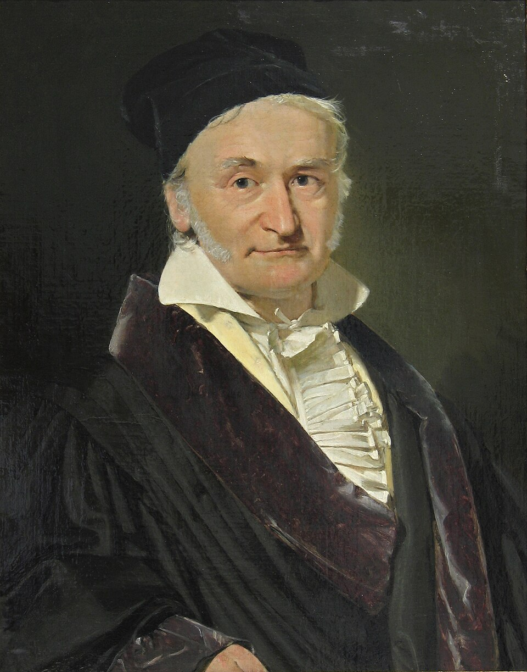
The schoolboy who refused to loop
>>>
legend set in the 1780s; traced in print back to 1856
Add 1 to 100, said the teacher; fifty pairs of 101, said the boy
A legend with a paper trail - first printed 1856, versions traced since
the loop earns 5050; the formula agrees without looping
total = 0
for num in range(101):
total = total + num
print(total)
prints 5050
program gauss_v1_0_0.py, lines 1 to 4 of 4, run under Python 3.13.16
Gauss, by Jensen (1840) - public domain
WHO Carl Friedrich Gauss (1777-1855), in a…
WHERE the anecdote's paper trail, collected …
WHEN legend set in th…
READ en.wikipedia.org
A loop is honest work - and sometimes a formula beats it
6 / 21
Notes:
STORY (legend set in the 1780s; traced in print back to 1856): The story says a teacher set the class to add every number from 1 to 100, and young Gauss answered at once: pair 1 with 100, 2 with 99 - fifty pairs of 101, 5050. The tale grew in the telling - Brian Hayes traced dozens of versions back to an 1856 memorial - but the mathematics needs no legend. The chapter's gauss program does it both ways: the loop accumulates 5050, and Gauss's closed form agrees without looping at all.
SOURCE: The anecdote's documented trail: first printed in Wolfgang Sartorius von Waltershausen's 1856 memorial of Gauss; versions collected by Brian Hayes ('Gauss's Day of Reckoning', American Scientist, 2006). Portrait: Jensen, 1840, public domain.

Slide 7
while repeats; for visits
>>>
The same five greetings, two machines
while: you manage the counter
for: range hands you each i
print('Hello!')
i = 0
while i < 5:
print('On this iteration, i is set to ' + str(i))
i = i + 1
print('Goodbye!')
prints Hello!
On this iteration, i is set to 0
On this iteration, i is set to 1
On this iteration, i is set to 2
On this iteration, i is set to 3
On this iteration, i is set to 4
Goodbye!
print('Hello!')
for i in range(5):
print('On this iteration, i is set to ' + str(i))
print('Goodbye!')
prints Hello!
On this iteration, i is set to 0
On this iteration, i is set to 1
On this iteration, i is set to 2
On this iteration, i is set to 3
On this iteration, i is set to 4
Goodbye!
program fivetimes_while_v1_0_0.py, lines 1 to 6 of 6, run under Python 3.13.16
program fivetimes_for_v1_0_0.py, lines 1 to 4 of 4, run under Python 3.13.16
same transcript, different bookkeeping
while guards a condition; for walks a collection
7 / 21
Notes:
SAY: Repetition is the ability of a program to run the same block of code more than once, and it is the subject of the first half of chapter 3. Chapter 2 showed how a program chooses between blocks, so that some lines run and others are skipped; this chapter adds the loop, a statement that sends execution back to the start of a block so that the same lines can serve many values (Sweigart, 2025).
ASK: Which version can forget to advance - and what happens then?
FULL TEXT: course page, chapter 3 - Repetition.

Slide 8
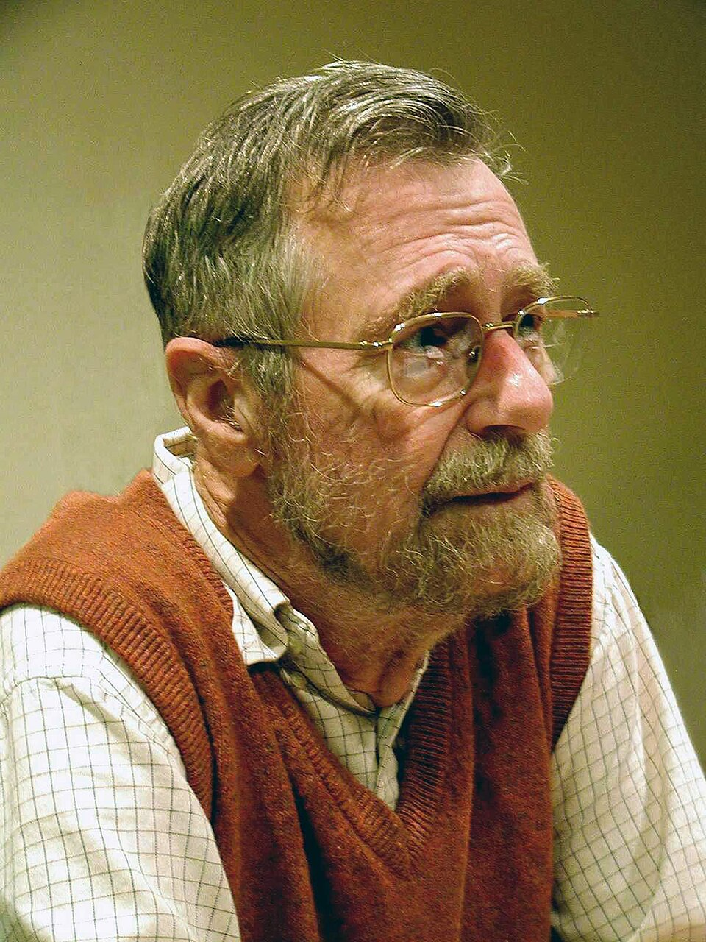
Why range(5) stops before five
>>>
1982-08-11
A handwritten 1982 memo: include the start, exclude the stop
Lengths become stop minus start; adjacent ranges meet without overlap
the memo's promise, kept by range
>>> len(range(0, 24))
24
>>> list(range(1, 11))
[1, 2, 3, 4, 5, 6, 7, 8, 9, 10]
>>> 'hello'[1:3]
'el'
>>> list(range(0, 5)) + list(range(5, 10)) == list(range(10))
True
Dijkstra - photo: Hamilton Richards, CC BY-SA 3.0
run under Python 3.13.16
WHO Edsger W. Dijkstra, Turing Award 1972
WHERE handwritten memo EWD831, Austin, Texas
WHEN 1982-08-11
READ cs.utexas.edu
Half-open ranges are a 1982 argument your loops obey
8 / 21
Notes:
STORY (1982-08-11): In August 1982 Dijkstra wrote a two-page memo, by fountain pen as always, titled 'Why numbering should start at zero'. His argument: half-open ranges - include the start, exclude the stop - make lengths obvious (stop minus start), let adjacent ranges meet without overlap, and avoid ugly sentinels. Python follows it everywhere: range(5) yields five numbers starting at 0, and the chapter's consoles show adjacent ranges clicking together exactly as the memo promised.
SOURCE: E.W. Dijkstra, EWD831, 'Why numbering should start at zero', dated 11 August 1982, in the EWD archive at the University of Texas. Photo: Hamilton Richards, CC BY-SA 3.0.

Slide 9
range: start, stop, step - lazily
>>>
A description of numbers, not a box of them
start and stop
the step, forwards and down
>>> list(range(12, 16))
[12, 13, 14, 15]
>>> len(range(12, 16))
4
>>> list(range(16, 12))
[]
>>> list(range(0, 10, 2))
[0, 2, 4, 6, 8]
>>> list(range(0, 10, 3))
[0, 3, 6, 9]
>>> len(range(0, 10, 3))
4
>>> range(0, 10, 0)
ValueError: range() arg 3 must not be zero
run under Python 3.13.16
run under Python 3.13.16
a billion numbers, no memory - laziness measured
the accumulator pattern every total uses
>>> range(10)
range(0, 10)
>>> range(10) == list(range(10))
False
>>> isinstance(range(3), list)
False
>>> sum(range(4))
6
>>> sum(range(101))
5050
>>> sum(range(100))
4950
>>> 50 * 101
5050
>>> len(range(101))
101
run under Python 3.13.16
run under Python 3.13.16
range describes numbers without building them
9 / 21
Notes:
SAY: Repetition is the ability of a program to run the same block of code more than once, and it is the subject of the first half of chapter 3. Chapter 2 showed how a program chooses between blocks, so that some lines run and others are skipped; this chapter adds the loop, a statement that sends execution back to the start of a block so that the same lines can serve many values (Sweigart, 2025).
ASK: Why does range(10**9) cost nothing until you loop it?
FULL TEXT: course page, chapter 3 - Repetition, Sequence.

Slide 10
Sequences
What for loops visit
Lists
Tuples and dicts
enumerate / zip
Unpacking
10 / 21
Notes:
SAY: In chapter 3 the word sequence stands for whatever a for loop can walk through. Python's glossary gives the strict meaning: a sequence is an iterable that supports efficient access to its elements through integer indices and that has a length, and the built-in sequence types include list, str, tuple and bytes (Python Software Foundation, 2026).
FULL TEXT: course page, chapter 3 - Sequence.

Slide 11
Lists, tuples, dicts - the things loops visit
>>>
Three containers, one loop
lists: ordered, changeable
dicts: loop keys, values, or pairs
>>> a = [1, 2]
>>> a.append(3)
None
>>> a
[1, 2, 3]
>>> a[0] = 99
>>> a
[99, 2, 3]
>>> list(range(3)) + [9]
[0, 1, 2, 9]
>>> {'Ada': 'active', 'Can': 'inactive'}['Can']
'inactive'
>>> list({'Ada': 'active', 'Can': 'inactive'})
['Ada', 'Can']
>>> {'Ada': 'active'}['Eda']
KeyError: 'Eda'
a dict grows and counts
run under Python 3.13.16
users = {'Ada': 'active', 'Can': 'inactive'}
del users['Can']
print(users, len(users))
prints {'Ada': 'active'} 1
run under Python 3.13.16
list: [ ] mutable
program dict_ops_v1_0_0.py, lines 1 to 3 of 3, run under Python 3.13.16
tuple: ( ) fixed
dict: { } key to value
Three containers, three jobs - and one for loop fits all
11 / 21
Notes:
SAY: In chapter 3 the word sequence stands for whatever a for loop can walk through. Python's glossary gives the strict meaning: a sequence is an iterable that supports efficient access to its elements through integer indices and that has a length, and the built-in sequence types include list, str, tuple and bytes (Python Software Foundation, 2026).
ASK: Which of the three would hold the days of the week - and why that one?
FULL TEXT: course page, chapter 3 - Sequence.

Slide 12
enumerate and zip: positions and pairs
>>>
Stop counting by hand
enumerate hands you index and item together
>>> list(enumerate(['Spring', 'Summer', 'Fall', 'Winter']))
[(0, 'Spring'), (1, 'Summer'), (2, 'Fall'), (3, 'Winter')]
>>> list(enumerate(['tic', 'tac', 'toe'], start=1))
[(1, 'tic'), (2, 'tac'), (3, 'toe')]
>>> next(enumerate('ab'))
(0, 'a')
the loop, whole
zip pairs two sequences - strict= catches ragged ones
run under Python 3.13.16
for i, v in enumerate(['tic', 'tac', 'toe']):
print(i, v)
prints 0 tic
1 tac
2 toe
>>> list(zip('abc', [1, 2]))
[('a', 1), ('b', 2)]
>>> list(zip('ab', [1, 2], strict=True))
[('a', 1), ('b', 2)]
>>> list(zip('ab', [1], strict=True))
ValueError: zip() argument 2 is shorter than argument 1
program for_pairs_v1_0_0.py, lines 1 to 2 of 2, run under Python 3.13.16
run under Python 3.13.16
Stop counting by hand - Python hands you the index
12 / 21
Notes:
SAY: In chapter 3 the word sequence stands for whatever a for loop can walk through. Python's glossary gives the strict meaning: a sequence is an iterable that supports efficient access to its elements through integer indices and that has a length, and the built-in sequence types include list, str, tuple and bytes (Python Software Foundation, 2026).
ASK: What does zip do with unequal lengths without strict=True?
FULL TEXT: course page, chapter 3 - Sequence, ModernPractice.

Slide 13
Loop control
Leaving early, skipping, and nesting
break
continue
Nested loops
Iterators
13 / 21
Notes:
SAY: Loop control is the set of statements and calls that change the course of a loop from the inside. A loop normally runs until its condition fails or its sequence is used up, but the program can also leave it early, skip a single iteration, or react to what happened when the loop ended.
FULL TEXT: course page, chapter 3 - LoopControl.

Slide 14
break, continue - and loops inside loops
>>>
The exits, demonstrated
break: out of the innermost loop
nested: the outer loop carries on
n = 0
while True:
n = n + 1
if n == 3:
break
print(n)
prints 3
for i in range(2):
for j in range(3):
if j == 1:
break
print(i, j)
prints 0 0
1 0
program break3_v1_0_0.py, lines 1 to 6 of 6, run under Python 3.13.16
program nested_break_v1_0_0.py, lines 1 to 5 of 5, run under Python 3.13.16
under every for: iter and next
continue skips; else rewards a clean finish
it = iter([10, 20])
print(next(it))
print(next(it))
print(next(it))
prints 10
20
>>> break
SyntaxError: 'break' outside loop (<string>, line 1)
>>> continue
SyntaxError: 'continue' not properly in loop (<string>, line 1)
>>> return
SyntaxError: 'return' outside function (<string>, line 1)
program iter_next_v1_0_0.py, lines 1 to 4 of 4, run under Python 3.13.16
run under Python 3.13.16
break leaves the innermost loop; label your exits with functions
14 / 21
Notes:
SAY: Loop control is the set of statements and calls that change the course of a loop from the inside. A loop normally runs until its condition fails or its sequence is used up, but the program can also leave it early, skip a single iteration, or react to what happened when the loop ended.
ASK: Rewrite the nested break to leave BOTH loops - what tool does chapter 4 offer?
FULL TEXT: course page, chapter 3 - LoopControl.

Slide 15
Modules
Importing what others finished
import
The standard library
random
Namespaces
15 / 21
Notes:
SAY: A module is a unit of Python code that a program can load and use, and this branch of the chapter explains how to do so. The book introduces the idea in one passage: Python comes with a set of modules called the standard library, and each module is a Python program that contains a related group of functions that can be embedded in your programs (Sweigart, 2025).
FULL TEXT: course page, chapter 3 - Module.

Slide 16
The 1997 twister inside random
>>>
1997-98
Matsumoto and Nishimura, 1997-98: the Mersenne Twister
Period 2^19937 - 1: the sequence outlives any lifetime
Python's default generator - and the docs say: not for cryptography
the module answers, deterministically where it can
>>> __import__('random').randint.__doc__.splitlines()[0]
'Return random integer in range [a, b], including both end points.'
>>> __import__('random').randrange(1, 2)
1
run under Python 3.13.16
WHO Makoto Matsumoto and Takuji Nishimura
WHERE Keio and Yamagata universities, Japan;…
WHEN 1997-98
READ en.wikipedia.org
import random wakes a named, dated, published algorithm
16 / 21
Notes:
STORY (1997-98): When the chapter imports random, it wakes a generator with a name like a fairground ride: the Mersenne Twister, published by Matsumoto and Nishimura in 1997-98. Its period is 2 to the 19937th minus 1 - a Mersenne prime - meaning the sequence of 'random' numbers will not repeat within any lifetime. It became the default generator of Python, R and countless tools; good enough for games and simulations, and - the docs warn - deliberately not for cryptography.
SOURCE: Matsumoto and Nishimura, 'Mersenne Twister: a 623-dimensionally equidistributed uniform pseudo-random number generator', ACM TOMACS 8(1), 1998; period 2^19937-1; Python's random module documents it as its core generator.

Slide 17
import: one line, a whole toolbox
>>>
Modules are namespaces you choose to open
import, then dot into it
the names stay inside the module
>>> len('hello')
5
>>> math.sqrt(16)
NameError: name 'math' is not defined
>>> __import__('math').sqrt(16)
4.0
>>> __import__('math').sqrt(16)
4.0
>>> 'sqrt' in dir(__import__('math'))
True
>>> __import__('math').nope
AttributeError: module 'math' has no attribute 'nope'
run under Python 3.13.16
run under Python 3.13.16
batteries included: the standard library, sampled
>>> len('hello')
5
>>> math.sqrt(16)
NameError: name 'math' is not defined
>>> __import__('math').sqrt(16)
4.0
run under Python 3.13.16
A module is a namespace you choose to open
17 / 21
Notes:
SAY: A module is a unit of Python code that a program can load and use, and this branch of the chapter explains how to do so. The book introduces the idea in one passage: Python comes with a set of modules called the standard library, and each module is a Python program that contains a related group of functions that can be embedded in your programs (Sweigart, 2025).
ASK: Why does the course never write from module import * ? (the next slide shows)
FULL TEXT: course page, chapter 3 - Module.

Slide 18
When imports and loops go wrong
>>>
Honest failures, read aloud
ModuleNotFoundError: the name, exactly
>>> random.randint(1, 10)
NameError: name 'random' is not defined
>>> __import__('no_such_module_x')
ModuleNotFoundError: No module named 'no_such_module_x'
>>> sys.exit()
NameError: name 'sys' is not defined
import * pollutes - counted
the loop-era errors, in one place
run under Python 3.13.16
>>> len(__import__('random').__all__)
26
>>> 'randint' in __import__('random').__all__
True
>>> 10 * (1/0)
ZeroDivisionError: division by zero
>>> int('x')
ValueError: invalid literal for int() with base 10: 'x'
>>> issubclass(ValueError, Exception)
True
>>> issubclass(SystemExit, Exception)
False
>>> issubclass(KeyboardInterrupt, Exception)
False
run under Python 3.13.16
run under Python 3.13.16
Read the last line first - Python names its reasons
18 / 21
Notes:
SAY: A module is a unit of Python code that a program can load and use, and this branch of the chapter explains how to do so. The book introduces the idea in one passage: Python comes with a set of modules called the standard library, and each module is a Python program that contains a related group of functions that can be embedded in your programs (Sweigart, 2025).
ASK: Which error here is a TYPO, which a MISSING INSTALL - and how do you tell?
FULL TEXT: course page, chapter 3 - Module, LoopControl.

Slide 19
The chapter in five lines
>>>
One line per part - each one provable from its slides
1
while guards a condition; for visits a collection - same transcript, different bookkeeping
2
range describes numbers lazily, half-open since Dijkstra's 1982 memo
3
Lists change, tuples do not, dicts map - and one for loop serves all three
4
break leaves the innermost loop; enumerate and zip end hand-counting
5
import opens a namespace: the 1997 Mersenne Twister answers your randint
If a line feels unproven, its part's slides carry the receipt
19 / 21
Notes:
SAY: Five lines, one per part; the agenda names the slides that prove each.
ASK: Which line would you defend first, and with which slide?
FULL TEXT: course page, chapter 3 - every section.

Slide 20
Where to go from here
>>>
The chapter's own checked sources - every entry a live link
Read
History
The textbook, chapter 3 - free online automatetheboringstuff.com/3e/chapter3.html
EWD831 - why numbering starts at zero cs.utexas.edu/users/EWD/transcriptions/EWD08xx/EWD831.html
The tutorial: for, range, loop else docs.python.org/3/tutorial/controlflow.html
The Mersenne Twister en.wikipedia.org/wiki/Mersenne_Twister
Reference
Style
Compound statements (for, while) docs.python.org/3/reference/compound_stmts.html
PEP 8 on imports peps.python.org/pep-0008/
Built-in types: sequences and dicts docs.python.org/3/library/stdtypes.html
The random module docs.python.org/3/library/random.html
Eight links, all checked by the build - Dijkstra's memo is two pages
20 / 21
Notes:
SAY: Every link is a source the chapter corpus cites and checked. Read EWD831 tonight - two handwritten pages, and range() never confuses you again.
ASK: Find the stdlib module that already solves your current side project.
FULL TEXT: course page, chapter 3 - Module.

Slide 21
What you should now be able to say
And where each claim gets its proof
When while fits and when for does
What range describes, and why it stops early
How enumerate and zip remove hand-counting
What import gives you, and what it protects
Questions?
21 / 21
Notes:
SAY: Four claims, each carried by a transcript you watched print. Next week: functions - naming the loops you just wrote.
FULL TEXT: course page, chapter 3.

