Slide 1
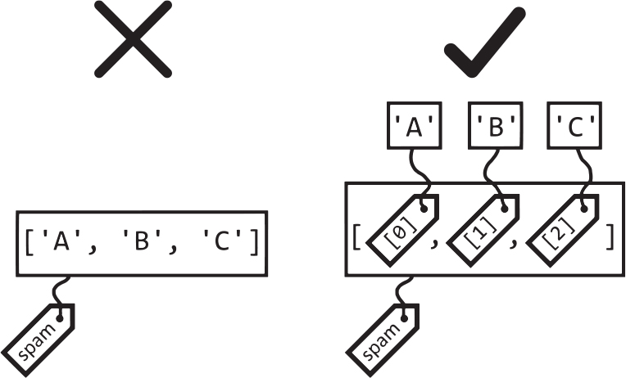
Chapter 6: Lists
One ordered, changeable row of values
Figure 6-4 - Sweigart, ATBS 3e, CC BY-NC-SA
SEN0414 Advanced Programming - Fall 2026
Yusuf Altunel, PhD - Istanbul Kultur University
1 / 49
Notes:
Chapter 6 is about lists: one ordered, changeable row of values. The deck has five parts and ends with short programs. Every code box on these slides is also in the chapter-code tab of the course page, in the same order, and runs there.

Slide 2
Today's route
>>>
Five parts and a wrap-up; every number is a slide, every result a table, chart or drawing from the run.
Part | What you learn | Slides
Questions | The questions and the map of the chapter | slides 2-4
1 The list as a value | Indexes, slices, other sequences | slides 5-12
2 Changing, combining, searching | Methods, in-place change, sort, short-circuit | slides 13-23
3 Loops and unpacking | range, enumerate, the removal trap, unpacking | slides 24-30
4 Names and copies | References, aliasing, shallow and deep copies | slides 31-35
5 Random choices and programs | choice, shuffle, four short programs | slides 36-45
Wrap-up | Summary, practice, resources | slides 46-49
Five parts, then programs you can read line by line
2 / 49
Notes:
The route has five parts and a wrap-up. The slide ranges are in the table, so you can jump. Each code slide shows its result as a table, chart or drawing. The hardest part is names and copies; mark it now and check it again at the summary.

Slide 3
The questions this chapter answers
>>>
Three competency questions frame the chapter; we come back to each one in the summary.
Which list operations read, replace, add, remove, find, order and combine items, and which of them change the list in place?
1
How do names, references, copies and function arguments decide whether a change to a list is seen elsewhere in a program?
2
Which printed results of the book differ in current Python, and which modern forms does the book leave out?
3
If you can answer these three, chapter 6 is yours
3 / 49
Notes:
Three questions frame the chapter. They are printed here so you can return to them at the end. Which of the three could you already answer from what you know about variables and strings?

Slide 4
One chapter, six branches
>>>
The map the whole chapter hangs on; the numbers under each branch are its slides.
The list data type
slides 5-12
Names and copies
slides 31-35
Changing, searching, ordering
slides 13-23
a list
Random choices
slides 36-40
Looping and unpacking
slides 24-30
Short programs
slides 41-44
Six branches: every slide today lives on this map
4 / 49
Notes:
A list is one idea with six branches. Each box names a branch and the slides that teach it. The fifth branch, random choices, and the sixth, short programs, are where lists meet chance and real code. The branches are the same as the five parts, with the last part split in two.

Slide 5
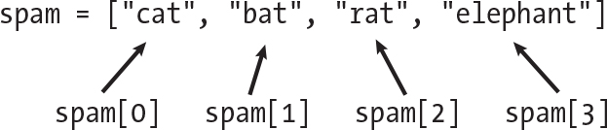
The list as a value
One value, many items, each reachable by number.
The List Data Type
One value that holds many items in order.
Indexes and slices
Numbers from zero reach one item; slices cut a part.
Figure 6-1 - Sweigart, ATBS 3e, CC BY-NC-SA
Sequence Data Types
Strings and tuples share the same numbering.
5 / 49
Notes:
Part one: what a list is. Concepts: the list data type, indexes and slices, and the other sequence types. The picture is Figure 6-1 of the book: a list in spam and the number that reaches each item.

Slide 6
The List Data Type: a row of numbered lockers
>>>
Square brackets make a list; a number picks one item, from zero at the front or with a minus sign from the end.
>>> spam = ['cat', 'bat', 'rat', 'elephant']
>>> print(spam[0], spam[3])
Four items in one list called spam. The first item is number 0, so the fourth is number 3.
>>> print(spam[-1], spam[-3])
>>> print(len(spam))
A minus sign counts from the end: -1 is the last item. len() tells how many items there are.
printed | result
spam[0], spam[3] | cat elephant
spam[-1], spam[-3] | elephant bat
len(spam) | 4
spam
cat
0 | -4
bat
1 | -3
rat
2 | -2
elephant
3 | -1
door number | number from the end
Numbers start at zero; minus numbers start at the end
6 / 49
Notes:
Read the list as lockers with numbers on the doors. Index 0 is the first item, index minus 1 the last. The diagram shows both numberings for the same four items. len() counts the lockers, so the last valid index is len minus 1.

Slide 7
Lists inside lists, and an index too big
>>>
A list may hold other lists; use one index per level. An index past the end raises an error that you can catch.
>>> grid = [['a', 'b'], ['c', 'd', 'e']]
>>> print(grid[1][2], len(grid[1]))
grid[1] is the second inner list; its item number 2 is 'e'. Two indexes, one per level.
>>> spam = ['cat', 'bat', 'rat']
>>> try:
>>> print(spam[10])
>>> except IndexError as err:
>>> print('IndexError:', err)
Asking for item 10 of a three-item list fails with an IndexError; try and except let the program carry on.
printed | result
grid[1][2], len(grid[1]) | e 3
spam[10] | IndexError: list index out of range
a
b
grid[0]
grid[1]
c
d
e
grid[1][2] is the highlighted 'e'
One index per level; a wrong index is an error you can catch
7 / 49
Notes:
Nested lists need one index per level: first the row, then the column. An index beyond the end raises IndexError. Catching it with try and except shows the message without a long traceback, and the program goes on.

Slide 8
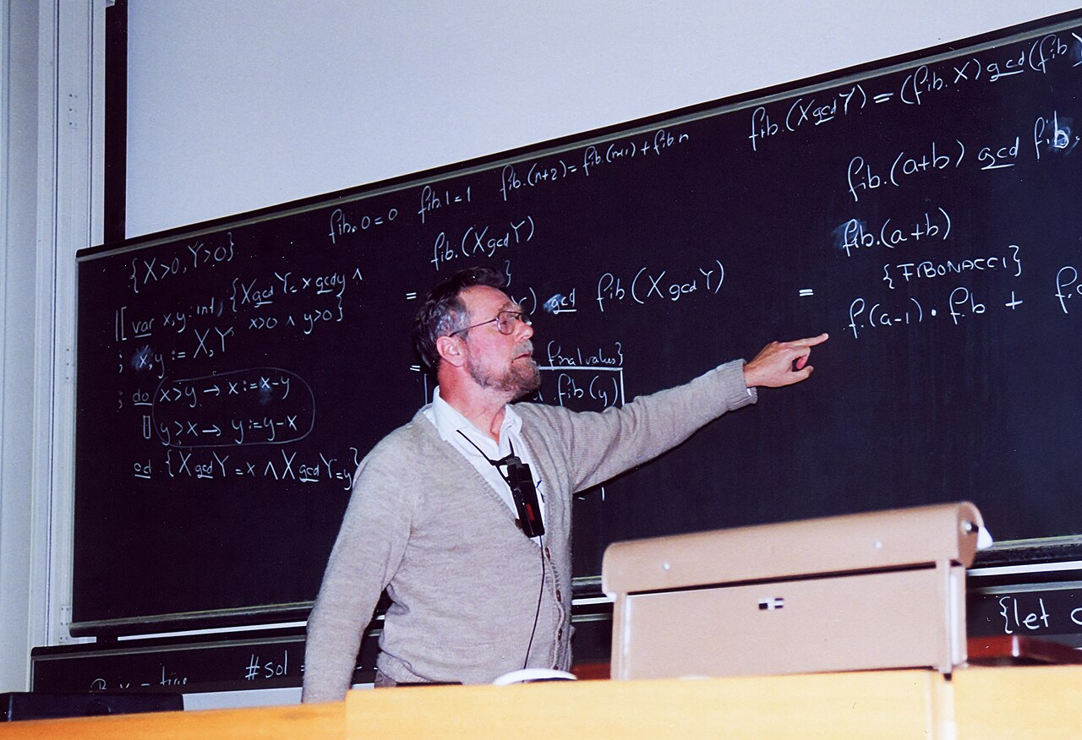
Why the first item is number zero
>>>
1982-08-11 - the note EWD831
WHO Edsger W. Dijkstra, Dutch computer scientist, then a Burroughs Research Fellow.
WHAT A short note arguing that N items should be numbered 0 to N-1: start included, end excluded.
WHEN 11 August 1982.
WHERE At home in Nuenen, the Netherlands; the note EWD831 is kept in the University of Texas archive.
Dijkstra, 1994 - photo: Andreas F. Borchert, CC BY-SA 4.0
WHY A mathematician had called young computing scientists pedantic for counting from zero, so Dijkstra set out his reasons.
HOW He compared four ways to write bounds and chose 2 <= i < 13: the difference is the length and neighbours meet.
READ Dijkstra: Why numbering should start at zero (EWD831)
A true story, with its picture and its source
8 / 49
Notes:
On 11 August 1982 Dijkstra wrote EWD831 at home in Nuenen. His reasoning is why Python counts from zero and why spam[1:3] excludes its end. Lesson: counting from zero makes the index equal the number of items before it. Photo: A. F. Borchert, CC BY-SA 4.0.

Slide 9
Slices: a part of a list, as a new list
>>>
list[start:stop:step]: the start is included, the stop is never included, and the result is a new list.
>>> spam = ['cat', 'bat', 'rat', 'elephant']
>>> print(spam[1:3], spam[:2])
>>> print(spam[2:], spam[::2])
Leave out the start and the slice begins at the front; leave out the stop and it runs to the end.
>>> print(spam[::-1])
>>> print(spam[:] == spam, spam[:] is spam)
A step of -1 walks backwards. spam[:] is a copy: equal in value, but not the same list.
printed | result
spam[1:3], spam[:2] | ['bat', 'rat'] ['cat', 'bat']
spam[2:], spam[::2] | ['rat', 'elephant'] ['cat', 'rat']
spam[::-1] | ['elephant', 'rat', 'bat', 'cat']
spam[:] == spam, spam[:] is spam | True False
spam[1:3]
cat
bat
rat
elephant
0
1
2
3
4
numbers sit between the items, like ruler marks
A slice runs from the start up to, never including, the stop
9 / 49
Notes:
Think of a ruler: the numbers sit between the items, and a slice takes what lies between two marks. A slice is always a new list, so spam[:] equals spam but is not spam. The diagram marks the slice spam[1:3].

Slide 10
Dijkstra's rule, checked in Python
>>>
Start included, end excluded: bounds subtract to the length, and neighbouring slices meet without a gap.
>>> s = list(range(10))
>>> print(s[2:5], len(s[2:5]))
Items 2 up to 5 of a list of ten: three items, and 5 minus 2 is 3.
>>> print(s[0:3] + s[3:10] == s)
>>> print([len(s[0:3]), len(s[3:10]), len(s)])
Two neighbouring slices put together give the whole list; their lengths add up to ten.
printed | result
s[2:5], len(s[2:5]) | [2, 3, 4] 3
s[0:3] + s[3:10] == s | True
lengths of the pieces | [3, 7, 10]
Start in, end out: lengths subtract and neighbours fit
10 / 49
Notes:
This is Dijkstra's argument in running code. Because the end is excluded, a slice from 2 to 5 holds 5 minus 2 items, and the slices 0 to 3 and 3 to 10 fit together with no gap and no overlap. The chart shows the lengths adding up.

Slide 11
Sequence Data Types: lists, strings, tuples
>>>
Lists, strings, tuples and ranges are all sequences: they share indexes, slices, len() and the in operator.
>>> name = 'Zophie'
>>> print(name[0], name[-1], name[1:4])
>>> print(list(name))
A string is a sequence of letters: it has indexes and slices, and list() turns it into a list of letters.
>>> point = (3, 4)
>>> print(point[0], len(point))
>>> print('a' in 'cat', 3 in [1, 2, 3])
A tuple is a list that cannot change. in asks whether an item or a piece is present.
printed | result
name[0], name[-1], name[1:4] | Z e oph
list(name) | ['Z', 'o', 'p', 'h', 'i', 'e']
point[0], len(point) | 3 2
'a' in 'cat', 3 in [1, 2, 3] | True True
sequence
list [ ]
str ' '
tuple ( )
range
One numbering works for every sequence
11 / 49
Notes:
What you learned about indexes and slices is not only for lists. Strings, tuples and ranges are sequences too and answer the same questions. The difference is mutability: a list can change, a string and a tuple cannot.

Slide 12
Everyday pictures: the list as a value
>>>
Each concept next to something from daily life; keep the picture, and the code will make sense.
ANALOGY The List Data Type
A row of numbered lockers: each locker holds one thing, the number on its door stays, and the row can grow.
ANALOGY List
A shopping list in pencil: items keep the order you wrote them, and you may rub one out or add one.
ANALOGY Sequence Data Types
Beads on a string: lists, strings and tuples are all strings of beads, counted and cut the same way.
ANALOGY len()
Counting the lockers in the row: len() says how many there are, never what is inside them.
A list is lockers in a row
12 / 49
Notes:
Four everyday pictures for the first concepts. Keep the lockers in mind: they explain indexes, slices and len. Ask students to find the picture that fits a string.

Slide 13
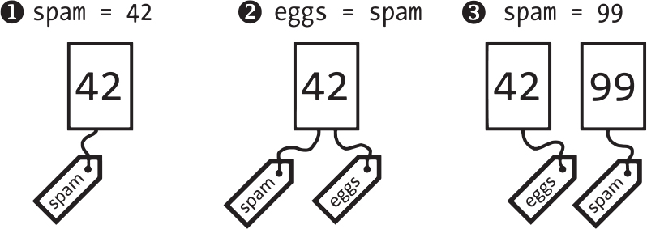
Changing, combining, searching
What a list can do, and which actions change the list itself.
In-place change
The same list is rewritten, not replaced.
Methods
Actions that belong to the list, like append.
Figure 6-2 - Sweigart, ATBS 3e, CC BY-NC-SA
Searching a list
Ask whether an item is there, and where.
Boolean short-circuit
Stop checking once the answer is known.
13 / 49
Notes:
Part two: change, combine, search and order. Keep one question in mind for every operation: does it change the list, return a new one, or return None? The picture is Figure 6-2 of the book.

Slide 14
Working with Lists: replace, add, remove
>>>
A list is mutable: these statements change the very list; only pop() also hands the removed item back.
>>> spam = ['cat', 'bat', 'rat', 'elephant']
>>> spam[1] = 'aardvark'
>>> spam.append('moose')
>>> spam.insert(1, 'chicken')
>>> print(spam)
Assign to an index to replace an item, append to add at the end, insert to add at a chosen place.
>>> print(spam.pop(), len(spam))
>>> del spam[0]
>>> spam.remove('rat')
>>> print(spam)
pop takes the last item and returns it; del and remove take an item out by place or by value.
printed | result
after assign, append, insert | ['cat', 'chicken', 'aardvark', 'rat', 'elephant', 'moose']
pop() and the length after it | moose 5
after del and remove | ['chicken', 'aardvark', 'elephant']
append, insert, pop, del and remove change the list itself
14 / 49
Notes:
One list changes step by step; it is the same list the whole time. The chart plots its length after each change: assignment keeps it, append and insert add one, pop, del and remove take one away.

Slide 15
Augmented Assignment Operators on lists
>>>
+ and * build a new list; += and *= change the existing list; the method extend adds many items at once.
>>> spam = [1, 2, 3]
>>> print(spam + ['A', 'B'])
>>> print(['X', 'Y'] * 3)
Joining and repeating make new lists; spam itself is untouched by these two lines.
>>> spam += [4]
>>> spam *= 2
>>> print(spam)
>>> spam.extend(['A', 'B'])
>>> print(spam)
+= and *= update spam in place. A method such as extend is called on the list with a dot.
printed | result
spam + ['A', 'B'] | [1, 2, 3, 'A', 'B']
['X', 'Y'] * 3 | ['X', 'Y', 'X', 'Y', 'X', 'Y']
after += and *= | [1, 2, 3, 4, 1, 2, 3, 4]
after extend | [1, 2, 3, 4, 1, 2, 3, 4, 'A', 'B']
+ makes a new list; += changes the list you have
15 / 49
Notes:
Compare the two families. Plus and times leave their operands alone and return a new list. Plus-equals and times-equals change the list in place. A method like extend is a function that belongs to the list and is called with a dot.

Slide 16
Searching a list: in, index, count
>>>
The in operator answers yes or no; index() answers where, and fails with a ValueError when the item is missing.
>>> pets = ['Zophie', 'Pooka', 'Fat-tail', 'Pooka']
>>> print('Pooka' in pets, 'Cat' not in pets)
>>> print(pets.index('Pooka'))
in and not in give True or False. index() gives the first place where the item stands.
>>> try:
>>> pets.index('Cat')
>>> except ValueError:
>>> print('Cat is not in the list')
>>> print(pets.count('Pooka'))
A missing item is an error for index(), so guard it with try. count() tells how often an item occurs.
printed | result
'Pooka' in pets, 'Cat' not in pets | True True
pets.index('Pooka') | 1
pets.index('Cat') guarded | Cat is not in the list
pets.count('Pooka') | 2
pets.index('Pooka') is 1
Zophie
number 0
Pooka
number 1
Fat-tail
number 2
Pooka
number 3
count('Pooka') = 2
in asks whether; index asks where
16 / 49
Notes:
Searching a list means going through it from the front. in says whether the item is there, index says where the first copy is, count says how many copies. index raises ValueError for a missing item, so check first or catch the error.

Slide 17
Short-Circuiting Boolean Operators
>>>
and and or stop as soon as the answer is known; the second operand is then never evaluated, so it cannot fail.
>>> spam = []
>>> print(spam and spam[0] == 'cat')
>>> print(bool(spam))
An empty list counts as false, so and stops at once and spam[0] is never tried: no IndexError.
>>> name = '' or 'Guest'
>>> print(name)
>>> print(0 or [] or 'last')
>>> print(1 and 2 and 3)
or returns the first true value it meets; and returns the first false one, else the last value.
printed | result
spam and spam[0] == 'cat' | []
bool(spam) | False
name | Guest
0 or [] or 'last' | last
1 and 2 and 3 | 3
spam is [] : false
and stops here
spam[0] never runs
the guard saves us from an IndexError
The second check runs only if the first did not decide
17 / 49
Notes:
Short-circuit evaluation is a guard. If the first operand of and is false, Python does not look at the second, so spam[0] on an empty list is never evaluated. Or and and return one of their operands, not necessarily True or False.

Slide 18
Ordering a list: sort and sorted
>>>
sort() reorders the list itself and returns None; sorted() leaves it alone and returns a new ordered list.
>>> nums = [2, 5, 3.14, 1, -7]
>>> nums.sort()
>>> print(nums)
>>> nums.sort(reverse=True)
>>> print(nums)
sort() works in place; reverse=True turns the order round. Do not write nums = nums.sort().
>>> letters = ['a', 'z', 'A', 'Z']
>>> print(sorted(letters))
>>> print(sorted(letters, key=str.lower))
>>> print(nums.sort())
Capital letters sort before small ones; key=str.lower compares lower-case forms. sort() itself returns None.
printed | result
nums after sort() | [-7, 1, 2, 3.14, 5]
nums after reverse=True | [5, 3.14, 2, 1, -7]
sorted(letters) | ['A', 'Z', 'a', 'z']
sorted(..., key=str.lower) | ['a', 'A', 'z', 'Z']
print(nums.sort()) | None
nums.sort()
same list, ordered
returns None
sorted(nums)
a new ordered list
nums unchanged
sort() changes the list and returns None
18 / 49
Notes:
A method that changes a list in place returns None, so never capture the result of sort. sorted returns a new list. The default order puts capital letters first; the key argument changes what is compared, not what is kept.

Slide 19
Everyday pictures: changing a list
>>>
Each concept next to something from daily life; keep the picture, and the code will make sense.
ANALOGY Working with Lists
A tidy workbench: you take items out, add some, sort them and put them back, always on the same bench.
ANALOGY In-place change
Rubbing out a line on your shopping list: it is still the same sheet of paper, only the writing changed.
ANALOGY Augmented Assignment Operators
Dropping one more coin in your savings jar: spam += [4] means 'add to this jar', not 'buy a second jar'.
ANALOGY Methods
Buttons on a remote control: each button belongs to that one television, and pressing it changes that very television.
Same sheet, same bench, same jar
19 / 49
Notes:
These pictures separate changing a thing from making a new one. The pencil list and the jar are the same object after the change. The remote control explains why methods are called with a dot.

Slide 20
Everyday pictures: add and remove
>>>
Each concept next to something from daily life; keep the picture, and the code will make sense.
ANALOGY append
Joining the back of a queue: you stand at the end and nobody else has to move.
ANALOGY insert
Sliding a new book into a chosen gap on a shelf: every book after it shifts one place to the right.
ANALOGY remove
Crossing the first matching name off a guest list: the guests below it move up one line.
A queue, a shelf and a guest list
20 / 49
Notes:
Three pictures for three methods. In a queue only the new person moves. On a shelf the books after the gap shift. On a guest list the names below the crossed one move up.

Slide 21

Twenty answers in a toy, a few in a list
>>>
1946 patent - 1950 eight-ball shape
WHO Albert C. Carter and Abe Bookman, whose firm Alabe Crafts sold the toy.
WHAT A fortune-telling toy: a die in blue liquid shows one of twenty answers after you ask a question.
WHEN Invented in 1946 (patent filed); made the black-and-white eight ball in 1950.
WHERE Cincinnati, Ohio; today the toy is made by Mattel.
WHY To answer yes-or-no questions by chance: ten answers affirmative, five neutral, five negative.
HOW One answer on each face of the die. The chapter's program keeps the answers in a list and picks one at a random index.
'It is certain.' - photo: Zaneology, CC BY 2.0
READ Magic 8 Ball - Wikipedia
A true story, with its picture and its source
21 / 49
Notes:
Carter and Bookman invented the toy in 1946 in Cincinnati. A twenty-faced die floats in blue liquid. The program keeps some of the answers in a list. Lesson: put the answers in a list and the program need not change. Photo: Zaneology, CC BY 2.0.

Slide 22
A Short Program: Magic 8 Ball with a List
>>>
The answers live in one list and a random index picks one; a new answer is one more item, not new code.
>>> import random
>>> messages = ['It is certain', 'Yes definitely',
>>> 'Ask again later', 'Very doubtful']
The list holds four of the toy's twenty answers. Adding a fifth answer means adding one more string here.
>>> random.seed(1946)
>>> for _ in range(3):
>>> pick = random.randint(0, len(messages) - 1)
>>> print(messages[pick])
A fixed seed makes every run print the same three answers. randint picks a random index; the list returns the answer.
printed | result
answer 1 | Yes definitely
answer 2 | It is certain
answer 3 | Yes definitely
messages
a list of 4 answers
randint(0, 3)
a random index
messages[pick]
answer: Yes definitely
list, index, answer
Put the answers in a list and the program need not change
22 / 49
Notes:
The program is data plus three lines of logic. Adding a fifth answer means adding one string to the list. The seed is fixed only so that the slide and the page show the same output; remove it and each run differs. This is the core of the book's program.

Slide 23
Everyday pictures: finding and ordering
>>>
Each concept next to something from daily life; keep the picture, and the code will make sense.
ANALOGY Searching a list
Running a finger down a guest list: in says whether the name is there, index says on which line.
ANALOGY index
The line number beside a name on the guest list: index() gives the first line where the name stands.
ANALOGY sort
Re-arranging the books on the shelf itself: sort() reorders the very list and hands nothing back.
ANALOGY Short-Circuiting Boolean Operators
A guard at a door: if the first check already says no, the guard never reads the second ticket.
Finger down the list, books on the shelf
23 / 49
Notes:
Searching and ordering. A finger moving down a guest list is a search from the front. Re-arranging the shelf is sort; making a second shelf in the same order would be sorted.

Slide 24
Loops and unpacking
Walking a list, changing it safely, naming its items.
range() and len()
Walk a list by position.
enumerate
Pair every item with its number.
The removal trap
Never remove from the list you loop over.
Figure 6-4 - Sweigart, ATBS 3e, CC BY-NC-SA
Starred unpacking
Give each item a name in one line.
24 / 49
Notes:
Part three: loops and unpacking. The removal trap is the memorable one. The picture is Figure 6-4 of the book: a list holds references to values, and each item carries a tag.

Slide 25
Looping: range(), len() and enumerate
>>>
range(len(x)) walks the positions; enumerate hands you position and item together, from any start number.
>>> supplies = ['pens', 'staplers',
>>> 'flamethrowers', 'binders']
>>> for i in range(len(supplies)):
>>> print(i, supplies[i])
range(len(supplies)) gives 0, 1, 2, 3; supplies[i] fetches the item at each position.
>>> for n, s in enumerate(supplies, 1):
>>> print(n, s, len(s))
enumerate(supplies, 1) pairs a counter that starts at 1 with each item, and len(s) counts its letters.
i | range(len(supplies)) | enumerate(supplies, 1)
0 | 0 pens | 1 pens 4
1 | 1 staplers | 2 staplers 8
2 | 2 flamethrowers | 3 flamethrowers 13
3 | 3 binders | 4 binders 7
enumerate gives the number and the item together
25 / 49
Notes:
Looping over positions with range and len works but is easy to get wrong. enumerate gives the position and the item in one step and can start at any number. print shows each pair; the chart counts the letters of each name.

Slide 26
Never remove from the list you loop over
>>>
The loop counts positions: after a removal the next item slides into the place just left, and is skipped.
>>> items = ['a', 'b', 'c', 'd']
>>> for x in items:
>>> items.remove(x)
>>> print(items)
Four items, four passes expected, but two letters are left behind: the loop skips every second item.
>>> items = ['a', 'b', 'c', 'd']
>>> keep = [x for x in items if x not in 'ab']
>>> print(keep)
>>> items.clear()
>>> print(items)
Build a new list with a comprehension instead, or use clear() to empty the list in one safe step.
printed | result
items after the loop | ['b', 'd']
keep, built safely | ['c', 'd']
items after clear() | []
start
a
b
c
d
after pass 1
b
c
d
after pass 2
b
d
'b' is never visited: it is skipped and stays
Build a new list instead of removing while looping
26 / 49
Notes:
This is the classic trap. The loop keeps its own position counter. Removing a, then looking at position 1, which is now c, skips b. The diagram traces the list after each pass. The safe way is to build a new list.

Slide 27
Unpacking: names for the items
>>>
Several names left of one equals sign take a list's items in order; a starred name collects the rest.
>>> size, color, mood = ['fat', 'gray', 'loud']
>>> print(size, color, mood)
Three names, three items: size gets 'fat', color gets 'gray', mood gets 'loud'.
>>> first, *rest = [1, 2, 3, 4]
>>> print(first, rest)
>>> a, b = 'x', 'y'
>>> a, b = b, a
>>> print(a, b)
*rest takes whatever is left, as a list. a, b = b, a swaps two names without a helper variable.
printed | result
size, color, mood | fat gray loud
first, rest | 1 [2, 3, 4]
a, b after the swap | y x
fat
gray
loud
size
color
mood
each item gets the name in the same position
One line can give every item its own name
27 / 49
Notes:
Unpacking assigns the items of a list to several names at once. The number of names must match the number of items, unless one name carries a star and takes the rest. The swap a, b = b, a relies on the same mechanism.

Slide 28
Building a list in one line
>>>
A comprehension says what each item is and, if you like, which items to keep; it replaces a loop that appends.
>>> squares = [x ** 2 for x in range(1, 7)]
>>> print(squares)
For every x from 1 to 6, put x squared into a new list. The chart plots the six squares.
>>> evens = [x for x in range(10) if x % 2 == 0]
>>> print(evens)
>>> print(sum(squares))
The if part keeps only some items. sum() adds up all the numbers of a list.
printed | result
squares | [1, 4, 9, 16, 25, 36]
evens | [0, 2, 4, 6, 8]
sum(squares) | 91
A comprehension is a loop that builds a list
28 / 49
Notes:
Comprehensions are the modern way to build one list from another. They are shorter than a loop with append and show the rule in one place. The chart plots the squares the first comprehension built.

Slide 29
input() returns text: turn it into a list
>>>
Whatever input() returns is a string; split() cuts it into words and int() turns each word into a number.
>>> line = '4 8 15 16 23 42' # what input() returns
>>> nums = [int(w) for w in line.split()]
>>> print(nums)
In a real program line = input('Numbers: '). Here the typed text is written out so the page can run it.
>>> print(sum(nums), max(nums), len(nums))
>>> print(type(line).__name__)
Sum, largest and count of the numbers; the last line proves that input() gave a str.
printed | result
nums | [4, 8, 15, 16, 23, 42]
sum, max, len | 108 42 6
type of line | str
text
'4 8 15 16 23 42'
split()
6 words
int()
6 numbers
input() gives the first box; the others are our work
input() gives text; split() and int() give a list of numbers
29 / 49
Notes:
input never returns a number, always text. To get a list of numbers, split the text into words and convert each one. The typed text is written into the example so the slide and the page can run without a keyboard.

Slide 30
Everyday pictures: counting, showing, asking
>>>
Each concept next to something from daily life; keep the picture, and the code will make sense.
ANALOGY range()
A turnstile counter that clicks 0, 1, 2, 3 and stops one before the number you set.
ANALOGY print()
A loudspeaker: it shows a value to the room, but the value stays where it was.
ANALOGY input()
A question at a reception desk: whatever the visitor says comes back as plain text, even a number.
Count, say, ask
30 / 49
Notes:
Three small tools. The turnstile explains why range stops one before its number. The loudspeaker shows print does not change the value. The desk explains why input always gives text.

Slide 31
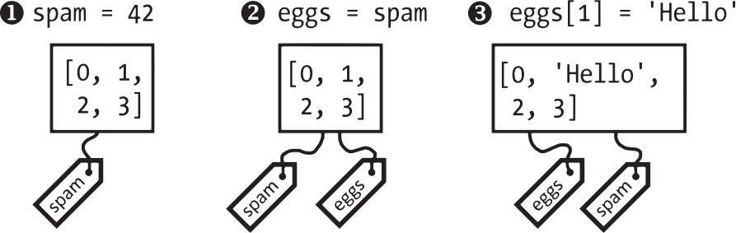
Names and copies
A name is a tag; two tags can reach one list.
References
A variable holds a way to reach a list.
Aliasing
Two names, one list: change one, see both.
Figure 6-3 - Sweigart, ATBS 3e, CC BY-NC-SA
Shallow copy
A new outer list that shares its inner lists.
Deep copy
Every level copied; nothing shared.
31 / 49
Notes:
Part four: the hardest part for beginners. A name is a tag on an object. Aliasing, shallow copy and deep copy are three answers to the question: who else sees my change? Picture: Figure 6-3 of the book.

Slide 32
References: two names, one list
>>>
Assigning a list to another name copies the reference, not the list: both names now reach the same list.
>>> spam = [0, 1, 2, 3]
>>> eggs = spam
>>> eggs[1] = 'Hello!'
eggs = spam puts a second name tag on the same list. Changing eggs[1] changes the list both names reach.
>>> print(spam)
>>> print(eggs is spam, id(eggs) == id(spam))
spam shows the change too, and is tells us the two names reach one object.
printed | result
spam | [0, 'Hello!', 2, 3]
eggs is spam, same id | True True
spam
one list
[0, 'Hello!', 2, 3]
eggs
two tags, one list
Assignment copies the name, never the list
32 / 49
Notes:
A variable holds a reference to a list, not the list. eggs = spam copies the reference, so both names reach one list. The is operator and id() confirm it. The diagram shows two tags on one list.

Slide 33
Passing a list to a function
>>>
A function receives a reference to the caller's list, so changing it inside the function changes it outside.
>>> def add_hello(items):
>>> items.append('Hello')
>>> return items
The parameter items is a second name for whatever list the caller passes in.
>>> nums = [1, 2, 3]
>>> result = add_hello(nums)
>>> print(nums, result is nums)
>>> print(len(nums))
nums grew although we never assigned to it, and result is the very same list.
printed | result
nums, result is nums | [1, 2, 3, 'Hello'] True
len(nums) | 4
nums (caller)
one list
[1, 2, 3, 'Hello']
items (function)
the function works on the caller's list
A function gets the list itself, not a copy
33 / 49
Notes:
Arguments are passed by assignment: the parameter becomes another name for the caller's object. A function that appends to its parameter changes the caller's list. To protect the original, pass a copy.

Slide 34
Copies: shallow and deep
>>>
copy.copy makes a new outer list that shares the inner lists; copy.deepcopy copies every level.
>>> import copy
>>> grid = [[1, 2], [3, 4]]
>>> shallow = copy.copy(grid)
>>> deep = copy.deepcopy(grid)
shallow shares the inner lists with grid; deep owns its own inner lists.
>>> grid[0][0] = 99
>>> print(shallow[0][0], deep[0][0])
>>> board = [[0] * 3] * 2
>>> board[0][0] = 9
>>> print(board)
Changing an inner item shows through the shallow copy only. [[0] * 3] * 2 repeats one inner list twice.
printed | result
shallow[0][0], deep[0][0] | 99 1
board | [[9, 0, 0], [9, 0, 0]]
grid
inner lists of grid
[[99, 2], [3, 4]]
shallow
deep
inner lists of deep
[[1, 2], [3, 4]]
Nested lists need deepcopy to be truly separate
34 / 49
Notes:
A shallow copy copies only the outer list, so the inner lists are shared. A deep copy copies all levels. The board line shows the same trap by repetition: two rows that are one list.

Slide 35
Everyday pictures: names and copies
>>>
Each concept next to something from daily life; keep the picture, and the code will make sense.
ANALOGY References
A name tag stuck on a locker: the tag is not the locker, and two tags can be stuck on one locker.
ANALOGY Aliasing
Two house keys cut for one flat: using either key changes the same flat.
ANALOGY Shallow copy
Copying the index card of a folder: a new card, but every line still points to the original papers.
ANALOGY Deep copy
Photocopying the whole folder, every page included: nothing is shared, so scribbles never reach the original.
Tags, keys and photocopies
35 / 49
Notes:
The most important pictures of the chapter. Tags are references; two keys are two names for one list. A shallow copy copies the index card, a deep copy the whole folder.

Slide 36
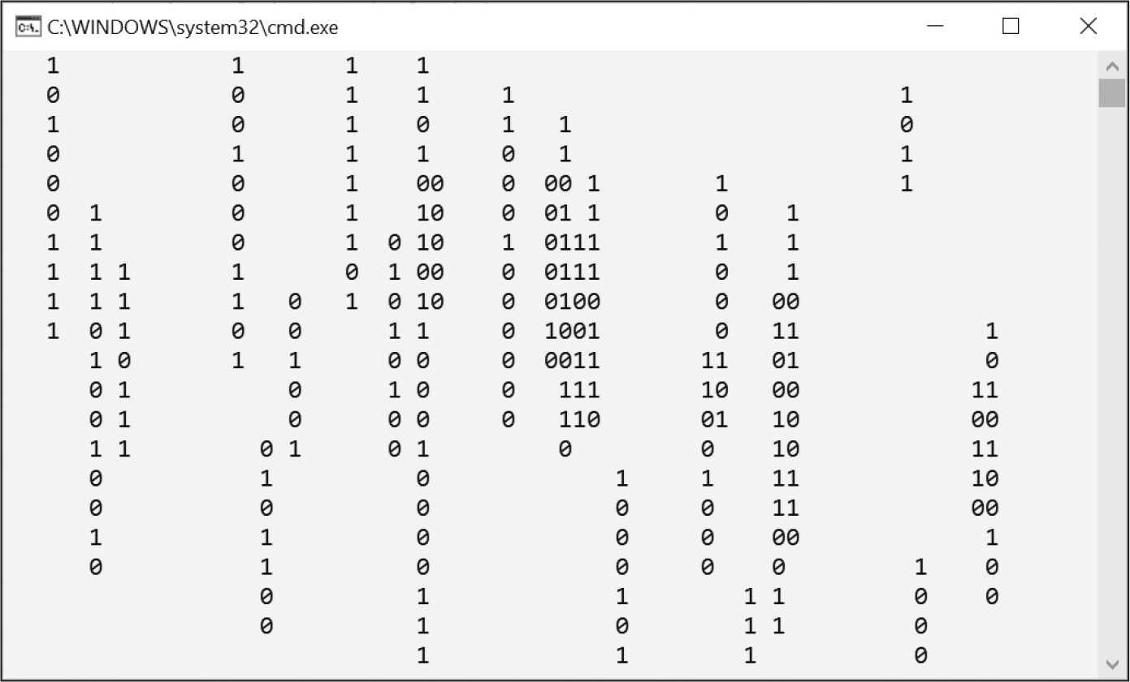
Random choices and programs
Chance and lists make games, screens and simulations.
random.choice
Pick one item at random.
random.shuffle
Put the items in a new random order.
Short programs
Eight ball, rain, comma code, coin flips.
Figure 6-5 - Sweigart, ATBS 3e, CC BY-NC-SA
36 / 49
Notes:
Part five: lists meet chance. Choice and shuffle, then four short programs that use only what the chapter taught. The picture is Figure 6-5 of the book: the screensaver running in a console.

Slide 37
Random selection: choice, shuffle, randint
>>>
choice picks one item, shuffle reorders the list in place and returns None, randint picks a whole number.
>>> import random
>>> random.seed(5)
>>> pets = ['cat', 'dog', 'owl', 'fox']
>>> print(random.choice(pets))
The fixed seed 5 makes the random numbers repeat. choice returns one item and leaves the list alone.
>>> random.shuffle(pets)
>>> print(pets)
>>> print(random.shuffle(pets))
>>> print(random.randint(1, 6))
shuffle changes pets and returns None; randint(1, 6) behaves like one die.
printed | result
random.choice(pets) | owl
pets after shuffle | ['dog', 'cat', 'fox', 'owl']
print(random.shuffle(pets)) | None
random.randint(1, 6) | 2
random.choice(pets)
one item; the list is unchanged
random.shuffle(pets)
the same list, new order; returns None
choice picks one; shuffle reorders the list itself
37 / 49
Notes:
The random module turns lists into games. The seed is fixed here only so the output repeats. Remember the in-place rule: shuffle changes the list and returns None, exactly like sort.

Slide 38
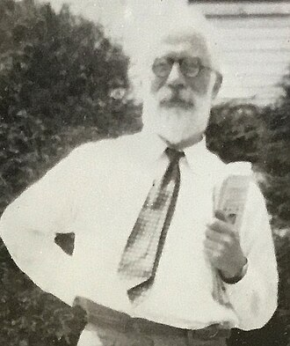
A fair shuffle, from pencil to computer
>>>
1938 on paper - 1964 as an algorithm
WHO Ronald Fisher and Frank Yates (1938); Richard Durstenfeld (1964); Donald Knuth, who popularised it.
WHAT A way to put items in random order so that every order is equally likely.
WHEN 1938 as pencil and paper; 1964 as a computer algorithm.
WHERE Statistical tables from Oliver and Boyd; Communications of the ACM, volume 7.
WHY A biased shuffle favours some orders; statisticians and game makers need every order to have the same chance.
HOW Walk the list from the end and swap each place with a random place at or before it. Python's random.shuffle does this.
Ronald Fisher, 1952 - photo: Barry Eagel, CC BY-SA 4.0
READ Fisher-Yates shuffle - Wikipedia
A true story, with its picture and its source
38 / 49
Notes:
Fisher and Yates printed the pencil method in 1938; Durstenfeld published the computer version in 1964; Knuth described it. random.shuffle still works this way. Lesson: a shuffle is fair only if every order is equally likely. Photo: B. Eagel, CC BY-SA 4.0.

Slide 39
A fair shuffle, counted six thousand times
>>>
Deal three cards 6000 times and count the six possible orders: a fair shuffle gives about 1000 of each.
>>> import random
>>> from collections import Counter
>>> random.seed(1938)
>>> cards = list('abc')
Three cards, a fixed seed so the run repeats, and Counter to count how often each order turns up.
>>> def deal():
>>> random.shuffle(cards)
>>> return ''.join(cards)
deal shuffles the three cards in place and returns them as one word, such as 'bca'.
>>> c = Counter(deal() for _ in range(6000))
>>> orders = sorted(c)
>>> print(orders)
>>> print([c[k] - 1000 for k in orders])
Deal 6000 times, list the six orders and print how far each count lies from 1000. The bars show those differences.
A shuffle is fair when every order is equally likely
39 / 49
Notes:
Counter counts how often each order appears. The differences from 1000 are small and have no pattern, which is what a fair shuffle gives. A biased shuffle would show a few bars far from zero.

Slide 40
Everyday pictures: chance
>>>
Each concept next to something from daily life; keep the picture, and the code will make sense.
ANALOGY Random selection
Drawing a name from a hat: every name has the same chance, and one draw says nothing about the next.
ANALOGY random.choice
Putting a hand in the hat and pulling out one slip, which stays in the hat.
ANALOGY random.shuffle
Shuffling a deck of cards by hand: the same cards in a new order, and the deck itself is changed.
A hat, a slip and a deck of cards
40 / 49
Notes:
Chance as a hat and a deck. Choice does not change the hat; shuffle changes the deck. A fixed seed is like agreeing in advance on the order of the slips.

Slide 41
The green rain that was never a code
>>>
1999 film - 2017 interview
WHO Simon Whiteley, who designed the glyphs for the film The Matrix.
WHAT The falling green characters: mirrored half-width Japanese kana, Latin letters and numerals.
WHEN The film in 1999; his remark to CNET on 19 October 2017.
WHERE In the film The Matrix; the chapter's screensaver runs in your own console window.
Figure 6-5 - Sweigart, ATBS 3e, CC BY-NC-SA
WHY He joked the code was sushi recipes from his wife's cookbooks; others doubt it, so treat it as a tale.
HOW The chapter's program keeps 70 counters in a list, one per column: above zero prints a digit and counts down.
READ Matrix digital rain - Wikipedia
A true story, with its picture and its source
41 / 49
Notes:
Simon Whiteley designed the glyphs of the film's green rain. His 2017 sushi joke is disputed. The chapter imitates the rain with a list of counters. Lesson: a list of counters can animate a screen. Image: Figure 6-5, Sweigart 2025, CC BY-NC-SA.

Slide 42
A Short Program: The Matrix Screensaver
>>>
One list of counters, one per column, drives the animation: above zero draws a digit and counts down.
>>> import random
>>> random.seed(7)
>>> ctr = [0] * 16
ctr holds how many more digits each of the sixteen columns must still draw. All start at zero.
>>> for row in range(5):
>>> for i in range(16):
>>> if ctr[i] == 0 and random.random() < 0.2:
>>> ctr[i] = 3
A column at zero may start a stream of three digits, with chance one in five. This runs for every column, row by row.
>>> print(random.choice('01') if ctr[i] else ' ', end='')
>>> ctr[i] = max(0, ctr[i] - 1)
>>> print()
A column with a counter above zero prints a random digit, otherwise a space; then its counter counts down by one.
printed | result
row 1 | 00 01 0 100
row 2 | 00 00 0 111
row 3 | 11 001 1 1010
row 4 | 1 1 01
row 5 | 11 0 101
ctr after the last row
0
0
0
1
2
0
0
0
0
0
0
0
0
1
2
0
a counter above zero means a digit is falling there
A list of counters can animate a screen
42 / 49
Notes:
Each column has a counter. At zero the column may start a new stream of digits; above zero it prints a random digit and counts down. Five rows are printed here; the real screensaver loops forever. The boxes show the counters after the last row.

Slide 43
Practice Programs: Comma Code
>>>
Turn any list into text with commas and an 'and' before the last item, and handle short lists on the way.
>>> def list_to_text(items):
>>> if len(items) < 3:
>>> return ' and '.join(items)
>>> return ', '.join(items[:-1]) + ', and ' + items[-1]
Fewer than three items need no comma. Otherwise join all but the last with commas, then add 'and' and the last item.
>>> tests = [['a', 'b', 'c'], ['x', 'y'], ['z'], []]
>>> for t in tests:
>>> print(repr(list_to_text(t)))
Four test lists: three items, two, one and none. repr shows the quotes so that the empty text is visible.
printed | result
three items | 'a, b, and c'
two items | 'x and y'
one item | 'z'
no items | ''
items[:-1]
items[-1]
a
b
c
result: 'a, b, and c'
Slices and join turn a list into a sentence
43 / 49
Notes:
The slice items[:-1] takes everything but the last item; join glues the pieces with a comma and a space. The four tests cover the cases: many items, two, one and none. repr shows the quotes so empty text is visible.

Slide 44
Practice Programs: Coin Flip Streaks
>>>
Flip a coin 100 times, look for six equal results in a row, and repeat to estimate how often that happens.
>>> import random
>>> random.seed(6)
>>> streaks = 0
>>> for experiment in range(10000):
The experiment is repeated 10,000 times; streaks counts the experiments that contain a run of six.
>>> flips = [random.choice('HT') for _ in range(100)]
>>> text = ''.join(flips)
>>> if 'HHHHHH' in text or 'TTTTTT' in text:
>>> streaks += 1
One experiment is a list of 100 random choices. Joined into text, six equal letters in a row are easy to find.
>>> print('Streak of 6:', 100 * streaks / 10000, '%')
The share of experiments with a streak. The chart splits the 10,000 experiments.
printed | result
the estimate | Streak of 6: 81.48 %
A list of random choices measures what intuition only guesses
44 / 49
Notes:
Most people expect six in a row to be rare. The simulation says about eight experiments in ten contain one. The fixed seed makes the estimate repeatable; change it and the number moves a little.

Slide 45
Everyday pictures: summary and practice
>>>
Each concept next to something from daily life; keep the picture, and the code will make sense.
ANALOGY Summary
The postcard from a trip: a few lines that bring back everything you saw.
ANALOGY Practice Questions
Scales on a piano: small drills that test one finger movement at a time.
ANALOGY Practice Programs
A first full piece after the scales: all your skills together make a real tune.
ANALOGY A Short Program: Magic 8 Ball with a List
A box of answer cards: a new answer is one more card, not a new machine.
ANALOGY A Short Program: The Matrix Screensaver
A row of rain gauges: each one counts down how much rain is left to fall in its column.
A postcard, scales and a tune
45 / 49
Notes:
Pictures for the closing parts. The summary is a postcard, the practice questions are scales, the practice programs a first tune. The two short programs are a box of cards and rain gauges.

Slide 46
Summary: who changes, who copies, who shares
>>>
Ask of every operation: does it change the list, return a new list, or share one?
Operation | What happens to the list | What you get back
append, insert, remove, pop, del | Changes the list in place | None (pop: the item)
sort(), random.shuffle() | Changes the list in place | None
sorted(), a slice, + and * | Leaves the list alone | A new list
eggs = spam | Shares one list | Nothing is copied
copy.copy(grid) | New outer list | Inner lists shared
copy.deepcopy(grid) | Every level copied | Nothing shared
for x in items: items.remove(x) | Skips items | Build a new list
Changes, copies or shares: ask it of every operation
46 / 49
Notes:
Read the table as a decision guide. For every list operation ask three things: does it change the list, return a new list, or share one? Most list bugs come from mixing these up.

Slide 47
Practice Questions and Practice Programs
>>>
Try them before the next class; the course page has a question bank and the runnable code.
Practice Questions
Practice Programs
What do spam[-1] and spam[1:3] return for the list ['cat', 'bat', 'rat', 'elephant']?
Comma Code: write list_to_text(items) so that ['a', 'b', 'c'] becomes 'a, b, and c'.
Why does 'for x in items: items.remove(x)' leave two items behind in a list of four?
Coin Flip Streaks: estimate how often six equal flips in a row occur among 100 flips.
After eggs = spam and eggs[0] = 9, what does spam[0] hold, and why?
Check yourself: three questions and two programs
47 / 49
Notes:
Five tasks. The three questions check understanding of indexes, loops and references. The two programs check that you can combine slices, loops and random. Both programs appeared on earlier slides; try them blind first.

Slide 48
Resources: where to go from here
>>>
Free to read and to watch; every link below is live.
Read
Standards and documentation
This chapter, free online (Sweigart)
copy - shallow and deep copy
Python tutorial: data structures
PEP 3132 - extended iterable unpacking
Sorting Techniques - the official HOWTO
random - pseudo-random numbers
Watch and try
The stories
Facts and myths about Python names
Dijkstra: why numbering starts at zero
Python Tutor - draw your lists and names
The Fisher-Yates shuffle
Magic 8 Ball
Matrix digital rain
Draw your lists in Python Tutor and watch the names
48 / 49
Notes:
Everything here is free. Paste the aliasing example of this deck into Python Tutor and watch two name tags arrive on one list. Then read the official sorting HOWTO for the key argument.

Slide 49
What you should now be able to say
>>>
Four claims, each one proven by code that ran on a slide of this deck.
1 What a list holds, and how indexes and slices reach it.
2 Which methods change a list in place and which return a new one.
3 Why two names can reach one list, and when a program must copy.
4 How a list drives an eight ball, a screensaver and a simulation.
Four claims; the code on the slides is the proof
49 / 49
Notes:
Four claims, each carried by code that ran on a slide. The course page carries the same code in its chapter-code tab, the stories with their sources and the question bank. Use the four claims as a self-test.

