Slide 1


Chapter 11: Web Scraping
CSE0408 Programming III
IKU Department of Computer Engineering
Yusuf Altunel, PhD

Slide 2

Content
Headlines
webbrowser modüle
Downloading files from Web
Saving downloaded files to Hard Drive
HTML
bs4.BeautifulSoap Module
Automate the Boring Stuff with Python
Practical Programming for Total Beginners
Chapter 11: Web Scraping

Slide 3



Chapter 11: Web Scraping
webbrowser module

Slide 4
Launching a Web Page
webbrowser module’s open() function can launch a new browser to a specified URL.
webbrowser
webbrowser.open()
Open a Page
Comes with Python
opens a browser to a specific page
the only thing the webbrowser module can do
function to open the web browser
Set the URL to a page address
openBrowser(url)

Slide 5
URL Based Applications
As long as you have a URL, the webbrowser module lets users cut out the step of opening the browser and directing themselves to a website.
Open all links
Local weather
Social Sites
Open all links on a page
in separate browser tabs.
Open the browser
to the URL for your local weather.
Open several social network sites
you regularly check.

Slide 6




Handle the Command Line Arguments
sys module
reading the potential command line arguments.
sys.argv
stores a list of the program’s arguments
filename and command line
len(sys.argv)
evaluates to an integer greater than 1,
meaning that command line arguments
have indeed been provided

Slide 7
webbrowser.open(URL)
  import webbrowser, sys, pyperclip
  def openBrowser(pageURL):
  webbrowser.open(pageURL)
  if __name__ == '__main__':
  #mapIt.py - Launches a map in the browser
  # using an address from the command line or clipboard.
  if len(sys.argv) > 1:
  # Get address from command line.
  address = ' '.join(sys.argv[1:])
  else:
  # Get address from clipboard.
  # 870 Valencia St, San Francisco, CA 94110
  address = pyperclip.paste()
  url= 'https://www.google.com/maps/place/' + address
  openBrowser(url)
  Command line:
  mapit 870 Valencia St, San Francisco, CA 94110
  sys.argv variable:
  ['mapIt.py', '870', 'Valencia', 'St, ', 'San', 'Francisco, ', 'CA', '94110']
Notes:
come back to make corrections

Slide 8

Chapter 11: Web Scraping
Downloading files from Web

Slide 9
Downloading a Web Page with the requests.get() Function
The requests module lets you easily download files from the Web
Without to worry about complicated issues such as network errors, connection problems, and data compression
requests.get()
type()
Response object
takes a string of a URL to download
By calling type()
on requests.get()’s return value
you can see that it returns a Response object
contains the response
the web server gave for your request.
The requests module doesn’t come with Python, so you’ll have to install it first
pip install requests

Slide 10
requests.get()
  import webbrowser, sys, pyperclip
  import requests
  #download file content from a URL
  # from Internet connected device
  def downloadPage(pageURL):
  res = requests.get(pageURL)
  type(res)
  successStatus = res.status_code == requests.codes.ok
  print("The request is a success?", successStatus)
  print("The size of the file is", len(res.text))
  print("Notice: ")
  print(res.text[:250])
  if __name__ == '__main__’:
  #download file content from a URL
  url = 'http://www.gutenberg.org/cache/epub/1112/pg1112.txt'
  downloadPage(url)
  The request is a success? True
  The size of the file is 179380
  Notice:
  ﻿The Project Gutenberg EBook of Romeo and Juliet, by William Shakespeare
  *******************************************************************
  THIS EBOOK WAS ONE OF PROJECT GUTENBERG'S EARLY FILES PRODUCED AT A
  TIME WHEN PROOFING METHODS AND TOO
You can tell that the request for this web page succeeded by checking the status_code attribute of the Response object.
the status code for “OK” in the HTTP protocol is 200.
You may already be familiar with the 404 status code for “Not Found.”
The URL goes to a text web page for the entire play of Romeo and Juliet, provided by Project Gutenberg.
Notes:
come back to make corrections

Slide 11
Checking for Errors: raise_for_status()
the Response object has a status_code attribute that can be checked against requests.codes.ok to see whether the download succeeded
raise_for_status()
error
succeed
A method on the Response object
A simpler way to check for success
raise an exception
if there was an error downloading the file
will do nothing
if the download succeeded
The requests module doesn’t come with Python, so you’ll have to install it first
pip install requests

Slide 12
requests.get()
  import webbrowser, sys, pyperclip
  import requests
  #download file content from a URL from Internet connected device with exception
  def downloadPageWithException(pageURL):
  try:
  res = requests.get(pageURL)
  res.raise_for_status()
  print("The size of the file is", len(res.text))
  print("Notice: ")
  print(res.text[:250])
  except Exception as exc:
  print('There was a problem: %s' % (exc))
  if __name__ == '__main__’:
  url = 'http://inventwithpython.com/page_that_does_not_exist'
  downloadPageWithException(url)
  The request is a success? True
  The size of the file is 179380
  Notice:
  ﻿The Project Gutenberg EBook of Romeo and Juliet, by William Shakespeare
  *******************************************************************
  THIS EBOOK WAS ONE OF PROJECT GUTENBERG'S EARLY FILES PRODUCED AT A
  TIME WHEN PROOFING METHODS AND TOO
ensure that a program halts if a bad download occurs.
If a failed download isn’t a deal breaker for your program,
you can wrap the raise_for_status() line
with try and except statements to handle this error case without crashing.
Notes:
come back to make corrections

Slide 13
Chapter 11: Web Scraping
Saving downloaded files to Hard Drive

Slide 14
Saving Downloaded Files to the Hard Drive
you can save the web page to a file on your hard drive with the standard open() function and write() method
There are some slight differences, though.
Binary mode
Open in binary mode
Text Files
you must open the file
in write binary mode
by passing the string 'wb’
as the second argument to open()
Even if the page is in plaintext
you need to write binary data
To write the web page to a file,
you can use a for loop with the Response object’s iter_content() method

Slide 15
Download a file from Internet
  import webbrowser, sys, pyperclip
  import requests
  #save an Internet file from a URL using a connected device with exception
  def saveInternetFileWithException(pageURL, fName):
  res = requests.get(pageURL)
  try:
  res = requests.get(pageURL)
  res.raise_for_status()
  playFile = open(fName, 'wb')
  print("Saving file", fName, end = '')
  for chunk in res.iter_content(10000):
  playFile.write(chunk)
  print(".", end = '')
  playFile.close()
  except Exception as exc:
  print('There was a problem: %s' % (exc))
  if __name__ == '__main__’:
  #download file content from a URL
  url = 'http://www.gutenberg.org/cache/epub/1112/pg1112.txt'
  fileName = 'RomeoAndJuliet.txt'
  saveInternetFileWithException(url, fileName)
  Saving file RomeoAndJuliet.txt..................
returns “chunks” of the content on each iteration through the loop
Each chunk is of the bytes data type
The write() method returns the number of bytes written to the file
Notes:
come back to make corrections

Slide 16
Chapter 11: Web Scraping
HTML

Slide 17
HTML basics
Hypertext Markup Language (HTML) is the format that web pages are written in.
Resources for Learning HTML:
Mozilla
HTMLDOG
Codecade
https://developer.mozilla.org/en-US/learn/html/
http://htmldog.com/guides/html/beginner/
http://www.codecademy.com/tracks/web/
if you need a beginner tutorial

Slide 18
A Quick Refresher
An HTML file is a plaintext file with the .html file extension
.html
tags
element
The text in these files is surrounded by tags
are words
enclosed in angle brackets.
The tags tell the browser
how to format the web page.
A starting tag and closing tag
can enclose some text to form an element.
The text (or inner HTML) is the content
between the starting and closing tags.

Slide 19
Hello World!
display Hello world! in the browser, with Hello in bold
The opening <strong> tag says that the enclosed text will appear in bold.
  <strong>Hello</strong> world!
The closing </strong> tags tells the browser where the end of the bold text is.
Notes:
come back to make corrections

Slide 20
A Quick Refresher
There are many different tags in HTML
attributes
angle brackets
a link
Some of tags have extra properties
in the form of attributes
within the angle brackets
<
>
<a> tag encloses text
that should be a link
<a href="http://inventwithpython.com">Python books</a>

Slide 21
A Quick Refresher
Some elements have an id attribute that is used to uniquely identify the element in the page
element
element’s id
web scraping
You will often instruct your programs
to seek out an element by its id attribute,
figuring out an element’s id attribute
using the browser’s developer tools
is a common task
in writing web scraping programs

Slide 22
Link
  Al's free <a href="http://inventwithpython.com">Python books</a>.
display The link rendered in the browser
The URL that the text links to is determined by the href attribute.
Notes:
come back to make corrections

Slide 23
Viewing the Source HTML of a Web Page
You’ll need to look at the HTML source of the web pages that your programs will work with.
right-click
View Source
HTML
Any web page in your web browser
select View Source or View page source
to see the HTML text of the page
The browser knows how to display, or render, the web page from this HTML.

Slide 24
Viewing the source of a web page

Slide 25
Opening Your Browser’s Developer Tools
In addition to viewing a web page’s source, you can look through a page’s HTML using your browser’s developer tools
installation
F12 to appear
Chrome
In Chrome and Internet Explorer for Windows
the developer tools are already installed
press F12 to make them appear
In Chrome, you can also bring
up the developer tools by selecting
->View
->Developer
->Developer Tools.
After enabling or installing the developer tools in your browser,
you can right-click any part of the web page
select Inspect Element from the context menu
to bring up the HTML responsible for that part of the page

Slide 26
Inspect in developer tools
In addition to viewing a web page’s source, you can look through a page’s HTML using your browser’s developer tools
Developer tools
Right click
bring HTML
After enabling or installing
the developer tools in your browser,
you can right-click any part of the web page
select Inspect Element from the context menü
to bring up the HTML
responsible for that part of the page

Slide 27
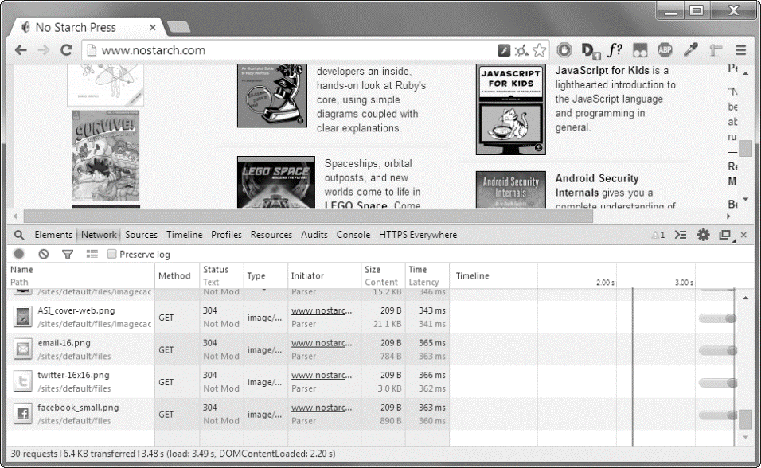
The Developer Tools window in the Chrome browser

Slide 28
Chapter 11: Web Scraping
bs4.BeautifulSoap Module

Slide 29
Parsing HTML with the BeautifulSoup Module
Beautiful Soup is a module for extracting information from an HTML page
bs4
Installation
import
The BeautifulSoup module’s name is bs4
Command line:
pip install beautifulsoup4
import Beautiful Soup
run import bs4.
even a simple HTML file involves many different tags and attributes and matters quickly get confusing with complex websites.
Thankfully, Beautiful Soup makes working with HTML much easier.

Slide 30
xample.html
  <!-- This is the example.html example file. -->
  <html><head><title>The Website Title</title></head>
  <body>
  <p>Download my <strong>Python</strong> book from <a href="http://
  inventwithpython.com">my website</a>.</p>
  <p class="slogan">Learn Python the easy way!</p>
  <p>By <span id="author">Al Sweigart</span></p>
  </body></html>
Alternatively, download it from http://nostarch.com/automatestuff/.
Notes:
come back to make corrections

Slide 31
Creating a BeautifulSoup Object from HTML
The bs4.BeautifulSoup() function
bs4.BeautifulSoup()
call
BeautifulSoup object
needs to be called
with a string containing the HTML it will parse.
The bs4.BeautifulSoup() function
returns is a BeautifulSoup object

Slide 32
BeautifulSoup Object from HTML
  def useBS4(pageURL):
  try:
  res = requests.get(pageURL)
  res.raise_for_status()
  noStarchSoup = bs4.BeautifulSoup(res.text)
  print(noStarchSoup)
  except Exception as exc:
  print('There was a problem: %s' % (exc))
  # main method
  if __name__ == '__main__':
  # ******useBS4(pageURL)**************
  # example to show BeautifulSoup Module
  url = 'http://nostarch.com'
  useBS4(url)
download the main page from the No Starch Press website
passes the text attribute of the response to bs4.BeautifulSoup().
noStarchSoup is the BeautifulSoup object
Notes:
come back to make corrections

Slide 33
Load HTML file from hard drive
The bs4.BeautifulSoup() to load HTML file
bs4.BeautifulSoup()
Pass file object
bs4.BeautifulSoup(file)
You can also load an HTML file from your hard drive
pass a File object
to bs4.BeautifulSoup().
file: HTML File:
file = open('example.html')

Slide 34
BeautifulSoup to Upload HTML File
  def uploadHTMLFile(fName):
  try:
  exampleFile = open(fName)
  exampleSoup = bs4.BeautifulSoup(exampleFile, features="html.parser")
  print(exampleSoup)
  except Exception as exc:
  print('There was a problem: %s' % (exc))
  # main method
  if __name__ == '__main__':
  # *******uploadHTMLFile(fName)******
  # upload HTML File from disk
  fileName = 'xample.html'
  uploadHTMLFile(fileName)
Once you have a BeautifulSoup object, you can use its methods to locate specific parts of an HTML document
Notes:
come back to make corrections

Slide 35
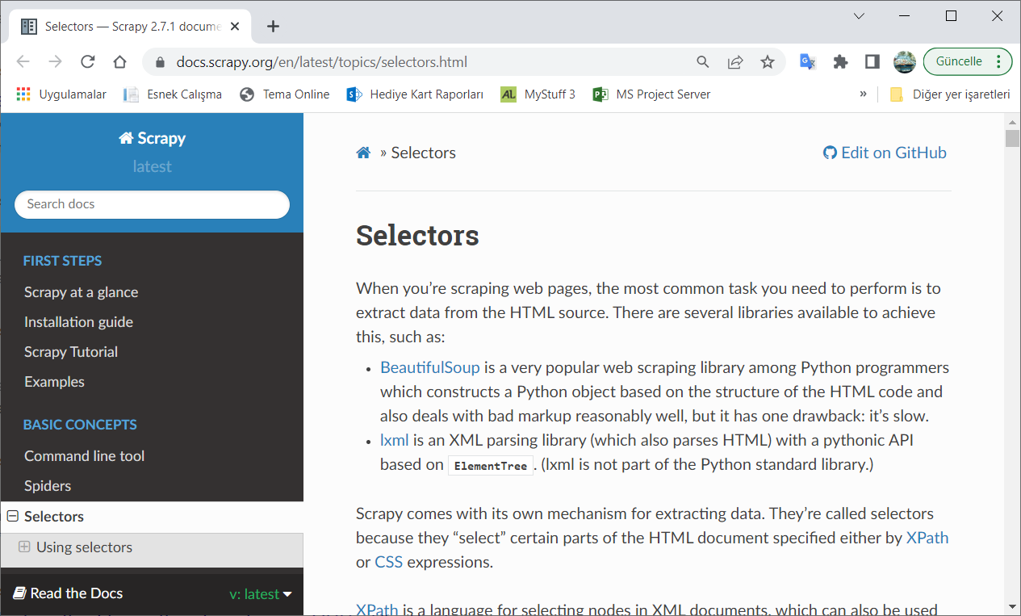
Finding an Element with the select() Method
You can retrieve a web page element from a BeautifulSoup object by calling the select()method and passing a string of a CSS selector for the element you are looking for.
Selectors
Specify patterns
Selector tutorial
are like regular expressions
They specify a pattern
to look for in HTML pages
instead of general text strings
https://docs.scrapy.org/en/latest/topics/selectors.html

Slide 36
examples of the most common CSS selector patterns

Slide 37
Finding an Element with the select() Method
The various selector patterns can be combined to make sophisticated matches
soup.select('p #author')
select()
Tag Objects List
will match any element
that has an id attribute of author
inside a <p> element
The select() method
will return a list of Tag objects
which is how Beautiful Soup represent an HTML element
The list will contain
one Tag object f
for every match in the BeautifulSoup object’s HTML
Tag values can be passed to the str() function to show the HTML tags they represent
Tag values also have an attrs attribute that shows all the HTML attributes of the tag as a dictionary

Slide 38
pull attribute from the BeautifulSoup object
  def searchAttributesInHTML(fName,attr):
  try:
  exampleFile = open(fName)
  exampleSoup = bs4.BeautifulSoup(exampleFile, features="html.parser")
  elems = exampleSoup.select(attr)
  print(elems)
  print(len(elems))
  print(elems[0].getText())
  print(str(elems[0]))
  print(elems[0].attrs)
  except Exception as exc:
  print('There was a problem: %s' % (exc))
  # main method
  if __name__ == '__main__':
  # ****searchAttributesInHTML(fName)*****
  # search for attributes in HTML File from disk
  fileName = 'xample.html'
  attribute = '#author'
  searchAttributesInHTML(fileName, attribute)
pull the element with id="author" out of our example HTML
We store this list of Tag objects in the variable elems
len(elems) tells us there is one Tag object in the list
Calling getText() on the element returns the element’s text, in this case, 'Al Sweigart'.
Notes:
come back to make corrections

Slide 39
pull <p> elements from the BeautifulSoup object
  def pullElements(fName,elm):
  try:
  exampleFile = open(fName)
  exampleSoup = bs4.BeautifulSoup(exampleFile, features="html.parser")
  pElems = exampleSoup.select(elm)
  print(str(pElems))
  print(len(pElems))
  print(pElems[0].getText())
  print(str(pElems[1]))
  print(pElems[1].getText())
  print(str(pElems[2]))
  print(pElems[2].getText())
  except Exception as exc:
  print('There was a problem: %s' % (exc))
  # main method
  if __name__ == '__main__':
  # *******pullElements(fName,elm)*******
  # pull elements from HTML disk File
  fileName = 'xample.html'
  element = 'p'
  searchAttributesInHTML(fileName, element)
select() to find any <p> elements and then store the first matched element in pElems.
Notes:
come back to make corrections

Slide 40
Getting Data from an Element’s Attributes: get() method
The get() method for Tag objects makes it simple to access attribute values from an element.
Pass attribute name
Get the value
select()
The method is passed a string of an attribute name
returns attribute’s value
The BeautifulSoup method
Find element within HTML
Tag objects get method returns value of the attribute

Slide 41
pull <p> elements from the BeautifulSoup object
  import bs4
  def getElementValue(fName,elm):
  try:
  exampleFile = open(fName)
  soup = bs4.BeautifulSoup(exampleFile, features="html.parser")
  foundForSelectedElement = soup.select(elm)[0]
  print("The element:", str(foundForSelectedElement))
  print("Value of Id:", foundForSelectedElement.get('id'))
  print("Attribute(s) of the elment:", foundForSelectedElement.attrs)
  except Exception as exc:
  print('There was a problem: %s' % (exc))
  # main method
  if __name__ == '__main__':
  # *******pullElements(fName,elm)***********
  # pull elements from HTML disk File
  fileName = 'xample.html'
  element = 'span'
  getElementValue(fileName, element)
select() to find any <span> elements and then the first (0) matched element in spanElem.
<!DOCTYPE html>
<html lang="en">
<head>
<meta charset="UTF-8">
<title>XAMPLE</title>
</head>
<body>
<p>Download my <strong>Python</strong> book from <a href="http://
inventwithpython.com">my website</a>.</p>
<p class="slogan">Learn Python the easy way!</p>
<p>By <span id="author">Al Sweigart</span></p>
</body></html>
Notes:
come back to make corrections

Slide 42
Chapter 11: Web Scraping
Controlling the Browser with the selenium Module

Slide 43
selenium Module
The selenium module lets Python directly control the browser by programmatically
Programmatic control
Interact
Simulate user
directly control the browser by programmatically
clicking links
filling in login information
almost as though there is a human user
interacting with the page
Selenium allows you to interact with web pages in a much more advanced way than Requests and BeautifulSoup

Slide 44
selenium Module
The selenium module launches a web browser
browser
slower
file download
launches a web browser
A bit slower
hard to run in the background
you just need to download some files
from the Web

Slide 45
Starting a Selenium-Controlled Browser
For these examples, you’ll need the Firefox web browser and install selenium package
import
from selenium import webdriver
launch
Importing the modules for Selenium
is slightly tricky
Instead of import selenium
you need to run from selenium import webdriver
you can launch the Firefox browser
with Selenium
If you don’t already have Firefox, you can download it for free from http://getfirefox.com/
To install selenium: pip install selenium

Slide 46
Selenium launch a web page
  #Launch a page link using Firefox. Notice, Firefox should be installed!
  def launchWebPageWithSelenium(siteLink):
  try:
  from selenium import webdriver
  browser = webdriver.Firefox()
  print("Browser: ", browser)
  browser.get(siteLink)
  except Exception as exc:
  print('There was a problem: %s' % (exc))
  # main method
  if __name__ == '__main__':
  # ******launchWebPageWithSelenium(siteLink)*******
  # launch a web page using selenium and Firefox
  link = 'http://inventwithpython.com'
  launchWebPageWithSelenium(link)
when webdriver.Firefox() is called, the Firefox web browser starts up.
Calling type() on the value webdriver.Firefox() reveals it’s of the WebDriver data type
Notes:
come back to make corrections

Slide 47
Finding Elements on the Page
WebDriver objects have quite a few methods for finding elements on a page.
They are divided into the find_element_* and find_elements_* methods
find_element_*
find_elements_*
WebDriver object
return a single WebElement object,
Representing the first element on the page that matches the query
return a list of WebElement_* objects
for every matching element on the page
find_element_* and find_elements_* methods
both are WebDriver object’s methods
If no elements exist on the page that match what the method is looking for, the selenium modüle raises a NoSuchElement exception

Slide 48
Table 11-3: Selenium’s WebDriver Methods for Finding Elements
Except for the *_by_tag_name() methods, the arguments to all the methods are case sensitive.

Slide 49
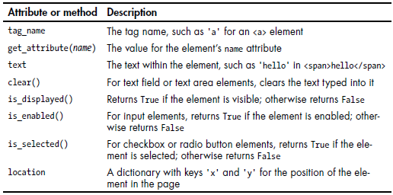
Table 11-4: WebElement Attributes and Methods
Once you have the WebElement object, you can find out more about it by reading the attributes or calling the methods in Table 11-4

Slide 50
browser.find_element_by_class_name()
  #Launch a page link using Firefox to find an element. Notice, Firefox should be installed!
  def launchToFindElement(siteLink, txt):
  try:
  from selenium import webdriver
  browser = webdriver.Firefox()
  elem = browser.find_element_by_class_name(txt)
  print('Found <%s> element with that class name!' % (elem.tag_name))
  except:
  print('Was not able to find an element with that name.')
  # main method
  if __name__ == '__main__':
  # *******************launchToFindElement******************
  # launch a web page using selenium and Firefox to find an element
  link = 'http://inventwithpython.com'
  element="bookcover"
  launchToFindElement(link,element)
open Firefox
direct it to a URL
try to find elements with the class name 'bookcover’,
print its tag name using the tag_name attribute
element is not found
so print a different message
Notes:
come back to make corrections

Slide 51
Clicking the Page
WebElement objects returned from the find_element_* and find_elements_* methods have a click() method
click()
usage
examples
method simulates a mouse click
on that element
The method
triggers whatever might happen
when the element is clicked by the mouse
to follow a link
to make a selection on a radio button
to click a Submit button

Slide 52
Click on an element using: click() method
  #Launch a page link using Firefox to find and click an element. Notice, Firefox should be installed!
  def clickElement(siteLink,element):
  try:
  from selenium import webdriver
  browser = webdriver.Firefox()
  browser.get(siteLink)
  linkElem = browser.find_element_by_link_text(element)
  print(linkElem)
  linkElem.click() # follows the "Read It Online" link
  except:
  print('Was not able to find an element with that name.')
  # main method
  if __name__ == '__main__':
  # *******clickElement(siteLink,element)*******
  # find an element and click it
  link = 'http://inventwithpython.com'
  element = 'Read It Online'
  clickElement(link, element)
opens Firefox
http://inventwithpython.com/
gets the WebElement object for the <a> element with the text Read It Online
simulates clicking that <a> element
It’s just like if you clicked the link yourself
the browser then follows that link.
Notes:
come back to make corrections

Slide 53
Filling Out and Submitting Forms
Sending keystrokes to text fields on a web page is a matter of finding the <input> or <textarea> element for that text field and then calling the send_keys() method
find elements
send_keys()
Launch page
<input> or
<textarea>
calling the send_keys() method
First launch the page
Using Firefox
or other appropriate browser

Slide 54
fill in the fields using send_keys()
  #Launch email page and fill in the fields automatically. Notice, Firefox should be installed!
  def signinForEmail(emailLink,emailText, email, passTxt, password):
  try:
  from selenium import webdriver
  browser = webdriver.Firefox()
  browser.get('http://gmail.com')
  emailElem = browser.find_element_by_id(emailText)
  emailElem.send_keys(email)
  passwordElem = browser.find_element_by_id(passTxt)
  passwordElem.send_keys(password)
  passwordElem.submit()
  except:
  print('Ops, something is wrong, cannot fill in!')
  # main method
  if __name__ == '__main__':
  # ******signinForEmail(emailLink,emailText, email, passTxt, password)*********
  # find an element and click it
  link = 'http://gmail.com'
  emailWord = 'Email'
  email='not_my_real_email@gmail.com'
  passwordTxt='Passwd'
  password = '12345'
  signinForEmail(link,emailWord,email,passwordTxt, password)
Notes:
come back to make corrections

Slide 55
Sending special keys
Selenium has a module for keyboard keys that are impossible to type into a string value, which function much like escape characters.
selenium.webdriver.common.keys module
Module
import Keys
simply write Keys
These values are stored in attributes in the
selenium.webdriver.common.keys module
it’s much easier to run from selenium.webdriver.common.keys
import Keys at the top of your program
then you can simply write Keys
anywhere you’d normally have to write
selenium.webdriver.common.keys

Slide 56
Table 11-5: Commonly Used Variables in the selenium.webdriver.common.keys Module
For example, if the cursor is not currently in a text field:
pressing the home and end keys will scroll the browser
to the top and bottom of the page, respectively

Slide 57
Scrolling using send_keys()
  #Launch a page and scroll. Notice, Firefox should be installed!
  def scrollPage(linkURL, htmlTxt):
  try:
  from selenium import webdriver
  from selenium.webdriver.common.keys import Keys
  browser = webdriver.Firefox()
  browser.get(linkURL)
  htmlElem = browser.find_element_by_tag_name(htmlTxt)
  htmlElem.send_keys(Keys.END) # scrolls to bottom
  htmlElem.send_keys(Keys.HOME) # scrolls to top
  except:
  print('Ops, something is wrong, cannot fill in!')
  # main method
  if __name__ == '__main__':
  # ***********scrollPage(linkURL, htmlTxt)***********
  # scroll the page
  link = 'http://nostarch.com'
  htmlText = 'html'
  scrollPage(link, htmlText)
Calling browser.find_element_by_tag_name('html') is a good place to send keys to the general web page.
The <html> tag is the base tag in HTML files:
The full content of the HTML file is enclosed within the <html> and </html> tags.
Notes:
come back to make corrections

Slide 58
Selenium can simulate clicks on various browser buttons as well through the following methods:

Slide 59
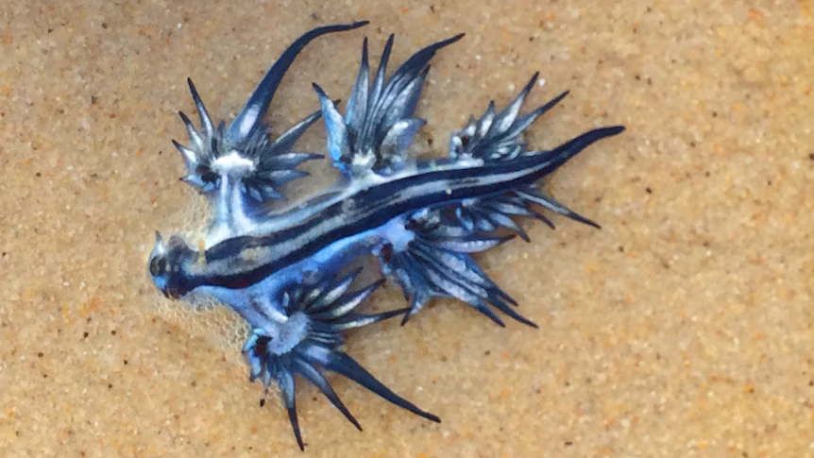



Self Assessment
Asses what you got so far!
Noticible issues
Interesting Details
Unclarified issues
webbrowser modüle
Downloading files from Web
Saving downloaded files to Hard Drive
HTML
bs4.BeautifulSoap Module
Controlling the Browser with the selenium Module
What is the most interesting details in this chapter?
What are the points need further explanations?

Slide 60






Thank You
Yusuf Altunel, PhD
https://www.linkedin.com/in/yusuf-altunel-2070a31b/
y.altunel@iku.edu.tr
http://cats.iku.edu.tr/portal/site/0181f2bc-77e3-4a85-ade9-77639d9bcfe7

