Slide 1

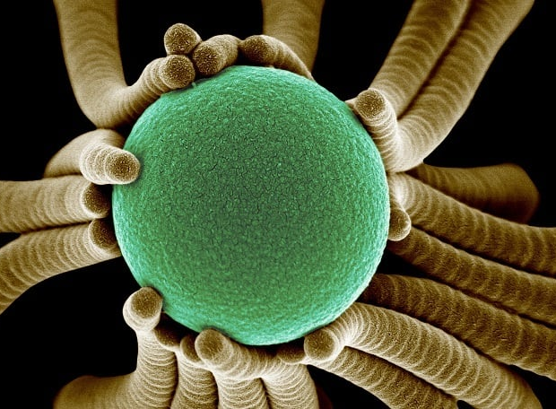
Chapter 12: Working with Excel Spreadsheets
CSE0408 Programming III
IKU Department of Computer Engineering
Yusuf Altunel, PhD

Slide 2
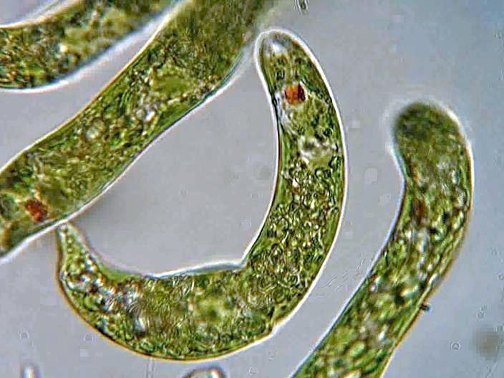
Content
Headlines
Excel Documents
OpenPyXL Module
Reading & Writing Excel Documents
Styles
Formulas
Adjusting Rows & Collumns
Charts
Automate the Boring Stuff with Python
Practical Programming for Total Beginners
Chapter 12: Working with Spreadsheets
Chapter 12: Working with Excel Spreadsheets

Slide 3



Chapter 12: Working with Excel Spreadsheets
Excel Documents
Chapter 12: Working with Excel Spreadsheets

Slide 4
Excel Documents
Workbook, sheet, columns, rows
Workbook
Extension
Sheet
An Excel spreadsheet document
A single workbook is saved in a file with the .xlsx extension
Each workbook can contain multiple sheets
has columns
  addressed by letters starting at A
has rows
  addressed by numbers starting at 1
Chapter 12: Working with Excel Spreadsheets

Slide 5
Excel Documents
Cell, value, data grid
Cell
Value
Data Grid
box at a particular column and row
Each cell can contain a number or text value
The grid of cells
with data makes up a sheet
Chapter 12: Working with Excel Spreadsheets

Slide 6
Chapter 12: Working with Excel Spreadsheets
Openpyxl module
Chapter 12: Working with Excel Spreadsheets

Slide 7
Python’s Spreadsheet Library
openpyxl module’s Works fine with any Spreadsheet applications .xlsx files such as Libre Office & Open Office Calc.
openpyxl
Supported files
pip install pillow
a Python library to read/write Excel 2010 files
xlsx
xlsm
xltx
xltm
to include images into an openpyxl file
install “pillow” library
Jpeg
png
bmp
…
Chapter 12: Working with Excel Spreadsheets

Slide 8
Installing OpenPyXL Module
The OpenPyXL module doesn’t come with Python, so you’ll have to install it first
pip install OpenPyXL
Documents
Github
License
https://openpyxl.readthedocs.io/en/stable/
https://github.com/ericgazoni/openpyxl
Module is under the MIT Licence
https://github.com/ericgazoni/openpyxl?tab=License-1-ov-file
Test with import openpyxl
Chapter 12: Working with Excel Spreadsheets

Slide 9
Python’s Spreadsheet Library
openpyxl does not guard against quadratic blowup or billion laughs xml attacks.
To guard against these attacks, install defusedxml.
XML Attacks
Quadratic blowup
billion laughs xml attack
quadratic blowup
billion laughs xml attacks
Install Pillow library
"pip install pillow"
type of attack that can occur when processing XML files
the exponential growth of memory and processing time
to resource exhaustion and potential denial of service vulnerabilities
Malicious XML files
When system tries to parse the file, it enters into an infinite loop, consuming excessive amounts of memory and CPU resources
Chapter 12: Working with Excel Spreadsheets

Slide 10
Chapter 12: Working with Excel Spreadsheets
Reading Data From Spreadsheet
Chapter 12: Working with Excel Spreadsheets

Slide 11
Working with Worksheets
Insert at the end: wb.create_sheet("Mysheet")
First position: wb.create_sheet("Mysheet",0)
Last position: wb.create_sheet("Mysheet",-1)
Creating worksheets
Default sheet names
Sheets are given a name automatically when they are created.
They are numbered in sequence: Sheet, Sheet1, Sheet2, …
Change sheet names
Worksheet.title property
Chapter 12: Working with Excel Spreadsheets

Slide 12
Working with Worksheets
Get names
worksheets names: wb.sheetnames
Loop through worksheets
for sheet in wb:
... print(sheet.title)
Create copies of worksheet
source = wb.active
target = wb.copy_worksheet(source)
using its name: wb[‘Sheet Name’]
Chapter 12: Working with Excel Spreadsheets

Slide 13
Cell Operations
Accessing cells with key
As keys of worksheet
c = ws['A4']
will return the cell at A4
create one if it does not exist yet
Alternative method
Worksheet.cell()
provides access to cells using row and column notation
d = ws.cell(row=4, column=2, value=10)
Assign value to a cell
ws['A4'] = 4
cell() method
Chapter 12: Working with Excel Spreadsheets

Slide 14
Cell Creation
No cells, initiially
Creatin by scorlling
Cells are created by default
scrolling through cells
even if they are assigned no value
worksheet contains no cells
Cell auto creation
when it is created in memory
when they are firstly accessed
will create them all in memory
from openpyxl import Workbook
wb = Workbook()
ws = wb.active
#create 100x100 cells in memory
#for nothing.
for x in range(1,101):
for y in range(1,101):
ws.cell(row=x, column=y)
Chapter 12: Working with Excel Spreadsheets

Slide 15
Accessing many cells
Slicing
Ranges of cells can be accessed
using slicing
Example
cell_range=ws['A1':'C2']
Similar operations
Ranges of rows
Range of columns
from openpyxl import Workbook
wb = Workbook()
ws = wb.active
#Working with ranges of cells
colC = ws['C']
col_range = ws['C:D']
row10 = ws[10]
row_range = ws[5:10]
Chapter 12: Working with Excel Spreadsheets

Slide 16
Row & Column Iterators
Iterators
Worksheet.iter_rows()
Row iterations
Column iterator
will return columns
Iteration through rows
Iteration through columns
Worksheet.iter_cols()
not available in read-only mode!
from openpyxl import Workbook
wb = Workbook()
ws = wb.active
#row iterator
for row in ws.iter_rows(min_row=1, max_col=3, max_row=2):
for cell in row:
print(cell)
print('********************’)
#column iterator
for row in ws.iter_cols(min_row=1, max_col=3, max_row=2):
for cell in row:
print(cell)
<Cell 'Sheet'.A1>
<Cell 'Sheet'.B1>
<Cell 'Sheet'.C1>
<Cell 'Sheet'.A2>
<Cell 'Sheet'.B2>
<Cell 'Sheet'.C2>
********************
<Cell 'Sheet'.A1>
<Cell 'Sheet'.A2>
<Cell 'Sheet'.B1>
<Cell 'Sheet'.B2>
<Cell 'Sheet'.C1>
<Cell 'Sheet'.C2>
Chapter 12: Working with Excel Spreadsheets

Slide 17
Worksheet rows & columns Attributes
Worksheet.rows
to iterate through all columns of a file
Worksheet.columns
to iterate through all the rows
read-only mode
Worksheet.columns property is not available
((<Cell Sheet.A1>, <Cell Sheet.B1>, <Cell Sheet.C1>),
(<Cell Sheet.A2>, <Cell Sheet.B2>, <Cell Sheet.C2>),
(<Cell Sheet.A3>, <Cell Sheet.B3>, <Cell Sheet.C3>),
(<Cell Sheet.A4>, <Cell Sheet.B4>, <Cell Sheet.C4>),
(<Cell Sheet.A5>, <Cell Sheet.B5>, <Cell Sheet.C5>),
(<Cell Sheet.A6>, <Cell Sheet.B6>, <Cell Sheet.C6>),
(<Cell Sheet.A7>, <Cell Sheet.B7>, <Cell Sheet.C7>),
(<Cell Sheet.A8>, <Cell Sheet.B8>, <Cell Sheet.C8>),
(<Cell Sheet.A9>, <Cell Sheet.B9>, <Cell Sheet.C9>))
((<Cell Sheet.A1>,
<Cell Sheet.A2>,
<Cell Sheet.A3>,
...
<Cell Sheet.C9>))
from openpyxl import Workbook
wb = Workbook()
ws = wb.active
#to iterate through all the rows or columns
ws = wb.active
ws['C9'] = 'hello world'
print(tuple(ws.rows))
print(tuple(ws.columns))
Chapter 12: Working with Excel Spreadsheets

Slide 18
Accessing Values
Worksheet Values
Worksheet.values property.
iterates over all the rows in a worksheet
returns just the cell values
values_only parameter
Both Worksheet.iter_rows() and Worksheet.iter_cols()
can take the values_only parameter
to return just the cell’s value
from openpyxl import Workbook
wb = Workbook()
ws = wb.active
for row in ws.values:
for value in row:
print(value)
from openpyxl import Workbook
wb = Workbook()
ws = wb.active
#Both Worksheet.iter_rows() and #Worksheet.iter_cols() can take the #values_only parameter
# to return just the cell’s value
for row in ws.iter_rows(min_row=1, max_col=3, max_row=2, values_only=True):
print(row)
(None, None, None)
(None, None, None)
Chapter 12: Working with Excel Spreadsheets

Slide 19
Accessing Values
c.value = <value>
To a cell
Assign a value
from openpyxl import Workbook
wb = Workbook()
ws = wb.active
for row in ws.iter_rows(min_row=1, max_col=2, max_row=4, values_only=True):
print(row)
#to work with a cell’s value directly, you can get or set it using the value property:
c = ws.cell(row=3, column=1)
c.value = 'hello, world'
print(c.value)
d = ws.cell(row=4, column=2)
d.value = 3.14
print(d.value)
for row in ws.iter_rows(min_row=1, max_col=2, max_row=4, values_only=True):
print(row)
(None, None)
(None, None)
(None, None)
(None, None)
hello, world
3.14
(None, None)
(None, None)
('hello, world', None)
(None, 3.14)
Chapter 12: Working with Excel Spreadsheets

Slide 20
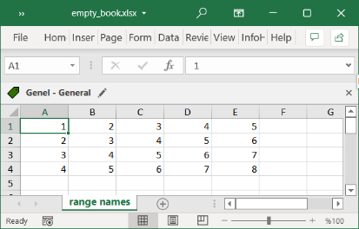
Loading from a file
penpyxl.load_workbook()
to open an existing workbook
filename = 'empty_book.xlsx'
Keyword argument
Tells the name of the file
from openpyxl import Workbook
from openpyxl.reader.excel import load_workbook
wb = Workbook()
ws = wb.active
ws.title = 'range names'
#10 rows & 5 columns
for i in range(1, 5):
ws.append(range(i,5+i))
#Save the file
wb.save('empty_book.xlsx')
wb = load_workbook(filename = 'empty_book.xlsx')
sheet_ranges = wb['range names']
print(sheet_ranges['D4'].value)
1 | 2 | 3 | 4 | 5
2 | 3 | 4 | 5 | 6
3 | 4 | 5 | 6 | 7
4 | 5 | 6 | 7 | 8
Chapter 12: Working with Excel Spreadsheets

Slide 21
Chapter 12: Working with Excel Spreadsheets
Writing Excel Document
Chapter 12: Working with Excel Spreadsheets

Slide 22
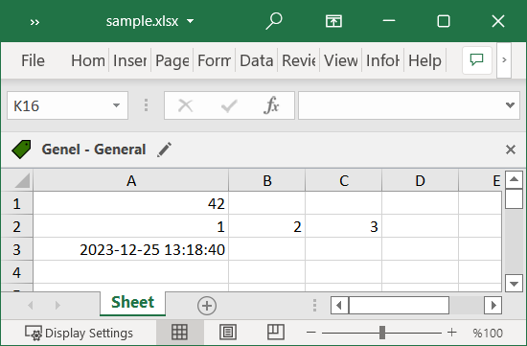
Creating a Simple File
from openpyxl import Workbook
wb = Workbook()
# grab the active worksheet
ws = wb.active
# Data can be assigned directly to cells
ws['A1'] = 42
# Rows can also be appended
ws.append([1, 2, 3])
# Python types will automatically be converted
import datetime
ws['A3'] = datetime.datetime.now()
# Save the file
wb.save("sample.xlsx")
42
1 | 2 | 3
2023-12-25 13:18:40
Chapter 12: Working with Excel Spreadsheets
Notes:
come back to make corrections

Slide 23
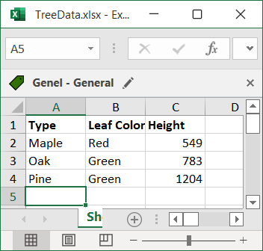
Creating a simple spreadsheet
Steps
add some data
create a sheet from scratch
then plot it
Explore
limited cell style
formatting
from openpyxl import Workbook
wb = Workbook()
ws = wb.active
treeData = [["Type", "Leaf Color", "Height"], ["Maple", "Red", 549], ["Oak", "Green", 783], ["Pine", "Green", 1204]]
for row in treeData:
ws.append(row)
from openpyxl.styles import Font
ft = Font(bold=True)
for row in ws["A1:C1"]:
for cell in row:
cell.font = ft
Type | Leaf Color | Height
Maple | Red | 549
Oak | Green | 783
Pine | Green | 1204
Chapter 12: Working with Excel Spreadsheets

Slide 24
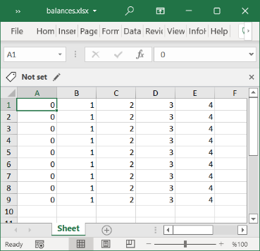
Saving to A File
Workbook.save()
The simplest and safest way to save a workbook object
Notice
This operation will overwrite existing files without warning
from openpyxl import Workbook
wb = Workbook()
ws = wb.active
#10 rows & 5 columns
for i in range(1, 10):
ws.append(range(5))
#Save the file
wb.save('balances.xlsx')
Chapter 12: Working with Excel Spreadsheets

Slide 25
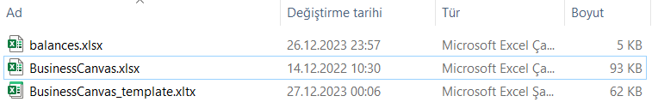
Saving as a Template
wb.template
wb.template=True
Attribute to tell the file is a templae
to save a workbook as a template
from openpyxl import Workbook
from openpyxl.reader.excel import load_workbook
wb = Workbook()
ws = wb.active
wb = load_workbook('BusinessCanvas.xlsx')
wb.template = True
wb.save('BusinessCanvas_template.xltx')
Chapter 12: Working with Excel Spreadsheets

Slide 26
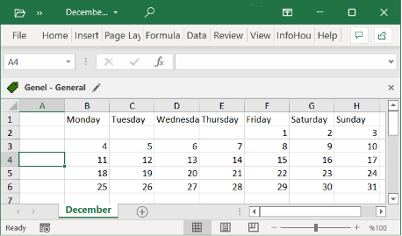

A Project to Get Month’s Calender
import calendar
import openpyxl
from openpyxl.utils import get_column_letter
from datetime import datetime
# Get the current month and year
current_month = datetime.now().month
current_year = datetime.now().year
# Create a new Excel workbook
workbook = openpyxl.Workbook()
sheet = workbook.active
sheet.title = calendar.month_name[current_month]
# Write the days of the week for the current month
days_in_month = calendar.monthrange(current_year, current_month)[1]
weeks = calendar.monthcalendar(current_year, current_month)
for col, day in enumerate(calendar.day_name, start=2):
sheet.cell(row=1, column=col, value=day)
for week_num, week in enumerate(weeks, start=1):
for day_num, day in enumerate(week, start=2):
if day != 0:
sheet.cell(row=week_num + 1, column=day_num, value=day)
# Save the workbook
workbook.save(f'{calendar.month_name[current_month]}_{current_year}_weeks.xlsx')
Monday | Tuesday | Wednesday | Thursday | Friday | Saturday | Sunday
 |  |  |  | 1 | 2 | 3
4 | 5 | 6 | 7 | 8 | 9 | 10
11 | 12 | 13 | 14 | 15 | 16 | 17
18 | 19 | 20 | 21 | 22 | 23 | 24
25 | 26 | 27 | 28 | 29 | 30 | 31
Chapter 12: Working with Excel Spreadsheets
Notes:
come back to make corrections

Slide 27
Saving as a Stream
Stream
to save the file to a stream
NamedTemporaryFile()
provide a NamedTemporaryFile()
when using a web application such as Pyramid, Flask or Django
from tempfile import NamedTemporaryFile
from openpyxl import Workbook
wb = Workbook()
with NamedTemporaryFile() as tmp:
wb.save(tmp.name)
tmp.seek(0)
stream = tmp.read()
Chapter 12: Working with Excel Spreadsheets

Slide 28
Chapter 12: Working with Excel Spreadsheets
Working with Styles
Chapter 12: Working with Excel Spreadsheets

Slide 29
Working with styles
Usage
to determine the formatting for numbers
to change the look of data
while displayed on screen.
can be applied to
font to set font size, color, underlining, etc.
fill to set a pattern or color gradient
border to set borders on a cell
cell alignment
protection
from openpyxl.styles import PatternFill, Border, Side, Alignment, Protection, Font
#Deafult values for the styles
font = Font(name='Calibri',
size=11,
bold=False,
italic=False,
vertAlign=None,
underline='none',
strike=False,
color='FF000000')
fill = PatternFill(fill_type=None,
start_color='FFFFFFFF',
end_color='FF000000')
border = Border(left=Side(border_style=None, color='FF000000'),
right=Side(border_style=None, color='FF000000'),
top=Side(border_style=None, color='FF000000'),
bottom=Side(border_style=None, color='FF000000'),
diagonal=Side(border_style=None, color='FF000000'),
diagonal_direction=0,
outline=Side(border_style=None, color='FF000000'),
vertical=Side(border_style=None, color='FF000000'),
horizontal=Side(border_style=None,color='FF000000'))
alignment=Alignment(horizontal='general',
vertical='bottom',
text_rotation=0,
wrap_text=False,
shrink_to_fit=False,
indent=0)
number_format = 'General'
protection = Protection(locked=True, hidden=False)
Chapter 12: Working with Excel Spreadsheets

Slide 30
Style Templates : Cell Styles and Named Styles
stops unwanted side-effects
Cell Styles
are shared between objects and once they have been assigned, they cannot be changed
such as changing the style for lots of cells
when only one changes
from openpyxl.styles import colors
from openpyxl.styles import Font, Color
from openpyxl import Workbook
wb = Workbook()
ws = wb.active
a1 = ws['A1']
d4 = ws['D4']
ft = Font(color="FF0000")
a1.font = ft
d4.font = ft
#a1.font.italic = True # is not allowed # doctest: +SKIP
# If you want to change the color of a Font, you need to reassign it::
a1.font = Font(color="FF0000", italic=True) # the change only affects A1
Chapter 12: Working with Excel Spreadsheets

Slide 31
Style Templates : Copying Styles
copy()
What is copied?
To copy style
All styles of the source
from openpyxl.styles import Font
from copy import copy
ft1 = Font(name='Arial', size=14)
ft2 = copy(ft1)
print(f'Font-1=> Name: {ft1.name}, Size: {ft1.size}')
print(f'Font-2=> Name: {ft2.name}, Size: {ft2.size}’)
ft2.name = "Tahoma"
print(f'Font-1=> Name: {ft1.name}, Size: {ft1.size}')
print(f'Font-2=> Name: {ft2.name}, Size: {ft2.size}')
Font-1=> Name: Arial, Size: 14.0
Font-2=> Name: Arial, Size: 14.0
Font-1=> Name: Arial, Size: 14.0
Font-2=> Name: Tahoma, Size: 14.0
Chapter 12: Working with Excel Spreadsheets

Slide 32
Chapter 12: Working with Excel Spreadsheets
Formulas
Chapter 12: Working with Excel Spreadsheets

Slide 33
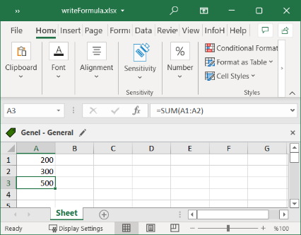
Formulas
Formula
can configure cells
to contain values calculated from other cells
Example
sheet['B9'] = '=SUM(B1:B8)'
store =SUM(B1:B8) as the value in cell B9
begin with an equal sign
Text value
A formula is set just like any other text value in a cell
import openpyxl
wb = openpyxl.Workbook()
sheet = wb.active
sheet['A1'] = 200
sheet['A2'] = 300
sheet['A3'] = '=SUM(A1:A2)'
wb.save('writeFormula.xlsx')
Chapter 12: Working with Excel Spreadsheets

Slide 34
Formulas
Reading the formula
You can also read the formula in a cell
just as any value
data_only keyword
pass True for the data_only keyword argument to load_workbook()
to see the result of the calculation for the formula
import openpyxl
from openpyxl.reader.excel import load_workbook
wbFormulas = load_workbook(filename = 'writeFormula.xlsx')
sheet = wbFormulas.active
print(sheet['A3'].value)
=SUM(A1:A2)
wbFormulas = load_workbook(filename = 'writeFormula.xlsx', data_only=True)
sheet = wbFormulas.active
print(sheet['A3'].value)
500
Chapter 12: Working with Excel Spreadsheets

Slide 35
Chapter 12: Working with Excel Spreadsheets
Adjusting Rows & Columns
Chapter 12: Working with Excel Spreadsheets

Slide 36
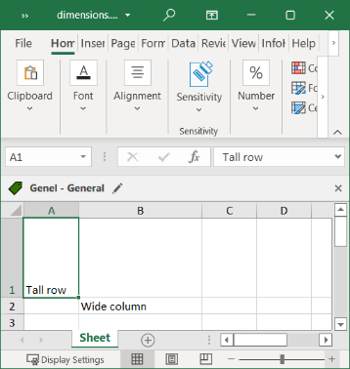
Adjusting Cell Size Programmatically
Adjusting cell size programmatically
to set a row or column’s size
based on cells’ contents
in a large number of spreadsheet files
Set the attributes: row_dimensions column_dimensions
write a Python program
Control
row heights & column widths
The row height
set to an integer or float value between 0 and 409.
one point equals 1/72 of an inch
represents the height measured in points
column width
can be set to an integer or float value
between 0 and 255
represents the number of characters at the default font size (11 point)
that can be displayed in the cell
The default column width is 8.43 characters
The default row height is 12.75
import openpyxl
wb = openpyxl.Workbook()
sheet = wb.active
sheet['A1'] = 'Tall row'
sheet['B2'] = 'Wide column'
sheet.row_dimensions[1].height = 70
sheet.column_dimensions['B'].width = 20
wb.save('dimensions.xlsx')
Chapter 12: Working with Excel Spreadsheets

Slide 37
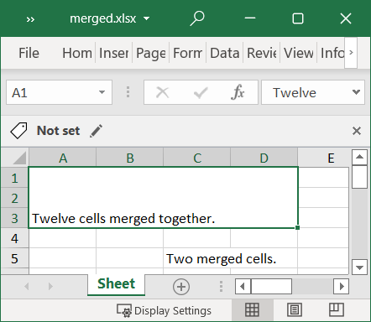
Merging and Unmerging Cells
To merge
Call
into a single cell with the
a rectangular area of cells
merge_cells() sheet method
The value
the value of the top-left cell of the merged group
import openpyxl
wb = openpyxl.Workbook()
#Merging the size
sheet = wb.active
sheet.merge_cells('A1:D3')
sheet['A1'] = 'Twelve cells merged together.'
sheet.merge_cells('C5:D5')
sheet['C5'] = 'Two merged cells.'
wb.save('merged.xlsx')
Chapter 12: Working with Excel Spreadsheets

Slide 38
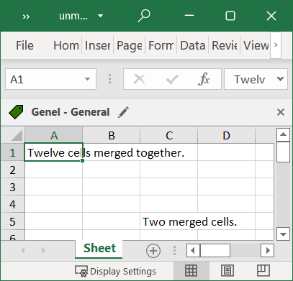
Merging and Unmerging Cells
To unmerge
call the sheet method
unmerge_cells()
Restoration
to being individual cells
the merged cells will go back
import openpyxl
wb = openpyxl.Workbook()
#unmerve the cells
wb = openpyxl.load_workbook('merged.xlsx')
sheet = wb.active
sheet.unmerge_cells('A1:D3')
sheet.unmerge_cells('C5:D5')
wb.save('unmerged.xlsx')
Chapter 12: Working with Excel Spreadsheets

Slide 39
Freeze Panes
freeze panes
Frozen column or row headers, for example, are always visible to the user even as they scroll through the spreadsheet.
“freeze” a few of the top rows or leftmost columns onscreen
freeze_panes attribute
To set to a Cell object or a string of a cell’s coordinates
To unfreeze all panes
set freeze_panes to None or 'A1'.
Chapter 12: Working with Excel Spreadsheets

Slide 40
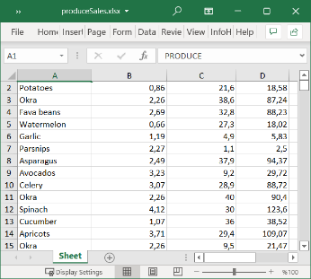
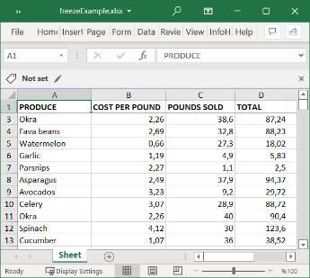
Freeze Panes
Unfreze
Freeze
import openpyxl
wb = openpyxl.Workbook()
#freeze the panes
wb = openpyxl.load_workbook('produceSales.xlsx')
sheet = wb.active
sheet.freeze_panes = 'A2'
wb.save('freezeExample.xlsx')
Chapter 12: Working with Excel Spreadsheets

Slide 41
Chapter 12: Working with Excel Spreadsheets
Charts
Chapter 12: Working with Excel Spreadsheets

Slide 42
Charts
OpenPyXL supports charts
Bar
Line
Scatter
pie charts
Data source
Using the data
in a sheet’s cells
1. Create a Reference object from a rectangular selection of cells.
4. Append the Series object to the Chart object.
2. Create a Series object by passing in the Reference object.
3. Create a Chart object.
5. Optionally, set the drawing.top, drawing.left, drawing.width, and
drawing.height variables of the Chart object.
6. Add the Chart object to the Worksheet object.
Chapter 12: Working with Excel Spreadsheets

Slide 43
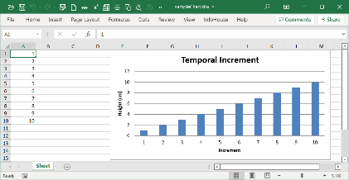
from openpyxl import Workbook
wb = Workbook()
sheet = wb.active
for i in range(1, 11): # create some data in column A
sheet['A' + str(i)] = i
from openpyxl.chart import BarChart, Reference
chart = BarChart()
chart.type = "col"
chart.title = "Temporal Increment"
chart.y_axis.title = 'Height (cm)'
chart.x_axis.title = 'Increment'
chart.legend = None
data = Reference(sheet, min_col=1, min_row=1, max_row=10, max_col=1)
categories = Reference(sheet, min_col=1, min_row=1, max_row=10, max_col=1)
chart.add_data(data)
chart.set_categories(categories)
sheet.add_chart(chart, "E1")
wb.save('sampleChart.xlsx')
Chart Names:
BarChart, LineChart, ScatterChart, PieChart
Chapter 12: Working with Excel Spreadsheets

Slide 44
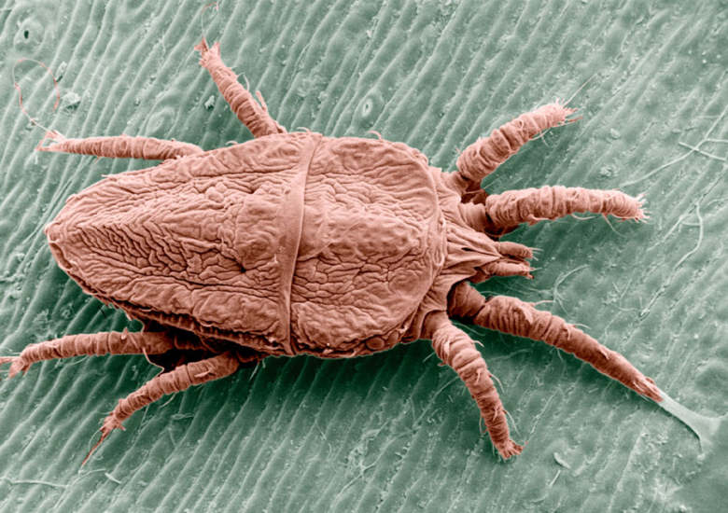



Self Assessment
Asses what you got so far!
Noticible issues
Interesting Details
Unclarified issues
Excel Documents
OpenPyXL Module
Reading & Writing Excel Documents
Playing with styles
Formulas
Adjusting Rows & Collumns
Charts
What is the most interesting details in this chapter?
What are the points need further explanations?

Slide 45
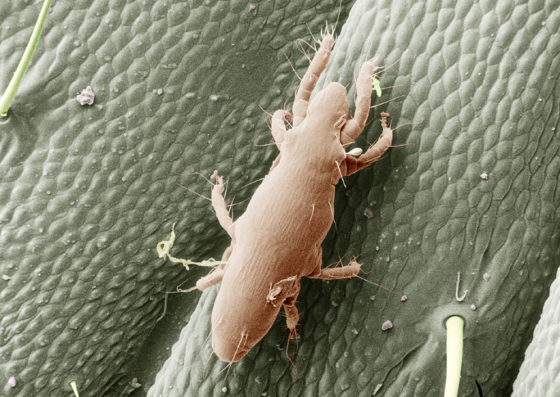





Thank You
Yusuf Altunel, PhD
https://www.linkedin.com/in/yusuf-altunel-2070a31b/
y.altunel@iku.edu.tr
http://cats.iku.edu.tr/portal/site/0181f2bc-77e3-4a85-ade9-77639d9bcfe7

