Slide 1

Chapter 2: Flow Control
CSE0408 Programming III
IKU Department of Computer Engineering
Yusuf Altunel, PhD

Slide 2


Content
Headlines
Boolean Values
Comparison Operators
Boolean Operators
Mixing Boolean and Comparison Operators
Elements of Flow Control
Flow Control Statements
Importing Modules
Ending Program and sys.exit()
Automate the Boring Stuff with Python
Practical Programming for Total Beginners
Chapter-1 Python Basics

Slide 3



Chapter-2 Flow Control
Boolean Values

Slide 4





Boolean Data Type
Only two Values
Capitalized Starting Letter
Examples
Boolean Variable
Incorrect Syntax
True
False
start with a capital T or F,
the rest of the word in lowercase
>>> spam = True
>>> spam
True
>>> True
True
Boolean values are used in expressions
can
be stored in variables
>>> true
NameError: name 'true' is not defined
True = 2 + 2
SyntaxError: cannot assign to True

Slide 5
Chapter-2 Flow Control
Comparison Operators

Slide 6


Comparison Operators
Precedence
Comparison Operators and Meaning
Comparison operators
compare two values
evaluate down to a single Boolean value

Slide 7



Comparison
>>> 42 ==42
True
>>> 42 == 99
False
>>> 2 != 3
True
>>> 2 != 2
False
>>> 'hello' == 'hello'
True
>>> 'hello' == 'Hello'
False
>>> 'dog' != 'cat'
True
>>> True == True
True
>>> True != False
True
>>> 42 == 42.0
True
>>> 42 == '42'
False
>>> 42 < 100
True
>>> 42 > 100
False
>>> 42 < 42
False
>>> eggCount = 42
>>> eggCount <= 42
True
>>> myAge = 29
>>> myAge >= 10
True
Equal
Not equal
Less than
42 ==42
2 != 3
42 < 100
Greater than
Less than or equal to
Greater than or equal to
42 > 100
eggCount <= 42
myAge >= 10

Slide 8
Chapter-2 Flow Control
Boolean Operators

Slide 9
Boolean Operators
There are three boolean operators
and
or
not
True
True and True
False
True and False
False and True
False and False
True
True or True
True or False
False or True
False
False or False
True
not False
False
Not True

Slide 10
Chapter-2 Flow Control
Mixing Boolean and Comparison Operators

Slide 11
Expressions on Python 3.8.0 Shell
comparison operators
evaluate to Boolean values
you can use them in expressions
with the Boolean operators
Operator precedence: Python evaluates
the not operators first,
then the and operators,
then the or operators.
>>> (4 < 5) and (5 < 6)
True
>>> (4 < 5) and (9 < 6)
False
>>> (1 == 2) or (2 == 2)
True
>>> 2 + 2 == 4 and not 2 + 2 == 5 and 2 * 2 == 2 + 2
True

Slide 12
Chapter-2 Flow Control
Elements of Flow Control

Slide 13




Expressions vs Data Types
Flow control statements
start with the condition
are followed by a block of code called the clause
Conditions
A flow control statement decides what to do based on
whether its condition is True or False
Blocks of Code
Python code can be grouped together in blocks
block begins and ends from the indentation of the lines of code

Slide 14



Clauses: Blocks of Code
Python uses Indentation for blocks
Rather than Curly Brackets { }
Begin with Indentation
Blocks inside of Blocks
End with Decreasing Indentation
Blocks begin when the indentation increases.
Blocks can contain other blocks.
Blocks end when
the indentation decreases to zero
or to a containing
block’s indentation

Slide 15
Indentation is for Blocks
>>> name = 'Mary'
>>> if name == 'Mary’:
print('Hello Mary’)
Hello Mary
>>> password = 'Python’
>>> if password == 'swordfish':
print('Access granted.')
else:
print('Wrong password.')
Wrong password.

Slide 16
Chapter-2 Flow Control
Flow Control Statements

Slide 17
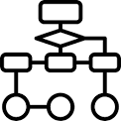


if Statements
Flow
Consists of
Example
The clause will execute
if the statement’s condition is True.
The clause is skipped
if the condition is False.
The if keyword
A condition
  an expression
  evaluates to True or False
A colon :
an indented block of code
  called the if clause
  starts on the next line,
>>> name = 'Alice'
>>> if name == 'Alice':
print('Hi, Alice.')
Hi, Alice.

Slide 18
Flow of If Statement
Start
Where the flow begins
Condition
name == 'Alice’
name variable has the value ‘Alice’ or not?
True Flow
name == 'Alice’
name variable has the value ‘Alice’
Evaluates to True
next, print('Hi, Alice.’)
moves to the next statement
False Flow
name == 'Alice’
name variable value is not ‘Alice’
Evaluates to False
moves to the next statement
Condition
Clause

Slide 19
else Statements
Flow
Consists of
Example
An if clause can optionally be followed by an else statement.
The else clause is executed
  only when the if statement’s condition is False.
The else keyword
A colon
Starting on the next line
  an indented block of code
  called the else clause
>>> name = 'Alice'
>>> if name == 'Alice':
print('Hi, Alice.')
else:
print('Hello, stranger.')
Hi, Alice.

Slide 20
Flow of else Statement
Start
Where the flow begins
Condition
name == 'Alice’
name variable has the value ‘Alice’ or not?
True Flow
name == 'Alice’
name variable has the value ‘Alice’
Evaluates to True
next, print('Hi, Alice.’)
moves to the next statement
False Flow
name == 'Alice’
name variable value is not ‘Alice’
Evaluates to False
next, print('Hello, stranger.’)
moves to the next statement
Condition
True Clause
False (Else) Clause

Slide 21
elif Statements
Flow
Consists of
Example
only one of the if or else clauses will execute,
you may have a case
  you want one of many possible clauses to execute.
The elif statement
  is an “else if” statement
  always follows an if
  or another elif statement
The elif keyword
A condition
  an expression
  evaluates to True or False
A colon
elif clause
  an indented block of code
  Starting on the next line
>>> name = 'Alice'
>>> age = 11
>>> if name == 'Alice':
print('Hi, Alice.')
elif age < 12:
print('You are not Alice, kiddo.')
Hi, Alice.

Slide 22
Flow of elif Statement
Start
Where the flow begins
Condition
name == 'Alice’
name variable has the value ‘Alice’ or not?
True Flow
name == 'Alice’
name variable has the value ‘Alice’
Evaluates to True
next, print('Hi, Alice.’)
moves to the next statement
False Flow
name != 'Alice’
name variable has the value other than ‘Alice’
Condition
age < 12
age is less than 12 or not?
True Flow
age < 12
age variable has the value less than 11
Evaluates to True
next, print('You are not Alice, kiddo.')
moves to the next statement
False Flow
moves to the next statement
Condition
True Clause
False (Else) Clause

Slide 23
elif Statements
>>> age = 11
>>> name = 'Alicia'
>>> if name == 'Alice':
print('Hi, Alice.')
elif age < 12:
print('You are not Alice, kiddo.')
elif age > 2000:
print('Unlike you, Alice is not an undead, immortal vampire.')
elif age > 70:
print('You are not Alice, grannie.')
You are not Alice, kiddo.
>>> age = 2200
>>> name = 'Alicia'
>>> if name == 'Alice':
print('Hi, Alice.')
elif age < 12:
print('You are not Alice, kiddo.')
elif age > 2000:
print('Unlike you, Alice is not an undead, immortal vampire.')
elif age > 100:
print('You are not Alice, grannie.')
Unlike you, Alice is not an undead, immortal vampire.

Slide 24
elif Statements
>>> age = 110
>>> name = 'Alicia'
>>> if name == 'Alice':
print('Hi, Alice.')
elif age < 12:
print('You are not Alice, kiddo.')
elif age > 2000:
print('Unlike you, Alice is not an undead, immortal vampire.')
elif age > 100:
print('You are not Alice, grannie.')
You are not Alice, grannie.
>>> age = 45
>>> name = 'Felicia'
>>> if name == 'Alice':
print('Hi, Alice.')
elif age < 12:
print('You are not Alice, kiddo.')
else:
print('You are neither Alice nor a little kid.')
You are neither Alice nor a little kid.

Slide 25
while Loop Statements
Flow
Consists of
Example
a block of code
  execute over and over again
The code in a while clause
  will be executed
  as long as the while statement’s condition is True
The while keyword
A condition
  an expression
  evaluates to True or False
A colon
indented block of code
  starting on the next line
  called the while clause
>>> spam = 0
>>> while spam < 5:
print('Hello, world.')
spam = spam + 1
Hello, world.
Hello, world.
Hello, world.
Hello, world.
Hello, world.

Slide 26
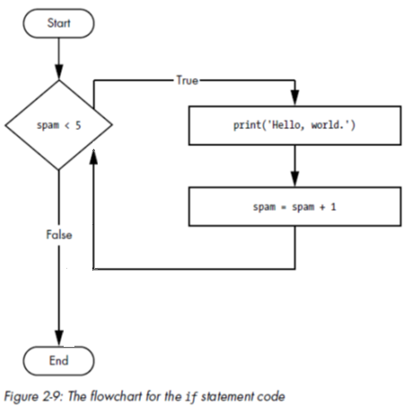
Flow of while Statement
Start
Where the flow begins
Condition
spam < 5
spam variable has the value less than 5 or not?
True Flow
print('Hello, world.’) # Display string Hello, world.
spam = spam +1 #Increment
Check the condition again
False Flow
spam >= 5
name variable has the value other than ‘Alice’
while
condition
while clause

Slide 27
while Statement
>>> name = ''
>>> while name != 'your name':
print('Please type your name.')
name = input()
print('Thank you!')
'Please type your name.
yusuf altunel
Please type your name.
your name
Thank you!

Slide 28
break Loop Statements
Flow
Consists of
Example
to break out
  a loop’s clause early.
it immediately exits the loop’s clause
  If the execution reaches a break statement
In code a break statement simply contains
the break keyword
while True:
print('Please type your name.’)
name = input()
if name == 'your name':
  break
print('Thank you!’)

Slide 29
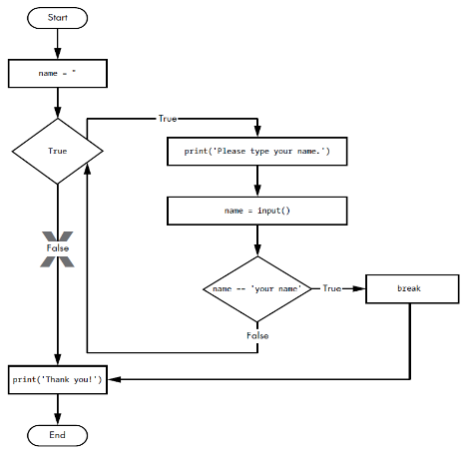
Flow of break Statement
Start
Where the flow begins
name = ''
Condition
True
always True
True Flow
print('Please type your name.’) # Display message
name = input()
Condition
name == 'your name'
Check the condition again
True Flow
Break
print(‘Thank you!') # Display message
End
False Flow
move to True Flow
while
True
while clause
if statement
Break

Slide 30
break Statement
count = 0
while count < 5:
if count == 4:
break
count = count + 1
if (count % 2) == 0:
print('An even number:', count)
else:
print('An odd number:', count)
An odd number: 1
An even number: 2
An odd number: 3
An even number: 4

Slide 31
continue Statement
Flow
Consists of
Example
used inside loops
jumps back to the start of the loop
  When the program execution reaches a continue statement,
  reevaluates the loop’s condition
In code a continue statement simply contains
the continue keyword
while True:
print('Please type your name.')
name = input()
if name == 'I cannot remember':
print('it is your name')
continue
if name == 'your name':
break
print('Thank you!')

Slide 32
Flow of continue Statement
while
True
while clause
if statement
continue
break

Slide 33
continue Statement
while True:
print('Please type your name.')
name = input()
if name == 'I cannot remember':
print('it is your name')
continue
if name == 'your name':
break
print('Thank you!')
Please type your name.
I cannot remember
it is your name
Please type your name.
ali?
Please type your name.
your name
Thank you!

Slide 34
for Loops and the range() Function
Flow
Consists of
Example
The for keyword
A variable name
The in keyword
A call to the range() method
  with up to three integers
  passed to it
A colon
an indented block of code
  Starting on the next line
  called the for clause
to execute a block of code
  only a certain number of times
print('My name is')
for i in range(5):
print('Jimmy Five Times (' + str(i) + ')')

Slide 35
Flow of for Statement
For
Looping
Done Looping

Slide 36
for Statement
total = 0
for num in range(10):
total = total + num
print('Now Total is:', total, 'Current num is:', num)
print('Total of numbers 0 to 9:', total)
Now Total is: 0 Current num is: 0
Now Total is: 1 Current num is: 1
Now Total is: 3 Current num is: 2
Now Total is: 6 Current num is: 3
Now Total is: 10 Current num is: 4
Now Total is: 15 Current num is: 5
Now Total is: 21 Current num is: 6
Now Total is: 28 Current num is: 7
Now Total is: 36 Current num is: 8
Now Total is: 45 Current num is: 9
Total of numbers 0 to 9: 45

Slide 37
for Loops and the range(Starting, Stopping, Intervals)
Flow
Consists of
Example
range function takes two arguments
  Starting
  Ending
  Intervals
to execute a block of code
  Starting from Starting value
  Ending until Stopping value
  By Intervals
for i in range(12, 16):
print(i)
for i in range(0, 10, 2):
print(i)

Slide 38
Chapter-2 Flow Control
Importing Modules

Slide 39
Importing Modules
All Python programs can call a basic set of functions called built-in functions, including the print(), input(), and len()
standard library
module
examples
a set of modules
Python program
contains a related group of functions
can be embedded in programs.
math module
  Mathematics related functions
random module
  random number related functions

Slide 40
import statement
Flow
Consists of
Example
import the module
  before you can use the functions
  with an import statement
The import keyword
The name of the module
Optionally,
  more module names
  separated by commas
import random
for i in range(5):
print(random.randint(1, 10))

Slide 41
Function Call
random.randint(i,j)
Call of function in random module
random
type random. in front of the function name
tell Python to look for this function inside the random module
randint(i,j)
evaluates to a random integer value
between the passed integers i,j

Slide 42
from import Statements
Alternative to import
With this form of import statement,
calls to functions in random
will not need the random. prefix
random
composed of
the from keyword
the module name
the import keyword, and a star
example
from random import *

Slide 43
import
from random import *
for i in range(5):
print(randint(1, 10))
import random
for i in range(5):
print(random.randint(1, 10))
8
6
3
6
7

Slide 44
Chapter-2 Flow Control
Ending a Program Early with sys.exit()

Slide 45
sys.exit() Function
Program exits early using sys.exit()
import sys
example
import sys before using exit
useful writing infinite loops
import sys
while True:
print('Type exit to exit.')
response = input()
if response == 'exit':
sys.exit()
print('You typed ' + response + '.')

Slide 46



Self Assessment
Asses what you got so far!
Noticible issues
Interesting Details
Unclarified issues
How to control the flow?
Boolean Values & Operators
Comparison Operators
Indentation
If, Else, Elif
While, For
Break, Continue
Importing Modules
What is the most interesting details in this chapter?
What are the points need further explanations?

Slide 47
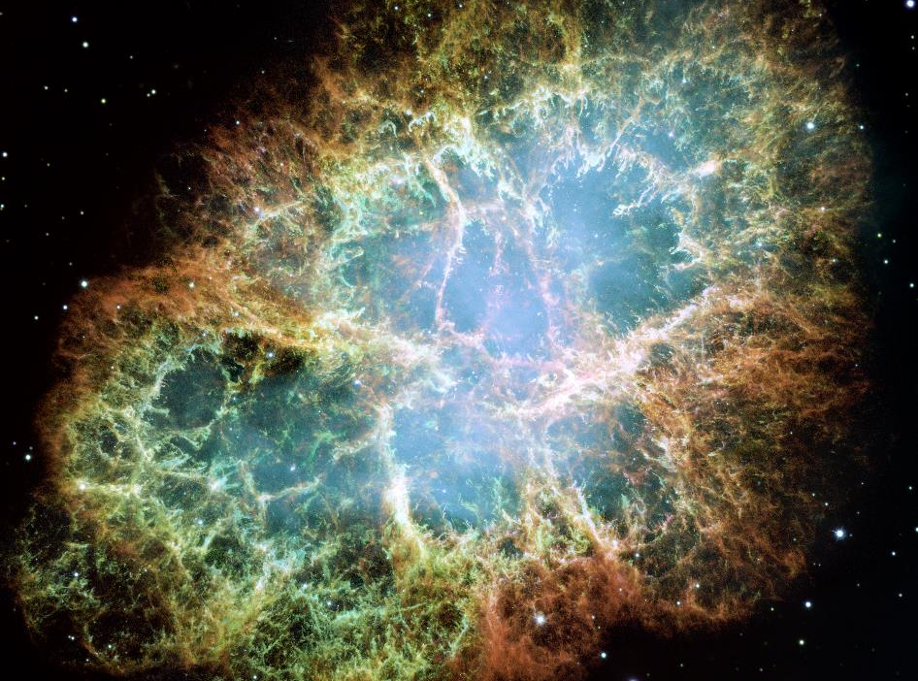





Thank You
Yusuf Altunel, PhD
https://www.linkedin.com/in/yusuf-altunel-2070a31b/
y.altunel@iku.edu.tr
http://cats.iku.edu.tr/portal/site/0181f2bc-77e3-4a85-ade9-77639d9bcfe7

