Slide 1
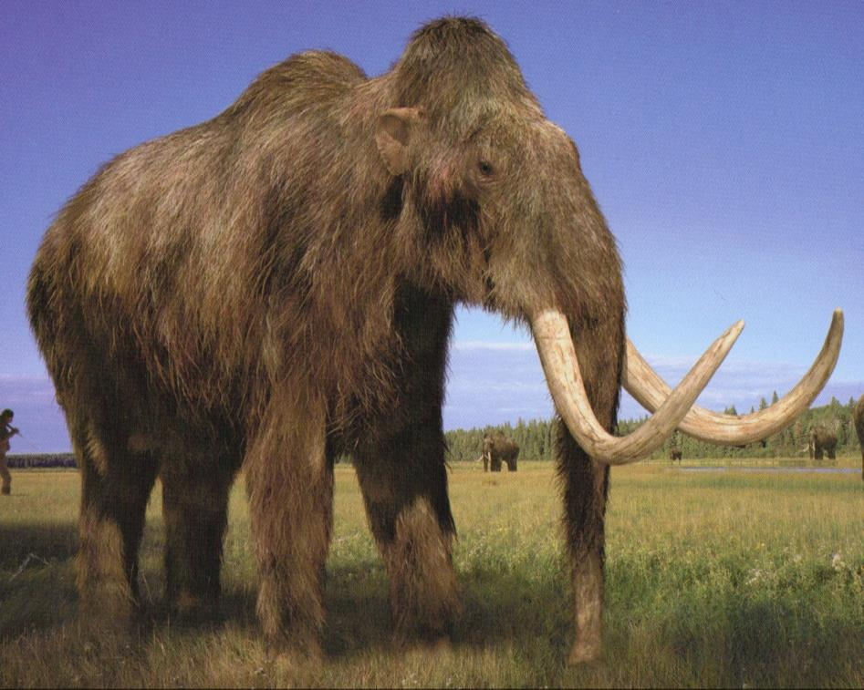
Chapter 5: Dictionaries & Structuring Data
CSE0408 Programming III
IKU Department of Computer Engineering
Yusuf Altunel, PhD

Slide 2

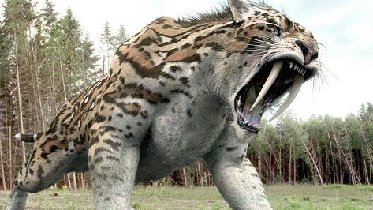
Content
Headlines
The Dictionary Data Type
Pretty Printing
Using Data Structures to Model Real-World Things
Automate the Boring Stuff with Python
Practical Programming for Total Beginners
Chapter 5 Dictionaries & Structuring Data

Slide 3





Dictionary Data Type
Flexibility
Collection
Indexes
Keys
Key-value pair
provides
a flexible way
To access and organize data
Collection
of many values
indexes for dictionaries
Use different data types
not just integers.
Indexes for dictionaries
are called keys
a key
with its associated value
is called a key-value pair

Slide 4
Dictionary typed with braces: {}
>>> myCat = {'size': 'fat', 'color': 'gray', 'disposition': 'loud'}
myCat variable
keys
values
fat
fur
assigns a dictionary
to the myCat variable
'size’,
'color’
'disposition'.
fat’
'gray'
'loud',
>>> myCat['size']
'fat'
>>> 'My cat has ' + myCat['color'] + ' fur.'
'My cat has gray fur.'

Slide 5
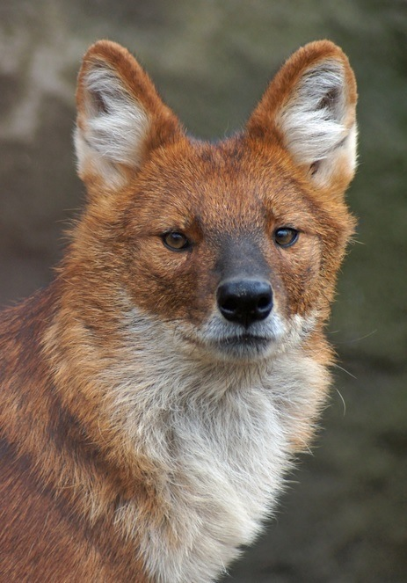


Chapter-5 Data Dictionary
The Dictionary Data Type

Slide 6
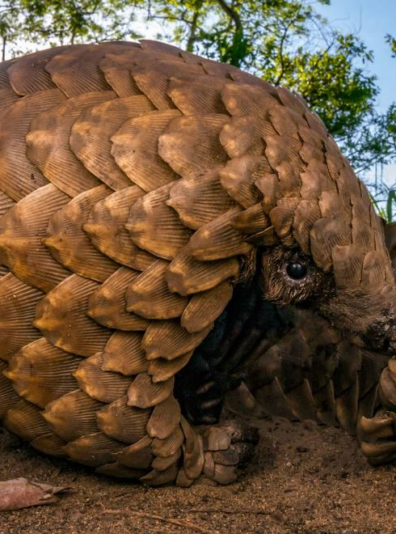



Dictionary
Similar to a list
Like a list
a dictionary is a collection of many values.
Difference from a list
indexes for dictionaries
can use many different data types
not just integers
Braces
a dictionary is typed
with braces, {}.

Slide 7
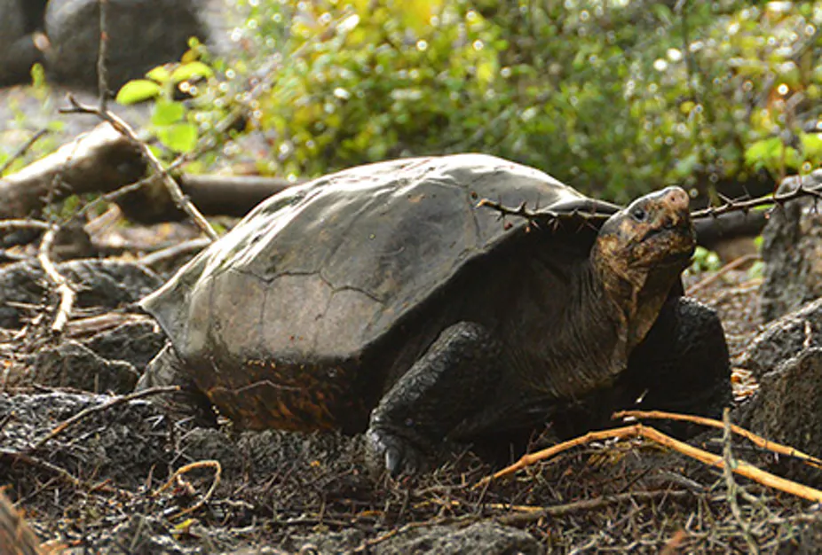
Dictionary with values
myCat = {'size': 'fat', 'color': 'gray', 'disposition': 'loud'}
Variable = {key₁: value₁, key₂: value₂, key₃: value₃, … key_{i}: value_{i}, … key_{n}: value_{n} }

Slide 8
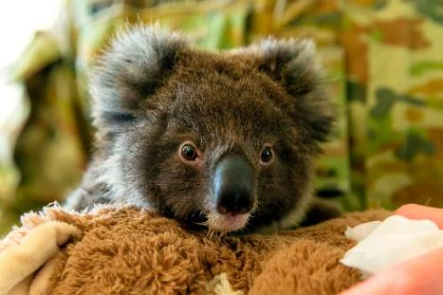
Dictionary with indexes & values
myCat = {'size': 'fat', 'color': 'gray', 'disposition': 'loud'}
>>> myCat = {'size': 'fat', 'color': 'gray', 'disposition': 'loud'}
>>> myCat['size']
'fat’
>>> 'My cat has ' + myCat['color'] + ' fur.'
'My cat has gray fur.'

Slide 9
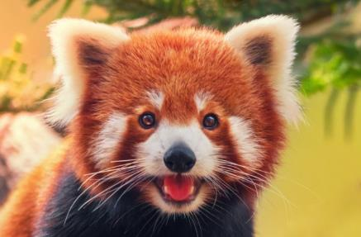
Dictionary indexes still can be integers
No need to start with 0
>>> spam = {12345: 'Luggage Combination', 42: 'The Answer'}
>>> print('This is ' + spam[42] + ': ' + spam[12345])
This is The Answer: Luggage Combination

Slide 10



Dictionaries vs Lists
items in dictionaries are unordered
Order of items in List
Order of items in dictionary
Examples
>>> spam = ['A', 'B', 'C']
>>> spam[0]
'A'
>>> spam[1]
'B'
>>> spam[2]
'C'
The first item in a list
Starts with index 0
there is no “first” item
in a dictionary.

Slide 11
Dictionaries vs Lists
the order of items in list matters unlike dictionaries
Examples
Order in list matters
Order in dictionary doesn’t matter
>>> spam = ['cats', 'dogs', 'moose']
>>> friend = ['dogs', 'moose', 'cats']
>>> spam == friend
False
>>> animals = {'name': 'Zophie', 'species': 'cat', 'age': '8'}
>>> pets = {'species': 'cat', 'age': '8', 'name': 'Zophie’}
>>> animals == pets
True
for determining
whether two lists
are the same,
does not matter
whether two dictionaries
are the same

Slide 12
Dictionaries vs Lists
Dictionaries can’t be sliced like lists, they are unordered
Examples
>>> spam = ['cats', 'dogs', 'moose']
>>> spam[0:1]
['cats']
>>> spam[0:2]
['cats', 'dogs’]
>>> animals = {'name': 'Zophie', 'species': 'cat', 'age': '8'}
>>> animals['name':2]
TypeError: unhashable type: 'slice'
Lists
Dictionaries
Can be slices
They are ordered
Cannot be slices
They are unordered

Slide 13
Dictionaries vs Lists
access to a not exist in a dictionary will result with error
Lists
Dictionaries
Examples
“out-of-range”
IndexError error
message.
KeyError error message
>>> spam = ['cats', 'dogs', 'moose']
>>> spam[5]
IndexError: list index out of range
>>> spam = {'name': 'Zophie', 'age': 7}
>>> spam['color']
KeyError: 'color'

Slide 14
Dictionaries: Powerful way to organize data
Arbitrary key values
Birthdays
Dictionary
loop
Easy processing
Lets to organize data
in powerful ways.
to store data about
friends’ birthdays.
Keys:
the names as keys
Values:
the birthdays
Use a loop
To iterate over the values
Make it easy
To process elements of the dictionary

Slide 15

birthdays.py
birthdays = {'Alice': 'Apr 1', 'Bob': 'Dec 12', 'Carol': 'Mar 4'}
while True:
print('Enter a name: (blank to quit)')
name = input()
if name == '':
break
if name in birthdays:
print(birthdays[name] + ' is the birthday of ' + name)
else:
print('I do not have birthday information for ' + name)
print('What is their birthday?')
bday = input()
birthdays[name] = bday
print('Birthday database updated.')
Enter a name: (blank to quit)
Alice
Apr 1 is the birthday of Alice
Enter a name: (blank to quit)
Eve
I do not have birthday information for Eve
What is their birthday?
Dec 5
Birthday database updated.
Enter a name: (blank to quit)
Eve
Dec 5 is the birthday of Eve
Enter a name: (blank to quit)

Slide 16
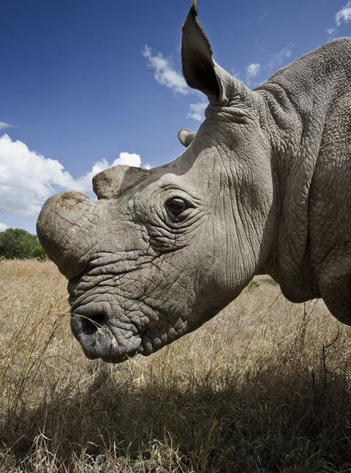
keys(), values(), items()
Dictinary methods
returns
list-like values
of the dictionary
not true lists
values returned by these methods
are not true lists:
They cannot be modified
do not have an append() method.
use in for loops
these data types:
dict_keys,
dict_values
dict_items
can be used in for loops

Slide 17
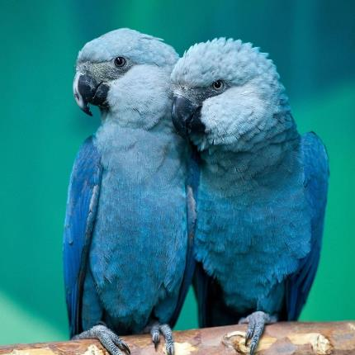
Iterating over the values
>>> spam = {'color': 'red', 'age': 42}
>>> for v in spam.values():
print(v)
red
42

Slide 18

Iterating over the keys
>>> spam = {'color': 'red', 'age': 42}
>>> for k in spam.keys():
print(k)
color
age

Slide 19

Iterating over both keys and values
>>> spam = {'color': 'red', 'age': 42}
>>> for i in spam.items():
print(i)
('color', 'red')
('age', 42)

Slide 20
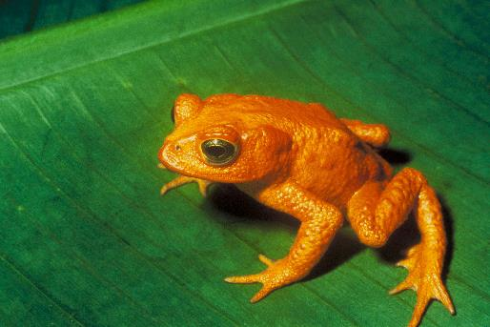
use list() method to convert tuples returned from methods
>>> spam = {'color': 'red', 'age': 42}
>>> spam.keys()
dict_keys(['color', 'age’])
>>> list(spam.keys())
['color', 'age’]
>>> list(spam.values())
['red', 42]
>>> list(spam.items())
[('color', 'red'), ('age', 42)]

Slide 21

multiple assignment trick in a for loop
in a for loop
to assign
the key and value
to separate variables.
>>> spam = {'color': 'red', 'age': 42}
>>> for k, v in spam.items():
print('Key: ' + k + ' Value: ' + str(v))
Key: color Value: red
Key: age Value: 42

Slide 22
Checking Whether a Key or Value Exists in a Dictionary
for lists
in and not in operators
can check
whether a value exists in a list.
for dictionaries
use the same operators
in
not in
exists or not
to see
a certain key or value
exists in a dictionary.

Slide 23
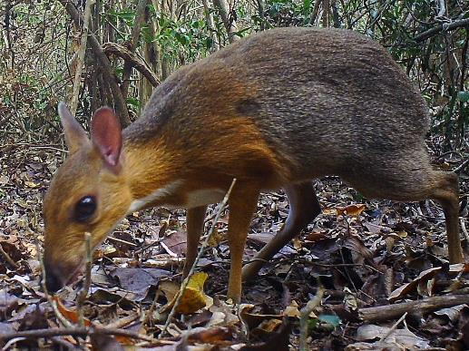
Checkign existince using in and not in
>>> spam = {'name': 'Zophie', 'age': 7}
>>> 'name' in spam.keys()
True
>>> 'Zophie' in spam.values()
True
>>> 'color' in spam.keys()
False
>>> 'color' not in spam.keys()
True
>>> 'color' in spam
False
>>> ('name', 'Zophie') in spam.items()
True

Slide 24
The get() Method
arguments
takes two
arguments
the key of the value
to retrieve
fallback value
to return
if that key
does not exist
Notes:
19.03.2021

Slide 25
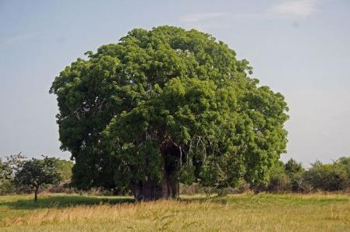
get() method
>>> picnicItems = {'apples': 5, 'cups': 2}
>>> 'I am bringing ' + str(picnicItems.get('cups', 0)) + ' cups.'
'I am bringing 2 cups.’
>>> 'I am bringing ' + str(picnicItems.get('eggs', 0)) + ' eggs.'
'I am bringing 0 eggs.’
Try this:
>>> 'I am bringing ' + str(picnicItems['eggs']) + ' eggs.’
KeyError: 'eggs'

Slide 26
The setdefault() Method
to set a value
in a dictionary
for a certain key
only if
that key
does not have a value
just one line of code
in
only
one line of code
nice shortcut
setdefault() method
is a nice shortcut
to ensure that
a key exists.

Slide 27
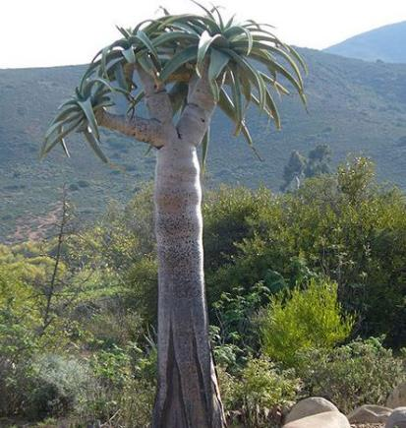
setdefault() method
>>> spam = {'name': 'Pooka', 'age': 5}
>>> spam.setdefault('color', 'black')
'black’
>>> spam
{'name': 'Pooka', 'age': 5, 'color': 'black'}
>>> spam.setdefault('color', 'white')
'black’
>>> spam
{'name': 'Pooka', 'age': 5, 'color': 'black'}

Slide 28
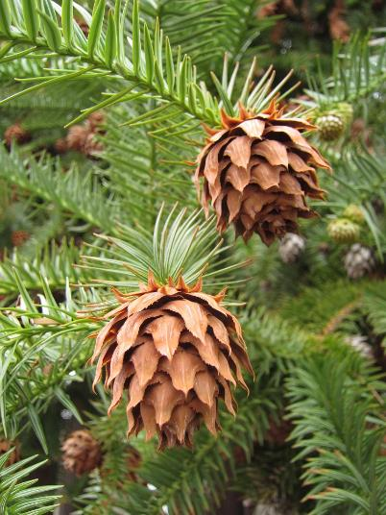
characterCount.py
message = 'It was a bright cold day in April, and the clocks were striking thirteen.'
count = {}
for character in message:
count.setdefault(character, 0)
count[character] = count[character] + 1
print(count)
{'I': 1, 't': 6, ' ': 13, 'w': 2, 'a': 4, 's': 3, 'b': 1, 'r': 5, 'i': 6, 'g': 2, 'h': 3, 'c': 3, 'o': 2, 'l': 3, 'd': 3, 'y': 1, 'n': 4, 'A': 1, 'p': 1, ',': 1, 'e': 5, 'k': 2, '.': 1}

Slide 29
Chapter-4 Lists
Pretty Printing

Slide 30
Pretty printing
import
pprint()
pformat()
cleaner display
Dictionary items
cleaner output
the pprint module
into the programs
to access
pretty print functions
“pretty print”
a dictionary’s values
helpful
for a cleaner display
the items in a dictionary
cleaner display
with the keys sorted.

Slide 31
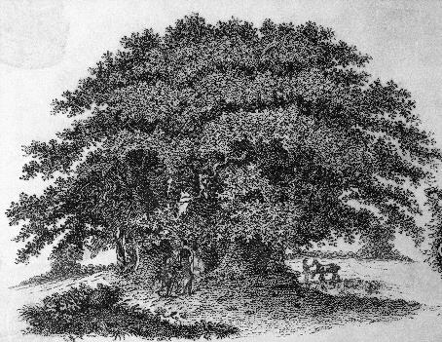
prettyCharacterCount.py
import pprint
message = 'It was a bright cold day in April, and the clocks were striking thirteen.'
count = {}
for character in message:
count.setdefault(character, 0)
count[character] = count[character] + 1
pprint.pprint(count)
{' ': 13,
',': 1,
'.': 1,
'A': 1,
'I': 1,
'a': 4,
'b': 1,
'c': 3,
'd': 3,
'e': 5,
'g': 2,
'h': 3,
'i': 6,
'k': 2,
'l': 3,
'n': 4,
'o': 2,
'p': 1,
'r': 5,
's': 3,
't': 6,
'w': 2,
'y': 1}

Slide 32
Chapter-5 Dictionaries and Structuring Data
Using Data Structures to Model Real-World Things

Slide 33

A Tic-Tac-Toe Board
large hash symbol #
with nine slots
looks like
a large hash symbol
#
each can contain
an X
an O
a blank

Slide 34
Data structure for Tic-Tac-Toe Board
theBoard = {'top-L': ' ', 'top-M': ' ', 'top-R': ' ',
'mid-L': ' ', 'mid-M': ' ', 'mid-R': ' ',
'low-L': ' ', 'low-M': ' ', 'low-R': ' '}
theBoard = {'top-L': ' ', 'top-M': ' ', 'top-R': ' ',
'mid-L': ' ', 'mid-M': 'X', 'mid-R': ' ',
'low-L': ' ', 'low-M': ' ', 'low-R': ' '}
theBoard = {'top-L': 'O', 'top-M': 'O', 'top-R': 'O',
'mid-L': 'X', 'mid-M': 'X', 'mid-R': ' ',
'low-L': ' ', 'low-M': ' ', 'low-R': 'X '}

Slide 35

prettyCharacterCount.py
theBoard = {'top-L': ' ', 'top-M': ' ', 'top-R': ' ',
'mid-L': ' ', 'mid-M': ' ', 'mid-R': ' ',
'low-L': ' ', 'low-M': ' ', 'low-R': ' '}
def printBoard(board):
print(board['top-L'] + '|' + board['top-M'] + '|' + board['top-R'])
print('-+-+-')
print(board['mid-L'] + '|' + board['mid-M'] + '|' + board['mid-R'])
print('-+-+-')
print(board['low-L'] + '|' + board['low-M'] + '|' + board['low-R'])
printBoard(theBoard)
| |
-+-+-
| |
-+-+-
| |

Slide 36
Chapter-5 Dictionaries and Structuring Data
Nested Dictionaries and Lists

Slide 37
Modeling complicated real-world entities
more complexity
contain
Lists
dictionaries
mix
complex programs
might need mixing
dictionary contain dictionaries
dictionary contain lists
lists contain lists
list contain dictionary
to model
more complicated things
dictionaries and lists
can contain
other dictionaries and lists
Lists are useful
to contain
an ordered series
of values
dictionaries are useful
for associating
keys with values

Slide 38
party.py
allGuests = {'Alice': {'apples': 5, 'pretzels': 12},
'Bob': {'ham sandwiches': 3, 'apples': 2},
'Carol': {'cups': 3, 'apple pies': 1}}
def totalBrought(guests, item):
numBrought = 0
for k, v in guests.items():
numBrought = numBrought + v.get(item, 0)
return numBrought
print('Number of things being brought:')
print(' - Apples ' + str(totalBrought(allGuests, 'apples')))
print(' - Cups ' + str(totalBrought(allGuests, 'cups')))
print(' - Cakes ' + str(totalBrought(allGuests, 'cakes')))
print(' - Ham Sandwiches ' + str(totalBrought(allGuests, 'ham sandwiches')))
print(' - Apple Pies ' + str(totalBrought(allGuests, 'apple pies')))
Number of things being brought:
- Apples 7
- Cups 3
- Cakes 0
- Ham Sandwiches 3
- Apple Pies 1

Slide 39



Self Assessment
Asses what you got so far!
Noticible issues
Interesting Details
Unclarified issues
Differences from lists
Key-value combinations
Extracting keys, values, and items
Existance of keys and values
Setting the default
Pretty prtinting
What is the most interesting details in this chapter?
What are the points need further explanations?

Slide 40
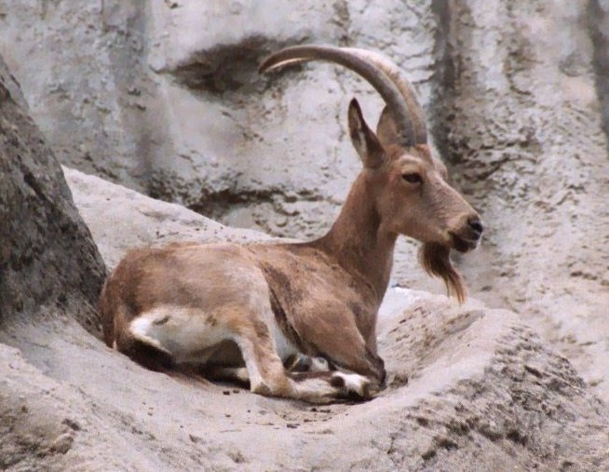





Thank You
Yusuf Altunel, PhD
https://www.linkedin.com/in/yusuf-altunel-2070a31b/
y.altunel@iku.edu.tr
http://cats.iku.edu.tr/portal/site/0181f2bc-77e3-4a85-ade9-77639d9bcfe7

