Slide 1
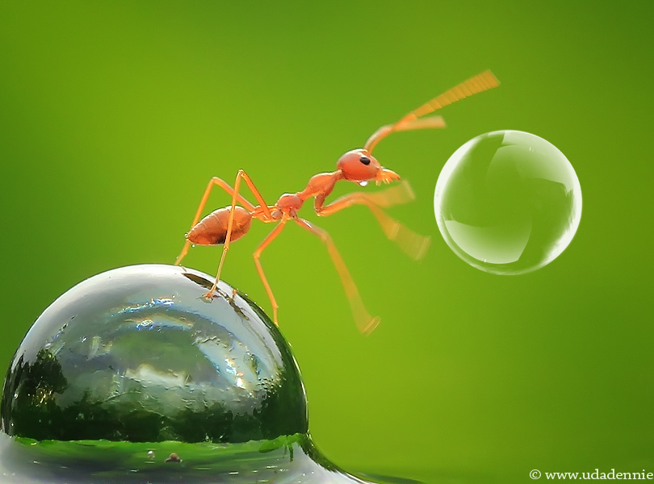
Chapter 8: Reading and Writing Files
CSE0408 Programming III
IKU Department of Computer Engineering
Yusuf Altunel, PhD

Slide 2


Content
Headlines
Files and File Paths
The os.path Module
The File Reading/Writing Process
Saving Variables with the shelve Module
Saving Variables with the pprint.pformat() Function
Automate the Boring Stuff with Python
Practical Programming for Total Beginners
Chapter 8: Reading and Writing Files

Slide 3
Phython Files
Persistency: save data to a file to persist even after program has finished
File
Size
Operations
Content
a single string value
potentially
gigabytes in size
for files on the hard drive
Create
Read
Save

Slide 4
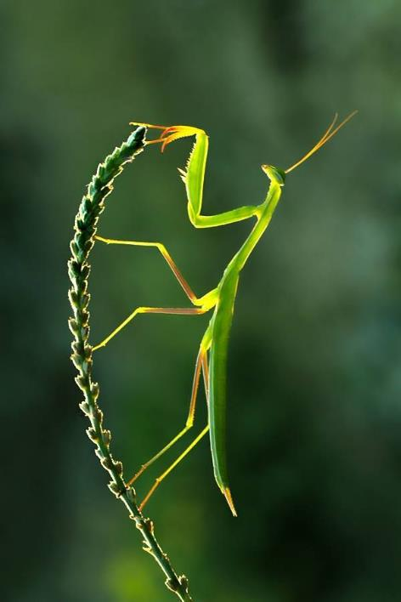


Chapter 8: Reading and Writing Files
Files and File Paths
Backslash on Windows and Forward Slash on OS X & Linux
The Current Working Directory
Absolute vs. Relative Paths
Creating New Folders with os.makedirs()

Slide 5
Files and File Paths
A file has two key properties: a filename (usually written as one word) and a path
Filename
Path
Folders
written as one word
with extension
without extenstion
projects.docx
project
specifies
the location of a file
on the computer
C:\Users\asweigart\Documents
Folders / Directories
Contain folders, files or both
asweigart
Documents

Slide 6




Root Folder
C:\ part of the path
contains all other folders
On Windows
the root folder is named C:\
also called the C: drive.
OS X, Linux
the root folder is /

Slide 7
Additional volumes
Types
DVD drive
USB thumb drive
On Windows
,appear as
New lettered root drives
such as D:\ or E:\.
OS X & Linux
on OS X
appear as new folders
under the /Volumes folder.
On Linux
appear as new folders
under the /mnt (“mount”) folder

Slide 8
Case sensitivity
Windows
filenames are
not case sensitive
on Windows
OS X
filenames are
not case sensitive
on OS X
Linux
filenames are
case sensitive
on Linux

Slide 9



Backslash on Windows and Forward Slash on OS X and Linux
(\) (/): Separators between folder names
backslash (\)
forward slash (/)
Multi OS Programs
On Windows
paths are written
using the backslashes
as separator
OS X and Linux
uses the forward slash
as the path separator
os.path.join()
work on various Oss
returns
a string with a file path
correct path separators

Slide 10
os.path.join('usr', 'bin', 'spam')
On Windows
returns
'usr\\bin\\spam'
double backslashes
each backslash
needs to be escaped
by another backslash character
on OS X or Linux
returns
'usr/bin/spam'

Slide 11

os.path.join()
>>> import os
>>> os.path.join('usr', 'bin', 'spam')
'usr\\bin\\spam’
myFiles = ['accounts.txt', 'details.csv', 'invite.docx']
>>> for filename in myFiles:
print(os.path.join('C:\\Users\\asweigart', filename))
C:\Users\asweigart\accounts.txt
C:\Users\asweigart\details.csv
C:\Users\asweigart\invite.docx
Notes:
come back to make corrections

Slide 12
Current Working Directory
Programs run in a current working directory
paths with no root
os.getcwd()
os.chdir()
are
under
the current working directory
get
the current working directory
as a string value
change
the current working directory

Slide 13

Working Directory Commands
>>> import os
>>> os.getcwd()
'C:\\Users\\yusuf.altunel\\AppData\\Local\\Programs\\Python\\Python38-32’
>>> os.chdir('C:\\Windows\\System32')
>>> os.getcwd()
'C:\\Windows\\System32'
>>> os.chdir('C:\\ThisFolderDoesNotExist’)
Traceback (most recent call last):
File "<pyshell#11>", line 1, in <module>
os.chdir('C:\\ThisFolderDoesNotExist')
FileNotFoundError: [WinError 2] Sistem belirtilen dosyayı bulamıyor: 'C:\\ThisFolderDoesNotExist'

Slide 14
Absolute vs. Relative Paths
There are two ways to specify a file path
absolute path
relative path
. and ..
always begins
with the root folder
is relative
to the program’s
current working directory
start a relative path
dot (.)
  This directory
dot-dot (..)
  Parent directory

Slide 15
Current vs. Parent Directory
There are two ways to specify a relative file path
dot (.)
dot-dot (..)
relative path
shorthand for
“this directory
Current directory
means
“the parent folder.”
starting from current direcotry
dot(.)
starting from parent direcotry
dot-dot (..)

Slide 16
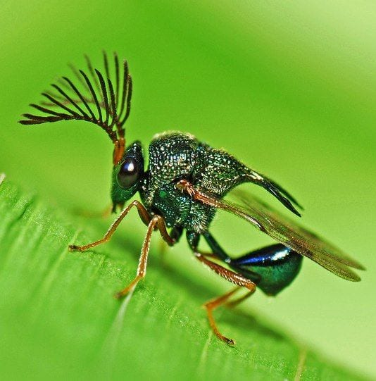
Relative vs Absolute path
Relative Path Examples
Absolute Path Examples
  ..\
  .\
  .\fizz
  .\fizz\spam.txt
  .\spam.txt
  ..\eggs
  ..\eggs\spam.txt
  ..\spam.txt
  C:\
  C:\bacon
  C:\bacon\fizz
  C:\bacon\fizz\spam.txt
  C:\bacon\spam.txt
  C:\eggs
  C:\eggs\spam.txt
  C:\spam.txt

Slide 17
Creating New Folders with os.makedirs()
os.makedirs() : to create new folders (directories) with the function
os.makedirs()
full path
hierarchy
create new folders
one inside of the other
intermediat folders created
to ensure
the full path exists
creates
hierarchy of folders

Slide 18
Creating full path
Created path
Command to create a path
  >>> import os
  >>> os.makedirs('C:\\delicious\\walnut\\waffles')
Create
  C:\delicious folder
  a walnut folder inside C:\delicious
  a waffles folder inside C:\delicious\walnut

Slide 19
Chapter 8: Reading and Writing Files
The os.path Module
Handling Absolute and Relative Paths
Finding File Sizes and Folder Contents
Checking Path Validity

Slide 20
The os.path Module
os.path module contains many helpful functions related to filenames and file paths
os.path.join()
inside of os
import os
to build paths
work on
any operating system.
os.path
module inside
the os module,
import os
to use the functions
full reference
https://docs.python.org/3/library/os.path.html

Slide 21
Handling Absolute and Relative Paths
os.path.abspath(path): convert relative to absolute path
os.path.abspath(path)
Usage
argument path
returns
the absolute path
of a relative path
easy way
to convert a relative path
into an absolute path
string
relative path

Slide 22
Handling Absolute and Relative Paths
os.path.isabs(path): is it absolute or relative path
os.path.isabs(path)
if relative path
argument path
returns True
if the argument is
an absolute path
returns False
if the argument is
a relative path
string
absolute or relative path

Slide 23
Handling Absolute and Relative Paths
os.path.relpath(path, start): relative path for a start path
os.path.relpath(path, start)
start not provided?
argument path
returns
a string of a relative path
from the start path to path
If start is not provided
the current working directory
is used as the start path.
string
absolute or relative path

Slide 24

Absolute and Relative Paths
  >>> import os
  >>> os.path.abspath('.')
  'C:\\Windows\\System32’
  >>> os.path.abspath('.\\Scripts')
  'C:\\Windows\\System32\\Scripts’
  >>> os.path.isabs('.')
  False
  >>> os.path.isabs(os.path.abspath('.'))
  True
  >>> os.path.relpath('C:\\Windows', 'C:\\')
  'Windows’

Slide 25
Calling os.path.dirname(path)
os.path.relpath(path, start): relative path for a start path
os.path.dirname(path)
working directory
argument path
returns
a string of everything
comes before the last slash
in the path argument
If start is not provided
the current working directory
is used as the start path.
string
absolute or relative path

Slide 26
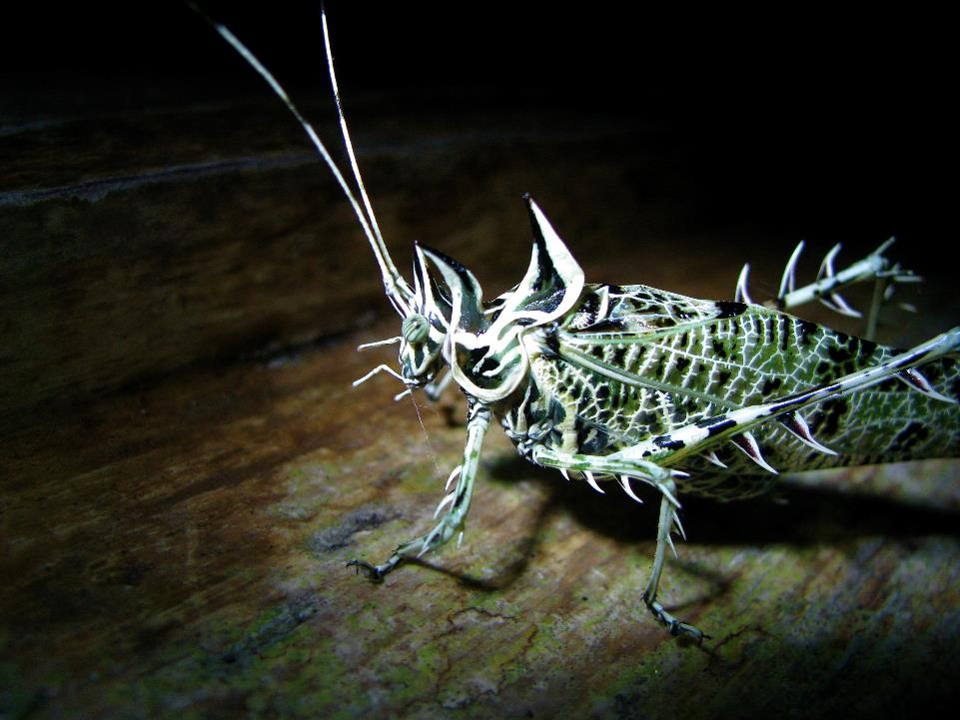
Calling os.path.dirname(path)
will return a string of everything
comes before the last slash
in the path argument.
Calling os.path.dirname(path)
will return
Dir name

Slide 27

Calling os.path.basename(path)
will return a string of everything
comes after the last slash
in the path argument
Calling os.path.basename(path)
will return
Base name

Slide 28

Calling os.path.split()
returns a tuple of
a path’s dir name
base name together
Calling os.path.split()
will return
(Dir name, Base name)

Slide 29

os.path modules
  >>> import os
  >>> path = 'C:\\Windows\\System32\\calc.exe'
  >>> os.path.dirname(path)
  'C:\\Windows\\System32’
  >>> os.path.basename(path)
  'calc.exe’
  >>> import os
  >>> calcFilePath = 'C:\\Windows\\System32\\calc.exe'
  >>> (os.path.dirname(calcFilePath), os.path.basename(calcFilePath))
  ('C:\\Windows\\System32', 'calc.exe’)
  >>> os.path.split(calcFilePath) #Shortcut for the above
  ('C:\\Windows\\System32', 'calc.exe’)
  >>> calcFilePath.split(os.path.sep)
  ['C:', 'Windows', 'System32', 'calc.exe']

Slide 30
Other OSs
OS X and Linux
there will be
a blank string
at the start of the returned list
split() string method
will work
on any operating system
pass os.path.sep
to
split()

Slide 31
Finding File Sizes and File Listing in a Folder
The os.path module provides functions to get info about files
file size
folder content
os.path functions
finding
the size of a file in bytes
exploring
the files and folders
inside a given folder
file and folder content
os.path.getsize(path)
os.listdir(path)

Slide 32
File Size: os.path.getsize(path)
The os.path module provides function to get file size
getsize(path)
path
returned
return
the size in bytes of
the file in the path argument.
contains
path of the file
İnteger value
number of bytes
file contains

Slide 33
Files in a folder: os.listdir(path)
The os.path module provides function to list files in a folder
listdir(path)
argument path
returned
return
a list of filenames
in the path argument.
contains
path of the folder
strings
file names
Note that this function is in the os module, not os.path

Slide 34
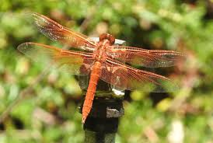
Finding File Sizes and File Listing in a Folder
  >>> import os
  >>> os.path.getsize('C:\\Windows\\System32\\calc.exe')
  26112
  >>> os.listdir('C:\\Program Files (x86)\\Python38-32')
  ['DLLs', 'Doc', 'include', 'Lib', 'libs', 'LICENSE.txt', 'NEWS.txt', 'python.exe', 'python3.dll', 'python38.dll', 'pythonw.exe', 'Scripts', 'tcl', 'Tools', 'vcruntime140.dll']
  >>> totalSize = 0
  >>> for filename in os.listdir('C:\\Program Files (x86)\\Python38-32'):
  totalSize = totalSize + os.path.getsize(os.path.join('C:\\Program Files (x86)\\Python38-32', filename))
  >>> print(totalSize)
  5472705

Slide 35
Checking Path Validity
The os.path module provides functions to check path exists and it is a file or folder.
os.path.exists(path)
os.path.isfile(path)
os.path.isdir(path)
return True
if the file or folder
exists
return False
if it does not exist
return True
if path argument exists
and is a file
return False
if path argument doesn’t exist
or is a not file.
return True
if path argument exists
and is a folder
return False
if path argument doesn’t exist
or is a not folder.

Slide 36

Validity Check for Files and Folders
  >>> import os
  >>> os.path.exists('C:\\Windows')
  True
  >>> os.path.exists('C:\\some_made_up_folder')
  False
  >>> os.path.isdir('C:\\Windows\\System32')
  True
  >>> os.path.isfile('C:\\Windows\\System32')
  False
  >>> os.path.isdir('C:\\Windows\\System32\\calc.exe')
  False
  >>> os.path.isfile('C:\\Windows\\System32\\calc.exe')
  True

Slide 37

check if a device exists
determine a DVD or flash drive currently attached
to the computer
check with the os.path.exists() function
  >>> os.path.exists('D:\\')
  False

Slide 38
Chapter 8: Reading and Writing Files
The File Reading/Writing Process
Opening Files with the open() Function
Reading the Contents of Files
Writing to Files

Slide 39
File Reading and Writing
The functions will apply to plaintext files
Plaintext files
do not include
Binary files
contain
only basic text characters
any of
font
size
color information
such as
word processing documents
PDFs
images
spreadsheets
executable programs

Slide 40
File Reading and Writing
three steps to reading or writing files in Python
call open()
read() & write()
close()
to
return a File object
call read() to
read content
call write() to
write into file object
Call to
Close the file
on the File object

Slide 41
Opening Files with the open() Function
three steps to reading or writing files in Python
call open()
path
return
pass a string path
indicating the file
to open
it can be
an absolute path
or relative path
open() function
returns a File object
to read in plaintext mode

Slide 42
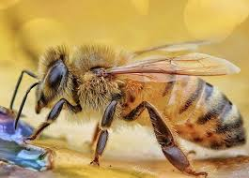
open()
#Create hello.txt in the path first
#later enter the following command
>>> helloFile = open('C:\\delicious\\walnut\\waffles\\hello.txt')
>>> helloFile
<_io.TextIOWrapper name='C:\\delicious\\walnut\\waffles\\hello.txt' mode='r' encoding='cp1254'>
>>> helloFile = open('C:\\delicious\\walnut\\waffles\\hello.txt', 'r')
open command will open the file in “reading plaintext” mode,
or read mode for short
you can use r as a second argument
read mode means: you can’t write or modify it in any way

Slide 43
Reading the Contents of Files
a File object can be used in reading data from it.
read()
content
String
method of file objecy
to read the content
from the file
the entire content
of a file
as a string value
fileObject.read()
helloContent = helloFile.read()

Slide 44

read()
#Create hello.txt in the path first
#later enter the following command
>>> helloFile = open('C:\\delicious\\walnut\\waffles\\hello.txt')
>>> helloContent = helloFile.read()
>>> helloContent
'\nThose are the days of Corona.\nBe safe everyone!’
>>> sonnetFile = open('C:\\delicious\\walnut\\waffles\\sonnet29.txt')
>>> sonnetFile.readlines()
["When, in disgrace with fortune and men's eyes,\n", 'I all alone beweep my outcast state,\n', 'And trouble deaf heaven with my bootless cries,\n', 'And look upon myself and curse my fate,']
readlines() method
to get a list of string values from the file
one string for each line of text

Slide 45
Writing to Files
write content to a file in a way similar to how the print() function “writes” strings to the screen
Write mode
Append mode
Second argument
will overwrite
the existing file
start from scratch
will append text
to the end of
the existing file
Pass ‘w’ to open()
for write mode
Pass ‘a’ to open()
for append mode

Slide 46

creating new file with append and write
If the filename passed to open() does not exist
  will create a new, blank file
for both write and append mode
new empty file is created
  Notice: close the files after finished!

Slide 47

Write and Append Mode
>>> os.getcwd()
'C:\\Windows\\System32’
>>> os.chdir('C:\\delicious\\walnut\\waffles')
>>> os.getcwd()
'C:\\delicious\\walnut\\waffles'
>>> baconFile = open('bacon.txt', 'w')
>>> baconFile.write('Hello world!\n')
13
>>> baconFile.close()
>>> baconFile = open('bacon.txt', 'a')
>>> baconFile.write('Bacon is not a vegetable.')
25
>>> baconFile.close()
>>> baconFile = open('bacon.txt')
>>> content = baconFile.read()
>>> baconFile.close()
>>> print(content)
Hello world!
Bacon is not a vegetable.

Slide 48
Chapter 8: Reading and Writing Files
Saving Variables with the shelve Module

Slide 49
The Shelve
save variables in your Python programs to binary shelf files using the shelve module
restore data
shelve module
save and restore
Into variables
from the hard drive
will let
to add Save
and Open features
save settings
to a shelf file
load them the next run
three new files are created
in the current working directory:
fileName.bak, fileName.dat, and fileName.dir.

Slide 50

Writing and Reading Variables
>>> import shelve
>>> shelfFile = shelve.open('mydata')
>>> cats = ['Zophie', 'Pooka', 'Simon']
>>> shelfFile['cats'] = cats
>>> shelfFile.close()
>>> shelfFile = shelve.open('mydata')
>>> type(shelfFile)
<class 'shelve.DbfilenameShelf’>
>>> shelfFile['cats']
['Zophie', 'Pooka', 'Simon']
>>> shelfFile.close()
>>> shelfFile = shelve.open('mydata')
>>> list(shelfFile.keys())
['cats’]
>>> list(shelfFile.values())
[['Zophie', 'Pooka', 'Simon']]
>>> shelfFile.close()
Just like dictionaries,
shelf values have keys() and values() methods
return list-like values of
the keys and values in the shelf

Slide 51
Chapter 8: Reading and Writing Files
Saving Variables with the pprint.pformat() Function
Notes:
03.04.2020

Slide 52
Saving Variables with the pprint.pformat() Function
pprint.pprint() function
pprint.pprint()
pprint.pformat()
formatted string
print to the screen
a list content
or dictionary
return this same text
as a string
instead of printing it
to be
easy to read
syntactically correct Python code

Slide 53
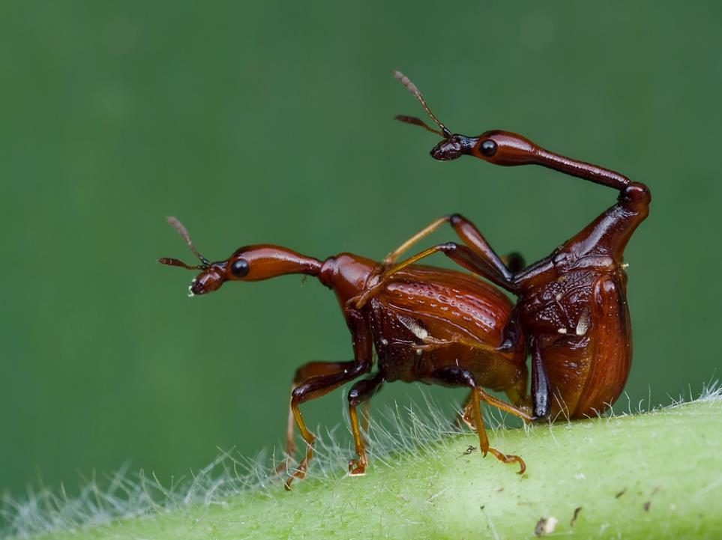
pprint.pformat()
to save dictionary stored in a variable
and its contents for future use.
pprint.pformat()
will give a string
to write to .py file
  Notice: close the files after finished!

Slide 54
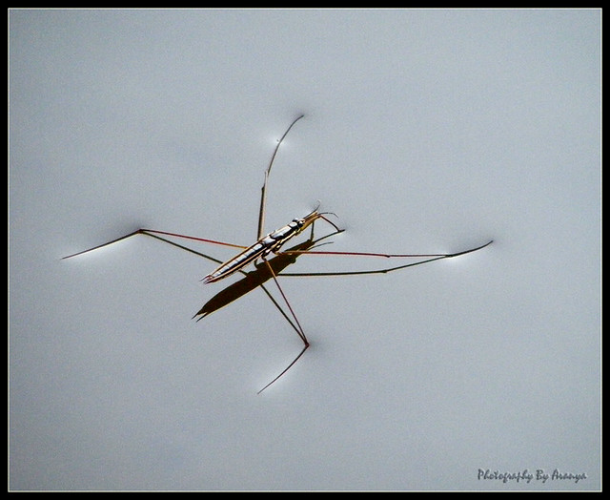
save to import later
>>> import pprint
>>> cats = [{'name': 'Zophie', 'desc': 'chubby'}, {'name': 'Pooka', 'desc': 'fluffy'}] fileObj.close()
>>> pprint.pformat(cats)
"[{'desc': 'chubby', 'name': 'Zophie'}, {'desc': 'fluffy', 'name': 'Pooka’}]"
>>> fileObj = open('myCats.py', 'w')
>>> fileObj.write('cats = ' + pprint.pformat(cats) + '\n')
83
>>>
>>> os.listdir()
['bacon.txt', 'Hello.txt', 'myCats.py', 'mydata.bak', 'mydata.dat', 'mydata.dir', 'sonnet29.txt’]
>>> import myCats
>>> myCats.cats
[{'desc': 'chubby', 'name': 'Zophie'}, {'desc': 'fluffy', 'name': 'Pooka’}]
>>> myCats.cats[0]
{'desc': 'chubby', 'name': 'Zophie’}
>>> myCats.cats[0]['name']
'Zophie'

Slide 55



Self Assessment
Asses what you got so far!
Noticible issues
Interesting Details
Unclarified issues
os library
Accessing to files and directories
Dealing with absolute and relative paths
Reading and writing to files
Saving Variables with the shelve Module
Saving Variables with the pprint.pformat() Function
What is the most interesting details in this chapter?
What are the points need further explanations?

Slide 56

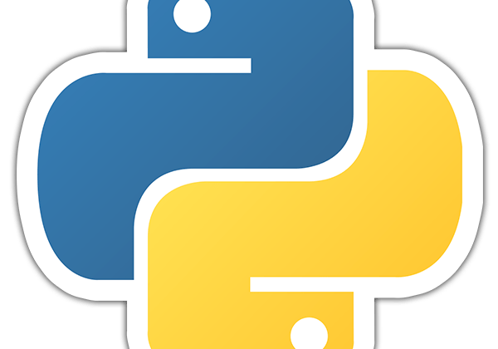




Thank You
Yusuf Altunel, PhD
https://www.linkedin.com/in/yusuf-altunel-2070a31b/
y.altunel@iku.edu.tr
https://cats.iku.edu.tr/

