Slide 1
>>>
Python Basics
Chapter 1 of Automate the Boring Stuff with Python, 3rd edition, for an advanced course
19
3
27
code examples that run on the chapter page
true stories with who, what, when, where, why and how
distinct chapter concepts, each with an everyday picture
SEN0414 Advanced Programming, Fall 2026. Yusuf Altunel, İstanbul Kültür Üniversitesi
1 / 39
Notes:
Welcome. This chapter is the prompt, the values it computes with, the operators that combine them, the names that remember them, and a first program. Every code slide shows the code, a plain explanation, and what the run printed as a table, chart or drawing.

Slide 2
>>>
Today's route
Four parts; every range is a run of slides you can jump to
Part | Slides | Code examples | You will run
Values and types | 4 - 11 | 5 | type, int, float, str, len
Operations | 12 - 19 | 5 | operators, precedence, plus and star on text
Names and functions | 20 - 28 | 6 | variables, print, conversions, errors, input, import
A first program | 29 - 35 | 3 | a first program, f-strings, binary
Changes, summary, practice, resources | 36 - 39 | - | what current Python adds
Open the chapter-code tab of the page: the same 19 examples, in this order.
2 / 39
Notes:
Four parts: values and types, operations, names and functions, and a first program. Each range is a run of slides you can jump to. The chapter-code tab of the page holds the same examples in the same order.

Slide 3
>>>
Three questions this chapter answers
Carry them through every part; the answers come back at the end
1
Which operations can raise an error, and which error?
Answer on slides 18, 26 and 22: TypeError, ValueError and NameError.
2
Which results can surprise a student in the chapter's own arithmetic?
Answer on slides 10 and 15: 0.1 + 0.2, and -3 ** 2.
3
Which concepts reach beyond the 3rd edition into current Python, and on what source?
Answer on slide 36: the table of changes names each source.
Errors are answers too: read the name of the error first.
3 / 39
Notes:
Three questions to carry through the chapter. Which operations can raise an error, and which? Which results can surprise a student? And what has changed in current Python since the book?

Slide 4
Part 1: Values and types
What the prompt computes with, and how Python labels it
Expression
A piece of code that Python turns into one value.
Slide | In this part
5 | Everyday pictures: values and types
6 | The shell: type an expression, get a value
7 | Story: Guido van Rossum and Python
8 | Data types: int, float and str
9 | Integers never overflow
10 | Floats are honest about being approximate
11 | Strings: text between quotes
Data type
The label that says what a value is and what it can do.
Integer
A whole number, exact however large it grows.
Float and string
A number with a fraction, and text between quotes.
4 / 39
Notes:
Part one. The shell evaluates an expression and prints its value. Every value has a data type: integer, float or string. Notice which results surprise you.

Slide 5
>>>
Everyday pictures: values and types
ANALOGY The shell is a pocket calculator with a screen: you type a sum and the answer appears at once.
Chapter concept | Everyday picture
Entering Expressions into the Interactive Shell | A pocket calculator with a screen: type a sum, read the answer, type the next one.
Expression | A recipe line: ingredients and steps that end in one finished dish, the value.
The Integer, Floating-Point, and String Data Types | Three kinds of container: crates for whole items, jugs for amounts with a fraction, signs for words.
Data type | The label on a container: it says what may be put in and what may be done with it.
5 / 39
Notes:
A calculator with a screen is the shell. An expression is a recipe line that ends in one value. A data type is the label on a container. Ask students to add their own everyday picture.

Slide 6
>>>
The shell: type an expression, get a value
>>> print(2 + 2)
>>> print('Py' + 'thon')
Python reads an expression, computes its value and shows it. 2 + 2 gives the number 4; 'Py' + 'thon' joins two pieces of text.
>>> print(2 + 3 * 6)
>>> print(3 * (2 + 4))
An expression may hold several operators. Multiplication goes before addition, and parentheses go before everything.
What the run printed (Python 3.13.16)
Expression | Value | Type
2 + 2 | 4 | int
'Py' + 'thon' | 'Python' | str
2 + 3 * 6 | 20 | int
3 * (2 + 4) | 18 | int
Read
Evaluate
Print
Loop
you type
Python computes
value appears
next prompt
the shell repeats these four steps for every line
The shell evaluates an expression and prints its value.
6 / 39
Notes:
The shell is a calculator that answers. In a program you write print yourself. Ask students to predict 2 + 3 * 6 before the run, and why it is not 30.

Slide 7
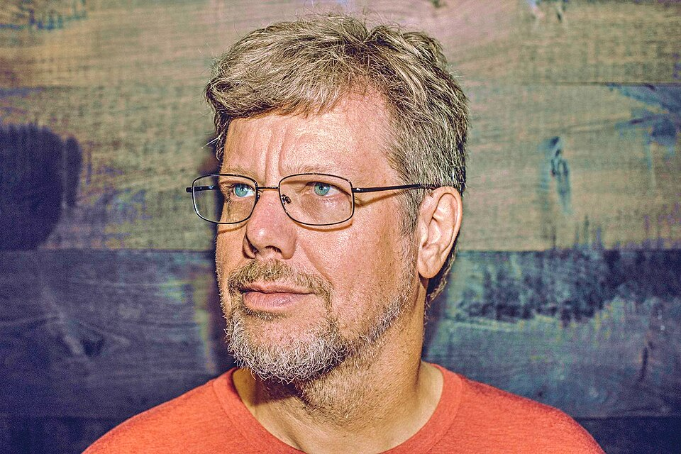
>>>
Story: a Christmas hobby named after a comedy troupe
WHO Guido van Rossum, a programmer at the Centrum Wiskunde & Informatica (CWI), working on the Amoeba project.
WHAT A hobby scripting language, a descendant of ABC, meant to be more readable than shell scripts.
WHEN December 1989, in the Christmas week when the office was closed; version 0.9.0 followed in February 1991.
WHERE At CWI in Amsterdam; the source code was posted to the alt.sources Usenet group.
WHY He wanted a language that is easy to read and to program, and he had a week without work.
Guido van Rossum, 2014. Photo: Daniel Stroud, CC BY-SA 4.0, Wikimedia Commons.
HOW He named it after the British comedy troupe Monty Python, not after the snake.
READ Guido van Rossum (Wikipedia)
7 / 39
Notes:
Guido van Rossum began Python in the Christmas week of 1989 at CWI in Amsterdam. The name comes from Monty Python. Ask students which of today's examples they would have written in a language without this readability.

Slide 8
>>>
Data types: int, float and str
>>> print(type(7))
>>> print(type(3.5))
>>> print(type('Alice'))
type names the data type of a value: int for whole numbers, float for numbers with a fraction, str for text.
>>> print(type(7 + 1))
>>> print(type(7 + 1.0))
A whole number plus a whole number stays an int. Mix in one float and the whole result becomes a float.
What the run printed (Python 3.13.16)
Value | Data type | What type() printed
7 | int | <class 'int'>
3.5 | float | <class 'float'>
'Alice' | str | <class 'str'>
7 + 1 | int | <class 'int'>
7 + 1.0 | float | <class 'float'>
int
+
int
int
int
+
float
float
one float makes the result a float
type() names the data type: int, float or str.
8 / 39
Notes:
Type names the data type of any value. A whole number plus a float gives a float. Ask: what type does 7 + 1.0 have, and why?

Slide 9
>>>
Integers never overflow
>>> print(7 + 1)
>>> print(2 ** 100)
>>> print(len(str(2 ** 100)))
A Python integer has no size limit. 2 ** 100 is written out in full, all 31 digits, and it is exact.
>>> print(int('42') + 1)
>>> print(int(4.7))
int reads text as a whole number. Given a float it cuts the fraction away; it does not round.
What the run printed (Python 3.13.16)
Expression | Result
7 + 1 | 8
int('42') + 1 | 43
int(4.7) | 4
2 ** 100 | 1267650600228229401...
Integers are exact, however big.
9 / 39
Notes:
Python integers never overflow. 2 to the power 100 has 31 digits and is exact. Int turns text into a number, and cuts a float without rounding.

Slide 10
>>>
Floats are honest about being approximate
>>> print(0.1 + 0.2)
>>> print(round(0.1 + 0.2, 2))
>>> print(0.1 + 0.2 == 0.3)
A float is stored in binary, so 0.1 and 0.2 are only close. round shows a tidy number, but == still says they differ.
>>> print(6 / 3)
>>> print(type(6 / 3))
>>> print(4 * 3.75 - 1)
Division with / always gives a float, even when it divides evenly. A float in the mix makes the result a float.
What the run printed (Python 3.13.16)
Expression | Result | Type
0.1 + 0.2 | 0.30000000000000004 | float
round(0.1 + 0.2, 2) | 0.3 | float
0.1 + 0.2 == 0.3 | False | bool
6 / 3 | 2.0 | float
4 * 3.75 - 1 | 14.0 | float
Floats are binary fractions; 0.1 + 0.2 is not 0.3.
10 / 39
Notes:
Zero point one plus zero point two is not exactly zero point three. Floats are binary fractions, so many decimals do not fit. Division with a slash always gives a float.

Slide 11
>>>
Strings: text between quotes
>>> print('Hello, world!')
>>> print(len('Hello, world!'))
A string is text between quotes. len counts every character, and spaces and punctuation count too.
>>> print('7' == 7)
>>> print(type('7'), type(7))
The text '7' and the number 7 look alike but are different values of different types, so they are not equal.
What the run printed (Python 3.13.16)
len('Hello, world!') counts these cells
H
e
l
l
o
,
·
w
o
r
l
d
!
len = 13
0
1
2
3
4
5
6
7
8
9
10
11
12
Value | Type | Equal to the other?
'7' | str | False
7 | int | False
teal: letters, grey: comma, space and mark; all 13 count
'7' is text and 7 is a number: different values.
11 / 39
Notes:
A string is text between quotes. Len counts characters. The text seven and the number seven are different values; Python never converts between them silently.

Slide 12
Part 2: Operations
Combining values: arithmetic, the order of work, and two string operators
Operators
Symbols such as plus, minus and star that combine values.
Slide | In this part
13 | Everyday pictures: operators
14 | Seven operators for numbers
15 | Who goes first: operator precedence
16 | Division three ways: quotient and remainder
17 | Everyday pictures: operations on text
18 | String concatenation: + joins text
19 | String replication: * repeats text
Precedence
The order in which operators run; parentheses go first.
Concatenation
Plus joins two strings into one longer string.
Replication
Star repeats a string a whole number of times.
12 / 39
Notes:
Part two. Operators combine values. Precedence decides who goes first, and parentheses override it. Plus and star also work on strings, with a different meaning.

Slide 13
>>>
Everyday pictures: operators
ANALOGY An operator is a verb between two values, and precedence is the order of work in a kitchen: chop before you stir.
Chapter concept | Everyday picture
Operator precedence | The kitchen rule 'chop first, then stir'; parentheses are a note saying 'do this one first'.
+ | A scale pan that adds weights, or glue between two paper strips.
- | Taking coins out of a purse.
* | Stamping the same picture again and again.
/ | Sharing a pizza fairly: every slice may be a fraction.
// | Counting how many full boxes you can fill.
% | The crumbs left over after the boxes are full.
** | Folding a sheet of paper: each fold doubles the thickness.
13 / 39
Notes:
Operators are verbs between values. Precedence is the order of work: chop before you stir. Go through the eight pictures and ask which one students remember best.

Slide 14
>>>
Seven operators for numbers
>>> print(5 + 2)
>>> print(5 - 2)
>>> print(5 * 2)
>>> print(5 / 2)
Plus, minus and times work as in school. The slash divides and always gives a float.
>>> print(5 // 2)
>>> print(5 % 2)
>>> print(5 ** 2)
Two slashes give the whole part of the division, the percent sign gives the remainder, and two stars raise to a power.
What the run printed (Python 3.13.16)
Operator | Name | Expression | Result
+ | add | 5 + 2 | 7
- | subtract | 5 - 2 | 3
* | multiply | 5 * 2 | 10
/ | divide | 5 / 2 | 2.5
// | floor divide | 5 // 2 | 2
% | remainder | 5 % 2 | 1
** | power | 5 ** 2 | 25
Seven operators; / always gives a float.
14 / 39
Notes:
Seven operators: plus, minus, times, divide, floor divide, remainder, power. The slash always gives a float. The double slash and the percent sign work as a pair.

Slide 15
>>>
Who goes first: operator precedence
>>> print(2 + 3 * 6)
>>> print((2 + 3) * 6)
Multiplication binds tighter than addition, so 2 + 3 * 6 is 20. Parentheses override the order and give 30.
>>> print(-3 ** 2)
>>> print((-3) ** 2)
>>> print(8 / 2 * 3)
The power binds tighter than the minus sign, so -3 ** 2 is -9. Equal operators run from left to right.
What the run printed (Python 3.13.16)
Order | Operators
1st | **
2nd | * / // %
3rd | + -
always first | ( )
Power first, then * and /, then + and -; parentheses win.
15 / 39
Notes:
The power goes first, then times and divide, then plus and minus. Parentheses override. Minus three to the power two is minus nine, because the power binds tighter. Predict, then run.

Slide 16
>>>
Division three ways: quotient and remainder
>>> print(23 // 7)
>>> print(23 % 7)
>>> print(23 // 7 * 7 + 23 % 7)
23 candies in boxes of 7 fill 3 boxes and leave 2 over. Quotient times divisor plus remainder gives 23 back.
>>> print(-7 // 2)
>>> print(23 / 7)
Floor division rounds down, so -7 // 2 is -4, not -3. True division keeps the fraction and gives a float.
What the run printed (Python 3.13.16)
box 1 of 7
box 2 of 7
box 3 of 7
left
1
2
3
4
5
6
7
8
9
10
11
12
13
14
15
16
17
18
19
20
21
22
23
23 // 7 = 3 full boxes
Expression | Result
-7 // 2 | -4
23 / 7 | 3.2857142857142856
23 % 7 = 2 left over
// is the whole part, % is the rest.
16 / 39
Notes:
Twenty-three candies in boxes of seven: three boxes and two left. Floor division gives the boxes, percent gives the rest. Floor division rounds down, so minus seven by two is minus four.

Slide 17
>>>
Everyday pictures: operations on text
ANALOGY Concatenation is glue and replication is a photocopier, both working on paper strips of text.
Chapter concept | Everyday picture
String concatenation | Gluing two paper strips end to end to make a longer strip.
String Concatenation and Replication | A glue stick and a photocopier: join two strips, or copy one strip several times.
str | A label maker that prints any value as a text label.
17 / 39
Notes:
Concatenation glues strips of text, replication photocopies them. Str is the label maker that turns any value into text. Keep the pictures; the code comes next.

Slide 18
>>>
String concatenation: + joins text
>>> print('Alice' + 'Bob')
>>> print('Hello' + ' ' + 'world')
Plus between two strings glues them together. No space is added, so a space has to be part of one string.
>>> try: print('Alice' + 42)
>>> except TypeError as e: print('TypeError:', e)
Plus does not glue text to a number. Python stops with a TypeError that names both types.
>>> print('Alice' + str(42))
str turns the number into text first, and then the join works.
What the run printed (Python 3.13.16)
Expression | Result
'Alice' + 'Bob' | 'AliceBob'
'Hello' + ' ' + 'world' | 'Hello world'
'Alice' + 42 | TypeError: can only concatenate str (not ...
'Alice' + str(42) | 'Alice42'
'Alice'
+
'Bob'
'AliceBob'
two strips glued, no gap
+ joins strings; mixing in a number is a TypeError.
18 / 39
Notes:
Plus joins strings and adds no space. Joining text to a number is a TypeError, because Python does not convert silently. Str fixes it. Errors are answers: read the message.

Slide 19
>>>
String replication: * repeats text
>>> print('Alice' * 3)
>>> print(3 * 'ab')
>>> print(repr('ab' * 0))
Star between a string and a whole number repeats the string. The order does not matter, and zero copies give an empty string.
>>> try: print('Alice' * 2.5)
>>> except TypeError as e: print('TypeError:', e)
The count must be an integer. A float such as 2.5 raises a TypeError.
What the run printed (Python 3.13.16)
Expression | Result
'Alice' * 3 | 'AliceAliceAlice'
3 * 'ab' | 'ababab'
'ab' * 0 | ''
'Alice' * 2.5 | TypeError: can't multiply sequence by...
* repeats a string; the count is a whole number.
19 / 39
Notes:
Star repeats a string. The count must be a whole number; a float raises a TypeError. Zero copies give the empty string. The chart shows how long each result is.

Slide 20
Part 3: Names and functions
Remembering values, and the toolbox that comes with Python
Variable
A name that refers to a value and can be reassigned.
Slide | In this part
21 | Everyday pictures: names
22 | Variables: names that remember
23 | print: the function that shows
24 | Everyday pictures: functions and modules
25 | Conversions and len: built-in functions
26 | Errors are answers too
27 | input always returns text
28 | Modules: import opens a toolbox
print and input
One shows text on the screen, the other reads typed text.
str, int, float
Built-in functions that convert one kind of value into another.
len
Counts the characters of a string.
20 / 39
Notes:
Part three. A variable is a name for a value. Print shows, input reads, and str, int, float and len convert and measure. Errors are answers too.

Slide 21
>>>
Everyday pictures: names
ANALOGY A variable is a labelled jar: the label is the name, the contents are the value.
Chapter concept | Everyday picture
Storing Values in Variables | Putting something into a jar and writing a label on it.
Variable | The label on the jar: read the jar through its label, or swap the contents.
print | A loudspeaker: whatever you hand it is announced to the room.
input | A suggestion box: the person writes on paper and drops it in.
Input as text | Everything in the suggestion box is paper: even a number arrives as written characters.
21 / 39
Notes:
A variable is a labelled jar. Print is the loudspeaker, input is the suggestion box. Everything in the box is paper, so even a number arrives as text.

Slide 22
>>>
Variables: names that remember
>>> spam = 42
>>> print(spam)
>>> spam = spam + 1
>>> print(spam)
The equals sign stores a value under a name. Assigning again gives the name a new value; the old value is replaced.
>>> try: print(Spam)
>>> except NameError as e: print('NameError:', e)
Names are case-sensitive. Spam was never assigned, so Python reports a NameError.
What the run printed (Python 3.13.16)
spam = 42
spam = spam + 1
print(Spam)
spam
42
spam
43
Spam
no jar
the tag (the name) points at a value; assigning again moves the tag to a new value; Spam is a different tag with nothing behind it
A name refers to a value; assigning again changes it.
22 / 39
Notes:
An assignment gives a name to a value. Assign again and the name refers to a new value. Names are case-sensitive: Spam was never assigned, so Python raises a NameError.

Slide 23
>>>
print: the function that shows
>>> print('Hello,', 'world!')
>>> print('Hello,', 'world!', sep='-', end=' <end>\n')
print separates its items with a space and ends the line. The options sep and end change the separator and the ending.
>>> print()
>>> print('the line above is empty')
print with nothing in the parentheses writes an empty line.
What the run printed (Python 3.13.16)
Call | Text written (· = space, ⏎ = end of line)
print('Hello,', 'world!') | Hello,·world!⏎
print('Hello,', 'world!', sep='-', end=' <end>\n') | Hello,-world!·<end>⏎
print() | ⏎
print('the line above is empty') | the·line·above·is·empty⏎
Hello,
·
world!
⏎
amber: separator, green: ending
Hello,
-
world!
·<end>⏎
amber: separator, green: ending
sep and end change what print writes between and after.
23 / 39
Notes:
Print takes any number of items. The options sep and end change the separator and the ending. Print with nothing in the parentheses writes an empty line.

Slide 24
>>>
Everyday pictures: functions and modules
ANALOGY A built-in function is a machine with a slot for the input and a slot for the result.
Chapter concept | Everyday picture
len | A ruler laid along the text: it tells how many characters, not what they mean.
int | A machine that reads text as a whole number and trims any fraction away.
float | A machine that turns text or a whole number into a number with a decimal point.
Modules (import) | A toolbox fetched from the shelf: import carries it to your desk.
24 / 39
Notes:
Len is a ruler for text. Int and float are machines with a slot in and a slot out. Ask which machine rejects the input and why.

Slide 25
>>>
Conversions and len: built-in functions
>>> print(str(29))
>>> print(int('42'))
>>> print(float('3.5'))
>>> print(int(4.7))
str makes text, int makes a whole number and float makes a number with a fraction. Each one converts its argument.
>>> print(len('hello'))
>>> print(len(str(12345)))
len counts characters. A number has no length, so str turns 12345 into text first: five characters.
What the run printed (Python 3.13.16)
Call | Result | Type of the result
str(29) | '29' | str
int('42') | 42 | int
float('3.5') | 3.5 | float
int(4.7) | 4 | int
len('hello') | 5 | int
len(str(12345)) | 5 | int
'42'
int()
42
29
str()
'29'
3
float()
3.0
str, int and float convert; len counts characters.
25 / 39
Notes:
Str, int and float convert. Len counts characters; a number has no length, so convert it to text first. The table shows input, function, result and type.

Slide 26
>>>
Errors are answers too
>>> print(int('42'))
>>> try: print(int('4.2'))
>>> except ValueError as e: print('ValueError:', e)
First an ordinary line: int reads the text 42 as a number. It cannot read 4.2 as a whole number: right type, wrong content. That is a ValueError.
>>> try: print(len(12345))
>>> except TypeError as e: print('TypeError:', e)
The type itself is wrong: a number has no length. That is a TypeError.
What the run printed (Python 3.13.16)
Call | Error | What Python said
int('42') | none | 42, an ordinary result: int
int('4.2') | ValueError | invalid literal for int() with base 10: '4.2'
len(12345) | TypeError | object of type 'int' has no len()
int('4.2')
wrong content
ValueError
len(12345)
wrong type
TypeError
ValueError: wrong content. TypeError: wrong type.
26 / 39
Notes:
A ValueError means the type is right but the content is wrong. A TypeError means the type itself does not fit the operation. Reading the error name tells you where to look.

Slide 27
>>>
input always returns text
>>> typed = '20' # the text input() would return
>>> print(type(typed).__name__)
Whatever a person types, input hands back a string. This example names the text directly so it needs no keyboard.
>>> print(typed + '1')
>>> print(int(typed) + 1)
Plus on the text glues characters: 201. Convert with int first and plus adds: 21.
What the run printed (Python 3.13.16)
person types
input()
a string
int()
a number
20
returns
'20'
converts
20
Expression | Result | Type
typed + '1' | '201' | str
int(typed) + 1 | 21 | int
text plus text glues; number plus number adds
input() returns text; convert before you calculate.
27 / 39
Notes:
Input always returns text, even when the person types a number. Plus on text glues, plus on numbers adds. Convert with int before you calculate.

Slide 28
>>>
Modules: import opens a toolbox
>>> import math
>>> print(type(math).__name__)
import binds a module to a name. A module is a toolbox of ready-made functions and values.
>>> print(math.sqrt(16))
>>> print(math.pi)
A dot reaches inside the module: sqrt is a function, pi is a value. sqrt always returns a float.
What the run printed (Python 3.13.16)
import math
math: module
math.sqrt(16)
4.0
math.pi
3.141592653589793
Expression | Result | Type
type(math).__name__ | 'module' | str
math.sqrt(16) | 4.0 | float
math.pi | 3.141592653589793 | float
import brings a toolbox; a dot reaches inside it.
28 / 39
Notes:
Import brings in a toolbox. The dot reaches inside it for a function, sqrt, or a value, pi. Standard library modules are free and always installed.

Slide 29
Part 4: A first program
Putting the pieces together, taking it apart, and how bits hold numbers
Hello, world
The smallest program that shows a visible result.
Slide | In this part
30 | Everyday pictures: a program and its bits
31 | Story: Brian Kernighan, hello, world
32 | Your first program
33 | Dissecting the program: join or fill in
34 | Story: Leibniz and binary numbers
35 | How computers store numbers: binary
Dissecting
Reading a program line by line and naming each part.
f-string
Fills named slots with values instead of joining pieces.
Binary
Numbers written with only the digits 0 and 1.
29 / 39
Notes:
Part four. A first program uses everything so far. Then we take it apart line by line, and finish with the binary digits behind every number.

Slide 30
>>>
Everyday pictures: a program and its bits
ANALOGY A program is a recipe: steps in order, ingredients kept in labelled jars.
Chapter concept | Everyday picture
Your First Program | A recipe followed line by line: greet, ask, answer.
Dissecting the Program | Taking a clock apart: each gear does one small job, and together they tell the time.
How Computers Store Data with Binary Numbers | A row of light switches: each is on or off, and the pattern of switches is the number.
30 / 39
Notes:
A program is a recipe. Dissecting it is taking a clock apart. Binary is a row of light switches. Each picture comes back on the slide that follows.

Slide 31
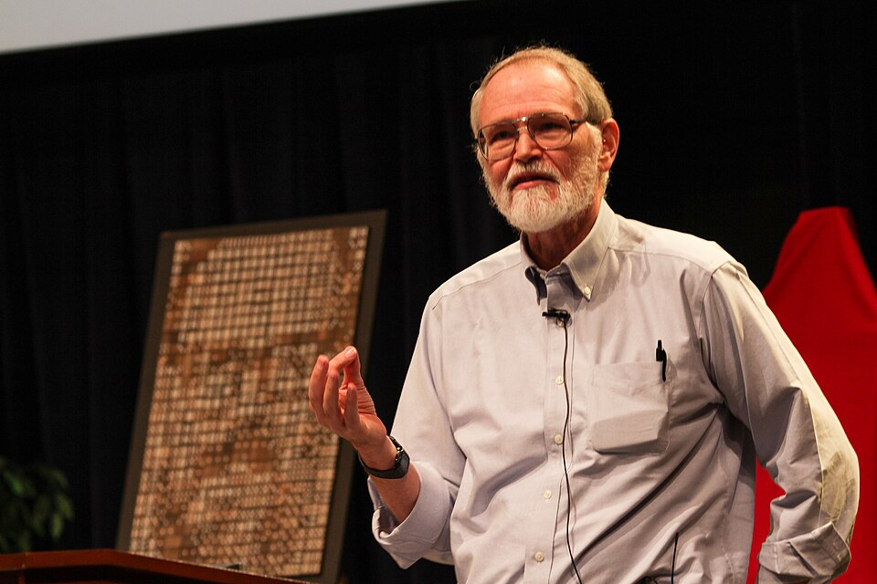
>>>
Story: where hello, world began, in 1972
WHO Brian Kernighan, a researcher at Bell Laboratories.
WHAT The first known program to put the words hello and world together, written as a teaching example.
WHEN 1972, in A Tutorial Introduction to the Language B; the 1978 book The C Programming Language made it famous.
WHERE Bell Laboratories; page 6 of the 1978 book, published by Prentice Hall.
WHY A beginner needs a first program that does one visible thing: print a greeting.
Brian Kernighan, 2012, at Bell Labs. Photo: Ben Lowe, CC BY 2.0, Wikimedia Commons.
HOW B held only four characters per constant, so the text sat in three variables; Python needs one line.
READ The Hello, World! program (Wikipedia)
31 / 39
Notes:
The first hello, world was in a 1972 tutorial for the language B. In B the text needed three variables; in Python it is one line. Ask what a first program proves: that writing, running and seeing output all work.

Slide 32
>>>
Your first program
>>> print('Hello, world!')
>>> print('What is your name?')
What the run printed (Python 3.13.16)
Line | What Python does
1 | shows: Hello, world!
2 | shows: What is your name?
3 | stores 'Ayse' in my_name
4 | shows: It is good to meet you, Ayse
5 | shows: The length of your name is:
6 | shows: 4
7 | stores '20' in my_age
8 | stores 21 in next_age
9 | shows: You will be 21 next year.
Two print calls greet the user and ask a question.
>>> my_name = 'Ayse' # the text input() would return
>>> print('It is good to meet you, ' + my_name)
>>> print('The length of your name is:')
>>> print(len(my_name))
A variable keeps the name. Concatenation builds the greeting and len measures the name.
>>> my_age = '20' # input() returns text
>>> next_age = int(my_age) + 1
>>> print('You will be ' + str(next_age) + ' next year.')
int turns the age text into a number so that plus can add one. str turns the result back into text for the join.
Greet, ask, measure, calculate: nine lines, four built-in functions.
32 / 39
Notes:
The first program greets, asks, measures and calculates. Because the page has no keyboard, the example names the text input would return. Trace it line by line in the table.

Slide 33
>>>
Dissecting the program: join or fill in
>>> name = 'Alice'
>>> age = 20
Two variables hold the pieces of the message.
>>> print('Hello, ' + name + '! You are ' + str(age) + '.')
>>> print(f'Hello, {name}! You are {age}.')
Both lines print the same sentence. The first joins five pieces and needs str. The f-string fills named slots with values.
What the run printed (Python 3.13.16)
join with +
fill slots with an f-string
'Hello, '
name
'! You are '
str(age)
'.'
f'Hello,
{name}
! You are
{age}
.'
Hello, Alice! You are 20.
Hello, Alice! You are 20.
Join pieces with +, or fill slots with an f-string.
33 / 39
Notes:
Two ways to build the same sentence: join five pieces with plus and str, or fill slots in an f-string. The f-string is shorter and needs no str. Which would you rather read?

Slide 34
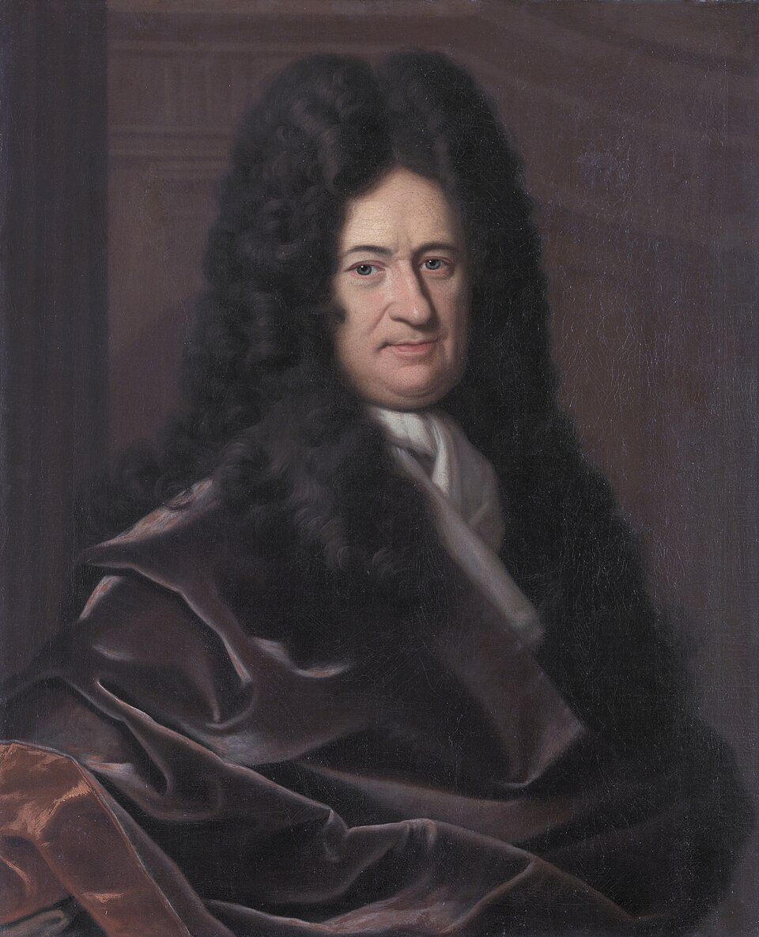
>>>
Story: Leibniz wrote every number with only 0 and 1
WHO Gottfried Wilhelm Leibniz, philosopher and mathematician; the Jesuit Joachim Bouvet wrote to him from China.
WHAT Binary arithmetic: every number written with the two digits 0 and 1, described in Explication de l'arithmétique binaire.
WHEN First notes on 15 March 1679; Bouvet's letter arrived on 1 April 1703; the paper was printed in 1705.
WHERE He sent the paper to the Académie Royale des Sciences in Paris; Bouvet's letter came from Peking.
WHY Bouvet saw that the hexagrams of the Chinese I Ching are binary numbers; Leibniz saw order in them.
Gottfried Wilhelm Leibniz, painting by Christoph Bernhard Francke, before 1729, Herzog Anton Ulrich Museum. Public domain, Wikimedia Commons.
HOW Every number is a sum of powers of two: 5 is 4 plus 1, written 101. Computers store numbers this way.
READ Leibniz and the binary system (historyofinformation.com)
34 / 39
Notes:
Leibniz described binary arithmetic in 1679 and in a paper for the Paris Academy in 1703. Bouvet's letter from Peking showed the I Ching hexagrams as binary numbers. Ask: why do computers prefer two digits?

Slide 35
>>>
How computers store numbers: binary
>>> print(bin(5))
>>> print(int('101', 2))
>>> print(2 ** 8)
bin shows a number as binary digits. int with base 2 reads them back. Eight binary digits, one byte, hold 2 ** 8 = 256 values.
>>> print(format(5, '08b'))
>>> print(format(255, '08b'))
format with 08b writes a number as exactly eight binary digits, padded with zeros on the left.
What the run printed (Python 3.13.16)
place value of each binary digit
128
64
32
16
8
4
2
1
0
0
0
0
0
1
0
1
00000101 = 4 + 1 = 5
11111111 = 255, the biggest byte
Every number is a sum of powers of two.
35 / 39
Notes:
Bin shows binary digits, int with base 2 reads them. Eight binary digits make a byte and hold 256 values. Each place is a power of two; the chart shows which places are on for the number five.

Slide 36
>>>
Current Python adds more
Features newer than the book, from the chapter research
Feature | Since | What it gives you
A better interactive interpreter and error messages | 3.13 | The shell and its messages help beginners more
F-strings get a formal grammar (PEP 701) | 3.12 | The natural successor to joining pieces with +
A free-threaded build, still experimental (PEP 703) | 3.13 | The global interpreter lock becomes optional
An experimental just-in-time compiler | 3.13 | A first step; this course does not need it
Python 3.14, first released on 2025-10-07 | 3.14 | Current bugfix release at the time of the research
Integers have unlimited precision; floats are C doubles | all | 2 ** 100 is exact; 0.1 + 0.2 is not 0.3
uv, a package manager written in Rust | - | Most admired technology in the 2025 Stack Overflow survey, 74 percent
Run what the book printed; then check what changed.
36 / 39
Notes:
Python moves on. The shell and its error messages improved in 3.13. The free-threaded build is experimental. F-strings have a formal grammar. Check each row against its source.

Slide 37
>>>
Summary
ANALOGY A summary is a packing list: only what you really need goes into the bag.
The shell evaluates an expression and prints one value.
code examples in each part of this chapter
1
2
Every value has a data type: int, float or str.
3
Operators combine values; precedence decides who goes first.
4
A variable names a value; print, input, len, str, int and float are built in.
5
A program is these pieces in order; computers store numbers in binary.
Five lines to keep; everything runs on the chapter page.
37 / 39
Notes:
Five sentences to keep. The chart counts the code examples of each part. Everything is on the chapter page, in the same order.

Slide 38
>>>
Practice Questions
Predict first, then run it on the chapter page
ANALOGY Practice questions are finger scales for a pianist: short drills before the performance.
1
Predict print(7 // 2 * 2 + 7 % 2). Which rule does the result show?
2
Write one line that prints your name five times with a space between the copies.
3
What error does print('Age: ' + 21) raise? Fix it in two different ways.
4
Change the first program so that it also says how old you will be in ten years.
Each answer fits in one line you can run.
38 / 39
Notes:
Four drills. Predict first, then run on the page. Ask students to explain each answer in one sentence.

Slide 39
>>>
Resources: where to go next
Reading and watching, chosen for this chapter; every link is live
Book: Automate the Boring Stuff, 3rd edition, chapter 1
https://automatetheboringstuff.com/3e/chapter1.html
PEP 701: f-strings get a formal grammar
https://peps.python.org/pep-0701/
The Python Tutorial: an informal introduction
https://docs.python.org/3/tutorial/introduction.html
PEP 703: making the GIL optional
https://peps.python.org/pep-0703/
Floating-point arithmetic: issues and limitations
https://docs.python.org/3/tutorial/floatingpoint.html
What's new in Python 3.14
https://docs.python.org/3/whatsnew/3.14.html
Built-in functions, all of them
https://docs.python.org/3/library/functions.html
Status of Python versions
https://devguide.python.org/versions/
Built-in types
https://docs.python.org/3/library/stdtypes.html
uv: a fast Python package manager
https://docs.astral.sh/uv/
PEP 8: the style guide
https://peps.python.org/pep-0008/
Video: The Story of Python, by Guido van Rossum
https://www.youtube.com/watch?v=J0Aq44Pze-w
PEP 20: the Zen of Python
https://peps.python.org/pep-0020/
Leibniz and the binary system
https://historyofinformation.com/detail.php?id=395
Pick one link and read it before the next class.
39 / 39
Notes:
Start with the book chapter and the Python tutorial. The stories link to first-hand sources. Choose one link and one video and read or watch it before the next class.

