Slide 1
>>>
Organizing Files
Chapter 11 of Automate the Boring Stuff with Python, 3rd edition, for an advanced course
19
4
25
code examples that run on the chapter page
true stories with who, what, when, where, why and how
distinct chapter concepts, each with an everyday picture
SEN0414 Advanced Programming, Fall 2026. Yusuf Altunel, İstanbul Kültür Üniversitesi
1 / 41
Notes:
Welcome. This chapter moves from one file to whole folders: copy, move, delete, walk and archive. Every code slide shows the code, a plain explanation, and what the run printed as a table, chart or drawing. The same examples run on the chapter page.

Slide 2
>>>
Today's route
Five parts; every range is a run of slides you can jump to
Part | Slides | Code examples | You will run
Copying and moving | 4 - 9 | 4 | copy, copytree, copy2, move
Deleting, and staying safe | 10 - 16 | 3 | unlink, rmdir, rmtree, a dry run
Folders and trees | 17 - 23 | 4 | listdir, glob, walk, folder sizes, mkdir
ZIP archives | 24 - 31 | 4 | write, append, extract, make_archive
Programs that organize files | 32 - 37 | 4 | backup, selective copy, big files, date renaming
Changes, summary, practice, resources | 38 - 41 | - | what current Python adds
Open the chapter-code tab of the page: the same 19 examples, in this order.
2 / 41
Notes:
Five parts: copying and moving, safe deletion, folder trees, ZIP archives, and programs. Each code slide has its place in the chapter-code tab of the page, in this same order.

Slide 3
>>>
Two questions this chapter answers
Carry them through every part; the answers come back at the end
1
Which operations change the disk for good, and how can a program show what it will do first?
Answer on slides 12 and 14: unlink and rmtree, then the dry run.
2
How does a program visit every file of a folder tree and pack the result into one archive?
Answer on slides 20 and 34: os.walk, then the backup project.
Know what a call destroys before you run it.
3 / 41
Notes:
Two questions to carry through the chapter. Which operations change the disk for good, and how can a program show what it will do first? And how do we visit every file of a tree, and pack it into one archive?

Slide 4
Part 1: Copying and moving
The shutil module relocates files and whole folders
shutil.copy
Copies one file; the original stays where it is.
Slide | In this part
5 | Everyday pictures: copying and moving
6 | shutil.copy: one file to a folder or a...
7 | shutil.copytree: a folder with everyth...
8 | copy and copy2: what happens to the ti...
9 | shutil.move: move, rename, overwrite
shutil.copytree
Copies a folder with everything inside it.
shutil.move
Relocates or renames; it can overwrite a file.
Time stamp
copy2 also keeps the modification time of the file.
4 / 41
Notes:
Part one. Copy keeps the original, move does not. Copytree takes a whole folder. Watch what each function returns.

Slide 5
>>>
Everyday pictures: copying and moving
ANALOGY A copy is a photocopy; a move is carrying the original to another desk.
Chapter concept | Everyday picture
The shutil Module | A removals firm: it carries, copies and packs whole files and folders for you.
Copying and moving | Photocopying a page, or lifting the page and putting it in another tray.
shutil.copy | A photocopier: the original stays, and you choose the name of the copy.
shutil.copytree | Photocopying a whole ring binder, every divider and page inside.
shutil.move | Moving a page to another tray; if the new tray holds the same page, it is replaced.
5 / 41
Notes:
Copy is a photocopier, move is carrying the original. Copytree copies a whole binder. Ask which function returns the new path.

Slide 6
>>>
shutil.copy: one file to a folder or a new name
>>> import os, shutil, tempfile
>>> from pathlib import Path
>>> os.chdir(tempfile.mkdtemp())
>>> Path('a.txt').write_text('Hello')
>>> Path('box').mkdir()
A new temporary folder keeps your real files safe. Then one small file and one empty folder to work with.
>>> print(shutil.copy('a.txt', 'box'))
>>> print(shutil.copy('a.txt', 'box/b.txt'))
>>> print(sorted(os.listdir('box')))
A folder as target keeps the name; a file name as target renames the copy. copy returns the new path.
What the run printed (Python 3.13.16)
box/a.txt
Target you gave | Name of the copy | Returned
a folder: 'box' | a.txt | box/a.txt
a file name: 'box/b.txt' | b.txt | box/b.txt
a.txt
box/b.txt
the folder box now holds ['a.txt', 'b.txt']
copy keeps the original and returns the new path.
6 / 41
Notes:
Copy keeps the original. A folder as target keeps the name; a file name as target renames the copy. The return value is the new path.

Slide 7
>>>
shutil.copytree: a folder with everything in it
>>> import os, shutil, tempfile
>>> from pathlib import Path
>>> os.chdir(tempfile.mkdtemp())
>>> Path('box/inner').mkdir(parents=True)
>>> Path('box/y.txt').write_text('y')
A new temporary folder keeps your real files safe. The folder box holds a subfolder and a file.
>>> print(shutil.copytree('box', 'bak'))
>>> try:
... shutil.copytree('box', 'bak')
>>> except FileExistsError:
... print('second copy refused: the folder exists')
>>> print(shutil.copytree('box', 'bak', dirs_exist_ok=True))
copytree copies the whole tree to a new name. A second copy is refused; dirs_exist_ok=True merges into the existing folder.
What the run printed (Python 3.13.16)
box
inner
bak
inner
Call | Result
copytree('box', 'bak') | bak
the same call again | refused
with dirs_exist_ok=True | bak
y.txt
y.txt
entries in box: 2, in bak: 2, equal: True
copytree needs a new name, or dirs_exist_ok=True.
7 / 41
Notes:
Copytree needs a target that does not exist. A second call is refused. Dirs exist ok merges into the existing folder.

Slide 8
>>>
copy and copy2: what happens to the time stamp
>>> import os, shutil, tempfile
>>> from pathlib import Path
>>> os.chdir(tempfile.mkdtemp())
>>> Path('a.txt').write_text('Hello')
>>> Path('box').mkdir()
>>> os.utime('a.txt', (1000000000, 1000000000))
A new temporary folder keeps your real files safe. os.utime sets the file's times to a fixed moment in 2001, so the run is repeatable.
>>> shutil.copy2('a.txt', 'box/c.txt')
>>> shutil.copy('a.txt', 'box/d.txt')
>>> t = lambda n: int(Path(n).stat().st_mtime)
>>> print('copy2 keeps the time:', t('box/c.txt'))
>>> print('copy gives a new time:', t('box/d.txt') == t('a.txt'))
copy2 also copies the modification time. Plain copy stamps the copy with the moment of copying.
What the run printed (Python 3.13.16)
File | Time stamp (seconds) | Same as a.txt?
a.txt | 1000000000 | True
c.txt | 1000000000 | True
d.txt | 1792924302 | False
chart: billions of seconds since 1970
copy2 keeps the time stamp; copy does not.
8 / 41
Notes:
Copy2 keeps the modification time, plain copy does not. We fix the time first so the run is repeatable.

Slide 9
>>>
shutil.move: move, rename, overwrite
>>> import os, shutil, tempfile
>>> from pathlib import Path
>>> os.chdir(tempfile.mkdtemp())
>>> Path('spam').mkdir(); Path('spam2').mkdir()
>>> Path('spam/file1.txt').write_text('Hello')
A new temporary folder keeps your real files safe. Two folders and one file in the first.
>>> print(shutil.move('spam/file1.txt', 'spam2'))
>>> print(shutil.move('spam2/file1.txt', 'spam/new_name.txt'))
A folder as target moves the file into it. A new file name moves and renames in one step.
>>> Path('spam2/f.txt').write_text('old')
>>> Path('spam/f.txt').write_text('new')
>>> shutil.move('spam/f.txt', 'spam2/f.txt')
>>> print(Path('spam2/f.txt').read_text(), Path('spam/f.txt').exists())
Moving onto an existing file name silently overwrites it. The source is gone afterwards.
What the run printed (Python 3.13.16)
spam/file1.txt
spam2/file1.txt
Move onto an existing file name | Result
spam2/f.txt now holds | new
spam/f.txt still exists | False
spam2/file1.txt
spam/new_name.txt
into a folder; then moved and renamed in one step
the old text was replaced; the source is gone
move relocates and renames; it can overwrite.
9 / 41
Notes:
Move relocates and renames in one call. Moving onto an existing file silently overwrites it. The source is gone afterwards.

Slide 10
Part 2: Deleting, and staying safe
Permanent deletion has no undo, so print before you delete
unlink
Deletes one file for good, with no recycle bin.
Slide | In this part
11 | Everyday pictures: deleting safely
12 | os.unlink and os.rmdir: one file, one ...
13 | shutil.rmtree: a folder and everything...
14 | Safe deletion: print first, delete later
15 | send2trash: the recycle bin
16 | Story: the recycle bin is a 1983 drawing
rmtree
Removes a whole folder tree in one call.
Dry run
Print what would go before anything is deleted.
send2trash
A third-party module that uses the recycle bin.
10 / 41
Notes:
Part two. Deleting cannot be undone. Learn the permanent functions, then the habit of printing before deleting.

Slide 11
>>>
Everyday pictures: deleting safely
ANALOGY Permanent deletion is a paper shredder; the recycle bin is the waste-paper basket beside it.
Chapter concept | Everyday picture
Safe deletion | Reading the shredding list aloud before anything goes into the machine.
unlink | A shredder: the page is gone, and nobody can fetch it back.
send2trash | The waste-paper basket: the page can still be pulled out until the bin is emptied.
rmtree | Demolishing a whole room with everything in it, not just emptying one shelf.
Dry run | A dress rehearsal: the actors say their lines, and nothing on stage is damaged.
11 / 41
Notes:
Unlink is a shredder, send2trash is the basket beside it. A dry run reads the list aloud before shredding.

Slide 12
>>>
os.unlink and os.rmdir: one file, one empty folder
>>> import os, shutil, tempfile
>>> from pathlib import Path
>>> os.chdir(tempfile.mkdtemp())
>>> Path('a.txt').write_text('x')
>>> os.unlink('a.txt')
>>> print('a.txt exists:', Path('a.txt').exists())
A new temporary folder keeps your real files safe. os.unlink deletes one file for good. There is no undo and no recycle bin.
>>> Path('d').mkdir(); Path('d/f.txt').write_text('x')
>>> try:
... os.rmdir('d')
>>> except OSError:
... print('rmdir refused: the folder d is not empty')
>>> os.unlink('d/f.txt'); os.rmdir('d')
>>> print('d exists:', Path('d').exists())
os.rmdir deletes only an empty folder. Empty it first, then remove it.
What the run printed (Python 3.13.16)
Step | What the run printed
unlink a.txt | a.txt exists: False
rmdir on a full folder | rmdir refused: the folder d is not empty
unlink the file, then rmdir | d exists: False
a.txt
gone
no recycle bin: os.unlink cannot be undone
unlink and rmdir cannot be undone.
12 / 41
Notes:
Unlink deletes one file for good, rmdir only an empty folder. There is no recycle bin. The first error is caught and explained.

Slide 13
>>>
shutil.rmtree: a folder and everything inside
>>> import os, shutil, tempfile
>>> from pathlib import Path
>>> os.chdir(tempfile.mkdtemp())
>>> Path('spam/eggs').mkdir(parents=True)
>>> Path('spam/eggs/f.txt').write_text('x')
>>> print(sorted(str(p) for p in Path('spam').rglob('*')))
A new temporary folder keeps your real files safe. A folder with one subfolder and one file: two things that will disappear with it.
>>> shutil.rmtree('spam')
>>> print('spam exists:', Path('spam').exists())
>>> shutil.rmtree('spam', ignore_errors=True)
>>> print('a missing folder is ignored')
rmtree removes the whole tree at once. ignore_errors=True stays quiet when there is nothing to remove.
What the run printed (Python 3.13.16)
spam
spam/eggs
spam/eggs/f.txt
rmtree('spam')
spam exists: False
ignore_errors=True: a missing folder is ignored
rmtree removes the whole tree at once.
13 / 41
Notes:
Rmtree removes a whole tree at once. Use ignore errors when a missing folder is fine. Predict the three items before the run.

Slide 14
>>>
Safe deletion: print first, delete later
>>> import os, shutil, tempfile
>>> from pathlib import Path
>>> os.chdir(tempfile.mkdtemp())
>>> for n in ('a.txt', 'b.txt', 'c.rxt'):
... Path(n).write_text(n)
A new temporary folder keeps your real files safe. Three small files; one has a strange extension.
>>> names = sorted(p.name for p in Path('.').glob('*.rxt'))
>>> print('typo *.rxt would delete:', names)
A typo in the pattern matches the wrong file. Printing first shows the mistake while nothing is lost.
>>> for p in sorted(Path('.').glob('*.txt')):
... print('would delete', p) # os.unlink(p)
Run it with the delete line commented out. Only when the printed list is right, remove the comment mark.
What the run printed (Python 3.13.16)
Pattern | Files it matches | Verdict
*.rxt | ['c.rxt'] | typo: the wrong file
*.txt | ['a.txt', 'b.txt'] | the right list
a.txt
b.txt
c.rxt
green: printed as 'would delete'
grey: stays untouched
printed: would delete a.txt; would delete b.txt
Print the list first; delete only when it is right.
14 / 41
Notes:
Print first, delete later. A typo in the pattern shows up as the wrong list, while nothing is lost. Comment the delete line back in only when the list is right.

Slide 15
>>>
send2trash: the recycle bin
A third-party helper; not in the standard library and not run on the chapter page
ANALOGY send2trash is the waste-paper basket: the page can still be pulled out until someone empties the bin.
 | os.unlink | send2trash.send2trash
Where the file goes | nowhere, it is gone | the recycle bin of the system
Can you get it back? | no | yes, until the bin is emptied
Where does it come from? | the standard library | pip install send2trash
Run on the chapter page? | yes | no, it needs an installed module
When in doubt, send to the bin instead of deleting.
15 / 41
Notes:
Send2trash is a third-party module, not in the standard library, so it is not run on the page. It moves to the recycle bin instead of deleting for good.

Slide 16

>>>
Story: the recycle bin is a 1983 drawing
WHO Susan Kare, a graphic designer hired by Apple, working with software architect Andy Hertzfeld.
WHAT She drew the trash can icon, one of the small pictures of the first Macintosh.
WHEN 1983; the Macintosh shipped in 1984.
WHERE Apple Computer, in California.
WHY Pictures made commands friendly for people who had never used a computer.
HOW send2trash moves a file into that same bin instead of deleting it, so the move can still be undone.
Susan Kare in a 1984 television demonstration of the Macintosh. Video frame, CC BY 3.0, Wikimedia Commons.
READ Susan Kare's icons, Smithsonian Magazine
16 / 41
Notes:
Susan Kare drew the trash can in 1983. The send2trash module moves a file to that bin. Ask: which of this chapter's functions can still be undone, and which cannot?

Slide 17
Part 3: Folders and trees
List one folder, then walk a whole tree
listdir and glob
Names of one folder, filtered by a pattern.
Slide | In this part
18 | Everyday pictures: folder trees
19 | Listing one folder: listdir, iterdir, ...
20 | os.walk: the folder, its subfolders, i...
21 | Counting bytes per folder while walking
22 | Path.mkdir: making folders, also in a ...
23 | Story: the folder tree is a 1965 Multi...
walk
Gives folder, subfolders and files at every step.
Folder sizes
Add up bytes per folder while walking.
mkdir
Builds a folder, or a whole chain of folders.
17 / 41
Notes:
Part three. List one folder, then walk a whole tree. The walk gives three things at every step. We also build folders.

Slide 18
>>>
Everyday pictures: folder trees
ANALOGY A folder tree is a building: floors hold rooms, and rooms hold cupboards.
Chapter concept | Everyday picture
Walking a Directory Tree | A caretaker's round through every floor of the building.
Walking a folder tree | Opening each door, looking in each cupboard, then going one level down.
walk | The caretaker's checklist: for each room, its inner rooms and its cupboards' contents.
mkdir | Building a new empty room; parents=True builds the corridor leading to it as well.
listdir and glob | Reading the names on one floor's door plates, or only the plates that match a pattern.
18 / 41
Notes:
A caretaker walks every floor. The walk gives each room, its inner rooms and its files. Mkdir builds a new room.

Slide 19
>>>
Listing one folder: listdir, iterdir, glob
>>> import os, shutil, tempfile
>>> from pathlib import Path
>>> os.chdir(tempfile.mkdtemp())
>>> Path('spam/eggs').mkdir(parents=True)
>>> Path('spam/b.pdf').write_text('x')
>>> Path('spam/file1.txt').write_text('x')
>>> Path('spam/eggs/f2.txt').write_text('x')
A new temporary folder keeps your real files safe. spam holds a folder, a PDF and a text file; the folder holds one more text file.
>>> print(sorted(os.listdir('spam')))
>>> print(sorted((p.name, p.is_dir())
... for p in Path('spam').iterdir()))
>>> print(sorted(p.name for p in Path('spam').glob('*.txt')))
>>> print(sorted(p.name for p in Path('spam').rglob('*.txt')))
listdir gives names; iterdir gives Path objects that know if they are folders. glob stays in one folder; rglob goes down into all subfolders.
What the run printed (Python 3.13.16)
Call | What it returns
os.listdir('spam') | ['b.pdf', 'eggs', 'file1.txt']
Path('spam').iterdir() | [('b.pdf', False), ('eggs', True), ('file1.txt', False)]
glob('*.txt') | ['file1.txt']
rglob('*.txt') | ['f2.txt', 'file1.txt']
spam
eggs
f2.txt
file1.txt
b.pdf
listdir for names, glob for patterns, rglob for the whole tree.
19 / 41
Notes:
Listdir gives names, iterdir gives Path objects, glob stays in one folder, rglob goes into all subfolders. Sorting makes the order repeatable.

Slide 20
>>>
os.walk: the folder, its subfolders, its files
>>> import os, shutil, tempfile
>>> from pathlib import Path
>>> os.chdir(tempfile.mkdtemp())
>>> Path('spam/eggs/bacon').mkdir(parents=True)
>>> Path('spam/eggs2').mkdir()
>>> Path('spam/file1.txt').write_text('x')
>>> Path('spam/eggs/file2.txt').write_text('x')
A new temporary folder keeps your real files safe. Four folders and two files. The walk starts at spam.
>>> for folder, subs, files in os.walk('spam'):
... subs.sort()
... print(folder, subs, sorted(files))
Each step gives the folder, its subfolders and its files. Sorting subs fixes the order of the visit.
>>> last = [f for f, s, fl in os.walk('spam', topdown=False)][-1]
>>> print('bottom-up ends at:', last)
With topdown=False the subfolders come first and the start folder comes last.
What the run printed (Python 3.13.16)
Step | Folder | Subfolders | Files
1 | spam | ['eggs', 'eggs2'] | ['file1.txt']
2 | spam/eggs | ['bacon'] | ['file2.txt']
3 | spam/eggs/bacon | [] | []
4 | spam/eggs2 | [] | []
spam
eggs
bacon
eggs2
bottom-up ends at: spam
os.walk gives folder, subfolders and files at every step.
20 / 41
Notes:
Each step of os.walk gives the folder, its subfolders and its files. Sorting the subfolder list fixes the order. Bottom-up ends with the start folder.

Slide 21
>>>
Counting bytes per folder while walking
>>> import os, shutil, tempfile
>>> from pathlib import Path
>>> os.chdir(tempfile.mkdtemp())
>>> Path('spam/eggs').mkdir(parents=True)
>>> Path('spam/a.txt').write_text('x' * 300)
>>> Path('spam/eggs/b.txt').write_text('x' * 120)
>>> Path('spam/eggs/c.txt').write_text('x' * 80)
A new temporary folder keeps your real files safe. Three files of 300, 120 and 80 bytes in two folders.
>>> sizes = {}
>>> for folder, subs, files in os.walk('spam'):
... sizes[folder] = sum(os.path.getsize(Path(folder, f))
... for f in files)
>>> print(dict(sorted(sizes.items())))
>>> print('total:', sum(sizes.values()))
For every folder the walk hands over, add up the sizes of its files. The dictionary maps each folder to its bytes.
What the run printed (Python 3.13.16)
Folder | Files in it | Bytes
spam | ['a.txt'] | 300
spam/eggs | ['b.txt', 'c.txt'] | 200
total |  | 500
A walk can add up bytes per folder.
21 / 41
Notes:
Walk the tree and add the file sizes per folder. The bar chart shows bytes per folder. Ask which folder is larger.

Slide 22
>>>
Path.mkdir: making folders, also in a chain
>>> import os, shutil, tempfile
>>> from pathlib import Path
>>> os.chdir(tempfile.mkdtemp())
>>> try:
... Path('x/y').mkdir()
>>> except FileNotFoundError:
... print('refused: the parent x is missing')
A new temporary folder keeps your real files safe. mkdir makes one folder. It refuses when the folder above it does not exist yet.
>>> Path('x/y').mkdir(parents=True)
>>> Path('x/y').mkdir(parents=True, exist_ok=True)
>>> print(sorted(str(p) for p in Path('x').rglob('*')))
parents=True builds the whole chain. exist_ok=True accepts a folder that is already there.
What the run printed (Python 3.13.16)
Path('x/y').mkdir()
refused: the parent x is missing
mkdir(parents=True)
x
y
the tree below x now: ['x/y']
parents=True builds the chain; exist_ok=True accepts it.
22 / 41
Notes:
Mkdir makes one folder and needs the parent. Parents true builds the chain. Exist ok true accepts an existing folder.

Slide 23
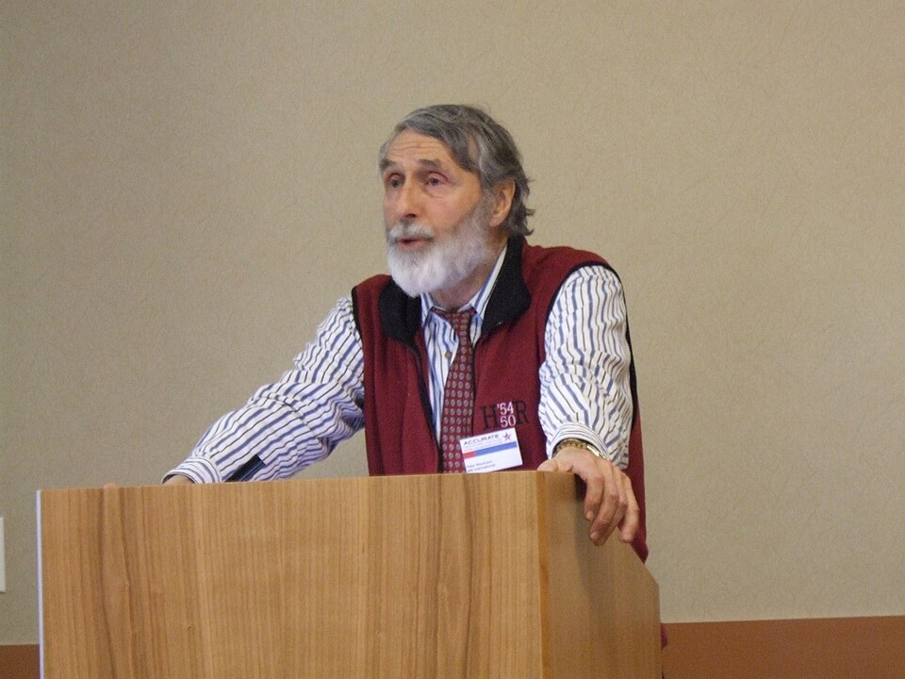
>>>
Story: the folder tree is a 1965 Multics design
WHO R. C. Daley of MIT's Project MAC and Peter G. Neumann of Bell Labs.
WHAT Their paper 'A General Purpose File System for Secondary Storage' laid out folders holding folders holding files.
WHEN 1965, at the Fall Joint Computer Conference.
WHERE Multics, the shared system of MIT, Bell Labs and General Electric.
WHY Many users had to share one disk and manage their own parts of it.
Peter G. Neumann. Photo: Joe Hall, CC BY 2.0, Wikimedia Commons.
HOW Unix kept the same tree, and os.walk descends it folder by folder today.
READ Multics history, multicians.org
23 / 41
Notes:
Daley and Neumann described a tree of folders in 1965. Unix kept it, and os.walk still visits it folder by folder. Ask students to draw the tree of their own laptop.

Slide 24
Part 4: ZIP archives
Many files in one parcel, and back again
ZipFile
Opens an archive to write, add or read.
Slide | In this part
25 | Everyday pictures: ZIP archives
26 | zipfile.ZipFile: write a file into an ...
27 | ZIP modes: read, append, exclusive
28 | extractall and extract: unpacking an a...
29 | shutil.make_archive and unpack_archive
30 | Story: the ZIP format was given away o...
31 | Story: the engine under ZIP_DEFLATED s...
Compression
ZIP_DEFLATED shrinks repeated text a great deal.
extract
Unpacks one member or all of them.
make_archive
Packs a whole folder in a single call.
24 / 41
Notes:
Part four. A ZIP file packs many files into one. Write it, read it, extract from it, and use the one-call helpers.

Slide 25
>>>
Everyday pictures: ZIP archives
ANALOGY A ZIP file is a vacuum-packed suitcase: many things, one small parcel, and they come out again.
Chapter concept | Everyday picture
Compressing Files with the zipfile Module | Vacuum-packing clothes: the same clothes, a much smaller bag.
Archives | A single suitcase for a whole wardrobe.
zipfile.ZipFile | The suitcase itself: open it to pack, to add one more item or to look inside.
extract | Taking one shirt out, or emptying the whole case onto the bed.
25 / 41
Notes:
A ZIP is a vacuum-packed suitcase. ZipFile opens it, extract unpacks one item or all of them.

Slide 26
>>>
zipfile.ZipFile: write a file into an archive
>>> import os, shutil, tempfile, zipfile
>>> from pathlib import Path
>>> os.chdir(tempfile.mkdtemp())
>>> Path('file1.txt').write_text('Hello' * 10000)
>>> with zipfile.ZipFile('example.zip', 'w') as z:
... z.write('file1.txt', compress_type=zipfile.ZIP_DEFLATED)
A new temporary folder keeps your real files safe. Mode 'w' starts a new archive. write adds a file; ZIP_DEFLATED is the compression that really shrinks it.
>>> with zipfile.ZipFile('example.zip') as z:
... info = z.getinfo('file1.txt')
>>> print(info.filename, info.file_size)
>>> small = info.compress_size < info.file_size / 100
>>> print('squeezed to under 1 percent:', small)
getinfo reports the original size and the stored size. Repeated text compresses very well.
What the run printed (Python 3.13.16)
Value | From getinfo
info.filename | file1.txt
info.file_size | 50000
info.compress_size | 97
compress_size / file_size | 0.002
ZIP_DEFLATED really shrinks repeated text.
26 / 41
Notes:
Mode w starts a new archive. Deflate with level nine compresses repeated text very well. Compare the two bars.

Slide 27
>>>
ZIP modes: read, append, exclusive
>>> import os, shutil, tempfile, zipfile
>>> from pathlib import Path
>>> os.chdir(tempfile.mkdtemp())
>>> Path('a.txt').write_text('A')
>>> with zipfile.ZipFile('x.zip', 'w') as z:
... z.write('a.txt')
A new temporary folder keeps your real files safe. Mode 'w' starts the archive x.zip with one member.
>>> with zipfile.ZipFile('x.zip', 'a') as z:
... z.writestr('two.txt', '2')
Mode 'a' adds to an archive that exists. writestr stores text without a file on disk.
>>> with zipfile.ZipFile('x.zip') as z:
... print(sorted(z.namelist()))
>>> try:
... zipfile.ZipFile('x.zip', 'x')
>>> except FileExistsError:
... print("mode 'x' refused: x.zip exists")
namelist lists the members. Mode 'x' creates a new archive only; it refuses to overwrite one.
What the run printed (Python 3.13.16)
Mode | What it does | Seen in the run
'w' | start a new archive | a.txt written
'a' | add to an existing archive | namelist: ['a.txt', 'two.txt']
'r' (default) | read an archive | namelist, getinfo, extract
'x' | create, never overwrite | refused: x.zip exists
w starts, a adds, x refuses to overwrite.
27 / 41
Notes:
Mode a adds to an archive, mode x refuses to overwrite one. Writestr stores text without a file on disk.

Slide 28
>>>
extractall and extract: unpacking an archive
>>> import os, shutil, tempfile, zipfile
>>> from pathlib import Path
>>> os.chdir(tempfile.mkdtemp())
>>> with zipfile.ZipFile('z.zip', 'w') as z:
... z.writestr('a.txt', 'A')
... z.writestr('sub/b.txt', 'B')
A new temporary folder keeps your real files safe. An archive with two members, one of them inside a subfolder.
>>> with zipfile.ZipFile('z.zip') as z:
... z.extractall('out')
>>> print(sorted(str(p) for p in Path('out').rglob('*')))
extractall unpacks every member into a folder and rebuilds the subfolders of the archive.
>>> with zipfile.ZipFile('z.zip') as z:
... print(z.extract('a.txt', 'new/folder'))
extract unpacks one member. The target folder is created when it is missing, and the new path is returned.
What the run printed (Python 3.13.16)
z.zip
a.txt
extractall('out') made | kind
out/a.txt | file
out/sub | folder
out/sub/b.txt | file
sub/b.txt
extract() gave new/folder/a.txt
extractall unpacks all; extract takes one.
28 / 41
Notes:
Extractall unpacks everything and rebuilds subfolders. Extract unpacks one member into a folder it creates.

Slide 29
>>>
shutil.make_archive and unpack_archive
>>> import os, shutil, tempfile, zipfile
>>> from pathlib import Path
>>> os.chdir(tempfile.mkdtemp())
>>> Path('spam/sub').mkdir(parents=True)
>>> Path('spam/a.txt').write_text('x')
>>> Path('spam/sub/b.txt').write_text('y')
A new temporary folder keeps your real files safe. A small tree to pack.
>>> name = shutil.make_archive('snap', 'zip', '.', 'spam')
>>> print(Path(name).name)
>>> with zipfile.ZipFile(name) as z:
... print(sorted(z.namelist()))
make_archive packs a whole folder into one ZIP in a single call. The names inside keep the folder name.
>>> shutil.unpack_archive(name, 'un')
>>> print(sorted(str(p) for p in Path('un').rglob('*')))
unpack_archive is the one-call way back: it guesses the format from the file name.
What the run printed (Python 3.13.16)
Inside the ZIP | After unpack_archive
spam/ | un/spam
spam/a.txt | un/spam/a.txt
spam/sub/ | un/spam/sub
spam/sub/b.txt | un/spam/sub/b.txt
spam/
make_archive packs
snap.zip
unpack_archive unpacks
un/
make_archive and unpack_archive: one call each way.
29 / 41
Notes:
Make archive packs a folder in one call, unpack archive reverses it. The names inside keep the folder name.

Slide 30
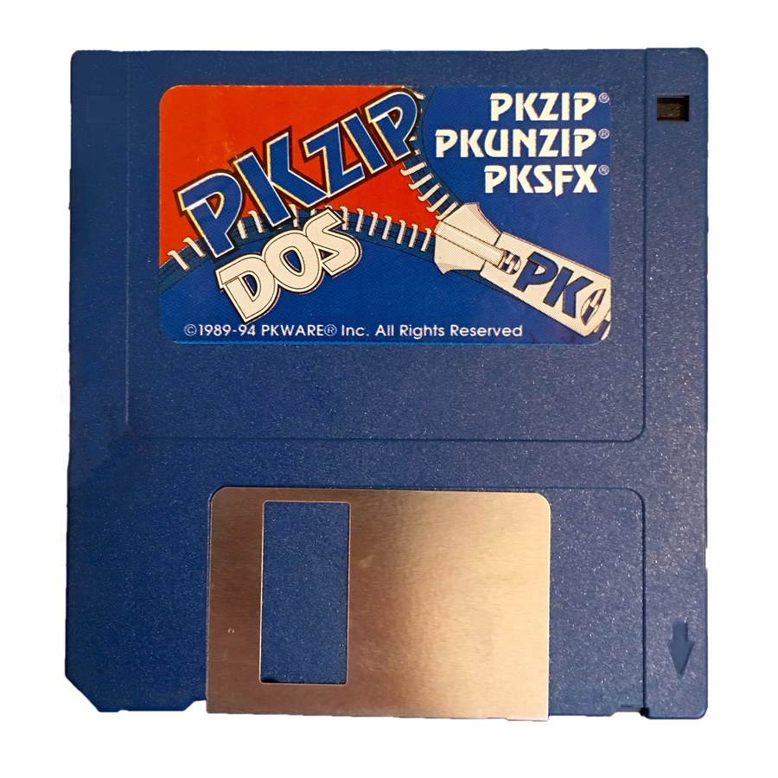
>>>
Story: the ZIP format was given away on 14 February 1989
WHO Phil Katz, programmer at PKWARE, with Gary Conway of Infinity Design Concepts.
WHAT They placed the .ZIP file format in the public domain, free for any program to read or write.
WHEN 14 February 1989, in a joint press release.
WHERE PKWARE in Glendale, Wisconsin.
WHY Katz had been sued over PKARC, his ARC-compatible archiver, so he and Conway designed a new, open format.
HOW Every zipfile.ZipFile call of this chapter reads and writes that same public-domain structure.
PKZIP floppy disk, 1989-94 edition. Photo: Blake Patterson, CC BY 2.0, Wikimedia Commons.
READ ZIP (file format), Wikipedia
30 / 41
Notes:
Phil Katz and Gary Conway released the ZIP format into the public domain on 14 February 1989. That openness is why zipfile can read archives from any tool. Ask students why a free format helps a programmer.

Slide 31

>>>
Story: the engine under ZIP_DEFLATED shipped on 1 May 1995
WHO Jean-loup Gailly, who wrote the compression half, and Mark Adler, who wrote the decompression half.
WHAT zlib 0.9, a free library for the DEFLATE method, free to embed in any program.
WHEN 1 May 1995.
WHERE Written over the internet; first built for the libpng image library.
WHY Programs needed compression that no company owned and no patent blocked.
Mark Adler. Photo: NASA, public domain, Wikimedia Commons.
HOW zipfile hands the bytes to zlib whenever a write asks for compress_type=zipfile.ZIP_DEFLATED.
READ Zlib, Wikipedia
31 / 41
Notes:
Gailly and Adler released zlib 0.9 on 1 May 1995. Python's zipfile uses it for the deflate method. Ask students what would break if compression were owned by one company.

Slide 32
Part 5: Programs that organize files
Four programs that use everything so far
backupToZip
Backs a folder up into a numbered ZIP.
Slide | In this part
33 | Everyday pictures: programs that organ...
34 | Project 5: back a folder up into a num...
35 | Practice program: copy every PDF of a ...
36 | Practice program: find the big files
37 | Practice program: American dates to Eu...
Selective copy
Copies only the files of one extension.
Big files
Finds the files above a size limit.
Date renaming
Swaps day and month inside file names.
32 / 41
Notes:
Part five. Four programs that use everything so far. Predict the output, then run each on the page.

Slide 33
>>>
Everyday pictures: programs that organize files
ANALOGY A practice program is a driving lesson on an empty car park: the real skill, no real risk.
Chapter concept | Everyday picture
Practice Programs | Driving lessons on an empty car park: every move is real, no damage is possible.
backupToZip | A nightly photocopy of the whole filing cabinet, numbered so no old copy is lost.
Selective copy | A librarian who copies only the blue-covered books from every shelf.
Date renaming | Relabelling every folder when the office switches from the American to the European calendar.
33 / 41
Notes:
Practice programs are driving lessons on an empty car park. Each one combines walking, copying and patterns.

Slide 34
>>>
Project 5: back a folder up into a numbered ZIP
>>> import os, tempfile, zipfile
>>> from pathlib import Path
>>> os.chdir(tempfile.mkdtemp())
>>> def backup_to_zip(folder):
... n = 1
... while Path(f'{folder}_{n}.zip').exists(): n += 1
What the run printed (Python 3.13.16)
spam
eggs
file2.txt
file1.txt
A new temporary folder; the function finds the first unused number.
the folder to back up
>>> # continued
... with zipfile.ZipFile(f'{folder}_{n}.zip', 'w') as z:
... for root, subs, files in os.walk(folder):
... for f in files: z.write(Path(root, f))
... return f'{folder}_{n}.zip'
spam_1.zip
spam_2.zip
first run, then second run
Walk the folder and write every file into the new ZIP, then return its name.
Members of spam_1.zip
spam/eggs/file2.txt
spam/file1.txt
>>> Path('spam/eggs').mkdir(parents=True)
>>> Path('spam/file1.txt').write_text('Hello')
>>> Path('spam/eggs/file2.txt').write_text('Hi')
>>> print(backup_to_zip('spam'), backup_to_zip('spam'))
>>> with zipfile.ZipFile('spam_1.zip') as z:
... print(sorted(z.namelist()))
Two runs make spam_1.zip and spam_2.zip, each with both files.
Walk, write, count: a numbered backup.
34 / 41
Notes:
Project five. Find the first free number, walk the folder, write every file. Run it twice to get spam one and spam two.

Slide 35
>>>
Practice program: copy every PDF of a tree
>>> import os, shutil, tempfile
>>> from pathlib import Path
>>> os.chdir(tempfile.mkdtemp())
>>> for d in ('src/a', 'src/b', 'dest'):
... Path(d).mkdir(parents=True)
What the run printed (Python 3.13.16)
A new temporary folder, with a source tree and an empty dest folder.
>>> files = ('src/one.pdf', 'src/a/two.PDF',
... 'src/b/three.txt', 'src/b/four.pdf')
>>> for f in files: Path(f).write_text(f)
Four files: three PDFs, one with capital letters, and one text file.
>>> for folder, subs, files in os.walk('src'):
... for f in files:
... if f.lower().endswith('.pdf'):
... shutil.copy(Path(folder, f), 'dest')
File | In src | Copied
four.pdf | yes | yes
one.pdf | yes | yes
three.txt | yes | no
two.PDF | yes | yes
Walk the tree and copy each PDF; lower() ignores capitals.
>>> print(sorted(os.listdir('dest')))
>>> print(sorted(f for _, _, fs in os.walk('src') for f in fs))
The copies are in dest, and the source keeps all four files.
Walk, test the extension, copy.
35 / 41
Notes:
Walk a tree and copy only the PDFs. Lower makes the test ignore capitals. The source keeps all four files.

Slide 36
>>>
Practice program: find the big files
>>> import os, shutil, tempfile
>>> from pathlib import Path
>>> os.chdir(tempfile.mkdtemp())
>>> Path('sub').mkdir()
>>> sizes = {'big.bin': 3000, 'mid.bin': 1200,
... 'tiny.txt': 40, 'sub/huge.bin': 9000}
What the run printed (Python 3.13.16)
A new temporary folder, and four sizes in bytes; one file sits in sub.
>>> for name, size in sizes.items():
... Path(name).write_bytes(b'x' * size)
Write each of the four files with that many bytes.
>>> found = {}
>>> for folder, subs, files in os.walk('.'):
... for f in files:
... path = Path(folder, f)
File | Bytes | Above 1000?
big.bin | 3000 | True
mid.bin | 1200 | True
sub/huge.bin | 9000 | True
tiny.txt | 40 | False
Walk every folder of the tree, including the subfolder sub.
>>> # continued
... if os.path.getsize(path) > 1000:
... found[str(path)] = os.path.getsize(path)
>>> print(dict(sorted(found.items(), key=lambda kv: -kv[1])))
Keep the files above 1000 bytes, the biggest first.
Walk, measure, keep what is above the limit.
36 / 41
Notes:
Walk everything and keep files above a size limit. The chart shows the sizes in bytes, biggest first.

Slide 37
>>>
Practice program: American dates to European dates
>>> import os, re, shutil, tempfile
>>> from pathlib import Path
>>> os.chdir(tempfile.mkdtemp())
>>> names = ('spam12-31-1900.txt', 'report01-02-2020.txt',
... 'notes.txt')
What the run printed (Python 3.13.16)
Before | After
notes.txt | notes.txt
report01-02-2020.txt | report02-01-2020.txt
spam12-31-1900.txt | spam31-12-1900.txt
A new temporary folder, and three names; two carry a month-day-year date.
>>> for name in names: Path(name).write_text('')
>>> pattern = re.compile(r'(\d\d)-(\d\d)-(\d\d\d\d)')
>>> before = sorted(os.listdir('.'))
The pattern keeps month, day and year as three groups.
01-02-2020 : month 01, day 02
>>> for old in before:
... if pattern.search(old):
... new = pattern.sub(r'\2-\1-\3', old)
... shutil.move(old, new)
>>> print(sorted(os.listdir('.')))
02-01-2020 : day 02, month 01
2 of 3 files renamed
sub swaps groups 1 and 2, shutil.move renames; notes.txt stays.
A pattern plus move renames many files at once.
37 / 41
Notes:
Swap month and day in file names with a pattern and shutil move. Files without a date stay as they are.

Slide 38
>>>
Current Python adds more
Features newer than the book, from the Python documentation
Feature | Since | What it gives you
Path.walk() on a Path object | 3.12 | The same three values as os.walk, from a Path
onexc in shutil.rmtree | 3.12 | Replaces onerror, which is deprecated
ZipFile.mkdir() | 3.11 | Adds an empty folder entry to an archive
Path.copy() and Path.move() | 3.14 | Copy and move without importing shutil
recurse_symlinks in glob | 3.13 | Choose whether glob follows symbolic links
Run what the book printed; then check what changed.
38 / 41
Notes:
Python moves on. Path walk since 3.12, onexc in rmtree since 3.12, Path copy and move since 3.14. Run what the book printed, then check what changed.

Slide 39
>>>
Summary
ANALOGY A summary is a packing list: only what you really need goes into the bag.
copy keeps the original; move relocates and can overwrite.
code examples in each part of this chapter
1
2
unlink, rmdir and rmtree cannot be undone; print first.
3
os.walk gives folder, subfolders and files at every step.
4
ZipFile writes, appends and reads archives; extract unpacks them.
5
A short program can back up, copy by type or rename in bulk.
Know what a call destroys before you run it.
39 / 41
Notes:
Five sentences to keep. The chart shows how many examples belong to each part.

Slide 40
>>>
Practice Questions
Predict first, then run it on the chapter page
ANALOGY Practice questions are finger scales for a pianist: short drills before the performance.
1
What is the difference between shutil.copy and shutil.move for the original file?
2
Why print the file names with a dry run before os.unlink is allowed to run?
3
Which three values does every step of os.walk give you?
4
Which ZipFile mode adds a file to an archive, and which refuses to overwrite one?
Each answer fits in one line you can run.
40 / 41
Notes:
Four drills. Predict first, then run on the page. Ask students to explain each answer in one sentence.

Slide 41
>>>
Resources: where to go next
Reading and watching, chosen for this chapter; every link is live
Book: Automate the Boring Stuff, 3rd edition, chapter 11
https://automatetheboringstuff.com/3e/chapter11.html
send2trash on the Python Package Index
https://pypi.org/project/Send2Trash/
Python documentation: shutil, high-level file operations
https://docs.python.org/3/library/shutil.html
ZIP file format specification (APPNOTE.TXT)
pkware.cachefly.net
Python documentation: os.walk
https://docs.python.org/3/library/os.html#os.walk
zlib home page
https://www.zlib.net/
Python documentation: zipfile
https://docs.python.org/3/library/zipfile.html
ZIP (file format) on Wikipedia
https://en.wikipedia.org/wiki/ZIP_(file_format)
Python documentation: pathlib
https://docs.python.org/3/library/pathlib.html
Multics history
https://multicians.org/history.html
What's new in Python 3.14
https://docs.python.org/3/whatsnew/3.14.html
Susan Kare's Macintosh icons (Smithsonian)
smithsonianmag.com
What's new in Python 3.12
https://docs.python.org/3/whatsnew/3.12.html
Video: working with ZIP files in Python (Corey Schafer)
https://www.youtube.com/watch?v=z0gguhEmWiY
Pick one link and read it before the next class.
41 / 41
Notes:
Start with the book chapter, then the Python documentation. The stories link to first-hand sources. Choose one link and read it before the next class.

