Slide 1
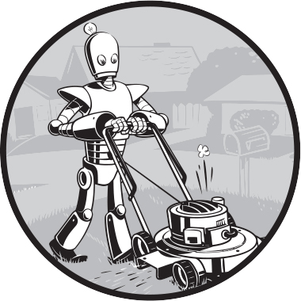
Chapter 7: Dictionaries and Structuring Data
Pairs, counts, models and the text that carries them
SEN0414 Advanced Programming · Fall 2026 · Yusuf Altunel, PhD · İstanbul Kültür University
Sweigart (2025), chapter 7 opener illustration
1 / 48
Notes:
This chapter is about the dictionary: pairs of a key and a value, found by key. We count with it, model a chessboard with it, copy it and write it down as text. Every result you see was run under Python 3.14.6.

Slide 2
Today's route
>>>
Five parts; every range is a run of slides you can jump to
1
Opening: questions and the map of the chapter (slides 1-3)
48
2
Part 1: The dictionary and its keys (slides 4-10)
slides, numbered bottom-right
3
Part 2: Reading and changing pairs (slides 11-18)
24
4
Part 3: Programs that count and learn (slides 19-25)
code examples, each with its result
5
Part 4: Structuring data (slides 26-36)
4
6
Part 5: Copies and writing data down (slides 37-42)
true stories: who, what, when, where, why, how
7
Today's Python, practice, summary and resources (slides 43-48)
Book sections: The Dictionary Data Type, Model Real-World Things Using Data Structures, Nested Dictionaries and Lists, Summary, Practice Questions, Practice Programs.
Five parts, from one pair to a chessboard, all of it executed.
2 / 48
Notes:
Five parts take us from one pair to a chessboard. Each part opens with a divider that names its concepts. The deck follows the sections of the book chapter and adds what current Python offers.

Slide 3
The questions this chapter answers
>>>
The summary comes back to each of them
1
Which operations read, add, replace and remove the pairs of a dictionary?
2
Which values may be keys, and why must a key be hashable?
3
How are counting, grouping and nesting solved with dictionaries?
4
How is a real thing modelled, displayed, copied and written down?
5
Which terms must a learner look up, and what is each one in everyday life?
Answer these five questions and you have the chapter.
Automate the Boring Stuff 3e, chapter 7: Summary
3 / 48
Notes:
These five questions are the chapter. Keep them in mind: each part of the deck answers one, and the summary answers all five in a line each.

Slide 4
Part 1: The dictionary and its keys
Pairs in braces, found by key
Dictionary
A collection of key-value pairs, found by key.
How they fit together
1. Pairs sit in braces
2. A key finds its value
3. Keys must be hashable
4. The order of adding is kept
Key and value
The key is the label; the value is what it finds.
Hashable keys
A key must never change, so lists cannot be keys.
Insertion order
Keys stay in the order they were added.
4 / 48
Notes:
Part one introduces the dictionary data type. A dictionary holds key-value pairs. A key must be hashable, and since Python 3.7 the keys remember the order in which they were added.

Slide 5
Code 1: A dictionary holds key-value pairs
>>>
Braces hold the pairs; a key finds its value
>>> my_cat = {'size': 'fat', 'color': 'gray', 'age': 8}
>>> print(my_cat['size'])
Braces hold three pairs. The key 'size' finds its value, 'fat', directly.
>>> print('My cat has ' + my_cat['color'] + ' fur.')
>>> print(len(my_cat))
A value can be used like any text. len() counts the pairs, not the characters.
What the run printed (Python 3.14.6)
Expression | Printed
my_cat['size'] | fat
'My cat has ' + color | My cat has gray fur.
len(my_cat) | 3
size
fat
color
gray
age
8
A key finds its value; the position of the pair does not matter.
Automate the Boring Stuff 3e, chapter 7: The Dictionary Data Type
5 / 48
Notes:
A dictionary is a collection of key-value pairs between braces. You ask by key and the value comes back at once, however many pairs there are. len() counts the pairs.

Slide 6
Code 2: Dictionaries versus lists
>>>
Two containers, two ways to name an item
>>> spam = ['cats', 'dogs', 'moose']
>>> bacon = ['moose', 'dogs', 'cats']
>>> print(spam == bacon)
Two lists with the same items in another order are not equal.
>>> eggs = {'name': 'Zophie', 'age': 8, 'species': 'cat'}
>>> ham = {'age': 8, 'species': 'cat', 'name': 'Zophie'}
>>> print(eggs == ham)
Two dictionaries with the same pairs are equal, whatever the order.
>>> print(list(ham))
Yet the dictionary still remembers the order in which its keys were added.
What the run printed (Python 3.14.6)
Expression | Printed | Why
spam == bacon | False | the same items in a different order
eggs == ham | True | the same pairs, in any order
list(ham) | ['age', 'species', 'name'] | the order of adding is still kept
Lists compare by position; dictionaries compare by pairs.
Automate the Boring Stuff 3e, chapter 7: Comparing Dictionaries and Lists
6 / 48
Notes:
A list names its items by position, so order matters for equality. A dictionary names them by key, so two dictionaries with the same pairs are equal. Insertion order is still kept and shown by list().

Slide 7
Code 3: Dictionaries remember insertion order
>>>
Since Python 3.7 the order of adding is a promise
>>> d = {}
>>> d['pear'] = 3
>>> d['apple'] = 5
>>> d['fig'] = 1
Add three pairs one after another: pear, apple, fig.
>>> print(list(d))
>>> print(d == {'fig': 1, 'pear': 3, 'apple': 5})
Loops and list() follow the order of adding. Equality ignores the order.
>>> del d['pear']
>>> d['pear'] = 9
>>> print(list(d))
A key removed and added again joins the end of the line.
What the run printed (Python 3.14.6)
after the three assignments
pear
apple
fig
after del and adding again
apple
fig
pear
Keys come back in the order they were added; equality does not care.
Automate the Boring Stuff 3e, chapter 7: The Dictionary Data Type
7 / 48
Notes:
The chapter says a dictionary has no first item. That was true of old Python. Since 3.7 the language guarantees that keys keep the order in which they were added, and a re-added key goes to the end.

Slide 8

Five words that gave dictionaries an order
>>>
A true story, told as who, what, when, where, why and how
WHO
Guido van Rossum, Python's creator, answering core developer INADA Naoki.
WHAT
He ruled that a dict keeps insertion order: 'Make it so.'
WHEN
Friday 15 December 2017, at 10:53 Eastern time.
WHERE
The python-dev mailing list, in the thread 'Guarantee ordered dict literals in v3.7?'
WHY
Python 3.6's dict kept order only as an implementation detail; users wanted a promise.
HOW
Python 3.7 made insertion order 'an official part of the Python language spec'.
Guido van Rossum - photo: Daniel Stroud, CC BY-SA 4.0
READ Guido's ruling on python-dev, 15 December 2017 mail.python.org
One short message turned an implementation detail into a promise.
8 / 48
Notes:
On 15 December 2017 Guido van Rossum answered a question about ordered dictionaries with the words 'Make it so'. From Python 3.7 the order of adding is part of the language, and the book's 'no first item' is out of date.

Slide 9
Code 4: Keys must be hashable
>>>
A key has to be a value that never changes
>>> d = {}
>>> d[(1, 2)] = 'a tuple works'
>>> print(d)
A tuple of numbers never changes, so it can be a key.
>>> try:
>>> d[[1, 2]] = 'a list fails'
>>> except TypeError as e:
>>> print(type(e).__name__)
A list can change, so it is unhashable and refused with a TypeError.
>>> print({1: 'int', 1.0: 'float', True: 'bool'})
The numbers 1, 1.0 and True are equal and hash alike, so they are one key.
What the run printed (Python 3.14.6)
Key tried | Allowed? | Printed
(1, 2) a tuple | yes | {(1, 2): 'a tuple works'}
[1, 2] a list | no, unhashable | TypeError
1, 1.0 and True | yes, but one key | {1: 'bool'}
A key must never change, so tuples are welcome and lists are not.
Automate the Boring Stuff 3e, chapter 7: The Dictionary Data Type
9 / 48
Notes:
Python files each key by its hash, a number that must never change while the key is in the dictionary. Lists, sets and dictionaries can change, so they are unhashable and cannot be keys. Equal numbers share one key.

Slide 10
Everyday pictures: the dictionary and its keys
>>>
Each term of this part, as something you already know
EVERYDAY The Dictionary Data Type
A filing cabinet with labelled tabs: you jump to the tab instead of leafing through every page.
EVERYDAY Comparing Dictionaries and Lists
A queue cares who stands where; a coat rack only cares which labels hang on it.
EVERYDAY dictionary
A phone book: look up a name and the number is next to it.
EVERYDAY key
The ticket you hand over at the coat check; it names exactly one coat.
EVERYDAY value
The coat itself: the thing you get back when you present the ticket.
EVERYDAY key-value pair
One line of the phone book: a name and its number, written together.
EVERYDAY unhashable type
Lockers numbered by hair colour: when the colour changes, the locker is lost.
Automate the Boring Stuff 3e, chapter 7: The Dictionary Data Type
10 / 48
Notes:
A dictionary is like a phone book or a coat check. The key is the ticket, the value is the coat, and a key must never change, or the coat is lost.

Slide 11
Part 2: Reading and changing pairs
Look at the parts, ask for a key, fill in defaults
Keys, values, items
Three views of the parts of a dictionary.
How they fit together
1. Look at the parts
2. Test for a key
3. Fill in a default
4. Add, remove or merge
in and get()
Ask whether a key exists without an error.
setdefault()
Add a pair only when the key is missing.
Change a pair
Assign, del, pop and merge change the contents.
11 / 48
Notes:
Part two covers the everyday operations. We read keys, values and items, test for a key safely, set defaults, and add, remove and merge pairs.

Slide 12
Code 5: Reading keys, values and items
>>>
Three methods return the parts of a dictionary
>>> spam = {'color': 'red', 'age': 42}
>>> print(list(spam.keys()))
>>> print(list(spam.values()))
keys() gives the keys and values() the values; list() makes them printable.
>>> for k, v in spam.items():
>>> print(k, '->', v)
items() hands over one (key, value) pair on each turn of the loop.
>>> print(list(spam.items()))
Each pair is a tuple that holds the key first and then the value.
What the run printed (Python 3.14.6)
Method | Gives | Printed
spam.keys() | the labels | ['color', 'age']
spam.values() | the contents | ['red', 42]
spam.items() | both, as pairs | [('color', 'red'), ('age', 42)]
keys() for the labels, values() for the contents, items() for both.
Automate the Boring Stuff 3e, chapter 7: Returning Keys and Values
12 / 48
Notes:
The three methods return views, not lists. Wrapping them in list() makes them printable. items() is the one you use in loops, because it gives the key and the value together.

Slide 13
Code 6: Checking whether a key exists
>>>
Test first, or ask with a fallback
>>> picnic = {'apples': 5, 'cups': 2}
>>> print('cups' in picnic)
>>> print('eggs' not in picnic)
in asks about keys, not values. Both tests answer True or False.
>>> print(picnic.get('eggs', 0))
>>> print(picnic.get('cups', 0))
get() returns the value, or your fallback when the key is missing.
>>> try:
>>> picnic['eggs']
>>> except KeyError as e:
>>> print('KeyError', e)
Square brackets on a missing key raise a KeyError that names the key.
What the run printed (Python 3.14.6)
Question | Printed
'cups' in picnic | True
'eggs' not in picnic | True
picnic.get('eggs', 0) | 0
picnic.get('cups', 0) | 2
picnic['eggs'] | KeyError 'eggs'
Use get() when a missing key is normal, and brackets when it is a bug.
Automate the Boring Stuff 3e, chapter 7: Checking Whether a Key Exists
13 / 48
Notes:
Brackets on a missing key raise a KeyError. The in test and get() do not, so they suit data where a key may be absent. get() lets you choose the fallback value.

Slide 14
Code 7: Setting default values with setdefault
>>>
Add the pair only when the key is missing
>>> picnic = {'apples': 5, 'cups': 2}
>>> print(picnic.setdefault('eggs', 12))
setdefault() adds the pair only when the key is missing, and returns the value.
>>> print(picnic.setdefault('eggs', 99))
>>> print(picnic)
The second call finds 'eggs' and leaves it alone, so 99 is never used.
What the run printed (Python 3.14.6)
Call | Printed | What happened
first | 12 | key missing: 12 stored
second | 12 | key found: 99 unused
setdefault() sets a value once and then leaves it alone.
Automate the Boring Stuff 3e, chapter 7: Setting Default Values
14 / 48
Notes:
setdefault() does two jobs in one call. If the key is missing it stores your default; either way it returns the value now in the dictionary. That makes counting and grouping short.

Slide 15
Code 8: Adding, removing and merging pairs
>>>
Assign, del, pop and the | operator
>>> spam = {'color': 'red', 'age': 42}
>>> spam['name'] = 'Pooka'
>>> del spam['age']
Assignment adds a pair; del removes one. A missing key in del raises a KeyError.
>>> print(spam.pop('color'))
>>> print(spam)
pop() removes a pair and hands its value back to you.
>>> print(spam | {'name': 'Rex', 'legs': 4})
>>> print(spam)
The | operator builds a new dictionary; the right-hand value wins. spam is unchanged.
What the run printed (Python 3.14.6)
Line | Printed
spam.pop('color') | red
print(spam) | {'name': 'Pooka'}
spam | {'name': 'Rex', 'legs': 4} | {'name': 'Rex', 'legs': 4}
print(spam) again | {'name': 'Pooka'}
Assignment adds or replaces, del and pop remove, and | merges into a new dictionary.
Automate the Boring Stuff 3e, chapter 7: The Dictionary Data Type
15 / 48
Notes:
Assignment adds a pair or replaces its value. del removes by key and pop also returns the value. The merge operator arrived in Python 3.9 and builds a new dictionary instead of changing either one.

Slide 16
Code 9: Views follow the dictionary
>>>
A view is a window; list() is a photograph
>>> stock = {'pear': 3, 'apple': 5}
>>> ks = stock.keys()
>>> frozen = list(stock)
A view is a live window; list() takes a photograph of the keys right now.
>>> stock['fig'] = 1
>>> print(list(ks))
>>> print(frozen)
After a change the window shows 'fig', but the photograph does not.
>>> print(sorted(stock))
>>> print(list(reversed(stock)))
sorted() returns a new sorted list; reversed() walks the newest key first.
What the run printed (Python 3.14.6)
Name | What it is | Shows
ks = stock.keys() | a live view | ['pear', 'apple', 'fig']
frozen = list(stock) | a photograph | ['pear', 'apple']
sorted(stock) | a new sorted list | ['apple', 'fig', 'pear']
reversed(stock) | newest first | ['fig', 'apple', 'pear']
A view follows the dictionary; list() and sorted() freeze it.
Automate the Boring Stuff 3e, chapter 7: Returning Keys and Values
16 / 48
Notes:
keys(), values() and items() return views that show later changes. list() copies the keys at one moment. sorted() returns a new sorted list, and reversed() walks the keys from the newest.

Slide 17
Everyday pictures: reading the parts
>>>
Keys, values, items and the views that follow them
EVERYDAY Returning Keys and Values
Reading only the index of a book, only its chapters, or both together.
EVERYDAY keys
The labels along a shelf edge, without the goods.
EVERYDAY values
The goods on the shelves, without their labels.
EVERYDAY items
Each shelf label together with its goods, one pair at a time.
EVERYDAY list()
A photograph of the shop window: it freezes what the window showed a moment ago.
Automate the Boring Stuff 3e, chapter 7: Returning Keys and Values
17 / 48
Notes:
keys, values and items are like the labels, the goods and both together on a shop shelf. A view is a window onto the shop, and list() is a photograph of it.

Slide 18
Everyday pictures: asking and changing
>>>
Existence tests, defaults and removal
EVERYDAY Checking Whether a Key Exists
Asking at the desk whether a ticket was ever issued, before you hand it over.
EVERYDAY get
A polite attendant who answers 'none' instead of shouting when the ticket is unknown.
EVERYDAY Setting Default Values
An empty form with a pre-printed zero in every box, so counting can start at once.
EVERYDAY setdefault
Hanging a new coat on a fresh hook only when the hook is free; otherwise the old coat stays.
EVERYDAY del
Tearing one line out of the phone book: the name and the number go together.
Automate the Boring Stuff 3e, chapter 7: Checking Whether a Key Exists
18 / 48
Notes:
Asking for a key is like asking the desk about a ticket. get() is the polite attendant, setdefault() hangs a coat only on a free hook, and del tears the line out.

Slide 19
Part 3: Programs that count and learn
A dictionary as the memory of a program
birthdays.py
A program that learns a new pair when asked.
How they fit together
1. Ask and remember
2. Count by key
3. Let Counter count
4. Group items in lists
characterCount.py
Count every character of a text by key.
Counter
One call builds the whole table of counts.
Grouping
Lists as values collect items under one key.
19 / 48
Notes:
Part three uses the dictionary as a program's memory. birthdays.py learns new pairs, characterCount.py counts characters, and Counter and defaultdict shorten counting and grouping.

Slide 20
Code 10: birthdays.py with the typing scripted
>>>
One in test chooses between a lookup and a new pair
>>> birthdays = {'Alice': 'Apr 1', 'Bob': 'Dec 12'}
>>> typed = iter(['Alice', 'Eve', 'Dec 5', 'Eve', ''])
The names and dates a person would type are scripted in a list.
>>> while (name := next(typed)) != '':
>>> if name in birthdays:
>>> print(name, 'has birthday', birthdays[name])
Read a name; an empty name ends the loop. A known name prints its date.
>>> else:
>>> birthdays[name] = next(typed)
>>> print('Learned', name, birthdays[name])
An unknown name takes the next typed line as its date and is stored.
What the run printed (Python 3.14.6)
Typed | The program did | Printed
Alice | found the key | Alice has birthday Apr 1
Eve, then Dec 5 | stored a new pair | Learned Eve Dec 5
Eve | found the new key | Eve has birthday Dec 5
dictionary now | 3 pairs | Alice, Bob, Eve
One in test and one assignment make a program that learns.
Automate the Boring Stuff 3e, chapter 7: birthdays.py
20 / 48
Notes:
The book's program asks with input() and leaves the loop with break; sys.exit() would end the whole program. Here a scripted list stands in for the keyboard so that the run is repeatable.

Slide 21
Code 11: characterCount.py counts every character
>>>
setdefault() starts each count at 0, then one is added
>>> message = ('It was a bright cold day in April, '
>>> 'and the clocks were striking thirteen.')
The first sentence of a famous novel is the text to count.
>>> count = {}
>>> for ch in message:
>>> count.setdefault(ch, 0)
>>> count[ch] += 1
setdefault() starts a new character at 0; then one is added per sighting.
>>> top = sorted(count.items(), key=lambda kv: -kv[1])[:8]
>>> print(top)
>>> print(sum(count.values()), len(count))
Sort the pairs by count, biggest first. Then total the counts and count the keys.
What the run printed (Python 3.14.6)
Measure | Value
characters | 73
different ones | 23
Counting by key turns any text into a table of totals.
Automate the Boring Stuff 3e, chapter 7: characterCount.py
21 / 48
Notes:
Each character is a key and its count is the value. setdefault() makes sure the key exists before one is added. The chart shows the eight most frequent characters of the sentence.

Slide 22
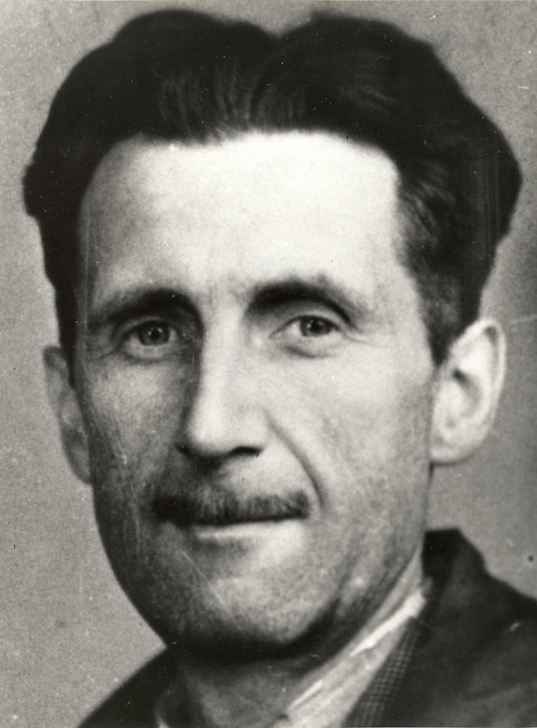
The sentence the character counter counts
>>>
A true story, told as who, what, when, where, why and how
WHO
George Orwell, the pen name of the writer Eric Blair.
WHAT
His novel Nineteen Eighty-Four opens with the sentence our program counts.
WHEN
8 June 1949.
WHERE
London: Secker & Warburg published the novel in the United Kingdom.
WHY
A famous, real sentence is honest test data for counting characters.
HOW
Our loop counts 73 characters, 23 of them different, using setdefault().
George Orwell, press card photo, 1943 - National Union of Journalists, public domain
READ Nineteen Eighty-Four, on Wikipedia en.wikipedia.org
The lines that count one sentence count a whole novel.
22 / 48
Notes:
The text in the character counter is the first sentence of Nineteen Eighty-Four, published on 8 June 1949. A real sentence makes the counts meaningful: thirteen spaces, and the same table would count the whole book.

Slide 23
Code 12: Counter does the counting
>>>
One call replaces the whole counting loop
>>> from collections import Counter
>>> c = Counter('abracadabra')
>>> print(c.most_common(2))
Counter builds the table of counts in one call. most_common() lists the leaders.
>>> print(c['a'], c['z'])
>>> print(sum(c.values()))
>>> print(dict(c))
A missing key counts as 0 and is not added. The counts add up to the text length.
What the run printed (Python 3.14.6)
Expression | Printed
c.most_common(2) | [('a', 5), ('b', 2)]
c['a'], c['z'] | 5 0
sum(c.values()) | 11
Counter counts in one call, and a missing key simply counts as zero.
Automate the Boring Stuff 3e, chapter 7: Setting Default Values
23 / 48
Notes:
Counter is a dictionary built for counting. It does by itself what the setdefault loop did. A key that was never seen answers 0 without being added.

Slide 24
Code 13: Grouping with setdefault and defaultdict
>>>
Each item is slipped into the list for its first letter
>>> words = ['ant', 'ape', 'bee', 'bat', 'cat']
>>> groups = {}
Five words to sort by their first letter, and an empty dictionary to fill.
>>> for w in words:
>>> groups.setdefault(w[0], []).append(w)
>>> print(groups)
setdefault() creates the list for a letter once; append() then adds the word.
>>> from collections import defaultdict
>>> g2 = defaultdict(list)
>>> for w in words:
>>> g2[w[0]].append(w)
>>> print(g2 == groups)
defaultdict(list) creates the missing list by itself, with the same result.
What the run printed (Python 3.14.6)
a
['ant', 'ape']
Is g2 == groups? | Printed
defaultdict result | True
b
['bee', 'bat']
c
['cat']
setdefault() and defaultdict both create the missing list for you.
Automate the Boring Stuff 3e, chapter 7: Setting Default Values
24 / 48
Notes:
Grouping is counting with lists instead of numbers. The first letter is the key and the list of words is the value. defaultdict(list) builds the empty list automatically, so the loop gets shorter.

Slide 25
Everyday pictures: programs that remember
>>>
Two programs and the two calls that stop them
EVERYDAY birthdays.py
A pocket diary that learns a new friend's date the first time you ask.
EVERYDAY characterCount.py
Tally marks on paper: one stroke per sighting, one row per character.
EVERYDAY input()
A shop assistant who stops and waits at the counter until you answer.
EVERYDAY sys.exit()
The fire door: you leave the building at once, whatever you were doing.
Automate the Boring Stuff 3e, chapter 7: birthdays.py
25 / 48
Notes:
birthdays.py is like a pocket diary and characterCount.py like tally marks. input() waits at the counter like an assistant, and sys.exit() is the fire door.

Slide 26
Part 4: Structuring data
Model a real thing with dictionaries and lists
Data model
Decide what a real thing must record.
How they fit together
1. Model the thing
2. Print a view of it
3. Nest the records
4. Total and convert
Chessboard
Squares are keys and pieces are values.
Nested records
A dictionary inside a dictionary holds records.
Inventory and loot
Counts per item, built from lists.
26 / 48
Notes:
Part four is about structuring data. We model a chessboard, validate it, nest dictionaries for a picnic, and turn lists of loot into inventories.

Slide 27
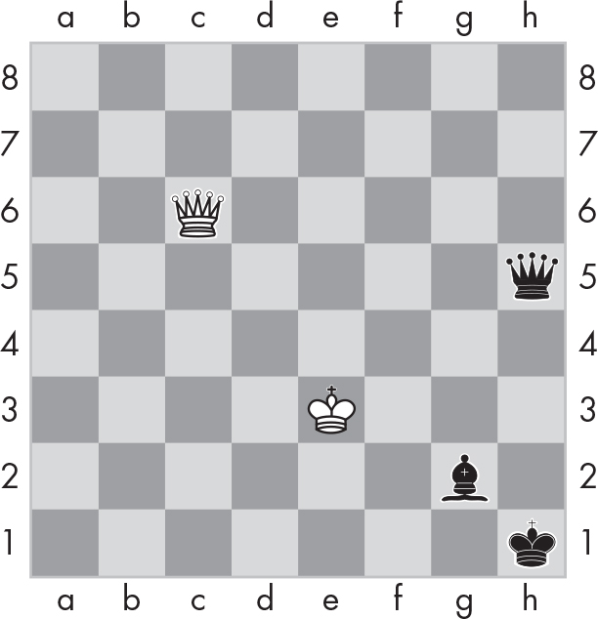
Code 14: Modelling a chessboard
>>>
A square is a key; the piece is the value
>>> board = {'h1': 'bK', 'c6': 'wQ', 'g2': 'bB',
>>> 'h5': 'bQ', 'e3': 'wK'}
Each occupied square is a key; the piece is its value, a colour letter then a piece letter.
>>> print('c6' in board, board.get('a1', 'empty'))
>>> print(sorted(board), len(board))
Ask about squares: c6 is occupied, a1 is empty, and only five keys exist.
What the run printed (Python 3.14.6)
h1
bK
Printed | Meaning
True empty | c6 occupied, a1 empty
['c6', 'e3', 'g2', 'h1', 'h5'] 5 | five keys, sorted
c6
wQ
g2
bB
h5
bQ
e3
wK
A good model stores only what is there.
Automate the Boring Stuff 3e, chapter 7: Model Real-World Things Using Data Structures
27 / 48
Notes:
This is the board of the book's Figure 7-2. Only occupied squares are keys, so an empty square is simply absent. The model keeps the data apart from how it is drawn.

Slide 28
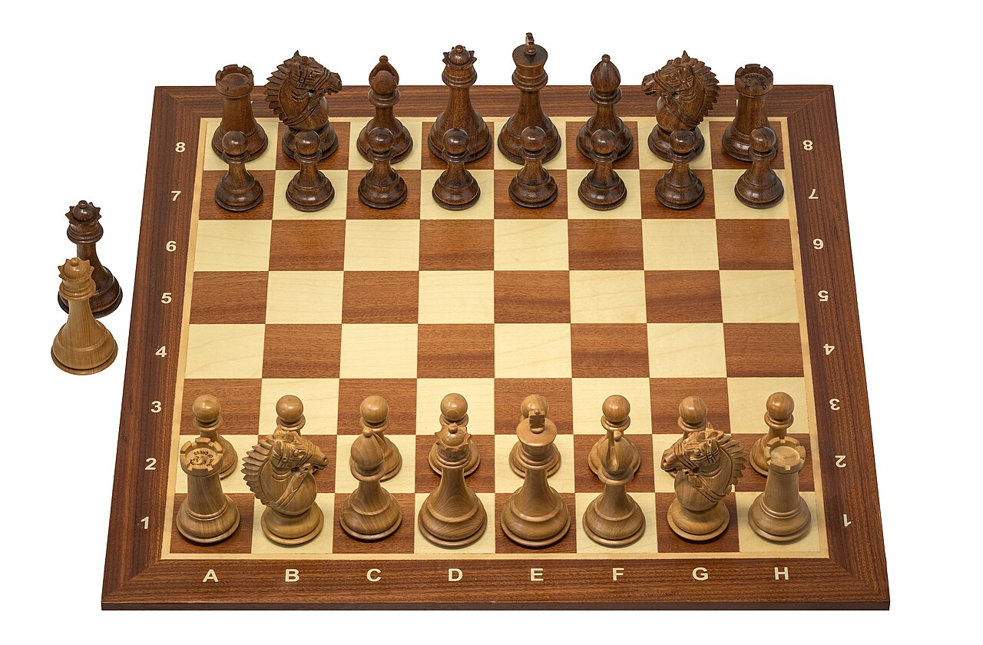
The squares a1 to h8 are almost three centuries old
>>>
A true story, told as who, what, when, where, why and how
WHO
Philipp Stamma, Howard Staunton and the chess federation FIDE.
WHAT
They named every square a1 to h8 and made that notation the standard.
WHEN
1730s: Stamma. 1847: Staunton's handbook. 1981: FIDE.
WHERE
In chess books such as Staunton's Chess-Player's Handbook, then in FIDE rules.
WHY
Players needed one short name for each of the 64 squares to write moves down.
HOW
Our keys 'a1' to 'h8' reuse those names, so a position reads like a score sheet.
A Staunton chess set - photo: Wilfredor, CC0
READ Algebraic notation (chess), on Wikipedia en.wikipedia.org
The best keys are often a notation people already use.
28 / 48
Notes:
Philipp Stamma used the modern square names in the 1730s, Howard Staunton described the system in 1847, and FIDE stopped recognising descriptive notation in 1981. The chessboard dictionary borrows those names as its keys.

Slide 29
Code 15: Printing the board from the dictionary
>>>
The dictionary is the data; the printout is one view
>>> board = {'a1': 'wR', 'e1': 'wK', 'e8': 'bK'}
>>> files = 'abcdefgh'
>>> for r in range(8, 0, -1):
A small position. Walk the ranks from 8 down to 1, as a chess diagram is drawn.
>>> row = [board.get(f + str(r), '..') for f in files]
>>> print(r, ' '.join(row))
Look up every square of the rank; an empty square prints as two dots.
What the run printed (Python 3.14.6)
 | a | b | c | d | e | f | g | h
8 |  |  |  |  | bK
7
6
5
4
3
2
1 | wR |  |  |  | wK
Measure | Value
keys in the dictionary | 3
squares drawn | 64
squares without a key | 61
The same dictionary can be drawn in any way you like.
Automate the Boring Stuff 3e, chapter 7: chessboard.py
29 / 48
Notes:
The printing code never changes the dictionary. For each rank it looks up eight squares with get() and a fallback of two dots. The table shows the printed lines as a board.

Slide 30
Code 16: Chess commands are dictionary operations
>>>
Moving a piece is copy-then-delete
>>> import copy
>>> START = {'a1': 'wR', 'e1': 'wK', 'e2': 'wP'}
>>> board = copy.copy(START)
Keep the starting position safe and play on a copy of it.
>>> board['e4'] = board['e2']
>>> del board['e2']
>>> print('{} moves {} to {}'.format('wP', 'e2', 'e4'))
A move copies the piece to the new square, deletes the old one, and reports it.
>>> print(sorted(board))
>>> print(sorted(START))
The board changed; the starting position did not.
What the run printed (Python 3.14.6)
START
a1 e1 e2
board = copy.copy(START)
a1 e1 e2
e2 moves to e4
board: a1 e1 e4
Printed report: wP moves e2 to e4. START still holds a1 e1 e2.
Every simulator command is one or two dictionary operations.
Automate the Boring Stuff 3e, chapter 7: Project 1: Interactive Chessboard Simulator
30 / 48
Notes:
The simulator's move command is an assignment followed by del. format() builds the sentence that reports the move. copy.copy() makes sure that START is still intact afterwards.

Slide 31
Code 17: A chess dictionary validator
>>>
Every rule becomes a check on keys or values
>>> squares = {f + r for f in 'abcdefgh'
>>> for r in '12345678'}
Build the set of all 64 legal square names, a1 to h8.
>>> board = {'e1': 'wK', 'e8': 'bK', 'z9': 'wQ'}
>>> bad = [s for s in board if s not in squares]
A position with one impossible square, z9. List every key that is not a square.
>>> kings = sorted(p for p in board.values() if p[1] == 'K')
>>> print(bad, kings, kings == ['bK', 'wK'])
Collect the kings from the values. A legal position has exactly one king of each colour.
What the run printed (Python 3.14.6)
Rule of the game | Looks at | Found | Verdict
every key is a real square | the keys | bad squares: ['z9'] | FAIL
one king of each colour | the values | kings: ['bK', 'wK'] | PASS
A validator turns each rule of the game into a test on keys or values.
Automate the Boring Stuff 3e, chapter 7: Chess Dictionary Validator
31 / 48
Notes:
The first rule looks at the keys: each must be a real square. The second looks at the values: one white king and one black king. The shortened validator shows the idea of the chapter's practice program.

Slide 32
Code 18: Nested dictionaries: the picnic
>>>
A dictionary inside a dictionary holds a record inside a record
>>> guests = {'Alice': {'apples': 5, 'pretzels': 12},
>>> 'Bob': {'apples': 2, 'ham sandwiches': 3}}
Each guest is a key; the value is another dictionary of what they brought.
>>> def total(item):
>>> return sum(v.get(item, 0) for v in guests.values())
Add up one item over all guests; get() gives 0 for a guest who did not bring it.
>>> print(total('apples'), total('cups'))
>>> print(guests['Alice']['pretzels'])
Two keys in a row reach the inner value. Nobody brought cups, so the total is 0.
What the run printed (Python 3.14.6)
Expression | Printed
total('apples'), total('cups') | 7 0
Alice's pretzels | 12
get() with a default keeps the picnic totals honest.
Automate the Boring Stuff 3e, chapter 7: Nested Dictionaries and Lists
32 / 48
Notes:
The outer dictionary maps a guest to an inner dictionary. Two brackets reach an inner value. get() with 0 avoids a KeyError for guests who did not bring an item.

Slide 33
Code 19: Fantasy game inventory
>>>
Display a dictionary of items and total them
>>> stuff = {'rope': 1, 'torch': 6, 'gold coin': 42}
>>> total = 0
The inventory maps each item to how many the player carries.
>>> for k, v in stuff.items():
>>> print(str(v) + ' ' + k)
>>> total += v
Print each item with its count, and add the count to a running total.
>>> print('Total number of items:', total)
The total is the sum of the values, not the number of keys.
What the run printed (Python 3.14.6)
Last line printed
Total number of items: 49
Each practice program reads a dictionary and applies a rule.
Automate the Boring Stuff 3e, chapter 7: Fantasy Game Inventory
33 / 48
Notes:
This is the display function of the inventory practice program. items() gives the item and its count, and the running total adds the counts. The chart draws the same dictionary.

Slide 34
Code 20: List-to-dictionary loot conversion
>>>
A list of loot is added into the inventory
>>> loot = ['gold coin', 'dagger', 'gold coin', 'ruby']
>>> inv = {'gold coin': 42, 'rope': 1}
A list of loot from the dragon, and the inventory so far.
>>> for item in loot:
>>> inv[item] = inv.get(item, 0) + 1
For every piece of loot, read the current count (0 if new) and add one.
>>> print(inv)
>>> print(sum(inv.values()))
Gold coin grew to 44, and two new items joined. Forty-seven items in all.
What the run printed (Python 3.14.6)
Measure | Value
items before | 43
items after | 47
get(item, 0) + 1 turns any list into counts.
Automate the Boring Stuff 3e, chapter 7: List-to-Dictionary Loot Conversion
34 / 48
Notes:
The loop looks up each item with get() and a default of 0, adds one and stores it back. Known items grow and new items appear. The chart shows the resulting inventory.

Slide 35
Everyday pictures: models and structures
>>>
A model keeps what matters and leaves the rest out
EVERYDAY data structure
A shelf layout: where each item is placed decides how quickly you find it.
EVERYDAY data model
The floor plan drawn before building: it decides which rooms and which details exist at all.
EVERYDAY Model Real-World Things Using Data Structures
A street map keeps the streets and drops every leaf and parked car.
EVERYDAY Nested Dictionaries and Lists
Russian dolls: each doll holds a smaller one, and you open them in turn.
EVERYDAY guestpicnic.py
A picnic checklist that adds up what each guest's basket holds.
EVERYDAY format
A letter template with blanks, filled in once the names are known.
Automate the Boring Stuff 3e, chapter 7: Model Real-World Things Using Data Structures
35 / 48
Notes:
A data model is like a floor plan and a street map: it keeps what matters. Nested dictionaries are like Russian dolls, and format is like a letter template.

Slide 36
Everyday pictures: the practice projects
>>>
The chessboard, its checker, the inventory and the loot
EVERYDAY Project 1: Interactive Chessboard Simulator
A pocket chess set that remembers where every piece stands and moves them when told.
EVERYDAY chessboard.py
A seating chart printed from the guest list: the list is the data, the picture is a view.
EVERYDAY Chess Dictionary Validator
A match arbiter checking a position is legal: one king each, every piece on a real square.
EVERYDAY Fantasy Game Inventory
A backpack list that says which items you carry and how many of each.
EVERYDAY List-to-Dictionary Loot Conversion
Sorting a heap of loot into labelled bins, one tally per bin.
EVERYDAY copy.copy()
A photocopy of a folder's cover: the new cover still points at the same pages inside.
Automate the Boring Stuff 3e, chapter 7: Project 1: Interactive Chessboard Simulator
36 / 48
Notes:
The chessboard is like a pocket chess set and the validator like an arbiter. copy.copy() is like photocopying a folder's cover, not its pages.

Slide 37
Part 5: Copies and writing data down
Keep a copy safe, carry data out, check its shape
Alias and copies
Shallow copies share what is inside them.
How they fit together
1. Copy with care
2. Write it down
3. Name the keys
4. Match the shape
JSON and pprint
Text carries a dictionary out and back.
TypedDict
Names the keys of a record for checkers.
match patterns
Test the shape of a dictionary and bind values.
37 / 48
Notes:
Part five finishes the chapter. We copy dictionaries with care, write them as JSON, name their keys with TypedDict, and match their shape with the match statement.

Slide 38
Code 21: Alias, shallow copy and deep copy
>>>
Changing an inner dictionary shows which copies share it
>>> import copy
>>> original = {'Alice': {'apples': 5}}
>>> alias = original
An alias is only a second name for the same dictionary.
>>> shallow = copy.copy(original)
>>> deep = copy.deepcopy(original)
copy() copies the outside only; deepcopy() copies everything inside as well.
>>> original['Alice']['apples'] = 99
>>> apples = lambda c: c['Alice']['apples']
>>> print(apples(alias), apples(shallow), apples(deep))
Change the inner dictionary through the original, then ask the three others.
>>> print(alias is original, shallow is original)
>>> print(shallow['Alice'] is original['Alice'])
A shallow copy is a new outer dictionary that still shares the inner ones.
What the run printed (Python 3.14.6)
Name | New outer dictionary? | Shares the inner one? | Apples after the change
alias | no, same object | yes | 99
shallow copy | yes | yes | 99
deep copy | yes | no | 5
A shallow copy shares the inner dictionaries; deepcopy does not.
Automate the Boring Stuff 3e, chapter 7: Nested Dictionaries and Lists
38 / 48
Notes:
The alias is the same object, so it sees every change. The shallow copy has its own outer dictionary but shares the inner ones, so it sees the change too. Only deepcopy is independent.

Slide 39
Code 22: Writing data down with json and pprint
>>>
Text carries a dictionary out of a program and back
>>> import json, pprint
>>> cat = {'name': 'Zophie', 'toys': ['ball', 'mouse']}
>>> text = json.dumps(cat)
dumps() turns the dictionary into text; the text could be saved in a file.
>>> print(text)
>>> print(json.loads(text) == cat)
loads() turns the text back into an equal dictionary.
>>> pprint.pprint({'b': [1, 2], 'a': {'x': 1}}, width=20)
pprint() lays nested data out tidily, one key to a line, sorted by key.
What the run printed (Python 3.14.6)
dictionary
cat
text (JSON)
{"name": "Zophie", "toys": ["ball", "mouse"]}
equal again?
json.loads(text) == cat: True
pprint printed: {'a': {'x': 1}, 'b': [1, 2]}
JSON is how a dictionary leaves a program and comes back.
Automate the Boring Stuff 3e, chapter 7: Nested Dictionaries and Lists
39 / 48
Notes:
JSON is plain text built from the same pieces as a dictionary: pairs and lists. dumps() writes it and loads() reads it back. pprint is for people reading nested data, not for storing it.

Slide 40

The notation that carries dictionaries
>>>
A true story, told as who, what, when, where, why and how
WHO
Douglas Crockford and Chip Morningstar; the standards body IETF later.
WHAT
A small text format of name-value pairs and lists, shaped like a Python dict.
WHEN
April 2001: first message. December 2005: Yahoo! December 2017: RFC 8259.
WHERE
State Software, the company Crockford co-founded, and the website json.org.
WHY
Web pages needed a light way to receive data without plug-ins such as Flash.
HOW
Python's json module writes a dictionary as that text with dumps() and reads it back with loads().
Douglas Crockford, 2013 - photo: Robert Claypool, CC0
READ Introducing JSON, on json.org json.org
JSON is how a dictionary leaves a program and comes back.
40 / 48
Notes:
Douglas Crockford and Chip Morningstar sent the first JSON message in April 2001. Yahoo began offering web services in JSON in December 2005, and the IETF published it as RFC 8259 in December 2017. Python's json module converts between it and dictionaries.

Slide 41
Code 23: Typed records and read-only views
>>>
Naming the keys of a dictionary for the type checker
>>> from typing import TypedDict
>>> class Cat(TypedDict):
>>> name: str
>>> age: int
A TypedDict names the keys of a record and the type of each value.
>>> c = Cat(name='Zophie', age=8)
>>> print(type(c).__name__, c['age'])
At run time it is an ordinary dict; only a type checker enforces the keys.
>>> from types import MappingProxyType
>>> ro = MappingProxyType(c)
>>> print(ro['age'], len(ro))
MappingProxyType gives a read-only view of the same dictionary.
What the run printed (Python 3.14.6)
Tool | At run time | Who enforces it
TypedDict Cat | type(c).__name__ is 'dict', age 8 | a type checker, not Python
MappingProxyType | age 8, length 2: read-only | Python itself: item assignment fails
TypedDict is checked by type checkers only; at run time it is a plain dict.
Automate the Boring Stuff 3e, chapter 7: Nested Dictionaries and Lists
41 / 48
Notes:
A TypedDict documents what keys a record has, but Python does not enforce it while running. MappingProxyType is a read-only window onto a dictionary, which stops accidental changes.

Slide 42
Code 24: Matching the shape of a dictionary
>>>
Keys are tested and values are bound
>>> cat = {'name': 'Zophie', 'age': 8}
A record with two keys: a name and an age, ready to be matched.
>>> match cat:
>>> case {'name': n, 'age': a} if a > 5:
>>> print(n, 'is a senior cat of', a)
>>> case {'name': n}:
>>> print(n, 'is a cat')
The first case needs both keys and an age above 5; otherwise the second case is tried.
What the run printed (Python 3.14.6)
cat
{'name': 'Zophie', 'age': 8}
case 1 fits
name, age and a > 5
Zophie is a senior cat of 8
case 2 is never tried: the first fitting case wins.
match tests which keys a dictionary has and binds their values.
Automate the Boring Stuff 3e, chapter 7: Nested Dictionaries and Lists
42 / 48
Notes:
A mapping pattern checks that the keys exist and binds the values to names. Extra keys are allowed. The first case that fits wins, and a guard such as a > 5 can refuse it.

Slide 43
What current Python adds to the chapter
>>>
The book is right about the basics; six things have moved on
Insertion order
Merge operators
Since Python 3.7 the order of adding is a promise, so the book's 'no first item' is out of date.
d1 | d2 builds a new dictionary and d1 |= d2 updates one (Python 3.9, PEP 584).
Live views
Hashing rule
keys(), values() and items() show later changes, and can be reversed since Python 3.8.
Equal keys must hash alike; a class with __eq__ but no __hash__ cannot be a key.
TypedDict
match patterns
Names the keys of a record for a type checker, but is a plain dict at run time (PEP 589).
Mapping patterns test keys and bind values (PEP 634, Python 3.10).
Teach the basics from the book and add what Python has learned since.
Automate the Boring Stuff 3e, chapter 7: Summary
43 / 48
Notes:
The chapter's printed outputs still hold. Six things differ or go further: the order promise, the merge operators, live views, the hashing rule, TypedDict and mapping patterns.

Slide 44
Practice Questions and Practice Programs
>>>
Try these on your own, then compare with the examples of the deck
Practice Questions
Practice Programs
What does the code for an empty dictionary look like?
Chess Dictionary Validator
Check that a board dictionary is a legal position.
What does a dictionary with the key 'foo' and the value 42 look like?
Fantasy Game Inventory
Display an inventory and add up its items.
What is the main difference between a dictionary and a list?
What happens if you try spam['foo'] when spam is {'bar': 100}?
List-to-Dictionary Loot Conversion
Add a list of loot into the inventory.
What is the difference between 'cat' in spam and 'cat' in spam.keys()?
Each question is answered by an example in this deck.
Automate the Boring Stuff 3e, chapter 7: Practice Questions
44 / 48
Notes:
The book ends with questions and programs. Answer the questions from the examples you have seen, then write the three programs yourself: the validator, the inventory and the loot conversion.

Slide 45
Everyday pictures: closing the chapter
>>>
The last three terms of the chapter
EVERYDAY Summary
The last line of a recipe card: what you must remember when the cooking is done.
EVERYDAY Practice Questions
Driving-school mock questions: quick checks that you understood before the real test.
EVERYDAY Practice Programs
A workshop evening: you build something real with the tools you have just learned.
Automate the Boring Stuff 3e, chapter 7: Summary
45 / 48
Notes:
A summary is like the last line of a recipe card. Practice questions are like mock driving questions, and practice programs are like a workshop evening.

Slide 46
Summary: the chapter in five lines
>>>
One line for each question the chapter set
1
Assign to add or replace a pair; del and pop remove one; get() helps when a key may be missing.
2
A key must be hashable: tuples are welcome, lists are not; keys keep their order since Python 3.7.
3
Counting and grouping use setdefault, Counter or defaultdict; a view follows its dictionary.
4
A chessboard is a dictionary of occupied squares; a nested dictionary holds a record in a record.
5
copy.copy() shares the inner dictionaries, deepcopy() does not, and JSON writes the data as text.
If a line feels unproven, its slides hold the example.
Automate the Boring Stuff 3e, chapter 7: Summary
46 / 48
Notes:
Here are the five lines that answer the five questions. If one of them feels unproven, go back to the slide that carries its example.

Slide 47
Resources: where to go from here
>>>
Every link was opened on the day this deck was made
Read
The textbook, chapter 7 (free online)
Python tutorial: data structures
Built-in types: dict and its views
Libraries
collections: Counter and defaultdict
copy: shallow and deep copies
json: the JSON encoder and decoder
History
Guido's ruling on dictionary order, 2017
PEP 584: merge operators for dict
RFC 8259: the JSON standard
Try and watch
Modern Dictionaries, R. Hettinger (video)
Python Tutor: step through your code
pprint: tidy printing of nested data
The course repository and corpus
13 links, each opened on the day this deck was built.
47 / 48
Notes:
These links lead to the textbook, the official documentation, the history behind the stories, a talk on modern dictionaries and a tool to step through your code. The last one is this course's own repository.

Slide 48
What you should now be able to say
>>>
Four claims, each carried by a result you saw printed
1
A dictionary finds values by key, and keys must be hashable.
2
Counting and grouping are a few lines with setdefault, or one with Counter.
3
A real thing becomes a dictionary of the parts that are there.
4
A shallow copy shares the inner dictionaries, and JSON writes the data down.
Questions are welcome; bring one example you could not predict.
48 / 48
Notes:
These four claims are what you should leave with. Bring one example you could not predict, and we will run it together.

