Slide 1
>>>
Web Scraping
Chapter 13 of Automate the Boring Stuff with Python, 3rd edition, for an advanced course
24
6
46
code examples that run on the chapter page
true stories with who, what, when, where, why and how
distinct chapter concepts, each with an everyday picture
SEN0414 Advanced Programming, Fall 2026. Yusuf Altunel, İstanbul Kültür Üniversitesi
1 / 51
Notes:
Welcome. This chapter follows a program from an address to a page it can read: the URL, the reply, the API, the HTML, and the browser it may have to drive. Every code slide shows the code, a plain explanation, and the result as a table, chart or diagram.

Slide 2
>>>
Today's route
Five parts; every range is a run of slides you can jump to
Part | Slides | Code examples | You will run
Addresses and manners | 4 - 13 | 6 | urlsplit, quote, status codes, robots.txt
Opening and downloading | 14 - 22 | 5 | webbrowser, showmap, a download, chunks
A weather API | 23 - 27 | 3 | json.loads, Kelvin, an endpoint and its key
Reading HTML | 28 - 37 | 6 | tags, select, links, comics, search results
Driving a browser | 38 - 46 | 4 | a script-built page, Selenium and Playwright shapes
Tools, changes, summary, practice, resources | 47 - 51 | - | which tool, and what current Python changes
Open the chapter-code tab of the page: the same 24 examples, in this order.
2 / 51
Notes:
Five parts: addresses and manners, opening and downloading, a weather API, reading HTML, and driving a browser. Each code slide has its place in the chapter-code tab of the page, in this same order.

Slide 3
>>>
Two questions this chapter answers
Carry them through every part; the answers come back at the end
1
Which tool reaches which kind of page, and what decides the choice?
Answer on slide 47: webbrowser, requests, an API, a parser, or a browser driver.
2
Which printed outputs and programs of the book differ in current Python and on today's web?
Answer on slide 48: the changes, from the chapter research.
Choose the tool by the page in front of the program.
3 / 51
Notes:
Two questions to carry through the chapter. Which tool reaches which kind of page, and what decides the choice? And which printed outputs and programs of the book differ in current Python and on today's web?

Slide 4
Part 1: Addresses and manners
An address has parts, a reply has a code, and a polite program obeys the site's rules
URL
An address cut into scheme, host, path and query.
Slide | In this part
5 | Everyday pictures: addresses and manners
6 | A URL is a scheme, a host, a path, a quer...
7 | Percent codes and the query string
8 | HTTP status codes: the first digit is the...
9 | The user agent tells a server who is asking
10 | robots.txt: the paths a crawler is asked ...
11 | Story: a courtesy file for robots, 30 Jun...
12 | A polite crawler waits between pages
13 | Story: the first spider counted 130 sites...
Status code
A three-digit number whose first digit is the class.
User agent
The name a program gives to the server.
robots.txt
The paths a crawler is asked not to visit.
4 / 51
Notes:
Part one. Before any download: an address has parts, a reply has a status code, a program has a name, and a site can say which paths it would rather not be crawled. Predict each answer before you read the result.

Slide 5
>>>
Everyday pictures: addresses and manners
ANALOGY A web address is a postal address; the status code is the stamp on the letter that comes back.
Chapter concept | Everyday picture
HTTP and HTTPS | Posting a letter: HTTP is a postcard anyone can read; HTTPS is a sealed envelope.
URL | A full postal address: city, street, flat, and a note for the doorman.
HTTPS | The sealed envelope: the post office sees the address, not the letter.
endpoint | One counter at the post office: every service has its own window.
user agent | A name badge at the door: it tells the guard who is asking.
Fetching a page | Asking the librarian for a book and carrying it back to your desk.
5 / 51
Notes:
A postal address is a good picture for a URL. HTTP is a postcard, HTTPS a sealed envelope. Ask students to add one more picture of their own.

Slide 6
>>>
A URL is a scheme, a host, a path, a query and a fragment
>>> from urllib.parse import urlsplit
>>> url = ('https://api.openweathermap.org/geo/1.0/direct'
>>> '?q=Boston&appid=KEY#top')
>>> parts = urlsplit(url)
urlsplit cuts one address into named parts. This address asks the geocoding endpoint of a weather API for the place Boston.
>>> for name in ('scheme', 'netloc', 'path', 'query', 'fragment'):
>>> print(name.ljust(8), getattr(parts, name))
Each part has a name. The fragment, after the number sign, is kept by the browser and not sent to the server.
What the run printed (Python 3.13.16)
sent to the server
Part | Value | What it does
scheme | https | how to talk to the server
netloc | api.openweathermap.org | which computer to ask
path | /geo/1.0/direct | which page or service
query | q=Boston&appid=KEY | the question: name=value pairs
fragment | top | a place inside the page
scheme, netloc,
path, query
fragment
kept by the browser
An address has five named parts.
6 / 51
Notes:
A URL is not one string but five parts. Urlsplit names them. Predict which part the server never receives, then check the fragment row.

Slide 7
>>>
Percent codes and the query string
>>> from urllib.parse import parse_qs, quote
>>> print(quote('777 Valencia St, San Francisco'))
quote writes a space as %20 and a comma as %2C, because an address may not hold them. A browser does the same for its address bar.
>>> query = parse_qs('q=San+Francisco%2CCA&appid=KEY')
>>> print(query)
parse_qs reads the name=value pairs back into a dictionary of lists. The plus sign and %2C turn back into a space and a comma.
What the run printed (Python 3.13.16)
Character | Name | quote(...)
' ' | space | %20
',' | comma | %2C
'&' | ampersand | %26
'=' | equals sign | %3D
'#' | number sign | %23
Key | parse_qs gives
q | ['San Francisco,CA']
appid | ['KEY']
'San+Francisco%2CCA' became 'San Francisco,CA'
Quote on the way out; parse_qs on the way in.
7 / 51
Notes:
A space and a comma may not stand in an address. Quote writes them as percent codes, parse_qs reads them back. Predict the encoded text before you run.

Slide 8
>>>
HTTP status codes: the first digit is the class
>>> from http import HTTPStatus
>>> for code in (200, 301, 404, 429, 500):
>>> status = HTTPStatus(code)
>>> print(code, status.phrase, '| class', code // 100)
Every reply starts with a three-digit code. HTTPStatus names the code, and the integer division by 100 gives the class.
What the run printed (Python 3.13.16)
Code | Phrase | Class | The class means
200 | OK | 2xx | success
301 | Moved Permanently | 3xx | redirection
404 | Not Found | 4xx | client error
429 | Too Many Requests | 4xx | client error
500 | Internal Server Error | 5xx | server error
The first digit is the class of the reply.
8 / 51
Notes:
The first digit of a status code is its class: two for success, three for redirection, four for the client's fault, five for the server's. Which class is a 429?

Slide 9
>>>
The user agent tells a server who is asking
>>> import urllib.request
>>> opener = urllib.request.build_opener()
>>> name, value = opener.addheaders[0]
>>> print(name, '->', value.split('/')[0])
Python's own downloader announces itself. A server can tell a script from a browser by this header, and may refuse a script.
>>> url = 'https://example.com/'
>>> headers = {'User-Agent': 'MyBot/1.0'}
>>> request = urllib.request.Request(url, headers=headers)
>>> print(request.get_header('User-agent'))
A polite program sets its own name, ideally with a contact address, so that a site owner knows whom to ask.
What the run printed (Python 3.13.16)
your script
urlopen(...)
header
User-agent: Python-urllib
the server sees
an unnamed script
your script
Request(...)
header
User-Agent: MyBot/1.0
the server sees
a named program
Name your program and give a contact.
9 / 51
Notes:
Python's downloader announces itself as Python-urllib, and a site may refuse it. A polite program sets its own name and a contact address.

Slide 10
>>>
robots.txt: the paths a crawler is asked to avoid
>>> import urllib.robotparser as rp
>>> robots = rp.RobotFileParser()
>>> robots.parse(['User-agent: *', 'Disallow: /simple/',
>>> 'Disallow: /account/'])
A robots.txt file lists the paths that crawlers are asked not to fetch. RobotFileParser reads its lines, here given as a list.
>>> for path in ('/project/x/', '/simple/x/', '/account/login/'):
>>> print(path, robots.can_fetch('*', 'https://pypi.org' + path))
can_fetch answers True or False for a path. It is a request and not a lock: a polite program honours it.
What the run printed (Python 3.13.16)
Path asked for | can_fetch | Rule that decides
/project/x/ | True | no rule matches
/simple/x/ | False | Disallow: /simple/
/account/login/ | False | Disallow: /account/
robots.txt
of the site
a request,
not a lock
robots.txt is a request: honour it.
10 / 51
Notes:
A robots.txt file lists paths a crawler is asked to avoid. The parser answers true or false. It is a request and not a lock, so honour it.

Slide 11
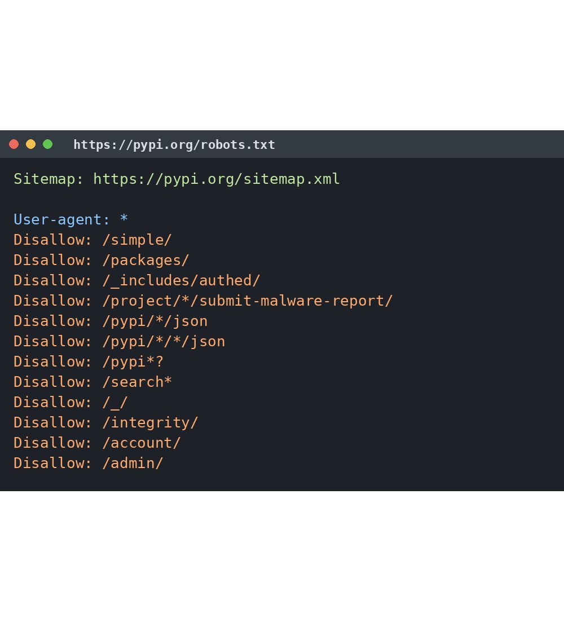
>>>
Story: a courtesy file for robots, 30 June 1994
WHO Martijn Koster and the robot authors of the robots list.
WHAT A Standard for Robot Exclusion: one file, /robots.txt, read first.
WHEN Consensus of 30 June 1994; published as RFC 9309 in September 2022.
WHERE The robots mailing list at nexor.co.uk, then the whole Web.
WHY Some robots swamped servers, or wandered into scripts with side effects such as voting.
A real robots.txt (pypi.org), drawn for this deck. Not the 1994 file.
HOW A plain text file of paths. Nobody enforces it, so a polite program honours it.
READ A Standard for Robot Exclusion (robotstxt.org)
11 / 51
Notes:
Martijn Koster wrote down the consensus of 30 June 1994. The file is a courtesy, not a lock: the text itself says nobody enforces it. Ask students: what would you do if a site asked you not to crawl a path?

Slide 12
>>>
A polite crawler waits between pages
>>> import urllib.robotparser as rp
>>> robots = rp.RobotFileParser()
>>> robots.parse(['User-agent: *', 'Crawl-delay: 2',
>>> 'Request-rate: 3/20'])
A site can state its own pace. Crawl-delay is the pause in seconds, and Request-rate is a number of pages per number of seconds.
>>> pause = robots.crawl_delay('*')
>>> rate = robots.request_rate('*')
>>> print('wait', pause, 'seconds; rate', tuple(rate))
The parser returns the numbers: a pause, and a rate of 3 pages per 20 seconds. The book's comic downloader sleeps one second for the same reason.
>>> for page, clock in zip('abc', range(0, 6, pause)):
>>> print('t =', clock, 'fetch page', page)
A fake clock shows the schedule without really waiting: one fetch, then a pause of two seconds.
What the run printed (Python 3.13.16)
Setting in robots.txt | The parser says
Crawl-delay: 2 | wait 2 seconds
Request-rate: 3/20 | 3 pages per 20 seconds
second of each fetch
the fake clock, one pause between pages
Wait between pages; the site may say how long.
12 / 51
Notes:
Some sites state a pause in their robots file. The fake clock shows the schedule without waiting. Predict the time of the third fetch.

Slide 13
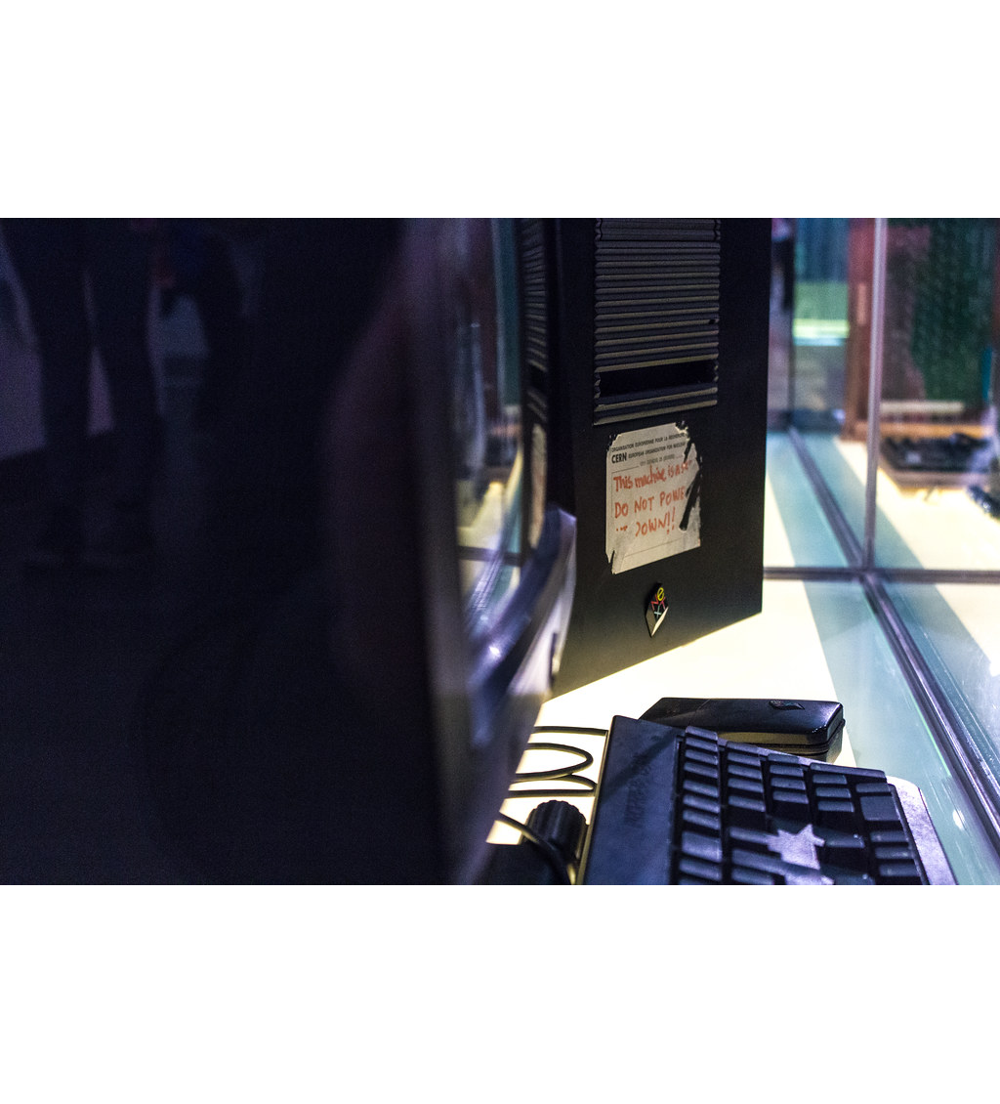
>>>
Story: the first spider counted 130 sites, 1993
WHO Matthew Gray, at the Massachusetts Institute of Technology (MIT).
WHAT The World Wide Web Wanderer, by his account the first automated Web agent, or spider.
WHEN Written in spring 1993; traversals ran from June 1993 to January 1996.
WHERE MIT; his reports are still online at mit.edu.
WHY At first to find new sites; as the Web grew, to chart its growth.
The first Web server (CERN), not Gray's machine. Photo: asvensson, CC BY 2.0, Flickr.
HOW Fetch a page, find its links, follow them, repeat. It counted 130 sites in June 1993 and 100,000 by January 1996.
READ Internet Growth and Statistics: Credits and Background (MIT)
13 / 51
Notes:
Matthew Gray built the first spider in 1993 to count the Web. 130 sites in June 1993, 100,000 by January 1996. Our link loop is the same idea at toy scale: fetch, find links, follow, repeat.

Slide 14
Part 2: Opening and downloading
Show a page to a person, or fetch it into the program and check the reply
webbrowser
Opens a page in your own browser and reads nothing.
Slide | In this part
15 | Everyday pictures: opening a page with we...
16 | Everyday pictures: downloading with reque...
17 | webbrowser.open asks your own browser to ...
18 | Project 6: a map address from the command...
19 | Fetching a page: the reply has a type and...
20 | Story: Requests, conceived in frustration...
21 | raise_for_status stops the program on a b...
22 | iter_content: save a download in chunks
requests
Downloads a page or a file into the program.
raise_for_status
Stops the program when the reply is a failure.
iter_content
Saves a big download in small chunks.
14 / 51
Notes:
Part two. Three ways to get at a page: ask the browser to show it, download it, or download it in chunks. The standard library stands in for requests so that every example runs on this page.

Slide 15
>>>
Everyday pictures: opening a page with webbrowser
ANALOGY The webbrowser module is a doorman: he opens the door to a page and never tells you what is inside.
Chapter concept | Everyday picture
webbrowser | A doorman who opens the door for you and stays silent about the room.
webbrowser.open() | Pressing a doorbell once: your own browser opens the page and the call returns.
Project 6: Run a Program with the webbrowser Module | A map shortcut on a phone: say the address once and the map opens.
15 / 51
Notes:
The webbrowser module is the simplest tool of the chapter. It only opens a page in your own browser and cannot read it.

Slide 16
>>>
Everyday pictures: downloading with requests
ANALOGY requests is a courier: it fetches the parcel and tells you whether it arrived.
Chapter concept | Everyday picture
Downloading Files from the Web with the requests Module | A courier who brings a parcel to your door and writes the delivery on a slip.
requests | The courier company: you hand over an address, it handles the roads.
requests.get() | Ordering one parcel: one address goes in, one parcel and a slip come out.
raise_for_status() | Reading the delivery slip: a damaged parcel stops you from unpacking it.
iter_content() | Unloading a lorry box by box, not tipping the whole load on the floor.
16 / 51
Notes:
Requests is the courier of the chapter. It brings the parcel, and raise_for_status reads the slip. Chunks let a huge parcel arrive box by box.

Slide 17
>>>
webbrowser.open asks your own browser to show a page
>>> import webbrowser
>>> opened = []
>>> webbrowser.open = lambda url: opened.append(url) or True
The real open starts your default browser. On this page a stand-in only records the address, so that no window opens.
>>> print(webbrowser.open('https://inventwithpython.com/'))
>>> print(opened)
open returns True when a browser was started. The program cannot read the page: it only points the browser at it.
What the run printed (Python 3.13.16)
your program
webbrowser.open(url)
your own browser
shows the page
open returned True
the recorder holds ['https://inventwithpython.com/']
the program learns nothing about the page itself
open shows a page; it cannot read it.
17 / 51
Notes:
On this page the open call is replaced by a recorder so that no window opens. The real call returns true when a browser started and cannot read the page.

Slide 18
>>>
Project 6: a map address from the command line
>>> from urllib.parse import quote
>>> argv = ['showmap.py', '777', 'Valencia', 'St,',
>>> 'San', 'Francisco,', 'CA', '94110']
sys.argv holds the words typed after python, with the script name first. Here the list is typed in by hand.
>>> address = ' '.join(argv[1:])
>>> search = 'https://www.openstreetmap.org/search?query='
>>> url = search + quote(address)
>>> print(address)
>>> print(url)
Join the words after the script name, percent-encode them and add them to the search address. webbrowser.open would show it.
What the run printed (Python 3.13.16)
argv
8 words
join argv[1:]
'777 Valencia St, San ...'
quote(address)
56 characters
search address
sent to the browser
https://www.openstreetmap.org/search?query=777%20Valencia%20St%2C%20San%20Francisco%2C%20CA%2094110
webbrowser.open(url) would now show the map
Join the words, quote them, open the address.
18 / 51
Notes:
Project six. The words typed after the script name become an address, which is percent-encoded and added to a search address. Predict the encoded text.

Slide 19
>>>
Fetching a page: the reply has a type and a body
>>> from urllib.request import urlopen
>>> reply = urlopen('data:text/plain,Romeo%20and%20Juliet')
requests.get() downloads a page. Python's own urlopen does the same job; a data: address carries its text inside the address, so no network is needed.
>>> print(reply.headers.get_content_type())
>>> body = reply.read()
>>> print(len(body), 'bytes:', body.decode('utf-8'))
The reply has a content type and a body of bytes. decode turns the bytes into text, like the text property of a response.
What the run printed (Python 3.13.16)
What came back | Value | Like the requests object
content type | text/plain | headers['Content-Type']
size of the body | 16 bytes | len(response.content)
body as text | 'Romeo and Juliet' | response.text
bytes
text
A reply has a type and a body of bytes.
19 / 51
Notes:
A data address holds its text inside the address, so urlopen needs no network. The reply has a content type and a body of bytes.

Slide 20

>>>
Story: Requests, conceived in frustration, 13 February 2011
WHO Kenneth Reitz, creator of Requests.
WHAT Requests, the Python library whose slogan is HTTP for Humans.
WHEN Version 0.0.1 on 13 February 2011 (Frustration, Conception); 0.2.0 on 14 February 2011 (Birth!).
WHERE GitHub and the Python Package Index; the photograph is from a talk in 2012.
WHY Downloading should not need worry about network errors, connection routing and data compression.
Kenneth Reitz giving a talk at Rupy, 17 November 2012. Image: Nils Pascal Illenseer, CC BY 3.0, Wikimedia Commons.
HOW One call, requests.get(), then raise_for_status(). Version 2.34.2 descends from that 0.2.0.
READ HISTORY.md of Requests (GitHub)
20 / 51
Notes:
Requests was conceived on 13 February 2011 and born the next day. The version history still says Frustration, Conception, Birth. Ask students what frustrated him: network errors, routing and compression.

Slide 21
>>>
raise_for_status stops the program on a bad reply
>>> from http import HTTPStatus
>>> def raise_for_status(code):
>>> if code >= 400:
>>> phrase = HTTPStatus(code).phrase
>>> raise RuntimeError('%d %s' % (code, phrase))
The stand-in does what the requests method does: a code of 400 or more is an error, and the error names the problem.
>>> for code in (200, 404, 500):
>>> try:
>>> raise_for_status(code)
>>> print(code, 'fine')
>>> except RuntimeError as err:
>>> print(code, 'stopped:', err)
Call it after every download. A good reply passes quietly; a bad one stops the program before it saves an error page as a file.
What the run printed (Python 3.13.16)
Reply code | What the check does | The program then
200 | passes quietly | goes on and saves
404 | raises: 404 Not Found | stops
500 | raises: 500 Internal Server Error | stops
Check every reply before you save it.
21 / 51
Notes:
Call raise_for_status after every download. A good reply passes quietly, a bad reply stops the program before it saves an error page as a file.

Slide 22
>>>
iter_content: save a download in chunks
>>> import os, tempfile
>>> body = b'To be, or not to be, that is the question.'
A downloaded file is bytes. This line is a short stand-in for a large file.
>>> def iter_content(data, size):
>>> for start in range(0, len(data), size):
>>> yield data[start:start + size]
iter_content hands out the body in pieces of a chosen size, so a huge file never has to fit in memory at once.
>>> with tempfile.TemporaryDirectory() as folder:
>>> with open(os.path.join(folder, 'speech.txt'), 'wb') as file:
>>> for chunk in iter_content(body, 16):
>>> print(file.write(chunk))
write returns the number of bytes it saved. Each chunk is written in binary mode; the temporary folder disappears afterwards.
What the run printed (Python 3.13.16)
Chunk | Text in the chunk | write() gave
1 | 'To be, or not to' | 16
2 | ' be, that is the' | 16
3 | ' question.' | 10
bytes saved per chunk
Save a big download chunk by chunk.
22 / 51
Notes:
Iter_content hands out a body in pieces. The write calls return the byte counts. Predict the last chunk, which is shorter.

Slide 23
Part 3: A weather API
A service answers in JSON; the program reads it and keeps its key secret
API
A service you call by address and read as data.
Slide | In this part
24 | Everyday pictures: a weather API
25 | An API answers in JSON; json.loads turns ...
26 | The API gives Kelvin; the program converts
27 | An endpoint, its parameters and a secret ...
API key
A secret that names your account to the service.
json.loads
Turns JSON text into dictionaries and lists.
Kelvin
The service's temperature scale; subtract 273.15.
23 / 51
Notes:
Part three. A weather service answers in JSON. We read the reply, convert Kelvin, and build the address with a hidden key. A key is a password.

Slide 24
>>>
Everyday pictures: a weather API
ANALOGY An API is a restaurant menu: you order by the listed names and a standard plate arrives.
Chapter concept | Everyday picture
Accessing a Weather API | Phoning the weather desk: you name a place and a fixed form comes back.
API | A restaurant menu: you order from the list and the kitchen stays out of sight.
API key | A membership card: it names you, so keep it private and never lend it.
json.loads() | Unpacking a flat-pack box: labelled parts become something you can use.
24 / 51
Notes:
An API is a menu. The key is a membership card: never print it in a log and never commit it to a repository.

Slide 25
>>>
An API answers in JSON; json.loads turns it into data
>>> import json
>>> reply = ('{"name": "Boston", "main": {"temp": 285.44},'
>>> ' "weather": [{"main": "Clouds"}]}')
>>> data = json.loads(reply)
A web API sends its answer as JSON text. json.loads turns the text into dictionaries, lists, numbers and strings.
>>> print(data['name'], data['weather'][0]['main'])
>>> print(type(data).__name__, list(data))
Reach inside with keys and list positions, one step at a time. The top level is a dictionary.
What the run printed (Python 3.13.16)
'name'
Expression | Value
data['name'] | 'Boston'
data['main']['temp'] | 285.44
data['weather'][0]['main'] | 'Clouds'
data
(a dict)
'main'
'weather' (list)
one key or position per step
JSON text becomes dictionaries and lists.
25 / 51
Notes:
A web API answers in JSON text. Json.loads turns it into dictionaries and lists. Read the data one key or position at a time.

Slide 26
>>>
The API gives Kelvin; the program converts
>>> kelvin = 285.44
>>> celsius = kelvin - 273.15
>>> fahrenheit = celsius * 9 / 5 + 32
The weather API reports temperatures in Kelvin. Subtract 273.15 for Celsius, then scale and shift for Fahrenheit.
>>> print('Result: %.1f C and %.1f F' % (celsius, fahrenheit))
The format %.1f keeps one decimal, as the chapter prints: 12.3 degrees Celsius and 54.1 degrees Fahrenheit.
What the run printed (Python 3.13.16)
Step | Calculation | Result
start | Kelvin from the API | 285.44
subtract | 285.44 - 273.15 | 12.29
scale and shift | 12.29 * 9 / 5 + 32 | 54.12
the same temperature
printed rounded to one decimal
Kelvin minus 273.15 is Celsius.
26 / 51
Notes:
The weather API reports Kelvin. Subtract 273.15 for Celsius, then convert to Fahrenheit. The chapter prints 12.3 and 54.1 for 285.44 Kelvin.

Slide 27
>>>
An endpoint, its parameters and a secret key
>>> from urllib.parse import urlencode
>>> endpoint = 'https://api.openweathermap.org/data/2.5/forecast'
>>> params = {'lat': 42.36, 'lon': -71.06, 'appid': 'KEY'}
The endpoint is the address of one service. The parameters say which place; the appid is the API key that names your account.
>>> url = endpoint + '?' + urlencode(params)
>>> print(url)
>>> print(url.replace('KEY', '***'))
urlencode joins the pairs with ampersands. Show the address in a log only with the key hidden: a key is a password.
What the run printed (Python 3.13.16)
api.openweathermap.org/data/2.5/f...
lat=42.36
lon=-71.06
appid=KEY
endpoint
parameter
parameter
API key: secret
in a log: api.openweathermap.org/data/2.5/forecast?lat=42.36&lon=-71.06&appid=***
The key is a password: hide it in logs.
27 / 51
Notes:
An endpoint is one address of a service. The key is a parameter, so it travels inside the address. Log the address only with the key hidden.

Slide 28
Part 4: Reading HTML
A page is a tree of elements; a parser, not a pattern, finds what you need
HTML tags
Nested elements, each with its own attributes.
Slide | In this part
29 | Everyday pictures: reading HTML
30 | Everyday pictures: picking things out of ...
31 | HTML is nested tags with attributes
32 | Pick elements by a path, read their text ...
33 | Story: Beautiful Soup, for pages somebody...
34 | Do not read HTML with a regular expression
35 | Practice program: link verification
36 | Project 8: the image and the Prev link of...
37 | Project 7: open the first results in brow...
select
Finds the elements that match a selector path.
get_text, get
Read the text, or one attribute, of an element.
Regex trap
A pattern misses links that a parser finds.
28 / 51
Notes:
Part four. HTML is a tree of elements. We list its tags, pick elements by a path, avoid regular expressions, and resolve the links that a page holds. Two of the book's projects use these steps.

Slide 29
>>>
Everyday pictures: reading HTML
ANALOGY HTML is a set of nested boxes; a parser is a person who opens them in order.
Chapter concept | Everyday picture
Understanding HTML | Russian dolls: every tag holds smaller tags and some text.
Parsing HTML | Reading a recipe card by card, noting each heading and each step.
Parsing HTML with Beautiful Soup | A patient proofreader who can read even a messy page.
Beautiful Soup (bs4) | A kitchen sieve: pour in the messy page and the structure stays.
bs4.BeautifulSoup() | Switching on the sieve: you pour in the text and name the parser.
CSS selector | A postal address for an element: street, house number, flat.
Developer Tools | X-ray glasses: you see the boxes inside the page in front of you.
29 / 51
Notes:
Seven pictures for reading HTML. The selector is an address for an element, and the developer tools show the boxes inside a page.

Slide 30
>>>
Everyday pictures: picking things out of a page
ANALOGY Picking things from a parsed page is like using the index of a book.
Chapter concept | Everyday picture
select() | Looking a word up in the index: you get every page where it appears.
get_text() | Reading only the printed words of a box, not its label.
get() | Reading one label on a box, such as the address on an envelope.
Project 7: Open All Search Results | Opening every tab of a shopping list at once instead of clicking one by one.
Project 8: Download XKCD Comics | Collecting a comic series by following the Previous arrow back to issue one.
30 / 51
Notes:
Select, get_text and get are the three moves of Beautiful Soup. The two projects use them to open results and to walk back through a comic series.

Slide 31
>>>
HTML is nested tags with attributes
>>> from html.parser import HTMLParser
>>> class Outline(HTMLParser):
>>> def handle_starttag(self, tag, attrs):
>>> print(tag, dict(attrs))
HTMLParser calls handle_starttag for every opening tag. The attributes arrive as a list of name and value pairs.
>>> page = ('<p id="a">Hello, <b>world</b>!</p>'
>>> '<a class="s" href="/x">link</a>')
>>> Outline().feed(page)
feed walks through the page text. The p tag holds an id, the b tag has none, and the a tag holds a class and an address.
What the run printed (Python 3.13.16)
the page
p {'id': 'a'}
a {'class': 's', 'href': '/x'}
tag, then its attributes
b {} (no attributes)
b sits inside p; a stands beside p
HTML is nested tags with attributes.
31 / 51
Notes:
HTML is nested tags with attributes. The parser calls a method for each opening tag. Predict which tag has no attributes.

Slide 32
>>>
Pick elements by a path, read their text and attributes
>>> import xml.etree.ElementTree as ET
>>> page = ('<div><p id="a">Hello, <b>world</b>!</p>'
>>> '<p class="s"><a href="/x">link</a></p></div>')
>>> root = ET.fromstring(page)
Beautiful Soup is not part of Python. ElementTree reads a well-formed page and offers the same three moves: select, get_text and get.
>>> by_id = root.findall(".//*[@id='a']")
>>> print(len(by_id), repr(''.join(by_id[0].itertext())))
The path .//*[@id='a'] plays select('#a'). itertext gathers the text of the element and of its children, as get_text does.
>>> link = root.find(".//p[@class='s']/a")
>>> print(link.get('href'), link.attrib)
>>> print(root.findall(".//*[@class='nope']"))
A path with a class and a child plays select('p.s > a'). get reads one attribute; no match gives an empty list.
What the run printed (Python 3.13.16)
Beautiful Soup | The stand-in does | Result
select('#a')[0].get_text() | ''.join(...itertext()) | 'Hello, world!' (1 match)
select('p.s > a')[0].get('href') | find(".//p[@class='s']/a").get('href') | /x
select('p.s a')[0].attrs | link.attrib | {'href': '/x'}
select('.nope') | findall(".//*[@class='nope']") | [] (no match)
select, get_text and get: the three moves.
32 / 51
Notes:
Beautiful Soup is not in the standard library, so ElementTree plays its part. The same three moves: select, get text, get an attribute.

Slide 33
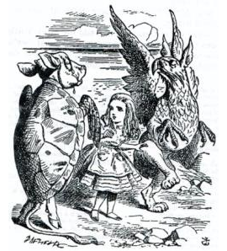
>>>
Story: Beautiful Soup, for pages somebody else wrote, 2004
WHO Leonard Richardson.
WHAT Beautiful Soup, a library that pulls data out of messy HTML.
WHEN Since 2004; version 3 was the official line from May 2006 to March 2012.
WHERE His own site, crummy.com, whose picture is Tenniel's Mock Turtle from Alice.
WHY His page says: you did not write that awful page, you just want some data out of it.
Tenniel's Mock Turtle (1865, public domain), as shown on crummy.com.
HOW It turns tag soup, badly built HTML, into a tree that select() and get_text() can search.
READ Beautiful Soup (crummy.com)
33 / 51
Notes:
Leonard Richardson has kept Beautiful Soup since 2004. His promise: you did not write that awful page, you only want data from it. That is why we use a parser and not a regular expression.

Slide 34
>>>
Do not read HTML with a regular expression
>>> import re
>>> html = '<a href="/x">x</a> <a class="k" href="/y">y</a>'
>>> print(re.findall('<a href="(.*?)">', html))
The pattern expects href right after a. The second link has a class first, so the pattern silently misses it.
>>> from html.parser import HTMLParser
>>> class Links(HTMLParser):
>>> found = []
>>> def handle_starttag(self, tag, attrs):
>>> if tag == 'a':
>>> self.found.append(dict(attrs)['href'])
A parser reads attributes by name, whatever their order. Beautiful Soup is a friendlier parser of the same kind.
>>> Links().feed(html)
>>> print(Links.found)
Both links are found. Use a parser for HTML and keep regular expressions for plain text.
What the run printed (Python 3.13.16)
Link in the page | Regular expression | Parser
/x | found | found
/y | MISSED | found
links found
the second link has a class before its href
Use a parser for HTML, not a pattern.
34 / 51
Notes:
The pattern needs href right after the tag name. The second link has a class first. A parser reads attributes by name and finds both.

Slide 35
>>>
Practice program: link verification
>>> from urllib.parse import urljoin, urldefrag
>>> site = 'https://example.com'
>>> page = site + '/guide/index.html'
>>> hrefs = ['intro.html', 'intro.html#top', '/about',
>>> 'https://other.org/x']
>>> seen = []
A page holds relative links, links with a fragment and links to other sites. The program must sort them out.
>>> for href in hrefs:
>>> full, fragment = urldefrag(urljoin(page, href))
>>> if full.startswith(site) and full not in seen:
>>> seen.append(full)
>>> print(seen)
urljoin makes every link absolute and urldefrag drops the fragment, so a page linked twice counts once. Other sites are skipped.
What the run printed (Python 3.13.16)
href on the page | Made absolute, no fragment | Verdict
intro.html | https://example.com/guide/intro.html | kept
intro.html#top | https://example.com/guide/intro.html | skipped: seen already
/about | https://example.com/about | kept
https://other.org/x | https://other.org/x | skipped: another site
Absolute, no fragment, same site, once.
35 / 51
Notes:
Practice program. Make links absolute, drop the fragment, skip other sites and count each page once. Predict how many pages remain.

Slide 36
>>>
Project 8: the image and the Prev link of a comic page
>>> import xml.etree.ElementTree as ET
>>> from urllib.parse import urljoin
>>> page = ('<body><div id="comic">'
>>> '<img src="//imgs.xkcd.com/comics/x.png"/></div>'
>>> '<a rel="prev" href="/2/">Prev</a></body>')
>>> root = ET.fromstring(page)
The chapter relies on the page structure of the comic site: the image sits inside the element with the id comic, and the Prev link has rel prev.
>>> src = root.find(".//*[@id='comic']/img").get('src')
>>> prev = root.find(".//a[@rel='prev']").get('href')
Two paths find the image address and the address of the previous comic.
>>> print(urljoin('https://xkcd.com/3/', src))
>>> print(urljoin('https://xkcd.com/3/', prev))
The image address begins with two slashes, so urljoin borrows the scheme. The loop would download, then follow Prev.
What the run printed (Python 3.13.16)
comic page
xkcd.com/3/
previous comic
xkcd.com/2/
previous comic
xkcd.com/1/
the loop follows Prev
image: imgs.xkcd.com/comics/x.png
the first comic's Prev link is #, so the loop stops
Image address, then the Prev link, then repeat.
36 / 51
Notes:
Project eight relies on the page structure of the comic site. The image address begins with two slashes, so urljoin borrows the scheme. Prev leads to the previous comic.

Slide 37
>>>
Project 7: open the first results in browser tabs
>>> import webbrowser, xml.etree.ElementTree as ET
>>> opened = []
>>> webbrowser.open = opened.append
>>> page = ('<ul><a href="/p/one"/><a href="/p/two"/>'
>>> '<a href="/p/three"/></ul>')
A recording stand-in replaces webbrowser.open again, so no tab really opens. The tiny results page holds three links; the real program downloads PyPI's.
>>> links = ET.fromstring(page).findall('.//a')
>>> for link in links[:2]:
>>> webbrowser.open('https://pypi.org' + link.get('href'))
>>> print(len(links), 'found;', opened)
Select all links, keep the first few, and open each address. The program does not wait for a person to click.
What the run printed (Python 3.13.16)
Result link | Opened?
https://pypi.org/p/one | yes: tab opened
https://pypi.org/p/two | yes: tab opened
https://pypi.org/p/three | no: not in the first two
links found against tabs opened
Select the links, open the first few.
37 / 51
Notes:
Project seven. Select all result links, keep the first few and open each one. A recording stand-in replaces the real open call.

Slide 38
Part 5: Driving a browser
When a script builds the page, only a real browser can read it
Dynamic page
A script writes the content after the download.
Slide | In this part
39 | Everyday pictures: driving a browser with...
40 | Everyday pictures: driving a browser with...
41 | Why a download is not enough: pages built...
42 | Story: Selenium began as a test runner fo...
43 | Selenium: find_element fails, find_elemen...
44 | Playwright: start, new page, goto, locator
45 | Story: Playwright reached Python on 30 Se...
46 | Interacting with a page: wait until the e...
Selenium
Drives a real browser through a separate driver.
Playwright
Drives a browser and waits by itself.
Headless
A browser that runs with no window at all.
38 / 51
Notes:
Part five. Some pages are written by a script after the download. Then only a real browser helps: Selenium or Playwright. We build small stand-ins to see how they behave.

Slide 39
>>>
Everyday pictures: driving a browser with Selenium
ANALOGY Browser automation is a puppeteer: you pull the strings and a real browser moves.
Chapter concept | Everyday picture
Controlling the Browser with Selenium | A puppeteer who works from outside the stage, through a separate driver.
Selenium | The old marionette stage: sturdy, many browsers, one driver for each.
webdriver.Firefox() | Hiring one actor: you start a Firefox that takes your cues.
find_element() | Asking for the first red chair; if there is none, the usher says so.
find_elements() | Asking for all the chairs; an empty row is a fair answer.
Browser automation | A robot arm that clicks and types in the page as you would.
headless mode | Rehearsing with the lights off and no audience: the show runs, nobody watches.
39 / 51
Notes:
Selenium drives a real browser from outside. Find_element and find_elements differ in what they do when nothing matches.

Slide 40
>>>
Everyday pictures: driving a browser with Playwright
ANALOGY Playwright is a stage manager who waits until the actor is ready before giving the cue.
Chapter concept | Everyday picture
Controlling the Browser with Playwright | A stage manager who waits for each actor and never rushes the cue.
Playwright | A newer theatre company with its own browsers, installed in a second step.
sync_playwright() | Opening the theatre for the evening and locking it when the show ends.
new_page() | A fresh tab is a fresh sheet of paper on the desk.
goto() | Walking to an address and standing at its door.
locator() | A note of where to look: it looks again each time you use it.
Interacting with a page | Pressing the buttons of a lift: click, type, scroll, then wait for the doors.
40 / 51
Notes:
Playwright starts with a context manager, opens a page, goes to an address and uses locators that wait. Browsers are installed by a second step.

Slide 41
>>>
Why a download is not enough: pages built by a script
>>> import xml.etree.ElementTree as ET
>>> source = ('<body><div id="app"></div>'
>>> '<script>show("Built by a script")</script></body>')
>>> root = ET.fromstring(source)
>>> app = root.find(".//*[@id='app']")
This page writes its own text with a script. The downloaded source holds only an empty element and the script.
>>> print('text in the source:', repr(app.text))
requests and a parser see exactly this: nothing to read.
>>> script = root.find('.//script').text
>>> app.text = script.split('"')[1]
>>> print('after the script ran:', repr(app.text))
A browser runs the script. This toy does it by hand. Selenium and Playwright drive a real browser, headless when no window is needed.
What the run printed (Python 3.13.16)
downloaded source
empty div + script
requests and a parser read
text in the source: None
a browser runs the script
shows 'Built by a script'
Selenium or Playwright
(headless: no window)
the text exists only after the script has run
A script-built page needs a real browser.
41 / 51
Notes:
The downloaded source holds an empty element and a script. A parser cannot read what the script writes. A real browser can, even headless.

Slide 42

>>>
Story: Selenium began as a test runner for a timesheet, 2004
WHO Jason Huggins, helped by Paul Gross and Jie Tina Wang.
WHAT JavaScriptTestRunner, the first form of Selenium.
WHEN 2004.
WHERE ThoughtWorks, Chicago.
WHY To test an internal Time and Expenses application written in Python and Plone.
HOW JavaScript ran inside the browser. Later Simon Stewart's WebDriver was merged in, so a program can drive a browser from outside.
The Selenium logo. Logo: selenium.dev, Apache-2.0.
READ Selenium History (selenium.dev)
42 / 51
Notes:
Selenium began in 2004 at ThoughtWorks as a test tool for a timesheet application. Later it merged with WebDriver. The browser is driven from outside, which is why a driver is needed.

Slide 43
>>>
Selenium: find_element fails, find_elements does not
>>> import xml.etree.ElementTree as ET
>>> root = ET.fromstring('<body><p>one</p><p>two</p></body>')
>>> def find_elements(path):
>>> return root.findall(path)
>>> def find_element(path):
>>> return find_elements(path)[0]
A stand-in for the page that webdriver.Firefox() would load. find_elements returns a list, possibly empty. find_element returns the first match.
>>> print(len(find_elements('.//p')), find_element('.//p').text)
>>> print(find_elements('.//h1'))
>>> try:
>>> find_element('.//h1')
>>> except IndexError:
>>> print('Result: find_element fails when nothing matches')
Two paragraphs are found, and the first says one. A search for h1 gives an empty list, but find_element fails. Selenium raises NoSuchElementException; here IndexError tells the same story.
What the run printed (Python 3.13.16)
Call | What comes back
find_elements('.//p') | a list of 2 elements
find_element('.//p').text | 'one'
find_elements('.//h1') | [] (empty list)
find_element('.//h1') | IndexError here; NoSuchElementException in Selenium
find_element fails; find_elements gives a list.
43 / 51
Notes:
A stand-in for the Selenium driver. Find_elements returns a list that may be empty, find_element returns the first match and fails when there is none.

Slide 44
>>>
Playwright: start, new page, goto, locator
>>> from contextlib import nullcontext
>>> class Page:
>>> def goto(self, url):
>>> print('visiting', url)
>>> def locator(self, css):
>>> return 'element ' + css
A stand-in page. goto visits an address; locator names the element to work with. The real locator also waits until the element is ready.
>>> class Playwright:
>>> def new_page(self):
>>> return Page()
new_page opens a fresh tab. The real program first calls p.firefox.launch() to start a browser.
>>> with nullcontext(Playwright()) as p:
>>> page = p.new_page()
>>> page.goto('https://example.com/')
>>> print(page.locator('h1'))
sync_playwright() is used in a with block, which starts the tool and stops it at the end. The steps are the chapter's: start, new page, goto, locator.
What the run printed (Python 3.13.16)
with ... as p
(starts the tool)
p.new_page()
(a fresh tab)
page.goto(url)
visiting https://example.com/
page.locator('h1')
element h1
1 start
2 open a tab
3 visit
4 find the element
the real program adds p.firefox.launch() and keeps the same four steps
Start, new page, goto, locator.
44 / 51
Notes:
The same four steps as the chapter's program: start, new page, goto, locator. The real program also launches a browser first.

Slide 45

>>>
Story: Playwright reached Python on 30 September 2020
WHO Arjun Attam, program manager, and the Playwright team at Microsoft.
WHAT Playwright for Python, announced in preview.
WHEN 30 September 2020; InfoQ had reported Playwright itself on 30 January 2020.
WHERE The Microsoft for Python Developers blog.
WHY Reliable end-to-end tests without timeouts: it waits for the page to be ready by itself.
HOW An event-driven design that listens to browser events such as DOM changes, network requests and navigations.
The Playwright logo. Logo: playwright.dev, Apache-2.0.
READ Announcing Playwright for Python (Microsoft)
45 / 51
Notes:
Arjun Attam announced Playwright for Python in preview on 30 September 2020. Its first promise is automatic waiting, which our last example imitates. Ask students why waiting matters on a slow page.

Slide 46
>>>
Interacting with a page: wait until the element is there
>>> looks = [None, None, 'Hello'] # what each look sees
A page can build an element late. Each entry is one look: nothing, nothing, then the text.
>>> def locator_text(limit):
>>> for look, text in enumerate(looks[:limit], 1):
>>> if text is not None:
Playwright keeps looking until the element is ready or time runs out. Selenium looks once.
>>> return 'found %r on look %d' % (text, look)
>>> return 'timeout after %d looks' % limit
Return the text and the look it appeared on, or report a timeout when the looks run out.
>>> print(locator_text(5))
>>> print(locator_text(2))
Five looks find the text on the third. Two looks give up, as Playwright does after thirty seconds.
What the run printed (Python 3.13.16)
is the element there at look n? (1 = yes)
Patience | Result
5 looks | found 'Hello' on look 3
2 looks | timeout after 2 looks
Playwright's real limit is thirty seconds
Playwright waits for the element; Selenium looks once.
46 / 51
Notes:
Playwright looks again until the element is ready. Selenium's find_element looks once. Predict the result with five looks and with two.

Slide 47
>>>
Which tool for which page?
Choose by the page in front of the program
Page in front of the program | Tool | Why
A person should see the page | webbrowser | Opens the user's own browser; reads nothing
A known address, text or a file | requests | get, raise_for_status, a timeout, chunks
A service that offers an API | requests and json | Structured answer; a key identifies you
Static HTML to read | Beautiful Soup | Parses the text received; select, get_text, get
A page built by a script, or a login | Selenium or Playwright | Only a real browser runs the script
Always: check the reply, pass a timeout, read robots.txt, wait between pages and keep the key secret.
The simplest tool that reaches the page is the right tool.
47 / 51
Notes:
Choose the tool by the page in front of the program. Webbrowser to show it, requests to fetch it, an API when there is one, a parser for static HTML, a browser driver only when a script builds the page.

Slide 48
>>>
Current Python and today's web change more
What differs from the book, from the chapter research
What changed | Version or date | What it means for the chapter
urllib.robotparser reads the wildcard * and the end mark $ | Python 3.14.5 | A rule like Disallow: /search* now blocks the path
PurePath.as_uri() is deprecated; use Path.as_uri() | Python 3.14 | file:// addresses of local help pages
datetime.utcfromtimestamp() is deprecated | Python 3.12 | Forecast times: fromtimestamp, in the machine's time zone
Selenium Manager finds the driver and browser itself | Selenium 4.51.0 | No manual geckodriver download
The error is NoSuchElementException | Selenium 4.51.0 | The chapter writes NoSuchElement
Browsers are installed by a second step, playwright install | Playwright 1.63.0 | pip install alone is not enough
Pass a timeout; use stream=True for a file | Requests 2.34.2 | A call without a timeout can hang
The PyPI search page answers with a challenge page | 12 Oct 2026 | searchpypi.py finds no result links
Run what the book printed; then check what changed.
48 / 51
Notes:
Python and the tools move on. The robots parser reads wildcard rules since Python 3.14.5. Selenium finds its driver by itself. Playwright needs a second install step. Run what the book printed, then check what changed.

Slide 49
>>>
Summary
ANALOGY A summary is a packing list: only what you really need goes into the bag.
An address has parts; a reply has a status code.
code examples in each part of this deck
1
2
A polite program reads robots.txt, waits and names itself.
3
Check every reply, and save big files in chunks.
4
An API answers in JSON; the key is a password.
5
Parse HTML with a parser; use a real browser only when a script builds the page.
Choose the tool by the page; behave politely.
49 / 51
Notes:
Five sentences to keep. The chart counts the code examples in each part of this deck.

Slide 50
>>>
Practice Questions
Predict first, then run what you can on the chapter page
ANALOGY Practice questions are finger scales for a pianist; the practice programs are the small recital pieces.
1
Cut 'https://xkcd.com/3/#top' into its parts. Which part does the server never receive?
2
A robots file says Disallow: /search/. What does can_fetch give for '/search/?q=a'?
3
Convert 300 Kelvin to Celsius and Fahrenheit with the code of the Kelvin slide.
4
Practice program: list the pages one link away on a page, without counting a page twice.
Each answer fits in a few lines you can run.
50 / 51
Notes:
Four drills and a project. Predict first, then run what you can on the page. Ask students to explain each answer in one sentence.

Slide 51
>>>
Resources: where to go next
Reading and watching, chosen for this chapter; every link is live
Book: Automate the Boring Stuff, 3rd edition, chapter 13
https://automatetheboringstuff.com/3e/chapter13.html
Selenium: locator strategies
selenium.dev
Python documentation: urllib.parse
https://docs.python.org/3/library/urllib.parse.html
Playwright for Python: locators
https://playwright.dev/python/docs/locators
Python documentation: urllib.robotparser
https://docs.python.org/3/library/urllib.robotparser.html
RFC 9309: Robots Exclusion Protocol
https://www.rfc-editor.org/rfc/rfc9309
Python documentation: html.parser
https://docs.python.org/3/library/html.parser.html
MDN: CSS selectors
developer.mozilla.org
Python documentation: webbrowser
https://docs.python.org/3/library/webbrowser.html
MDN: HTTP response status codes
developer.mozilla.org
Requests: Quickstart
requests.readthedocs.io
OpenWeather: Geocoding API
https://openweathermap.org/api/geocoding-api
Beautiful Soup documentation
https://www.crummy.com/software/BeautifulSoup/bs4/doc/
Video: Web testing with Playwright (PyOhio 2022)
pyvideo.org
Pick one link and read it before the next class.
51 / 51
Notes:
Start with the book chapter, then the Python documentation, the documents of the four tools and the two protocol texts. The stories link to first-hand sources. Choose one link and read it before the next class.

