Slide 1
>>>
>>> int('x')
ValueError: invalid literal for int() with base 10: 'x'
Chapter 5: Debugging
Tracebacks, assertions, logging - and the moth that started it all
run under Python 3.14.6
SEN0414 Advanced Programming · Fall 2026 · Yusuf Altunel, PhD · İstanbul Kültür University
Notes:
SAY: Chapters 1-4 wrote programs; chapter 5 is for the day they misbehave: reading what Python tells you, planting tripwires, keeping logs, and pausing the program mid-thought.
FULL TEXT: course page, chapter 5.

Slide 2
Today's route
>>>
Five parts; every number is a slide you can jump to
1
Questions and the chapter map (slides 3-4)
23
slides, numbered bottom-right
2
Reading the report - tracebacks, unwinding, notes (slides 5-8)
3
3
Assertions - executable assumptions (slides 9-10)
true stories, each with WHO / WHERE / WHEN / READ
4
Logging - levels, files, the off switch (slides 11-15)
16
5
The hunt, summary, and resources (slides 16-23)
consoles and whole programs, run live
Five parts - and a moth with its own museum label
2 / 23
Notes:
SAY: Five parts, from a museum moth to a paused program - every transcript verified off this very file.
ASK: Which part do you expect to be hardest - mark it now, check at the summary.
FULL TEXT: course page, chapter 5 - every section.

Slide 3
The questions this chapter answers
>>>
Its own competency questions - we return to each
1
Which constructs signal, check, record and inspect a program's behaviour, and what decides which of them a given problem calls for?
2
Which printed outputs and concepts of the chapter differ in current Python, and on what source?
3
Which terms does the chapter use that a learner would have to look up, and which concept of the corpus explains each one?
recorded under Python 3.14.6
bug-and-fix program pairs
the log as evidence
If you can answer these, chapter 5 is yours
3 / 23
Notes:
SAY: A bug is a place where a program does something other than what its author meant it to do, and debugging is the work of finding and removing such places. Chapter 5 opens with the observation that once a learner can write basic programs, the bugs become less simple, and it offers tools and techniques for finding the root cause of a bug quickly and with little effort (Sweigart, 2025).
FULL TEXT: course page, chapter 5 - BugModel.

Slide 4
One chapter, six branches
>>>
The concept map the whole chapter hangs on
Six branches; the count under each is how many concepts the course page explains for it - today walks the spine.
Bug Model
10 concepts
Error Signalling
12 concepts
Assertion
10 concepts
Logging
18 concepts
Debugger
19 concepts
Modern Practice
7 concepts
Six branches - every slide today lives on this map
4 / 23
Notes:
SAY: A bug is a place where a program does something other than what its author meant it to do, and debugging is the work of finding and removing such places. Chapter 5 opens with the observation that once a learner can write basic programs, the bugs become less simple, and it offers tools and techniques for finding the root cause of a bug quickly and with little effort (Sweigart, 2025).
FULL TEXT: course page, chapter 5 - BugModel, Logging.

Slide 5
Reading the report
Tracebacks, raised errors, and notes
The traceback
raise
Unwinding
Notes
5 / 23
Notes:
SAY: Error signalling is the way a program says that something has gone wrong. In Python the saying is done with exceptions: an exception is an object that carries a description of the problem and travels up through the running code until something handles it.
FULL TEXT: course page, chapter 5 - ErrorSignalling.

Slide 6
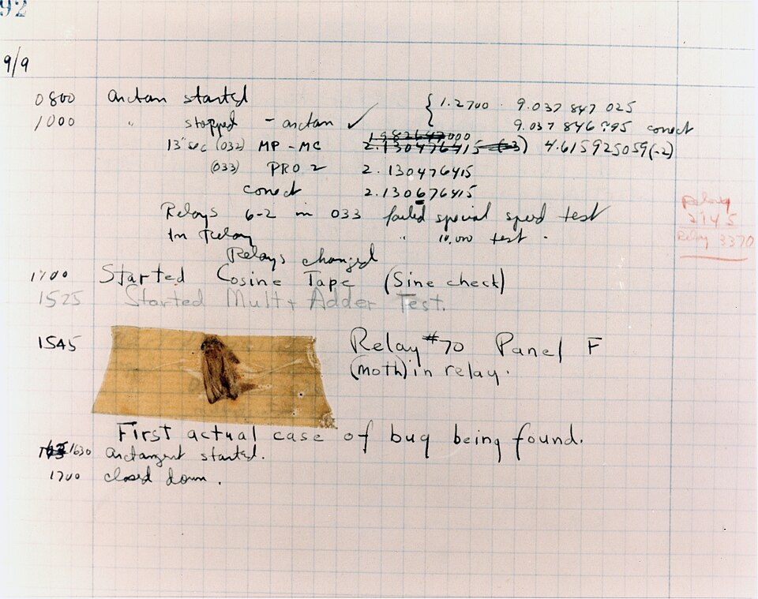
The bug you can visit in a museum
>>>
1947-09-09
9 September 1947: the Mark II stops
Relay 70, panel F: a moth
'First actual case of bug being found'
The page survives at the Smithsonian
the Mark II logbook page, moth taped in - U.S. Navy photo, public domain
WHO Grace Hopper's Harvard Mark II team
WHERE the machine's logbook - now at the Smi…
WHEN 1947-09-09
READ en.wikipedia.org
Every bug since has been a metaphor; this one had wings
6 / 23
Notes:
STORY (1947-09-09): On 9 September 1947 the Harvard Mark II stopped, and the operators traced the fault to a moth caught in relay 70 of panel F. They taped the insect into the logbook with the note 'First actual case of bug being found' - the joke being that engineers already said 'bug' for faults. The page, moth and all, survives at the Smithsonian, and the photograph on this slide is the Navy's own. Debugging has meant removing the moth ever since.
SOURCE: The Mark II logbook page of 1947-09-09, 'First actual case of bug being found', held by the Smithsonian's National Museum of American History; photograph courtesy of the Naval Surface Warfare Center, Dahlgren (public domain). Note: a common file title misdates it 1945; the log page itself is dated September 9, 1947.

Slide 7
Read the traceback upward
>>>
A crash in a box-printing program, dissected
the box prints, then the crash - read the report bottom line first
def box_print(symbol, width, height):
if len(symbol) != 1:
raise Exception('Symbol must be a single character string.')
if width <= 2:
raise Exception('Width must be greater than 2.')
if height <= 2:
raise Exception('Height must be greater than 2.')
print(symbol * width)
for i in range(height - 2):
print(symbol + (' ' * (width - 2)) + symbol)
print(symbol * width)
for sym, w, h in (('*', 4, 4), ('x', 1, 3), ('ZZ', 3, 3)):
try:
box_print(sym, w, h)
except Exception as err:
print('An exception happened: ' + str(err))
prints ****
* *
* *
****
An exception happened: Width must be greater than 2.
An exception happened: Symbol must be a single character string.
program boxprint_v1_0_0.py, lines 1 to 17 of 17, run under Python 3.14.6
The last line names the crime; the lines above name the scene
7 / 23
Notes:
SAY: Error signalling is the way a program says that something has gone wrong. In Python the saying is done with exceptions: an exception is an object that carries a description of the problem and travels up through the running code until something handles it.
ASK: Which line of the report names YOUR file, and which names the library's?
FULL TEXT: course page, chapter 5 - ErrorSignalling.

Slide 8
Unwind, catch, annotate
>>>
An exception climbs until someone claims it
three frames up, one except claims it
add_note: context travels WITH the error
def read_age(text):
return int(text)
def load(record):
return read_age(record['age'])
def process(records):
return [load(r) for r in records]
try:
process([{'age': '41'}, {'age': 'abc'}])
except ValueError as e:
print('caught:', e)
prints caught: invalid literal for int() with base 10: 'abc'
try:
try:
int('x')
except ValueError as e:
e.add_note('while reading the age field')
raise
except ValueError as e:
print(e.__notes__)
prints ['while reading the age field']
program notes_v1_0_0.py, lines 1 to 8 of 8, run under Python 3.14.6
program unwinding_v1_0_0.py, lines 1 to 13 of 13, run under Python 3.14.6
notes are 3.11+ modern practice
An exception travels up until someone claims it
8 / 23
Notes:
SAY: Error signalling is the way a program says that something has gone wrong. In Python the saying is done with exceptions: an exception is an object that carries a description of the problem and travels up through the running code until something handles it.
ASK: Where would the note have saved you an hour last week?
FULL TEXT: course page, chapter 5 - ErrorSignalling, ModernPractice.

Slide 9
Assertions
Executable assumptions
assert
Messages
The -O caveat
9 / 23
Notes:
SAY: An assertion is a statement that a certain condition must be true at a certain point of a program, together with a check that stops the program at once if it is not. The chapter calls an assertion a sanity check, a test that makes sure the code is not doing something obviously wrong, and it performs such checks with the assert statement, which raises an AssertionError exception when the check fails (Sweigart, 2025).
FULL TEXT: course page, chapter 5 - Assertion.

Slide 10
assert: executable assumptions
>>>
Tripwires for states that must never happen
bare assert: it fires, but mutely
with a message: the tripwire explains itself
ages = [26, 57, 92, 54, 22, 15, 17, 80, 47, 73]
ages.reverse()
try:
assert ages[0] <= ages[-1]
print('the list is sorted')
except AssertionError as e:
print(type(e).__name__, repr(str(e)))
prints AssertionError ''
x = -1
try:
assert x > 0, f'x must be positive, got {x}'
except AssertionError as e:
print(e)
prints x must be positive, got -1
program assertmsg_v1_0_0.py, lines 1 to 5 of 5, run under Python 3.14.6
python -O strips asserts: they guard the programmer, never user input
program assertdemo_v1_0_0.py, lines 1 to 7 of 7, run under Python 3.14.6
src = "assert False, 'boom'\nprint('reached')"
try:
exec(compile(src, 'x', 'exec'))
except AssertionError as e:
print('normal run:', e)
exec(compile(src, 'x', 'exec', optimize=1))
prints normal run: boom
reached
program optimised_v1_0_0.py, lines 1 to 6 of 6, run under Python 3.14.6
An assert is a tripwire for states that must never happen
10 / 23
Notes:
SAY: An assertion is a statement that a certain condition must be true at a certain point of a program, together with a check that stops the program at once if it is not. The chapter calls an assertion a sanity check, a test that makes sure the code is not doing something obviously wrong, and it performs such checks with the assert statement, which raises an AssertionError exception when the check fails (Sweigart, 2025).
ASK: Which chapter-4 validation would be WRONG as an assert, and why?
FULL TEXT: course page, chapter 5 - Assertion.

Slide 11
Logging
The print statement that grew up
Levels
To a file
force and disable
Lazy formatting
11 / 23
Notes:
SAY: Logging is the practice of making a program write down what it does while it runs. The Python logging HOWTO defines it as a means of tracking events that happen when some software runs: the developer adds logging calls to the code to indicate that certain events have occurred, and each event is described by a message and has an importance, which is called its level or severity (Python Software Foundation, 2026).
FULL TEXT: course page, chapter 5 - Logging.

Slide 12
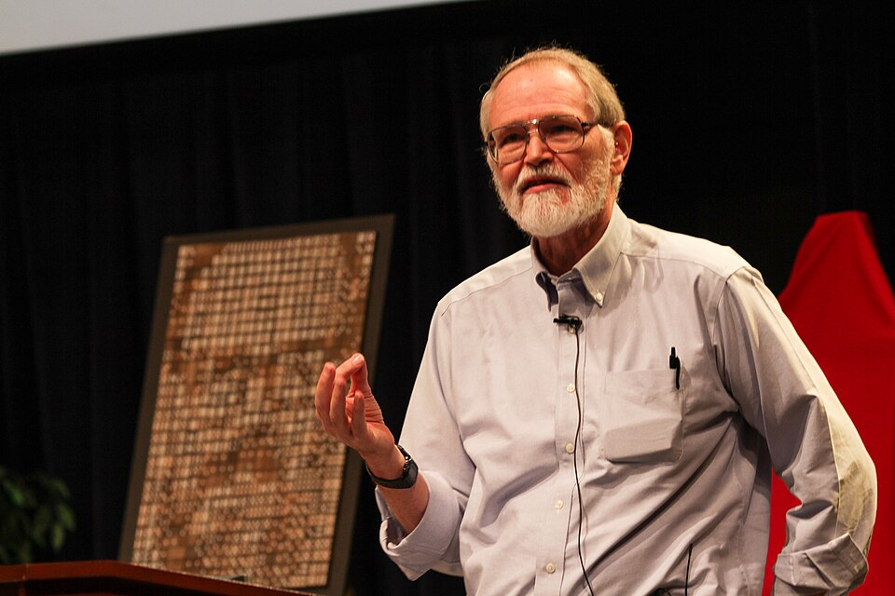
The most effective debugging tool
>>>
1979
Bell Labs, 1979: 'careful thought, coupled with
judiciously placed print statements'
This chapter agrees - then gives print levels,
timestamps, files, and an off switch
Brian Kernighan at Bell Labs - photo: Ben Lowe, CC BY 2.0
WHO Brian Kernighan, Be…
WHERE 'Unix for Beginners…
WHEN 1979
READ en.wikipe…
Logging is the print statement that grew up
12 / 23
Notes:
STORY (1979): In a 1979 Bell Labs paper Kernighan wrote the sentence every debugger vendor has to argue with: 'The most effective debugging tool is still careful thought, coupled with judiciously placed print statements.' This chapter agrees, then upgrades the print statement into logging. Same idea - but with levels, timestamps, files, and an off switch that does not require deleting your evidence.
SOURCE: Brian W. Kernighan, 'Unix for Beginners' (Bell Laboratories, 1979), the 'careful thought... judiciously placed print statements' sentence; biography and bibliography at en.wikipedia.org/wiki/Brian_Kernighan. Photo: Ben Lowe, CC BY 2.0, at Bell Labs.

Slide 13
A logging system with a birth certificate
>>>
PEP 282, 2002; stdlib since Python 2.3
PEP 282 (2002), Vinay Sajip and Trent Mick - modelled on log4j's levels
In the standard library since Python 2.3; these slides run that exact machinery
the ladder, asked directly
>>> [(n, getattr(__import__('logging'), n)) for n in ('DEBUG', 'INFO', 'WARNING', 'ERROR', 'CRITICAL')]
[('DEBUG', 10), ('INFO', 20), ('WARNING', 30), ('ERROR', 40), ('CRITICAL', 50)]
>>> __import__('logging').getLogger().getEffectiveLevel()
30
run under Python 3.14.6
WHO Vinay Sajip and Trent Mick, through th…
WHERE peps.python.org - and the logging modu…
WHEN PEP 282, 2002; s…
READ peps.python.org
The five log levels are a 2002 design decision
13 / 23
Notes:
STORY (PEP 282, 2002; stdlib since Python 2.3): Python's logging module did not drift into the language; it was proposed as PEP 282 in 2002 by Vinay Sajip and Trent Mick, modelled on log4j's levels, and entered the standard library in Python 2.3. DEBUG, INFO, WARNING, ERROR, CRITICAL - the five-step ladder on these slides is that PEP's design, and the chapter's demos run it: to the console, to a file, forced, and disabled.
SOURCE: PEP 282, 'A Logging System', authors Vinay Sajip and Trent Mick (2002), implemented as the standard library's logging module from Python 2.3 (peps.python.org/pep-0282).

Slide 14
Levels: choose what you hear
>>>
One knob from DEBUG to CRITICAL
level=INFO: the DEBUG line stays silent
import logging, sys
logging.basicConfig(level=logging.INFO, stream=sys.stdout, format='%(levelname)s - %(message)s')
logging.debug('debug message')
logging.info('info message')
logging.warning('warning message')
logging.error('error message')
logging.critical('critical message')
prints INFO - info message
WARNING - warning message
ERROR - error message
CRITICAL - critical message
program levelsdemo_v1_0_0.py, lines 1 to 7 of 7, run under Python 3.14.6
force=True rewires mid-program - 3.8+ practice
logging.info('first call rules')
logging.basicConfig(level=logging.DEBUG, stream=sys.stdout, format='%(levelname)s - %(message)s', force=True)
logging.debug('force=True replaces it')
prints INFO - first call rules
DEBUG - force=True replaces it
program force_v1_0_0.py, lines 5 to 7 of 7, run under Python 3.14.6
Set the level, not your patience - DEBUG to CRITICAL
14 / 23
Notes:
SAY: Logging is the practice of making a program write down what it does while it runs. The Python logging HOWTO defines it as a means of tracking events that happen when some software runs: the developer adds logging calls to the code to indicate that certain events have occurred, and each event is described by a message and has an importance, which is called its level or severity (Python Software Foundation, 2026).
ASK: Which level would your coin-toss homework log its guesses at?
FULL TEXT: course page, chapter 5 - Logging.

Slide 15
Log to a file; switch it off cleanly
>>>
Evidence on disk, silence on demand
filename= sends the evidence to disk - and CRITICAL still reaches you
import logging, os, tempfile
path = os.path.join(tempfile.mkdtemp(), 'myProgramLog.txt')
logging.basicConfig(filename=path, level=logging.DEBUG, format='%(levelname)s - %(message)s')
logging.debug('to the file')
logging.critical('also to the file')
print(open(path).read(), end='')
prints DEBUG - to the file
CRITICAL - also to the file
program filelog_v1_0_0.py, lines 1 to 6 of 6, run under Python 3.14.6
logging.disable: one line silences below a level - no deletions
import logging, sys
logging.basicConfig(level=logging.INFO, stream=sys.stdout, format='%(levelname)s - %(message)s')
logging.critical('before disable')
logging.disable(logging.CRITICAL)
logging.critical('after disable')
logging.error('after disable')
logging.disable(logging.NOTSET)
logging.error('after re-enabling')
prints CRITICAL - before disable
ERROR - after re-enabling
program disable_v1_0_0.py, lines 1 to 8 of 8, run under Python 3.14.6
Evidence goes to files; disable beats delete
15 / 23
Notes:
SAY: Logging is the practice of making a program write down what it does while it runs. The Python logging HOWTO defines it as a means of tracking events that happen when some software runs: the developer adds logging calls to the code to indicate that certain events have occurred, and each event is described by a message and has an importance, which is called its level or severity (Python Software Foundation, 2026).
ASK: Why does disable() beat deleting log calls the night before a demo?
FULL TEXT: course page, chapter 5 - Logging.

Slide 16
The hunt
Two real bugs, found by their logs
Factorial, off by one
String vs int
The debugger
16 / 23
Notes:
SAY: A bug is a place where a program does something other than what its author meant it to do, and debugging is the work of finding and removing such places. Chapter 5 opens with the observation that once a learner can write basic programs, the bugs become less simple, and it offers tools and techniques for finding the root cause of a bug quickly and with little effort (Sweigart, 2025).
FULL TEXT: course page, chapter 5 - BugModel.

Slide 17
Hunt one bug, with the log as witness
>>>
factorial(3) returns 0 - the log says why
read the DEBUG lines: i starts at 0, and the product dies with it
import logging, sys
logging.basicConfig(level=logging.DEBUG, stream=sys.stdout, format='%(levelname)s - %(message)s')
def factorial(n):
logging.debug('Start of factorial(%s)', n)
total = 1
for i in range(n + 1):
total *= i
logging.debug('i is %s, total is %s', i, total)
logging.debug('End of factorial(%s)', n)
return total
print(factorial(3))
prints DEBUG - Start of factorial(3)
DEBUG - i is 0, total is 0
DEBUG - i is 1, total is 0
DEBUG - i is 2, total is 0
DEBUG - i is 3, total is 0
DEBUG - End of factorial(3)
0
program factorial_bug_v1_0_0.py, lines 1 to 12 of 12, run under Python 3.14.6
The log shows the loop die one step early
17 / 23
Notes:
SAY: A bug is a place where a program does something other than what its author meant it to do, and debugging is the work of finding and removing such places. Chapter 5 opens with the observation that once a learner can write basic programs, the bugs become less simple, and it offers tools and techniques for finding the root cause of a bug quickly and with little effort (Sweigart, 2025).
ASK: Before the next slide: which single argument of range() is wrong?
FULL TEXT: course page, chapter 5 - BugModel, Logging.

Slide 18
The one-character fix, witnessed
>>>
Same program, range(1, ...) - the log now testifies
the log ends at 6 - and reads as the proof the fix worked
import logging, sys
logging.basicConfig(level=logging.DEBUG, stream=sys.stdout, format='%(levelname)s - %(message)s')
def factorial(n):
logging.debug('Start of factorial(%s)', n)
total = 1
for i in range(1, n + 1):
total *= i
logging.debug('i is %s, total is %s', i, total)
logging.debug('End of factorial(%s)', n)
return total
print(factorial(3))
prints DEBUG - Start of factorial(3)
DEBUG - i is 1, total is 1
DEBUG - i is 2, total is 2
DEBUG - i is 3, total is 6
DEBUG - End of factorial(3)
6
program factorial_fixed_v1_0_0.py, lines 1 to 12 of 12, run under Python 3.14.6
1
The fix is one character class: range(n + 1) became range(1, n + 1)
The log that found the bug doubles as the proof of the fix
18 / 23
Notes:
SAY: A bug is a place where a program does something other than what its author meant it to do, and debugging is the work of finding and removing such places. Chapter 5 opens with the observation that once a learner can write basic programs, the bugs become less simple, and it offers tools and techniques for finding the root cause of a bug quickly and with little effort (Sweigart, 2025).
ASK: Keep or delete these DEBUG lines after the fix - argue both ways in one sentence.
FULL TEXT: course page, chapter 5 - BugModel, Logging.

Slide 19
The string that beat the integer
>>>
The chapter's coin toss never wins - types tell
seeded for the slide: toss is an int, your guess is a str - they can never be equal
import random
random.seed(7)
guess = input('Guess the coin toss! Enter heads or tails: ')
toss = random.randint(0, 1) # 0 is tails, 1 is heads
if toss == guess:
print('You got it!')
else:
print('Nope! Guess again!')
print(type(toss).__name__, type(guess).__name__)
prints Guess the coin toss! Enter heads or tails: heads
Nope! Guess again!
int str
program cointoss_bug_v1_0_0.py, lines 1 to 9 of 9, run under Python 3.14.6
the second recorded run, guessing tails, loses identically:
Guess the coin toss! Enter heads or tails: tails
Nope! Guess again!
int str
fix: compare like with like
Types are part of the bug - the log prints them
19 / 23
Notes:
SAY: A bug is a place where a program does something other than what its author meant it to do, and debugging is the work of finding and removing such places. Chapter 5 opens with the observation that once a learner can write basic programs, the bugs become less simple, and it offers tools and techniques for finding the root cause of a bug quickly and with little effort (Sweigart, 2025).
ASK: Write the one-line fix both ways - which reads better at the call site?
FULL TEXT: course page, chapter 5 - BugModel.

Slide 20
The debugger: the program, paused
>>>
breakpoint() - a conversation mid-thought
the demo the lab runs under pdb
def add(a, b):
total = a + b
return total
def main():
x = add(2, 3)
y = add(x, 10)
print(y)
main()
prints 15
1
breakpoint() drops you into pdb at that line
2
n steps over; s steps in; p prints a name
3
c continues; q quits the session
4
The lab: watch total grow, step by step
program debugdemo_v1_0_0.py, lines 1 to 10 of 10, run under Python 3.14.6
n next
s step in
p name
c continue
q quit
A debugger is a conversation with a paused program
20 / 23
Notes:
SAY: The debugger is a tool that runs a program one instruction at a time and lets the programmer look at the program between the steps. The chapter defines it as a feature of the Mu editor that executes a program one instruction at a time, giving a chance to inspect the values in variables while the code runs and to track how the values change over the course of the program (Sweigart, 2025).
ASK: At which line would a breakpoint have caught the factorial bug fastest?
FULL TEXT: course page, chapter 5 - Debugger.

Slide 21
The chapter in five lines
>>>
One line per part - each one provable from its slides
1
A traceback reads upward: the last line names the crime, the ones above the scene
2
Exceptions climb until claimed; add_note sends context along for the ride
3
assert trips on impossible states - and python -O reminds you whom it guards
4
Logging is print with levels, files and an off switch - a 2002 PEP you inherit
5
Two real bugs fell today: the log cornered one, types confessed the other
If a line feels unproven, its part's slides carry the receipt
21 / 23
Notes:
SAY: Five lines, one per part; the agenda names the slides that prove each.
ASK: Which line would you defend first, and with which slide?
FULL TEXT: course page, chapter 5 - every section.

Slide 22
Where to go from here
>>>
The chapter's own checked sources - every entry a live link
Read
History
The textbook, chapter 5 - free online automatetheboringstuff.com/3e/chapter5.html
PEP 282 - a logging system (2002) peps.python.org/pep-0282/
The tutorial: errors and exceptions docs.python.org/3/tutorial/errors.html
The 1947 moth, at the Smithsonian en.wikipedia.org/wiki/Software_bug
Reference
Practice
logging - the module these slides ran docs.python.org/3/library/logging.html
python -O and assertions docs.python.org/3/using/cmdline.html
pdb - the debugger docs.python.org/3/library/pdb.html
PEP 678 - notes on exceptions peps.python.org/pep-0678/
Built-in exceptions docs.python.org/3/library/exceptions.html
Eight links, checked by the build - one of them has a moth in it
22 / 23
Notes:
SAY: Every link is a source the chapter corpus cites and checked. Homework: run the coin toss UNSEEDED, lose three times, then fix it and log every toss at DEBUG.
ASK: Bring one traceback you met this week - we will read it upward together.
FULL TEXT: course page, chapter 5 - Logging.

Slide 23
What you should now be able to say
And where each claim gets its proof
How to read a traceback, and in which direction
What an assert guards, and what it must never guard
Five log levels, to console or file, silenced cleanly
How a log and a breakpoint corner a real bug
Questions?
23 / 23
Notes:
SAY: Four claims, each carried by a transcript you watched print. Five chapters, one look, every number earned - the first half of the course stands.
FULL TEXT: course page, chapter 5.

