Slide 1
>>>
>>> {'cat': 'Zophie'}['cat']
'Zophie'
run under Python 3.14.6
Chapter 7: Dictionaries
Dictionaries and Structuring Data: pairs, counts, models and the text that carries them
SEN0414 Advanced Programming · Fall 2026 · Yusuf Altunel, PhD · İstanbul Kültür University
Notes:
Chapters 1 to 6 worked with single values and with lists, where a position names an item. This chapter introduces the dictionary, where a name of your own choosing names an item, and then uses it to count letters, to group words, to model a chessboard and to write data down as text. Every example on these slides was run under Python 3.14.6 and the result printed beside it is the result Python gave.

Slide 2
Today's route
>>>
Five parts; every range is a run of slides you can jump to
1
The dictionary type and its keys (slides 3-9)
26
slides, numbered bottom-right
2
Loops, counting and grouping (slides 10-14)
4
3
Structuring data: the chessboard and the picnic (slides 15-19)
true stories, each with who, where, when and a link
4
Copies and writing data down (slides 20-22)
20
5
Practice, summary and resources (slides 23-25)
consoles and programs, all run before they were shown
Five parts, from one pair to a chessboard, all of it executed.
2 / 26
Notes:
The route has five parts. It starts with the dictionary type and its keys, moves to loops, counting and grouping, then to structuring data with a chessboard and a picnic, then to copies and to writing data down, and ends with practice, a summary and further resources. The ranges name the exact slides, so you can return to the part you need, and four of the slides are true stories that explain where a feature of the language came from.

Slide 3
The questions this chapter answers
>>>
The chapter's own competency questions; the summary comes back to each
1
Which operations read, add, replace and remove the pairs of a dictionary, and what decides which of them a given problem calls for?
2
Which values may be keys, why must they be hashable, and which behaviours of the chapter's text differ in current Python (insertion order, the unhashable message, merge operators)?
3
How are counting, grouping and nesting solved with dictionaries, and when does each of the setdefault, Counter and defaultdict tools fit best?
4
How is a real thing modelled as a data structure, as the chessboard simulator does, and how is the structure displayed, copied and written down as text?
5
Which terms does the chapter use that a learner would have to look up, and which concept of the corpus explains each one?
7 branches
73 concepts
49 examples
Python 3.14.6
Answer these five questions and you have the chapter.
3 / 26
Notes:
These five questions are the checklist for the chapter. The first asks what you can do to the pairs of a dictionary, the second asks what may serve as a key, the third asks how counting, grouping and nesting are solved, the fourth asks how a real thing is modelled and written down, and the fifth is about vocabulary. The chips below them give the size of the chapter: its branches, the concepts the course page explains, the worked examples and the Python they ran on. The summary slide answers every question in one line.

Slide 4
The dictionary data type
>>>
A collection of key-value pairs, looked up by key
a dictionary is written in braces, and a key finds its value
>>> my_cat = {'size': 'fat', 'color': 'gray', 'disposition': 'loud'}
>>> my_cat['size']
'fat'
>>> 'My cat has ' + my_cat['color'] + ' fur.'
'My cat has gray fur.'
>>> len(my_cat)
3
A phone book
The name is the key and the number beside it is the value. You look a person up by name and never ask which page they are on, and you do not care which entry was written first.
run under Python 3.14.6
Each pair joins a key to a value with a colon; the pairs sit in braces.
A key finds its value directly, however many pairs the dictionary holds.
Since Python 3.7 a dictionary also remembers the order in which keys were added.
A dictionary finds a value by its key, not by its position.
4 / 26
Notes:
A dictionary stores pairs. The key is the part you look things up by, and the value is the part you want back. In the console on this slide the keys are the words size, color and disposition, and my_cat['size'] returns the value that was stored with the key size. A phone book is the everyday picture: you search by name, the name stands for the number, and the order in which people were added is not how you find them. The last bullet matters because older teaching, including the printed chapter, says a dictionary has no order, whereas every current Python keeps insertion order.

Slide 5
Dictionaries versus lists
>>>
Two containers, two ways to name an item
lists compare by order, dictionaries do not
A list
A dictionary
>>> spam = ['cats', 'dogs', 'moose']
>>> bacon = ['moose', 'dogs', 'cats']
>>> spam == bacon
False
>>> eggs = {'name': 'Zophie', 'species': 'cat', 'age': '8'}
>>> ham = {'age': '8', 'name': 'Zophie', 'species': 'cat'}
>>> eggs == ham
True
>>> list(ham)
['age', 'name', 'species']
Items are named by position: 0, 1, 2.
Two lists are equal only if the items come in the same order.
Use it for a sequence: the days of a week.
Items are named by a key you choose.
Two dictionaries are equal if they hold the same pairs, in any order.
Use it for a lookup: a birthday for each name.
Equal, yet remembered
eggs == ham is True, and list(ham) still shows the order of insertion.
Dictionaries with the same pairs are equal, in any order.
5 / 26
Notes:
The comparison on the left is the difference to remember. A list is a row of boxes numbered from zero, so moving an item changes the list. A dictionary is a set of labelled drawers, so the same drawers in another order are still the same dictionary. The console on the right shows both facts: the two lists are not equal because their order differs, the two dictionaries are equal although their pairs were written in a different order, and the keys of the second one still come out in the order in which they were added.

Slide 6

Five words that gave dictionaries an order
>>>
2017-12-15
Python 3.6 (2016): a compact dictionary happens to keep insertion order
It was a detail of CPython, not a promise of the language
15 December 2017: Guido van Rossum writes 'Make it so.'
From Python 3.7 the language guarantees insertion order
Guido van Rossum - photo: Daniel Stroud, CC BY-SA 4.0
WHO Guido van Rossum, the creator of Pytho…
WHERE the python-dev mailing list - and the …
WHEN 2017-12-15
READ mail.python.org
One ruling made insertion order part of the language.
6 / 26
Notes:
Python 3.6, released in 2016, made dictionaries remember the order of insertion, but only as a detail of the CPython implementation. Its new compact layout followed a proposal by Raymond Hettinger and the dictionary design of the PyPy interpreter, and it used 20 to 25 percent less memory than Python 3.5. On 15 December 2017 Guido van Rossum settled the question for the whole language with 'Make it so. "Dict keeps insertion order" is the ruling. Thanks!' From Python 3.7 the language itself guarantees it. The chapter's sentence that a dictionary has no first item is the one thing in it that this ruling overtook. The account rests on these sources. Guido van Rossum, message to python-dev, 15 December 2017 (mail.python.org/pipermail/python-dev/2017-December/151283.html); What's New in Python 3.6, 'New dict implementation' (proposal by Raymond Hettinger, first implemented by PyPy; 20% to 25% less memory); What's New in Python 3.7 and the Python documentation of mapping types (order is insertion order since 3.7). Photo: Daniel Stroud, CC BY-SA 4.0, Wikimedia Commons.

Slide 7
Keys must be hashable
>>>
A key has to be a value that never changes
a tuple is accepted as a key, a list is refused, and 1, 1.0 and True collide
>>> d = {}
>>> d[(1, 2)] = 'a tuple can be a key'
>>> d[[1, 2]] = 'a list cannot'
TypeError: cannot use 'list' as a dict key (unhashable type: 'list')
>>> {1: 'int', 1.0: 'float', True: 'bool'}
{1: 'bool'}
>>> hash('cat') == hash('cat')
True
run under Python 3.14.6
Hashable
int, float, str, bool, and tuples of these
Not hashable
list, dict and set can change
One key, three spellings
1, 1.0 and True are equal
Keys must never change, and 1, 1.0 and True are one key.
7 / 26
Notes:
A dictionary finds a key by computing a number from it, called its hash, and that number is only trustworthy if the key can never change. This is why a tuple works as a key and a list does not. Python 3.14 words the error as cannot use list as a dict key, and older versions said unhashable type list, so the wording on your machine may differ while the rule stays the same. The last console row shows a quirk: because 1, 1.0 and True are equal and hash alike, the dictionary keeps a single key, the first one written, and the last value assigned to it.

Slide 8
Reading a key
>>>
Test first, ask with a fallback, or add only if missing
in, get(), a missing key, and setdefault()
>>> picnic = {'apples': 5, 'cups': 2}
>>> 'cups' in picnic
True
>>> 'eggs' not in picnic
True
>>> picnic.get('eggs', 0)
0
>>> picnic['eggs']
KeyError: 'eggs'
>>> picnic.setdefault('eggs', 12)
12
>>> picnic
{'apples': 5, 'cups': 2, 'eggs': 12}
A coat-check ticket
Hand over a ticket you were given and you get your coat. A ticket never issued gets you a refusal, which is a KeyError. get() is the attendant who answers 'none' instead of refusing, and setdefault() hangs a new coat up when the ticket is new.
run under Python 3.14.6
Use get() when a missing key is normal.
8 / 26
Notes:
There are three ways to read a key that might not be there. The in operator asks whether the key exists and gives True or False. The get method returns the value or a default you supply, and it leaves the dictionary unchanged, so the 'eggs' lookup returns 0 and adds nothing. Square brackets raise a KeyError for a missing key, which you see in the console as KeyError: 'eggs', and setdefault stores a value only when the key is missing, then returns whatever the dictionary now holds for that key. The last row proves that setdefault changed the dictionary and get did not.

Slide 9
Changing pairs
>>>
Add, replace, remove and merge
assign to add or replace, del and pop to remove, | to merge
>>> spam = {'color': 'red', 'age': 42}
>>> spam['name'] = 'Pooka'
>>> del spam['age']
>>> spam.pop('color')
'red'
>>> spam | {'age': 7}
{'name': 'Pooka', 'age': 7}
>>> spam
{'name': 'Pooka'}
>>> dict.fromkeys(['a', 'b'], 0)
{'a': 0, 'b': 0}
What each line did
spam['name'] = ... added a pair. del removed the age pair, and a missing key would raise a KeyError. pop() removed color and handed its value back. The | operator built a new dictionary from two, and where both have a key the right-hand value wins; spam itself did not change.
run under Python 3.14.6
Assignment adds or replaces, pop removes, and | merges.
9 / 26
Notes:
Assigning to a key does two jobs: it adds the pair if the key is new and replaces the value if the key already exists. The del statement and the pop method remove a pair, and pop also returns the value, which is handy when you want to use what you remove. Since Python 3.9 the | operator merges two dictionaries into a new one in which the right-hand side wins on a shared key, and |= does the same in place. The last row, dict.fromkeys, builds a dictionary from a list of keys with one starting value.

Slide 10
A program that remembers: birthdays
>>>
The in test chooses between a lookup and a new pair
program birthdays_v1_0_0.py, lines 1 to 16 of 16 - Python 3.14.6
typed: Alice, Eve, Dec 5, Eve
birthdays = {'Alice': 'Apr 1', 'Bob': 'Dec 12', 'Carol': 'Mar 4'} # name -> birthday
while True:
print('Enter a name: (blank to quit)')
name = input()
if name == '':
break
if name in birthdays: # is the name one of the keys?
print(birthdays[name] + ' is the birthday of ' + name)
else:
print('I do not have birthday information for ' + name)
print('What is their birthday?')
bday = input()
birthdays[name] = bday # a new key-value pair
print('Birthday database updated.')
prints Enter a name: (blank to quit)
Alice
Apr 1 is the birthday of Alice
Enter a name: (blank to quit)
Eve
I do not have birthday information for Eve
What is their birthday?
Dec 5
Birthday database updated.
Enter a name: (blank to quit)
Eve
Dec 5 is the birthday of Eve
Enter a name: (blank to quit)
An unknown name is asked for its birthday and stored, so the next lookup of the same name succeeds.
One in test and one assignment make a program that learns.
10 / 26
Notes:
This is the chapter's first whole program. The dictionary holds a birthday for each name, the in operator decides whether the name is known, and an unknown name is added with an assignment so that the next lookup succeeds. In the run on the right the typed names were Alice, Eve, Dec 5 and Eve, followed by an empty line that ends the loop. Eve was unknown the first time, so the program asked for her birthday and stored it, and the second time it answered from the dictionary. The data lives only as long as the program does, which is the reason for the last part of the chapter on writing data down.

Slide 11
Views and loops
>>>
items() unpacks pairs, and keys() is a view that sees later changes
program loops_v1_0_0.py, lines 1 to 8 of 8 - Python 3.14.6
spam = {'color': 'red', 'age': 42}
for k, v in spam.items(): # each pass unpacks one (key, value) tuple
print('Key: ' + str(k) + ' Value: ' + str(v))
keys = spam.keys() # a view, not a copy
spam['name'] = 'Pooka'
print(list(keys)) # the view shows the later change
print(sorted(spam)) # a sorted list of the keys
print(list(reversed(spam))) # newest key first
prints Key: color Value: red
Key: age Value: 42
['color', 'age', 'name']
['age', 'color', 'name']
['name', 'age', 'color']
A shop window
A view is a window onto the shop, not a photograph of it. When the shelf changes, the window changes. A list() or sorted() is the photograph.
for k, v in d.items() gives each pair; sorted(d) is a new sorted list of keys; reversed(d) walks the newest key first.
A view follows the dictionary; list() and sorted() freeze it.
11 / 26
Notes:
Looping over a dictionary gives its keys, and the methods keys, values and items give views of the keys, the values and the pairs. A view is live: the program takes spam.keys() before adding the key name, and printing the view afterwards still shows name, because the view looks at the dictionary and not at a snapshot. When you want a snapshot, or a sorted order, wrap the view in list() or call sorted() on the dictionary. Python 3.8 added reversed() for dictionaries, which is why the last line prints the newest key first.

Slide 12
Counting characters
>>>
setdefault() starts each count at 0, then one is added per character
program charcount_short_v1_0_0.py, lines 1 to 9 of 9 - Python 3.14.6
message = 'It was a bright cold day in April, and the clocks were striking thirteen.'
count = {} # character -> how many times it was seen
for character in message:
count.setdefault(character, 0) # make sure the key exists, starting at 0
count[character] = count[character] + 1 # then add one
print(count['c'], count[' '], count['A']) # the book reads these three off its output
print(len(count), 'different characters in', sum(count.values()), 'characters')
prints 3 13 1
23 different characters in 73 characters
Tally marks on paper: one stroke per sighting, one row per character, and the chart shows the longest rows.
Counting by key turns any text into a table of totals.
12 / 26
Notes:
Counting is the dictionary pattern you will use most. The key is the thing being counted, here a character, and the value is how many times it has been seen. The setdefault call makes sure the key exists with a count of zero, and the next line adds one. The program prints three counts that the chapter's output also shows, and then the number of different characters, 23, against the 73 characters of the message. The chart beside the code takes its eight tallest bars from the same message, counted by a Counter, and the space is the most common character.

Slide 13
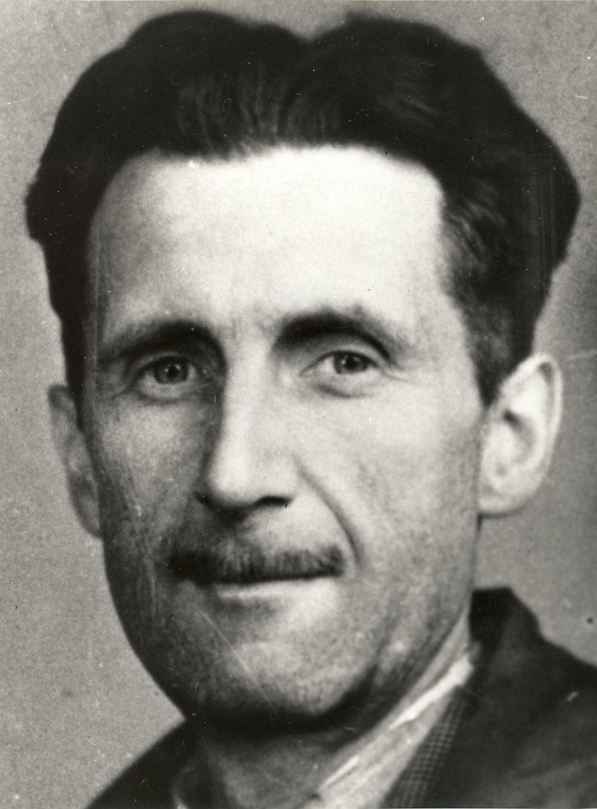
The sentence the character counter counts
>>>
1949-06-08
The message in the program is the first sentence of Nineteen Eighty-Four
Secker and Warburg published the novel in London on 8 June 1949
Counted by the program: 73 characters, 23 of them different
Thirteen spaces and three letters c, from the same table
Photo: George Orwell's press card photo, 1943 - National Union of Journalists, public domain
WHO George Orwell, published by Secker and…
WHERE London - the opening line of Nineteen …
WHEN 1949-06-08
READ en.wikipedia.org
The lines that count one sentence count a whole novel.
13 / 26
Notes:
The message in characterCount.py, 'It was a bright cold day in April, and the clocks were striking thirteen.', is the opening line of George Orwell's novel Nineteen Eighty-Four, which Secker and Warburg published in London on 8 June 1949. Counting its 73 characters with a dictionary gives 23 different characters, 13 spaces and 3 letters c. The same table shows 6 letters t and one capital A, and the thirteen strokes of the clocks are what tells the reader at once that this world is wrong. The same few lines count the words of a whole novel. The account rests on these sources. George Orwell, Nineteen Eighty-Four (Secker and Warburg, London, 8 June 1949), first sentence; Al Sweigart, Automate the Boring Stuff with Python, 3rd edition (2025), chapter 7, characterCount.py. The counts are the output of the executed program of this chapter. Photo: Branch of the National Union of Journalists (1943), public domain, Wikimedia Commons.

Slide 14
Counter, defaultdict and grouping
>>>
setdefault() or defaultdict(list) groups words; Counter counts in one call
program grouping_v1_0_0.py, lines 1 to 12 of 12 - Python 3.14.6
Counter counts in one call
words = ['apple', 'avocado', 'banana', 'blueberry', 'cherry', 'apricot']
groups = {} # first letter -> list of words
for word in words:
groups.setdefault(word[0], []).append(word) # create the list once, then append
for letter, found in groups.items():
print(letter, found)
from collections import defaultdict
same = defaultdict(list) # the same job, the missing key creates its list
for word in words:
same[word[0]].append(word)
print(dict(same) == groups)
prints a ['apple', 'avocado', 'apricot']
b ['banana', 'blueberry']
c ['cherry']
True
>>> from collections import Counter
>>> c = Counter('abracadabra')
>>> c.most_common(2)
[('a', 5), ('b', 2)]
>>> c['a']
5
>>> c['z']
0
>>> sum(c.values())
11
run under Python 3.14.6
Pigeonholes: each word is slipped into the hole for its first letter, and a new hole appears when needed.
Counter counts, defaultdict groups, both create missing keys.
14 / 26
Notes:
Two tools from the collections module remove the setdefault line. A Counter takes any iterable and returns a dictionary of counts, and its most_common method lists the biggest first. A missing key in a Counter reads as 0 instead of raising an error. The grouping program on the right solves a related problem, sorting words into lists by first letter, first with setdefault and then with a defaultdict, and its last line prints True because the two dictionaries are equal. Pigeonholes are the picture: each word goes into the hole labelled with its first letter.

Slide 15
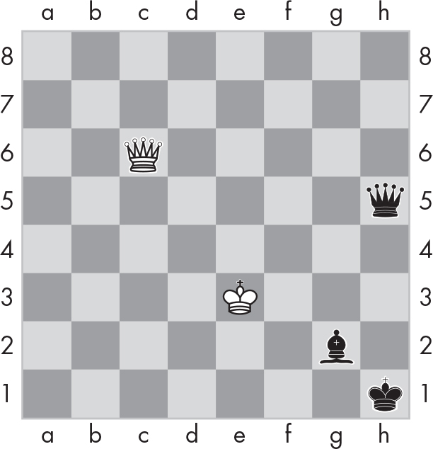
Modelling a real thing
>>>
A chessboard becomes a dictionary
Figure 7-2's board as a dictionary
>>> board = {'h1': 'bK', 'c6': 'wQ', 'g2': 'bB', 'h5': 'bQ', 'e3': 'wK'}
>>> 'c6' in board
True
>>> board.get('a1', 'empty')
'empty'
>>> sorted(board)
['c6', 'e3', 'g2', 'h1', 'h5']
>>> len(board)
5
run under Python 3.14.6
A square is a key such as 'c6'; the piece is the value, a colour letter and a piece letter.
Sweigart (2025), Figure 7-2: the board that the dictionary describes
A good model stores only what is there.
15 / 26
Notes:
To model a real thing you decide what the keys and the values are. For a chessboard the book uses the name of a square, such as c6, as the key and a two-letter piece, such as wQ for a white queen, as the value. Only occupied squares are stored, so an empty square is simply a key that is absent, which the console shows with board.get('a1', 'empty'). The figure is Figure 7-2 of Sweigart's chapter, used for teaching with its credit, and it shows the five pieces that the dictionary on the left describes.

Slide 16
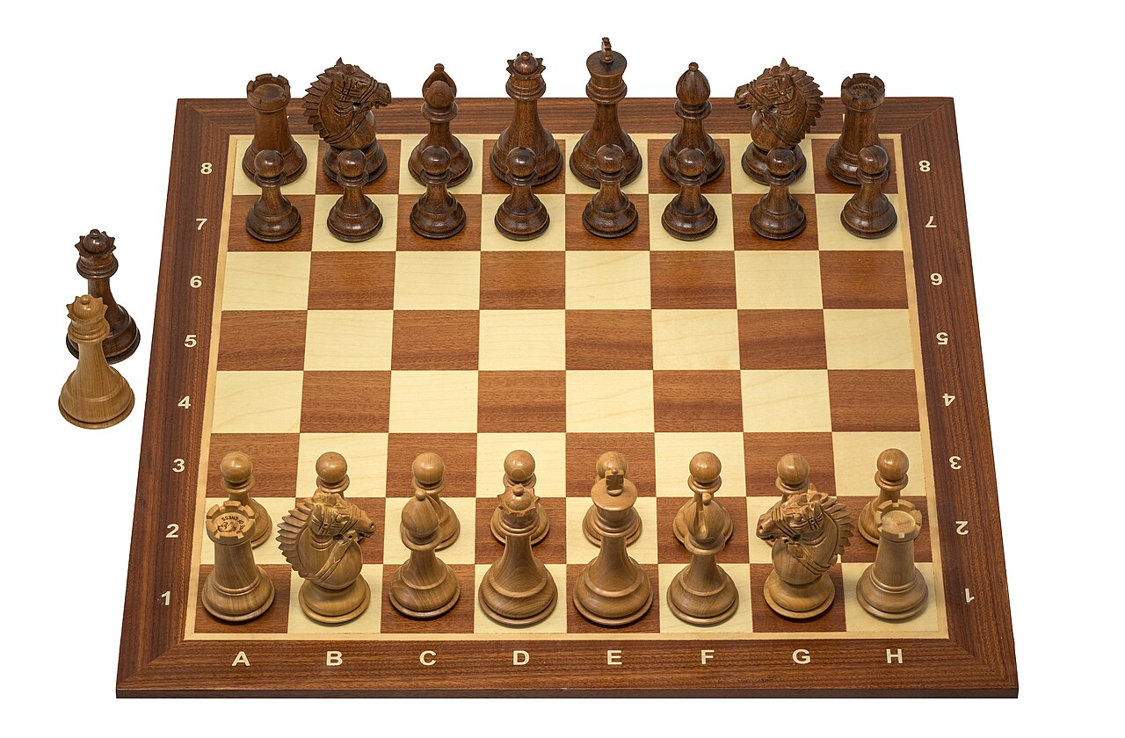
The squares a1 to h8 are three centuries old
>>>
1730s; 1847; 1981
1730s: Philipp Stamma devises an early form of algebraic notation
1847: Howard Staunton describes the system in his handbook
1981: FIDE stops recognising descriptive notation
The program's keys 'a1' to 'h8' reuse that notation
A Staunton chess set - photo: Wilfredor, CC0
WHO Philipp Stamma, Howard Staunton and FI…
WHERE the chess books of an eighteenth-centu…
WHEN 1730s; 1847; 1981
READ en.wikipedia.org
The best keys are often a notation people already use.
16 / 26
Notes:
The dictionary keys 'a1' to 'h8' of the chessboard program are a data structure that chess players have used for almost three hundred years. An early form of algebraic notation was devised by the Syrian player Philipp Stamma in the 1730s. Howard Staunton described the system in his Chess-Player's Handbook in 1847, and German chess literature took it up in the nineteenth century. English-language books preferred descriptive notation for most of the twentieth century, until in 1981 FIDE stopped recognising it and algebraic notation became the international standard. The author's program simply turned an old notation into the keys of a Python dictionary. The account rests on these sources. 'Algebraic notation (chess)', Wikipedia, citing Stamma (1737), Staunton, The Chess-Player's Handbook (1847) and the FIDE decision of 1981; Al Sweigart, Automate the Boring Stuff with Python, 3rd edition (2025), chapter 7. Photo: Wilfredor, CC0, Wikimedia Commons.

Slide 17
The board as a table
>>>
The starting position, drawn from the dictionary
 | a | b | c | d | e | f | g | h
8 | bR | bN | bB | bQ | bK | bB | bN | bR
7 | bP | bP | bP | bP | bP | bP | bP | bP
6
5
4
3
2 | wP | wP | wP | wP | wP | wP | wP | wP
1 | wR | wN | wB | wQ | wK | wB | wN | wR
32
squares hold a piece, so 32 keys
32
squares have no key at all
A seating chart
It lists only the seats that someone occupies. Nobody writes 'empty' 32 times.
The dictionary is the data; the table is one view of it.
17 / 26
Notes:
The table is not typed in; it was produced by looking up each of the 64 square names in the starting-position dictionary, and an empty cell means the lookup found no key. Of the 64 squares 32 hold a piece, so the dictionary has 32 keys and the other 32 squares do not appear in it. The dictionary is the model, and the table is only one way of displaying it, which is the point of keeping the data separate from the printing function. The book's program draws this same board as text in a terminal window.

Slide 18
Chess commands are dictionary operations
>>>
Every command of the simulator is one or two operations on the board
program chessMoves_v1_0_0.py, lines 1 to 17 of 17 - Python 3.14.6
import copy
STARTING_PIECES = {'a1': 'wR', 'e1': 'wK', 'e2': 'wP', 'd7': 'bP', 'e8': 'bK', 'h8': 'bR'} # a small start position
board = copy.copy(STARTING_PIECES) # a copy, so STARTING_PIECES stays intact
board['e4'] = board['e2'] # move e2 e4: copy the piece to the new key ...
del board['e2'] # ... then delete the old key
print('after move e2 e4:', sorted(board))
del board['d7'] # remove d7
board['d5'] = 'wP' # set d5 wP
print('after remove and set:', sorted(board))
board = copy.copy(STARTING_PIECES) # reset
print('after reset:', len(board), 'pieces, e2 holds', board['e2'])
board = {} # clear
print('after clear:', len(board), 'pieces')
prints after move e2 e4: ['a1', 'd7', 'e1', 'e4', 'e8', 'h8']
after remove and set: ['a1', 'd5', 'e1', 'e4', 'e8', 'h8']
after reset: 6 pieces, e2 holds wP
after clear: 0 pieces
Moving a piece is copy-then-delete.
18 / 26
Notes:
The chapter's simulator accepts the commands move, remove, set, reset, clear and quit, and each one is a single dictionary operation or two. A move copies the piece to the new key and then deletes the old key, remove deletes a key, set assigns one, reset replaces the board with a copy of the starting position, and clear empties it. This short program drives the same operations without the text board so that you can see each effect in the printed list of keys. The copy in the reset line is important and it is the subject of slide 20.

Slide 19
Nested dictionaries: the picnic
>>>
Dictionaries inside a dictionary hold records inside a record
program guestpicnic_v1_0_0.py, lines 1 to 16 of 16 - Python 3.14.6
all_guests = {'Alice': {'apples': 5, 'pretzels': 12},
'Bob': {'ham sandwiches': 3, 'apples': 2},
'Carol': {'cups': 3, 'apple pies': 1}}
def total_brought(guests, item):
num_brought = 0
for k, v in guests.items(): # k is a guest, v is that guest's dictionary
num_brought = num_brought + v.get(item, 0) # 0 when the guest brings none
return num_brought
print('Number of things being brought:')
print(' - Apples ' + str(total_brought(all_guests, 'apples')))
print(' - Cups ' + str(total_brought(all_guests, 'cups')))
print(' - Cakes ' + str(total_brought(all_guests, 'cakes')))
print(' - Ham Sandwiches ' + str(total_brought(all_guests, 'ham sandwiches')))
print(' - Apple Pies ' + str(total_brought(all_guests, 'apple pies')))
prints Number of things being brought:
- Apples 7
- Cups 3
- Cakes 0
- Ham Sandwiches 3
- Apple Pies 1
get() with a default keeps the picnic totals honest.
19 / 26
Notes:
A guest list is a dictionary of dictionaries: each guest is a key, and each guest's value is another dictionary of items and quantities. The function total_brought walks the guests and uses get with a default of zero, so a guest who brings none of an item simply adds nothing. The printed totals are 7 apples, 3 cups, no cakes, 3 ham sandwiches and 1 apple pie. A filing cabinet is the picture, with a folder for each guest and a sheet inside it for each kind of food.

Slide 20
Copying: alias, shallow and deep
>>>
Changing an inner dictionary shows which copies share it
program copying_v1_0_0.py, lines 1 to 12 of 12 - Python 3.14.6
import copy
original = {'Alice': {'apples': 5}, 'Bob': {'apples': 2}}
alias = original # no copy at all: a second name
shallow = copy.copy(original) # a new outer dictionary, the same inner ones
deep = copy.deepcopy(original) # new at every level
original['Alice']['apples'] = 99 # change an inner dictionary
print(alias['Alice']['apples'])
print(shallow['Alice']['apples'])
print(deep['Alice']['apples'])
print(shallow['Alice'] is original['Alice'], deep['Alice'] is original['Alice'])
prints 99
99
5
True False
Alias
two names for one person
Shallow copy
shortcuts to the same files
Deep copy
a full photocopy of everything
A shallow copy shares inner dictionaries; deepcopy does not.
20 / 26
Notes:
Three lines make three different things. The assignment alias = original creates no copy, it only gives the same dictionary a second name. The call copy.copy builds a new outer dictionary whose inner dictionaries are still the same objects, so changing an inner value is seen through the shallow copy, while copy.deepcopy copies every level. After the program changes an inner value to 99, the alias and the shallow copy print 99 and the deep copy still prints 5, and the last line prints True False, because the shallow copy shares the inner dictionary and the deep copy does not.

Slide 21
Writing data down and checking its shape
>>>
Text, tidy printing, typed records and patterns
json, pprint and TypedDict in a console
program matching_v1_0_0.py, lines 1 to 6 of 6
>>> import json, pprint, typing
>>> cat = {'name': 'Zophie', 'age': 8}
>>> json.dumps(cat)
'{"name": "Zophie", "age": 8}'
>>> json.loads('{"cats": [1, 2]}')
{'cats': [1, 2]}
>>> pprint.pformat({'b': 1, 'a': 2})
"{'a': 2, 'b': 1}"
>>> Cat = typing.TypedDict('Cat', {'name': str, 'age': int})
>>> type(Cat(name='Zophie', age=8))
<class 'dict'>
cat = {'name': 'Zophie', 'age': 8}
match cat: # keys are tested, values are bound
case {'name': name, 'age': age} if age > 5:
print(name, 'is a senior cat of', age)
case {'name': name}:
print(name, 'is a cat')
prints Zophie is a senior cat of 8
The first case needs both keys and an age above 5; otherwise the second case matches.
run under Python 3.14.6
TypedDict is checked by type checkers only: at run time Cat(...) is a plain dict.
JSON carries a dictionary out of a program.
21 / 26
Notes:
A dictionary vanishes when the program ends, so it has to be turned into text to be saved or sent. The json module's dumps turns a dictionary into JSON text and loads turns it back, and pprint.pformat lays a big dictionary out tidily, with its keys sorted. The TypedDict describes which keys a record must have, but Python does not enforce it when the program runs, as the last row shows with its plain dict, and only a type checker complains. The match statement on the right tests a dictionary against a pattern and binds the values it finds, so the first case needs both keys and an age above 5.

Slide 22

The notation that carries dictionaries
>>>
2001-04; 2017-12-13
April 2001: Crockford and Morningstar send the first JSON message
December 2005: Yahoo offers some web services in JSON
13 December 2017: the IETF publishes JSON as RFC 8259
Python's json module converts a dictionary to that text and back
Douglas Crockford, 2013 - photo: Robert Claypool, CC0
WHO Douglas Crockford and Chip Morningstar…
WHERE California - and json.org and the IETF…
WHEN 2001-04; 2017-12…
READ json.org
JSON is how a dictionary leaves a program and comes back.
22 / 26
Notes:
A dictionary exists only while its program runs, so something must carry it to another program. Douglas Crockford, who co-founded State Software in March 2001, and Chip Morningstar sent the first JSON message in April 2001, and json.org began in 2001 to describe the format. Yahoo offered some of its web services in JSON in December 2005. The IETF published JSON as RFC 8259, an Internet Standard, on 13 December 2017, two days before the Python ruling on dictionary order. Python's json module turns a dictionary into that text and back. The account rests on these sources. 'JSON', Wikipedia (first message April 2001; State Software founded March 2001; Yahoo, December 2005; RFC 8259, 13 December 2017); json.org; the Python json module documentation. Photo: Robert Claypool, CC0, Wikimedia Commons.

Slide 23
Practice: the fantasy game inventory
>>>
Display a dictionary of items, then add the dragon's loot to it
program inventory_v1_0_0.py, lines 1 to 22 of 22 - Python 3.14.6
what the run printed
stuff = {'rope': 1, 'torch': 6, 'gold coin': 42, 'dagger': 1, 'arrow': 12}
def display_inventory(inventory):
print('Inventory:')
item_total = 0
for k, v in inventory.items(): # key: the item, value: how many
print(str(v) + ' ' + k)
item_total = item_total + v
print('Total number of items: ' + str(item_total))
def add_to_inventory(inventory, added_items):
for item in added_items: # the loot is a list and may repeat an item
inventory.setdefault(item, 0) # a new item starts at 0 ...
inventory[item] = inventory[item] + 1 # ... and every sighting adds one
return inventory
display_inventory(stuff)
print()
inv = {'gold coin': 42, 'rope': 1}
dragon_loot = ['gold coin', 'dagger', 'gold coin', 'gold coin', 'ruby']
inv = add_to_inventory(inv, dragon_loot)
display_inventory(inv)
prints Inventory:
1 rope
6 torch
42 gold coin
1 dagger
12 arrow
Total number of items: 62
Inventory:
45 gold coin
1 rope
1 dagger
1 ruby
Total number of items: 48
Each practice program reads a dictionary and applies a rule.
23 / 26
Notes:
The practice project of the chapter stores a player's items as a dictionary from the item name to the count. The first function prints each item and the total, which is 62 for the starting stuff, and the second function adds a list of loot to an inventory, using setdefault so that a new item starts at zero. The loot list repeats gold coin three times, so the inventory ends with 45 gold coins, since it started with 42, and 48 items in all. The chessboard validator project is on the course page, in the practice section.

Slide 24
The chapter in five lines
>>>
One line for each question the chapter set
1
Assign to add or replace a pair, and use del or pop to remove one, with get() when a missing key is normal.
2
A key must be hashable, so a tuple is welcome and a list is not, and dictionaries have kept insertion order since 3.7.
3
Counting and grouping take setdefault, Counter or defaultdict, and a view follows the dictionary while list() freezes it.
4
A chessboard is a dictionary of occupied squares, and a nested dictionary holds a record inside a record.
5
copy.copy shares the inner dictionaries, deepcopy does not, and JSON writes the data down as text.
If a line feels unproven, its slides hold the example.
24 / 26
Notes:
These five lines answer the five questions of slide 3, one each. The first line covers the operations on pairs, the second covers the rules for keys and the changes between the printed chapter and today's Python, and the third covers counting, grouping and views. The fourth is about modelling and nesting, and the fifth is about copying and writing data down. If a line feels unproven, the part of the route that carries it has the slides with the executed examples.

Slide 25
Where to go from here
>>>
Every link was opened on the day this deck was made
Read
History
The textbook, chapter 7 - free online automatetheboringstuff.com/3e/chapter7.html
Guido's ruling on dictionary order, 2017 mail.python.org/pipermail/python-dev/2017-December/151283.html
Python tutorial: data structures docs.python.org/3/tutorial/datastructures.html
PEP 584: merge operators for dict peps.python.org/pep-0584/
Built-in types: dict and its views docs.python.org/3/library/stdtypes.html
RFC 8259: the JSON standard datatracker.ietf.org/doc/html/rfc8259
Libraries
Watch and try
collections: Counter and defaultdict docs.python.org/3/library/collections.html
Modern Dictionaries, Raymond Hettinger youtube.com/watch?v=p33CVV29OG8
copy: shallow and deep copies docs.python.org/3/library/copy.html
Python Tutor: step through your code pythontutor.com/
json and pprint docs.python.org/3/library/json.html
Eleven links, each opened on the day this deck was built.
25 / 26
Notes:
Every link on this slide was opened on the day the deck was made. The textbook chapter is free to read online and has the chessboard and picnic programs, and the documentation links lead to the exact module of each library used today. The history links are for the curious: the python-dev message is the ruling that gave dictionaries their order, and the video is a talk by the core developer who proposed the compact layout. Python Tutor lets you step through a program and watch a dictionary change, which is the best way to understand the copying slide.

Slide 26
What you should now be able to say
>>>
Four claims, each carried by a result you saw printed
A dictionary finds values by key, and keys must be hashable.
Counting and grouping are three lines with setdefault, or one with Counter.
A real thing becomes a dictionary of the parts that are there.
A shallow copy shares the inner dictionaries, and JSON writes the data down.
49 console rows run
9 programs run
4 true stories
Questions are welcome; bring one example you could not predict.
26 / 26
Notes:
Four claims, each carried by a result you saw printed. If you can say them in your own words and run the examples yourself, you have the chapter. The next chapter moves on to strings and text editing.

