Slide 1
>>>
Debugging
Chapter 5 of Automate the Boring Stuff with Python, 3rd edition, for an advanced course
20
3
40
code examples that run on the chapter page
true stories with who, what, when, where, why and how
chapter concepts, each with an everyday picture
SEN0414 Advanced Programming, Fall 2026. Yusuf Altunel, İstanbul Kültür Üniversitesi
1 / 43
Notes:
Welcome. This chapter teaches four instruments for finding bugs: raise, assert, logging and the debugger. Every code slide shows the code, a plain explanation, and the result of the run as a table, chart or drawing. The same examples run on the chapter page.

Slide 2
>>>
Today's route
Five parts; every range is a run of slides you can jump to
Part | Slides | Code examples | You will run
Exceptions and tracebacks | 4 - 10 | 4 | raise, except, traceback, notes
Assertions | 11 - 15 | 3 | assert, messages, python -O
Logging | 16 - 25 | 6 | levels, basicConfig, file, disable
Hunting bugs with the log | 26 - 32 | 5 | factorial, string sum, coin toss
The debugger | 33 - 38 | 2 | a line stepper, breakpoint(), pdb
Instruments, changes, summary, practice, resources | 39 - 43 | - | which tool for which question
Open the chapter-code tab of the page: the same 20 examples, in this order.
2 / 43
Notes:
Five parts: exceptions and tracebacks, assertions, logging, hunting bugs with the log, and the debugger. Each code slide has its place in the chapter-code tab of the page, in this same order.

Slide 3
>>>
Two questions this chapter answers
Carry them through every part; the answers come back at the end
1
Which constructs signal, check, record and inspect a program's behaviour, and what decides which one a problem calls for?
Answer on slide 39: four instruments, chosen by the question you ask.
2
Which printed outputs and concepts of the chapter differ in current Python, and on what source?
Answer on slide 40: notes, error locations and the attach of Python 3.14.
Raise, assert, log, step: four instruments for four questions.
3 / 43
Notes:
Two questions to carry through the chapter. Which instrument fits which problem? And which printed outputs of the book differ in current Python? The answers come back near the end.

Slide 4
Part 1: Exceptions and tracebacks
A function refuses a bad call; the exception climbs; the traceback tells the way
Raising Exceptions
A function refuses a call it cannot serve by raising an exception.
Slide | In this part
5 | Everyday pictures: errors and exceptions
6 | Story: the bug you can visit in a museum
7 | raise: a function refuses a bad call
8 | except ... as err: the exception object
9 | The traceback: where an exception passed
10 | add_note: context travels with the error
Exception object
Carries its class, its arguments and the message you gave it.
traceback
The report of the calls an exception passed on its way up.
Notes
Context that an except clause adds before it raises again.
4 / 43
Notes:
Part one. A function refuses a bad call with raise. The exception climbs the call stack, and the traceback is the report of that climb.

Slide 5
>>>
Everyday pictures: errors and exceptions
ANALOGY An exception is a fire alarm: it stops the normal day and tells the building where to look.
Chapter concept | Everyday picture
Raising Exceptions | Pulling the fire alarm: the function stops and the building hears it.
bug | A pebble in a shoe: small, but you feel it at every step.
error message | The note on the alarm panel: which room, and what happened.
exception | An alarm that climbs floor by floor until someone answers it.
raise | Pulling the alarm lever on purpose.
Exception() class | The alarm model: a plain bell, or a special siren for gas.
box_print() | A stamp that refuses to print on the wrong paper size.
traceback | Muddy footprints from the front door to the broken vase.
5 / 43
Notes:
An exception is a fire alarm. Raise pulls the lever, the traceback shows the path the alarm took. Ask students to add one more everyday picture of their own.

Slide 6
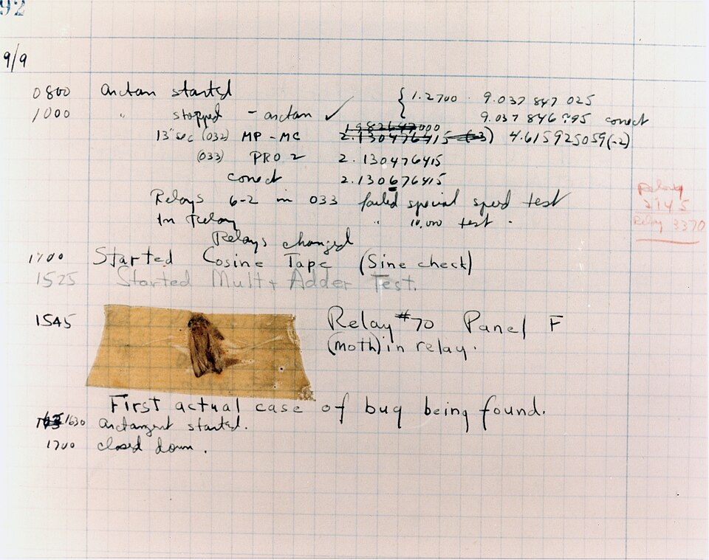
>>>
Story: the bug you can visit in a museum
WHO Grace Hopper's team of operators at the Harvard Mark II computer.
WHAT A moth stuck in relay 70 of panel F. They taped it into the logbook: 'First actual case of bug being found'.
WHEN 9 September 1947, as the log page says; a common file title wrongly says 1945.
WHERE Harvard University, Cambridge, Massachusetts. The page is now at the Smithsonian.
WHY The machine had stopped; finding the cause meant opening it up and looking for evidence.
The Mark II logbook page, 9 September 1947. Photo: U.S. Navy, Naval Surface Warfare Center Dahlgren, public domain.
HOW Debugging still goes this way: find the cause, remove it, keep a record.
READ Software bug, with the 1947 logbook page (Wikipedia)
6 / 43
Notes:
The logbook page is dated 9 September 1947. The moth was taped in beside the joke about the first actual case of a bug. Ask students what evidence they keep when they debug.

Slide 7
>>>
raise: a function refuses a bad call
>>> def box_print(symbol, width, height):
>>> if len(symbol) != 1:
>>> raise Exception('Symbol must be a single character string.')
>>> if width <= 2:
box_print checks its three arguments. A bad one stops the function with raise and an Exception that carries a message.
>>> raise Exception('Width must be greater than 2.')
>>> if height <= 2:
>>> raise Exception('Height must be greater than 2.')
>>> row = symbol + ' ' * (width - 2) + symbol
>>> rows = [symbol * width] + [row] * (height - 2)
Good arguments reach the drawing lines: the top edge, the middle rows and the bottom edge, printed as one box.
>>> print('\n'.join(rows + [symbol * width]))
>>> box_print('*', 5, 4)
What the run printed (Python 3.13.16)
box_print(...) | What happened | Message of the exception
'ab', 5, 4 | raised | Symbol must be a single character string.
'*', 2, 4 | raised | Width must be greater than 2.
'*', 5, 1 | raised | Height must be greater than 2.
'*', 5, 4 | printed a box | -
the box that was printed
*
*
*
*
*
*
*
*
*
*
*
*
*
*
raise stops the function and tells the caller why.
7 / 43
Notes:
Box print refuses a call it cannot serve. Each raise stops the function and hands an Exception with a message to the caller. Predict the box before the run.

Slide 8
>>>
except ... as err: the exception object
>>> try:
>>> raise Exception('custom message')
>>> except Exception as err:
>>> print(type(err).__name__, err.args, str(err))
The message given to Exception is kept in args, and str(err) gives it back. The except clause catches the exception by its class.
>>> try:
>>> raise ValueError('a more specific class')
>>> except Exception as err:
>>> print(type(err).__name__, isinstance(err, Exception))
ValueError is a more specific class of Exception, so the same except clause catches it too.
What the run printed (Python 3.13.16)
Expression | Value
type(err).__name__ | 'Exception'
err.args | ('custom message',)
str(err) | 'custom message'
isinstance(ValueError(), Exception) | True
BaseException
Exception
is a kind of
ValueError
AssertionError
An exception is an object with a class, args and a message.
8 / 43
Notes:
The message is kept in args. The except clause catches by class, and a more specific class is still an Exception. The diagram shows the family tree.

Slide 9
>>>
The traceback: where an exception passed
>>> import traceback
>>> def read_age(text):
>>> return int(text)
>>> def load(record):
>>> return read_age(record['age'])
load calls read_age, and read_age turns the text into a number with int.
>>> try:
>>> load({'age': 'abc'})
>>> except ValueError as e:
>>> print('caught:', e)
>>> frames = traceback.extract_tb(e.__traceback__)
>>> print([f.name for f in frames])
'abc' is not a number, and nobody inside claims the error, so it climbs to the try. The traceback lists the calls it passed, outermost first.
What the run printed (Python 3.13.16)
<module> (the try)
load
read_age
load({...})
read_age(...)
int(text) fails
the ValueError climbs back until a try claims it
caught: invalid literal for int() with base 10: 'abc'
The traceback lists the calls, outermost first.
9 / 43
Notes:
Nobody in read age, load or process claims the error, so it climbs to the try. The traceback lists the calls it passed, outermost first.

Slide 10
>>>
add_note: context travels with the error
>>> import traceback
>>> try:
>>> try:
>>> int('x')
>>> except ValueError as e:
>>> e.add_note('while reading the age field')
>>> raise
The inner except adds a note and raises the same error again. The note says where in the work the error happened.
>>> except ValueError as e:
>>> print(e.__notes__)
>>> print(traceback.format_exception(e)[-1].strip())
The notes are kept in __notes__. The formatted report prints them right after the error message.
What the run printed (Python 3.13.16)
Last lines of the report | What the line is
ValueError: invalid literal for int() with base 10: 'x' | class and message of the error
while reading the age field | the note, printed after the message
e.__notes__ = ['while reading the age field']
add_note sends context along with the error.
10 / 43
Notes:
Since Python 3.11 an exception can carry notes. The note is added where the context is known and printed after the message. Ask why raise without arguments keeps the original error.

Slide 11
Part 2: Assertions
Executable beliefs of the programmer, not checks on the user
assert
A statement that raises AssertionError when its condition is false.
Slide | In this part
12 | Everyday pictures: assertions
13 | assert: a check the programmer believes
14 | assert for the programmer, raise for t...
15 | python -O removes every assert
Message
The second expression explains the failure and is built only on failure.
User or bug?
Errors of the user are raised; errors of the programmer are asserted.
python -O
Optimised runs remove every assert statement from the program.
11 / 43
Notes:
Part two. An assert is a tripwire for the programmer. It checks beliefs, not user input, and it disappears under python dash capital O.

Slide 12
>>>
Everyday pictures: assertions
ANALOGY An assertion is a tripwire a builder strings across a place nobody should ever reach.
Chapter concept | Everyday picture
Assertions | Smoke detectors fitted by the builder, not by the tenant.
assertion | One tripwire across one doorway.
assert | Stringing the wire: the statement that sets the trap.
sanity check | Testing the ladder before you climb it.
programmer error | A wiring mistake of the electrician, not of the person who flips the switch.
sort() and the list ages | Lining people up by age, then checking that the first is not older than the last.
12 / 43
Notes:
An assertion is a tripwire set by the builder. It checks what must be true if the program is correct. It guards the programmer, never the user.

Slide 13
>>>
assert: a check the programmer believes
>>> ages = [26, 57, 92, 54, 22, 15, 17, 80, 47, 73]
>>> ages.sort()
>>> assert ages[0] <= ages[-1]
>>> print('sorted: ok')
After sort the first age cannot be larger than the last. The assert states that belief and stays silent when it holds.
>>> ages.reverse()
>>> try:
>>> assert ages[0] <= ages[-1]
>>> except AssertionError as e:
>>> print(type(e).__name__, repr(str(e)))
A reversed list breaks the belief. The assert raises AssertionError, an ordinary exception, with an empty message.
What the run printed (Python 3.13.16)
sort()
15
17
22
26
47
54
57
73
80
92
15 <= 92 is True: the assert stays silent
reverse()
92
80
73
57
54
47
26
22
17
15
92 <= 15 is False: AssertionError
Printed: sorted: ok | AssertionError ''
An assert states what must be true.
13 / 43
Notes:
The assert states a belief and is silent when it holds. When it fails it raises AssertionError. Ask students why the book says not to catch it.

Slide 14
>>>
assert for the programmer, raise for the user
>>> def average(scores):
>>> if len(scores) == 0:
>>> raise ValueError('give at least one score')
>>> total = sum(scores)
>>> assert total >= 0, f'negative total: {total}'
An empty list is a mistake the user can make, so it is raised. A negative total can only be our own bug, so it is asserted.
>>> return total / len(scores)
>>> for data in ([4, 6], [], [-5, 1]):
>>> try:
>>> print(average(data))
>>> except (ValueError, AssertionError) as e:
>>> print(type(e).__name__ + ':', e)
The second expression of assert becomes the message of the AssertionError. It is built only when the check fails.
What the run printed (Python 3.13.16)
average(...) | Result | Statement | Who can cause it
[4, 6] | 5.0 | none fired | -
[] | ValueError: give at least one score | raise | the user (bad input)
[-5, 1] | AssertionError: negative total: -4 | assert | our own bug
Raise for the user; assert for the programmer.
14 / 43
Notes:
The user can pass an empty list, so we raise. Only our own bug can make a negative total, so we assert. The message is built only when the check fails.

Slide 15
>>>
python -O removes every assert
>>> src = "assert False, 'boom'\nprint('reached')"
>>> try:
>>> exec(compile(src, 'x', 'exec'))
>>> except AssertionError as e:
>>> print('normal run:', e)
A normal run raises the AssertionError at the assert line, so the next line is never reached.
>>> exec(compile(src, 'x', 'exec', optimize=1))
>>> print(__debug__)
Compiled with optimization, as under python -O, the program has no assert at all and reaches the next line.
What the run printed (Python 3.13.16)
normal run
assert False, 'boom'
normal run: boom
'reached' never printed
python -O
assert removed
prints 'reached'
__debug__ is True
python -O removes every assert.
15 / 43
Notes:
Under python dash O, assert statements are removed. That is why asserts guard the programmer and never the user. Compile with optimize equals one shows it.

Slide 16
Part 3: Logging
A record of what the program did, without stopping it
Levels
Five names from DEBUG to CRITICAL, with the numbers 10 to 50.
Slide | In this part
17 | Everyday pictures: logging
18 | Story: the most effective debugging tool
19 | Story: a logging system with a birth c...
20 | Logging levels: five names, five numbers
21 | basicConfig: choose what you hear
22 | The format string: what each line shows
23 | filename=: evidence on disk
24 | logging.disable: silence without delet...
25 | Arguments are formatted only when needed
basicConfig
One call sets the threshold, the format and the destination.
filename
Sends the log to a text file instead of the screen.
disable
Silences logging up to a level without deleting any call.
16 / 43
Notes:
Part three. Logging leaves a record without stopping the program. Choose a level, a format and a destination, and switch it off without deleting a line.

Slide 17
>>>
Everyday pictures: logging
ANALOGY A log is the ship's logbook: written while sailing, read when something went wrong.
Chapter concept | Everyday picture
Logging | A flight recorder: always on, read after the incident.
log message | One line in the logbook.
logging level | A tag from whisper to siren on every entry.
logging.basicConfig() | Setting up the logbook once: how loud, what layout, which book.
format string with %(asctime)s | A form with blanks for the date, the urgency and the text.
named parameter filename | Choosing the notebook in which the entries are written.
logging.disable() | A mute button: the entries stay in the code, the radio goes quiet.
17 / 43
Notes:
A log is a logbook. Each entry has a level, the format is the form, and the file is the notebook. Disable is the mute button.

Slide 18
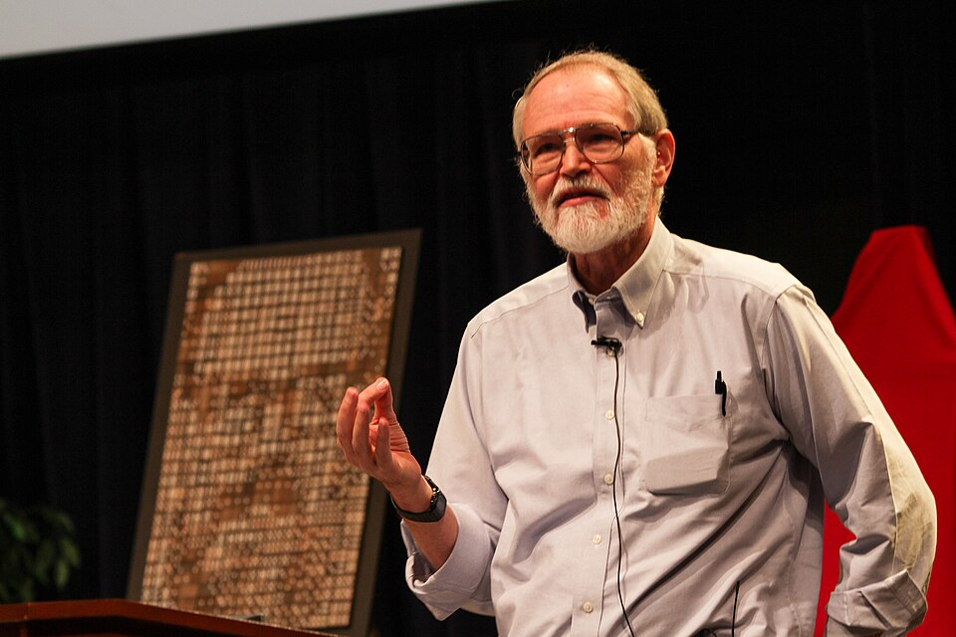
>>>
Story: the most effective debugging tool
WHO Brian Kernighan, computer scientist at Bell Labs.
WHAT The sentence: 'The most effective debugging tool is still careful thought, coupled with judiciously placed print statements.'
WHEN 1979, in the Bell Labs memorandum 'Unix for Beginners'.
WHERE Bell Laboratories, Murray Hill, New Jersey.
WHY Tools help, but a debugging session starts with thinking about what the program should do.
HOW This chapter agrees, then upgrades the print statement into logging, with levels, files and an off switch.
Brian Kernighan at Bell Labs, 2012. Photo: Ben Lowe, CC BY 2.0, Wikimedia Commons.
READ Brian Kernighan (Wikipedia)
18 / 43
Notes:
Kernighan wrote this in 1979. Thinking comes first, print statements second. Logging is the same idea with levels and an off switch. Ask: when is a print statement enough?

Slide 19

>>>
Story: a logging system with a birth certificate
WHO Vinay Sajip and Trent Mick, the authors of PEP 282.
WHAT PEP 282, 'A Logging System': loggers, levels, handlers and formatters for Python's standard library.
WHEN Created on 4 February 2002; part of Python since version 2.3.
WHERE The Python Enhancement Proposals, peps.python.org, status Final.
WHY Every program printed its own notes in its own way. A shared system makes logs work together.
HOW The five levels DEBUG to CRITICAL on these slides are that design, and every logging example here runs it.
Python logo. Source: python.org, Python Software Foundation, used under its trademark policy.
READ PEP 282, A Logging System (peps.python.org)
19 / 43
Notes:
PEP 282 was created in February 2002 and landed in Python 2.3. The five levels are its design. Ask students which level they would use for a missing file.

Slide 20
>>>
Logging levels: five names, five numbers
>>> import logging
>>> levels = ('DEBUG', 'INFO', 'WARNING', 'ERROR', 'CRITICAL')
>>> print([(name, getattr(logging, name)) for name in levels])
Each level is a name with a number: 10, 20, 30, 40 and 50. A higher number means a more serious message.
>>> print(logging.WARNING > logging.INFO, logging.getLevelName(30))
Levels compare as numbers, and getLevelName turns a number back into its name.
What the run printed (Python 3.13.16)
Call | Number | Typical use
logging.debug() | 10 | details for the programmer
logging.info() | 20 | the program works as planned
logging.warning() | 30 | something unexpected (default)
logging.error() | 40 | a part of the work failed
logging.critical() | 50 | the program may not go on
Five names, five numbers, 10 to 50.
20 / 43
Notes:
Five names, five numbers, from ten to fifty. A message is shown when its number reaches the threshold. Warning is the default threshold.

Slide 21
>>>
basicConfig: choose what you hear
>>> import logging, sys
>>> fmt = '%(levelname)s - %(message)s'
>>> cfg = dict(stream=sys.stdout, format=fmt, force=True)
>>> logging.basicConfig(level=logging.INFO, **cfg)
cfg gathers the format, the place to write and force=True. basicConfig adds the threshold: INFO hides DEBUG.
>>> logging.debug('debug message')
>>> logging.info('info message')
>>> logging.warning('warning message')
>>> logging.error('error message')
>>> logging.critical('critical message')
Five calls, one per level. Only the messages at the threshold or above are printed, and no call has to be deleted.
What the run printed (Python 3.13.16)
messages shown at each threshold
Printed at threshold INFO
INFO - info message
WARNING - warning message
ERROR - error message
CRITICAL - critical message
The threshold hides the lower levels.
21 / 43
Notes:
One call to basicConfig sets the threshold, the format and the destination. With INFO the debug line stays silent. Force equals true replaces an earlier setup.

Slide 22
>>>
The format string: what each line shows
>>> import logging, time
>>> text = '%(asctime)s - %(levelname)s - %(message)s'
>>> fmt = logging.Formatter(text, datefmt='%Y-%m-%d %H:%M')
>>> fmt.converter = time.gmtime
The format string names the fields of a line: the time, the level and the message. Here the time is shown in UTC.
>>> args = ('demo', logging.WARNING, 'app.py', 7)
>>> rec = logging.LogRecord(*args, 'disk is %s%% full', (91,), None)
>>> rec.created = 1790000000
>>> print(fmt.format(rec))
To keep the result fixed, the record is built by hand with a fixed time. In a program, logging builds it for you.
What the run printed (Python 3.13.16)
%(asctime)s
%(levelname)s
%(message)s
2026-09-21 14:13
WARNING
disk is 91% full
one log line: 2026-09-21 14:13 - WARNING - disk is 91% full
The format string chooses the fields of each line.
22 / 43
Notes:
The format string names the fields of a line. To keep the result fixed, the record is built by hand. In a real program logging does that for you.

Slide 23
>>>
filename=: evidence on disk
>>> import logging, os, tempfile
>>> path = os.path.join(tempfile.mkdtemp(), 'myProgramLog.txt')
>>> fmt = '%(levelname)s - %(message)s'
>>> cfg = dict(format=fmt, force=True)
>>> logging.basicConfig(filename=path, level=logging.DEBUG, **cfg)
The named parameter filename sends every message to a text file instead of the screen. A temporary folder keeps the demo clean.
>>> logging.debug('to the file')
>>> logging.critical('also to the file')
>>> print(open(path).read(), end='')
Nothing appears on the screen while the program runs. Reading the file afterwards shows both messages.
What the run printed (Python 3.13.16)
logging.debug() and logging.critical()
myProgramLog.txt
Line | Level | Message
1 | DEBUG | to the file
2 | CRITICAL | also to the file
the screen: nothing
the messages go to the file, not to the screen
filename= sends the log to a file.
23 / 43
Notes:
The named parameter filename sends the log to a file. The screen stays quiet; the evidence stays on disk. A critical message still lands in the file.

Slide 24
>>>
logging.disable: silence without deleting
>>> import logging, sys
>>> fmt = '%(levelname)s - %(message)s'
>>> cfg = dict(stream=sys.stdout, format=fmt, force=True)
>>> logging.basicConfig(level=logging.INFO, **cfg)
>>> logging.critical('before disable')
The first message is printed, because CRITICAL is above the INFO threshold.
>>> logging.disable(logging.CRITICAL)
>>> logging.critical('after disable')
>>> logging.error('after disable')
>>> logging.disable(logging.NOTSET)
>>> logging.error('after re-enabling')
disable(CRITICAL) silences that level and all below it. NOTSET switches everything back on.
What the run printed (Python 3.13.16)
Call | Printed?
critical('before disable') | printed
disable(CRITICAL), then critical(...) | silent
error('after disable') | silent
disable(NOTSET), then error(...) | printed
2 of 4 calls printed
disable(CRITICAL) silences everything up to CRITICAL, so even the error call stays quiet until NOTSET.
disable silences a level and everything below.
24 / 43
Notes:
Disable silences a level and everything below it. Notset switches everything back on. No logging call has to be deleted.

Slide 25
>>>
Arguments are formatted only when needed
>>> import logging
>>> class Loud:
>>> calls = 0
>>> def __str__(self):
>>> Loud.calls += 1
>>> return 'loud'
What the run printed (Python 3.13.16)
calls of __str__ while a DEBUG message is below the threshold
Loud counts how often Python turns it into text. That count shows when the formatting work really happens.
>>> log = logging.getLogger('demo')
>>> log.setLevel(logging.INFO)
>>> log.addHandler(logging.NullHandler())
>>> log.debug('value is %s', Loud())
>>> print('lazy:', Loud.calls)
>>> log.debug(f'value is {Loud()}')
>>> print('f-string:', Loud.calls)
Style | Text built? | __str__ calls
arguments | no | 0
f-string | yes | 1
A DEBUG message is below the INFO threshold. With arguments it costs nothing; an f-string builds the text first anyway.
Arguments are formatted only when needed.
25 / 43
Notes:
A message with arguments is formatted only if it is emitted. The f-string builds the text first, even when nobody reads it. Count the calls.

Slide 26
Part 4: Hunting bugs with the log
Three small mistakes, each found by reading evidence
Off by one
A loop that starts at zero multiplies everything by zero.
Slide | In this part
27 | Everyday pictures: hunting a bug
28 | Hunt one bug with the log as witness
29 | The one-character fix, witnessed
30 | The string that beat the number
31 | The coin toss that can never win
32 | Compare like with like
Text, not number
input() returns strings, and plus joins strings.
Type mismatch
A number never equals a text, so the comparison always fails.
Log as proof
The same log that finds a bug also proves the fix.
26 / 43
Notes:
Part four. Three bugs from the chapter: a loop that starts too early, strings that were meant to be numbers, and a comparison that can never be true.

Slide 27
>>>
Everyday pictures: hunting a bug
ANALOGY Hunting a bug is detective work: collect clues, test one idea at a time.
Chapter concept | Everyday picture
Practice Program: Buggy Coin Toss Game | A rigged table: whatever you bet, you cannot win.
range(n + 1) | Counting guests from the empty doorway: one step too early.
total *= i | A snowball rolling downhill; one zero flattens it.
string concatenation with + | Gluing two number cards side by side: 5 and 3 make 53, not 8.
input() | A mailbox: whatever arrives is a sealed envelope, never the number inside.
random.randint() | A die with only two faces.
toss == guess | Comparing an apple with the word 'apple': never the same thing.
guess not in tuple | A guest list at the door: names not on it are turned away.
27 / 43
Notes:
Each of the three buggy programs hides one small mistake: a zero at the start, a string where a number belongs, a comparison across types.

Slide 28
>>>
Hunt one bug with the log as witness
>>> import logging, sys
>>> fmt = '%(levelname)s - %(message)s'
>>> cfg = dict(stream=sys.stdout, format=fmt, force=True)
>>> logging.basicConfig(level=logging.DEBUG, **cfg)
What the run printed (Python 3.13.16)
total after each step of the loop
The log is set to DEBUG, so every step of the loop will be written down.
>>> def factorial(n):
>>> logging.debug('Start of factorial(%s)', n)
>>> total = 1
>>> for i in range(n + 1):
>>> total *= i
i | total | log line
0 | 0 | i is 0, total is 0
1 | 0 | i is 1, total is 0
2 | 0 | i is 2, total is 0
3 | 0 | i is 3, total is 0
>>> logging.debug('i is %s, total is %s', i, total)
>>> logging.debug('End of factorial(%s)', n)
>>> return total
>>> print(factorial(3))
factorial(3) should give 6 but prints 0. The log shows why: the loop starts at i = 0 and the product dies at once.
factorial(3) printed 0 (should be 6)
The log shows the loop dying at i = 0.
28 / 43
Notes:
Read the DEBUG lines: i starts at zero and total dies with it. The log is the witness that shows the loop starts one step too early.

Slide 29
>>>
The one-character fix, witnessed
>>> import logging, sys
>>> fmt = '%(levelname)s - %(message)s'
>>> cfg = dict(stream=sys.stdout, format=fmt, force=True)
>>> logging.basicConfig(level=logging.DEBUG, **cfg)
What the run printed (Python 3.13.16)
total after each step of the loop
The same log set-up as before: DEBUG level, printed to the screen in the same format.
>>> def factorial(n):
>>> logging.debug('Start of factorial(%s)', n)
>>> total = 1
>>> for i in range(1, n + 1):
>>> total *= i
i | total | log line
1 | 1 | i is 1, total is 1
2 | 2 | i is 2, total is 2
3 | 6 | i is 3, total is 6
>>> logging.debug('i is %s, total is %s', i, total)
>>> logging.debug('End of factorial(%s)', n)
>>> return total
>>> print(factorial(3))
range(1, n + 1) starts at 1, so the product grows 1, 2, 6. The same log now proves that the fix worked.
factorial(3) printed 6 (correct)
The same log proves the fix.
29 / 43
Notes:
Range from one to n plus one. The product grows one, two, six. The same log that found the bug now proves the fix.

Slide 30
>>>
The string that beat the number
>>> first, second, third = '5', '3', '42'
input() always returns text, so three typed answers are three strings. Here they are given directly, with no keyboard.
>>> print('The sum is ' + first + second + third)
>>> print('The sum is', int(first) + int(second) + int(third))
Adding strings with + joins them, so 5, 3 and 42 become 5342. Converting each answer with int gives the sum 50.
What the run printed (Python 3.13.16)
Variable | Value | Type
first | '5' | str
second | '3' | str
third | '42' | str
the sum that was printed
input() gives text; + joins text.
30 / 43
Notes:
Input gives text. Plus joins text. Five, three and forty-two become 5342. Convert each answer with int before adding.

Slide 31
>>>
The coin toss that can never win
>>> import random
>>> random.seed(7)
>>> guess = 'heads' # input() always gives a str
>>> toss = random.randint(0, 1) # 0 is tails, 1 is heads
randint gives a number, and the guess is a text. The seed makes the toss repeatable.
>>> print(type(toss).__name__, type(guess).__name__, toss == guess)
>>> print('You got it!' if toss == guess else 'Nope! Guess again!')
>>> for g in ('heads', 'tails', 'maybe'):
A number never equals a text, so every guess loses. The tuple test only checks that the guess is a legal word.
>>> print(g, 'not in tuple:', g not in ('heads', 'tails'))
What the run printed (Python 3.13.16)
toss = 1 (int)
==
guess = 'heads' (str)
False
toss | guess | toss == guess
0 | 'tails' | False
0 | 'heads' | False
1 | 'tails' | False
1 | 'heads' | False
g | g not in ('heads', 'tails')
heads | False
tails | False
maybe | True
A number never equals a text.
31 / 43
Notes:
The toss is a number and the guess is a text. They are never equal, so the game never lets you win. The tuple test only checks the spelling.

Slide 32
>>>
Compare like with like
>>> import random
>>> random.seed(7)
>>> guess = 'heads'
>>> buggy = fixed = 0
Two counters will count the wins of the buggy comparison and of the fixed one.
>>> for _ in range(1000):
>>> toss = random.randint(0, 1)
>>> buggy += toss == guess
>>> fixed += ('heads' if toss == 1 else 'tails') == guess
The fix turns the number into its word before comparing. About half of 1000 tosses now agree with the guess.
>>> print('buggy wins:', buggy, 'fixed wins:', fixed)
What the run printed (Python 3.13.16)
wins out of 1000 tosses, always guessing heads
buggy wins: 0
fixed wins: 489
about half: a fair coin
Compare like with like.
32 / 43
Notes:
Turn the number into its word before the comparison. Out of a thousand tosses the fixed game agrees about half the time; the buggy one never.

Slide 33
Part 5: The debugger
Pause the program, look at its variables, step through the lines
Breakpoint
A line at which the debugger pauses the running program.
Slide | In this part
34 | Everyday pictures: the debugger
35 | Everyday pictures: the debugger controls
36 | The controls of the debugger
37 | Inside a debugger: pause at every line
38 | breakpoint() and the commands of pdb
Inspector pane
Shows the values of the variables while the program is paused.
Step controls
Step In, Step Over and Step Out move through the code.
pdb
The standard debugger, started by the call breakpoint().
33 / 43
Notes:
Part five. A debugger pauses the program and shows its variables. First see how it works inside, then the controls and the breakpoint call.

Slide 34
>>>
Everyday pictures: the debugger
ANALOGY A debugger is a pause button on the film of your program, with a magnifier for every variable.
Chapter concept | Everyday picture
Using the Debugger | Watching the cooking through the oven window, and pausing it.
debugger | The pause button with a magnifier.
breakpoint | A red flag on the road: the car stops there.
Inspector pane | The dashboard that shows speed and fuel while the car stands still.
Mu editor and Run button | The classroom workbench with its green start button.
34 / 43
Notes:
A debugger pauses the film of the program. A breakpoint says where, the inspector shows the variables. The Mu editor is where the book shows it.

Slide 35
>>>
Everyday pictures: the debugger controls
ANALOGY Stepping is walking through a house: into a room, past a room, or back out to the hall.
Chapter concept | Everyday picture
Continue | Release the brake and drive to the next red flag.
Step In | Walk through the door of the room the recipe names.
Step Over | Trust the helper in the kitchen: the dish arrives, you do not watch.
Step Out | Finish the work in this room and return to the hall.
Stop | The emergency stop button of the machine.
35 / 43
Notes:
Five controls: continue, step in, step over, step out and stop. Ask which control you would use when the next line calls a function you trust.

Slide 36
>>>
The controls of the debugger
From the line x = add(2, 3), with a breakpoint on it
Control | What it does | Pauses next at
Continue | Runs to the next breakpoint, or to the end | the next red dot
Step In | Runs the line; enters a function it calls | total = a + b
Step Over | Runs the line as a whole, calls included | return add(x, 10)
Step Out | Runs the rest of this function, then pauses | back in main
Stop | Ends the program at once | nowhere
main: x = add(2, 3)
Step Over
main: return add(x, 10)
Step In
Step Out
add: total = a + b
add: return total
Step In enters, Step Over skips, Step Out leaves.
36 / 43
Notes:
The two functions on the left, and what each control does from the line that calls add. Step in enters, step over skips, step out leaves.

Slide 37
>>>
Inside a debugger: pause at every line
>>> import sys
>>> def add(a, b):
>>> total = a + b
>>> return total
>>> def main():
>>> x = add(2, 3)
>>> return add(x, 10)
What the run printed (Python 3.13.16)
Pause | In | Inspector pane
1 | main | (nothing yet)
2 | add | a=2, b=3
3 | add | a=2, b=3, total=5
4 | main | x=5
5 | add | a=5, b=10
6 | add | a=5, b=10, total=15
main calls add twice. The first answer, 5, becomes the first argument of the second call.
>>> steps = []
>>> def watch(f, event, arg):
>>> if event == 'line':
>>> steps.append((f.f_code.co_name, dict(f.f_locals)))
>>> return watch
>>> sys.settrace(watch)
>>> main()
>>> sys.settrace(None)
>>> print(*steps, sep='\n')
settrace calls watch before every line. A real debugger pauses there and shows the variables, as this list does.
A debugger pauses at every line and shows the variables.
37 / 43
Notes:
A debugger is a program that watches another program line by line. Settrace gives us the same hook. The list is what an inspector pane would show at each pause.

Slide 38
>>>
breakpoint() and the commands of pdb
>>> import pdb, sys
>>> sys.breakpointhook = lambda: print('the hook was called')
>>> breakpoint()
>>> sys.breakpointhook = sys.__breakpointhook__
>>> print(sys.breakpointhook.__name__)
breakpoint() simply calls sys.breakpointhook, which normally starts pdb. Here the hook is swapped for a print, so the program goes on.
>>> names = 'step next return continue break where'.split()
>>> print([n for n in names if hasattr(pdb.Pdb, 'do_' + n)])
pdb offers the editor's controls as commands: step, next, return, continue, break and where. Setting PYTHONBREAKPOINT to 0 also turns the call off.
What the run printed (Python 3.13.16)
Control of the editor | pdb command | In this Python?
Continue | continue | yes
Step In | step | yes
Step Over | next | yes
Step Out | return | yes
breakpoint | break | yes
call stack | where | yes
the hook was called
hook name: 'breakpointhook'
Stop has no pdb command of its own: quit leaves the debugger.
breakpoint() calls sys.breakpointhook.
38 / 43
Notes:
Breakpoint calls sys dot breakpointhook. Swap the hook and the call does something else. Pdb offers the editor's controls as commands.

Slide 39
>>>
Choose the instrument by the question
Four instruments; each answers a different question
The question | The instrument | Everyday picture | Seen on slides
Can the caller do something about it? | raise and except | a fire alarm | 7 - 10
Must this always be true, if my code is right? | assert | a tripwire | 13 - 15
What happened while the program ran? | logging | a logbook | 20 - 25
What is the state at this one line? | the debugger | a pause button | 36 - 38
Raise for the user, assert for the programmer, log for the record, step for the state.
39 / 43
Notes:
Choose by the question. Can the caller fix it? Raise. Must it always be true? Assert. What happened during the run? Log. What is the state at this line? Debugger.

Slide 40
>>>
Current Python adds more
Features newer than the book, from the chapter research
Feature | Since | What it gives you
add_note and __notes__ on every exception | 3.11 | Context travels with the error and is printed after it
Tracebacks mark the failing part of a line | 3.11 | A chained lookup shows which subscript failed
basicConfig(force=True) | 3.8 | Replaces a set-up that already exists
breakpoint() and PYTHONBREAKPOINT | 3.7 | One call starts the debugger; 0 switches it off
python -m pdb -p PID | 3.14 | Attach the debugger to a running process
assert is removed under -O | all | A check the program needs is never an assert
Run what the book printed; then check what changed.
40 / 43
Notes:
Python moves on. Notes arrived in 3.11, better error locations in 3.11, and the safe attach to a running process in 3.14. The book does not cover these.

Slide 41
>>>
Summary
ANALOGY A summary is a packing list: only what you really need goes into the bag.
raise stops a function and tells the caller why; the traceback shows the way.
code examples per part of the chapter
1
2
assert states what must be true; python -O removes it.
3
Logging has five levels, a format and a destination, and it can be switched off.
4
The log is evidence: it finds a bug and proves the fix.
5
A debugger pauses the program and shows its variables.
Four instruments, four questions.
41 / 43
Notes:
Five sentences to keep. The chart shows how many examples each part ran.

Slide 42
>>>
Practice Questions
Predict first, then run it on the chapter page
ANALOGY Practice questions are finger scales for a pianist: short drills before the performance.
1
Why does factorial(3) print 0 when the loop is range(n + 1)? Change one character to fix it.
2
What is the difference between raise and assert? Which one checks a value typed by a user?
3
Your DEBUG lines show on the screen but the log file stays empty. Which basicConfig arguments decide this?
4
How do you silence all logging at once without deleting a single logging call?
Each answer fits in one line you can run.
42 / 43
Notes:
Four drills. Predict first, then run on the page. Ask students to explain each answer in one sentence.

Slide 43
>>>
Resources: where to go next
Reading and history, chosen for this chapter; every link is live
Book: Automate the Boring Stuff, 3rd edition, chapter 5
https://automatetheboringstuff.com/3e/chapter5.html
Logging Cookbook
https://docs.python.org/3/howto/logging-cookbook.html
The Python tutorial: errors and exceptions
https://docs.python.org/3/tutorial/errors.html
pdb: the Python debugger
https://docs.python.org/3/library/pdb.html
Language reference: the raise and assert statements
https://docs.python.org/3/reference/simple_stmts.html
PEP 282: A Logging System (2002)
https://peps.python.org/pep-0282/
Built-in exceptions
https://docs.python.org/3/library/exceptions.html
PEP 678: notes on exceptions
https://peps.python.org/pep-0678/
traceback: print or retrieve a stack traceback
https://docs.python.org/3/library/traceback.html
PEP 768: a safe external debugger interface (Python 3.14)
https://peps.python.org/pep-0768/
Logging HOWTO
https://docs.python.org/3/howto/logging.html
The 1947 moth and the word 'bug' (Wikipedia)
https://en.wikipedia.org/wiki/Software_bug
logging: the module reference
https://docs.python.org/3/library/logging.html
The Mu editor, home of the book's debugger
https://codewith.mu/
Pick one link and read it before the next class.
43 / 43
Notes:
Start with the book chapter, then the Python documentation. The stories link to first-hand sources. Choose one link and read it before the next class.

