Slide 1
>>>
Google Sheets
Chapter 15 of Automate the Boring Stuff with Python, 3rd edition, for an advanced course
25
5
64
code examples that run on the chapter page
true stories with who, what, when, where, why and how
distinct chapter concepts, each with an everyday picture
SEN0414 Advanced Programming, Fall 2026. Yusuf Altunel, İstanbul Kültür Üniversitesi
1 / 53
Notes:
Welcome. This chapter reads and writes Google Sheets from Python with EZSheets. Google was never reached: every result comes from the real library talking to a stand-in for Google, and each slide says so. The same examples stand in the chapter-code tab of the page.

Slide 2
>>>
Today's route
Five parts; every range is a run of slides you can jump to
Part | Slides | Code examples | You will run
Access, sign-in and token files | 4 - 14 | 6 | the scopes, a token file, the sign-in address, a pickle
Spreadsheet objects | 15 - 23 | 5 | create, open, attributes, download, delete
Sheet objects | 24 - 35 | 7 | cells, rows, batching, sheets, copy
Forms and quotas | 36 - 40 | 2 | form answers and the quota retry
Project 11, a fake blockchain | 41 - 48 | 5 | audit, add a transaction, a lost update
Tools, changes, summary, practice, resources | 49 - 53 | - | what each object sends, and what differs today
Open the chapter-code tab of the page: the same 25 examples, in this order.
2 / 53
Notes:
Five parts: access and sign-in, spreadsheet objects, sheet objects, forms and quotas, and Project 11. Each range is a run of slides. The code slides have their place in the chapter-code tab of the page, in the same order.

Slide 3
>>>
Two questions this chapter answers
Carry them through every part; the answers come back at the end
1
Which object of EZSheets stands for which part of a Google account, and which request does each call send to Google?
Answer on slide 49: the objects, and the request each one sends.
2
Which printed outputs, programs and numbers of the book differ in current Python, the current library and Google's pages?
Answer on slide 50: the changes, from the chapter research.
Every call of EZSheets is a request to Google, and a request is counted.
3 / 53
Notes:
Two questions to carry through the chapter. Which object of EZSheets stands for which part of a Google account, and which request does each call send? And which outputs and programs of the book differ today?

Slide 4
Part 1: Access, sign-in and token files
Sign in first; the pieces that need no account run here
Credentials file
The client card that names your program.
Slide | In this part
5 | Everyday pictures: setting up the account
6 | Everyday pictures: signing in and tokens
7 | Before the sign-in: what EZSheets knows
8 | A token file holds a credentials object
9 | Story: OAuth began in 2006 to end passwor...
10 | The sign-in address: code, offline access...
11 | Everyday pictures: the libraries underneath
12 | The challenge is a hash of a secret the p...
13 | A token file is a pickle, and a pickle ca...
14 | A token has a lifetime; the refresh token...
Token file
The saved key card, kept as a pickle.
Scope
A list of the permissions the program asks for.
Refresh token
Renews a key card without a new sign-in.
4 / 53
Notes:
Part one. Before any request, the program must be let in: a cloud project, a credentials file, a sign-in, and token files. We look at the pieces that run without an account: the address, the challenge, and the token as a pickle.

Slide 5
>>>
Everyday pictures: setting up the account
ANALOGY Setting up is like getting a library card: you prove who you are once, and then the library lets your program borrow.
Chapter concept | Everyday picture
Installing and Setting Up EZSheets | Buying the key-cutting machine before any key is cut.
Creating a New Google Cloud Project | Opening a customer account at the bank for your program.
Google Cloud project | The customer account: every key and every bill belongs to it.
Enabling the Sheets and Drive APIs | Telling the bank which counters your program may use: sheets and files.
Configuring the OAuth Consent Screen | The form the bank shows you: this program asks for these permissions.
OAuth consent screen | The sign at the counter that says what the visitor wants to do.
Creating Credentials | The bank printing a client card for your program.
credentials file | The client card itself: it names the program, but does not open your safe.
5 / 53
Notes:
The library card picture carries the setup. Each step in the Google console has a counterpart at the bank counter. Ask students which step they would do last.

Slide 6
>>>
Everyday pictures: signing in and tokens
ANALOGY A token is like a hotel key card: it opens one door for a limited time, and the desk can cancel it.
Chapter concept | Everyday picture
Logging In with the Credentials File | Showing the client card at the desk, once, while you stand there.
ezsheets.init() | The first walk to the desk, when the program asks to be let in.
token file | The key card in your pocket: whoever holds it can open the door.
refresh token | The slip that lets you ask the desk for a new key card without queueing again.
scope | The list of doors on the key card: only the rooms you asked for.
Revoking the Credentials File | Telling the desk to cancel the client card; every old key card stops working.
pickle | A sealed parcel that holds a Python object; opening it can do what the sender wrote.
webbrowser | The messenger who opens the page where you click Allow.
6 / 53
Notes:
A token is a key card. The refresh token gets new key cards. A scope lists the doors. Pickle is the parcel that the token file is made of; we open one on a later slide.

Slide 7
>>>
Before the sign-in: what EZSheets knows
>>> import ezsheets, google_standin
>>> google_standin.uninstall()
>>> print('ezsheets', ezsheets.__version__)
>>> print('signed in:', ezsheets.IS_INITIALIZED)
uninstall() takes the stand-in for Google out, so the library is as it is before any sign-in. IS_INITIALIZED stays False until a sign-in has worked.
>>> print('sheets scope:', ezsheets.SCOPES_SHEETS[0])
>>> print('drive scope:', ezsheets.SCOPES_DRIVE[0])
A scope is a permission the program asks for. EZSheets asks for the whole spreadsheets scope and the whole drive scope.
What the run printed (Python 3.13.16)
What EZSheets reports | Value from the run
release | ezsheets 2026.4.28
signed in (IS_INITIALIZED) | False
sheets scope | .../auth/spreadsheets
drive scope | .../auth/drive
import ezsheets
signed in: False
no request leaves yet
Before the sign-in, no request can leave.
7 / 53
Notes:
The first lines run without any account. The release is 2026.4.28. IS_INITIALIZED is False until a sign-in has worked. The two scopes are the whole spreadsheets scope and the whole drive scope.

Slide 8
>>>
A token file holds a credentials object
>>> import json, pickle
>>> from google.oauth2.credentials import Credentials
>>> creds = Credentials(token='FAKE-access', refresh_token='FAKE-refresh',
>>> token_uri='https://oauth2.googleapis.com/token',
>>> scopes=['https://www.googleapis.com/auth/spreadsheets'])
A made-up token with the fields of a real one: access token, refresh token, scopes.
>>> for key, value in json.loads(creds.to_json()).items():
>>> print(key, '=', value)
>>> print(type(pickle.loads(pickle.dumps(creds))).__name__)
to_json lists the fields. EZSheets saves the object with pickle in token-sheets.pickle.
What the run printed (Python 3.13.16)
Field of the token file | Value (made up for this slide)
token | FAKE-access
refresh_token | FAKE-refresh
token_uri | https://oauth2.googleapis.com/token
scopes | .../auth/spreadsheets
universe_domain | googleapis.com
account | (empty)
Credentials object
pickle.dumps
token-sheets.pickle
amber: the two secrets; whoever holds them can open your sheets
A token file holds two secrets and the scopes.
8 / 53
Notes:
A made-up token with the fields of a real one. The access token is short-lived; the refresh token asks for a new one. EZSheets pickles this object into token-sheets.pickle.

Slide 9
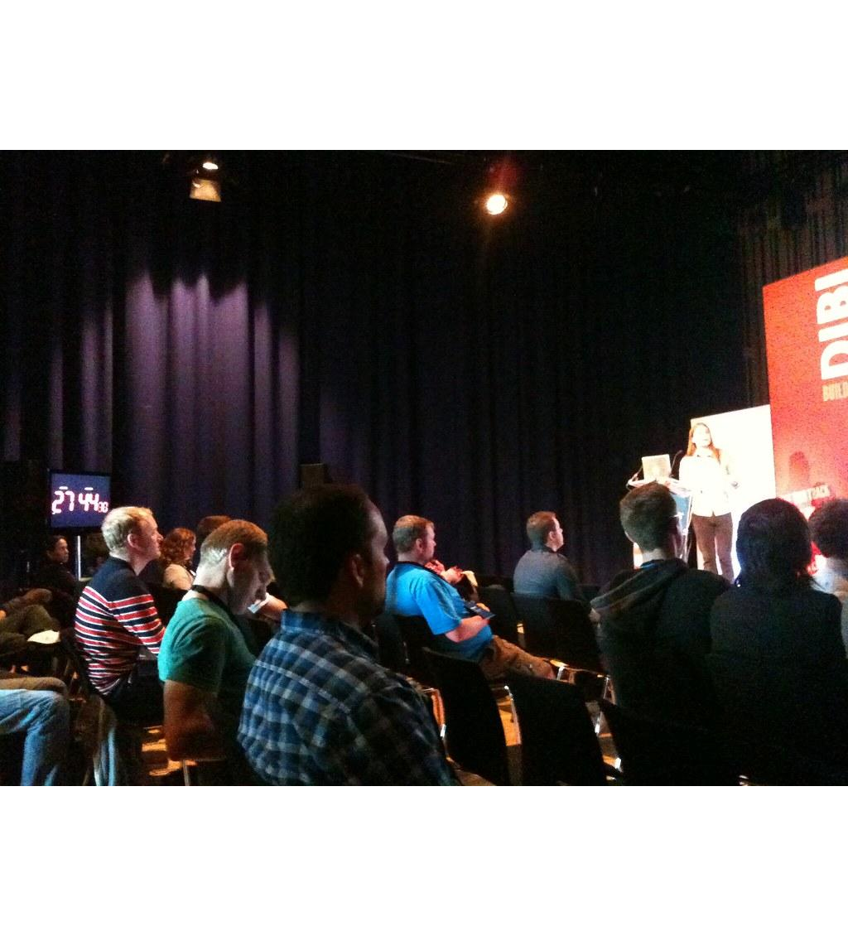
>>>
Story: OAuth began in 2006 to end password sharing
WHO Blaine Cook, Chris Messina, David Recordon and Larry Halff.
WHAT OAuth, an open standard that lets a program act for you without ever learning your password.
WHEN From November 2006; a Google group in April 2007; RFC 6749 in October 2012.
WHERE A CitizenSpace OpenID meeting, then an online Google group.
WHY Twitter and OpenID needed a way to share access without sharing passwords; no open standard existed.
HOW They wrote a proposal in the group, drafted a specification in July 2007, and the IETF published it. Your token files are its result.
Blaine Cook, who began OAuth in 2006. Photo: steve-uk, CC BY 2.0, Flickr.
READ Introduction to OAuth (oauth.net)
9 / 53
Notes:
OAuth began in November 2006 when Blaine Cook, working on Twitter's OpenID, met Chris Messina and others. The photograph is Blaine Cook at a later talk. Your token files exist so that a script never learns your password.

Slide 10
>>>
The sign-in address: code, offline access and a challenge
>>> from google_auth_oauthlib.flow import Flow
>>> SCOPE = 'https://www.googleapis.com/auth/spreadsheets'
>>> cfg = {'installed': {'client_id': 'FAKE', 'client_secret': 'FAKE',
>>> 'auth_uri': 'https://accounts.google.com/o/oauth2/auth',
>>> 'token_uri': 'https://oauth2.googleapis.com/token'}}
The credentials file as a dictionary: an id and a secret, here made up, and Google's two addresses.
>>> flow = Flow.from_client_config(cfg, [SCOPE],
>>> redirect_uri='http://localhost:8080/')
>>> url, state = flow.authorization_url(access_type='offline')
No network is used: the flow only builds the address the browser would open.
>>> q = dict(p.split('=') for p in url.split('?')[1].split('&'))
>>> for k in ('response_type', 'access_type', 'code_challenge_method'):
>>> print(k, '=', q[k])
Three parts of the address: a code, offline access and a SHA-256 challenge.
What the run printed (Python 3.13.16)
Part of the address | Value | Plain meaning
response_type | code | ask for a one-time code
access_type | offline | also give a refresh token
redirect_uri | http%3A%2F%2Floca... | come back to this computer
code_challenge_method | S256 | the challenge is a SHA-256 hash
code_challenge | (43 chars) | 43 characters, a hash of the secret
scope | https%3A%2F%2Fwww... | the permission asked for
program
browser opens
this address
Google asks
you to agree
The sign-in address asks for a code, offline.
10 / 53
Notes:
No network is used. The flow builds the address the browser would open: a code is asked for, offline access, a return to localhost 8080, and a hashed challenge. Compare with the sign-in described by RFC 8252.

Slide 11
>>>
Everyday pictures: the libraries underneath
ANALOGY EZSheets is like a taxi booking app: the app is simple, and the big phone network sits underneath.
Chapter concept | Everyday picture
ezsheets | The app on your phone: short calls, such as getRow.
googleapiclient | The phone network under the app: it builds every request.
google_auth_oauthlib | The identity check at the door of the network.
http.client | The plain post office the library uses for a short link.
shlex | A careful reader that keeps a quoted name in one piece.
sys | The notice board by the door: it shows what was typed after the program's name.
11 / 53
Notes:
EZSheets is thin. Google's client library builds each request. Two standard modules, http.client and shlex, and sys appear in the chapter's projects.

Slide 12
>>>
The challenge is a hash of a secret the program keeps
>>> import hashlib, base64
>>> verifier = b'dBjftJeZ4CVP-mB92K27uhbUJU1p1r_wW1gFWFOEjXk'
The program makes a random secret, the verifier, and keeps it. This one is the example of RFC 7636, the standard behind the challenge.
>>> digest = hashlib.sha256(verifier).digest()
>>> challenge = base64.urlsafe_b64encode(digest).rstrip(b'=')
>>> print('verifier :', verifier.decode())
>>> print('challenge:', challenge.decode())
Only the hash, the challenge, goes into the address. Later the program shows the verifier; Google hashes it again and compares.
What the run printed (Python 3.13.16)
verifier
(kept secret)
dBjftJeZ4C...
SHA-256
then base64url
challenge
(sent in the address)
E9Melhoa2O...
Google keeps
the challenge
later: the program shows the verifier; Google hashes it again, and only the same program can match the challenge
The challenge is a hash of a secret kept at home.
12 / 53
Notes:
The verifier stays in the program. Only its SHA-256 hash, the challenge, is sent. This is the example of RFC 7636. Someone who steals the address cannot finish the sign-in without the verifier.

Slide 13
>>>
A token file is a pickle, and a pickle can run code
>>> import pickle
>>> class Trap:
>>> def __reduce__(self):
>>> return (print, ('this line ran while loading',))
A class can tell pickle what to call when it is loaded. Here the call is harmless: it prints a line. In an attack it would be any code.
>>> data = pickle.dumps(Trap())
>>> print('file written:', len(data), 'bytes')
>>> pickle.loads(data)
Loading the bytes runs the call. EZSheets loads token-sheets.pickle when it is imported, so never use a token file from someone else.
What the run printed (Python 3.13.16)
token-sheets.pickle
(67 bytes)
import ezsheets
calls pickle.load
the file's own call
is made at once
printed: this line ran while loading
here the call only prints a line; in an attack it could be any code, with your rights
A token file from someone else is a program.
13 / 53
Notes:
A pickle can run code when it is loaded. This one only prints a line. EZSheets loads token-sheets.pickle at import, so a token file from someone else is a program, not data.

Slide 14
>>>
A token has a lifetime; the refresh token renews it
>>> import datetime as dt
>>> from google.oauth2.credentials import Credentials
>>> now = dt.datetime.now(dt.timezone.utc).replace(tzinfo=None)
The library compares a token's expiry with the clock. Times are in UTC without a time zone, as the library keeps them.
>>> for name, h in (('fresh', 1), ('stale', -1), ('week old', -168)):
>>> c = Credentials('X', 'X', expiry=now + dt.timedelta(hours=h))
>>> print(name, '| valid:', c.valid, '| expired:', c.expired)
An expired token is renewed with the refresh token. In an app in Testing status the refresh token itself dies after seven days.
What the run printed (Python 3.13.16)
Token | Expires | valid | expired | What the library does
fresh | in 1 h | True | False | sends it as it is
stale | 1 h ago | False | True | renews it with the refresh token
week old | 168 h ago | False | True | renews it with the refresh token
Testing status of the app: the refresh token itself dies after seven days (Google's identity page, finding F7)
A token has a lifetime; the refresh token renews it.
14 / 53
Notes:
The library compares the expiry with the clock. An expired token is renewed with the refresh token. In Testing status the refresh token dies after seven days; this was played against a local server, not Google.

Slide 15
Part 2: Spreadsheet objects
Each call here is one request to Google
Spreadsheet
One spreadsheet, held by its id.
Slide | In this part
16 | Everyday pictures: spreadsheet objects
17 | Create a spreadsheet, list the spreadshee...
18 | Open a spreadsheet: id, address and getId...
19 | Spreadsheet attributes: title, sheetTitle...
20 | Story: Google Sheets began as a small web...
21 | Everyday pictures: downloading and deleting
22 | Upload a file, download a spreadsheet in ...
23 | Delete moves a spreadsheet to the Trash
Attributes
Only the title can be rewritten.
downloadAs
Asks Google to export the spreadsheet as a file.
Trash
Where delete() sends a spreadsheet first.
15 / 53
Notes:
Part two. Spreadsheet objects: create, list, open by id or address, read attributes, upload and download, and delete. Each call is a request to Google; here a stand-in answers.

Slide 16
>>>
Everyday pictures: spreadsheet objects
ANALOGY A spreadsheet is like a ring binder in a cloud cupboard: you hold a label, and every look inside is a trip to the cupboard.
Chapter concept | Everyday picture
Spreadsheet Objects | The label on the binder, held in your hand.
Spreadsheet object | One binder: it knows its title, its pages and its address.
ezsheets.Spreadsheet() | Asking the cupboard for a binder, or for a new one.
Creating, Uploading, and Listing Spreadsheets | Buying a binder, posting a paper file into one, and reading the shelf list.
ezsheets.upload() | Posting a paper file; the cupboard turns it into a binder.
ezsheets.listSpreadsheets() | Reading the shelf list: id and title, nothing more.
Accessing Spreadsheet Attributes | Reading the label of a binder; only the title can be rewritten.
Spreadsheet.refresh() | Going back to the cupboard to see what changed since you looked.
16 / 53
Notes:
A Spreadsheet object is a label for a binder in the cloud. Every look inside is a request. Only the title can be rewritten; id, url and sheetTitles are read-only.

Slide 17
>>>
Create a spreadsheet, list the spreadsheets of the account
>>> import ezsheets, google_standin
>>> g = google_standin.install()
>>> ss = ezsheets.Spreadsheet()
>>> other = ezsheets.createSpreadsheet('Boringcoin')
>>> print(ss.title, '|', other.title)
install() plugs the stand-in for Google into ezsheets. Spreadsheet() makes a spreadsheet; createSpreadsheet gives it a title.
>>> print(ezsheets.listSpreadsheets())
>>> print(len(g.log), 'requests so far')
listSpreadsheets returns a dictionary from id to title. The recorder counts the requests.
What the run printed (Python 3.13.16)
Spreadsheet id | Title
ID001 | Untitled spreadsheet
ID002 | Boringcoin
Requests the library sent | Times
POST create spreadsheet | 2
GET spreadsheet properties | 8
GET cell values | 3
GET drive files (list or export) | 1
list of the stand-in account
Every call is a request to Google.
17 / 53
Notes:
The stand-in plays Google. Spreadsheet() creates, listSpreadsheets lists. The table counts the requests the library sent; a real quota counts the same requests.

Slide 18
>>>
Open a spreadsheet: id, address and getIdFromUrl
>>> import ezsheets, google_standin
>>> g = google_standin.install()
>>> ss = ezsheets.Spreadsheet(g.load('SHEET123', 'Boringcoin', [['A']]))
>>> url = 'https://docs.google.com/spreadsheets/d/SHEET123/edit#gid=0'
A stand-in for the public Boringcoin sheet is loaded under a made-up id.
>>> print(ezsheets.Spreadsheet('SHEET123').title)
>>> print(ezsheets.Spreadsheet(url).title)
>>> print(ezsheets.getIdFromUrl(url))
>>> print(ezsheets.getIdFromUrl('https://docs.google.com/spreadsheets/d/SHEET123'))
An id or an address opens the same spreadsheet. getIdFromUrl cuts by position, so an address ending after the id loses a character.
What the run printed (Python 3.13.16)
Call | Result
Spreadsheet('SHEET123') | Boringcoin
Spreadsheet(url) with .../edit#gid=0 | Boringcoin
getIdFromUrl(url) | SHEET123
getIdFromUrl('.../d/SHEET123') | SHEET12 (last character lost)
id or address
ezsheets.Spreadsheet
the same sheet: Boringcoin
An id or an address opens the same spreadsheet.
18 / 53
Notes:
One spreadsheet, opened by id and by address. getIdFromUrl cuts the id by position, so an address that ends right after the id loses its last character.

Slide 19
>>>
Spreadsheet attributes: title, sheetTitles, id and url
>>> import ezsheets, google_standin
>>> g = google_standin.install()
>>> ss = ezsheets.Spreadsheet()
>>> ss.title = 'Sweigart Books'
>>> print(ss.title, ss.sheetTitles, ss.id, ss.url)
The title is the only attribute you can change; the new title is sent to Google at once. The others describe the spreadsheet.
>>> for name in ('id', 'url', 'sheetTitles'):
>>> try: setattr(ss, name, 'x')
>>> except AttributeError as e: print(name, '->', e)
The other three are read-only: setting one raises an AttributeError, which the program catches and prints.
What the run printed (Python 3.13.16)
Attribute | Value | Can you set it?
title | Sweigart Books | yes: a request is sent
sheetTitles | ('Sheet1',) | property 'sheetTitles' of 'Spreads...
id | ID001 | no: property 'id' of 'Spreadsheet'...
url | docs.google.com/spreadsheets/... | no: property 'url' of 'Spreadsheet...
the error text is the one printed by the run: a property without a setter
Only the title can be set.
19 / 53
Notes:
Title can be set and is sent at once. The other three attributes are properties without a setter, so setting them raises an AttributeError.

Slide 20
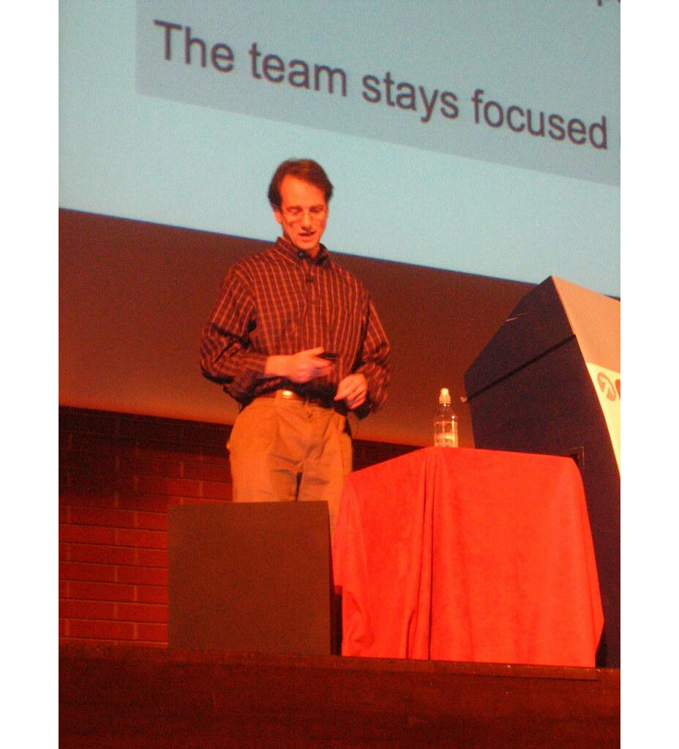
>>>
Story: Google Sheets began as a small web spreadsheet
WHO Jonathan Rochelle and Farzad Khosrowshahi of 2Web Technologies, then Google.
WHAT XL2Web, a spreadsheet in a web browser, became Google Labs Spreadsheets and then Google Sheets.
WHEN Google bought it in 2006; the limited test began on 6 June 2006.
WHERE On the web, at Google Labs.
WHY A spreadsheet in a browser can be shared, with no file to send around; Rochelle's post is titled 'It's nice to share'.
HOW A limited number of users could try it, first come first served; a beta for all Google Account holders replaced the test.
Jonathan Rochelle of Google. Photo: adactio, CC BY 2.0, Flickr.
READ Google Sheets (Wikipedia)
20 / 53
Notes:
Google Sheets began as XL2Web by 2Web Technologies. Google bought it in 2006 and opened a limited test on 6 June 2006. The photograph is Jonathan Rochelle. A browser spreadsheet is a service you call, not a file.

Slide 21
>>>
Everyday pictures: downloading and deleting
ANALOGY Deleting is like moving a binder to the recycling box: it is gone from the shelf, but not from the building.
Chapter concept | Everyday picture
Downloading and Uploading Spreadsheets | Photocopying a binder to take home, or bringing a paper copy in.
Spreadsheet.downloadAsExcel() | Asking for the copy as a loose Excel file.
Converting Spreadsheets to Other Formats | Asking for the same pages as PDF, CSV or ODS.
Deleting Spreadsheets | Clearing the shelf.
Spreadsheet.delete() | Moving the binder to the recycling box; delete for good empties the box.
Trash | The recycling box: the library still counts what is inside.
21 / 53
Notes:
Downloading asks Google to export; the file name is made safe. Delete moves to the Trash first. Ask what a user expects from the word delete.

Slide 22
>>>
Upload a file, download a spreadsheet in six formats
>>> import ezsheets, google_standin, os, tempfile
>>> g = google_standin.install()
>>> os.chdir(tempfile.mkdtemp())
>>> open('data.csv', 'w').write('a,b\n1,2\n')
A small file is made in a temporary folder. upload() turns it into a spreadsheet.
>>> print(ezsheets.upload('data.csv').title)
>>> ss = ezsheets.Spreadsheet(g.load('X', 'Sweigart Books (DO NOT DELETE)', [['T']]))
>>> for fmt in ('Excel', 'CSV', 'TSV', 'PDF', 'ODS', 'HTML'):
>>> print(fmt, '->', getattr(ss, 'downloadAs' + fmt)())
Each downloadAs method exports the spreadsheet and saves a file. Odd characters in the title become underscores.
What the run printed (Python 3.13.16)
Method | File saved | Title of the spreadsheet
downloadAsExcel | Sweigart_Books_(DO_NOT_DELETE).xlsx | Sweigart Books (DO NOT DELETE)
downloadAsCSV | Sweigart_Books_(DO_NOT_DELETE).csv | same
downloadAsTSV | Sweigart_Books_(DO_NOT_DELETE).tsv | same
downloadAsPDF | Sweigart_Books_(DO_NOT_DELETE).pdf | same
downloadAsODS | Sweigart_Books_(DO_NOT_DELETE).ods | same
downloadAsHTML | Sweigart_Books_(DO_NOT_DELETE).zip | same
upload made the spreadsheet 'data.csv'; spaces and brackets became underscores
A download name is made safe, not kept.
22 / 53
Notes:
Upload turns a file into a spreadsheet. Each downloadAs method asks for an export. The default file name replaces every character except letters, digits, underscore and dot. The book prints a different name.

Slide 23
>>>
Delete moves a spreadsheet to the Trash
>>> import ezsheets, google_standin
>>> g = google_standin.install()
>>> ss = ezsheets.Spreadsheet()
>>> keep = ezsheets.createSpreadsheet('Keep me')
>>> ss.delete()
>>> print(g.log[-1][0], g.log[-1][3])
>>> print(ezsheets.listSpreadsheets())
delete() only moves the spreadsheet to the Trash: a PATCH sets trashed to True. It is still listed.
>>> ss.delete(permanent=True)
>>> print(g.log[-1][0], 'then', list(ezsheets.listSpreadsheets().values()))
delete(permanent=True) sends a DELETE request. Only now is it gone from the list.
What the run printed (Python 3.13.16)
ss.delete()
request: PATCH {'trashed': True}
still listed: 2 spreadsheets
delete(permanent=True)
request: DELETE
listed now: 1
the Trash is a second life: listSpreadsheets does not leave a trashed spreadsheet out
delete() moves to the Trash.
23 / 53
Notes:
delete() only moves to the Trash; listSpreadsheets does not leave it out. delete(permanent=True) removes it for good. Check your own Trash before you trust a list.

Slide 24
Part 3: Sheet objects
Read from a local copy, write with requests
A1 notation
The letter first, then the row number.
Slide | In this part
25 | Everyday pictures: sheets, cells and addr...
26 | Read and write a cell: A1 notation and co...
27 | Addresses and column letters: convertAddr...
28 | Everyday pictures: rows and columns
29 | Rows and columns: get and update whole li...
30 | Cell by cell costs a request each; a colu...
31 | Story: Google turned off the old Sheets A...
32 | Everyday pictures: more sheets in a sprea...
33 | Create, move and delete the sheets of a s...
34 | Copy a sheet to another spreadsheet, and ...
35 | Surprises: equal sheets, the in operator,...
getRow, getColumn
Read a whole line as a list of text.
updateColumn
Writes a whole column with one request.
copyTo
Copies a sheet into another spreadsheet.
24 / 53
Notes:
Part three. Sheet objects: cells in A1 notation, rows and columns, batching, creating, moving, copying and clearing sheets. Count the requests: they are what the quota counts.

Slide 25
>>>
Everyday pictures: sheets, cells and addresses
ANALOGY A sheet is like a cinema floor plan: every seat has a letter and a number, and the numbers start at 1.
Chapter concept | Everyday picture
Sheet Objects | The floor plan of one hall.
Sheet object | One page of the binder, with its own rows and columns.
Reading and Writing Data | Reading a seat's name tag, or writing a new one.
A1 notation | Seat B2: the letter first, then the row.
1-based index | Seat numbers start at 1, not at 0 like a list.
ezsheets.convertAddress() | Turning 'seat B2' into 'column 2, row 2' and back.
ezsheets.getColumnLetterOf() | Reading the sign of column 27: AA.
ezsheets.getColumnNumberOf() | Counting the seats from the sign: ZZZ is column 18278.
25 / 53
Notes:
A1 notation: letter first, then the row. Both numbering systems start at 1. Column letters count like digits without a zero: 27 is AA.

Slide 26
>>>
Read and write a cell: A1 notation and column, row
>>> import ezsheets, google_standin
>>> g = google_standin.install()
>>> rows = [['PRODUCE', 'COST', 'POUNDS'], ['Okra', '2.26', '38.6']]
>>> sheet = ezsheets.Spreadsheet(g.load('P', 'produce', rows)).sheets[0]
A stand-in for the chapter's produce sheet: three columns and one row of data.
>>> g.log.clear()
>>> print(sheet['A1'], sheet[1, 1], sheet['B2'], sheet[2, 2])
>>> print(len(g.log), 'requests to read four cells')
A cell is 'B2' or (2, 2): letter or column first, counting from 1. Reading a loaded sheet sends nothing.
>>> sheet['B2'] = 30
>>> print(repr(sheet['B2']), '|', g.log[-1][0], g.log[-1][2].split('&')[0])
>>> sheet.refresh()
>>> print(repr(sheet['B2']))
A write is one PUT request. The local copy shows 30 until refresh() reads the text Google holds.
What the run printed (Python 3.13.16)
 | A | B | C
1 | PRODUCE | COST | POUNDS
2 | Okra | 30 | 38.6
reading four cells: 0 requests
write: PUT valueInputOption=USER_ENTERED
local copy after the write: 30 (a number)
after refresh(): '30' (text)
A write is one request; a read is none.
26 / 53
Notes:
A cell by name or by column and row, both from 1. Reading from a loaded sheet costs no request; a write is one PUT, typed as if by a person. The book prints the text 30; the current library shows the number until refresh.

Slide 27
>>>
Addresses and column letters: convertAddress and friends
>>> import ezsheets
>>> print(ezsheets.convertAddress('A2'), ezsheets.convertAddress(1, 2))
>>> print(ezsheets.convertAddress((2, 5)))
convertAddress turns a name such as 'A2' into a (column, row) pair, and a pair back into a name.
>>> L, N = ezsheets.getColumnLetterOf, ezsheets.getColumnNumberOf
>>> print(L(2), L(27), L(999))
>>> print(N('B'), N('ZZZ'))
Column letters count like digits without a zero: 27 is AA, 999 is ALK and ZZZ is column 18278, the last one a sheet can have.
What the run printed (Python 3.13.16)
Call | Result
convertAddress('A2') | (1, 2)
convertAddress(1, 2) | 'A2'
convertAddress((2, 5)) | 'B5'
getColumnLetterOf(2) | 'B'
Call | Result
getColumnLetterOf(27) | 'AA'
getColumnLetterOf(999) | 'ALK'
getColumnNumberOf('B') | 2
getColumnNumberOf('ZZZ') | 18278
the results come from calling the library again with the same arguments; amber: the last column of a sheet
Letters count like digits without a zero.
27 / 53
Notes:
Pure functions, no account needed. 27 is AA, 999 is ALK, ZZZ is 18278. The book prints the same values.

Slide 28
>>>
Everyday pictures: rows and columns
ANALOGY A row or a column is like a row of seats: you can ask for the whole row at once, or change it with one announcement.
Chapter concept | Everyday picture
Sheet.getRow() | Reading out one whole row of seats.
Sheet.getRows() | Reading out the whole hall.
Sheet.getColumn() | Reading out the seats of one letter, from front to back.
Sheet.updateRow() | Replacing the name tags of one row with one announcement.
Sheet.updateRows() | Replacing several rows with one announcement.
Sheet.updateColumn() | Replacing the name tags of one column at once.
28 / 53
Notes:
Rows and columns are lists of text. A row or column is read from the local copy and written with one request.

Slide 29
>>>
Rows and columns: get and update whole lines
>>> import ezsheets, google_standin
>>> g = google_standin.install()
>>> rows = [['PRODUCE', 'COST', 'POUNDS'], ['Okra', '2.26', '38.6'],
>>> ['Garlic', '1.19', '10']]
>>> sheet = ezsheets.Spreadsheet(g.load('P', 'produce', rows)).sheets[0]
The stand-in produce sheet: a heading and two rows.
>>> print(sheet.getRow(2))
>>> print(sheet.getColumn('A') == sheet.getColumn(1), sheet.getColumn(1)[:3])
getRow and getColumn return lists of text. A column is a letter or a number.
>>> sheet.updateRow(3, ['Pumpkin', '11.50', '20'])
>>> sheet.updateColumn(1, [v.upper() for v in sheet.getColumn(1)])
>>> print(sheet.getRows())
Each update replaces a whole line with one request.
What the run printed (Python 3.13.16)
 | A | B | C
1 | PRODUCE | COST | POUNDS
2 | OKRA | 2.26 | 38.6
3 | PUMPKIN | 11.50 | 20
amber: updateRow(3, [...]) replaced row 3
teal: updateColumn(1, ...) wrote column A
one request each; the values are text
first run: ['Okra', '2.26', '38.6']
A row or a column is a list of text.
29 / 53
Notes:
Rows and columns are lists of text. updateRow and updateColumn replace a whole line with one request. All values are strings.

Slide 30
>>>
Cell by cell costs a request each; a column costs one
>>> import ezsheets, google_standin
>>> g = google_standin.install()
>>> values = [str(n) for n in range(1, 9)]
>>> sheet = ezsheets.Spreadsheet(g.load('S', 'Counts', [['']] * 8)).sheets[0]
A stand-in sheet of one column and eight empty rows, and eight values.
>>> g.log.clear()
>>> for row, value in enumerate(values, 1): sheet[1, row] = value
>>> print('cell by cell:', len(g.log), 'requests')
Writing cell by cell sends one PUT request for each value.
>>> g.log.clear()
>>> sheet.updateColumn(1, values)
>>> print('whole column:', len(g.log), 'request')
updateColumn sends all eight in one request. Google limits requests, not values.
What the run printed (Python 3.13.16)
8 values, 8 vs 1 requests
Google counts requests per minute, not values: batch your writes
Batch: one request for many values.
30 / 53
Notes:
Cell by cell, eight requests; one column, one request. Google limits requests per minute, so batching is the cure for slow programs.

Slide 31
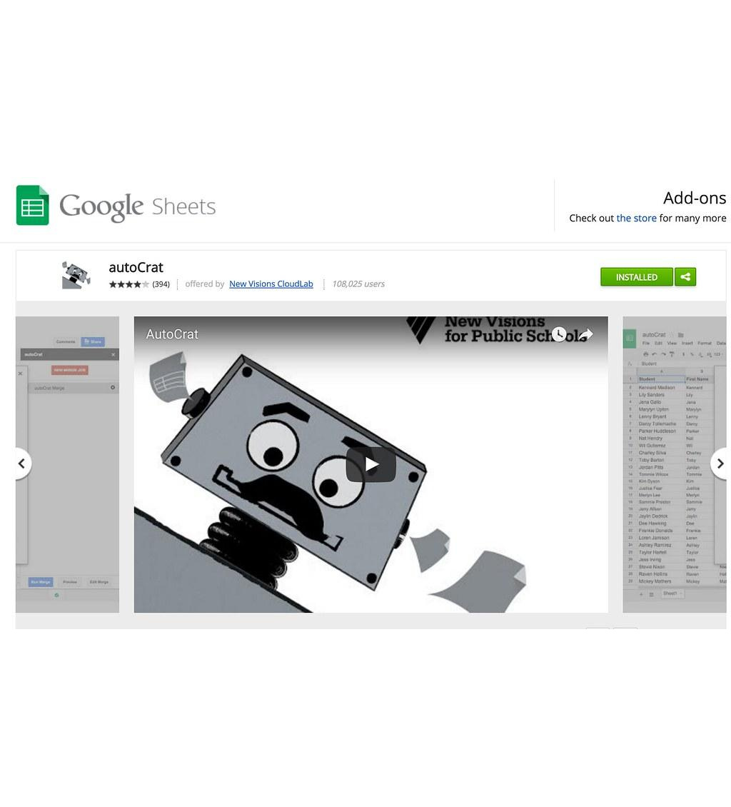
>>>
Story: Google turned off the old Sheets API in 2021
WHO The Google Sheets API team, and every developer with an app on version 3.
WHAT Sheets API v3 was turned down; v4, JSON-based, is the version that EZSheets and every current client use.
WHEN 2 August 2021.
WHERE Google for Developers, the Sheets API migration guide; v4 lives at sheets.googleapis.com.
WHY v4 has a simpler JSON interface and much functionality that v3 lacked.
HOW Google published a migration guide and a turn-down date. A program must follow the service when its address and version change.
The Google Sheets add-ons page. Screenshot: Wesley Fryer, CC BY 2.0, Flickr.
READ Migrate from the Sheets API v3 (Google for Developers)
31 / 53
Notes:
Google turned down Sheets API v3 on 2 August 2021. EZSheets speaks v4. The picture is a screenshot of the Google Sheets add-ons page, not of the API; say so. A library is only as stable as the service behind it.

Slide 32
>>>
Everyday pictures: more sheets in a spreadsheet
ANALOGY Sheets are like the pages of a binder: you can add a page, move it, copy it to another binder or tear it out.
Chapter concept | Everyday picture
Creating, Moving, and Deleting Sheets | Adding, reordering and tearing out pages.
Spreadsheet.Sheet() | A button that looks like 'new page' but hands nothing back.
Spreadsheet.createSheet() | The button that hands you the new page.
Sheet.delete() | Tearing one page out; the last page cannot be torn out.
Copying Sheets | Photocopying a page into another binder.
Sheet.copyTo() | The photocopier: the copy is called 'Copy of ...'.
Sheet.clear() | Rubbing out every name tag but keeping the floor plan.
32 / 53
Notes:
Sheet() hands nothing back; createSheet hands the sheet. The last sheet of a spreadsheet cannot be deleted. Copy puts a sheet into another spreadsheet.

Slide 33
>>>
Create, move and delete the sheets of a spreadsheet
>>> import ezsheets, google_standin
>>> g = google_standin.install()
>>> ss = ezsheets.Spreadsheet()
>>> print(ss.Sheet('Spam'))
>>> ss.createSheet('Eggs')
>>> ss.createSheet('Bacon', 0)
>>> print(ss.sheetTitles)
Spreadsheet.Sheet() returns nothing in the current library, so it prints None. createSheet returns the Sheet, and a second argument chooses its place.
>>> ss.sheets[0].index = 2
>>> print(ss.sheetTitles)
>>> ss.sheets[1].delete()
>>> print(ss.sheetTitles)
Setting index moves a sheet to a new place; delete() removes one. Sheets are counted from 0, like list items.
What the run printed (Python 3.13.16)
after createSheet('Eggs') and createSheet('Bacon', 0)
0
Bacon
1
Sheet1
2
Spam
3
Eggs
after sheets[0].index = 2
0
Sheet1
1
Spam
2
Bacon
3
Eggs
after sheets[1].delete()
0
Sheet1
1
Bacon
2
Eggs
the first print was None: Spreadsheet.Sheet() returns nothing; createSheet returns the Sheet
createSheet returns the Sheet; Sheet() does not.
33 / 53
Notes:
Spreadsheet.Sheet() returns None; createSheet returns the Sheet. The book's listings print Sheet objects with the old behaviour. Index moves a sheet; delete removes one.

Slide 34
>>>
Copy a sheet to another spreadsheet, and clear one
>>> import ezsheets, google_standin
>>> g = google_standin.install()
>>> rows = [['PRODUCE', 'COST', 'POUNDS'], ['Okra', '2.26', '38.6']]
>>> source = ezsheets.Spreadsheet(g.load('P', 'produce', rows)).sheets[0]
>>> target = ezsheets.Spreadsheet()
A source sheet with data, and a new empty spreadsheet for the copy.
>>> source.copyTo(target)
>>> target.refresh()
>>> print(target.sheetTitles, target.sheets[1].getRows())
copyTo adds a 'Copy of ...' sheet to the other spreadsheet. refresh() reads it.
>>> source.clear()
>>> print(source.getRows(), source.rowCount, source.columnCount)
clear() empties every cell; the sheet keeps its size.
What the run printed (Python 3.13.16)
the copy in the other spreadsheet
the source after clear()
 | A | B | C
1 | PRODUCE | COST | POUNDS
2 | Okra | 2.26 | 38.6
 | A | B | C
1
2
titles: ('Sheet1', 'Copy of Sheet1'); the cleared sheet keeps its size (rows, columns): 2 3
copyTo copies; clear() keeps the size.
34 / 53
Notes:
copyTo puts a copy in another spreadsheet and names it Copy of. clear() empties every cell but keeps the size. Refresh to see what Google now holds.

Slide 35
>>>
Surprises: equal sheets, the in operator, an empty cell
>>> import ezsheets, google_standin
>>> g = google_standin.install()
>>> a = ezsheets.Spreadsheet().sheets[0]
>>> b = ezsheets.Spreadsheet().sheets[0]
>>> print('equal:', a == b, '| ids', a.sheetId, b.sheetId)
Two sheets are equal when their sheet ids are equal. The first sheet of every new spreadsheet has the id 0, so unrelated sheets compare equal.
>>> names = ezsheets.Spreadsheet(g.load('Q', 'Q', [['Alice', '1']])).sheets[0]
>>> print('Alice in sheet:', 'Alice' in names)
>>> print('empty cell is', repr(names['C1']))
The in operator searches the coordinates, not the values, so a name in a cell is not found. An empty cell is an empty string, never None.
What the run printed (Python 3.13.16)
Statement | Result | Why
a == b for sheets of two spreadsheets | True | equal when sheetId is equal; both are 0
'Alice' in sheet | False | in searches the coordinates, not the values
sheet['C1'] for an empty cell | '' | an empty string, never None
ids shown in the run: ids 0 0
Equal ids make equal sheets.
35 / 53
Notes:
Three surprises of the library. Two sheets are equal when their ids are equal, and the first sheet of every spreadsheet has id 0. The in operator searches coordinates. Empty cells are empty strings.

Slide 36
Part 4: Forms and quotas
Forms save answers as rows; Google limits requests
Google Forms
Its answers arrive as rows of a sheet.
Slide | In this part
37 | Everyday pictures: forms and quotas
38 | Google Forms answers are rows: collect th...
39 | Story: Google Forms arrived in 2008
40 | Quota: the library waits 10 to 45 seconds...
Quota
How many requests Google allows each minute.
IGNORE_QUOTA
Switches off the library's own throttle only.
Backoff
Wait longer after each refusal, then try again.
36 / 53
Notes:
Part four. Google Forms, whose answers are rows; and the quotas. The book's numbers differ from Google's page, and the library retries a limited way.

Slide 37
>>>
Everyday pictures: forms and quotas
ANALOGY A quota is like a turnstile: only so many people pass each minute, and the rest wait their turn.
Chapter concept | Everyday picture
Google Forms | A paper questionnaire box whose slips are copied into a binder.
Downloading Google Forms Data | Reading the slips from the binder instead of from the box.
Working with Google Sheets Quotas | Learning how many people the turnstile lets through.
quota | The number of people the turnstile lets through each minute.
IGNORE_QUOTA | A switch that stops the library's own counting, not the turnstile.
Practice Programs | Small recital pieces after the finger exercises.
37 / 53
Notes:
A form saves its answers as rows. The quota is a turnstile; IGNORE_QUOTA switches off the library's own throttle only. Practice programs follow the finger exercises.

Slide 38
>>>
Google Forms answers are rows: collect the e-mail addresses
>>> import ezsheets, google_standin
>>> g = google_standin.install()
>>> answers = [['Timestamp', 'Name', 'Email address'],
>>> ['10:00', 'Ada', 'ada@example.org'],
>>> ['10:05', 'Alan', 'alan@example.org'],
>>> ['10:09', 'Ada', 'ada@example.org']]
A form saves each answer as a row of a spreadsheet. These three answers stand in for the response sheet of a real form.
>>> sheet = ezsheets.Spreadsheet(g.load('F', 'Responses', answers)).sheets[0]
>>> emails = sheet.getColumn(3)[1:]
>>> print(emails)
>>> print(sorted(set(emails)))
Column 3 holds the addresses; the first item is the heading, so it is cut off. A set removes the address that answered twice.
What the run printed (Python 3.13.16)
Timestamp | Name | Email address
10:00 | Ada | ada@example.org
10:05 | Alan | alan@example.org
10:09 | Ada | ada@example.org
3 answers
2 different addresses
amber: answered twice
A form's answers are rows.
38 / 53
Notes:
A form saves answers as rows. Column 3 holds the addresses; the heading is cut off. A set removes the address that answered twice. The real response sheet is made by Google Forms.

Slide 39
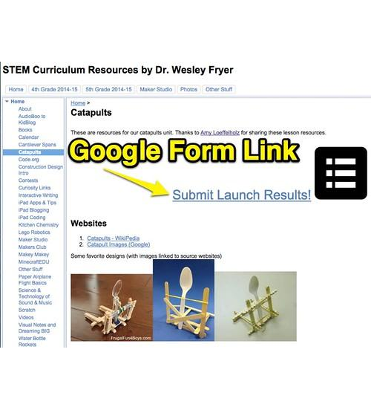
>>>
Story: Google Forms arrived in 2008
WHO Google, as part of the Google Docs suite.
WHAT Google Forms, a web application for making surveys. The answers can fill a spreadsheet automatically.
WHEN 2008; the pages that could be opened give the year only, not the day.
WHERE On the web, in Google Docs.
WHY So that answers arrive as rows that a program can read, which is the first practice program of the chapter.
HOW The owner picks a new or an existing spreadsheet as the place for the responses; EZSheets then opens it like any other.
A web page that links to a Google Form. Screenshot: Wesley Fryer, CC BY 2.0, Flickr.
READ Google Forms (Wikipedia)
39 / 53
Notes:
Google Forms was introduced in 2008; the pages we could open give the year, not the day. The picture is a web page with the Forms icon and a link to a form. A form is a front door that writes rows for your script.

Slide 40
>>>
Quota: the library waits 10 to 45 seconds and retries
>>> import ezsheets, google_standin, time, types
>>> g = google_standin.install()
>>> pauses = []
>>> ezsheets.time = types.SimpleNamespace(sleep=pauses.append, time=time.time)
The pauses are recorded instead of slept, so the example needs no waiting. The library's clock is put back at the end.
>>> g.fail = [(429, 'RESOURCE_EXHAUSTED')] * 20
>>> try:
>>> ezsheets.Spreadsheet()
>>> except Exception as e:
>>> print(len(g.log), 'tries,', sum(pauses), 'seconds,', type(e).__name__)
>>> ezsheets.time = time
Google answers 429 again and again. The library pauses 10, 15, ... 45 seconds, tries nine times and gives up. Any other error stops it at once.
What the run printed (Python 3.13.16)
9 tries in all
waited 220 seconds in total
then: HttpError
seconds shown: the pause before the next try
The library waits 220 seconds, then gives up.
40 / 53
Notes:
Google answers 429 and the library waits 10, 15, up to 45 seconds, nine tries and 220 seconds in all, then raises HttpError. IGNORE_QUOTA does not change this retry. Google advises exponential backoff.

Slide 41
Part 5: Project 11, a fake blockchain
A sheet that pretends to be a ledger: audit it, extend it
Project 11
A shared sheet of who paid whom.
Slide | In this part
42 | Everyday pictures: the project
43 | Project 11, step 1: audit the Boringcoin ...
44 | The audit meets an empty row of the grid
45 | Project 11, step 2: add one transaction
46 | Two programs add a row: one transaction i...
47 | Story: a 2008 message announced the cash ...
48 | Finding mistakes in a spreadsheet: quanti...
Audit
Add up what each account holds.
Lost update
Two writers use the same row number.
Bean Count
Check each total against a rule.
41 / 53
Notes:
Part five. Project 11, a spreadsheet that pretends to be a blockchain: audit it, add a transaction, see a lost update, and check the totals of the practice sheet.

Slide 42
>>>
Everyday pictures: the project
ANALOGY A ledger is like a notebook at a corner shop: easy to add up, and just as easy to forge with a pencil.
Chapter concept | Everyday picture
Project 11: Fake Blockchain Cryptocurrency Scam | A shop notebook that pretends to be a bank.
fake blockchain | A notebook with an honest look and no guard at the door.
Finding Mistakes in a Spreadsheet | Checking the till slip against the price tags.
42 / 53
Notes:
Project 11 is a ledger: easy to add up, easy to forge. Checking a sheet against a rule, as the Bean Count program does, is the same skill.

Slide 43
>>>
Project 11, step 1: audit the Boringcoin ledger
>>> import ezsheets, google_standin
>>> g = google_standin.install()
>>> ledger = [['PRE-MINE', 'Alice', '1000'], ['PRE-MINE', 'Bob', '500'],
>>> ['Alice', 'Bob', '200'], ['Bob', 'Carol', '150']]
>>> sheet = ezsheets.Spreadsheet(g.load('B', 'Boringcoin', ledger)).sheets[0]
A stand-in for the Boringcoin sheet: sender, recipient, amount. PRE-MINE invents money.
>>> accounts = {}
>>> for sender, recipient, amount in sheet.getRows():
>>> if sender != 'PRE-MINE':
>>> accounts[sender] = accounts.get(sender, 0) - int(amount)
>>> accounts[recipient] = accounts.get(recipient, 0) + int(amount)
One walk over the rows: the sender loses the amount, the recipient gains it.
>>> print(accounts)
>>> print('Total Boringcoins:', sum(accounts.values()))
An honest ledger adds up to the money PRE-MINE created.
What the run printed (Python 3.13.16)
Total Boringcoins: 1500
PRE-MINE created 1500
an honest ledger adds up to what was created
An honest ledger adds up.
43 / 53
Notes:
Step 1 of Project 11. PRE-MINE invents money; every other row moves it. If the ledger is honest, the balances add up to what was created. The real sheet has 1,000 rows; this one has six.

Slide 44
>>>
The audit meets an empty row of the grid
>>> import ezsheets, google_standin
>>> g = google_standin.install()
>>> ledger = [['PRE-MINE', 'Alice', '1000'], ['Alice', 'Bob', '200']]
>>> sheet = ezsheets.Spreadsheet(g.load('B', 'Boringcoin', ledger)).sheets[0]
>>> sheet.rowCount += 1
The real sheet is a grid of 1,000 rows, so getRows also returns the empty ones. One added row shows what an empty row looks like.
>>> print('audit of', len(sheet.getRows()), 'rows')
>>> try: total = sum(int(row[2]) for row in sheet.getRows())
>>> except ValueError as e: print('stopped:', e)
int('') cannot read an empty amount, so the loop of Step 1 stops with a ValueError. A guard for an empty first cell avoids it.
What the run printed (Python 3.13.16)
 | A | B | C
1 | PRE-MINE | Alice | 1000
2 | Alice | Bob | 200
3
audit of 3 rows
stopped: invalid literal for int() with base 10: ''
red: the empty row that stopped the loop
getRows also returns the empty rows.
44 / 53
Notes:
The real sheet is a grid of 1,000 rows, so getRows also returns the empty rows. int of an empty string raises ValueError. A guard for an empty first cell fixes the audit.

Slide 45
>>>
Project 11, step 2: add one transaction
>>> import ezsheets, google_standin, sys
>>> g = google_standin.install()
>>> sys.argv = ['add.py', 'Al Sweigart', 'Eve', '2000']
>>> sender, recipient, amount = sys.argv[1:]
The program reads sender, recipient and amount from the command line, here set by hand.
>>> ledger = [['PRE-MINE', 'Alice', '1000'], ['Alice', 'Bob', '200']]
>>> sheet = ezsheets.Spreadsheet(g.load('B', 'Boringcoin', ledger)).sheets[0]
>>> g.log.clear()
>>> sheet.rowCount += 1
Adding a row changes the sheet's size, which costs three requests.
>>> for col, value in enumerate((sender, recipient, amount), 1):
>>> sheet[col, sheet.rowCount] = value
>>> print(sheet.getRow(sheet.rowCount), '|', len(g.log), 'requests')
Each cell is one more request: six in all. A name with a space needs quotes.
What the run printed (Python 3.13.16)
Request | Why
GET | size of the sheet, its values
POST | batchUpdate: one row more
PUT x 3 | sender, recipient, amount
new row: ['Al Sweigart', 'Eve', '2000']
One transaction costs six requests.
45 / 53
Notes:
Step 2 of Project 11. A change of size costs three requests, and each cell one more: six requests for one transaction. Quote a name with a space on the command line, or sys.argv has four items.

Slide 46
>>>
Two programs add a row: one transaction is lost
>>> import ezsheets, google_standin
>>> g = google_standin.install()
>>> ledger = [['PRE-MINE', 'Alice', '1000'], ['Alice', 'Bob', '200']]
>>> first = ezsheets.Spreadsheet(g.load('B', 'Boringcoin', ledger)).sheets[0]
>>> second = ezsheets.Spreadsheet('B').sheets[0]
Two programs open the same spreadsheet. Each keeps its own copy of the row count.
>>> for who, sheet in (('first', first), ('second', second)):
>>> sheet.rowCount += 1; sheet[1, sheet.rowCount] = who
>>> print(who, 'writes to row', sheet.rowCount)
>>> first.refresh()
>>> print(first.rowCount, first.getRow(3))
Both count the next row from their own copy, so both write to row 3 and the second silently replaces the first. No error is raised.
What the run printed (Python 3.13.16)
first program
writes 'first'
 | A | B | C
1 | PRE-MINE | Alice | 1000
2 | Alice | Bob | 200
3 | second
both: row 3
row 3 holds 'second'
second program
writes 'second'
'first' is gone; no error
Two writers can lose a row.
46 / 53
Notes:
Two programs each count the next row from their own copy, so both write to row 3, and the second overwrites the first. No error is raised. A guard or a lock is needed.

Slide 47
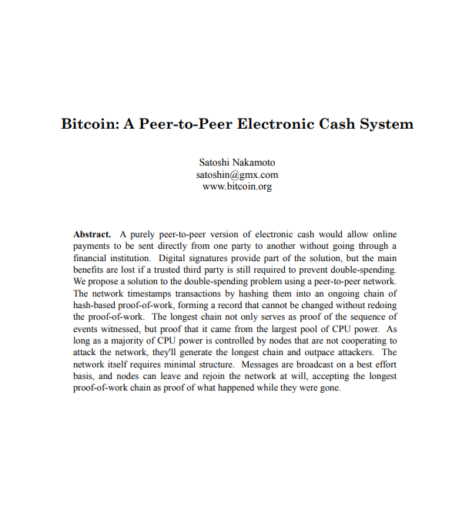
>>>
Story: a 2008 message announced the cash Boringcoin copies
WHO Satoshi Nakamoto, the name of the unknown author, writing to a cryptography mailing list.
WHAT A message that announced a peer-to-peer electronic cash system and the paper bitcoin.pdf.
WHEN Friday 31 October 2008, 14:10 Eastern time.
WHERE The cryptography mailing list hosted at metzdowd.com.
WHY Electronic cash with no trusted third party. The chapter's Boringcoin ledger is a joke copy of the idea.
HOW The message lists the properties: a peer-to-peer network prevents double spending, there is no mint, new coins come from proof of work.
The first page of bitcoin.pdf, the paper the message announced. Wikimedia Commons, CC BY 4.0.
READ The message of 31 October 2008 (metzdowd.com)
47 / 53
Notes:
On 31 October 2008 Satoshi Nakamoto announced the paper bitcoin.pdf to a mailing list. No photograph of the author exists, so the picture is the first page of the paper. A ledger of rows is easy to audit and easy to forge.

Slide 48
>>>
Finding mistakes in a spreadsheet: quantity times price
>>> import ezsheets, google_standin
>>> g = google_standin.install()
>>> beans = [['Qty', 'Price', 'Total'], ['4', '25', '100'],
>>> ['3', '40', '130'], ['10', '12', '120']]
>>> rows = ezsheets.Spreadsheet(g.load('BEAN', 'Beans', beans)).sheets[0].getRows()
A stand-in for the Bean Count sheet: quantity, price and a typed total. One total is wrong.
>>> for n, (qty, price, total) in enumerate(rows[1:], 2):
>>> if int(qty) * int(price) != int(total):
>>> print('row', n, 'says', total, 'is', int(qty) * int(price))
Check every row against quantity times price. The heading is row 1, so data starts at row 2.
What the run printed (Python 3.13.16)
Row | Quantity | Price | Total typed | Quantity x price | Check
2 | 4 | 25 | 100 | 100 | ok
3 | 3 | 40 | 130 | 120 | wrong
4 | 10 | 12 | 120 | 120 | ok
red: 1 of 3 totals are wrong
Check a total with a rule.
48 / 53
Notes:
The practice program: check each total against quantity times price. The sheet's row numbers count the heading. Two totals are wrong in this stand-in.

Slide 49
>>>
Which object sends which request
From the chapter research; each answer has its code slide
EZSheets object | Stands for | Request it sends | See slide
Spreadsheet() | one spreadsheet of the account | POST to create; GET to open | 17
Sheet, sheet['B2'] | one tab, and one cell of it | GET values; PUT one cell | 26
getRow, getColumn | a line of text values | none after the first load | 29
updateColumn | a whole column | one PUT for all values | 30
rowCount += 1 | the size of the grid | GET, GET, POST: three | 45
delete() | the Trash | PATCH trashed: true | 23
downloadAsExcel | a file on your disk | GET export | 22
token-sheets.pickle | your sign-in | none: a local pickle | 8
Requests counted on the stand-in for Google; Google itself was never reached.
Spreadsheet is the binder, Sheet the page, a cell a seat, the token file the key card.
49 / 53
Notes:
Which object stands for which part of the account, and the request each call sends. Our first question answered. Spreadsheet is the binder, Sheet the page, a cell a seat, the token file the key card.

Slide 50
>>>
What differs from the book today
From the chapter research, checked on 12 October 2026
What the book says | Today | See slide
ss.Sheet('Spam') returns the new Sheet | Sheet() returns None; use createSheet | 33
sheet['B2'] = 30 prints '30' | prints the number 30 until refresh() | 26
Downloads are named Sweigart_Books.xlsx | named Sweigart_Books_(DO_NOT_DELETE).xlsx | 22
250 new spreadsheets a day | no such figure; 300 reads and 300 writes a minute per project | 40
The setup is done once | in Testing status the sign-in expires every seven days | 14
Token files are JSON files | they are pickles, and a pickle can run code | 13
The consent screen wizard | now the pages Branding, Audience, Data Access | 10
Up to 10 million cells | Google's help says 20 million cells or 100 MB | -
Step 2 adds one row | it sends six requests, and two writers can collide | 46
The book opens sheets by short links (autbor.com) | some requests were answered 403; open by id | 18
Run what the book printed; then check what changed.
50 / 53
Notes:
What differs today, from the chapter research: the return of Sheet(), the number after a write, the download name, Google's quota page, the seven-day limit of Testing, the console pages, the cell limit, and pickles.

Slide 51
>>>
Summary
ANALOGY A summary is a packing list: only what you really need goes into the bag.
A program must be let in: a cloud project, a credentials file, token files.
code examples in each part of this deck
1
2
A token file is a pickle: never load one you did not make.
3
Spreadsheet is a binder, Sheet a page; each call is a request.
4
Batch your writes: Google limits requests, not values.
5
A ledger of rows is easy to audit and just as easy to forge.
A binder in the cloud: every look inside is a request.
51 / 53
Notes:
Five sentences to keep. The chart counts the code examples in each part of this deck.

Slide 52
>>>
Practice Questions
Predict first, then run what you can on the chapter page
ANALOGY Practice questions are finger scales for a pianist; the practice programs are the small recital pieces.
1
Which column letters name column 703, and which number has the name ZZ? Use the code of the addresses slide.
2
A program writes 100 cells one at a time. How many requests are sent, and how many with updateColumn?
3
Two programs open the same ledger and each adds a row. What do you see in the sheet, and why?
4
Practice program: write a Bean Count check that also prints the correct total next to each wrong one.
Each answer fits in a few lines you can run.
52 / 53
Notes:
Four drills and a program. Predict first, then run what you can on the page. Ask students to explain each answer in one sentence.

Slide 53
>>>
Resources: where to go next
Reading and watching, chosen for this chapter; every link is live
Book: Automate the Boring Stuff, 3rd edition, chapter 15
https://automatetheboringstuff.com/3e/chapter15.html
Google Identity: OAuth 2.0 for desktop apps
developers.google.com
EZSheets documentation (Read the Docs)
https://ezsheets.readthedocs.io/en/latest/
RFC 7636: Proof Key for Code Exchange
https://www.rfc-editor.org/rfc/rfc7636.txt
EZSheets on the Python Package Index
https://pypi.org/project/ezsheets/
Python documentation: pickle
https://docs.python.org/3/library/pickle.html
Google Sheets API: usage limits
https://developers.google.com/workspace/sheets/api/limits
OWASP: Deserialization Cheat Sheet
cheatsheetseries.owasp.org
Google Sheets API: reading and writing values
developers.google.com
gspread documentation: the other library
https://docs.gspread.org/en/latest/
Google Sheets API: choose scopes
https://developers.google.com/workspace/sheets/api/scopes
Introduction to OAuth (oauth.net)
https://oauth.net/about/introduction/
Google Sheets API: migrate from v3
developers.google.com
Bitcoin: A Peer-to-Peer Electronic Cash System
https://bitcoin.org/bitcoin.pdf
Pick one link and read it before the next class.
53 / 53
Notes:
Start with the book chapter and the EZSheets documentation, then Google's quota page and the standards behind the sign-in. Choose one link and read it before the next class.

