Slide 1
>>>
Python Basics
Chapter 1 of Automate the Boring Stuff with Python, 3rd edition, for an advanced course
19
3
27
code examples that run on the chapter page
true stories told with real names, dates and places
distinct chapter concepts, each with an everyday picture
SEN0414 Advanced Programming, Fall 2026. Yusuf Altunel, İstanbul Kültür Üniversitesi
1 / 58
Notes:
Welcome. This chapter is the prompt, the values it computes with, the operators that combine them, the names that remember them, and a first program. Every concept gets an idea, a reason and a picture first, then the code, then what the run printed.

Slide 2
>>>
Today's route
Four parts; every range is a run of slides you can jump to
Part | Slides | Code examples | You will run
Values and types | 4 - 16 | 5 | type, int, float, str, len
Operations | 17 - 29 | 5 | operators, precedence, plus and star on text
Names and functions | 30 - 44 | 6 | variables, print, conversions, errors, input, import
A first program | 45 - 54 | 3 | a first program, f-strings, binary
Changes, summary, practice, resources | 55 - 58 | - | what current Python adds
Open the chapter-code tab of the page: the same 19 examples, in this order.
2 / 58
Notes:
Four parts: values and types, operations, names and functions, and a first program. Each range is a run of slides you can jump to. The chapter-code tab of the page holds the same code in the same order. Ask the class which part they expect to find hardest, and why.

Slide 3
>>>
Three questions this chapter answers
Carry them through every part; the answers come back at the end
1
Which operations can raise an error, and which error?
Answer on slides 27, 40 and 33: TypeError, ValueError and NameError.
2
Which results can surprise a student in the chapter's own arithmetic?
Answer on slides 14 and 22: 0.1 + 0.2, and -3 ** 2.
3
Which concepts reach beyond the 3rd edition into current Python, and on what source?
Answer on slide 55: the table of changes names each source.
Errors are answers too: read the name of the error first.
3 / 58
Notes:
Three questions to carry through the chapter. Which operations can raise an error, and which error? Which results can surprise a student? And what has changed in current Python since the book? Ask students to write a guess for each now and check it at the end.

Slide 4
Part 1: Values and types
What the prompt computes with, and how Python labels it
Expression
A piece of code that Python turns into one value.
Slide | In this part
5 | Everyday pictures: values and types
7 | The shell: type an expression, get a value
8 | Story: Guido van Rossum and Python
10 | Data types: int, float and str
12 | Integers never overflow
14 | Floats are honest about being approximate
16 | Strings: text between quotes
Data type
The label that says what a value is and what it can do.
Integer
A whole number, exact however large it grows.
Float and string
A number with a fraction, and text between quotes.
4 / 58
Notes:
Part one. The shell evaluates an expression and prints its value, and every value has a data type: integer, float or string. Example: seven plus one point zero is a float. Ask the class which result in this part they expect to surprise them.

Slide 5
>>>
Everyday pictures: values and types
ANALOGY The shell is a pocket calculator with a screen: you type a sum and the answer appears at once.
Chapter concept | Everyday picture
Entering Expressions into the Interactive Shell | A pocket calculator with a screen: type a sum, read the answer, type the next one.
Expression | A recipe line: ingredients and steps that end in one finished dish, the value.
The Integer, Floating-Point, and String Data Types | Three kinds of container: crates for whole items, jugs for amounts with a fraction, signs for words.
Data type | The label on a container: it says what may be put in and what may be done with it.
5 / 58
Notes:
A calculator with a screen is the shell. An expression is a recipe line that ends in one value. A data type is the label on a container. Example: the crate, the jug and the sign. Ask students to add an everyday picture of their own for a data type.

Slide 6
>>>
The shell: type a line, read the value
The idea
How it works, step by step
The shell is a prompt where Python reads one expression, computes its value and prints it at once. An expression is any code that ends in a value.
You type
1
an expression such as 2 + 3 * 6
The reason
Python evaluates
2
Quick answers let you test an idea in seconds. The shell is the fastest way to see what Python does with a line.
multiplication first, then addition
Python prints
3
the value, 20
An everyday picture
The shell is a pocket calculator with a screen: type a sum, read the answer, type the next one.
The shell waits
4
for the next line
The shell evaluates an expression and prints its value.
6 / 58
Notes:
The shell reads an expression, computes its value and prints it. An expression is any code that ends in one value. Example: two plus three times six. Ask the class: is the answer twenty or thirty, and which rule decides?

Slide 7
>>>
The shell: type an expression, get a value
print(2 + 2)
print('Py' + 'thon')
print(2 + 3 * 6)
print(3 * (2 + 4))
Python reads an expression, computes its value and shows it. 2 + 2 gives the number 4; 'Py' + 'thon' joins two pieces of text.
An expression may hold several operators. Multiplication goes before addition, and parentheses go before everything.
What the run printed (Python 3.13.16)
Expression | Value | Type
2 + 2 | 4 | int
'Py' + 'thon' | 'Python' | str
2 + 3 * 6 | 20 | int
3 * (2 + 4) | 18 | int
Read
Evaluate
Print
Loop
you type
Python computes
value appears
next prompt
the shell repeats these four steps for every line
The shell evaluates an expression and prints its value.
7 / 58
Notes:
In a script you write print yourself, and the table shows each expression with its value and type. Predict two plus three times six before the run, and say why it is not thirty. Then change a number and run it again.

Slide 8
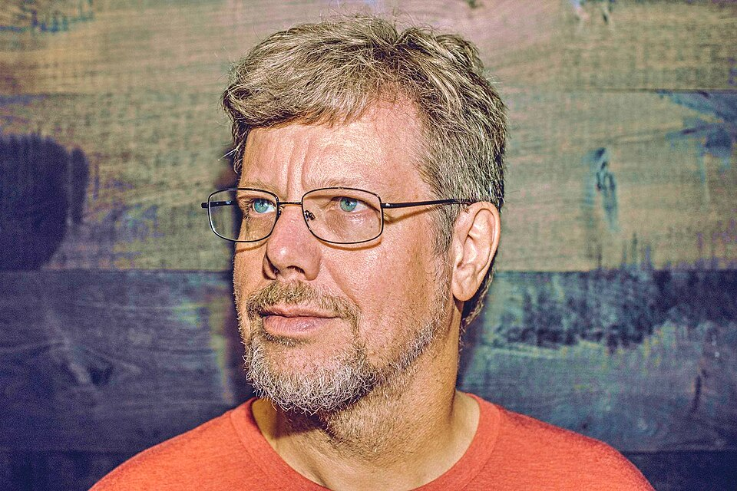
>>>
Story: a Christmas hobby named after a comedy troupe
In December 1989, Guido van Rossum, a programmer at the Centrum Wiskunde & Informatica in Amsterdam, found the office closed for Christmas and a week of free time.
He began a hobby scripting language, a descendant of ABC, because he wanted code that is easy to read. Version 0.9.0 followed in February 1991 on Usenet.
He named it with a joke, after the British comedy troupe Monty Python and not after the snake. The shell on the next slides is where that language answers you.
Guido van Rossum, 2014. Photo: Daniel Stroud, CC BY-SA 4.0, Wikimedia Commons.
Guido van Rossum (Wikipedia)
8 / 58
Notes:
Guido van Rossum began Python in the Christmas week of 1989 at CWI in Amsterdam, and the name comes from Monty Python, not the snake. Show the Wikipedia page for the date. Ask the class: what makes a language pleasant to read for a beginner?

Slide 9
>>>
Data types: int, float and str
The idea
How it works, step by step
Every value has a data type that says what it is. Whole numbers are int, numbers with a fraction are float, and text is str.
A value
1
7, 3.5 or 'Alice'
The reason
type() asks
2
The type decides which operations make sense. You can add two numbers, but you cannot divide a word.
which label is on this value?
Python answers
3
int, float or str
An everyday picture
A data type is the label on a container: crates for whole items, jugs for fractions, signs for words.
Mixed sums
4
one float makes a float
type() names the data type: int, float or str.
9 / 58
Notes:
Every value has a type that says what it is and what it can do. Example: seven is an int, three and a half is a float. Ask the class: what type does seven plus one point zero have, and why?

Slide 10
>>>
Data types: int, float and str
print(type(7))
print(type(3.5))
print(type('Alice'))
print(type(7 + 1))
print(type(7 + 1.0))
type names the data type of a value: int for whole numbers, float for numbers with a fraction, str for text.
A whole number plus a whole number stays an int. Mix in one float and the whole result becomes a float.
What the run printed (Python 3.13.16)
Value | Data type | What type() printed
7 | int | <class 'int'>
3.5 | float | <class 'float'>
'Alice' | str | <class 'str'>
7 + 1 | int | <class 'int'>
7 + 1.0 | float | <class 'float'>
int
+
int
int
int
+
float
float
one float makes the result a float
type() names the data type: int, float or str.
10 / 58
Notes:
The function type names the type of any value. The table colours int, float and str, and the second group shows that one float turns the whole sum into a float. Ask the class to predict the type of seven plus one.

Slide 11
>>>
Integers: exact, however large
The idea
How it works, step by step
A Python integer is a whole number with no size limit. Python keeps every digit, so a huge result is still exact.
You ask
1
2 ** 100
The reason
Python computes
2
Exact whole numbers mean counting never loses a digit. Other languages stop at a fixed size and wrap around.
with as many digits as needed
Python prints
3
all 31 digits, exactly
An everyday picture
An integer is a stack of crates: you can always add one more crate on top.
int() converts
4
text to a number, cutting fractions
Integers are exact, however big.
11 / 58
Notes:
Python integers have no size limit, so they never overflow. Example: two to the power one hundred has thirty-one digits and is exact. Ask the class: what would a language with fixed-size integers print for it, and why does that matter?

Slide 12
>>>
Integers never overflow
print(7 + 1)
print(2 ** 100)
print(len(str(2 ** 100)))
print(int('42') + 1)
print(int(4.7))
A Python integer has no size limit. 2 ** 100 is written out in full, all 31 digits, and it is exact.
int reads text as a whole number. Given a float it cuts the fraction away; it does not round.
What the run printed (Python 3.13.16)
Expression | Result
7 + 1 | 8
int('42') + 1 | 43
int(4.7) | 4
2 ** 100 | 1267650600228229401...
the chart counts the digits of each result
Integers are exact, however big.
12 / 58
Notes:
The chart counts the digits of each result. Two to the power one hundred is written out in full. The function int reads text as a whole number and cuts a float without rounding. Ask the class what int of four point seven gives.

Slide 13
>>>
Floats: close, not exact
The idea
How it works, step by step
A float is a number with a fraction, stored in binary. Many decimals, such as 0.1, have no exact binary form, so the stored value is only close.
You type
1
0.1 + 0.2
The reason
Python adds
2
Knowing this saves you from a false belief. Never test two floats for equality; compare them after rounding.
two binary approximations
Python prints
3
0.30000000000000004
An everyday picture
A float is a ruler marked in thirds: you can only read 0.1 as the nearest mark.
== says
4
False, so round before you compare
Floats are binary fractions; 0.1 + 0.2 is not 0.3.
13 / 58
Notes:
A float is stored in binary, so most decimals are only close. Example: zero point one plus zero point two is not exactly zero point three. Ask the class: why does a shop program never compare two floats with the equals sign?

Slide 14
>>>
Floats are honest about being approximate
print(0.1 + 0.2)
print(round(0.1 + 0.2, 2))
print(0.1 + 0.2 == 0.3)
print(6 / 3)
print(type(6 / 3))
print(4 * 3.75 - 1)
A float is stored in binary, so 0.1 and 0.2 are only close. round shows a tidy number, but == still says they differ.
Division with / always gives a float, even when it divides evenly. A float in the mix makes the result a float.
What the run printed (Python 3.13.16)
Expression | Result | Type
0.1 + 0.2 | 0.30000000000000004 | float
round(0.1 + 0.2, 2) | 0.3 | float
0.1 + 0.2 == 0.3 | False | bool
6 / 3 | 2.0 | float
4 * 3.75 - 1 | 14.0 | float
Floats are binary fractions; 0.1 + 0.2 is not 0.3.
14 / 58
Notes:
The table marks the surprising line: the sum is not equal to zero point three. Rounding shows a tidy number, but the stored value stays unchanged. Division with a slash always gives a float. Ask the class what six divided by three prints.

Slide 15
>>>
Strings: text between quotes
The idea
How it works, step by step
A string is text written between quotes. len counts every character, and spaces and punctuation count too.
You type
1
'Hello, world!'
The reason
Python stores
2
Most data a person reads is text. The quotes tell Python where the text starts and ends.
13 characters in a row
len counts
3
letters, comma, space, mark
An everyday picture
A string is a row of beads on a thread: len counts the beads, whatever is painted on them.
'7' vs 7
4
text and number are different
'7' is text and 7 is a number: different values.
15 / 58
Notes:
A string is text between quotes, and len counts every character. Example: Hello, world has thirteen, because the comma, the space and the mark count too. Ask the class: is the text seven equal to the number seven, and how could you find out?

Slide 16
>>>
Strings: text between quotes
print('Hello, world!')
print(len('Hello, world!'))
print('7' == 7)
print(type('7'), type(7))
A string is text between quotes. len counts every character, and spaces and punctuation count too.
The text '7' and the number 7 look alike but are different values of different types, so they are not equal.
What the run printed (Python 3.13.16)
len('Hello, world!') counts these cells
H
e
l
l
o
,
·
w
o
r
l
d
!
len = 13
0
1
2
3
4
5
6
7
8
9
10
11
12
Value | Type | Equal to the other?
'7' | str | False
7 | int | False
teal: letters, grey: comma, space and mark; all 13 count
'7' is text and 7 is a number: different values.
16 / 58
Notes:
The picture counts the thirteen cells, letters in teal and marks in grey. The table shows why the text seven and the number seven are different values: Python never converts between them silently. Ask the class to predict the type of each.

Slide 17
Part 2: Operations
Combining values: arithmetic, the order of work, and two string operators
Operators
Symbols such as plus, minus and star that combine values.
Slide | In this part
18 | Everyday pictures: operators
20 | Seven operators for numbers
22 | Who goes first: operator precedence
24 | Division three ways: quotient and remainder
25 | Everyday pictures: operations on text
27 | String concatenation: + joins text
29 | String replication: * repeats text
Precedence
The order in which operators run; parentheses go first.
Concatenation
Plus joins two strings into one longer string.
Replication
Star repeats a string a whole number of times.
17 / 58
Notes:
Part two. Operators combine values, precedence decides who goes first, and parentheses override it. Plus and star also work on strings, with a different meaning. Example: two plus three times six. Ask the class to predict it before the run.

Slide 18
>>>
Everyday pictures: operators
ANALOGY An operator is a verb between two values, and precedence is the order of work in a kitchen: chop before you stir.
Chapter concept | Everyday picture
Operator precedence | The kitchen rule 'chop first, then stir'; parentheses are a note saying 'do this one first'.
+ | A scale pan that adds weights, or glue between two paper strips.
- | Taking coins out of a purse.
* | Stamping the same picture again and again.
/ | Sharing a pizza fairly: every slice may be a fraction.
// | Counting how many full boxes you can fill.
% | The crumbs left over after the boxes are full.
** | Folding a sheet of paper: each fold doubles the thickness.
18 / 58
Notes:
Operators are verbs between values. Precedence is the order of work in a kitchen: chop before you stir. Go through the eight pictures one by one. Example: folding paper doubles it, which is the power. Ask which picture the students remember best.

Slide 19
>>>
Seven operators for numbers
The idea
How it works, step by step
An operator is a symbol that combines two values. Python has seven for numbers: add, subtract, multiply, divide, floor divide, remainder and power.
Left value
1
5
The reason
Operator
2
Arithmetic is the first thing a program does with data. Knowing all seven saves loops later.
+ - * / // % **
Right value
3
2
An everyday picture
Operators are verbs between two nouns: add, take away, stamp, share, count boxes, keep the crumbs, fold.
Result
4
7, 3, 10, 2.5, 2, 1, 25
Seven operators; / always gives a float.
19 / 58
Notes:
Python has seven arithmetic operators. Example: five divided by two gives two point five, and five floor-divided by two gives two. Ask the class: which operator pair would you use to split sweets between friends and then count the leftovers?

Slide 20
>>>
Seven operators for numbers
print(5 + 2)
print(5 - 2)
print(5 * 2)
print(5 / 2)
print(5 // 2)
print(5 % 2)
print(5 ** 2)
Plus, minus and times work as in school. The slash divides and always gives a float.
Two slashes give the whole part of the division, the percent sign gives the remainder, and two stars raise to a power.
What the run printed (Python 3.13.16)
Operator | Name | Expression | Result
+ | add | 5 + 2 | 7
- | subtract | 5 - 2 | 3
* | multiply | 5 * 2 | 10
/ | divide | 5 / 2 | 2.5
// | floor divide | 5 // 2 | 2
% | remainder | 5 % 2 | 1
** | power | 5 ** 2 | 25
Seven operators; / always gives a float.
20 / 58
Notes:
The table lists each operator with its result for five and two, and the bar chart draws them. The slash always gives a float. The double slash and the percent sign work as a pair. Ask the class to predict five to the power two.

Slide 21
>>>
Precedence: who goes first
The idea
How it works, step by step
Precedence is the order in which operators run. Power goes first, then multiply and divide, then add and subtract, and parentheses beat all.
Parentheses
1
( ) always run first
The reason
Power
2
Without a rule, one line could mean two things. Python follows the school rule, so you can predict the result.
** binds tighter than a minus sign
Times and divide
3
equal rank, left to right
An everyday picture
Precedence is the order of work in a kitchen: chop before you stir, unless the recipe says otherwise.
Plus and minus
4
come last
Power first, then * and /, then + and -; parentheses win.
21 / 58
Notes:
Precedence is the order in which operators run. Example: two plus three times six is twenty, but with parentheses around two plus three it is thirty. Ask the class: why is minus three to the power two equal to minus nine?

Slide 22
>>>
Who goes first: operator precedence
print(2 + 3 * 6)
print((2 + 3) * 6)
print(-3 ** 2)
print((-3) ** 2)
print(8 / 2 * 3)
Multiplication binds tighter than addition, so 2 + 3 * 6 is 20. Parentheses override the order and give 30.
The power binds tighter than the minus sign, so -3 ** 2 is -9. Equal operators run from left to right.
What the run printed (Python 3.13.16)
Order | Operators
1st | **
2nd | * / // %
3rd | + -
always first | ( )
equal rank: left to right
Power first, then * and /, then + and -; parentheses win.
22 / 58
Notes:
The chart shows five expressions and their values, and the table lists the order of the operators. Power goes first, then times and divide, then plus and minus. Equal rank runs left to right. Ask the class to predict eight divided by two times three.

Slide 23
>>>
Quotient and remainder
The idea
How it works, step by step
Floor division // gives how many whole times one number fits into another. The remainder % gives what is left over.
23 candies
1
boxes of 7
The reason
23 // 7
2
Splitting into groups, wrapping around a clock and checking odd or even all need the pair.
3 full boxes
23 % 7
3
2 candies left over
An everyday picture
Candies in boxes: // counts the full boxes, and % counts the candies left on the table.
Check
4
3 * 7 + 2 gives 23 again
// is the whole part, % is the rest.
23 / 58
Notes:
Floor division counts full boxes and the remainder counts what is left. Example: twenty-three candies in boxes of seven fill three boxes and leave two. Ask the class: how can you check that the pair of answers is right, using only multiplication and addition?

Slide 24
>>>
Division three ways: quotient and remainder
print(23 // 7)
print(23 % 7)
print(23 // 7 * 7 + 23 % 7)
print(-7 // 2)
print(23 / 7)
23 candies in boxes of 7 fill 3 boxes and leave 2 over. Quotient times divisor plus remainder gives 23 back.
Floor division rounds down, so -7 // 2 is -4, not -3. True division keeps the fraction and gives a float.
What the run printed (Python 3.13.16)
box 1 of 7
box 2 of 7
box 3 of 7
left
1
2
3
4
5
6
7
8
9
10
11
12
13
14
15
16
17
18
19
20
21
22
23
23 // 7 = 3 full boxes
Expression | Result
-7 // 2 | -4
23 / 7 | 3.2857142857142856
23 % 7 = 2 left over
// is the whole part, % is the rest.
24 / 58
Notes:
The drawing sorts twenty-three candies into boxes of seven. Quotient times divisor plus remainder gives twenty-three back. Floor division rounds down, so minus seven by two is minus four, not minus three. Ask the class to predict minus seven percent two.

Slide 25
>>>
Everyday pictures: operations on text
ANALOGY Concatenation is glue and replication is a photocopier, both working on paper strips of text.
Chapter concept | Everyday picture
String concatenation | Gluing two paper strips end to end to make a longer strip.
String Concatenation and Replication | A glue stick and a photocopier: join two strips, or copy one strip several times.
str | A label maker that prints any value as a text label.
25 / 58
Notes:
Concatenation glues strips of text, and replication photocopies them. The function str is the label maker that turns any value into text. Example: gluing Alice to Bob. Ask the class why a glue stick cannot join a strip of paper to a number.

Slide 26
>>>
Concatenation: + joins text
The idea
How it works, step by step
Plus between two strings glues them into one longer string. Python adds no space, and it refuses to glue text to a number.
Two strings
1
'Alice' and 'Bob'
The reason
Plus glues
2
Programs build messages from pieces. The refusal protects you from a silent mistake.
'AliceBob', no gap
Text and number
3
TypeError names both types
An everyday picture
Concatenation is gluing two paper strips end to end; a number is not a strip until str makes it one.
str() fixes it
4
'Alice42'
+ joins strings; mixing in a number is a TypeError.
26 / 58
Notes:
Plus between two strings glues them without a space. Example: Alice plus Bob gives AliceBob. Python refuses to glue text to a number and raises a TypeError. Ask the class: which function turns the number forty-two into text, and where in the line does it go?

Slide 27
>>>
String concatenation: + joins text
print('Alice' + 'Bob')
print('Hello' + ' ' + 'world')
try:
print('Alice' + 42)
except TypeError as e:
print('TypeError:', e)
print('Alice' + str(42))
Plus between two strings glues them together. No space is added, so a space has to be part of one string.
Plus does not glue text to a number. Python stops with a TypeError that names both types.
str turns the number into text first, and then the join works.
What the run printed (Python 3.13.16)
Expression | Result
'Alice' + 'Bob' | 'AliceBob'
'Hello' + ' ' + 'world' | 'Hello world'
'Alice' + 42 | TypeError: can only concatenate str (not ...
'Alice' + str(42) | 'Alice42'
'Alice'
+
'Bob'
'AliceBob'
two strips glued, no gap
+ joins strings; mixing in a number is a TypeError.
27 / 58
Notes:
The table shows four joins and marks the failing one. The error message names both types, which is the clue. The function str makes the number into text first, and then the join works. Ask the class to read the error aloud.

Slide 28
>>>
Replication: * repeats text
The idea
How it works, step by step
Star between a string and a whole number repeats the string that many times. Zero copies give the empty string.
A string
1
'Alice'
The reason
Star and a count
2
Repeating text draws lines and borders without a loop. The count must be a whole number.
* 3
Python copies
3
'AliceAliceAlice'
An everyday picture
Replication is a photocopier: put one strip in, press the button three times, get three strips.
A float count
4
2.5 raises a TypeError
* repeats a string; the count is a whole number.
28 / 58
Notes:
Star between a string and a whole number repeats the string. Example: Alice times three. Zero copies give the empty string, and a float count raises a TypeError. Ask the class: what does the order three times ab give, and does the order of the two matter?

Slide 29
>>>
String replication: * repeats text
print('Alice' * 3)
print(3 * 'ab')
print(repr('ab' * 0))
try:
print('Alice' * 2.5)
except TypeError as e:
print('TypeError:', e)
Star between a string and a whole number repeats the string. The order does not matter, and zero copies give an empty string.
The count must be an integer. A float such as 2.5 raises a TypeError.
What the run printed (Python 3.13.16)
Expression | Result
'Alice' * 3 | 'AliceAliceAlice'
3 * 'ab' | 'ababab'
'ab' * 0 | ''
'Alice' * 2.5 | TypeError: can't multiply sequence by...
* repeats a string; the count is a whole number.
29 / 58
Notes:
The table lists the results and the chart counts their characters. The order of the string and the number does not matter. The count must be an integer, so Alice times two point five fails. Ask the class what the empty string looks like when printed.

Slide 30
Part 3: Names and functions
Remembering values, and the toolbox that comes with Python
Variable
A name that refers to a value and can be reassigned.
Slide | In this part
31 | Everyday pictures: names
33 | Variables: names that remember
35 | print: the function that shows
36 | Everyday pictures: functions and modules
38 | Conversions and len: built-in functions
40 | Errors are answers too
42 | input always returns text
44 | Modules: import opens a toolbox
print and input
One shows text on the screen, the other reads typed text.
str, int, float
Built-in functions that convert one kind of value into another.
len
Counts the characters of a string.
30 / 58
Notes:
Part three. A variable is a name for a value. Print shows, input reads, and str, int, float and len convert and measure. Errors are answers too. Example: adding text to a number. Ask the class what Python will say before you run it.

Slide 31
>>>
Everyday pictures: names
ANALOGY A variable is a labelled jar: the label is the name, the contents are the value.
Chapter concept | Everyday picture
Storing Values in Variables | Putting something into a jar and writing a label on it.
Variable | The label on the jar: read the jar through its label, or swap the contents.
print | A loudspeaker: whatever you hand it is announced to the room.
input | A suggestion box: the person writes on paper and drops it in.
Input as text | Everything in the suggestion box is paper: even a number arrives as written characters.
31 / 58
Notes:
A variable is a labelled jar: the label is the name, the contents are the value. Print is the loudspeaker, and input is the suggestion box. Example: a number dropped in the box arrives as paper. Ask the class why input gives text.

Slide 32
>>>
Variables: names that remember
The idea
How it works, step by step
A variable is a name that refers to a value. The equals sign stores a value under the name, and a new assignment replaces the old value.
spam = 42
1
the label spam is put on 42
The reason
spam = spam + 1
2
Without names a program could not reuse a result. Names make code readable and values reusable.
the jar now holds 43
print(spam)
3
reads the jar through its label
An everyday picture
A variable is a labelled jar: the label is the name, the contents are the value.
print(Spam)
4
no such label: NameError
A name refers to a value; assigning again changes it.
32 / 58
Notes:
A variable is a name that refers to a value. Example: spam equals forty-two, then spam equals spam plus one, and the jar now holds forty-three. Ask the class: why does Spam with a capital S fail, when spam with a small s works?

Slide 33
>>>
Variables: names that remember
spam = 42
print(spam)
spam = spam + 1
print(spam)
try:
print(Spam)
except NameError as e:
print('NameError:', e)
The equals sign stores a value under a name. Assigning again gives the name a new value; the old value is replaced.
Names are case-sensitive. Spam was never assigned, so Python reports a NameError.
What the run printed (Python 3.13.16)
spam = 42
spam = spam + 1
print(Spam)
spam
42
spam
43
Spam
no jar
the tag (the name) points at a value; assigning again moves the tag to a new value; Spam is a different tag with nothing behind it
A name refers to a value; assigning again changes it.
33 / 58
Notes:
The drawing moves the label from one value to the next. Names are case-sensitive, so Spam was never assigned and Python reports a NameError. Ask the class to predict what the third print shows, and then to run it and read the message aloud.

Slide 34
>>>
print: the function that shows
The idea
How it works, step by step
print writes its items on the screen, separated by a space and followed by a new line. The options sep and end change the separator and the ending.
Items
1
'Hello,' and 'world!'
The reason
sep
2
A program that never shows anything cannot be checked. print is how a script talks to the person.
goes between the items
end
3
goes after the last item
An everyday picture
print is a loudspeaker: whatever you hand it is announced to the room.
No items
4
an empty line
sep and end change what print writes between and after.
34 / 58
Notes:
The function print writes its items separated by a space and ends the line. Example: Hello and world become Hello world. The options sep and end change the separator and the ending. Ask the class: what does print with nothing inside write?

Slide 35
>>>
print: the function that shows
print('Hello,', 'world!')
print('Hello,', 'world!', sep='-', end=' <end>\n')
print()
print('the line above is empty')
print separates its items with a space and ends the line. The options sep and end change the separator and the ending.
print with nothing in the parentheses writes an empty line.
What the run printed (Python 3.13.16)
Call | Text written (· = space, ⏎ = end of line)
print('Hello,', 'world!') | Hello,·world!⏎
print('Hello,', 'world!', sep='-', end=' <end>\n') | Hello,-world!·<end>⏎
print() | ⏎
print('the line above is empty') | the·line·above·is·empty⏎
Hello,
·
world!
⏎
amber: separator, green: ending
Hello,
-
world!
·<end>⏎
amber: separator, green: ending
sep and end change what print writes between and after.
35 / 58
Notes:
The table shows the exact text each call writes, with a dot for each space and a mark for each line end. The amber chip is the separator and the green chip is the ending. Ask the class to change sep to a comma and predict the line.

Slide 36
>>>
Everyday pictures: functions and modules
ANALOGY A built-in function is a machine with a slot for the input and a slot for the result.
Chapter concept | Everyday picture
len | A ruler laid along the text: it tells how many characters, not what they mean.
int | A machine that reads text as a whole number and trims any fraction away.
float | A machine that turns text or a whole number into a number with a decimal point.
Modules (import) | A toolbox fetched from the shelf: import carries it to your desk.
36 / 58
Notes:
Len is a ruler for text. Int and float are machines with a slot for the input and a slot for the result. Import fetches a toolbox from the shelf. Example: the machine int reads the text forty-two. Ask which machine rejects the text four point two.

Slide 37
>>>
Conversions and len
The idea
How it works, step by step
str, int and float are built-in functions that convert a value to text, to a whole number or to a float. len counts the characters of a string.
str(29)
1
the text '29'
The reason
int('42')
2
Values arrive in the wrong type all the time, for example text from a keyboard. Conversion fixes the type before you calculate.
the number 42
float('3.5')
3
the float 3.5
An everyday picture
Each function is a machine with a slot for the input and a slot for the result; len is a ruler along the text.
len('hello')
4
5 characters
str, int and float convert; len counts characters.
37 / 58
Notes:
The functions str, int and float convert a value, and len counts characters. Example: str of twenty-nine is the text twenty-nine. Ask the class: why does len of the number twelve thousand three hundred forty-five fail, and what fixes it?

Slide 38
>>>
Conversions and len: built-in functions
print(str(29))
print(int('42'))
print(float('3.5'))
print(int(4.7))
print(len('hello'))
print(len(str(12345)))
str makes text, int makes a whole number and float makes a number with a fraction. Each one converts its argument.
len counts characters. A number has no length, so str turns 12345 into text first: five characters.
What the run printed (Python 3.13.16)
Call | Result | Type of the result
str(29) | '29' | str
int('42') | 42 | int
float('3.5') | 3.5 | float
int(4.7) | 4 | int
len('hello') | 5 | int
len(str(12345)) | 5 | int
'42'
int()
42
29
str()
'29'
3
float()
3.0
str, int and float convert; len counts characters.
38 / 58
Notes:
The table lists each call, its result and the type of the result. The drawing shows a value going in and a converted value coming out. A number has no length, so str turns it into text first. Ask the class what int of four point seven gives.

Slide 39
>>>
Errors are answers too
The idea
How it works, step by step
An error name tells you what went wrong. A ValueError means the type was right but the content was not. A TypeError means the type itself does not fit.
int('4.2')
1
text is right, content is wrong
The reason
ValueError
2
The name points you to the cause at once. Reading it first saves the time spent guessing.
int cannot read 4.2
len(12345)
3
a number has no length
An everyday picture
An error is a stamped reply from the post office: wrong address inside, or wrong kind of parcel.
TypeError
4
the type itself does not fit
ValueError: wrong content. TypeError: wrong type.
39 / 58
Notes:
An error name says what went wrong. A ValueError means the type is right but the content is not, as in int of the text four point two. A TypeError means the type itself does not fit. Ask the class: which error does len of a number raise?

Slide 40
>>>
Errors are answers too
print(int('42'))
try:
print(int('4.2'))
except ValueError as e:
print('ValueError:', e)
try:
print(len(12345))
except TypeError as e:
print('TypeError:', e)
First an ordinary line: int reads the text 42 as a number. It cannot read 4.2 as a whole number: right type, wrong content. That is a ValueError.
The type itself is wrong: a number has no length. That is a TypeError.
What the run printed (Python 3.13.16)
Call | Error | What Python said
int('42') | none | 42, an ordinary result: int
int('4.2') | ValueError | invalid literal for int() with base 10: '4.2'
len(12345) | TypeError | object of type 'int' has no len()
int('4.2')
wrong content
ValueError
len(12345)
wrong type
TypeError
ValueError: wrong content. TypeError: wrong type.
40 / 58
Notes:
The table shows an ordinary call and two failing calls with Python's own messages, and the drawing sorts them by cause. Read the name first, then the message. Ask the class to predict the error for int of the text hello.

Slide 41
>>>
input always returns text
The idea
How it works, step by step
The function input waits for a person to type and returns what they typed as a string. Even the digits 20 arrive as the text '20'.
A person types
1
20
The reason
input() returns
2
Plus on text glues and plus on numbers adds. If you forget to convert, the answer is quietly wrong.
the string '20'
typed + '1'
3
glues to '201'
An everyday picture
input is a suggestion box: everything in it is paper, so even a number arrives as written characters.
int(typed) + 1
4
adds to 21
input() returns text; convert before you calculate.
41 / 58
Notes:
The function input always returns text, even when the person types digits. Example: the text twenty plus the text one glues to two hundred and one. Ask the class: which function do you call before you calculate with it, and what does it return?

Slide 42
>>>
input always returns text
typed = '20' # the text input() would return
print(type(typed).__name__)
print(typed + '1')
print(int(typed) + 1)
Whatever a person types, input hands back a string. This example names the text directly so it needs no keyboard.
Plus on the text glues characters: 201. Convert with int first and plus adds: 21.
What the run printed (Python 3.13.16)
person types
input()
a string
int()
a number
20
returns
'20'
converts
20
Expression | Result | Type
typed + '1' | '201' | str
int(typed) + 1 | 21 | int
text plus text glues; number plus number adds
input() returns text; convert before you calculate.
42 / 58
Notes:
This example names the text input would return, so no keyboard is needed. The drawing follows the typed value into a string and then into a number. Plus on text glues, plus on numbers adds. Ask the class to predict each line.

Slide 43
>>>
Modules: import opens a toolbox
The idea
How it works, step by step
A module is a file of ready-made functions and values. The word import binds the module to a name, and a dot reaches inside it.
import math
1
fetch the toolbox
The reason
math.sqrt(16)
2
Nobody writes square roots from scratch. The standard library gives hundreds of tools for free.
a function, returns 4.0
math.pi
3
a value, 3.14159...
An everyday picture
A module is a toolbox fetched from the shelf: import carries it to your desk, the dot opens a drawer.
type(math)
4
tells you: module
import brings a toolbox; a dot reaches inside it.
43 / 58
Notes:
Import brings a module into your program, and a dot reaches inside it. Example: math dot sqrt of sixteen is four point zero, and math dot pi is the value of pi. Ask the class: why is the answer to a square root a float?

Slide 44
>>>
Modules: import opens a toolbox
import math
print(type(math).__name__)
print(math.sqrt(16))
print(math.pi)
import binds a module to a name. A module is a toolbox of ready-made functions and values.
A dot reaches inside the module: sqrt is a function, pi is a value. sqrt always returns a float.
What the run printed (Python 3.13.16)
import math
math: module
math.sqrt(16)
4.0
math.pi
3.141592653589793
Expression | Result | Type
type(math).__name__ | 'module' | str
math.sqrt(16) | 4.0 | float
math.pi | 3.141592653589793 | float
import brings a toolbox; a dot reaches inside it.
44 / 58
Notes:
The drawing shows the name math pointing at the module and the two things taken from it. The standard library is free and always installed. Ask the class to name one other module they have heard of and what it might hold.

Slide 45
Part 4: A first program
Putting the pieces together, taking it apart, and how bits hold numbers
Hello, world
The smallest program that shows a visible result.
Slide | In this part
46 | Everyday pictures: a program and its bits
47 | Story: Brian Kernighan, hello, world
49 | Your first program
51 | Dissecting the program: join or fill in
52 | Story: Leibniz and binary numbers
54 | How computers store numbers: binary
Dissecting
Reading a program line by line and naming each part.
f-string
Fills named slots with values instead of joining pieces.
Binary
Numbers written with only the digits 0 and 1.
45 / 58
Notes:
Part four. A first program uses everything so far. Then we take it apart line by line, and finish with the binary digits behind every number. Example: the greeting program. Ask the class which earlier idea they see in each of its lines.

Slide 46
>>>
Everyday pictures: a program and its bits
ANALOGY A program is a recipe: steps in order, ingredients kept in labelled jars.
Chapter concept | Everyday picture
Your First Program | A recipe followed line by line: greet, ask, answer.
Dissecting the Program | Taking a clock apart: each gear does one small job, and together they tell the time.
How Computers Store Data with Binary Numbers | A row of light switches: each is on or off, and the pattern of switches is the number.
46 / 58
Notes:
A program is a recipe: steps in order, ingredients in labelled jars. Dissecting it is taking a clock apart, and binary is a row of light switches. Example: five is the switches for four and one. Ask the class which picture helps them most.

Slide 47
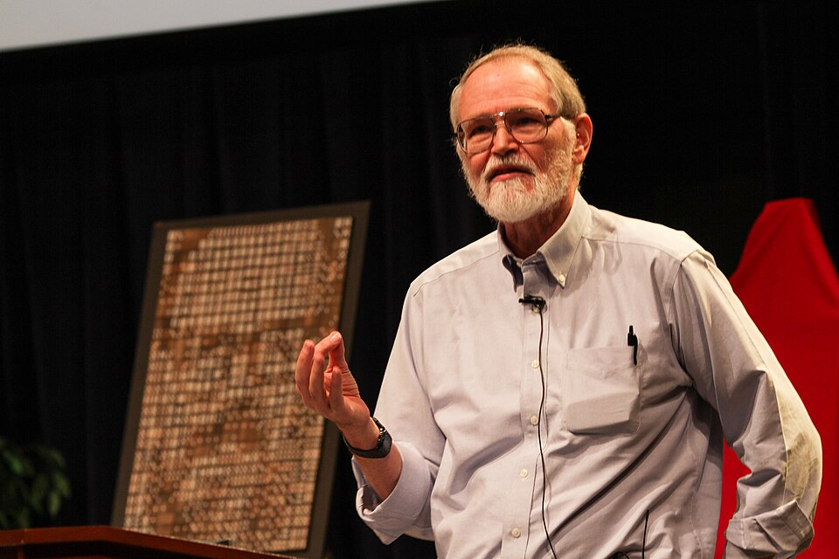
>>>
Story: where hello, world began, in 1972
In 1972, Brian Kernighan of Bell Laboratories wrote A Tutorial Introduction to the Language B. It holds the first known program that puts the words hello and world together.
A beginner needs a first program that does one visible thing. In B a constant held only four characters, so the greeting was split over three variables.
The 1978 book The C Programming Language made it famous on page 6. In Python the same greeting fits in one line, as the first program shows.
Brian Kernighan, 2012, at Bell Labs. Photo: Ben Lowe, CC BY 2.0, Wikimedia Commons.
The Hello, World! program (Wikipedia)
47 / 58
Notes:
The first hello, world was in a 1972 tutorial for the language B, and the 1978 C book made it famous. In B the text needed three variables; in Python it is one line. Ask the class: what does a first program prove when it prints?

Slide 48
>>>
Your first program
The idea
How it works, step by step
A program is a list of lines that run in order. This one greets, asks a name, measures it, and works out an age.
Greet
1
print shows the greeting
The reason
Remember
2
One program shows how output, variables, conversion and arithmetic fit together.
my_name holds the name
Measure
3
len counts the letters
An everyday picture
A program is a recipe followed line by line: greet, ask, answer.
Calculate
4
int, plus 1, then str
Greet, ask, measure, calculate: nine lines, four built-in functions.
48 / 58
Notes:
The first program greets, asks, measures and calculates. Example: it keeps the name in a variable and builds the greeting with plus. Ask the class: which line would break if you forgot to convert the age to a number, and what would the error say?

Slide 49
>>>
Your first program
print('Hello, world!')
print('What is your name?')
my_name = 'Ayse' # the text input() would return
print('It is good to meet you, ' + my_name)
print('The length of your name is:')
print(len(my_name))
my_age = '20' # input() returns text
next_age = int(my_age) + 1
print('You will be ' + str(next_age) + ' next year.')
Two print calls greet the user and ask a question.
A variable keeps the name. Concatenation builds the greeting and len measures the name.
int turns the age text into a number so that plus can add one. str turns the result back into text for the join.
What the run printed (Python 3.13.16)
Line | What Python does
1 | shows: Hello, world!
2 | shows: What is your name?
3 | stores 'Ayse' in my_name
4 | shows: It is good to meet you, Ayse
5 | shows: The length of your name is:
Line | What Python does
6 | shows: 4
7 | stores '20' in my_age
8 | stores 21 in next_age
9 | shows: You will be 21 next year.
Greet, ask, measure, calculate: nine lines, four built-in functions.
49 / 58
Notes:
Because the page has no keyboard, the example names the text input would return. The table traces every line: what it shows and what it stores. Ask the class to change the name and the age and predict the output before the run.

Slide 50
>>>
Dissecting the program
The idea
How it works, step by step
Dissecting means reading a program line by line and naming each part. The same sentence can be joined with plus or filled into an f-string.
Two variables
1
name and age hold the pieces
The reason
Join with +
2
Reading code is a skill of its own. The f-string is shorter and needs no str.
five pieces, str(age) needed
Fill an f-string
3
{name} and {age} are slots
An everyday picture
Dissecting is taking a clock apart: each gear does one small job, and together they tell the time.
Same sentence
4
both lines print it
Join pieces with +, or fill slots with an f-string.
50 / 58
Notes:
Dissecting a program means reading it line by line and naming each part. Example: the same sentence built by joining five pieces, and by filling an f-string. Ask the class: which of the two would you rather read, and why?

Slide 51
>>>
Dissecting the program: join or fill in
name = 'Alice'
age = 20
print('Hello, ' + name + '! You are ' + str(age) + '.')
print(f'Hello, {name}! You are {age}.')
Two variables hold the pieces of the message.
Both lines print the same sentence. The first joins five pieces and needs str. The f-string fills named slots with values.
What the run printed (Python 3.13.16)
join with +
fill slots with an f-string
'Hello, '
name
'! You are '
str(age)
'.'
f'Hello,
{name}
! You are
{age}
.'
Hello, Alice! You are 20.
Hello, Alice! You are 20.
the same sentence twice: the slots {name} and {age} need no str() and no plus signs
Join pieces with +, or fill slots with an f-string.
51 / 58
Notes:
The drawing breaks both lines into pieces: teal for text, amber for values. The f-string is shorter and needs no str. Both lines print the same sentence. Ask the class to add the city as a third slot and show both versions.

Slide 52
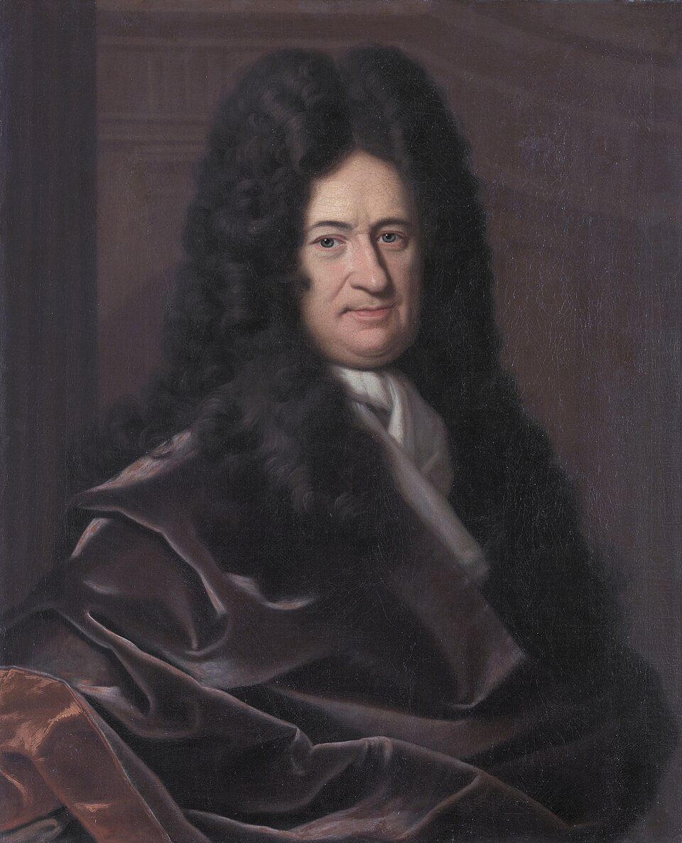
>>>
Story: Leibniz wrote every number with only 0 and 1
Gottfried Wilhelm Leibniz first noted binary arithmetic on 15 March 1679. On 1 April 1703 a letter reached him from the Jesuit Joachim Bouvet in Peking.
Bouvet wrote because he had seen that the hexagrams of the Chinese I Ching are binary numbers. Leibniz saw order in them; his paper reached the Paris Academy, printed 1705.
Every number can be written with two digits, as a sum of powers of two: 5 is 4 plus 1, written 101. Computers store numbers this way.
Gottfried Wilhelm Leibniz, painting by Christoph Bernhard Francke, before 1729, Herzog Anton Ulrich Museum. Public domain, Wikimedia Commons.
Leibniz and the binary system (historyofinformation.com)
52 / 58
Notes:
Leibniz described binary arithmetic in 1679, and Bouvet's letter from Peking in 1703 showed the I Ching hexagrams as binary numbers. Open the link and read out the dates. Ask the class: why would a machine prefer two digits to ten?

Slide 53
>>>
Binary: numbers from 0 and 1
The idea
How it works, step by step
Binary writes every number with only the digits 0 and 1. Each place is a power of two, and eight places make one byte.
bin(5)
1
'0b101'
The reason
Place values
2
A circuit is either on or off, so two digits are all hardware can keep. Every number in memory is a pattern of them.
4 + 0 + 1 gives 5
int('101', 2)
3
reads the bits back
An everyday picture
Binary is a row of light switches: each is on or off, and the pattern is the number.
One byte
4
8 places hold 256 values
Every number is a sum of powers of two.
53 / 58
Notes:
Binary writes numbers with only zero and one, and each place is a power of two. Example: five is four plus one, written one zero one. Ask the class: how many different values fit in one byte, and how do you work that out?

Slide 54
>>>
How computers store numbers: binary
print(bin(5))
print(int('101', 2))
print(2 ** 8)
print(format(5, '08b'))
print(format(255, '08b'))
bin shows a number as binary digits. int with base 2 reads them back. Eight binary digits, one byte, hold 2 ** 8 = 256 values.
format with 08b writes a number as exactly eight binary digits, padded with zeros on the left.
What the run printed (Python 3.13.16)
place value of each binary digit
128
64
32
16
8
4
2
1
0
0
0
0
0
1
0
1
00000101 = 4 + 1 = 5
11111111 = 255, the biggest byte
Every number is a sum of powers of two.
54 / 58
Notes:
The picture shows the eight places of a byte and which ones are switched on for five. The function bin shows the digits, and int with base two reads them back. Ask the class to write ten in binary and check it with bin.

Slide 55
>>>
Current Python adds more
Features newer than the book, from the chapter research
Feature | Since | What it gives you
A better interactive interpreter and error messages | 3.13 | The shell and its messages help beginners more
F-strings get a formal grammar (PEP 701) | 3.12 | The natural successor to joining pieces with +
A free-threaded build, still experimental (PEP 703) | 3.13 | The global interpreter lock becomes optional
An experimental just-in-time compiler | 3.13 | A first step; this course does not need it
Python 3.14, first released on 2025-10-07 | 3.14 | Current bugfix release at the time of the research
Integers have unlimited precision; floats are C doubles | all | 2 ** 100 is exact; 0.1 + 0.2 is not 0.3
uv, a package manager written in Rust | - | Most admired technology in the 2025 Stack Overflow survey, 74 percent
Run what the book printed; then check what changed.
55 / 58
Notes:
Python moves on. The shell and its error messages improved in 3.13, and the free-threaded build is experimental. F-strings have a formal grammar since 3.12. Example: PEP 701. Ask the class to check one row against its source before trusting it.

Slide 56
>>>
Summary
ANALOGY A summary is a packing list: only what you really need goes into the bag.
The shell evaluates an expression and prints one value.
code examples in each part of this chapter
1
2
Every value has a data type: int, float or str.
3
Operators combine values; precedence decides who goes first.
4
A variable names a value; print, input, len, str, int and float are built in.
5
A program is these pieces in order; computers store numbers in binary.
Five lines to keep; everything runs on the chapter page.
56 / 58
Notes:
Five sentences to keep, and the chart counts the code examples of each part. Everything is on the chapter page, in the same order. Example: the first sentence, the shell prints one value. Ask each student to say which sentence they still doubt.

Slide 57
>>>
Practice questions
Predict first, then run it on the chapter page
ANALOGY Practice questions are finger scales for a pianist: short drills before the performance.
1
Predict print(7 // 2 * 2 + 7 % 2). Which rule does the result show?
2
Write one line that prints your name five times with a space between the copies.
3
What error does print('Age: ' + 21) raise? Fix it in two different ways.
4
Change the first program so that it also says how old you will be in ten years.
Each answer fits in one line you can run.
57 / 58
Notes:
Four drills. Predict first, then run on the page. Example: seven floor-divided by two, times two, plus seven remainder two. Ask students to explain each answer in one sentence to a neighbour, and to name the rule that decided it.

Slide 58
>>>
Resources: where to go next
Reading and watching, chosen for this chapter; every link is live
Book: Automate the Boring Stuff, 3rd edition, chapter 1
https://automatetheboringstuff.com/3e/chapter1.html
PEP 701: f-strings get a formal grammar
https://peps.python.org/pep-0701/
The Python Tutorial: an informal introduction
https://docs.python.org/3/tutorial/introduction.html
PEP 703: making the GIL optional
https://peps.python.org/pep-0703/
Floating-point arithmetic: issues and limitations
https://docs.python.org/3/tutorial/floatingpoint.html
What's new in Python 3.14
https://docs.python.org/3/whatsnew/3.14.html
Built-in functions, all of them
https://docs.python.org/3/library/functions.html
Status of Python versions
https://devguide.python.org/versions/
Built-in types
https://docs.python.org/3/library/stdtypes.html
uv: a fast Python package manager
https://docs.astral.sh/uv/
PEP 8: the style guide
https://peps.python.org/pep-0008/
Video: The Story of Python, by Guido van Rossum
https://www.youtube.com/watch?v=J0Aq44Pze-w
PEP 20: the Zen of Python
https://peps.python.org/pep-0020/
Leibniz and the binary system
https://historyofinformation.com/detail.php?id=395
Pick one link and read it before the next class.
58 / 58
Notes:
Start with the book chapter and the Python tutorial, then the video by Guido van Rossum. The stories link to first-hand sources. Example: the floating-point page explains zero point one plus zero point two. Ask each student to choose one link to read before the next class.

