Slide 1
>>>
Excel Spreadsheets
Chapter 14 of Automate the Boring Stuff with Python, 3rd edition, for an advanced course
24
6
46
code examples that run on the chapter page
true stories with who, what, when, where, why and how
distinct chapter concepts, each with an everyday picture
SEN0414 Advanced Programming, Fall 2026. Yusuf Altunel, İstanbul Kültür Üniversitesi
1 / 51
Notes:
Welcome. This chapter reads and writes Excel workbooks from Python with openpyxl. Every code slide shows the code, a plain explanation, and the result as a table, chart or drawn diagram. The same examples stand in the chapter-code tab of the page, in this order.

Slide 2
>>>
Today's route
Five parts; every range is a run of slides you can jump to
Part | Slides | Code examples | You will run
Reading a workbook | 4 - 19 | 8 | the zip, sheets, cells, letters, slices, dates
Two projects on real data | 20 - 25 | 4 | the census tally and the price correction
Writing and formulas | 26 - 33 | 4 | save, formulas, rounding, insert_rows
Looks and layout | 34 - 41 | 5 | fonts, sizes, merge, freeze panes
Charts | 42 - 46 | 3 | Reference, Series, BarChart
Tools, changes, summary, practice, resources | 47 - 51 | - | what openpyxl keeps, and what differs today
Open the chapter-code tab of the page: the same 24 examples, in this order.
2 / 51
Notes:
Five parts: reading a workbook, the two projects, writing and formulas, looks and layout, and charts. Each range is a run of slides. The code slides have their place in the chapter-code tab of the page, in the same order.

Slide 3
>>>
Two questions this chapter answers
Carry them through every part; the answers come back at the end
1
Which object of openpyxl stands for which part of a workbook, and what does it keep of what the spreadsheet program stored?
Answer on slide 47: what openpyxl keeps, and what it does not do.
2
Which printed outputs, programs and files of the book differ in current Python and the current library?
Answer on slide 48: the changes, from the chapter research.
openpyxl keeps what was stored; the application calculates and draws.
3 / 51
Notes:
Two questions to carry through the chapter. Which object of openpyxl stands for which part of a workbook, and what does it keep of what the spreadsheet program stored? And which outputs and programs of the book differ today?

Slide 4
Part 1: Reading a workbook
An .xlsx file is a zip; a workbook holds sheets, and a sheet holds cells
xlsx file
A zip of XML parts that openpyxl opens.
Slide | In this part
5 | Everyday pictures: the file and the workb...
6 | An .xlsx file is a zip of XML parts
7 | Story: the .xlsx format became a standard...
8 | Sheets: create_sheet, sheetnames and the ...
9 | Story: openpyxl was born in 2010
10 | Everyday pictures: sheets and cells
11 | A cell by name, by row and column, and it...
12 | Story: a student pictured the spreadsheet...
13 | get_column_letter and column_index_from_s...
14 | A slice of cells, one column, and the gen...
15 | Everyday pictures: reading many cells
16 | Every cell has a data type: number, text ...
17 | Story: Excel turned gene names into dates...
18 | Looking at a cell changes the workbook
19 | Read-only mode: values row by row, with i...
Workbook
The whole file, holding a list of sheets.
Cell
One box with a name, a value and a type.
Column letter
A number written in letters, without a zero.
4 / 51
Notes:
Part one. A workbook is a zip of XML. We open it, list its sheets, take cells by name and by number, convert column letters, read slices and dates, and see that looking at a cell can create it. Predict each result first.

Slide 5
>>>
Everyday pictures: the file and the workbook
ANALOGY A workbook is a ring binder: every sheet is one page in it, and the whole binder travels as one file.
Chapter concept | Everyday picture
Reading Excel Files | Reading a ledger: you look at every line and change nothing.
xlsx file | A parcel of small labelled papers tied into one bundle; you can unpack it with any zip tool.
openpyxl | An interpreter who reads and writes the binder without Excel in the room.
workbook | A ring binder that holds all the pages of one job.
Workbook() | Buying a new binder that already holds one blank page.
openpyxl.load_workbook() | Taking a binder off the shelf and opening it on your desk.
Writing Excel Documents | Writing a new ledger page by page, and filing it at the end.
save() | Putting the binder back on the shelf: a binder with the same label is replaced.
5 / 51
Notes:
The binder picture carries the whole chapter. A workbook is the binder, a sheet is a page, a cell is a box. Ask students to add a picture of their own for the saved file.

Slide 6
>>>
An .xlsx file is a zip of XML parts
>>> import io, zipfile, openpyxl
>>> wb = openpyxl.Workbook()
>>> buf = io.BytesIO()
>>> wb.save(buf)
Workbook() makes a new workbook in memory. save() writes the .xlsx bytes; here into memory, so that this example needs no disk file.
>>> names = sorted(zipfile.ZipFile(buf).namelist())
>>> print(len(names), 'parts in the zip')
>>> for name in names: print(name)
An .xlsx file is an ordinary zip archive. The names inside show what openpyxl keeps: the workbook, a sheet, the strings and the styles.
What the run printed (Python 3.13.16)
Part inside the zip | What it holds
[Content_Types].xml | what kind each part is
_rels/.rels | where to start reading
docProps/app.xml | which program wrote the file
docProps/core.xml | author and dates
xl/_rels/workbook.xml.rels | links from the workbook to its parts
xl/styles.xml | fonts, fills and number formats
xl/theme/theme1.xml | colours and fonts of the theme
xl/workbook.xml | the list of sheets
xl/worksheets/sheet1.xml | the cells of the first sheet
book.xlsx
a zip of 9
XML parts
openpyxl reads it
An .xlsx file is a zip of XML parts.
6 / 51
Notes:
An .xlsx file is a zip. Predict how many parts a new workbook has, then read the count. The workbook, one sheet, the styles and a theme are all separate files.

Slide 7
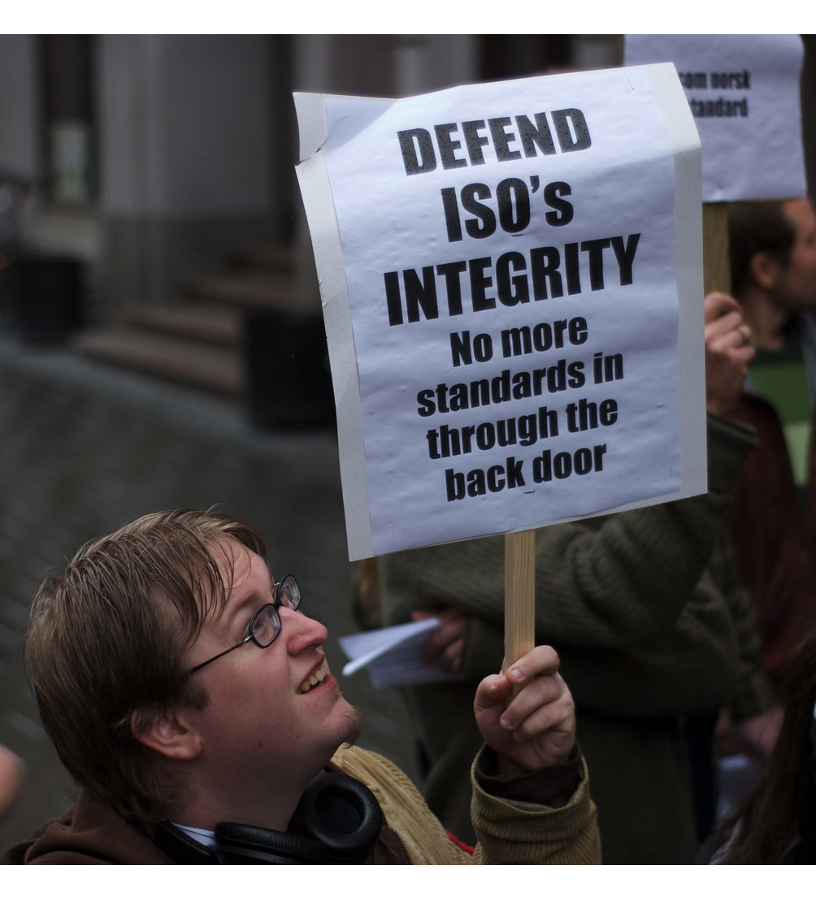
>>>
Story: the .xlsx format became a standard in 2006
WHO Microsoft, and the committee TC45 of Ecma International.
WHAT Office Open XML, the family of formats of .xlsx files: SpreadsheetML inside a ZIP-based package.
WHEN TC45 set up in December 2005; ECMA 376 approved in December 2006; ISO/IEC 29500 approved in early 2008.
WHERE Ecma International, then ISO/IEC JTC 1.
WHY Microsoft submitted its Office formats for review, to make them a documented standard that any program may read.
HOW A zip of XML files. Any program with a zip library can open an .xlsx file, and openpyxl does exactly that.
A rally about the OOXML vote in ISO, Oslo, 9 April 2008. Photo: Andy Armstrong, CC BY-SA 2.0, Flickr.
READ OOXML Format Family (Library of Congress)
7 / 51
Notes:
An .xlsx file is a documented zip of XML. Ecma approved it in December 2006, ISO in early 2008. The photograph is a rally in Oslo about the ISO vote, not the format itself; say so. Any program may read the format, which is why openpyxl can.

Slide 8
>>>
Sheets: create_sheet, sheetnames and the active sheet
>>> import io, openpyxl
>>> wb = openpyxl.Workbook()
>>> wb.create_sheet('Sheet2')
>>> wb.create_sheet('Sheet3', 1)
>>> buf = io.BytesIO(); wb.save(buf)
A new workbook has one sheet named Sheet. create_sheet adds one at the end, or at the index you give. The stand-in for example3.xlsx goes into memory.
>>> wb = openpyxl.load_workbook(buf)
>>> print(wb.sheetnames)
>>> print(wb.active.title, wb['Sheet3'].title)
load_workbook opens the saved bytes again. sheetnames lists the sheets in tab order, and the active sheet is the one that was open when the file was saved.
What the run printed (Python 3.13.16)
the tabs of the reloaded workbook, with their index
0
Sheet
1
Sheet3
2
Sheet2
wb.active.title = 'Sheet'
wb.sheetnames = ['Sheet', 'Sheet3', 'Sheet2']
A workbook is a list of sheets; one is active.
8 / 51
Notes:
Create_sheet adds a sheet at the end or at an index. Sheetnames lists them in tab order. The active sheet is the one that was open when the file was saved.

Slide 9

>>>
Story: openpyxl was born in 2010
WHO Eric Gazoni and Charlie Clark, volunteers.
WHAT openpyxl, a Python library that reads and writes Office Open XML files.
WHEN First upload to PyPI, openpyxl 1.1.0, on 11 August 2010; the newest release, 3.1.5, on 28 June 2024.
WHERE The open-source Python community.
WHY No library could read and write the format natively from Python; the project was first based on PHPExcel.
HOW A library written in Python, so no Excel is needed. Every program of chapter 14 is built on it.
The logo of the openpyxl documentation, enlarged. Not a picture of the authors.
READ openpyxl documentation
9 / 51
Notes:
openpyxl was born in 2010 from the lack of a Python library for the format. Its authors are volunteers. The newest release is 3.1.5 of June 2024. Always say which release you ran.

Slide 10
>>>
Everyday pictures: sheets and cells
ANALOGY A sheet is a page of graph paper, and every cell has an address like a seat in a cinema: row and seat.
Chapter concept | Everyday picture
worksheet | One page of graph paper in the binder.
active sheet | The page the binder was left open at.
create_sheet() | Slipping a new page into the binder, at the back or at a place you choose.
cell | One box of the graph paper; it holds one value or one formula.
cell() | Asking for the seat by row and number: row 2, seat 2.
openpyxl.utils | A small box of tools beside the binder, such as a ruler and a converter.
get_column_letter() | Turning a seat number into its sign on the cinema wall: 27 becomes AA.
column_index_from_string() | Turning the sign on the wall back into a number.
10 / 51
Notes:
A sheet is graph paper, and a cell has an address. Column letters count like digits without a zero: 27 is AA. Ask which seat is column 900.

Slide 11
>>>
A cell by name, by row and column, and its coordinate
>>> import openpyxl
>>> ws = openpyxl.Workbook().active
>>> for row in [('Apples', 73), ('Cherries', 85), ('Pears', 14)]:
>>> ws.append(row)
append writes one row below the last used row. These three rows stand in for the chapter's fruit sheet.
>>> print(ws['A1'].value, ws.cell(row=2, column=2).value)
>>> print(ws['B3'].coordinate, ws.max_row, ws.max_column)
>>> print(ws['A1'])
A cell is found by its name, A1, or by row and column number with cell(). max_row and max_column give the size of the used area.
What the run printed (Python 3.13.16)
 | A | B | C
1 | Apples | 73
2 | Cherries | 85
3 | Pears | 14
ws['A1'] = 'Apples'
ws.cell(row=2, column=2) = 85
ws['B3'].coordinate = 'B3'
max_row = 3, max_column = 2: the used area
A cell has a name and a row and column number.
11 / 51
Notes:
A cell by name or by row and column. Max_row and max_column are the size of the used area. The Cell object prints with its sheet and coordinate.

Slide 12
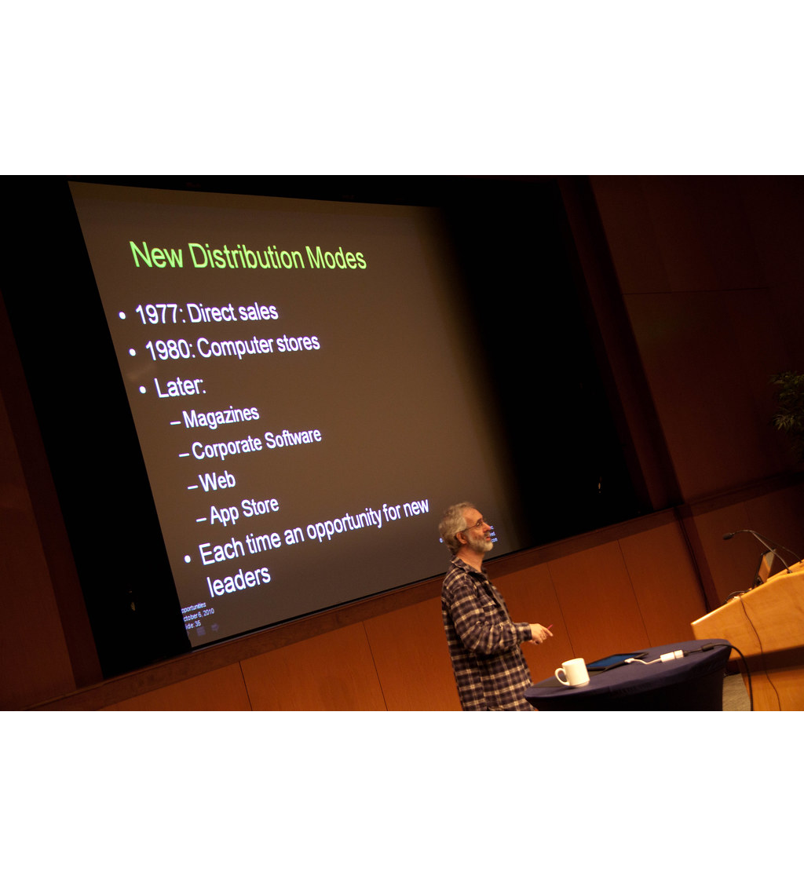
>>>
Story: a student pictured the spreadsheet in 1978
WHO Dan Bricklin, a student, and later Bob Frankston.
WHAT The idea of the electronic spreadsheet; VisiCalc, its first product, came out for the Apple II in 1979.
WHEN Spring 1978 the idea; 8 October 1978 the first prototype on an Apple II; 1979 VisiCalc.
WHERE Harvard Business School, Cambridge, Massachusetts.
WHY To put numbers, formula results and text on a screen in rows and columns with human-friendly names.
HOW He built the screen in Basic on the school's timesharing system, then on an Apple II borrowed from Dan Fylstra.
Dan Bricklin at the Business of Software conference, 2010. Photo: Betsy Weber, CC BY 2.0, Flickr.
READ The Idea, by Dan Bricklin (bricklin.com)
12 / 51
Notes:
Dan Bricklin had the idea in spring 1978 at Harvard Business School. His journal dates the first Apple II prototype to 8 October 1978. The grid of named rows and columns is the idea that openpyxl still addresses. Ask: why is the cell name A1 so human?

Slide 13
>>>
get_column_letter and column_index_from_string
>>> from openpyxl.utils import get_column_letter, column_index_from_string
>>> print([get_column_letter(n) for n in (1, 2, 27, 900)])
>>> print(column_index_from_string('AA'), column_index_from_string('XFD'))
Column 27 is AA, because the letters count like digits without a zero. Column 900 is AHP, and the last column of a sheet is XFD.
>>> try:
>>> get_column_letter(0)
>>> except ValueError as e:
>>> print('ValueError:', e)
There is no column 0, and no column beyond 18278. The wrong number stops the program with a ValueError.
What the run printed (Python 3.13.16)
number | 1 | 2 | 26 | 27 | 52 | 53 | 702 | 703 | 900
letters | A | B | Z | AA | AZ | BA | ZZ | AAA | AHP
XFD = column 16384, the last one
number 0 is refused: ValueError
letters count like digits without a zero: Z, then AA
Letters count like digits without a zero.
13 / 51
Notes:
Column letters are a number system without zero. Predict column 27 and column 900. A number outside 1 to 18278 raises a ValueError.

Slide 14
>>>
A slice of cells, one column, and the generators
>>> import openpyxl
>>> ws = openpyxl.Workbook().active
>>> for r in [(1, 'Apples', 73), (2, 'Cherries', 85), (3, 'Pears', 14)]:
>>> ws.append(r)
A small sheet of three rows and three columns.
>>> block = ws['A1':'C2']
>>> print(len(block), 'rows of', len(block[0]), 'cells')
>>> for row in block: print([c.value for c in row])
A slice such as A1:C2 gives a tuple of rows, and each row is a tuple of cells.
>>> print([c.value for c in ws['B']])
>>> print(type(ws.rows).__name__, type(ws.columns).__name__)
ws['B'] is the whole column B. rows and columns are generators, so they can be looped over but not indexed.
What the run printed (Python 3.13.16)
 | A | B | C
1 | 1 | Apples | 73
2 | 2 | Cherries | 85
3 | 3 | Pears | 14
ws['A1':'C2']: the teal cells
ws['B']: column B, amber and green
ws.rows, ws.columns: generators
A slice gives rows; a rows property is a generator.
14 / 51
Notes:
A slice gives rows of cells. A whole column is ws['B']. Rows and columns are generators, so you can loop but not index them.

Slide 15
>>>
Everyday pictures: reading many cells
ANALOGY Reading a big sheet is like reading a long scroll: unroll one line at a time and you never need the whole scroll on the table.
Chapter concept | Everyday picture
iter_rows() | Unrolling the scroll line by line, handing you each line as it appears.
read-only mode | Reading the scroll through a window: fast and light, but you may not write on it.
insert_rows() | Pushing new empty lines into a page; the notes in the margin still point at the old lines.
15 / 51
Notes:
Iter_rows hands out one line at a time, and read-only mode avoids holding every cell in memory. Insert_rows moves values but not references.

Slide 16
>>>
Every cell has a data type: number, text or date
>>> import datetime, openpyxl
>>> ws = openpyxl.Workbook().active
>>> ws['A1'] = datetime.datetime(2035, 4, 5, 13, 34, 2)
>>> ws['B1'] = 'SEPT2'
>>> ws['C1'] = 73
Python values go into cells as they are: a datetime, a string that only looks like a gene name or a date, and a number.
>>> print(ws['A1'].value)
>>> for c in ws[1]:
>>> print(c.coordinate, c.data_type, type(c.value).__name__)
data_type is n for a number, s for a string and d for a date. A string stays a string: openpyxl never turns SEPT2 into a date.
What the run printed (Python 3.13.16)
Cell | Value | data_type | Python type | A person would call it
A1 | 2035-04-05 13:34:02 | d | datetime | date
B1 | SEPT2 | s | str | text
C1 | 73 | n | int | number
SEPT2 stays text: only a spreadsheet application would turn it into a date
Numbers, text and dates keep their own data types.
16 / 51
Notes:
Every cell has a data type: n, s, d, f. A datetime stays a date, and a string stays a string. SEPT2 would become a date in Excel, but not in openpyxl.

Slide 17
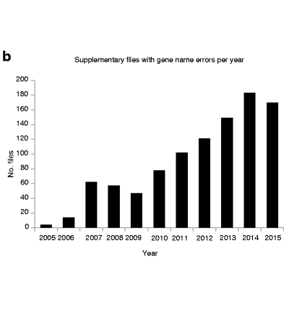
>>>
Story: Excel turned gene names into dates, 2016
WHO Mark Ziemann, Yotam Eren and Assam El-Osta.
WHAT A screening of 35,175 Excel files from 18 journals for gene names that Excel had turned into dates.
WHEN Published 23 August 2016, on files of 2005 to 2015.
WHERE Genome Biology.
WHY By default Excel turns SEPT2 and MARCH1 into the dates 2-Sep and 1-Mar; the problem was first described in 2004.
HOW Errors in 987 files from 704 of 3,597 papers with gene lists: 19.6 percent. In openpyxl a string stays a string.
Panel b of Fig. 1: files with gene-name errors per year. Ziemann et al. 2016, CC BY 4.0, cropped.
READ Gene name errors are widespread (Genome Biology)
17 / 51
Notes:
Excel turns SEPT2 into a date by default. In 2016 three researchers counted errors in 704 of 3,597 papers. The picture is panel b of Figure 1 of their paper: the files with errors, year by year. Check what a spreadsheet application did to your data before you trust it.

Slide 18
>>>
Looking at a cell changes the workbook
>>> import openpyxl
>>> ws = openpyxl.Workbook().active
>>> ws['A1'] = 'tall'
>>> print(ws.max_row, ws.dimensions)
A sheet with one value in A1 has one used row.
>>> ws.cell(row=40, column=1)
>>> print(ws.max_row, ws.dimensions)
>>> print(ws['A40'].value is None)
Only looking at row 40 created the cell and raised max_row to 40. A loop up to max_row now reaches empty rows, which is how Project 9 can fail.
What the run printed (Python 3.13.16)
max_row of the sheet
Moment | dimensions
before | A1:A1
after | A1:A40
A40 holds None, but the cell now exists
Looking at a cell can create it.
18 / 51
Notes:
Looking at a cell creates it. Cell(row=40) raised max_row from 1 to 40. A loop to max_row then reaches empty rows. Predict the dimensions before you run.

Slide 19
>>>
Read-only mode: values row by row, with iter_rows
>>> import io, openpyxl
>>> ws = openpyxl.Workbook().active
>>> for i in range(1, 6): ws.append([i, i * 10])
>>> buf = io.BytesIO(); ws.parent.save(buf)
A stand-in file with five rows and two columns.
>>> fast = openpyxl.load_workbook(buf, read_only=True)
>>> sheet = fast.active
>>> print(type(sheet).__name__, sheet.max_row)
>>> rows = list(sheet.iter_rows(min_row=2, max_row=4, values_only=True))
>>> print(rows)
read_only=True reads a big file row by row without holding every cell in memory. iter_rows with values_only gives plain tuples of values.
What the run printed (Python 3.13.16)
iter_rows(min_row=2, max_row=4, values_only=True) gave:
memory on the real census file (research finding F8)
row of the sheet | column A | column B
row 2 | 2 | 20
row 3 | 3 | 30
row 4 | 4 | 40
Read-only mode saves memory.
19 / 51
Notes:
Read-only mode reads row by row and uses little memory. On the real census file, the cell loop peaked at 114 MB, read-only iteration at 11 MB. Iter_rows with values_only gives tuples.

Slide 20
Part 2: Two projects on real data
Read and tally a census sheet, then correct the prices of a produce sheet
Project 9
Tally tracts and population by county.
Slide | In this part
21 | Everyday pictures: the two projects
22 | Project 9: read the census sheet row by row
23 | Project 9: tally tracts and population wi...
24 | pprint.pformat: save the tally as a Pytho...
25 | Project 10: correct prices in a sheet of ...
setdefault
Creates a missing key once, never twice.
pformat
Writes the result as Python text.
Project 10
Corrects prices and keeps the formulas.
20 / 51
Notes:
Part two. Two projects on real data: a tally of census tracts by county, and a correction of produce prices. The files are replaced by small stand-ins with the same columns, so every example runs on this page.

Slide 21
>>>
Everyday pictures: the two projects
ANALOGY A project is a recipe on a card: read the ingredients, follow the steps, write down the result.
Chapter concept | Everyday picture
Project 9: Reading Data from a Spreadsheet | Counting the votes of every district from a pile of ballot slips.
census tract | One small neighbourhood, the unit the census counts.
setdefault() | A hotel clerk who gives you a key only if you have none yet, and never a second one.
pprint | A tidy printer that lays a long list out in readable lines.
pprint.pformat() | Typing the tidy list into a letter instead of onto the screen.
Project 10: Updating a Spreadsheet | Correcting the price tags in a shop, and leaving the old stock list untouched.
sys | The notice board at the door of the program: it shows what was typed to start it.
Practice Programs | Small recital pieces that follow the finger exercises.
21 / 51
Notes:
Project 9 reads and tallies; Project 10 reads, corrects and saves a copy. The practice programs are the small recital pieces. Sys holds what was typed after the script name.

Slide 22
>>>
Project 9: read the census sheet row by row
>>> import openpyxl
>>> sheet = openpyxl.Workbook().active
>>> sheet.append(['CensusTract', 'State', 'County', 'POP2010'])
A stand-in for censuspopdata.xlsx: a header row, then one row for each census tract.
>>> tracts = [('02020000100', 'AK', 'Anchorage', 4115),
>>> ('02020000200', 'AK', 'Anchorage', 3040),
>>> ('01001020100', 'AL', 'Autauga', 1912)]
>>> for tract in tracts: sheet.append(tract)
Three tracts in two states and two counties. The real file has 72,865 rows.
>>> for row in range(2, sheet.max_row + 1):
>>> print(row, [sheet[c + str(row)].value for c in 'BCD'])
Row 1 holds the headers, so the loop starts at row 2. Columns B, C and D hold the state, the county and the population.
What the run printed (Python 3.13.16)
 | A | B | C | D
1 | CensusTract | State | County | POP2010
2 | 02020000100 | AK | Anchorage | 4115
3 | 02020000200 | AK | Anchorage | 3040
4 | 01001020100 | AL | Autauga | 1912
row 1: the headers
B, C, D: read by the loop
the loop printed 3 rows, 2 to 4
Row 1 is the header; the loop starts at row 2.
22 / 51
Notes:
Project 9, first steps. Row 1 holds the headers, so the loop starts at row 2. Columns B, C and D hold state, county and population. The real file has 72,865 rows; the stand-in has three.

Slide 23
>>>
Project 9: tally tracts and population with setdefault
>>> rows = [('AK', 'Anchorage', 4115), ('AK', 'Anchorage', 3040),
>>> ('AL', 'Autauga', 1912), ('AL', 'Autauga', 2170)]
The values the last loop read from the sheet, typed in so that this example stands alone.
>>> county_data = {}
>>> for state, county, pop in rows:
>>> county_data.setdefault(state, {})
Start with an empty dictionary. setdefault creates the state's entry once and leaves an existing one alone.
>>> county_data[state].setdefault(county, {'tracts': 0, 'pop': 0})
>>> county_data[state][county]['tracts'] += 1
>>> county_data[state][county]['pop'] += pop
>>> print(county_data)
The same for the county, then add one tract and its population to it.
What the run printed (Python 3.13.16)
State | County | Tracts | Population
AK | Anchorage | 2 | 7,155
AL | Autauga | 2 | 4,082
population by county
Count with a dictionary and setdefault.
23 / 51
Notes:
Project 9, the tally. Setdefault creates a missing key once. The counts are tracts and population by county. Predict the population of Anchorage before you read the result.

Slide 24
>>>
pprint.pformat: save the tally as a Python file
>>> import pprint
>>> county_data = {'AK': {'Anchorage': {'tracts': 2, 'pop': 7155}},
>>> 'AL': {'Autauga': {'tracts': 2, 'pop': 4082}}}
The result of the tally of Project 9, typed in so that this example stands alone.
>>> text = 'allData = ' + pprint.pformat(county_data)
>>> print(text)
>>> ns = {}
>>> exec(text, ns)
>>> print(ns['allData']['AK']['Anchorage']['pop'])
pformat turns the dictionary into text that is valid Python. The book writes it to census2010.py and imports it; here exec reads the text back.
What the run printed (Python 3.13.16)
county_data
(a dictionary)
pprint.pformat
(text)
'allData = ...'
(valid Python)
exec(text)
allData is back
allData = {'AK': {'Anchorage': {'pop': 7155, 'tracts': 2}},
'AL': {'Autauga': {'pop': 4082, 'tracts': 2}}}
allData['AK']['Anchorage']['pop'] = 7155
pformat writes a dictionary as Python.
24 / 51
Notes:
Pformat turns the dictionary into Python text. The book writes it to census2010.py and imports it. Exec reads the same text back here.

Slide 25
>>>
Project 10: correct prices in a sheet of produce
>>> import openpyxl
>>> ws = openpyxl.Workbook().active
>>> ws.append(['PRODUCE', 'COST PER POUND', 'POUNDS SOLD', 'TOTAL'])
>>> ws.append(['Garlic', 1.19, 10.0, '=ROUND(B2*C2,2)'])
>>> ws.append(['Celery', 3.07, 4.5, '=ROUND(B3*C3,2)'])
A stand-in for produceSales3.xlsx. Garlic and celery carry wrong prices. The total of each row is a formula: text that starts with an equal sign.
>>> updates = {'Garlic': 3.07, 'Celery': 1.19}
>>> for row in range(2, ws.max_row + 1):
>>> name = ws.cell(row=row, column=1).value
The correct prices are a dictionary. The loop reads the name in column A of every row below the header.
>>> if name in updates:
>>> ws.cell(row=row, column=2).value = updates[name]
>>> print([ws.cell(row=r, column=2).value for r in range(2, 4)])
When the name is in the dictionary, replace the price in column B. The formulas in column D are not touched.
What the run printed (Python 3.13.16)
PRODUCE | COST PER POUND | POUNDS SOLD | TOTAL (a formula, still text) | price
Garlic | 3.07 | 10.0 | =ROUND(B2*C2,2) | corrected
Celery | 1.19 | 4.5 | =ROUND(B3*C3,2) | corrected
the amber cells were replaced; the total formulas were not touched, and they hold no result
Change the cell, keep the formula.
25 / 51
Notes:
Project 10. The prices of garlic, celery and lemon are corrected, the formulas stay. The book saves the result under a new name so the original is kept.

Slide 26
Part 3: Writing and formulas
A formula is only text; an application calculates it and caches the result
save()
Writes the whole workbook and replaces the old file.
Slide | In this part
27 | Everyday pictures: formulas
28 | Writing a workbook: title, new sheets, re...
29 | A formula is text, and openpyxl never cal...
30 | Story: Excel came to the Macintosh on 2 M...
31 | Exact halves: a spreadsheet's ROUND and P...
32 | Story: a spreadsheet error left five coun...
33 | insert_rows moves values but not references
Formula
Text that starts with an equal sign.
data_only
Reads the result an application stored.
insert_rows
Moves values but not the references.
26 / 51
Notes:
Part three. Writing a workbook, and formulas. A formula is only text for openpyxl; a spreadsheet program calculates it. We see what is cached, what is lost on save, and why rounding can differ.

Slide 27
>>>
Everyday pictures: formulas
ANALOGY A formula in a file is a recipe written on a card; the cooked dish is only there if somebody cooked it.
Chapter concept | Everyday picture
Formulas | Cooking instructions written beside the ingredients.
formula | One recipe card: it says what to do and cooks nothing.
cached result | The photograph of the finished dish that the last cook left in the folder.
data_only | Asking for the photograph and not for the recipe; no cook means no photograph.
27 / 51
Notes:
A formula is a recipe card. openpyxl stores the card and never cooks. The cached result is the photograph that a real spreadsheet program left in the file.

Slide 28
>>>
Writing a workbook: title, new sheets, remove, save
>>> import io, openpyxl
>>> wb = openpyxl.Workbook()
>>> wb.active.title = 'Spam Bacon Eggs Sheet'
>>> wb['Spam Bacon Eggs Sheet']['A1'] = 'Hello, world!'
A new workbook, its sheet renamed, and A1 filled. Nothing is on disk yet.
>>> wb.create_sheet(index=0, title='First Sheet')
>>> wb.create_sheet(index=2, title='Middle Sheet')
>>> wb.remove(wb['Middle Sheet'])
>>> print(wb.sheetnames)
create_sheet puts a sheet at a position; remove takes one away.
>>> buf = io.BytesIO(); wb.save(buf)
>>> copy = openpyxl.load_workbook(buf)
>>> print(copy.sheetnames, copy['Spam Bacon Eggs Sheet']['A1'].value)
save writes the whole workbook, and replaces an old file without asking. Loading it again proves what was written.
What the run printed (Python 3.13.16)
Workbook()
1 sheet
title and A1
Spam Bacon Eggs Sheet
create_sheet x2
3 sheets
remove
2 sheets
save and load
2 sheets
0
First Sheet
1
Spam Bacon Eggs Sheet
A1 = 'Hello, world!'
Save writes the whole workbook.
28 / 51
Notes:
Create_sheet at an index, remove a sheet, save, load again. Save overwrites the old file without asking. Loading again proves what was written.

Slide 29
>>>
A formula is text, and openpyxl never calculates it
>>> import io, openpyxl
>>> ws = openpyxl.Workbook().active
>>> ws['A1'], ws['A2'] = 200, 300
>>> ws['A3'] = '=SUM(A1:A2)'
>>> print(ws['A3'].value, ws['A3'].data_type)
A formula is a string that starts with an equal sign. Its data type is f. Python only stores the text.
>>> buf = io.BytesIO(); ws.parent.save(buf)
>>> kept = openpyxl.load_workbook(buf)['Sheet']
>>> cached = openpyxl.load_workbook(buf, data_only=True)['Sheet']
>>> print(kept['A3'].value, '|', cached['A3'].value)
data_only=True asks for the result that a spreadsheet program stored. This file was never opened in one, so there is no result: None.
What the run printed (Python 3.13.16)
Cell | what Python stored | what data_only=True reads
A1 | 200 | 200
A2 | 300 | 300
A3 | =SUM(A1:A2) | None
openpyxl writes
=SUM(A1:A2)
no program opened
the file
the cached result
is None
a spreadsheet program calculates the formula and stores its result when it saves the file
openpyxl stores a formula; it never calculates it.
29 / 51
Notes:
A formula is a string with data type f. With data_only=True you get the stored result, and a file that openpyxl wrote has none: None. A spreadsheet program must open and save it first.

Slide 30
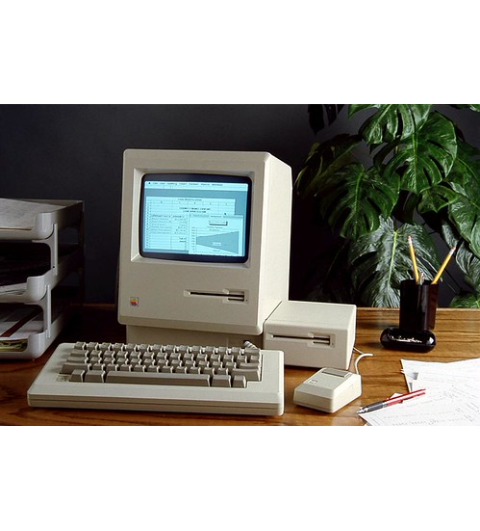
>>>
Story: Excel came to the Macintosh on 2 May 1985
WHO Steve Jobs of Apple and Bill Gates of Microsoft.
WHAT Excel for the Macintosh, after Multiplan of 1982.
WHEN Announced 2 May 1985, on sale 30 September 1985; Excel 2.05, the first for Windows, on 19 November 1987.
WHERE Tavern on the Green, New York City, at a press conference.
WHY Lotus 1-2-3 had become the leading program, so Microsoft began a new spreadsheet in 1983, code-named Odyssey.
HOW Excel kept a Lotus bug on purpose: 29 February 1900 counts as a day. The Office Open XML format still carries it.
A Macintosh showing Excel 1.0, 1985. Photo: Microsoft Sweden, CC BY 2.0, Flickr.
READ Microsoft Excel (Wikipedia)
30 / 51
Notes:
Excel for the Macintosh was announced on 2 May 1985. It kept a Lotus 1-2-3 bug on purpose: 29 February 1900. A file format keeps the habits and the bugs of its program. Ask students which habit of a tool they have inherited.

Slide 31
>>>
Exact halves: a spreadsheet's ROUND and Python's round
>>> from decimal import Decimal, ROUND_HALF_UP
>>> for text in ('0.125', '1.005', '2.675', '65.205'):
>>> x = float(text)
>>> up = Decimal(text).quantize(Decimal('0.01'), ROUND_HALF_UP)
>>> print(text, round(x, 2), up)
A spreadsheet's ROUND takes a half away from zero. Python rounds the binary float: 0.125 is exact and goes to the even digit, the others sit just off the half.
What the run printed (Python 3.13.16)
Exact half as text | Python round(x, 2) | spreadsheet ROUND (half up) | the same?
0.125 | 0.12 | 0.13 | NO
1.005 | 1.0 | 1.01 | NO
2.675 | 2.67 | 2.68 | NO
65.205 | 65.2 | 65.21 | NO
Python rounds
the binary float
a spreadsheet rounds
the decimal shown
Binary rounding and decimal rounding differ at halves.
31 / 51
Notes:
Python rounds the binary number it holds, a spreadsheet rounds the decimal number it shows. On the real produce file the two differed in 629 of 23,757 rows. Predict 2.675.

Slide 32
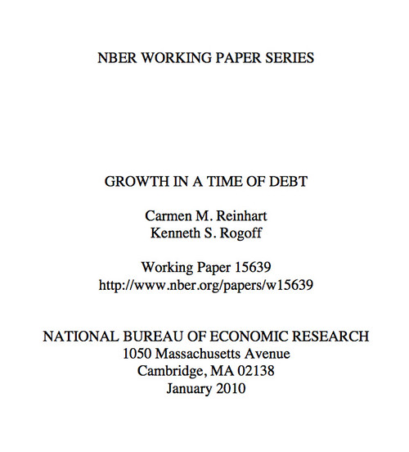
>>>
Story: a spreadsheet error left five countries out, 2013
WHO Thomas Herndon, with Michael Ash and Robert Pollin.
WHAT A working paper that tested Reinhart and Rogoff's study of public debt and economic growth.
WHEN 15 April 2013.
WHERE Political Economy Research Institute (UMass).
WHY To replicate the published result from the authors' own working spreadsheet.
HOW A coding error left out five countries, from Australia to Denmark. Growth above 90 percent debt was 2.2 percent a year, not -0.1.
Title page of Reinhart and Rogoff's working paper, 2010. Image: Open Knowledge Foundation, CC BY 2.0, Flickr.
READ Herndon, Ash and Pollin: a critique (PERI)
32 / 51
Notes:
In April 2013 three economists found a coding error in a published spreadsheet: five countries left out. The picture is the title page of the paper they tested. A formula is code, so it needs a second reader and a test.

Slide 33
>>>
insert_rows moves values but not references
>>> import sys, openpyxl
>>> sys.argv = ['blankRowInserter.py', '3', '2']
>>> ws = openpyxl.Workbook().active
>>> for i in range(1, 6): ws.append(['row %d' % i, i])
>>> ws['B6'] = '=SUM(B1:B5)'
The practice program reads a row number and a count from sys.argv. A list stands in for the command line here.
>>> start, count = int(sys.argv[1]), int(sys.argv[2])
>>> ws.insert_rows(start, count)
>>> print([ws.cell(row=r, column=1).value for r in range(1, 8)])
>>> print(ws['B8'].value)
Two blank rows now sit at row 3, and the sum moved down to B8. But it still says B1:B5: insert_rows does not rewrite references inside formulas.
What the run printed (Python 3.13.16)
 | A | B
1 | row 1 | 1
2 | row 2 | 2
3
4
5 | row 3 | 3
6 | row 4 | 4
7 | row 5 | 5
8 |  | =SUM(B1:B5)
amber: the two inserted blank rows
red: B8 holds =SUM(B1:B5)
the sum moved from B6 to B8,
but it still adds B1:B5, not B1:B7
insert_rows does not fix formulas.
33 / 51
Notes:
Two blank rows were inserted at row 3. The values moved down, but the SUM still says B1:B5. Insert_rows does not rewrite references, merged ranges or row heights.

Slide 34
Part 4: Looks and layout
Fonts, sizes, merges and frozen panes are objects and settings
Font()
A style object that cannot be changed.
Slide | In this part
35 | Everyday pictures: fonts, rows and columns
36 | Everyday pictures: merge, freeze and insert
37 | A multiplication table with bold headings
38 | Setting the font style of cells
39 | Adjusting rows and columns
40 | Merge and unmerge cells
41 | freeze_panes: the cell above and left of ...
Row height
Measured in points, like type.
Merged cell
Only the top-left cell stays real.
Freeze panes
Pins rows and columns to the window.
34 / 51
Notes:
Part four. Fonts, row heights, column widths, merged cells and frozen panes. Each is an object or a setting that openpyxl stores. Style objects cannot be changed; you assign a new one.

Slide 35
>>>
Everyday pictures: fonts, rows and columns
ANALOGY Layout is the dress of a table: it does not change the numbers, and every piece of it is an object you put on.
Chapter concept | Everyday picture
Setting the Font Style of Cells | Choosing the pen and the ink for each box.
Font() | A pen set that holds only the pens you put into it; the rest stays as before.
openpyxl.styles | The stationery cupboard: fonts, fills and borders.
Adjusting Rows and Columns | Moving the shelves of a bookcase to fit the books.
row height | The height of a shelf, measured in points.
column width | The width of a bookcase, measured in characters.
35 / 51
Notes:
A font is an object, and it keeps only what it is given. Row height is in points, column width in characters. Ask why Calibri 11 is not always true.

Slide 36
>>>
Everyday pictures: merge, freeze and insert
ANALOGY Merging cells is knocking out a wall between rooms, and freezing panes is pinning a heading to the window.
Chapter concept | Everyday picture
merge_cells() | Knocking down the walls between a block of rooms to make one hall.
merged cell | The hall: only the corner room keeps its name and its furniture.
unmerge_cells() | Rebuilding the walls; the furniture stays in the corner room.
freeze panes | A heading pinned to the window frame, while the page slides underneath.
36 / 51
Notes:
A merged range keeps one real cell. Freeze panes pins the rows above and the columns left of a cell. Insert_rows does not move merged ranges.

Slide 37
>>>
A multiplication table with bold headings
>>> import openpyxl
>>> from openpyxl.styles import Font
>>> N = 4
>>> ws = openpyxl.Workbook().active
The practice program takes N from the command line; here N is 4. Font comes from openpyxl.styles.
>>> for i in range(1, N + 1):
>>> ws.cell(row=1, column=i + 1, value=i).font = Font(bold=True)
>>> ws.cell(row=i + 1, column=1, value=i).font = Font(bold=True)
The first row and the first column hold the headings 1 to N, in bold.
>>> for j in range(1, N + 1):
>>> ws.cell(row=i + 1, column=j + 1, value=i * j)
>>> for row in ws.iter_rows(values_only=True): print(row)
Every other cell holds the product of its row heading and its column heading. The last line prints the grid; the empty corner A1 is None.
What the run printed (Python 3.13.16)
 | A | B | C | D | E
1 |  | 1 | 2 | 3 | 4
2 | 1 | 1 | 2 | 3 | 4
3 | 2 | 2 | 4 | 6 | 8
4 | 3 | 3 | 6 | 9 | 12
5 | 4 | 4 | 8 | 12 | 16
teal: the headings, in bold
A1 stays empty: None
cell (row i, column j) = i * j
One Font object can style many cells.
37 / 51
Notes:
The practice program in a small size. One Font object is shared by the heading cells. Predict the corner cell A1: nothing was written there.

Slide 38
>>>
Setting the font style of cells
>>> import openpyxl
>>> from openpyxl.styles import Font
>>> ws = openpyxl.Workbook().active
>>> ws['A1'].font = Font(size=24, italic=True)
>>> ws['B3'].font = Font(name='Times New Roman', bold=True)
Font comes from openpyxl.styles and keeps only the options you give. A1 gets a size and italic; B3 gets a name and bold.
>>> for c in (ws['A1'], ws['B3'], ws['C5']):
>>> print(c.coordinate, c.font.name, c.font.sz, c.font.b)
A1 has no name and B3 has no size. Calibri 11 is the default only for cells that were never styled, such as C5.
>>> try: ws['A1'].font.bold = True
>>> except AttributeError as e: print('AttributeError:', e)
A style object cannot be changed. To change one option, assign a new Font.
What the run printed (Python 3.13.16)
Cell | font.name | font.sz | bold | italic
A1 | None | 24.0 | False | True
B3 | Times New Roman | None | True | False
C5 | Calibri | 11.0 | False | False
Hello, world!
Bold Times New Roman
sample text; A1 is 24 pt here shown at 18
amber: nothing was given, so nothing is stored
A style keeps only what it is given.
38 / 51
Notes:
A style object keeps only what it was given. A1 has a size and no name; B3 a name and no size. A style cannot be changed in place: assign a new Font.

Slide 39
>>>
Adjusting rows and columns
>>> import openpyxl
>>> ws = openpyxl.Workbook().active
>>> ws['A5'], ws['B5'] = 'Tall row', 'Wide column'
>>> ws.row_dimensions[5].height = 70
>>> ws.column_dimensions['B'].width = 20
>>> ws.column_dimensions['D'].hidden = True
Row height is in points and column width in characters. A column can be hidden without being deleted.
>>> print(ws.row_dimensions[5].height, ws.column_dimensions['B'].width)
>>> print(ws.column_dimensions['D'].hidden)
>>> print(sorted(ws.column_dimensions), sorted(ws.row_dimensions))
Reading a dimension creates it too. Here only the rows and columns that were set are listed.
What the run printed (Python 3.13.16)
A
B
C
Setting | Value from the run
row_dimensions[5].height | 70.0 points
column_dimensions['B'].width | 20.0 characters
column_dimensions['D'].hidden | True
D hidden
4
5
6
column B is wider, row 5 is taller, column D has no width
Heights are in points, widths in characters.
39 / 51
Notes:
Row height in points, column width in characters. A hidden column is still in the file. Reading a dimension also creates it.

Slide 40
>>>
Merge and unmerge cells
>>> import openpyxl
>>> ws = openpyxl.Workbook().active
>>> ws.merge_cells('F1:I3')
>>> ws['F1'] = 'Twelve cells merged together.'
>>> print(*ws.merged_cells.ranges, type(ws['G2']).__name__)
merge_cells joins a block into one. Only the top-left cell is a real Cell; the other eleven are MergedCell objects.
>>> try:
>>> ws['G2'] = 'x'
>>> except AttributeError as e:
>>> print('AttributeError:', e)
>>> ws.unmerge_cells('F1:I3')
>>> print(len(ws.merged_cells.ranges), type(ws['G2']).__name__)
A merged cell is read-only. After unmerge_cells the text stays in the top-left cell and the others are ordinary empty cells again.
What the run printed (Python 3.13.16)
after merge_cells('F1:I3')
after unmerge_cells('F1:I3'): twelve cells again
F1:I3: one real cell
'Twelve cells merged together.'
 | F | G | H | I
1 | Twelve cells merged together.
2
3
type of G2 while merged: MergedCell, read-only; after: Cell
A merged range keeps one real cell.
40 / 51
Notes:
After merge_cells only the top-left cell is real. The others are MergedCell objects and are read-only. Unmerge gives empty cells back, the text stays in the corner.

Slide 41
>>>
freeze_panes: the cell above and left of it stays in view
>>> import openpyxl
>>> for setting in ('A2', 'B1', 'C2'):
>>> ws = openpyxl.Workbook().active
>>> ws.freeze_panes = setting
>>> pane = ws.sheet_view.pane
>>> print(setting, pane.xSplit, pane.ySplit)
The cell you name is the first one that scrolls. A2 freezes row 1, B1 freezes column A, and C2 freezes both.
What the run printed (Python 3.13.16)
freeze_panes = 'A2'
freeze_panes = 'B1'
freeze_panes = 'C2'
 | A | B | C | D
1
2
3
4
 | A | B | C | D
1
2
3
4
 | A | B | C | D
1
2
3
4
frozen: 0 column(s), 1 row(s)
frozen: 1 column(s), 0 row(s)
frozen: 2 column(s), 1 row(s)
The named cell is the first that scrolls.
41 / 51
Notes:
The cell you name is the first that scrolls. A2 freezes row 1, B1 freezes column A, C2 freezes both. The view is saved in the sheet's pane.

Slide 42
Part 5: Charts
openpyxl writes the order; an application draws the chart
Reference
Names the cells of the data.
Slide | In this part
43 | Everyday pictures: charts
44 | Charts: Reference, Series, BarChart and a...
45 | Reference: columns come before rows
46 | What a saved chart looks like inside the ...
Series
Wraps the cells with a title.
BarChart
The chart itself, with its bars.
add_chart
Places the chart on the sheet.
42 / 51
Notes:
Part five. Charts. openpyxl writes a chart as XML; Excel or LibreOffice draws it. We name the cells with Reference, wrap them in a Series, and add a BarChart to the sheet.

Slide 43
>>>
Everyday pictures: charts
ANALOGY A chart is a drawing order: openpyxl writes the order, and Excel or LibreOffice is the painter.
Chapter concept | Everyday picture
Charts | A wall painting commissioned from a painter who is not in the room.
chart | The painting itself, as the painter will draw it.
openpyxl.chart | The painter's catalogue of chart types.
Reference() | Pointing at the cells with a finger: from this corner to that corner.
Series() | A line of the data with its own label, ready to be drawn.
BarChart() | A blank frame for bars, hung on the wall.
add_chart() | Hanging the frame on the wall at a chosen spot.
43 / 51
Notes:
openpyxl writes a drawing order and a painter draws it. Reference names the cells, Series wraps them, BarChart is the frame, add_chart hangs it.

Slide 44
>>>
Charts: Reference, Series, BarChart and add_chart
>>> import openpyxl
>>> from openpyxl.chart import BarChart, Reference, Series
>>> ws = openpyxl.Workbook().active
>>> for i in range(1, 11): ws['A%d' % i] = i * i
Ten squares in column A are the data of the chart.
>>> ref = Reference(ws, 1, 1, 1, 10)
>>> series = Series(ref, title='First series')
>>> chart = BarChart()
>>> chart.title = 'My Chart'
Reference names the cells by their corners. Series wraps them with a title. BarChart is the chart itself.
>>> chart.append(series)
>>> ws.add_chart(chart, 'C2')
>>> print(ref, len(ws._charts))
append puts the series into the chart; add_chart places the chart on the sheet, its corner at C2.
What the run printed (Python 3.13.16)
the chart the program asked for: My Chart, series 'First series'
ref = 'Sheet'!$A$1:$A$10
1 chart on the sheet
Excel or LibreOffice draws the bars
Reference, Series, BarChart, add_chart.
44 / 51
Notes:
Reference names the cells, Series wraps them, BarChart is the chart, add_chart places it. The bars in the deck are the data of column A. The application draws the chart when it opens the file.

Slide 45
>>>
Reference: columns come before rows
>>> import openpyxl
>>> from openpyxl.chart import Reference
>>> ws = openpyxl.Workbook().active
Reference needs a worksheet and four numbers, which name the corner cells of a block.
>>> column_b = Reference(ws, 2, 1, 2, 10)
>>> row_2 = Reference(ws, 1, 2, 10, 2)
>>> print(column_b)
>>> print(row_2)
The order is min_col, min_row, max_col, max_row: column first. The chapter's text says row first, but its example hides the mistake because the block is square.
What the run printed (Python 3.13.16)
 | A | B | C | D | E | F | G | H | I | J
1
2
3
4
5
6
Reference(ws, 2, 1, 2, 10)
'Sheet'!$B$1:$B$10
Reference(ws, 1, 2, 10, 2)
'Sheet'!$A$2:$J$2
rows 1 to 6 of 10 are drawn; column B goes on down to row 10
min_col, min_row, max_col, max_row
Reference: column first, then row.
45 / 51
Notes:
The order is min_col, min_row, max_col, max_row: column first. The chapter's text says row first, and its example hides this because the block is square.

Slide 46
>>>
What a saved chart looks like inside the file
>>> import io, zipfile, openpyxl
>>> from openpyxl.chart import BarChart, Reference
>>> ws = openpyxl.Workbook().active
A new sheet, and the two pieces of openpyxl that a chart needs.
>>> for v in (1, 4, 9): ws.append([v])
>>> chart = BarChart(); chart.add_data(Reference(ws, 1, 1, 1, 3))
>>> ws.add_chart(chart, 'C2')
A small chart of three values is added to the sheet.
>>> buf = io.BytesIO(); ws.parent.save(buf)
>>> names = sorted(zipfile.ZipFile(buf).namelist())
>>> print([n for n in names if 'chart' in n or 'drawing' in n])
The saved file has a drawing part and a chart part of its own. openpyxl writes the XML that describes the chart; the application draws it.
What the run printed (Python 3.13.16)
ws.add_chart(chart)
ws.parent.save(buf)
the zip holds
xl/charts/chart1.xml
an application draws
the bars from the XML
xl/drawings/_rels/drawing1.xml.rels
xl/drawings/drawing1.xml
A chart is XML; an application draws it.
46 / 51
Notes:
A chart is stored as XML inside the zip: a drawing part and a chart part. openpyxl writes the order; the spreadsheet program draws.

Slide 47
>>>
What openpyxl keeps, and what it does not do
From the chapter research; each answer has its code slide
Question | Answer of openpyxl | See slide
Does it calculate a formula? | No: it stores the text; a spreadsheet program calculates | 29
Does it keep the result of a formula? | Only if you read with data_only=True; a saved file loses it | 29
Does looking at a cell change the file? | Yes: the cell, and the sheet's size, are created | 18
Does insert_rows fix the formulas? | No: values and styles move, references do not | 33
Does it draw a chart or a font? | No: it writes XML; an application draws it | 46
Is a file from outside safe to open? | Not against XML bombs; install defusedxml first | 48
Always: say which release you ran, keep the original file, and let an application calculate and draw.
openpyxl keeps what was stored; it calculates and draws nothing.
47 / 51
Notes:
What openpyxl keeps and what it does not: values and formulas as text, settings of looks, and chart orders. It does not calculate, draw or follow references. Choose the right tool for each question.

Slide 48
>>>
What differs from the book today
From the chapter research, checked on 12 October 2026
What differs from the book | Version or date | What it means for the chapter
get_sheet_by_name warns; get_highest_row is gone | openpyxl 3.1.5 | The online scripts stop: use wb[name] and max_row
Reference takes the column first | openpyxl 3.1.5 | The chapter says row first; its example is square
A saved workbook has no formula results | openpyxl 3.1.5 | Project 10 saves None for D2; open and save in an application
ROUND and round differ on exact halves | 12 Oct 2026 | 629 of 23,757 rows of the real produce file
Font() keeps only what it is given | openpyxl 3.1.5 | Calibri 11 holds only for cells never styled
Looking at a cell creates it | openpyxl 3.1.5 | Project 9's loop can reach empty rows
The newest release is quiet but current | 3.1.5, 28 Jun 2024 | Runs the same on Python 3.12 to 3.14
No guard against XML bombs | openpyxl documentation | Install defusedxml before you open a foreign file
Run what the book printed; then check what changed.
48 / 51
Notes:
What differs today. The book's online scripts use removed names. Reference is column first. A saved workbook loses formula results. openpyxl is stable and quiet. Install defusedxml before you open a file you did not make.

Slide 49
>>>
Summary
ANALOGY A summary is a packing list: only what you really need goes into the bag.
An .xlsx file is a zip; a workbook holds sheets, a sheet holds cells.
code examples in each part of this deck
1
2
Cells have names, numbers and data types; looking can create them.
3
A formula is text: a spreadsheet program calculates it.
4
Fonts, sizes, merges and frozen panes are objects and settings.
5
A chart is a drawing order that an application draws.
A workbook is a binder: keep the original, and check what the application did.
49 / 51
Notes:
Five sentences to keep. The chart counts the code examples in each part of this deck.

Slide 50
>>>
Practice Questions
Predict first, then run what you can on the chapter page
ANALOGY Practice questions are finger scales for a pianist; the practice programs are the small recital pieces.
1
Which letters name column 703, and which number has the name ZZ? Use the code of the column-letters slide.
2
A sheet holds =SUM(B1:B5) in B6. Two rows are inserted at row 3. Where is the formula, and what does it add?
3
What does Reference(ws, 3, 2, 3, 9) name? Write the range, then run it.
4
Practice program: write a Blank Row Inserter that also fixes the SUM of the last row.
Each answer fits in a few lines you can run.
50 / 51
Notes:
Four drills. Predict first, then run what you can on the page. Ask students to explain each answer in one sentence.

Slide 51
>>>
Resources: where to go next
Reading and watching, chosen for this chapter; every link is live
Book: Automate the Boring Stuff, 3rd edition, chapter 14
https://automatetheboringstuff.com/3e/chapter14.html
Python documentation: pprint
https://docs.python.org/3/library/pprint.html
openpyxl documentation: start page
https://openpyxl.readthedocs.io/en/stable/
Python documentation: decimal
https://docs.python.org/3/library/decimal.html
openpyxl tutorial: workbooks, data_only, copy
https://openpyxl.readthedocs.io/en/stable/tutorial.html
Python documentation: zipfile
https://docs.python.org/3/library/zipfile.html
openpyxl: working with styles
https://openpyxl.readthedocs.io/en/stable/styles.html
Library of Congress: OOXML format family
loc.gov
openpyxl: charts, introduction
openpyxl.readthedocs.io
Dan Bricklin: The Idea (VisiCalc history)
http://www.bricklin.com/history/saiidea.htm
openpyxl: optimised modes (read-only)
https://openpyxl.readthedocs.io/en/stable/optimized.html
Gene name errors are widespread (Genome Biology)
genomebiology.biomedcentral.com
openpyxl on the Python Package Index
https://pypi.org/project/openpyxl/
defusedxml on the Python Package Index
https://pypi.org/project/defusedxml/
Pick one link and read it before the next class.
51 / 51
Notes:
Start with the book chapter and the openpyxl documentation, then the file format standard and the stories' first-hand sources. Choose one link and read it before the next class.

