Slide 1
>>>
Loops
Chapter 3 of Automate the Boring Stuff with Python, 3rd edition, for an advanced course
22
3
34
code examples that run on the chapter page
true stories with who, what, when, where, why and how
distinct chapter concepts, each with an everyday picture
SEN0414 Advanced Programming, Fall 2026. Yusuf Altunel, İstanbul Kültür Üniversitesi
1 / 43
Notes:
Welcome. This chapter teaches repetition: while, for and range, the containers a loop visits, modules and leaving a program early. Every code slide shows the code, a plain explanation and the run as a table, chart or drawing. The same examples run on the chapter page.

Slide 2
>>>
Today's route
Five parts; every range is a run of slides you can jump to
Part | Slides | Code examples | You will run
Repeating with while | 4 - 12 | 5 | while, accumulator, break, continue, :=
Counting with for and range | 13 - 18 | 3 | for, range, half-open ranges
What a for loop visits | 19 - 26 | 6 | lists, dictionaries, enumerate, zip, iter
Modules and leaving early | 27 - 33 | 4 | import, namespaces, sys.exit
Two short programs | 34 - 39 | 4 | Guess the Number, Rock, Paper, Scissors
Changes, summary, practice, resources | 40 - 43 | - | what current Python adds
Open the chapter-code tab of the page: the same 22 examples, in this order.
2 / 43
Notes:
Five parts: while loops, for and range, what a for loop visits, modules and leaving early, and two short programs. Each code slide has its place in the chapter-code tab of the page, in this same order.

Slide 3
>>>
Two questions this chapter answers
Carry them through every part; the answers come back at the end
1
What decides when a loop repeats and when it stops, and which statements leave or skip a pass?
Answer on slide 41: the test, break, continue, and else on a loop.
2
Which parts of the book's chapter differ in current Python, and on what source?
Answer on slide 40: the walrus, strict zip and the new warning.
A loop is a test, a block and a way out.
3 / 43
Notes:
Two questions to carry through the chapter. What decides when a loop repeats and when it stops? And which parts of the book differ in current Python? The answers come back in the summary.

Slide 4
Part 1: Repeating with while
A test is checked before every pass; break and continue change the flow
while
Repeats a block as long as its test is true.
Slide | In this part
5 | Everyday pictures: repeating
6 | while: repeat as long as the test is t...
7 | An accumulator adds up 1 to 100
8 | Story: Gauss added 1 to 100 without a ...
9 | while True runs until break leaves it
10 | continue skips the rest of one pass
11 | The assignment expression in a loop test
12 | Story: the walrus operator and PEP 572
Accumulator
A variable that collects a total pass by pass.
break and continue
Leave the loop, or jump back to its test.
Walrus :=
Names a value inside the test of a loop.
4 / 43
Notes:
Part one. A while loop tests first, then runs its block. Watch the test turn False. Break and continue change the flow, and the walrus names a value inside the test.

Slide 5
>>>
Everyday pictures: repeating
ANALOGY A loop is a washing-machine cycle: the same steps again and again until the programme ends.
Chapter concept | Everyday picture
Loop | A washing-machine cycle: the same steps again and again until the programme ends.
while | A guard who asks at every round: is the door still open? If yes, walk another round.
while Loop Statements | The guard's written rule: keep patrolling as long as the condition holds.
Iteration | One lap on a running track; the loop is the whole race.
Loop variable | The lap counter on the stadium board: it changes every lap and keeps the last number.
Accumulator | A piggy bank: every pass drops one more coin into the same jar.
Early exit | A fire exit: you may leave the hall before the show is over.
break | The emergency brake of a train: everything stops at once.
continue | Skipping a song: the playlist goes on with the next one.
5 / 43
Notes:
A washing machine repeats a cycle until the programme ends. A guard decides at every round whether to walk another one. Ask students to add one more everyday loop of their own.

Slide 6
>>>
while: repeat as long as the test is true
>>> spam = 0
>>> while spam < 5:
spam starts at 0. The while statement tests spam < 5 before every pass through its block.
>>> print('pass', spam, 'spam < 5 is', spam < 5)
>>> spam = spam + 1
The indented lines are the block. It prints the pass and adds 1; without the second line the loop never stops.
>>> print('stop: spam is', spam, 'and spam < 5 is', spam < 5)
When the test turns False, Python skips the block and goes on below it.
What the run printed (Python 3.13.16)
Test | spam | spam < 5 | Block runs?
1 | 0 | True | yes
2 | 1 | True | yes
3 | 2 | True | yes
4 | 3 | True | yes
5 | 4 | True | yes
6 | 5 | False | no: the loop ends
The test comes first; the block runs while it is True.
6 / 43
Notes:
The test comes first. Run the block, come back, test again. Predict how many passes there will be before you read the table. The last test is False, so the block is skipped.

Slide 7
>>>
An accumulator adds up 1 to 100
>>> total, n, steps = 0, 1, []
>>> while n <= 100:
total is the accumulator: it starts at 0 and collects a little at every pass. n counts from 1 to 100.
>>> total = total + n
>>> if n % 20 == 0:
>>> steps.append(total)
>>> n = n + 1
Every pass adds n to total. After every twentieth number the program keeps a snapshot of the running total.
>>> print(total, 100 * 101 // 2, steps)
The second number is Gauss's formula n(n+1)/2. The loop and the formula agree.
What the run printed (Python 3.13.16)
After n = | Running total | n(n+1)/2 | Equal?
20 | 210 | 210 | True
40 | 820 | 820 | True
60 | 1830 | 1830 | True
80 | 3240 | 3240 | True
100 | 5050 | 5050 | True
Start at zero, add at every pass, read the total at the end.
7 / 43
Notes:
An accumulator starts at zero and collects. The chart shows the running total at every twentieth number. Gauss's formula gives the same 5050 without a loop.

Slide 8
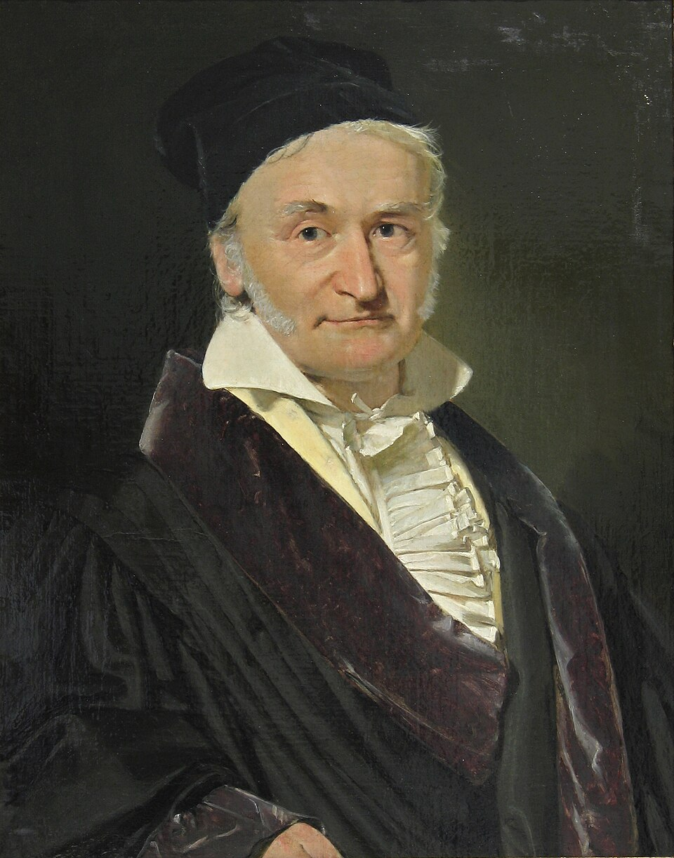
>>>
Story: Gauss added 1 to 100 without a loop
WHO Carl Friedrich Gauss, a schoolboy in Brunswick, Germany, as the legend tells it.
WHAT He added 1 to 100 as fifty pairs of 101 and answered 5050 at once, without counting.
WHEN The tale is set in the 1780s; its oldest print is a memorial of 1856, so it is a traced legend.
WHERE A school in Brunswick; the trail of printed versions was collected by Brian Hayes, American Scientist, 2006.
WHY It shows what an accumulator loop does, and that a formula can sometimes replace it.
HOW Pair 1 with 100, 2 with 99, and so on: 50 pairs of 101. The slide before prints 100 * 101 // 2.
Carl Friedrich Gauss, portrait by Christian Albrecht Jensen, 1840. Public domain, Wikimedia Commons.
READ Carl Friedrich Gauss (Wikipedia)
8 / 43
Notes:
The Gauss tale has a paper trail back to an 1856 memorial, so call it a legend. The loop and the formula both give 5050. Ask students which one they would trust for a million numbers.

Slide 9
>>>
while True runs until break leaves it
>>> answers = iter(['', 'Al', 'Alice'])
>>> while True:
iter() stands in for a typing person: each next(answers) is one typed answer.
>>> name = next(answers)
>>> print('typed', repr(name), '- is it Alice?', name == 'Alice')
Each pass reads one answer and prints whether it is the right one.
>>> if name == 'Alice':
>>> break
>>> print('Welcome,', name)
break leaves the loop at once, although the test is still True. The program goes on after the block.
What the run printed (Python 3.13.16)
Pass | Typed | Is it Alice? | What the loop does
1 | '' | False | go round again
2 | 'Al' | False | go round again
3 | 'Alice' | True | break: leave the loop
Welcome, Alice
printed after the loop, once break has left it
while True needs a break to end.
9 / 43
Notes:
While True never stops by itself, so break is its exit. The iterator replaces a typing person, so the example runs without a keyboard. Count the passes.

Slide 10
>>>
continue skips the rest of one pass
>>> n, shown, skipped = 0, [], []
>>> while n < 8:
>>> n = n + 1
n counts from 1 to 8. The lists shown and skipped remember what happened to each number.
>>> if n % 2 == 0:
>>> skipped.append(n)
>>> continue
>>> shown.append(n)
For an even n, continue jumps straight back to the while test. The line after it is skipped in that pass.
>>> print('shown', shown, 'skipped', skipped)
Odd numbers reach the end of the block; even numbers never do.
What the run printed (Python 3.13.16)
1
2
3
4
5
6
7
8
List | Numbers | How many
shown | [1, 3, 5, 7] | 4
skipped | [2, 4, 6, 8] | 4
amber: continue sent the loop back to the test
teal: the number reached shown.append
continue returns to the test; break leaves the loop.
10 / 43
Notes:
Continue does not leave the loop; it returns to the test. Even numbers skip the append. Compare the two lists with the picture of the numbers 1 to 8.

Slide 11
>>>
The assignment expression in a loop test
>>> import io
>>> f = io.StringIO('Loops repeat work.')
StringIO makes a file-like object from a text. It plays the part of a file that is read in small pieces.
>>> while chunk := f.read(5):
>>> print(repr(chunk))
The walrus := reads five characters and names them chunk in one expression. The loop ends when read gives an empty string.
>>> print(repr(f.read(5)), bool(''))
At the end of the text read gives '', and an empty string counts as False.
What the run printed (Python 3.13.16)
Read | chunk | Length | Truth value | Loop
1 | 'Loops' | 5 | True | goes on
2 | ' repe' | 5 | True | goes on
3 | 'at wo' | 5 | True | goes on
4 | 'rk.' | 3 | True | goes on
5 | '' | 0 | False | ends
x := value names the value inside the test.
11 / 43
Notes:
The walrus reads and names in one expression, which is what the PEP's own file-reading loop needs. The empty string at the end is False, so the loop stops.

Slide 12

>>>
Story: the walrus operator and PEP 572
WHO Chris Angelico, Tim Peters and Guido van Rossum wrote PEP 572; Guido, Python's creator, decided it.
WHAT The walrus operator :=, which names a value inside an expression, as in while chunk := f.read(5).
WHEN The PEP was created on 28 February 2018; the operator arrived in Python 3.8.
WHERE On the python-dev mailing list and in the PEP at peps.python.org.
WHY Reading a file in pieces needed a read and a test on separate lines; := joins them.
HOW After the debate Guido accepted it, and on 12 July 2018 he stepped down as Python's 'benevolent dictator for life'.
Guido van Rossum, 2014. Photo: Daniel Stroud, CC BY-SA 4.0, Wikimedia Commons.
READ PEP 572, Assignment Expressions (peps.python.org)
12 / 43
Notes:
PEP 572 was created in February 2018 and shipped in Python 3.8. Guido stepped down as BDFL on 12 July 2018. Ask students when naming a value inside a test helps readability, and when it hurts.

Slide 13
Part 2: Counting with for and range
A for loop takes the values one at a time; range describes them
for
Takes the items of a sequence one at a time.
Slide | In this part
14 | Everyday pictures: for and range
15 | for: one value of range(5) per pass
16 | range(start, stop, step)
17 | Story: why range stops before the end
18 | range describes numbers; it does not s...
range()
Describes a row of numbers without storing it.
Half-open interval
Includes the start and leaves out the stop.
Loop variable
Holds the current item and keeps its last value.
13 / 43
Notes:
Part two. For takes the items of a sequence one by one. Range describes numbers without storing them, and it stops before the stop value.

Slide 14
>>>
Everyday pictures: for and range
ANALOGY A for loop is a postman with a street list; range prints the house numbers only when he asks.
Chapter concept | Everyday picture
for | A postman who visits each house on his list, one after the other.
for Loops and the range() Function | The postman's round: a street list, counted by number.
range() | A ticket machine that prints ticket 7 only when someone asks for it.
Half-open interval | A school year: it starts on 1 September and ends the day before the next one begins.
Sequence to iterate | The street list the postman works through, house by house.
Sequence | A queue at the bakery: every person has a place number.
Iterable | A deck of cards: you can deal from it as often as you like.
Iterator | The dealer's hand: it remembers where it is and gives out the next card.
14 / 43
Notes:
The postman has a list and visits each house. Range is the list of house numbers, printed on demand. A school year shows why a half-open interval has no overlaps.

Slide 15
>>>
for: one value of range(5) per pass
>>> total = 0
>>> for i in range(5):
The for statement takes the values of range(5) one by one and puts each into the loop variable i.
>>> total = total + i
>>> print('i is', i, 'total is', total)
No counter has to be started or advanced by hand. The block runs once for each value.
>>> print('after the loop i is still', i)
The loop variable is not deleted when the loop ends. It keeps the last value, 4.
What the run printed (Python 3.13.16)
Pass | i | total
1 | 0 | 0
2 | 1 | 1
3 | 2 | 3
4 | 3 | 6
5 | 4 | 10
for needs no counter; i keeps its last value.
15 / 43
Notes:
For needs no counter. The chart shows the total after each pass. After the loop, i still holds 4, because the loop variable is never deleted.

Slide 16
>>>
range(start, stop, step)
>>> print(list(range(5)), list(range(2, 8)))
One argument is the stop; two arguments are start and stop. The stop value itself is never included.
>>> print(list(range(0, 10, 3)), list(range(5, 0, -2)))
The third argument is the step. A negative step counts down.
>>> print(list(range(0, 3)) + list(range(3, 7)) == list(range(7)))
Half-open ranges meet without gap or overlap: 0 to 3 and 3 to 7 make 0 to 7.
What the run printed (Python 3.13.16)
Call | Items | Count
range(5) | [0, 1, 2, 3, 4] | 5
range(2, 8) | [2, 3, 4, 5, 6, 7] | 6
range(0, 10, 3) | [0, 3, 6, 9] | 4
range(5, 0, -2) | [5, 3, 1] | 3
which of 0 to 9 each call gives
0
1
2
3
4
5
6
7
8
9
0
1
2
3
4
5
6
7
8
9
0
1
2
3
4
5
6
7
8
9
0
1
2
3
4
5
6
7
8
9
Start is in, stop is out; the step may be negative.
16 / 43
Notes:
Start is included, stop is not. Length is stop minus start. A negative step counts down. Two neighbouring ranges leave no gap and no overlap.

Slide 17
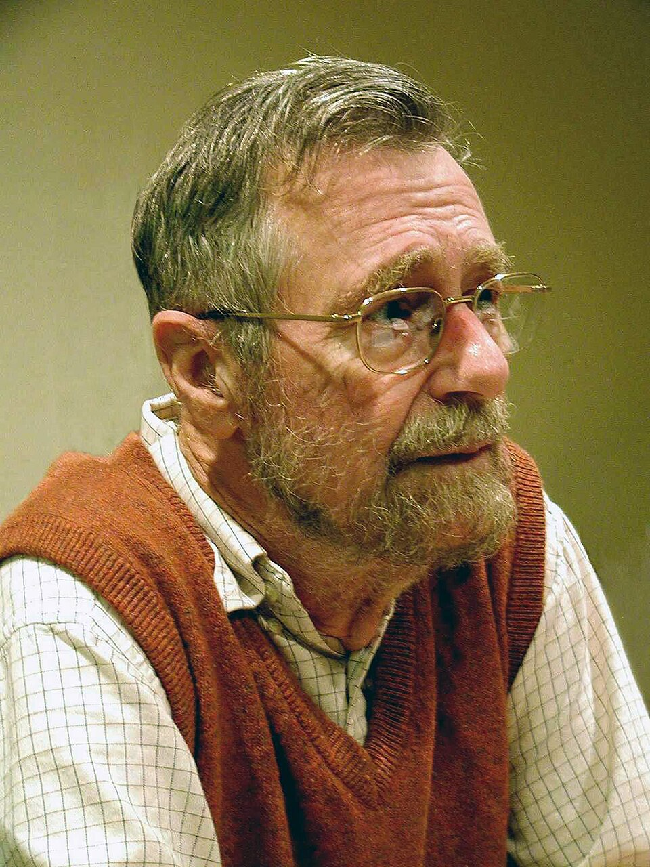
>>>
Story: why range stops before the end
WHO Edsger W. Dijkstra, Dutch computer scientist, Turing Award 1972.
WHAT A two-page handwritten memo, EWD831, titled 'Why numbering should start at zero'.
WHEN 11 August 1982.
WHERE Nuenen, the Netherlands, where he was a Burroughs research fellow; the memo is kept in the EWD archive at the University of Texas at Austin.
WHY He wanted lengths and neighbouring ranges to work without special cases.
Edsger W. Dijkstra. Photo: Hamilton Richards, CC BY-SA 3.0, Wikimedia Commons.
HOW Include the start, leave out the stop: range(2, 8) has 8 - 2 = 6 items, and range(0, 3) meets range(3, 7).
READ Edsger W. Dijkstra (Wikipedia)
17 / 43
Notes:
Dijkstra's memo EWD831 is dated 11 August 1982. Half-open ranges give lengths as stop minus start and let neighbours meet. Ask: how many items has range(10, 25)?

Slide 18
>>>
range describes numbers; it does not store them
>>> r = range(10 ** 9)
>>> print(len(r), r[999999999])
A billion numbers are described, not stored. len and indexing answer at once.
>>> print(123456789 in r, r[:3])
>>> print(r, type(r).__name__)
The in test is arithmetic, not a search. Slicing a range gives another range, not a list.
What the run printed (Python 3.13.16)
Expression | Result | How Python answers
len(r) | 1000000000 | from start, stop and step
r[999999999] | 999999999 | by arithmetic
123456789 in r | True | by arithmetic, no search
r[:3] | range(0, 3) | another range, not a list
start 0 stop 10**9 step 1
any value, on demand
stored: 3 numbers
range holds a recipe, not the numbers.
18 / 43
Notes:
Range stores three numbers and computes the rest on demand. That is why a range of a billion costs nothing. Slicing gives another range.

Slide 19
Part 3: What a for loop visits
Containers, pairs and the iterator that hands out the items
List and tuple
Ordered containers, one changeable and one fixed.
Slide | In this part
20 | Everyday pictures: what a loop visits
21 | for visits a list and a tuple
22 | for visits the pairs of a dictionary
23 | enumerate and zip replace index arithm...
24 | zip: stop silently, or insist on equal...
25 | Under every for: iter and next
26 | break, and the else clause of a loop
Dictionary
Keys with values, visited as pairs with items().
enumerate and zip
A counter and pairs without index arithmetic.
Iterator
The object that hands out one item at a time.
19 / 43
Notes:
Part three. A loop can visit lists, tuples, dictionaries and strings. Enumerate and zip remove index arithmetic. Under every for sit iter and next.

Slide 20
>>>
Everyday pictures: what a loop visits
ANALOGY A list is a shopping list, a tuple a printed ticket and a dictionary a phone book.
Chapter concept | Everyday picture
List | A shopping list: add an item, cross one out, change the order.
Tuple | A printed ticket: row and seat are fixed once it is printed.
Dictionary | A phone book: look up a name and you get a number.
Sequence unpacking | Opening a gift box and putting each item on its own shelf at once.
Assignment expression | A cashier who says the total aloud and writes it down in one move.
20 / 43
Notes:
A list changes, a tuple does not, a dictionary looks up by key. Unpacking puts each part of a pair into its own name. The walrus names a value and uses it in one move.

Slide 21
>>>
for visits a list and a tuple
>>> pets = ['cat', 'tiger', 'owl']
>>> for pet in pets:
>>> print(pet.upper(), len(pet))
A list is visited in order, item by item. Each pass shows the loop variable pet in capitals and its length.
>>> point = (3, 4)
>>> for coordinate in point:
>>> print(coordinate * 2)
A tuple is visited in the same way, but it cannot be changed. Lists use brackets and tuples use parentheses.
What the run printed (Python 3.13.16)
 | list | tuple
brackets | [ ] | ( )
has append() | True | False
visited by for | yes | yes
printed by the loop | CAT 3, TIGER 5, OWL 3 | 6, 8
Lists change, tuples do not; for visits both.
21 / 43
Notes:
Both containers are visited in order. The chart shows the length of each pet name. The tuple cannot be changed; the list can.

Slide 22
>>>
for visits the pairs of a dictionary
>>> ages = {'cat': 4, 'dog': 7, 'owl': 2}
>>> for name, age in ages.items():
>>> print(name, 'is', age)
items() gives key and value pairs. The loop variables name and age unpack each pair into two names.
>>> print(sum(ages.values()), list(ages))
values() gives only the values. A loop over the dictionary alone visits its keys.
What the run printed (Python 3.13.16)
Call | Gives
ages.items() | [('cat', 4), ('dog', 7), ('owl', 2)]
ages.values() | [4, 7, 2]
list(ages) | ['cat', 'dog', 'owl']
sum(ages.values()) | 13
items() gives pairs; the loop unpacks them.
22 / 43
Notes:
Items gives pairs, and the loop unpacks each into two names. Values gives the values only. The chart shows the three ages.

Slide 23
>>>
enumerate and zip replace index arithmetic
>>> names = ['ann', 'bo', 'cy']
>>> scores = [90, 75, 82]
Two lists that belong together by position.
>>> for i, name in enumerate(names, start=1):
>>> print(i, name)
enumerate hands out a counter and the item together, so range(len(names)) is not needed.
>>> for name, score in zip(names, scores):
>>> print(name, score)
zip walks two lists side by side and gives one pair per pass.
What the run printed (Python 3.13.16)
enumerate | zip
1, 'ann' | ('ann', 90)
2, 'bo' | ('bo', 75)
3, 'cy' | ('cy', 82)
enumerate counts, zip pairs.
23 / 43
Notes:
Enumerate gives counter and item. Zip gives pairs from two lists. Both remove range(len(...)). The chart shows the scores.

Slide 24
>>>
zip: stop silently, or insist on equal lengths
>>> try:
>>> for a, b in zip([1, 2, 3], ['x', 'y'], strict=True):
>>> print(a, b)
strict=True makes zip check the lengths. The first two pairs are fine.
>>> except ValueError as err:
>>> print('ValueError:', err)
When one list runs out first, zip raises a ValueError (Python 3.10 and later).
>>> print(list(zip([1, 2, 3], ['x', 'y'])))
Without strict, zip stops at the shorter list and the 3 is dropped without a word.
What the run printed (Python 3.13.16)
1
'x'
Call | What happens
zip(..., strict=True) | ValueError: zip() argument 2 is shorter than argument 1
zip(...) without strict | [(1, 'x'), (2, 'y')]
2
'y'
3
no partner
strict=True turns a silent drop into an error.
24 / 43
Notes:
Without strict, zip drops the extra item silently. With strict it raises a ValueError. This check arrived in Python 3.10. Ask when silent dropping is a bug.

Slide 25
>>>
Under every for: iter and next
>>> it = iter(['a', 'b'])
>>> print(next(it), next(it))
iter asks a list for an iterator. Each next gives the following item. A for loop does this behind the scenes.
>>> try:
>>> next(it)
>>> except StopIteration:
>>> print('exhausted')
When no items are left, next raises StopIteration. The for statement catches it and ends the loop quietly.
>>> print(iter(it) is it, iter([1]) is [1])
An iterator returns itself from iter. An iterable such as a list gives a new iterator every time.
What the run printed (Python 3.13.16)
['a', 'b']
iter(...)
next -> a
next -> b
next -> StopIteration
Step | Printed | Meaning
print(next(it), next(it)) | a b | two items, in order
next(it) once more | exhausted | StopIteration was caught
iter(it) is it, iter([1]) is [1] | True False | iterator: True; list: False
A for loop is iter and next until StopIteration.
25 / 43
Notes:
A for loop asks for an iterator, then calls next until StopIteration. The diagram shows the two steps. An iterator returns itself; a list does not.

Slide 26
>>>
break, and the else clause of a loop
>>> for nums in ([3, 5, 8], [3, 5]):
>>> for n in nums:
The outer loop takes two lists. The inner loop looks for the first even number in each.
>>> if n % 2 == 0:
>>> print(nums, 'first even', n)
>>> break
break leaves only the inner loop. The outer loop carries on with the next list.
>>> else:
>>> print(nums, 'no even number')
The else belongs to the inner for. It runs only when the loop ended without a break.
What the run printed (Python 3.13.16)
List | First even number | break happened? | else ran?
[3, 5, 8] | 8 | True | False
[3, 5] | none | False | True
break -> skip else
no break -> else runs
else on a loop means: no break happened.
26 / 43
Notes:
The else of a loop runs when no break happened. The first list has an even number, so break fires and else is skipped. The second list has none.

Slide 27
Part 4: Modules and leaving early
Borrow code by name, and end a program with a status
import
Opens another file of code under its own name.
Slide | In this part
28 | Everyday pictures: modules
29 | import random: a seeded dice roll
30 | Two import forms, two namespaces
31 | When import fails: the module search p...
32 | Everyday pictures: leaving early
33 | sys.exit() ends a program with an exit...
Namespace
Each module keeps its own names apart.
sys.exit()
Ends a program by raising the exception SystemExit.
Exit status
A number that tells the caller how it ended.
27 / 43
Notes:
Part four. Import opens a module and keeps its names in a namespace. Sys.exit ends a program by raising an exception that carries the exit status.

Slide 28
>>>
Everyday pictures: modules
ANALOGY A module is a labelled toolbox from the hardware shop: you borrow it and keep your own toolbox apart.
Chapter concept | Everyday picture
Importing Modules | Borrowing a toolbox from the shop by its label.
Module | A labelled toolbox of ready-made tools.
Namespace | A street address: two houses can each have a kitchen without any mix-up.
Module search path | The shops on your list, visited in order until one has the toolbox.
28 / 43
Notes:
A module is a toolbox with a label. A namespace keeps its names apart from yours. If no shop on the search path has the toolbox, Python says so.

Slide 29
>>>
import random: a seeded dice roll
>>> import random
>>> random.seed(42)
>>> rolls = []
import random opens a standard module. seed(42) fixes the starting point, so every run gives the same rolls.
>>> for _ in range(6):
>>> rolls.append(random.randint(1, 6))
randint(1, 6) includes both ends. The underscore says that the loop variable is not used.
>>> print(rolls, random.__name__, type(random).__name__)
A module is an object with a name. Its contents are reached with a dot.
What the run printed (Python 3.13.16)
What | Value
rolls | [6, 1, 1, 6, 3, 2]
random.__name__ | 'random'
type(random).__name__ | 'module'
A seed makes random repeat itself.
29 / 43
Notes:
The seed fixes the sequence, so everyone sees the same six rolls. The chart counts how often each face came up. A module is an object with a name.

Slide 30
>>>
Two import forms, two namespaces
>>> import math
>>> from math import sqrt as root
import math brings in the module name. from ... import ... as ... brings in one name under a new name.
>>> print(math.sqrt(16), root(16))
Both reach the same function. math.sqrt names its module; root does not.
>>> try:
>>> sqrt(16)
>>> except NameError as err:
>>> print('NameError:', err)
The name sqrt was never brought into this namespace, so Python cannot find it.
What the run printed (Python 3.13.16)
this program
module math
sqrt here? False
math
sqrt
pi
math and root both lead into math; the bare name sqrt does not exist here
root
floor
import keeps the module name; from-import copies one name.
30 / 43
Notes:
Two ways in. Import math keeps the module name; from-import copies one name. The diagram shows the two namespaces. Sqrt alone is not defined.

Slide 31
>>>
When import fails: the module search path
>>> import sys
>>> print(type(sys.path).__name__, len(sys.path) > 0)
The search path is an ordinary list of folders, kept in sys.path. This line prints first: the type and whether the list has any folder.
>>> try:
>>> import nosuchmodule
import looks for the module in every folder of the module search path, one after the other.
>>> except ModuleNotFoundError as err:
>>> print(type(err).__name__, '-', err)
When no folder holds it, Python raises ModuleNotFoundError and names the module. The error message is the second line of the result.
What the run printed (Python 3.13.16)
import nosuchmodule
folder 1 of sys.path
folder 2
... folder n
not found
Printed | Meaning
list True | sys.path is a list of folders
ModuleNotFoundError - No module named 'nosuchmodule' | the module name is in the error text
A missing module raises ModuleNotFoundError.
31 / 43
Notes:
The search path is just a list of folders; the first line shows it. Python visits each folder in turn. Nothing is found, so ModuleNotFoundError names the module.

Slide 32
>>>
Everyday pictures: leaving early
ANALOGY sys.exit() is the stop button of a lift; the exit status is the light that tells why it stopped.
Chapter concept | Everyday picture
Ending a Program Early with sys.exit() | Pressing the stop button of a lift: the doors open and everyone leaves in order.
Exception | A fire alarm: it interrupts normal life and must be handled, or the building stops.
Exit status | A traffic light at the garage exit: green (0) for fine, red for a problem.
SyntaxWarning | A yellow road sign: you may drive on, but the road ahead is risky.
32 / 43
Notes:
Sys.exit is the stop button; the exit status tells the caller why. An exception interrupts normal flow. The warning sign is the new Python 3.14 check on finally.

Slide 33
>>>
sys.exit() ends a program with an exit status
>>> import sys
>>> try:
>>> print('working')
>>> sys.exit(3)
>>> print('never printed')
sys.exit() stops the program. The number 3 is the exit status; 0 means success, any other number means a problem.
>>> except SystemExit as err:
>>> print('SystemExit with code', err.code)
sys.exit() works by raising the exception SystemExit, so a program can even catch it.
>>> finally:
>>> print('finally still runs')
Because it is an exception, the finally clause still runs on the way out.
What the run printed (Python 3.13.16)
print('working')
sys.exit(3)
except SystemExit
finally
Exit status | Usual meaning
0 | the program finished well
1 or more | something went wrong; 3 is our choice
working
SystemExit raised
SystemExit with code 3
finally still runs
print('never printed')
sys.exit raises SystemExit; the status is its code.
33 / 43
Notes:
Sys.exit raises SystemExit, so except and finally both see it. The exit status is 3 here; zero means success. The line after sys.exit never runs.

Slide 34
Part 5: Two short programs
The book's games, with scripted input so that they run on the page
Guess the Number
A loop with hints and a limit of six guesses.
Slide | In this part
35 | Everyday pictures: short programs
36 | Guess the Number: at most six guesses
37 | Guess the Number: the ending, with for...
38 | Rock, Paper, Scissors: one round
39 | Rock, Paper, Scissors: six rounds and ...
Rock, Paper, Scissors
A loop that keeps the score of every outcome.
Scripted input
iter and next stand in for a typing person.
Seeded random
A fixed seed makes every run repeat itself.
34 / 43
Notes:
Part five. Two short programs from the book, with scripted input so they run on the page. Predict the output, then check it against the run.

Slide 35
>>>
Everyday pictures: short programs
ANALOGY A short program is a board game: a few rules, a loop of turns and a winner at the end.
Chapter concept | Everyday picture
A Short Program: Guess the Number | Twenty questions about one number: higher, lower, got it.
A Short Program: Rock, Paper, Scissors | The playground game: three moves, each beating exactly one other.
Summary | A packing list: only what you really need goes into the bag.
Practice Questions | Finger scales for a pianist: short drills before the performance.
35 / 43
Notes:
Both programs are small games with a loop of turns. The summary and the practice questions close the chapter. Ask which game students would extend first.

Slide 36
>>>
Guess the Number: at most six guesses
>>> import random
>>> random.seed(7)
>>> secret = random.randint(1, 20)
>>> guesses = iter([10, 15, 12, 11])
The secret is drawn from 1 to 20. A scripted iterator replaces the person who types the guesses.
>>> for taken in range(1, 7):
>>> guess = next(guesses)
>>> if guess == secret:
>>> break
The player gets at most six guesses. A right guess leaves the loop with break.
>>> print(guess, 'low' if guess < secret else 'high')
>>> print('stopped after', taken, 'guesses; secret', secret)
A wrong guess prints a hint. After the loop, taken still holds the number of the last pass.
What the run printed (Python 3.13.16)
Pass | Guess | Hint
1 | 10 | low
2 | 15 | high
3 | 12 | high
4 | 11 | right: break
break leaves the loop; the loop variable keeps the count.
36 / 43
Notes:
The secret is 11. The scripted guesses walk toward it: 10 is low, 15 is high, 12 is high, 11 is right. Break leaves the loop; taken keeps the count.

Slide 37
>>>
Guess the Number: the ending, with for and else
>>> secret = 11
>>> for guesses in ([10, 15, 12, 11], [1, 2, 3, 4, 5, 6]):
Two scripted games: one player finds the secret, the other never does.
>>> for taken, guess in enumerate(guesses, start=1):
>>> if guess == secret:
>>> print('Good job! You got it in', taken, 'guesses.')
>>> break
enumerate counts the guesses from 1. A right guess prints the count and leaves the inner loop.
>>> else:
>>> print('Nope. The number was', secret)
The else runs only when all six guesses were wrong and break never happened.
What the run printed (Python 3.13.16)
Game | Guesses | Printed | else ran?
1 | 10, 15, 12, 11 | Good job! You got it in 4 guesses. | False
2 | 1, 2, 3, 4, 5, 6 | Nope. The number was 11 | True
for and else: the else is the lose branch.
37 / 43
Notes:
The else on the inner loop is the lose branch. It runs only if break never happened. The chart shows how many guesses each game used.

Slide 38
>>>
Rock, Paper, Scissors: one round
>>> beats = {'r': 's', 'p': 'r', 's': 'p'}
>>> player, computer = 'p', 'r'
beats says which move each move defeats. The two moves are fixed here, so every run plays the same round.
>>> if player == computer:
>>> result = 'tie'
>>> elif beats[player] == computer:
>>> result = 'win'
>>> else:
>>> result = 'lose'
Three outcomes, one chain of tests: the same letter is a tie; a move that beats the other is a win.
>>> print(player, 'vs', computer, '->', result)
One line reports the round.
What the run printed (Python 3.13.16)
player: p (paper)
Move | beats
r (rock) | s (scissors)
p (paper) | r (rock)
s (scissors) | p (paper)
result: win
computer: r (rock)
One chain of tests gives three outcomes.
38 / 43
Notes:
Three outcomes, one chain of tests. The diagram shows the two moves and the result. Paper covers rock, so the player wins.

Slide 39
>>>
Rock, Paper, Scissors: six rounds and a score
>>> beats = {'r': 's', 'p': 'r', 's': 'p'}
>>> score = {'win': 0, 'lose': 0, 'tie': 0}
The score is a dictionary of three accumulators, one for each outcome.
>>> for player, computer in zip('rpsrps', 'rrrprs'):
>>> key = 'win' if beats[player] == computer else 'lose'
>>> if player == computer:
>>> key = 'tie'
zip pairs the player's six moves with the computer's six. The key is win or lose first; the same letter turns it into a tie.
>>> print(player, 'vs', computer, key)
>>> score[key] += 1
>>> print(score)
Each round prints its result and adds 1 to the matching accumulator.
What the run printed (Python 3.13.16)
Round | Player | Computer | Result
1 | r | r | tie
2 | p | r | win
3 | s | r | lose
4 | r | p | lose
5 | p | r | win
6 | s | s | tie
One accumulator for each outcome.
39 / 43
Notes:
Six rounds, one accumulator for each outcome. The table lists the rounds. The chart is the final score: two wins, two losses, two ties.

Slide 40
>>>
Current Python adds more
Features newer than the book, from the chapter research
Feature | Since | What it gives you
Assignment expression x := value | 3.8 | Names a value inside the test of a loop
zip(a, b, strict=True) | 3.10 | Raises ValueError when the lengths differ
return, break or continue leaving a finally block | 3.14 | The compiler emits a SyntaxWarning
range() is a lazy sequence | all | Values are computed when they are asked for
sys.exit() raises SystemExit | all | finally clauses still run on the way out
Control-C raises KeyboardInterrupt | all | Stops a loop that never ends
Run what the book printed; then check what changed.
40 / 43
Notes:
Python moves on. The walrus came in 3.8, strict zip in 3.10. Python 3.14 warns about return, break or continue that leave a finally block. Control-C stops an endless loop.

Slide 41
>>>
Summary
ANALOGY A summary is a packing list: only what you really need goes into the bag.
A while loop tests first and repeats its block while the test is True.
code examples in each part of this chapter
1
2
A for loop takes the items of any iterable; range stops before its stop value.
3
break leaves, continue returns to the test, else runs when no break happened.
4
enumerate and zip replace index arithmetic; iter and next sit under every for.
5
import opens a namespace; sys.exit() raises SystemExit with an exit status.
A loop is a test, a block and a way out.
41 / 43
Notes:
Five sentences to keep. The chart counts the loop statements and tools of this chapter by what they do.

Slide 42
>>>
Practice Questions
Predict first, then run it on the chapter page
ANALOGY Practice questions are finger scales for a pianist: short drills before the performance.
1
Change the while example so that it prints only the even values of spam. Which line do you add?
2
What does list(range(10, 0, -3)) give? Predict it, then run it.
3
Why does zip([1, 2, 3], 'ab') stop after two pairs, and how do you make it raise an error?
4
Rewrite the Guess the Number loop to allow ten guesses and print how many are left.
Each answer fits in a few lines you can run.
42 / 43
Notes:
Four drills. Predict first, then run them on the chapter page. Ask students to explain each answer in one sentence.

Slide 43
>>>
Resources: where to go next
Reading and watching, chosen for this chapter; every link is live
Book: Automate the Boring Stuff, 3rd edition, chapter 3
https://automatetheboringstuff.com/3e/chapter3.html
Python glossary: iterable, iterator, sequence
https://docs.python.org/3/glossary.html
Python tutorial: More control flow tools
https://docs.python.org/3/tutorial/controlflow.html
PEP 572: Assignment expressions
https://peps.python.org/pep-0572/
Language reference: the while and for statements
https://docs.python.org/3/reference/compound_stmts.html
PEP 618: Length-checking zip
https://peps.python.org/pep-0618/
Built-in functions: range, enumerate, zip
https://docs.python.org/3/library/functions.html
What's new in Python 3.14
https://docs.python.org/3/whatsnew/3.14.html
The sys module: sys.exit and sys.path
https://docs.python.org/3/library/sys.html
Dijkstra, EWD831: Why numbering should start at zero
cs.utexas.edu
Built-in exceptions: SystemExit, KeyboardInterrupt
https://docs.python.org/3/library/exceptions.html
Python Tutor: watch a loop run step by step
https://pythontutor.com/
Python tutorial: Modules
https://docs.python.org/3/tutorial/modules.html
Video: Loops and iterations (Corey Schafer)
https://www.youtube.com/watch?v=6iF8Xb7Z3wQ
Pick one link and read it before the next class.
43 / 43
Notes:
Start with the book chapter, then the Python tutorial and reference. The stories link to first-hand sources. Choose one link and read it before the next class.

