Slide 1
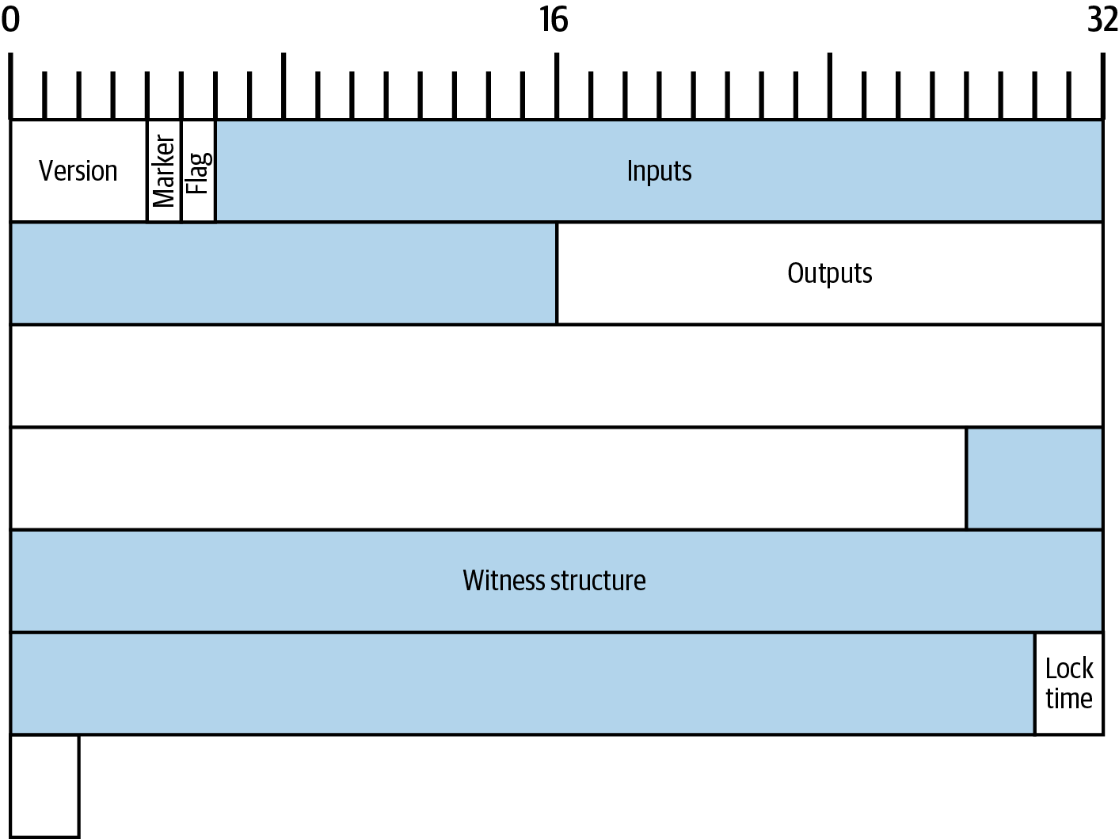
₿
Chapter 6: Transactions
One real transaction, 194 bytes, read field by field - and every number recomputed
a byte map of Alice's transaction - Antonopoulos & Harding, Mastering Bitcoin 3e, CC BY-SA
SEN0401 Special Topics in Software Engineering: Block Chain · Fall 2026 · Yusuf Altunel, PhD · İstanbul Kültür University
Notes:
This deck reads one real Bitcoin transaction, Alice's payment to Bob from the book's own example, byte by byte. Every number on the slides was computed from those bytes with the Python standard library and the chapter's own library, and the identifier and the weight were compared with an independent explorer's record of the same transaction, because no Bitcoin Core node was available where this deck was built. The full text of every slide is on the course page for chapter 6.

Slide 2
Today's route
₿
Five parts; every number is a slide you can jump to
1
Questions and the chapter map (slides 3-4)
26
slides, numbered bottom-right
2
A transaction, byte by byte - block 170 and the pizza (slides 5-9)
4
3
Sequence and lock time - three meanings, three readings (slides 10-12)
true stories, each with WHO / WHERE / WHEN / READ
4
Outputs - amounts, the 2010 overflow, dust (slides 13-16)
21
5
Witnesses, the coinbase, the weight, and resources (slides 17-26)
live-run consoles, each shown with its result
Five parts - and at the end, a transaction you have parsed yourself
2 / 26
Notes:
The route has five parts and ends with a transaction the reader can parse alone. One story is the first transaction ever to spend an output, one is the most expensive pizza in history, one is a block that briefly created 184 billion bitcoins, and one is an exchange that blamed the protocol. The part a reader expects to be hardest is worth marking now and checking at the summary slide.

Slide 3
The questions this chapter answers
₿
Its own competency questions - we return to each
1
What does a Bitcoin transaction ask full nodes to do?
2
How is a transaction serialized in the extended and the legacy format?
3
What do the version?
4
Which three meanings has the sequence field carried?
5
Why did placing witnesses in the input script make the transaction identifier malleable?
6
How are weight and vbytes computed, and does the chapter's figure of 569 for Alice's transaction reproduce from the bytes?
7
Where do the chapter's statements differ from the standards?
3 / 26
Notes:
This first branch asks what a Bitcoin transaction is before any of its bytes are read. The book opens with a contrast. The seven questions are the chapter's own competency questions, and each one is answered by a slide range of this deck and in full on the course page. A question to think about is this: which of the seven you could already answer from chapters 2 and 3? The full explanation is on the course page, chapter 6, under What a transaction is, in the concept What a transaction is.

Slide 4
One chapter, eight branches
₿
The concept map the whole chapter hangs on
Eight branches, one per field group; the deck follows the bytes in order and stops at four true stories.
What a transaction is
10 concepts
Version, marker and flag
8 concepts
Inputs
18 concepts
The sequence field
13 concepts
Outputs
14 concepts
Witnesses
20 concepts
Lock time and the coinbase
12 concepts
Weight and foundations
12 concepts
Eight branches - every slide today lives on this map
4 / 26
Notes:
This first branch asks what a Bitcoin transaction is before any of its bytes are read. The book opens with a contrast. The count under each branch is how many concepts the course page explains for it; the deck walks the spine of the eight in the order the bytes are serialized. A question to think about is this: why the sequence field, four bytes inside each input, earns a branch of its own? The full explanation is on the course page, chapter 6, under Inputs and What a transaction is, in the concepts What a transaction is, Inputs.

Slide 5
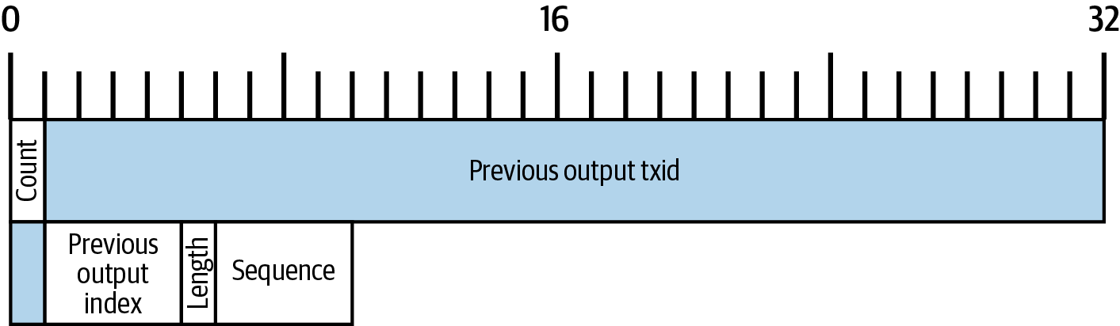
A transaction, byte by byte
What a transaction asks of strangers, and how it is written as bytes
The request
194 bytes
the inputs field of Alice's transaction - Antonopoulos & Harding, Mastering Bitcoin 3e, CC BY-SA
Inputs and outpoints
Byte order
5 / 26
Notes:
This first branch asks what a Bitcoin transaction is before any of its bytes are read. The book opens with a contrast. The picture is the book's map of the inputs field of Alice's transaction, which the slides of this part recompute from the hexadecimal. A question to think about is this: what a transaction would have to contain if it were a message to Bob rather than a request to full nodes? The full explanation is on the course page, chapter 6, under Serialization formats and What a transaction is, in the concepts What a transaction is, Serialization formats.

Slide 6
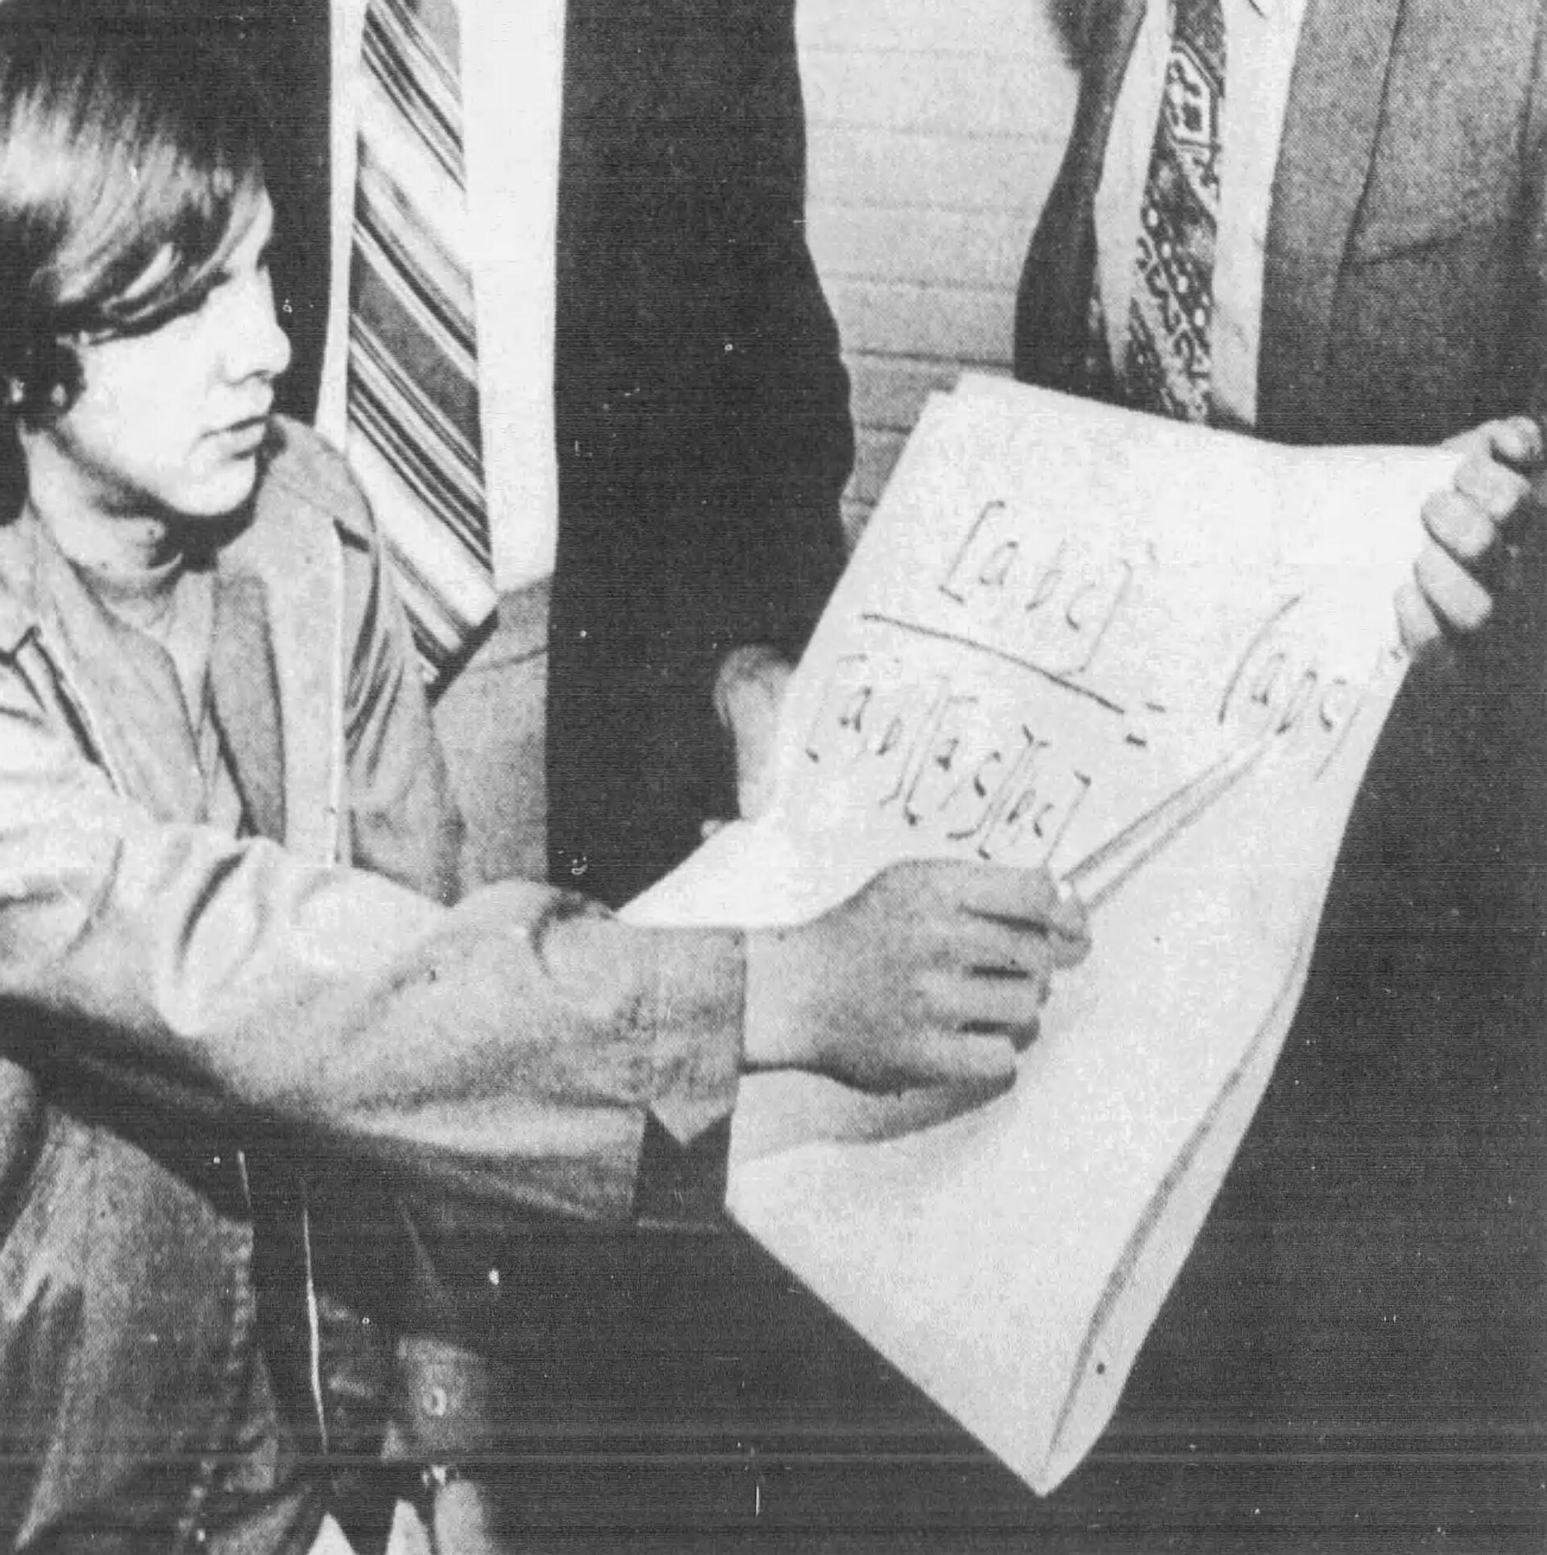
Ten bitcoins to Hal Finney, block 170
₿
2009-01-12
11 January 2009: Finney posts two words, running bitcoin
The next day the author of the software sends him 10 BTC
One input spends the coinbase of block 9; two outputs, 10 and 40 BTC
Legacy format: no marker, no flag, no witness - parsed below
the first transaction, from its saved bytes
>>> parse_tx(FIRST)['segwit'], FIRST_REC['status']['block_height']
(False, 170)
run under Python 3.14.6
Hal Finney, 1972 - Daily News-Post, public domain
WHO Satoshi Nakamoto (send…
WHERE block 170 of the block…
WHEN 2009-01…
READ mempool.spa…
6 / 26
Notes:
This is a true story, dated 2009-01-12. On 11 January 2009 Hal Finney posted two words, running bitcoin, and the next day the software's author sent him 10 BTC. The transaction, f4184fc5..., sits in block 170 and is the first ever to spend an output: its single input points at the coinbase of block 9, 161 blocks earlier, and its two outputs pay 10 BTC to Finney's public key and 40 BTC back to the sender. It is a legacy transaction - no marker, no flag, no witness - and the chapter's own library parses it and recomputes its identifier from the bytes. Every field this chapter reads was already there, unchanged, in 2009. The console parses the saved bytes of that transaction and finds no segwit marker and the block height 170, which is what the explorer records too. The lesson the slide carries is that the format you are reading is the one from block 170. The sources are these. The transaction f4184fc596403b9d638783cf57adfe4c75c605f6356fbc91338530e9831e9e16 as saved in ch06-evidence from mempool.space on 2026-10-08: block 170, 275 bytes, one input spending output 0 of 0437cd7f..., outputs of 10 BTC and 40 BTC; Finney's post of 2009-01-11 is on Wikimedia Commons as 'First tweet about bitcoin'. Photo: Hal Finney in 1972, Daily News-Post staff photo, public domain.

Slide 7
194 bytes, seven fields
₿
Alice's transaction parsed by the chapter's own library
The legacy form is 125 bytes; the marker, the flag and the 67-byte witness structure are the other 69.
size, version, marker and flag, counts, lock time: version 1, extended format, one input, two outputs
>>> len(ALICE) // 2, tx['size']
(194, 194)
>>> tx['version'], tx['marker'], tx['flag'], tx['segwit']
(1, 0, 1, True)
>>> len(tx['inputs']), len(tx['outputs']), len(tx['witness'][0]), tx['locktime']
(1, 2, 1, 0)
the fixed fields at their offsets; all the spans sum to 194 bytes
run under Python 3.14.6
>>> [s for s in tx['spans'] if s[0] in ('version', 'marker', 'flag', 'lock time')]
[('version', 0, 4), ('marker', 4, 1), ('flag', 5, 1), ('lock time', 190, 4)]
>>> sum(k for n, p, k in tx['spans'])
194
run under Python 3.14.6
extended format, version 1
1 in, 2 out, 1 witness
lock time 0
Every byte belongs to a named field, and the fields are found in order
7 / 26
Notes:
A serialized transaction is the transaction written as bytes in Bitcoin Core's format. The book retrieves Alice's payment to Bob again with the getrawtransaction command and prints the result as hexadecimal, two characters per byte, noting that it takes 64 hexadecimal characters to display 32 bytes (Antonopoulos and Harding, 2023). Read the first console from the top: the two lengths agree, the marker is zero and the flag one, and the counts are what the byte map shows. A question to think about is this: why a parser must read the input count before it can find the lock time? The full explanation is on the course page, chapter 6, under Serialization formats, in the concepts Serialized transaction, Byte map.

Slide 8
Inputs: an outpoint, read both ways round
₿
32 bytes of identifier, 4 of index - and the byte order that trips everyone
the outpoint: the identifier in internal order, index 1, and the 100,000-satoshi output in block 774,958
>>> i0 = tx['inputs'][0]
>>> i0['txid_internal'][:16], i0['vout']
('eb3ae38f27191aa5', 1)
>>> internal_to_display(i0['txid_internal'])[:16]
'4ac5418026798669'
>>> PREV_REC['vout'][1]['value'], PREV_REC['status']['block_height']
(100000, 774958)
the fold-tac pipeline in Python: the reversed bytes equal the identifier the library computes
run under Python 3.14.6
>>> d = 'eb3ae38f27191aa5f3850dc9cad00492b88b72404f9da135698679268041c54a'
>>> ''.join(reversed([d[i:i + 2] for i in range(0, 64, 2)]))[:16]
'4ac5418026798669'
>>> txid(PREV)[:16]
'4ac5418026798669'
run under Python 3.14.6
eb3a... hashed
4ac5... shown
two spellings
An input states no amount; the node reads it from the output the outpoint names
8 / 26
Notes:
An outpoint is the field of an input that points at the output being spent. The book says that since control over bitcoins is assigned in transaction outputs, Alice points to the previous output using an outpoint field, that each input must contain a single outpoint, and that the outpoint contains a 32-byte txid for the transaction where Alice received the bitcoins she now wants to spend, followed by the output index (Antonopoulos and Harding, 2023). The reversed identifier in the right console equals the identifier the library computes for the previous transaction, which is the check that the reversal is the right one. A question to think about is this: which of the two spellings an explorer shows, and which one a node hashes? The full explanation is on the course page, chapter 6, under Internal and display byte order and The outpoint, in the concepts Outpoint, Display byte order.

Slide 9
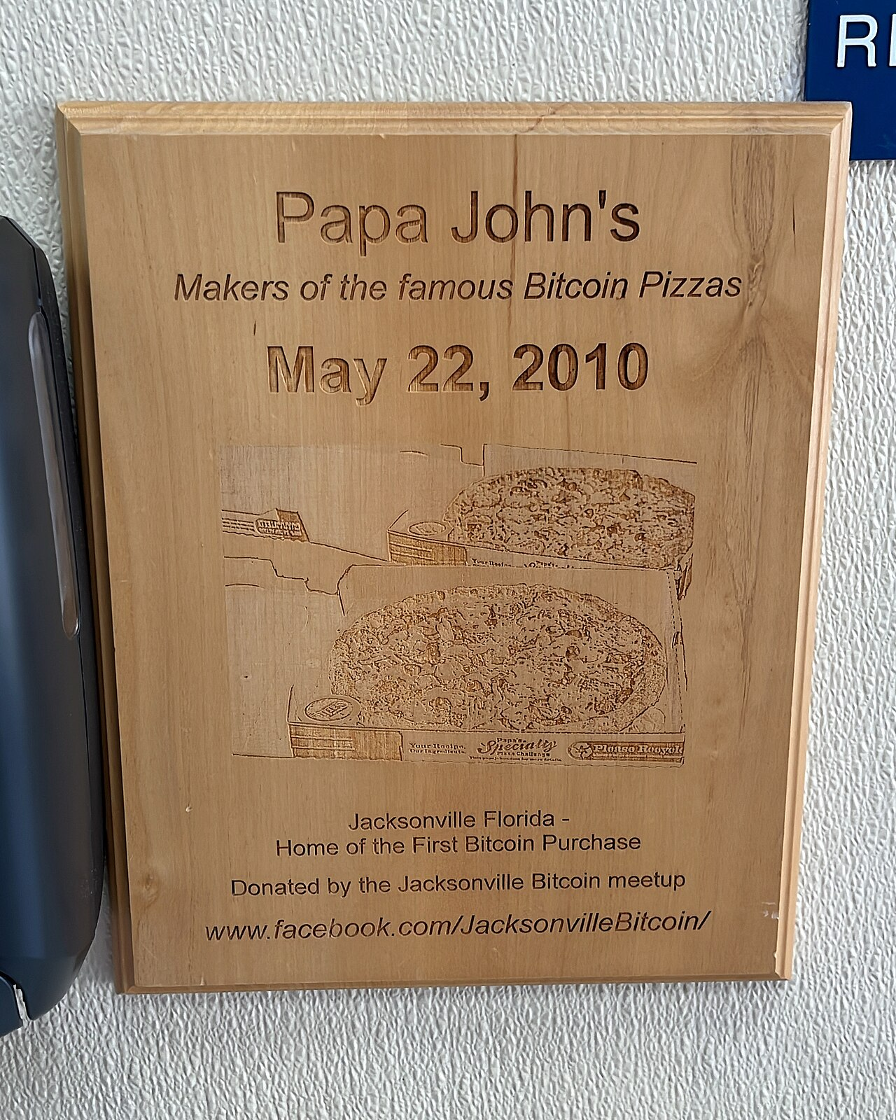
10,000 bitcoins for two pizzas
₿
2010-05-22
22 May 2010: Laszlo Hanyecz pays 10,000 BTC for two pizzas
131 inputs, one output, and 0.99 BTC left to the miner as fee
Block 57,043 - and the whole 23,620-byte transaction parses below
the pizza transaction: inputs, output, fee, identifier
>>> p = parse_tx(PIZZA)
>>> len(p['inputs']), bytes.fromhex(PIZZA)[4], len(p['outputs'])
(131, 131, 1)
>>> p['outputs'][0]['value'] // COIN, PIZZA_REC['fee'] / COIN
(10000, 0.99)
>>> txid(PIZZA)[:16], PIZZA_REC['status']['block_height']
('a1075db55d416d3c', 57043)
run under Python 3.14.6
the plaque at Papa John's, Jacksonville - photo: Sanjev Rajaram, CC0
WHO Laszlo Hanyecz, program…
WHERE a Papa John's on Atlant…
WHEN 2010-05-…
READ bitcointalk.…
9 / 26
Notes:
This is a true story, dated 2010-05-22. Four days after offering 10,000 BTC on the bitcointalk forum to anyone who would send him two pizzas, Laszlo Hanyecz reported that the deal was done. The payment, a1075db5..., confirmed in block 57,043 on 22 May 2010: 131 inputs, because his wallet gathered mining rewards of 50 BTC each, and a single output of 10,000 BTC, with 0.99 BTC left as the fee. The transaction is 23,620 bytes and, as a legacy transaction, weighs exactly four times that. The chapter's library parses all 131 inputs and recomputes its identifier; the bitcoin community marks 22 May as Pizza Day. The console counts the 131 inputs twice, once from the parsed list and once from the single count byte 0x83, and recomputes the identifier that the explorer and the forum thread name. The lesson the slide carries is that an input count of 131 is what one-output payments can look like. The sources are these. The bitcointalk thread 'Pizza for bitcoins?' opened by laszlo on 2010-05-18 and his report of 2010-05-22; the transaction a1075db55d416d3ca199f55b6084e2115b9345e16c5cf302fc80e9d5fbf5d48d saved in ch06-evidence from mempool.space: block 57,043, 131 inputs, 1 output of 1,000,000,000,000 satoshis, fee 99,000,000 satoshis, weight 94,480. Photo: the plaque at Papa John's, Atlantic Ave, Jacksonville, by Sanjev Rajaram, CC0.

Slide 10
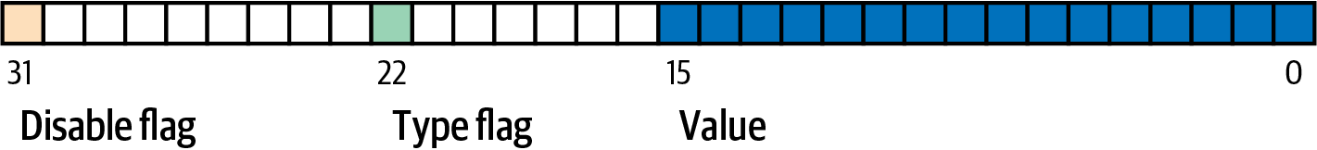
Sequence and lock time
Four bytes with three meanings, and four bytes with three readings
BIP68's layout of the sequence field - Antonopoulos & Harding, Mastering Bitcoin 3e, CC BY-SA
The card game
Replace by fee
BIP68 timelocks
Lock time and MTP
10 / 26
Notes:
This branch reads the last four bytes of an input, which the book calls its sequence number, and follows the three meanings the field has carried. The figure is BIP68's own layout of the sequence field as the book reproduces it: the disable flag, the type flag and the sixteen bits of value. A question to think about is this: how one field can carry three meanings without the three ever colliding? The full explanation is on the course page, chapter 6, under Lock time and The sequence field, in the concepts The sequence field, Lock time.

Slide 11
One field, three meanings
₿
Final, replaceable, or a relative timelock - decided bit by bit
0xffffffff
final: no replacement, no lock
below 0xfffffffe
BIP125: replaceable
below 2^31, v2
BIP68: a relative timelock
the BIP125 threshold, tested on three values
>>> [(hex(s), sequence_decode(s)['rbf_signal']) for s in (0xffffffff, 0xfffffffe, 0xfffffffd)]
[('0xffffffff', False), ('0xfffffffe', False), ('0xfffffffd', True)]
30 blocks from 774,958; an hour in 512-second units; the constants
run under Python 3.14.6
>>> sequence_decode(30)['relative_timelock'], earliest_block(774958, 30)
(('blocks', 30), 774988)
>>> s = sequence_for(seconds=3600)
>>> hex(s), sequence_decode(s)['relative_timelock']
('0x400008', ('seconds', 4096))
>>> hex(SEQUENCE_LOCKTIME_TYPE_FLAG), hex(SEQUENCE_LOCKTIME_DISABLE_FLAG), hex(SEQUENCE_LOCKTIME_MASK)
('0x400000', '0x80000000', '0xffff')
run under Python 3.14.6
Bit 31 of the sequence is this chapter's security bit
11 / 26
Notes:
The sequence number is the four-byte unsigned integer that ends each input, after the outpoint and the input script. The book says the final four bytes of an input are its sequence number and that the use and meaning of this field has changed over time (Antonopoulos and Harding, 2023). The first console shows that 0xfffffffe does not signal while 0xfffffffd does; the second shows the lock of 30 blocks landing at 774,988 and an hour rounding up to eight units of 512 seconds. A question to think about is this: why a transaction that sets a relative timelock also, unavoidably, signals replaceability? The full explanation is on the course page, chapter 6, under Original sequence-based replacement and Sequence as a relative timelock, in the concepts Sequence number, BIP68 relative timelock.

Slide 12
Lock time, and the clock it is checked against
₿
A height below 500,000,000, a time above it, and the median of eleven blocks
0
eligible for any block
below 500,000,000
a block height: that block or later
500,000,000 or more
an epoch time, against the median time past
Alice's lock time is 0; the transaction that funded her used 774,957 and confirmed in 774,958
>>> tx['locktime'], parse_tx(PREV)['locktime'], PREV_REC['status']['block_height']
(0, 774957, 774958)
>>> locktime_decode(123456), locktime_decode(ALICE_REC['status']['block_time'])
(('block height', 123456), ('epoch time', 1675559245))
eleven block times, their median, and how far it trails the newest: 600 seconds here
run under Python 3.14.6
>>> times = [1675556500 + 100 * k for k in (15, 21, 5, 27, 24, 0, 26, 18, 12, 23, 25)]
>>> median_time_past(times), max(times) - median_time_past(times)
(1675558600, 600)
run under Python 3.14.6
Lock time says not before; nothing in a transaction can say not after
12 / 26
Notes:
The lock time field is the final field in a serialized transaction. The first console decodes Alice's zero, the funding transaction's 774,957 and a block's time; the second sorts eleven timestamps and takes the sixth, which trails the newest by 600 seconds in this sample. A question to think about is this: why a time lock set for noon is usually only satisfiable in the early afternoon? The full explanation is on the course page, chapter 6, under Lock time, in the concepts The lock time field, Median time past.

Slide 13
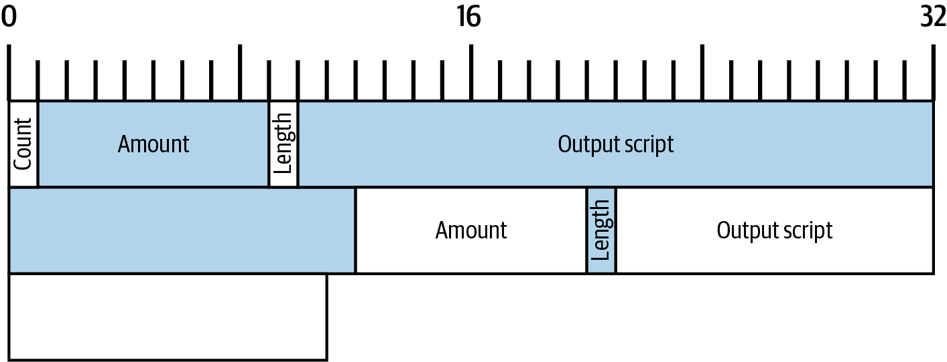
Outputs
Satoshis, the consensus range, dust, and the script that says who may spend
Amounts
The 2010 overflow
the outputs field - Antonopoulos & Harding, Mastering Bitcoin 3e, CC BY-SA
Dust
Output scripts
13 / 26
Notes:
This branch reads the outputs field, the 75 bytes of Alice's transaction that assign her bitcoins to new conditions. The book says the outputs field contains several fields related to specific outputs and, as with the inputs, starts from a byte map; the field begins with a count, and each output has an amount followed by a length-prefixed output script, the script that contains the conditions that will need to be fulfilled in order to spend the bitcoins (Antonopoulos and Harding, 2023). The figure is the book's map of the outputs field: a count, then for each output eight bytes of amount, a length and a script. A question to think about is this: why the fee is written nowhere in these bytes? The full explanation is on the course page, chapter 6, under Outputs and The output list, in the concepts Outputs, The output list.

Slide 14
Amounts: 20,000, 75,000, and a 5,000 fee
₿
8-byte signed integers of satoshis, and the fee nobody writes down
the two amounts, the fee as a difference, and the consensus maximum
>>> [(o['value'], o['value'] / COIN) for o in tx['outputs']]
[(20000, 0.0002), (75000, 0.00075)]
>>> PREV_REC['vout'][1]['value'] - sum(o['value'] for o in tx['outputs']), ALICE_REC['fee']
(5000, 5000)
>>> MAX_MONEY, money_range(MAX_MONEY + 1)
(2100000000000000, False)
each output's script: 34 bytes of taproot for Bob, 22 bytes of version 0 for the change
run under Python 3.14.6
>>> [(o['value'], len(bytes.fromhex(o['script'])), segwit_output_version(o['script'])[0]) for o in tx['outputs']]
[(20000, 34, 1), (75000, 22, 0)]
run under Python 3.14.6
100,000 in
20,000 + 75,000 out
5,000 fee
max 2,100,000,000,000,000
An output is an amount and a condition; no field holds a balance or a fee
14 / 26
Notes:
The amount is the first field of a specific output. The book says it is also called value in Bitcoin Core, that it is an 8-byte signed integer indicating the number of satoshis to transfer, that a satoshi is the smallest unit of bitcoin that can be represented in an on-chain transaction, and that there are 100 million satoshis in a bitcoin (Antonopoulos and Harding, 2023). The fee in the first console is computed as the previous output's amount minus the two new amounts, and it equals the fee the explorer reports. A question to think about is this: what a wallet shows as a balance when the chain holds only whole outputs? The full explanation is on the course page, chapter 6, under The output list and The output script, in the concepts Amount, Output script.

Slide 15
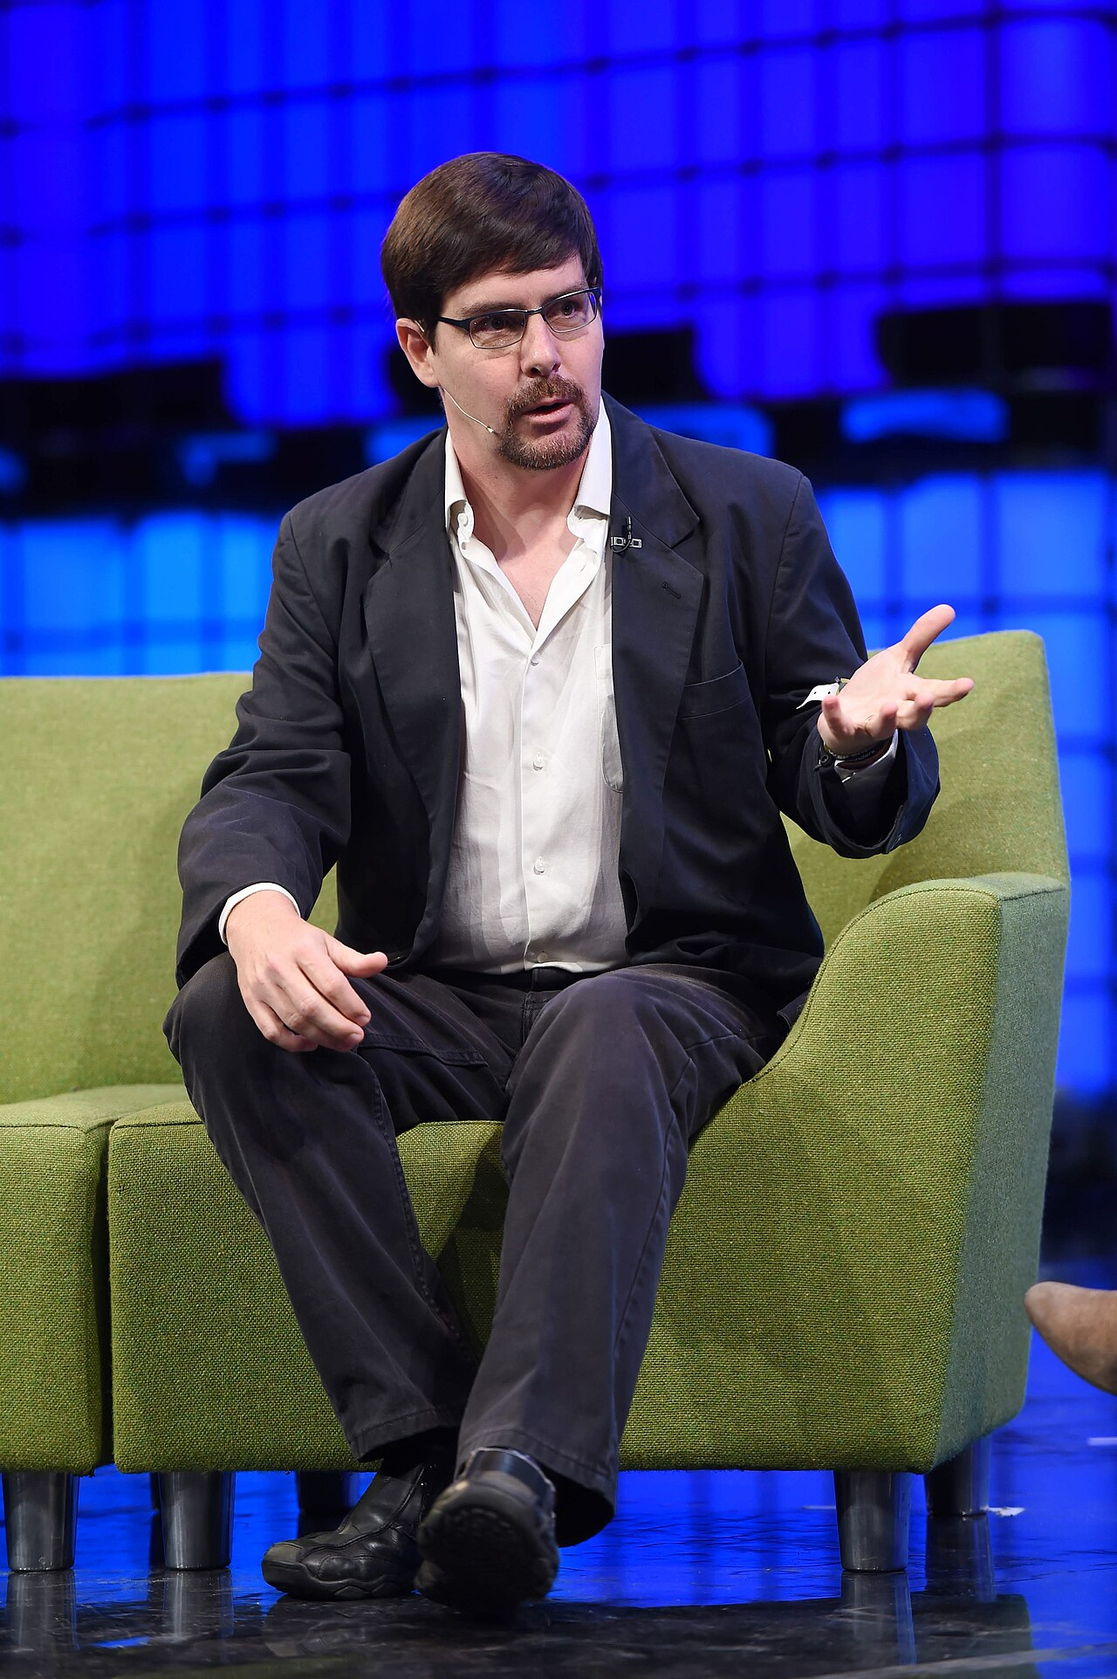
The block that created 184 billion bitcoins
₿
2010-08-15
15 August 2010: block 74,638 holds two outputs of 92,233,720,368.54 BTC
Summed as 64-bit integers they wrap to a small negative number: the check passes
A patch within five hours, 0.3.10 the next day, the chain reorganised at 74,691
the overflow reproduced, and refused by the range check Core still cites
>>> big = 92_233_720_368_54277039
>>> w = (2 * big) & 0xffffffffffffffff
>>> big > MAX_MONEY, w - 2 ** 64 if w >= 2 ** 63 else w
(True, -997538)
>>> money_range(w - 2 ** 64), money_range(big), 50 * COIN - (w - 2 ** 64) > 50 * COIN
(False, False, True)
run under Python 3.14.6
Gavin Andresen, 2014 - photo: Stephen McCarthy / Web Summit, CC BY 2.0
WHO an unknown attacker; Jef…
WHERE block 74,638 - and the b…
WHEN 2010-08-…
READ en.bitcoin.it
15 / 26
Notes:
This is a true story, dated 2010-08-15. Block 74,638 contained a transaction with two outputs of 92,233,720,368.54277039 BTC each. Added as 64-bit integers the two amounts overflowed to a small negative number, so the check that outputs do not exceed inputs passed and the chain accepted 184 billion bitcoins out of thin air. Jeff Garzik reported the block within two hours, Satoshi Nakamoto pushed a patch within about five hours and released version 0.3.10 the next day with a check on the sum of the outputs, and the honest chain overtook the bad one at block 74,691, erasing the transaction. Bitcoin Core's tx_check.cpp still cites the bug, CVE-2010-5139, beside the three refusals this chapter reads: a negative value, a value above 21 million, a total that leaves the range. The console doubles the overflowing amount as a 64-bit signed integer, obtains the negative sum of 997,538 satoshis that the 2010 check accepted, and shows that the money-range check refuses both the sum and each output. The lesson the slide carries is that a signed amount needs a range check; the chain learned it the hard way. The sources are these. The Bitcoin wiki's 'Value overflow incident' page: block 74638 on 2010-08-15, two outputs of 92,233,720,368.54277039 BTC, the 0.3.10 fix and the reorganisation at block 74691; the forum thread 'Strange block 74638' (bitcointalk topic 822) with its timeline of the patch; Bitcoin Core src/consensus/tx_check.cpp at commit 05bc2f5, '(see CVE-2010-5139)', saved in ch06-evidence. Photo: Gavin Andresen, the developer to whom Satoshi handed the project after this era, at Web Summit 2014 - Stephen McCarthy / Web Summit, CC BY 2.0.

Slide 16
Dust, measured
₿
Bitcoin Core's threshold is a size times a rate - and it depends on the output type
The bars are the console's own output; the checker re-runs it off this file.
the four thresholds, and the sizes behind two of them
>>> P2PKH = '76a914' + '00' * 20 + '88ac'
>>> P2WPKH, P2TR = '0014' + '00' * 20, '5120' + '00' * 32
>>> RET = '6a04deadbeef'
>>> [dust_threshold(s) for s in (P2PKH, P2WPKH, P2TR, RET)]
[546, 294, 330, 0]
>>> DUST_RELAY_TX_FEE, (34 + 148) * 3, (31 + 67) * 3
(3000, 546, 294)
run under Python 3.14.6
1
Output size plus the smallest input that could spend it, times 3 satoshis a byte
2
An OP_RETURN output can never be spent, so it is never dust
Dust is a policy about who pays for the UTXO set: everyone, for ever
16 / 26
Notes:
The dust limit is the value below which a relaying node treats an output as dust and refuses to relay or mine the transaction that creates it. The bars are computed, never quoted: the console's fourth line produced them, and the last line shows the rate and the sizes that give 546 and 294. A question to think about is this: why a 600-satoshi output passes the dust policy and may still not be worth spending on a busy day? The full explanation is on the course page, chapter 6, under Uneconomical outputs and dust, in the concepts Dust limit, Data-carrier output.

Slide 17
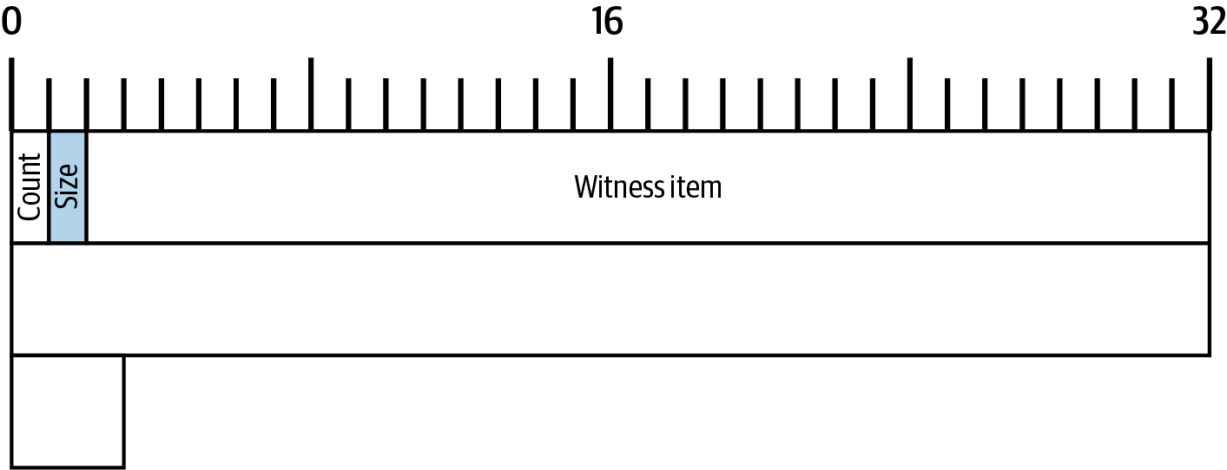
Witnesses
Where the proof of authorisation lives, and why it moved
Malleability
Mt. Gox, 2014
the witness structure - Antonopoulos & Harding, Mastering Bitcoin 3e, CC BY-SA
Segregated witness
The soft fork
17 / 26
Notes:
This branch explains the witness structure, the 67 bytes near the end of Alice's transaction that prove she was allowed to spend. The figure is the book's map of the witness structure: one stack for Alice's one input, holding one 65-byte item, her signature. A question to think about is this: what a court would ask of a witness that it cannot ask of a number? The full explanation is on the course page, chapter 6, under The idea of a witness and Witnesses, in the concepts Witnesses, The idea of a witness.

Slide 18
Malleability: the same spend, four identifiers
₿
Re-encode a push in a legacy input script and the txid changes; outside the txid it cannot
four ways to push the number 2: four identifiers for the first bitcoin transaction
>>> push_encodings(2)
{'OP_2': '52', 'OP_PUSH1 0x02': '0102', 'OP_PUSH2 0x0002': '020200', 'OP_PUSHDATA1 0x0102': '4c0102'}
>>> sorted({txid(with_input_script(FIRST, s))[:8] for s in push_encodings(2).values()})
['0423a53a', '18da36d1', '4d986cd8', 'b3485f99']
Alice's txid is the hash of the 125 legacy bytes; a new witness changes the wtxid, not the txid
run under Python 3.14.6
>>> txid(ALICE)[:16], hash256(legacy)[::-1].hex()[:16]
('466200308696215b', '466200308696215c')
>>> mutated = with_witness_item(ALICE, '00' * 65)
>>> txid(mutated) == txid(ALICE), wtxid(mutated) == wtxid(ALICE)
(True, False)
run under Python 3.14.6
the witness is outside the txid - by design
What a hash covers decides what can be built on it
18 / 26
Notes:
Third-party transaction malleability is the second problem: it is often possible to solve the same script in different ways. The first console's set has four members, one per encoding; the second console's last line is the whole of segregated witness in two booleans. A question to think about is this: what Bob loses when a stranger's re-encoded copy of Alice's transaction confirms instead of hers? The full explanation is on the course page, chapter 6, under Segregated witness and The malleability problems, in the concepts Third-party transaction malleability, Segregated witness.

Slide 19
Mt. Gox blames malleability
₿
2014-02-10
302,000 BTC
1,811 BTC
850,000 BTC
ever involved in malleability attacks (Decker and Wattenhofer)
of those before the press release of 10 February
the shortfall declared in the filing of 28 February
Withdrawals halted on 7 February; the press release blamed a bug in the bitcoin software
Researchers who had recorded the network for a year found no widespread attacks before the announcement
Software that tracked payments by txid saw mutated copies as failed payments
WHO Mt. Gox, then the largest bitcoin exch…
WHERE Shibuya, Tokyo - and the whole Bitcoin…
WHEN 2014-02-10
READ arxiv.org
19 / 26
Notes:
This is a true story, dated 2014-02-10. On 7 February 2014 Mt. Gox halted bitcoin withdrawals, and on 10 February it issued a press release blaming a bug in the bitcoin software: someone could alter transaction details to make it seem that a sending of bitcoins had not occurred when it had. That is third-party malleability - a stranger re-encodes a push in the input script, the txid changes, and software that tracks payments by txid believes the payment failed. Decker and Wattenhofer, who had recorded the network's transactions for a year, found no widespread malleability attacks before the announcement: about 302,000 BTC were ever involved in such attacks, and only 1,811 BTC of them before the press release. On 28 February the exchange filed for bankruptcy protection, 850,000 BTC short; segregated witness, activated in 2017, took the input script out of the txid for good. The three figures are the paper's and the bankruptcy filing's, as the fact row's link gives them; no free-licence photograph of the exchange could be verified, so the slide shows the numbers. The lesson the slide carries is that track outpoints, not txids - and do not blame the protocol first. The sources are these. Decker and Wattenhofer, 'Bitcoin Transaction Malleability and MtGox', arXiv:1403.6676 (ETH Zurich, March 2014; ESORICS 2014): the figures 302,000 BTC ever involved and 1,811 BTC before the press release, and the finding of no widespread attacks before the closure; the Mt. Gox press release of 2014-02-10 and the bankruptcy filing of 2014-02-28 as summarised at en.wikipedia.org/wiki/Mt._Gox. No free-licence photograph of the exchange or its office could be verified, so the slide shows the story's figures instead.

Slide 20
Segregated witness as a soft fork
₿
Old nodes allow an empty input script; new nodes require one
What an old node sees
What a new node requires
A script of a number 0-16 and 2-40 bytes: anyone can spend it
An empty input script is allowed
Every segwit block is valid to it
The same template is a witness program with a version
The input script must be empty
A valid witness in the witness structure
Alice's outputs are witness programs of versions 1 and 0; her input script is empty, her witness 65 bytes
>>> segwit_output_version(tx['outputs'][0]['script'])[0], segwit_output_version(tx['outputs'][1]['script'])[0]
(1, 0)
>>> tx['inputs'][0]['script'] == '', len(bytes.fromhex(tx['witness'][0][0]))
(True, 65)
run under Python 3.14.6
reject more
accept no more
block 481,824 - August 2017
A soft fork can only restrict; upgrades are built on anyone-can-spend
20 / 26
Notes:
A soft fork is a backward-compatible change to the consensus rules. The two columns are the book's own sentence turned into a table, and the console checks it on Alice's bytes: two witness programs, an empty input script, a witness item. A question to think about is this: why a change that only tightens the rules can be enforced by a minority of nodes while a change that loosens them cannot? The full explanation is on the course page, chapter 6, under Segregated witness, in the concepts Soft fork, Witness program.

Slide 21
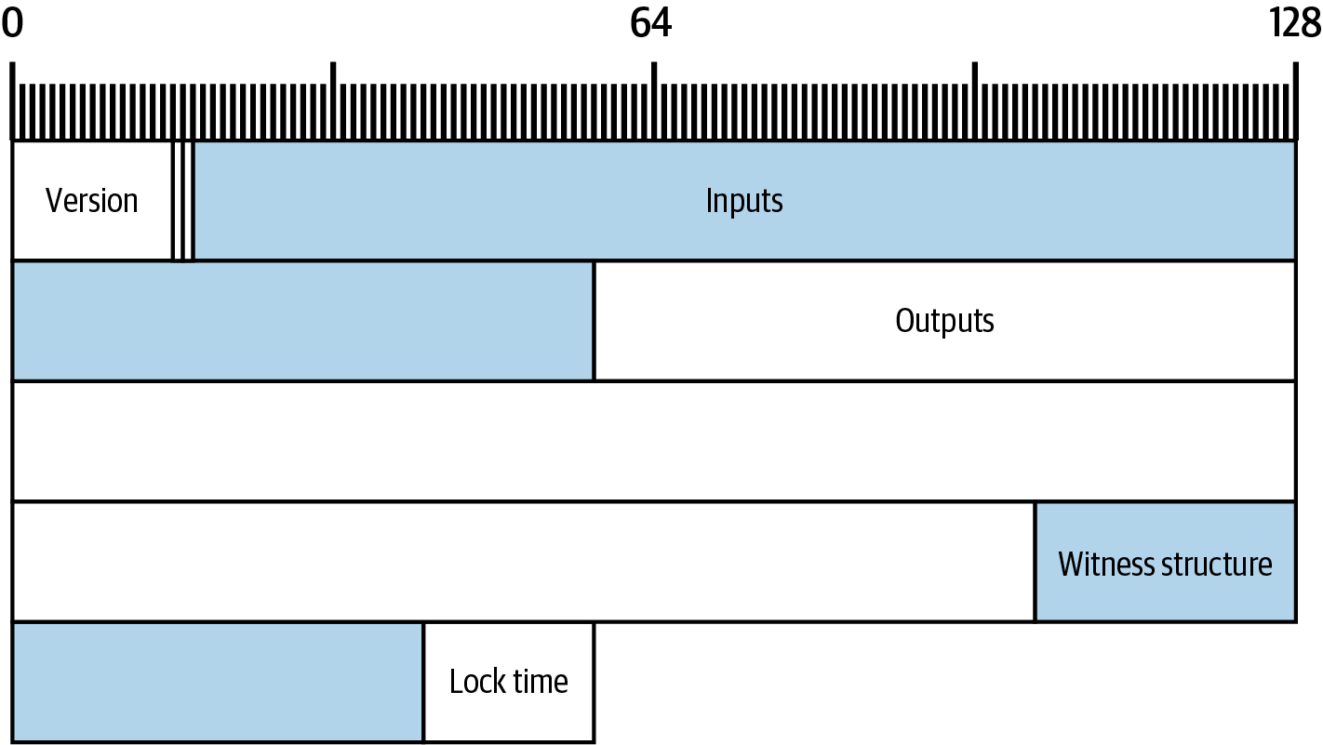
The coinbase and the weight
Where bitcoins come from, and how a block is filled
Null outpoint
The subsidy
the same transaction in weight units - Antonopoulos & Harding, Mastering Bitcoin 3e, CC BY-SA
Maturity
Weight and vbytes
21 / 26
Notes:
The coinbase transaction is the first transaction in each block. The figure is the book's map of Alice's transaction drawn in weight units rather than bytes: the witness shrinks to a quarter and everything else stays. A question to think about is this: why the two maps of the same transaction have different shapes? The full explanation is on the course page, chapter 6, under Coinbase transactions and Weight and vbytes, in the concepts Coinbase transactions, Weight and vbytes.

Slide 22
The subsidy, halving by halving
₿
50 BTC shifted right once per 210,000 blocks - down to one satoshi, then zero
Nine halvings drawn from one executed line; the library and Core's GetBlockSubsidy agree on every bar.
one satoshi from 6,720,000, zero from 6,930,000
>>> [block_subsidy(h) for h in (6720000, 6929999, 6930000)]
[1, 1, 0]
>>> last_subsidy_height(), total_subsidy() / COIN
(6929999, 20999999.9769)
run under Python 3.14.6
block 170 spends block 9's coinbase: mature
>>> r = FIRST_REC
>>> r['vin'][0]['txid'][:16], r['status']['block_height']
('0437cd7f8525ceed', 170)
>>> coinbase_mature(9, 170), 170 - 9, COINBASE_MATURITY
(True, 161, 100)
run under Python 3.14.6
The coinbase is the only transaction that creates bitcoins
22 / 26
Notes:
The block subsidy is the part of a coinbase's claim that consists of bitcoins that have never previously been circulated. The book says the subsidy started at 50 BTC per block and halves every 210,000 blocks, approximately every four years, with values rounded down to the nearest satoshi, and it dates the subsidy to block 6,720,000 (Antonopoulos and Harding, 2023). The bars are the first executed line of the subsidy example; the console beside them shows where the schedule ends, which is 209,999 blocks later than the figure the book names. A question to think about is this: why the schedule sums to a little under 21 million and never exactly to it? The full explanation is on the course page, chapter 6, under Coinbase transactions, in the concepts Block subsidy, Maturity rule.

Slide 23
569: the weight, field by field
₿
The book's table recomputed from the bytes - and Bitcoin Core's figure matched without a node
No node ran here: 569 is recomputed from the bytes and compared with the explorer's saved record.
569 from the bytes and from the explorer; 143 vbytes
>>> len(legacy) * 3 + len(bytes.fromhex(ALICE)), weight(ALICE)
(569, 569)
>>> ALICE_REC['weight'], vbytes(ALICE)
(569, 143)
>>> weight(FIRST) == 4 * parse_tx(FIRST)['size']
True
run under Python 3.14.6
the spans that weigh one per byte; the header
>>> [w for n, b, f, w in field_weights(ALICE) if f == 1]
[1, 1, 1, 1, 65]
>>> sum(w for n, b, f, w in field_weights(ALICE)), 80 * 3 + 80
(569, 320)
run under Python 3.14.6
Weight is what a transaction pays for, and witness bytes cost a quarter
23 / 26
Notes:
Weight is the modern unit of measurement for the size of Bitcoin transactions and blocks. The book says each block is limited in the amount of transaction data it can contain, so most software needs to measure the transactions it creates or processes, and that the unit is called weight (Antonopoulos and Harding, 2023). The twelve bars are the book's twelve rows, each computed from the byte spans the parser recorded, and they sum to 569; the console shows the same 569 three ways, the third being the explorer's saved record. A question to think about is this: why the witness item of 65 bytes weighs less than the 34-byte script that pays Bob? The full explanation is on the course page, chapter 6, under Weight and vbytes, in the concepts Weight, Weight factors.

Slide 24
The chapter in five lines
₿
One line per part - each one provable from its slides
1
A transaction is a request to strangers: inputs point, witnesses prove, outputs assign - 194 bytes, every one named
2
The sequence field has meant three things; the lock time is read against the median of eleven blocks
3
An output is an amount and a condition; the fee is a difference, and dust is a policy about everyone's database
4
Witnesses in the input script made identifiers malleable; segregated witness moved them out, as a soft fork
5
The coinbase creates under a schedule that ends at block 6,929,999, and weight is what a block is filled by
If a line feels unproven, its part's slides carry the receipt
24 / 26
Notes:
These five lines are the deck in miniature, one per part, and each of them is carried by a slide range that the agenda names. A line that feels unproven should send the reader back to its consoles, because every figure in it was computed on a slide. The full text behind all five lines is on the course page for chapter 6.

Slide 25
Where to go from here
₿
Checked 2026-10-08; every entry is a live link in this file
Read
Tools
This chapter, free (CC BY-SA) raw.githubusercontent.com/bitcoinbook/bitcoinbook/develop/ch06_transactions.adoc
Alice's transaction on mempool.space mempool.space/tx/466200308696215bbc949d5141a49a4138ecdfdfaa2a8029c1f9bcecd1f96177
The malleability paper behind the Mt. Gox story arxiv.org/abs/1403.6676
learnmeabitcoin - a raw transaction, drawn learnmeabitcoin.com/technical/transaction/
Standards
Community
BIP 141 - segregated witness, weight raw.githubusercontent.com/bitcoin/bips/master/bip-0141.mediawiki
Pizza for bitcoins? - the 2010 thread bitcointalk.org/index.php?topic=137.0
BIP 68 - the relative timelock raw.githubusercontent.com/bitcoin/bips/master/bip-0068.mediawiki
Strange block 74638 - the overflow, live bitcointalk.org/index.php?topic=822.0
BIP 125 - opt-in replace-by-fee raw.githubusercontent.com/bitcoin/bips/master/bip-0125.mediawiki
Parse any transaction yourself and match the explorer's identifier and weight
25 / 26
Notes:
Everything here is free to read, and every link was fetched on the date in the subtitle. A good exercise is to take any confirmed transaction from the explorer, paste its hexadecimal into the chapter's library on the course page, and check that the identifier and the weight you compute are the ones the explorer shows. The course page for chapter 6 carries the full resource list with a sentence on why each entry is there.

Slide 26
What you should now be able to say
And where each claim gets its proof
What a transaction asks full nodes to do, field by field
What the sequence and lock time permit, and when
Why identifiers were malleable, and how segwit fixed it
How 569 is computed, and who creates bitcoins under which schedule
Questions?
26 / 26
Notes:
Four claims, each carried by a computation that ran on a slide of this deck against the chapter's own transaction, the standards and Bitcoin Core's sources. The course page for chapter 6 carries every word behind them, the stories with their sources, and the question bank to test the four claims on yourself.

