Slide 1
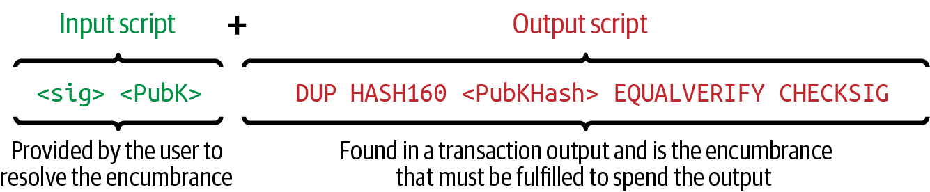
₿
locking and unlocking scripts - Mastering Bitcoin 3e, CC BY-SA
Chapter 7: Scripts and Signatures
Authorization and Authentication: scripts that lock coins, signatures that unlock them, every spend run in a real interpreter
SEN0401 Special Topics in Software Engineering: Block Chain · Fall 2026 · Yusuf Altunel, PhD · İstanbul Kültür University
Notes:
This deck explains how Bitcoin decides who may spend an output: the output carries a locking script, the spender supplies an unlocking script, and a node runs the two and accepts the spend only if the result is true. Every example on the slides was executed by this course's own Python port of Bitcoin's script interpreter on real, signed spends, because no Bitcoin Core node was available where the deck was built; the port is checked against Core's published test vectors and against every input of a real block. The full text of every slide is on the course page for chapter 7.

Slide 2
Today's route
₿
The questions, then five parts; every number is a slide you can jump to
1
Questions and the chapter map (slides 3-4)
26
2
Scripts and the stack - the OP_RETURN bug of 2010 (slides 5-7)
slides, numbered bottom-right
3
Signatures, multisig and script hash - the 2015 DER fork (slides 8-12)
3
4
Time and flow control - timelocks and the three paths (slides 13-15)
true stories, each with WHO / WHERE / WHEN / READ
5
Witness programs and script trees (slides 16-18)
17
6
Taproot and tapscript - the 2021 soft fork, summary and resources (slides 19-26)
live-run consoles, each shown with its result
Five parts - and at the end, a taproot spend you have read yourself
2 / 26
Notes:
The route has five parts and ends with a taproot spend the reader has examined alone. One story is the bug of 2010 in which an input script of one number and OP_RETURN could spend any output, one is the fork of July 2015 that followed a rule about the encoding of signatures, and one is the path of a signature scheme from a patent to the soft fork of November 2021. The part a reader expects to be hardest is worth marking now and checking at the summary slide.

Slide 3
The questions this chapter answers
₿
Its own competency questions - we return to each
1
What does a Bitcoin output ask of its spender, and how do the input script and the output script together decide whether a spend is authorized?
2
How does a script run on a stack, why is the language deliberately not Turing complete, and why can every node verify a spend without knowing anything but the transaction and the outputs it spends?
3
How do pay to public key hash, scripted multisignatures and pay to script hash move the cost of a complicated condition from the payer to the spender, and what does the signature check count?
4
How do lock time, OP_CHECKLOCKTIMEVERIFY, the sequence field and OP_CHECKSEQUENCEVERIFY make a spend wait, and where do the book and Bitcoin Core's rules differ by one block?
5
How does segregated witness fix signature malleability and add a version byte for later upgrades, and what do P2WPKH, P2WSH and the nested forms look like on the chain?
6
How do a script tree, a tweaked key and a scriptless multisignature combine into taproot, and what does a key path spend or a script path spend reveal?
7
What does tapscript change in the language, and which statements of the book differ from the BIPs and from Bitcoin Core's sources?
3 / 26
Notes:
Script is the programming language that the original Bitcoin software introduced for transaction validation. The book describes it as a Forth-like stack-based language, says that both the script placed in an output and the legacy input script used in a spending transaction are written in it, and says that it is a very simple language that requires minimal processing and cannot easily do many of the fancy things modern programming languages can (Antonopoulos and Harding, 2023). The seven questions are the chapter's own competency questions, and each one is answered by a part of this deck and in full on the course page. A question to think about is this: which of the seven you could already answer from chapters 5 and 6? The full explanation is on the course page, chapter 7, under The language and its limits, in the concept Script.

Slide 4
One chapter, nine branches
₿
The concept map the whole chapter hangs on
Nine branches, one per family of spending conditions; the deck walks them in the order Bitcoin gained them.
Transaction scripts and the Script language
10 concepts
Locking to a key
6 concepts
Scripted multisignatures
4 concepts
Pay to script hash
5 concepts
Data output and timelocks
6 concepts
Flow control and complex scripts
5 concepts
Segregated witness scripts
7 concepts
Script trees and key tweaks
5 concepts
Taproot and tapscript
7 concepts
Nine branches - every slide today lives on this map
4 / 26
Notes:
Script is the programming language that the original Bitcoin software introduced for transaction validation. The book describes it as a Forth-like stack-based language, says that both the script placed in an output and the legacy input script used in a spending transaction are written in it, and says that it is a very simple language that requires minimal processing and cannot easily do many of the fancy things modern programming languages can (Antonopoulos and Harding, 2023). The count under each branch is how many concepts the course page explains for it; the deck follows the spine of the nine, from the stack machine to taproot. A question to think about is this: why a language with no loops still needs nine branches to describe? The full explanation is on the course page, chapter 7, under From a public key to its hash and The language and its limits, in the concepts Script, Pay to public key hash.

Slide 5
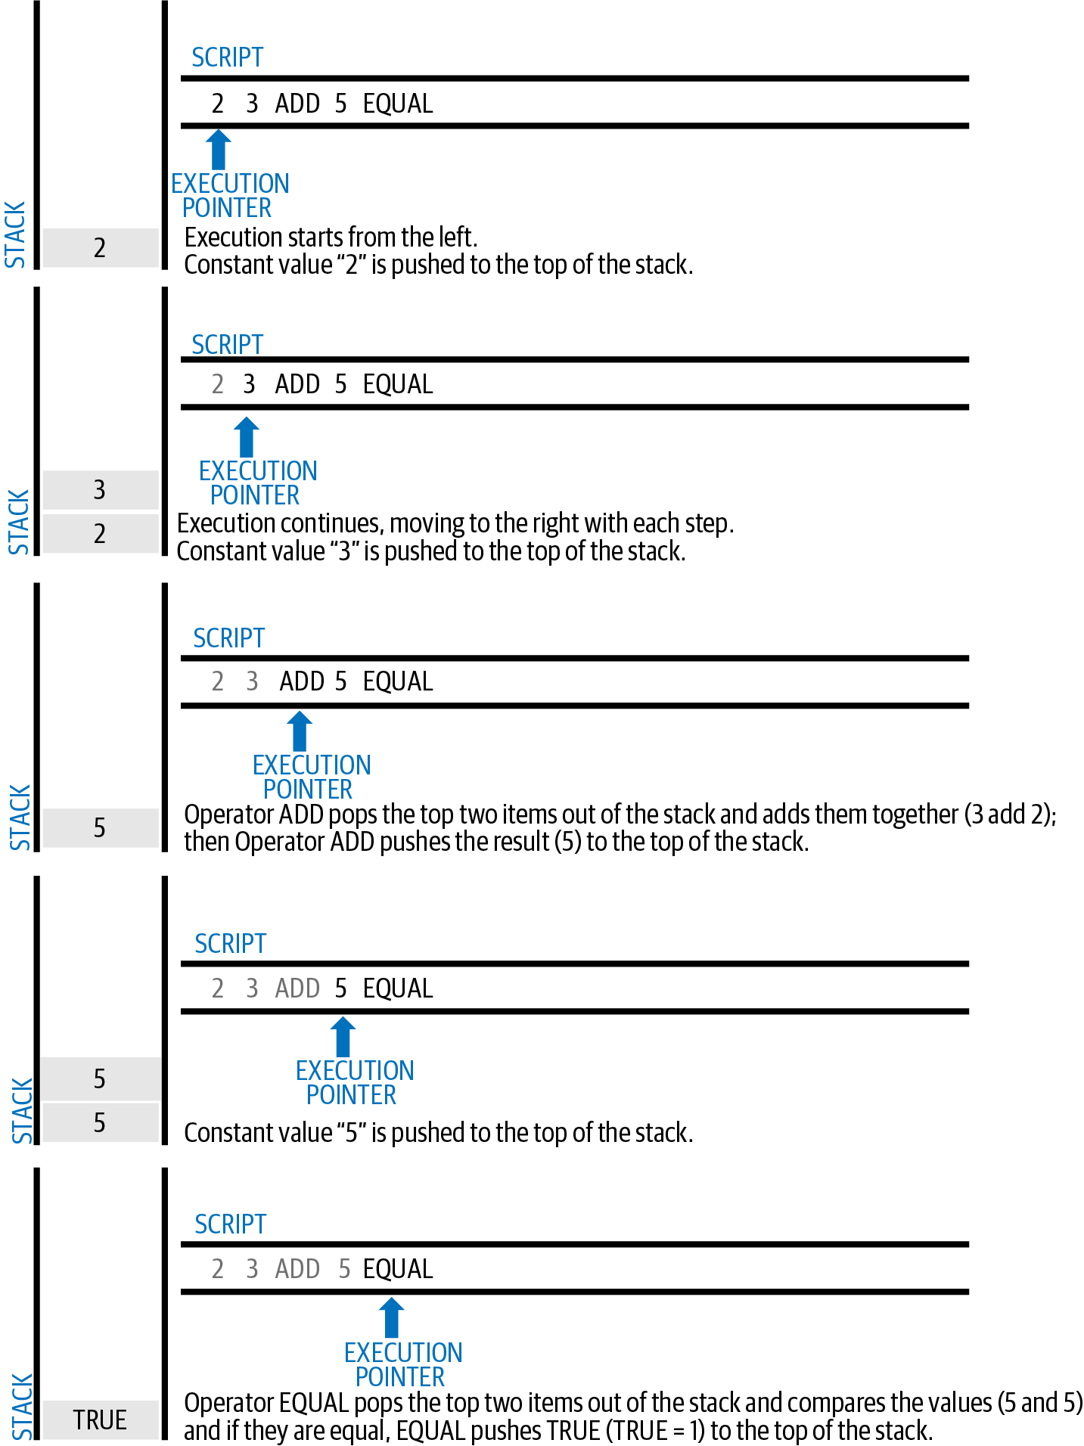
Scripts and the stack
The language, its two scripts and a bug of 2010
A stack machine
Lock and unlock
A key hash
OP_RETURN, 2010
a simple stack calculation - Mastering Bitcoin 3e, CC BY-SA
5 / 26
Notes:
Script is the programming language that the original Bitcoin software introduced for transaction validation. The book describes it as a Forth-like stack-based language, says that both the script placed in an output and the legacy input script used in a spending transaction are written in it, and says that it is a very simple language that requires minimal processing and cannot easily do many of the fancy things modern programming languages can (Antonopoulos and Harding, 2023). The figure is the book's picture of a simple stack calculation, the same two numbers added and compared that the next slide runs. A question to think about is this: what a language without loops can still express? The full explanation is on the course page, chapter 7, under The language and its limits, in the concepts Script, The script execution stack.

Slide 6
A script is a short program for a stack
₿
Push data, or pop inputs and push a result; the top of the stack is the verdict
Unlocking script
pushes the proof, usually a signature and a key
Locking script
runs on the same stack and checks the proof
Top of the stack
non-zero: the spend is valid
2 3 ADD 5 EQUAL, run; then its bytes
a real key-hash spend, then two broken ones
>>> L.run('2 3', 'OP_ADD 5 OP_EQUAL')
'OK'
>>> L.run('2 3', 'OP_ADD 6 OP_EQUAL')
'EVAL_FALSE'
>>> L.assemble('2 3 OP_ADD 5 OP_EQUAL').hex()
'5253935587'
>>> spk = L.p2pkh_script(L.hash160(K.pub(1)))
>>> len(spk), L.classify(spk)[0]
(25, 'pubkeyhash')
>>> p2pkh(), p2pkh(signer=2), p2pkh(amount_after=99999)
('OK', 'EVAL_FALSE', 'EVAL_FALSE')
run under Python 3.14.6
run under Python 3.14.6
no loops
no state
a Python port of Core's engine
A spend is a proof run against a condition, and the verdict is one value
6 / 26
Notes:
A stack is a very simple data structure that the book compares to a stack of cards. It has two base operations: push adds an item on top of the stack and pop removes the top item. The left console runs the arithmetic script of the book's figure and shows its five bytes; the right console builds a real pay to public key hash output, signs a spend, and then breaks it twice, by signing with another key and by changing the amount after signing. A question to think about is this: why changing the amount after signing makes the signature check fail? The full explanation is on the course page, chapter 7, under From a public key to its hash and The language and its limits, in the concepts The script execution stack, Pay to public key hash.

Slide 7
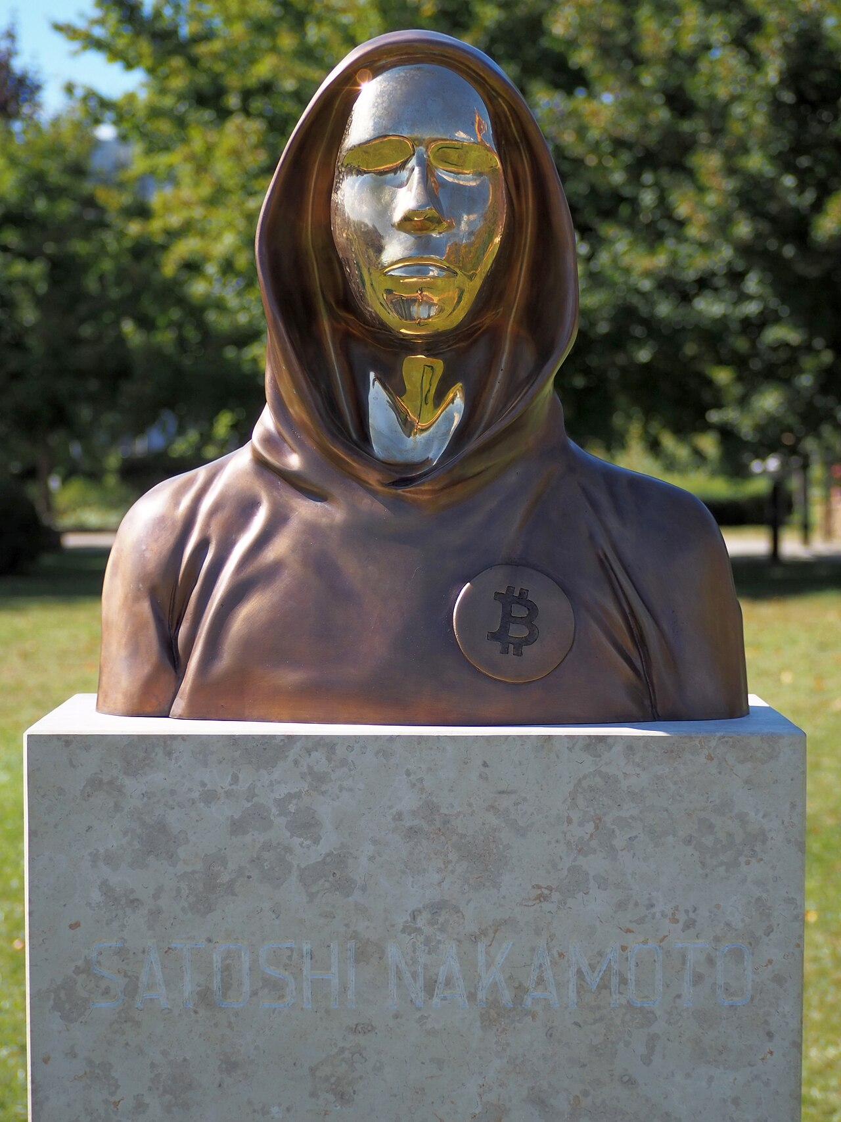
The script that ended with a true result
₿
2010-07-28
28 July 2010: two bugs are found and shown on the test network
Version 0.3.0 joined the two scripts, and OP_RETURN jumped to the end
So 1 OP_RETURN ended the run true; fixed in 0.3.5
2010 model accepts 1 OP_RETURN; today's engine refuses; the owner still spends
>>> old_joined('OP_1 OP_RETURN', LOCK)
'OK'
>>> L.run('OP_1 OP_RETURN', LOCK, flags=())
'OP_RETURN'
>>> L.run('0x06' + b'secret'.hex(), LOCK, flags=())
'OK'
Bust of Satoshi Nakamoto, Budapest - Fekist, CC BY-SA 4.0
run under Python 3.14.6
WHO Satoshi Nakamoto, the a…
WHERE the Bitcoin test networ…
WHEN 2010-07-…
READ en.bitcoin.it
7 / 26
Notes:
This is a true story, dated 2010-07-28. On 28 July 2010 two bugs were discovered and demonstrated on the test network. One of them, recorded as CVE-2010-5141, let an attacker spend coins that they did not own: the first software joined the input script and the output script into one program and treated OP_RETURN as a jump to the end, so an input script of 1 followed by OP_RETURN ended the run with a true value and the output script never ran. The bug was never exploited on the main network and was fixed in version 0.3.5, and by version 0.3.7 the two scripts run one after the other and OP_RETURN fails. After the discovery many unused script words were disabled for safety, and the chapter's library shows that today's tapscript turns disabled values such as OP_LSHIFT, number 152, into OP_SUCCESS opcodes, which make a script succeed on purpose. The first console line is a model of the 2010 design in which the input script 1 OP_RETURN ends the joined script with a true value; the second line gives the verdict of today's engine, which fails the script at OP_RETURN; the third line shows that the genuine owner, who pushes the secret, is still accepted. The lesson the slide carries is that run the two scripts separately, and fail closed on anything unknown. The sources are these. The Bitcoin Wiki entry on Common Vulnerabilities and Exposures, saved in ch07-evidence: CVE-2010-5141, 2010-07-28, wxBitcoin and bitcoind, 'OP_RETURN could be used to spend any output', fixed in 0.3.5, never exploited on the main network; the sources of Bitcoin 0.3.0 and 0.3.7 (script.cpp), whose difference the chapter's library reproduces; BIP342 on OP_SUCCESS opcodes; the book's chapter 7 section on separate execution. Photo: the bronze bust of Satoshi Nakamoto in Graphisoft Park, Budapest, unveiled on 16 September 2021 - Fekist, CC BY-SA 4.0.

Slide 8
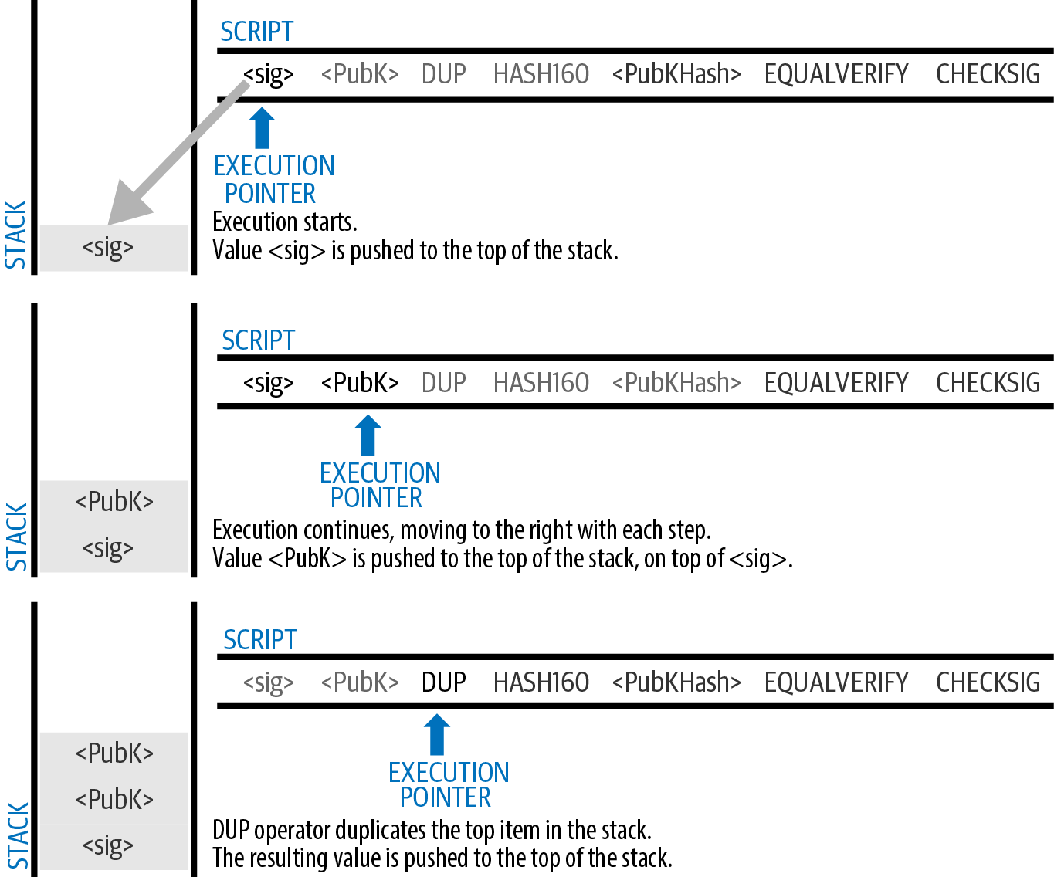
Signatures, multisig and script hash
Signatures, t of k keys and script hashes
DER and the hash type
Strict DER, 2015
2-of-3 multisig
Pay to script hash
validating a P2PKH script - Mastering Bitcoin 3e, CC BY-SA
8 / 26
Notes:
An ECDSA signature is two numbers, r and s, and the way they are written as bytes is a rule of the protocol. The book says that for ECDSA the encoding uses an international standard called the Distinguished Encoding Rules, DER, while for schnorr signatures a simpler serialization is used (Antonopoulos and Harding, 2023). The figure is the book's picture of validating a pay to public key hash script step by step, the pattern that every lock of this part repeats. A question to think about is this: which step of the figure fails first when the key does not match the hash? The full explanation is on the course page, chapter 7, under Checking a signature and The t-of-k script and its limits, in the concepts Signature encoding (DER), Scripted multisignature.

Slide 9
A signature is two numbers, written in strict DER
₿
Strict encoding is a consensus rule since BIP66; the low form of s is only a relay policy
The same signature, padded with a zero byte, passes without the DERSIG rule and fails with it.
a signature of 72 bytes, strictly encoded and low-s; a padded copy is refused only when DERSIG applies
>>> sig = L.ecdsa_sign(K.secret(1), L.sha256(b'pay Bob'))
>>> len(sig) + 1, sig[0], L.is_valid_der(sig + b'\x01'), L.is_low_s(sig + b'\x01')
(72, 48, True, True)
>>> p2pkh(loose=True, flags=L.MAINNET_FLAGS - {'DERSIG'}), p2pkh(loose=True)
('OK', 'SIG_DER')
run under Python 3.14.6
A signature is the pair r and s in DER, followed by one hash-type byte
The hash type says which parts of the transaction the signature commits to
ALL
NONE
SINGLE
plus ANYONECANPAY
Two valid-looking encodings of one signature must not both be valid
9 / 26
Notes:
An ECDSA signature is two numbers, r and s, and the way they are written as bytes is a rule of the protocol. The book says that for ECDSA the encoding uses an international standard called the Distinguished Encoding Rules, DER, while for schnorr signatures a simpler serialization is used (Antonopoulos and Harding, 2023). The first console signs a message with a demonstration key and checks the encoding; the second builds the same signature with an extra zero byte in r, which the engine accepts without the DERSIG flag and refuses with it, as the nodes of 2015 began to do. A question to think about is this: why two encodings of the same signature are a problem for a rule that every node must apply identically? The full explanation is on the course page, chapter 7, under Checking a signature, in the concepts Signature encoding (DER), The signature hash and its hash types.

Slide 10
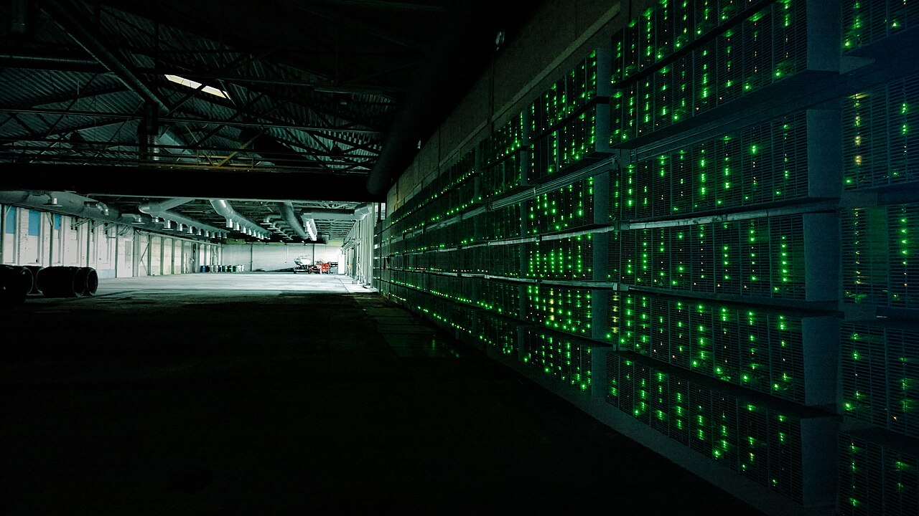
Half the miners did not check the block
₿
2015-07-04
BIP66 made strict DER the only valid signature encoding, from block 363,725 on 4 July 2015
About half of the hash rate mined without fully validating and built on an invalid block
A fork of 6 blocks lasted from 02:10 to 03:50 UTC; a second, of 3 blocks, followed on 5 July
A bitcoin mining farm, 2014 - Marko Ahtisaari, CC BY 2.0
the same padded signature: accepted before the rule, SIG_DER under it
>>> sig = L.ecdsa_sign(K.secret(1), L.sha256(b'pay Bob'))
>>> len(sig) + 1, sig[0], L.is_valid_der(sig + b'\x01'), L.is_low_s(sig + b'\x01')
(72, 48, True, True)
>>> p2pkh(loose=True, flags=L.MAINNET_FLAGS - {'DERSIG'}), p2pkh(loose=True)
('OK', 'SIG_DER')
run under Python 3.14.6
WHO the miners who enfor…
WHERE the Bitcoin network …
WHEN 2015-0…
READ bitcoin.org
10 / 26
Notes:
This is a true story, dated 2015-07-04. BIP66 made strict DER the only valid encoding of a signature, and it took effect once 950 of the last 1,000 blocks were version 3, which happened early on 4 July 2015, at block 363,725. A small miner that had not upgraded then produced an invalid block, as was expected, but roughly half of the network's hash rate was mining without fully validating blocks and built on top of it, so a fork of 6 blocks lasted from 02:10 to 03:50 UTC and a second of 3 blocks followed on 5 July. No double spend was seen in the first fork; several large miners lost income, and the alert advised users of lightweight wallets to wait 30 more confirmations. Bitcoin Core 0.9.5 and later were unaffected because they checked the rule. The console takes a signature that is valid except for a padded integer and shows that the engine accepts it only when the strict-DER flag is not set, which is exactly the difference between a node that enforced BIP66 and one that did not. The lesson the slide carries is that a rule that you do not check for yourself protects nobody. The sources are these. The Bitcoin.org network alert 'Some Miners Generating Invalid Blocks', 4 July 2015, last updated 15 July 2015, saved in ch07-evidence: the 950-of-1,000 threshold, the roughly 50 percent of hash rate that was SPV mining, the forks of 6 blocks (4 July, 02:10 to 03:50 UTC) and 3 blocks (5 July), no double spend in the first, the 30 extra confirmations; BIP66 and Bitcoin Core's chainparams for the activation height 363,725 (block timestamp 01:54:32 UTC, mempool.space). Photo: a bitcoin mining farm, 14 June 2014 - Marko Ahtisaari, CC BY 2.0; it is a general view of mining hardware and not of the 2015 pools.

Slide 11
Multisignature: t of k keys, in order
₿
A 105-byte script for 2 of 3; the signatures must follow the order of the keys
2 of 3 with real signatures: the right order, the wrong order, one signature short, and the extra element
>>> len(RED), L.classify(RED)[0]
(105, 'multisig')
>>> K.ms_spend(2, 3, [0, 2]), K.ms_spend(2, 3, [2, 0]), K.ms_spend(2, 3, [1])
('OK', 'EVAL_FALSE', 'INVALID_STACK_OPERATION')
>>> K.ms_spend(2, 3, [0, 1], dummy=b'\x01'), K.ms_spend(2, 3, [0, 1], dummy=b'\x01', flags=L.MAINNET_FLAGS - {'NULLDUMMY'})
('SIG_NULLDUMMY', 'OK')
run under Python 3.14.6
bare: 3 keys by policy
script hash: 15 keys
The opcode pops one extra stack element, which must be empty since BIP147
consensus: 20 keys
Signatures follow the order of the keys, and the odd extra element must be empty
11 / 26
Notes:
A scripted multisignature is an output script that sets a condition where k public keys are recorded in the script and at least t of them must provide signatures to spend the funds. The book calls this t-of-k and notes that earlier editions, and much other documentation, write m-of-n, which is hard to say aloud because m and n sound alike (Antonopoulos and Harding, 2023). The first line measures the script, 105 bytes with three compressed keys; the second shows that the signatures of keys 0 and 2 pass while the same signatures in the opposite order fail and one signature alone runs out of stack; the third shows that a non-empty dummy element is refused under the NULLDUMMY rule. A question to think about is this: why the opcode needs the signatures in the same order as the keys? The full explanation is on the course page, chapter 7, under The t-of-k script and its limits, in the concepts Scripted multisignature, Multisignature limits.

Slide 12
Pay to script hash: the payer sees only a hash
₿
A 23-byte output, a 3-address, and a redeem script that the spender reveals
Payer
pays to a 23-byte hash: any script looks alike
Spender
reveals the redeem script as the last item
Node
hashes it, compares, then runs it
the 2-of-3 script as an output: its address, a real spend, and a spend whose script hashes to something else
>>> spk = L.p2sh_script(L.hash160(RED))
>>> L.script_to_address(spk)[:6], len(spk)
('3BuKam', 23)
>>> K.ms_spend(2, 3, [0, 1], wrap='p2sh'), K.p2sh_spend(RED, hashed=RED + b'\x00')
('OK', 'EVAL_FALSE')
run under Python 3.14.6
payer: short output
spender: the script and fee
Pay to script hash moves the size and the fee of the script to its spender
12 / 26
Notes:
The redeem script is the script that a pay to script hash output stands for. The book says it is called that because it is presented to the system at redemption time rather than as an output script. The console hashes the 105-byte script into a 23-byte output and a 34-character address starting with 3, spends it with two real signatures, and then shows that presenting a script that hashes to a different value fails. A question to think about is this: who pays for the storage of a long script under pay to script hash, and why that is fairer? The full explanation is on the course page, chapter 7, under Hashing the script, in the concepts Redeem script, Pay to script hash output.

Slide 13
Time and flow control
Making a spend wait, and letting one output have several ways out
Absolute lock
Relative lock
IF and VERIFY
Three paths
13 / 26
Notes:
OP_CHECKLOCKTIMEVERIFY, written CLTV in short, is an opcode that makes an output spendable only after a given block height or time. The book says it was introduced in December 2015 as a soft fork on the specification BIP65, that it is a per-output timelock where the lock time is per transaction, and that the output is restricted so it can be spent only in a transaction whose lock time is greater than or equal to the value in the script (Antonopoulos and Harding, 2023) (Todd, 2014). The boxes name the four slides of this part: the two kinds of timelock, the conditional opcodes, and the book's company contract that uses them all. A question to think about is this: the difference between a time that is fixed on the calendar and one that starts when the output is confirmed? The full explanation is on the course page, chapter 7, under Absolute timelocks and Relative timelocks, in the concepts OP_CHECKLOCKTIMEVERIFY, OP_CHECKSEQUENCEVERIFY.

Slide 14
Two timelocks, both enforced by the script
₿
Absolute: the lock time field. Relative: the age in the sequence field
wait until height 800,000: the lock time must be at least that, and the input must not be final
>>> K.key_spend(CLTV, locktime=800000, sequence=0xfffffffe)
'OK'
>>> K.key_spend(CLTV, locktime=799999, sequence=0xfffffffe), K.key_spend(CLTV, locktime=800000)
('UNSATISFIED_LOCKTIME', 'UNSATISFIED_LOCKTIME')
>>> K.is_final(800000, 800000, 0, [0xfffffffe]), K.is_final(800000, 800001, 0, [0xfffffffe])
(False, True)
run under Python 3.14.6
wait 4,320 blocks (30 days): version 2, the same kind, an age at least as large
>>> K.key_spend(CSV, version=2, sequence=4320)
'OK'
>>> K.key_spend(CSV, version=2, sequence=4319), K.key_spend(CSV, version=1, sequence=4320)
('UNSATISFIED_LOCKTIME', 'UNSATISFIED_LOCKTIME')
>>> K.key_spend(CSV, version=2, sequence=0x80000000 | 4320)
'UNSATISFIED_LOCKTIME'
run under Python 3.14.6
Scripts check the transaction's own fields, so consensus enforces the wait
14 / 26
Notes:
OP_CHECKLOCKTIMEVERIFY, written CLTV in short, is an opcode that makes an output spendable only after a given block height or time. The book says it was introduced in December 2015 as a soft fork on the specification BIP65, that it is a per-output timelock where the lock time is per transaction, and that the output is restricted so it can be spent only in a transaction whose lock time is greater than or equal to the value in the script (Antonopoulos and Harding, 2023) (Todd, 2014). The first console spends real outputs and shows when the absolute lock holds: a lock time of 800,000 passes, 799,999 fails, and a final input fails; its last line shows that a lock time of 800,000 is first final in a block of height 800,001, which differs by one block from the book's wording; the second console shows the relative lock failing for an age of 4,319 blocks, for version 1, and for a sequence with the disable flag. A question to think about is this: why OP_CHECKLOCKTIMEVERIFY fails when the input's sequence is final? The full explanation is on the course page, chapter 7, under Absolute timelocks and Relative timelocks, in the concepts OP_CHECKLOCKTIMEVERIFY, OP_CHECKSEQUENCEVERIFY.

Slide 15
One output, three ways out
₿
Partners at any time, the lawyer with one after 30 days, alone after 90
Path 1
two of three partners, any time
Path 2
the lawyer and one partner, after 30 days
Path 3
the lawyer alone, after 90 days
the 192-byte script spent through each path with real signatures; too young an age fails
>>> len(K.moh_script()), K.moh_spend(1)
(192, 'OK')
>>> K.moh_spend(2, sequence=4320), K.moh_spend(2, sequence=4319)
('OK', 'UNSATISFIED_LOCKTIME')
>>> K.moh_spend(3, sequence=12960), K.moh_spend(3, sequence=4320)
('OK', 'UNSATISFIED_LOCKTIME')
run under Python 3.14.6
30 days = 4,320 blocks
90 days = 12,960 blocks
One output, several redemption paths, each with its own terms
15 / 26
Notes:
The capital-account script is the book's combined example. Mohammed, a company owner in Dubai, wants a capital account with flexible rules: the participants are Mohammed, his two partners Saeed and Zaira, and the company lawyer; two of the three partners decide by majority; if there is a problem with their keys, the lawyer can recover the funds with one of the three partner signatures; and if all partners are unavailable or incapacitated for a while, the lawyer can manage the account directly. The console measures the script, 192 bytes, and spends it through the three paths with real signatures; path 2 passes at an age of 4,320 blocks and fails at 4,319, and path 3 passes at 12,960 blocks and fails at 4,320. A question to think about is this: why the lawyer needs a partner for the first 90 days but not afterwards? The full explanation is on the course page, chapter 7, under A script with timelocks and several signers and Conditionals and guards, in the concepts Capital account script, Scripts with several paths.

Slide 16
Witness programs and script trees
Where the proof moved to, what a real block spends, and how alternatives hide in a hash
Witness programs
Segwit addresses
A real block
Merkle tree of scripts
16 / 26
Notes:
A witness program is what BIP141 calls an output script that consists of a one-byte push opcode, one of OP_0 and OP_1 to OP_16, followed by a direct data push between 2 and 40 bytes. The value of the first push is the version byte, and the following byte vector is the witness program. The four boxes are the two slides of this part and the two ideas they carry, the version byte of a witness program and the tree of alternative scripts. A question to think about is this: how a version byte lets later upgrades reuse the same output format? The full explanation is on the course page, chapter 7, under Trees of alternative scripts and Witness programs and their addresses, in the concepts Witness program, Merklized alternative script tree.

Slide 17
Witness programs, and what 1,022 real inputs spend
₿
The first 599 transactions of block 775,072, classified by the chapter's own library
The bars come from executed code over a saved block; the checker re-runs the console off this file.
native and nested spends; a wrong amount fails
>>> K.wpkh_spend(), K.wpkh_spend(nested=True)
('OK', 'OK')
>>> K.wpkh_spend(signed_amount=99999)
'EVAL_FALSE'
>>> L.script_to_address(L.p2wpkh_script(L.hash160(K.pub(1))))
'bc1qm5gqhe7e46jhyy2ca00x66slmrlljwa33n9fts'
run under Python 3.14.6
1
A witness program is a version byte and a push of 2 to 40 bytes
2
Version 0 is P2WPKH and P2WSH, version 1 is taproot
Most inputs spend witness programs, and the signature commits to the amount
17 / 26
Notes:
A witness program is what BIP141 calls an output script that consists of a one-byte push opcode, one of OP_0 and OP_1 to OP_16, followed by a direct data push between 2 and 40 bytes. The value of the first push is the version byte, and the following byte vector is the witness program. The bars are the second line of the block census: 626 of the 1,022 inputs spend a native P2WPKH output and 194 a legacy key hash output, and six spend taproot; the console on the right signs a native and a nested P2WPKH spend, and shows that a signature made over a different amount is refused because the version 0 signature hash commits to the amount. A question to think about is this: why a signature that commits to the amount lets a hardware wallet know the fee? The full explanation is on the course page, chapter 7, under Witness programs and their addresses, in the concepts Witness program, Pay to witness public key hash.

Slide 18
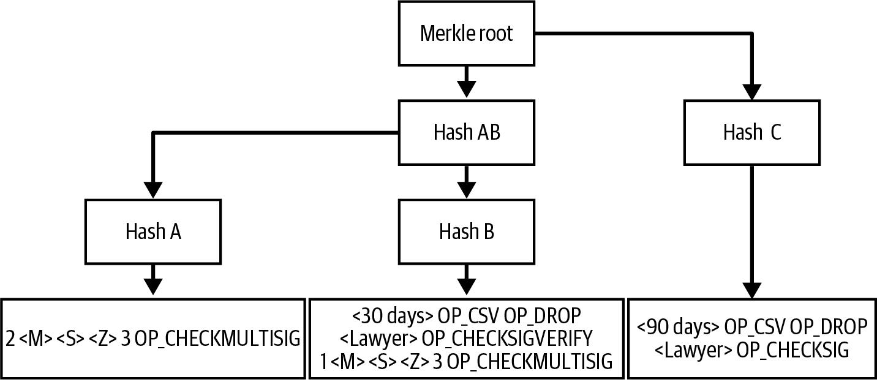
A tree of scripts hides every script you do not use
₿
A Merkle tree commits to all scripts; the spender shows one and its proof
Only the depth of the tree matters: 20 hashes of 32 bytes prove one script out of a million.
a MAST with three sub-scripts - Mastering Bitcoin 3e, CC BY-SA
the contract as a tree: proofs, then larger trees
>>> [len(p) for p in K.tap_tree(MOH_LEAVES)[1]]
[2, 2, 1]
>>> [(n, (n - 1).bit_length()) for n in (3, 8, 1024, 2**20)]
[(3, 2), (8, 3), (1024, 10), (1048576, 20)]
run under Python 3.14.6
The cost grows with the depth of the tree, not with the number of scripts
18 / 26
Notes:
A Merklized alternative script tree, MAST for short, is the way to use a merkle tree to authorize many different spending conditions. The book describes it step by step: each member of the set of conditions is passed through a hash function to create a short commitment called a leaf; each leaf is paired with another and hashed again, giving a commitment to the leaves called a branch; the step is repeated until one identifier remains, the merkle root. The picture is the book's Merklized alternative script tree with three scripts; the first console line builds that tree for the three-path contract and finds proofs of two, two and one hashes; the bars show the length of a proof for 3, 8, 1,024 and 1,048,576 scripts, one hash per level of depth. A question to think about is this: why a million alternative scripts cost only twenty hashes to prove one of them? The full explanation is on the course page, chapter 7, under Trees of alternative scripts, in the concepts Merklized alternative script tree, Two meanings of MAST.

Slide 19
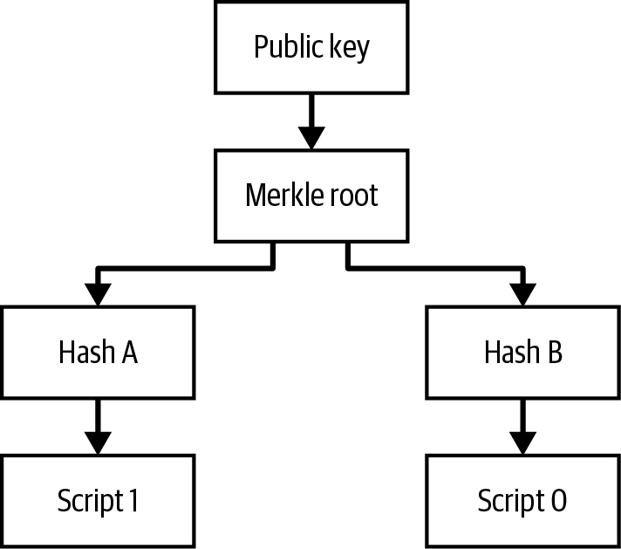
Taproot and tapscript
One key for agreement, one script for the rest
Output key
Key path
Script path
Tapscript
a taproot output - Mastering Bitcoin 3e, CC BY-SA
19 / 26
Notes:
Taproot is the name of the output type and of the soft fork that added it. The book builds it from the earlier ideas: pay to contract tweaks a key to commit to an agreement, and taproot commits instead to the program code of a contract by tweaking with the root of a MAST. The figure is the book's picture of a taproot output in which the public key commits to the Merkle root of a script tree. A question to think about is this: what an observer of the chain can learn from a spend by the key path? The full explanation is on the course page, chapter 7, under Taproot outputs, in the concepts Taproot output, Key path spending.

Slide 20
Taproot: one 32-byte key that commits to a tree
₿
Output key = internal key + tweak; the key path shows one 64-byte signature
Internal key P
possibly the sum of many keys
Tweak by the tree root
Q = P + hash(P, root) x G
Output key Q
32 bytes, in a bc1p address
output key and address; a 64-byte key path spend of 308 units; an untweaked key fails
>>> par, q = L.taproot_tweak_pubkey(K.xpub(1), b'')
>>> L.script_to_address(L.p2tr_script(q))[:6], len(q)
('bc1pwd', 32)
>>> r, wit, wt = K.tr_keypath(1)
>>> r, len(wit[0]), wt
('OK', 64, 309)
>>> K.tr_keypath(1, MOH_LEAVES)[0], K.tr_keypath(1, MOH_LEAVES, tamper='untweaked')[0]
('OK', 'SCHNORR_SIG')
run under Python 3.14.6
key path: one signature
witness version 1
BIP340, BIP341
When everyone agrees, the chain shows one signature and no script
20 / 26
Notes:
Taproot is the name of the output type and of the soft fork that added it. The book builds it from the earlier ideas: pay to contract tweaks a key to commit to an agreement, and taproot commits instead to the program code of a contract by tweaking with the root of a MAST. The console derives the output key of an output without scripts and its address, then spends a second output that does commit to a tree by the key path with one 64-byte signature that weighs 308 units; signing with the untweaked key instead fails the Schnorr check. A question to think about is this: why the signer must use the key tweaked by the tree's root? The full explanation is on the course page, chapter 7, under Taproot outputs, in the concepts Taproot output, Key path spending.

Slide 21
The script path: reveal one script, hide the rest
₿
Witness = inputs, script, and a control block linking it to the output key
Revealing a script costs about what P2WSH costs; the cooperative key path costs half.
per-leaf results, weights and control blocks
>>> [moh_tap(i)[0] for i in range(3)]
['OK', 'OK', 'OK']
>>> [moh_tap(i)[2] for i in range(3)]
[577, 617, 414]
>>> [moh_wsh(p) for p in (1, 2, 3)]
[585, 584, 509]
>>> [len(moh_tap(i)[1][-1]) for i in range(3)]
[97, 97, 65]
run under Python 3.14.6
The key path of the same output weighs 308 units
A control block is 33 + 32 x depth bytes
A script path spend shows one script and nothing about the others
21 / 26
Notes:
Script path spending is the spending of a taproot output by one of its scripts. The book lists what the witness holds: a version number; the underlying key, the taproot internal key; the script to execute, called the leaf script; one 32-byte hash for each junction in the Merkle tree along the path that connects the leaf to the root; and any data needed to satisfy the script, such as signatures or preimages (Antonopoulos and Harding, 2023). The bars compare the same three-path contract as three tapscript leaves and as one P2WSH script; the leaf of the second path weighs 617 units against 584, so the script path costs about the same as the old way, but the key path of the same output would weigh only 308; the last line shows control blocks of 97, 97 and 65 bytes for a tree of three leaves. A question to think about is this: why a contract that is almost always settled by agreement is cheaper in taproot? The full explanation is on the course page, chapter 7, under Taproot outputs, in the concepts Script path spending, Control block.

Slide 22
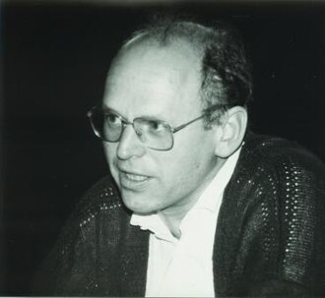
From a patented signature to taproot
₿
2021-11-14
Claus Schnorr patented his signature scheme and kept it out of open standards for almost two decades
BIP340, BIP341 and BIP342 specified Schnorr signatures, taproot and tapscript
The rules took effect at block 709,632 on 14 November 2021
a taproot key path spend: one 64-byte Schnorr signature, 308 weight units
>>> r, wit, wt = K.tr_keypath(1)
>>> r, len(wit[0]), wt
('OK', 64, 309)
Claus-Peter Schnorr, Oberwolfach, 1986 - Konrad Jacobs, MFO, CC BY-SA 2.0 de
run under Python 3.14.6
WHO Claus-Peter Schnorr, wh…
WHERE block 709,632, mined on…
WHEN 2021-11-…
READ mempool.space
22 / 26
Notes:
This is a true story, dated 2021-11-14. Claus Schnorr patented the signature algorithm he discovered and kept it out of open standards and open-source software for almost two decades, so cryptographers of the early 1990s built the DSA family that led to the ECDSA signatures Bitcoin used from its first release. BIP340 was assigned in January 2020 to standardise Schnorr signatures on Bitcoin's curve, BIP341 and BIP342 added the taproot output and tapscript, and the rules took effect at block 709,632 on 14 November 2021, a block of 2,043 transactions. Bitcoin Core's source still notes the height, with a warning height one miner confirmation window later at 711,648. A payment such as Alice's in the chapter spends such an output with one 64-byte signature, which looks the same whether one person or a million made it. The console builds a taproot output, spends it by the key path and shows that the witness is a single 64-byte Schnorr signature, whatever number of people produced the key. The lesson the slide carries is that patents delayed Schnorr for decades; a soft fork brought it to every wallet. The sources are these. The book's chapter 8, section 'ECDSA Signatures' (the patent, 'almost two decades', ECDSA the only signature algorithm until the taproot soft fork in 2021); BIP340 (assigned 2020-01-19, 64-byte Schnorr signatures); BIP341 and BIP342; Bitcoin Core src/kernel/chainparams.cpp at commit 05bc2f5, 'taproot activation height + miner confirmation window'; the block record from mempool.space: height 709,632, timestamp 2021-11-14 05:15:27 UTC, 2,043 transactions. Photo: Claus-Peter Schnorr at Oberwolfach, 1986 - Konrad Jacobs (Mathematisches Forschungsinstitut Oberwolfach), CC BY-SA 2.0 de.

Slide 23
Tapscript: three small changes to the language
₿
OP_CHECKSIGADD counts signatures; unknown opcodes succeed for upgrades
2 of 3 with OP_CHECKSIGADD: 104 bytes, spent with one empty signature; with only one signature it fails
>>> len(K.csa_script([0, 1, 2], 2)), len(RED)
(104, 105)
>>> K.tr_spend([K.csa_script([0, 1, 2], 2)], 0, [b'', ('sig', 1), ('sig', 0)])[0]
'OK'
>>> K.tr_spend([K.csa_script([0, 1, 2], 2)], 0, [b'', b'', ('sig', 0)])[0]
'EVAL_FALSE'
87 opcode values are OP_SUCCESS; a script that contains OP_LSHIFT succeeds, and the legacy engine refuses it
run under Python 3.14.6
>>> sum(1 for o in range(256) if L.is_op_success(o))
87
>>> K.tr_spend([bytes([0x51, 152])], 0, [])[0]
'OK'
>>> L.run('OP_1 OP_LSHIFT', 'OP_1', flags=())
'DISABLED_OPCODE'
run under Python 3.14.6
Tapscript counts signatures one at a time and leaves room for upgrades
23 / 26
Notes:
OP_CHECKSIGADD is the opcode that replaces OP_CHECKMULTISIG. The book says that it increments a counter by one when it successfully verifies a signature, which makes it possible to count how many signatures passed and compare the count with the number wanted. The first console measures the tapscript form of 2 of 3 at 104 bytes against 105 in legacy script and spends it in a real taproot transaction with one empty signature, which counts nothing, and fails when only one signature counts; the second console counts the 87 OP_SUCCESS values and shows that a leaf holding the disabled opcode OP_LSHIFT, number 152, is accepted, while the legacy engine rejects the same opcode as disabled. A question to think about is this: why making unknown opcodes succeed lets a later soft fork give them a meaning? The full explanation is on the course page, chapter 7, under Tapscript, in the concepts OP_CHECKSIGADD, OP_SUCCESS opcodes.

Slide 24
The chapter in five lines
₿
One line per part - each one provable from its slides
1
A script is a stack program with no loops and no state: the unlocking script proves, the locking script checks, and the top value is the verdict
2
A signature is two numbers in strict DER; multisignatures count them in key order, and pay to script hash moves a long script to its spender
3
Lock time and sequence let a spend wait, and conditionals give one output several ways out
4
Segregated witness moved the proof into a witness program with a version, and a tree of scripts hides every alternative that is not used
5
Taproot commits a key to a tree: the key path shows one signature, the script path one script, and tapscript counts signatures one by one
If a line feels unproven, its part's slides carry the receipt
24 / 26
Notes:
These five lines are the deck in miniature, one per part, and each of them is carried by a slide range that the agenda names. A line that feels unproven should send the reader back to its consoles, because every figure in it was computed on a slide with the chapter's own interpreter. The full text behind all five lines is on the course page for chapter 7.

Slide 25
Where to go from here
₿
Checked 2026-10-08; every entry is a live link in this file
Read
The stories
The whitepaper, nine pages bitcoin.org/bitcoin.pdf
Bitcoin 0.3.0, the first script engine raw.githubusercontent.com/bitcoin/bitcoin/v0.3.0/script.cpp
The Bitcoin Wiki's Script page en.bitcoin.it/wiki/Script
The early bugs, CVE-2010-5141 en.bitcoin.it/wiki/Common_Vulnerabilities_and_Exposures
Standards
The July 2015 network alert bitcoin.org/en/alert/2015-07-04-spv-mining
BIP 66 - strict DER signatures raw.githubusercontent.com/bitcoin/bips/master/bip-0066.mediawiki
Tools
BIP 141 - segregated witness raw.githubusercontent.com/bitcoin/bips/master/bip-0141.mediawiki
Bitcoin Optech - taproot bitcoinops.org/en/topics/taproot/
BIP 341 - taproot raw.githubusercontent.com/bitcoin/bips/master/bip-0341.mediawiki
The Bitcoin Wiki on taproot en.bitcoin.it/wiki/Taproot
BIP 342 - tapscript raw.githubusercontent.com/bitcoin/bips/master/bip-0342.mediawiki
Read the first engine beside today's rules and find where OP_RETURN changed
25 / 26
Notes:
Everything here is free to read, and every link was fetched on the date in the subtitle. A good exercise is to read the source of the first script engine next to today's rules and find the line where OP_RETURN changed meaning, then run the same script in the chapter's library on the course page. The course page for chapter 7 carries the full resource list, including the chapter itself and Bitcoin Core's interpreter, with a sentence on why each entry is there.

Slide 26
What you should now be able to say
And where each claim gets its proof
How a locking and an unlocking script decide a spend
How a signature, a multisignature and a script hash are checked
How timelocks and conditionals shape who can spend, and when
What segwit and taproot change, and what a key path or script path reveals
Questions?
26 / 26
Notes:
Four claims, each carried by computations that ran on slides of this deck with the chapter's own interpreter, which is checked against Bitcoin Core's published script tests and against every input of a real block. The course page for chapter 7 carries every word behind them, the stories with their sources, and the question bank to test the four claims on yourself.

