Slide 1
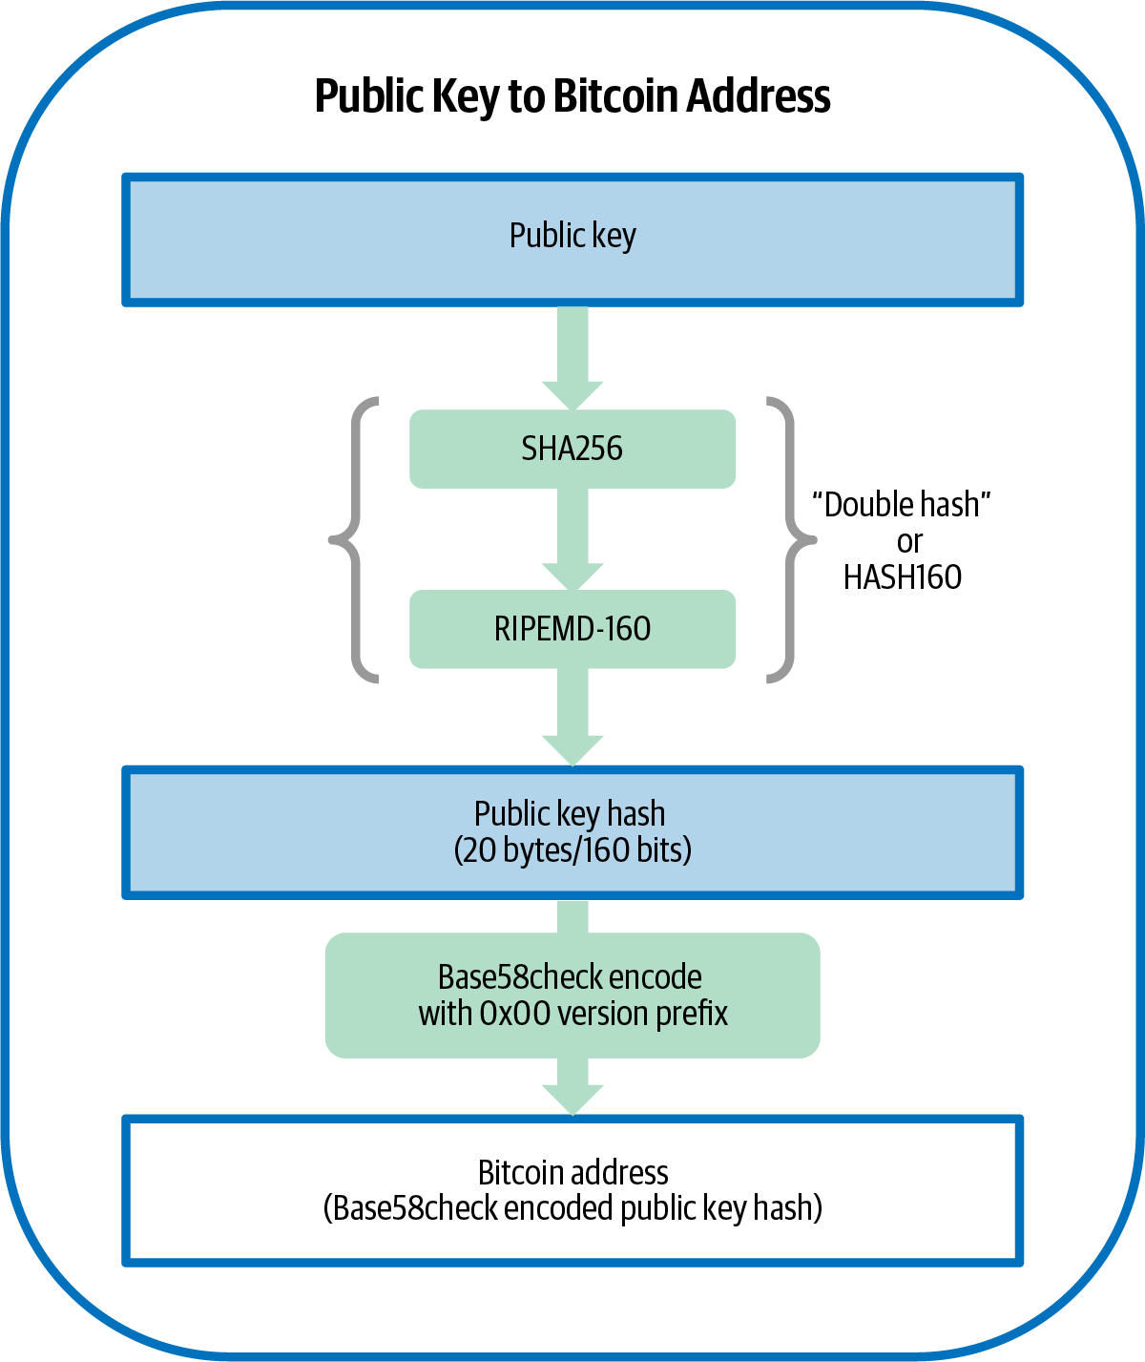
₿
Chapter 4: Keys and Addresses
From a secret number to the string you can safely read out loud
key to address - Mastering Bitcoin 3e, CC BY-SA
SEN0401 Special Topics in Software Engineering: Block Chain · Fall 2026 · Yusuf Altunel, PhD · İstanbul Kültür University
Notes:
SAY: Chapter 3 gave you the node; chapter 4 gives you ownership: one secret number, the curve that hides it, and the address formats that carry it in public.
FULL TEXT: course page, chapter 4.

Slide 2
Today's route
₿
Five parts; every number is a slide you can jump to
1
Questions and the chapter map (slides 3-4)
25
slides, numbered bottom-right
2
Keys - the number, the curve, the proof (slides 5-10)
3
3
Formats - base58, WIF, checksums (slides 11-14)
true stories, each with WHO / WHERE / WHEN / READ
4
Addresses - P2PKH to taproot, measured (slides 15-20)
20
5
Practice, summary, and resources (slides 21-25)
live-run consoles, each shown with its result
Five parts - from one secret number to safe habits
2 / 25
Notes:
SAY: Five parts: the key, its public face, its travel clothes, its addresses, and the habits - every claim arrives with its receipt, and one slide is signed by Satoshi's own source comment.
ASK: Which part do you expect to be hardest - mark it now, check at the summary.
FULL TEXT: course page, chapter 4 - every section.

Slide 3
The questions this chapter answers
₿
Its own competency questions - we return to each
1
How does a private key become a public key?
2
Which encodings can one and the same key or commitment appear in?
3
Which output script does each kind of address stand for?
4
What does the checksum of each address format guarantee?
5
Where do the statements and numbers of the 3rd edition's chapter 4 differ from the primary standards and from a run of Bitcoin Core 31.1?
6
Which terms do the explanations of this chapter rely on?
If you can answer these, chapter 4 is yours
3 / 25
Notes:
SAY: This branch of the chapter starts from a payment. Alice wants to pay Bob, but the thousands of full nodes that will verify her transaction do not know who Alice or Bob are, and the design is meant to keep it that way, to protect their privacy (Antonopoulos and Harding, 2023).
FULL TEXT: course page, chapter 4 - Keys.

Slide 4
One chapter, five branches
₿
The concept map the whole chapter hangs on
Each branch is a question the chapter answers; the grey lists are the concepts that answer it, every one explained on the course page.
Keys
Key Pair · Random Source · Curve · Hashing
Format
Representation · Key Encoding · Checksummed
Chapter 4
Address
Scripts · Legacy · Segwit
Practice
Modern · Assurance
Semantics
Identifiers
Five branches - every slide today lives on this map
4 / 25
Notes:
SAY: This branch of the chapter starts from a payment. Alice wants to pay Bob, but the thousands of full nodes that will verify her transaction do not know who Alice or Bob are, and the design is meant to keep it that way, to protect their privacy (Antonopoulos and Harding, 2023).
FULL TEXT: course page, chapter 4 - Keys, Format, Address.

Slide 5
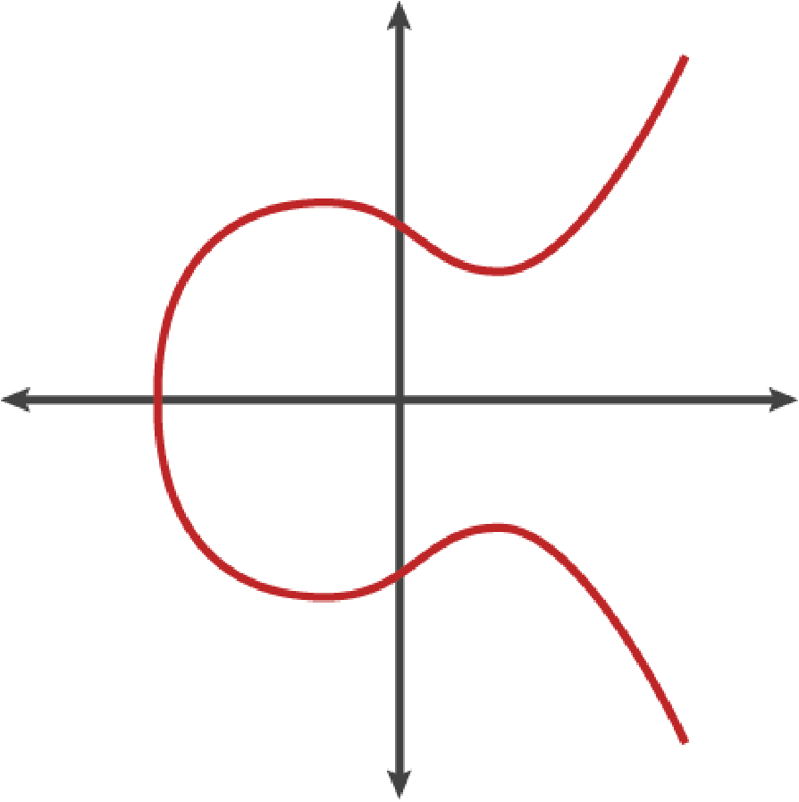
Keys
A number, a curve, and a one-way multiplication
Private key
The curve
Public key
Proof by signature
the curve - Mastering Bitcoin 3e, CC BY-SA
5 / 25
Notes:
SAY: This branch of the chapter starts from a payment. Alice wants to pay Bob, but the thousands of full nodes that will verify her transaction do not know who Alice or Bob are, and the design is meant to keep it that way, to protect their privacy (Antonopoulos and Harding, 2023).
FULL TEXT: course page, chapter 4 - Keys.

Slide 6

The 1976 paper that split the key in two
₿
1976-11
'We stand today on the brink of a revolution in cryptography'
One key splits in two: publish one half, keep the other
Tied by a computation easy forward, infeasible backward
Turing Award, 2015 - this chapter runs their idea
Diffie and Hellman - Wikimedia Commons, CC BY-SA 3.0
WHO Whitfield Diffie and Martin Hellman (T…
WHERE IEEE Transactions on Information Theory
WHEN 1976-11
READ en.wikipedia.org
Public and private halves - one 1976 idea under every address
6 / 25
Notes:
STORY (1976-11): In November 1976 two Stanford researchers published 'New Directions in Cryptography', opening with a sentence that aged well: 'We stand today on the brink of a revolution in cryptography.' Their idea - a key split into a public half and a private half, tied by a one-way computation - is the exact machinery this chapter runs: multiply a point, publish the result, keep the multiplier. Forty years later the ACM gave them the Turing Award for it.
SOURCE: Diffie and Hellman, 'New Directions in Cryptography', IEEE Transactions on Information Theory 22(6), November 1976; ACM A.M. Turing Award 2015. Photo: Wikimedia Commons 'Diffie and Hellman', CC BY-SA 3.0.

Slide 7
A private key is just a number
₿
Any 256-bit number - and the run shows the edges
the edges, probed - the error is real
1
Pick a number below the curve order n - that is the whole secret
>>> 2**256 - N
432420386565659656852420866394968145599
>>> 0 < k < N
True
>>> (2 ** 256).to_bytes(32, 'big')
OverflowError: int too big to convert
2
256 bits of honest randomness; dice work, habits do not
3
One too large and the arithmetic itself refuses
run under Python 3.14.4
how big 2^256 - 1 is
>>> round(math.log10(2 ** 256), 2)
77.06
>>> (2 ** 256 - 1).bit_length()
256
run under Python 3.14.4
Any 256-bit number - the hard part is choosing it unpredictably
7 / 25
Notes:
SAY: A private key is simply a number, picked at random. Control over the private key is the root of user control over all funds associated with the corresponding public key: the key is used to create the signatures that spend bitcoins by proving control of the funds used in a transaction (Antonopoulos and Harding, 2023).
ASK: Why is a password a bad private key even if it is long?
FULL TEXT: course page, chapter 4 - PrivateKey, Entropy.

Slide 8
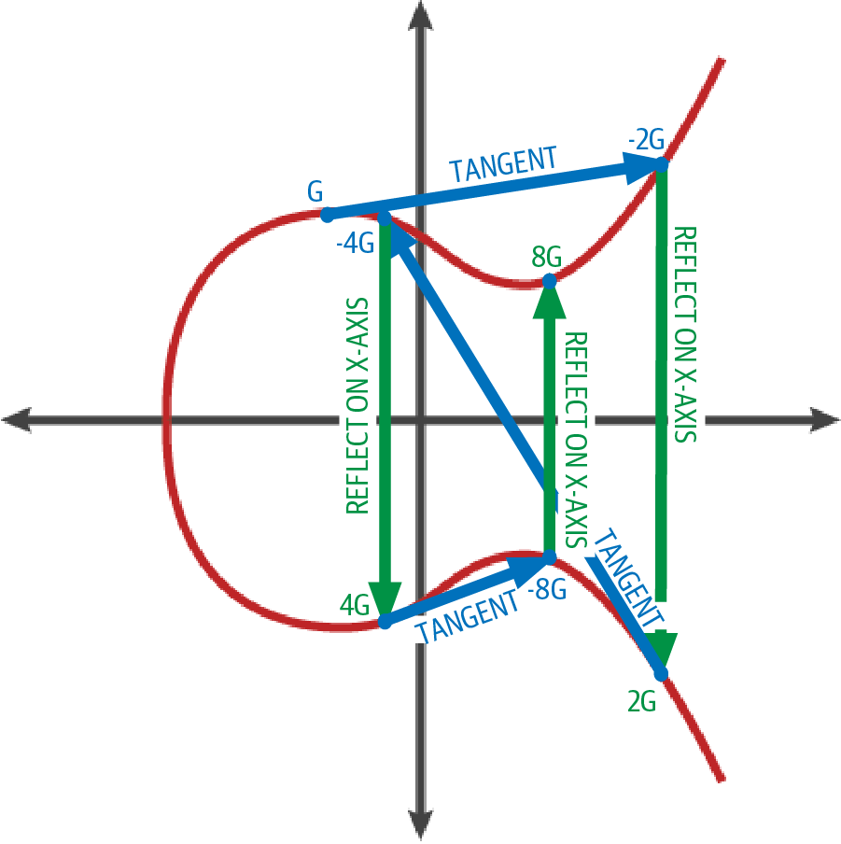
The curve everyone agreed on
₿
secp256k1 - checked live, not taken on faith
the two primes, re-tested in the build
>>> P == 2**256 - 2**32 - 977
True
>>> P == 2**256 - 2**32 - 2**9 - 2**8 - 2**7 - 2**6 - 2**4 - 1
True
>>> is_probable_prime(P), is_probable_prime(N)
(True, True)
run under Python 3.14.4
G generates; after n steps the cycle closes
>>> pub_bytes(G).hex()
'0279be667ef9dcbbac55a06295ce870b07029bfcdb2dce28d959f2815b16f81798'
>>> ec_add(ec_mul(N - 1), G) is None
True
point addition - Mastering Bitcoin 3e, CC BY-SA
run under Python 3.14.4
secp256k1: two primes, one base point, shared by all
8 / 25
Notes:
SAY: The name secp256k1 identifies the specific elliptic curve and the set of constants that Bitcoin uses. The curve is y squared = x cubed + 7 over a finite field of prime order p, with p = 2 to the 256 minus 2 to the 32 minus 2 to the 9 minus 2 to the 8 minus 2 to the 7 minus 2 to the 6 minus 2 to the 4 minus 1 (Antonopoulos and Harding, 2023).
ASK: Who chose these constants - and why does 'nothing up my sleeve' matter?
FULL TEXT: course page, chapter 4 - Secp256k1, GeneratorPoint.

Slide 9
Double-and-add: the one-way street
₿
The exact code that computed every key on these slides
def ec_add(a, b):
if a is None: return b
if b is None: return a
if a[0] == b[0] and (a[1] + b[1]) % P == 0: return None
m = (3 * a[0] * a[0] * pow(2 * a[1], -1, P) if a == b else (b[1] - a[1]) * pow(b[0] - a[0], -1, P)) % P
x = (m * m - a[0] - b[0]) % P
return (x, (m * (a[0] - x) - a[1]) % P)
def ec_mul(k, pt=G):
out = None
while k:
if k & 1: out = ec_add(out, pt)
pt = ec_add(pt, pt); k >>= 1
return out
256
doublings to walk k*G
~2^128
sen0401_ch04_keys - the deck_check gate requires this source, verbatim
work to walk back (best known)
3G = G+G+G - the homework check
>>> (k.bit_length() - 1, bin(k).count('1') - 1)
(252, 123)
>>> ec_mul(3) == ec_add(ec_add(G, G), G)
True
run under Python 3.14.4
256 doublings forward - and no known road back
9 / 25
Notes:
SAY: Elliptic curve multiplication takes a point P and a whole number k and produces kP, which is defined as P + P + P + ... + P with k terms.
ASK: Where exactly does 'easy forward, hard backward' live in these 13 lines?
FULL TEXT: course page, chapter 4 - PointMultiplication, DiscreteLogarithm.

Slide 10
Prove the key without showing it
₿
Chapter 1's house-key analogy, now executable
1
A signature answers a challenge using k, revealing only K; verify needs the public half alone
2
The wrong key fails - the run shows both verdicts
sign, verify, then try the neighbour's key
>>> challenge = int.from_bytes(hashlib.sha256(b'a fresh challenge').digest(), 'big')
>>> sig = ecdsa_sign(k, challenge, 0x27182818284590452353602874713526)
>>> ecdsa_verify(K, challenge, sig)
True
>>> ecdsa_verify(ec_mul(k + 1), challenge, sig)
False
run under Python 3.14.4
car key: opens
house deed: proves
Chapter 1's house key, kept honest: sign, never reveal
10 / 25
bitcoin key: both - so never show it
Notes:
SAY: A digital signature is a number that a signer computes from a message and from a private key. Anyone who has the message, the signature and the matching public key can verify the signature, that is, can check that it was produced by the holder of the private key and that the message has not been altered since.
ASK: What would 'showing the key' even mean here - and what breaks the moment you do?
FULL TEXT: course page, chapter 4 - DigitalSignature, KeyControlProof.

Slide 11
Formats
The same numbers, dressed to travel
Base58Check
WIF
Compression
Checksums
11 / 25
Notes:
SAY: This branch is about writing the same information down in different ways. A private key, a public key and a hash commitment are all numbers, and a number can be shown in binary, in hexadecimal, in a compact alphabet with a built-in checksum, or in a two-dimensional barcode.
FULL TEXT: course page, chapter 4 - Format.

Slide 12
Why 58? Satoshi left the reasons in the file
₿
2009-2010
/**
* Why base-58 instead of standard base-64 encoding?
* - Don't want 0OIl characters that look the same in some fonts and
* could be used to create visually identical looking data.
* - A string with non-alphanumeric characters is not as easily accepted as input.
* - E-mail usually won't line-break if there's no punctuation to break at.
* - Double-clicking selects the whole string as one word if it's all alphanumeric.
*/
src/base58.h at the pinned commit - the file's copyright line names Satoshi Nakamoto, 2009-2010 (MIT)
why keys start with 5 or K: the version byte
>>> [b58check(bytes([v]) + bytes(20))[0] for v in (0x00, 0x05, 0x6f, 0xc4)]
['1', '3', 'm', '2']
>>> b58check(b'\x80' + bytes(32))[0], b58check(b'\x80' + bytes(32) + b'\x01')[0]
('5', 'K')
run under Python 3.14.4
WHO Satoshi Nakamoto - named by the file's…
WHERE src/base58.h in the bitcoin/bitcoin tr…
WHEN 2009-2010
READ github.com
The address alphabet is usability engineering, documented
12 / 25
Notes:
STORY (2009-2010): Open src/base58.h in the source tree this course pins and the first thing after the copyright lines - 'Copyright (c) 2009-2010 Satoshi Nakamoto' - is a design memo. Why base-58 and not base-64? Because 0, O, I and l look alike in some fonts; because punctuation breaks selection and line-wrapping; because an all-alphanumeric string survives e-mail and double-clicks whole. Four human reasons, zero mathematics - the alphabet of every legacy address is a usability decision, documented by its author in the code itself.
SOURCE: src/base58.h at the corpus-pinned commit 05bc2f53 of bitcoin/bitcoin: the copyright line naming Satoshi Nakamoto (2009-2010) and the 'Why base-58 instead of standard base-64' comment, quoted verbatim on the slide (MIT).

Slide 13
From key to WIF and back
₿
Wallet Import Format - transport clothing for k
k, 32 bytes
the number itself
0x80 prefix
+ 0x01 if compressed
checksum
4 bytes of SHA256^2
base58
the string you export
round trip: encode, decode, same bytes
>>> wif(k, False)
'5J3mBbAH58CpQ3Y5RNJpUKPE62SQ5tfcvU2JpbnkeyhfsYB1Jcn'
>>> wif(k)
'KxFC1jmwwCoACiCAWZ3eXa96mBM6tb3TYzGmf6YwgdGWZgawvrtJ'
>>> b58check_decode(wif(k)).hex()
'801e99423a4ed27608a15a2616a2b0e9e52ced330ac530edcc32c8ffc6a526aedd01'
run under Python 3.14.4
WIF is the same number, dressed for transport
13 / 25
Notes:
SAY: The wallet import format, abbreviated WIF, is the text form in which a private key is exported from one wallet and imported into another. It is the base58check encoding of the version byte 0x80 followed by the 32-byte private key, and, for keys that produce compressed public keys, an extra byte 01 at the end (Antonopoulos and Harding, 2023).
ASK: Decode a WIF by eye: which characters can never appear?
FULL TEXT: course page, chapter 4 - WalletImportFormat, CompressedPrivateKey.

Slide 14
The checksum that catches your typo
₿
Four bytes between you and a lost payment
a real address, a real typo, a real refusal
1
Hash the payload twice, keep four bytes, append
>>> dsha(b'\x00' + H160)[:4].hex()
'37fefcd0'
>>> b58check_decode('1J7mdg5rbQyUHENYdx39WVWK7fsLpEoXZy').hex()
'00bbc1e42a39d05a4cc61752d6963b7f69d09bb27b'
>>> b58check_decode('1J7mdg5rbQyUHENYdx39WVWK7fsLpEoXZz')
AssertionError: checksum does not match
2
Any single typo breaks the match
3
The run flips one character - and is refused
run under Python 3.14.4
the whole encoder, applied to the book's hash160
>>> len(B58), '0' in B58, 'O' in B58, 'l' in B58, 'I' in B58
(58, False, False, False, False)
>>> b58check(b'\x00' + H160)
'1J7mdg5rbQyUHENYdx39WVWK7fsLpEoXZy'
run under Python 3.14.4
Four bytes stop a mistyped address from costing coins
14 / 25
Notes:
SAY: A checksum is a short value derived from a piece of data and attached to it. Anyone who has the data and the attached value can recompute the check and see whether they still agree; if the data was altered, they will with overwhelming probability disagree.
ASK: What does the checksum NOT protect you from? (the next story answers)
FULL TEXT: course page, chapter 4 - Checksum, Base58Check.

Slide 15
Addresses
Commitments you can read out loud
P2PKH
SegWit / bech32
Taproot
What wallets pick
15 / 25
Notes:
SAY: This branch turns the keys of the first branch into something one person can hand to another. An address is a short string that a receiver gives to a payer so that the payer's wallet can build a transaction output that only the receiver can spend.
FULL TEXT: course page, chapter 4 - Address.

Slide 16
From public key to address, exactly
₿
Two hashes and an alphabet - executed, then validated by the node
K, 33 bytes
compressed point
SHA256
then RIPEMD160
hash160
20 bytes
Base58Check
1... address
both hashes, and why compression matters
the node validates the result
>>> hash160(PUB).hex()
'bbc1e42a39d05a4cc61752d6963b7f69d09bb27b'
>>> hash160(PUBU).hex()
'211b74ca4686f81efda5641767fc84ef16dafe0b'
>>> hash160(PUB) == hash160(PUBU)
False
>>> p2pkh(PUB)
'1J7mdg5rbQyUHENYdx39WVWK7fsLpEoXZy'
>>> p2pkh(PUBU)
'1424C2F4bC9JidNjjTUZCbUxv6Sa1Mt62x'
>>> CORE_VALIDATE[p2pkh(PUB)]['scriptPubKey']
'76a914bbc1e42a39d05a4cc61752d6963b7f69d09bb27b88ac'
run under Python 3.14.4
run under Python 3.14.4
address: 1J7mdg5rbQyUHENYdx39WVWK7fsLpEoXZy
Two hashes and an alphabet - the pipeline, executed
16 / 25
Notes:
SAY: A pay to public key hash address, abbreviated P2PKH, is the legacy address in which the output script commits to the HASH160 of the receiver's public key. The output script is OP_DUP OP_HASH160 <commitment> OP_EQUALVERIFY OP_CHECKSIG and the spender's input script is the signature followed by the public key (Antonopoulos and Harding, 2023).
ASK: Why hash the key at all - why not publish K as the address?
FULL TEXT: course page, chapter 4 - P2pkhAddress, Hash160.

Slide 17
The address that eats coins
₿
since 2011; balance fetched 2026-10-06
13.41747849
5,832
0
BTC sent to it, as of this build's live fetch
separate deposits over the years
satoshis ever spent from it - no key exists
The address spells a sentence - chosen as text, so no private key was ever behind it
Checksum valid, coins accepted, coins gone: commitment is not existence
Vanity addresses differ only in effort: 58^11 tries for eleven chosen characters
WHO thousands of senders; no key holder - …
WHERE address 1BitcoinEaterAddressDontSendf5…
WHEN since 2011; bala…
READ blockstream.info
An address commits to a key - it cannot conjure one
17 / 25
Notes:
STORY (since 2011; balance fetched 2026-10-06): Spell a message inside an address, append a valid checksum, and you get 1BitcoinEaterAddressDontSendf59kuE - a perfectly valid address whose matching key nobody has, because it was chosen as text, not derived from a key. People send coins to it anyway: at this build it held 13.41747849 BTC across 5,832 deposits, and not one satoshi has ever left. The checksum protects you from mistyping an address; nothing protects coins sent to an address that commits to no key.
SOURCE: blockstream.info API, address 1BitcoinEaterAddressDontSendf59kuE, fetched 2026-10-06 during this build: funded 1,341,747,849 sat over 5,832 outputs, spent 0 - the figures pinned in EATER below.

Slide 18
SegWit and bech32: the second alphabet
₿
Move the witness; drop the look-alikes
txid steady while the witness moves
1
SegWit moves signatures out of the txid's reach
>>> body, witness = b'transaction without its witness', b' and the witness bytes'
>>> dsha(body).hex()[:16]
'1bbba9e8d2ce607d'
>>> dsha(body + witness).hex()[:16]
'bf5cec85a6365a79'
2
bech32: one case, no 1/b/i/o - QR-friendly
3
A witness program is version + bytes, re-encoded
encode, decode, same program - version 0
run under Python 3.14.4
>>> segwit_address('bc', 0, bytes.fromhex(PROG_WPKH))
'bc1q9d3xa5gg45q2j39m9y32xzvygcgay4rgc6aaee'
>>> len(segwit_address('bc', 0, bytes.fromhex(PROG_WPKH)))
42
>>> segwit_decode('bc', segwit_address('bc', 0, bytes.fromhex(PROG_WPKH)))[0]
0
run under Python 3.14.4
New addresses move the witness and drop the look-alikes
18 / 25
Notes:
SAY: Segregated witness, shortened to segwit, is an upgrade of the Bitcoin protocol that defines a new structure called the witness, committed to blocks separately from the tree of transactions. The structure contains the data required to check that a transaction is valid, but not the data that determines what the transaction does; in particular, scripts and signatures are moved into it (Lombrozo et al., 2015).
ASK: Read bc1q... aloud to a friend: which old-alphabet mistakes are now impossible?
FULL TEXT: course page, chapter 4 - SegwitUpgrade, Bech32Address.

Slide 19
Error detection, measured
₿
Not claimed - counted, against the standards' own vectors
1
Base58's checksum is strong but unstructured; bech32's BCH code GUARANTEES small errors are caught
2
The run mutates addresses and counts the escapes: zero
one, two, three flips - none slip through
>>> [i for i, (a, b) in enumerate(zip(TYPED_OK, TYPED_BAD)) if a != b]
[25, 40]
>>> segwit_decode('bc', TYPED_BAD) is None
True
>>> UNDETECTED = VERIFY['substitution_errors_undetected']
>>> UNDETECTED['one'], UNDETECTED['two'], UNDETECTED['three_or_four_random_of_200000']
(0, 0, 0)
all BIP-350 vectors pass, valid and invalid
run under Python 3.14.4
>>> V = VECTORS
>>> VERIFY['bip350_valid_vectors'], VERIFY['bip350_invalid_vectors']
([8, 8], [15, 15])
run under Python 3.14.4
bech32m catches what base58 provably misses
19 / 25
Notes:
SAY: Error detection is the property of a format that lets software notice that a string has been altered by an accident, such as a mistyped character.
ASK: Why does 'provably catches' beat 'has never missed so far'?
FULL TEXT: course page, chapter 4 - ErrorDetection, BchCode.

Slide 20
Taproot, and what wallets do today
₿
Version 1, and a real wallet's own defaults
a version-1 address from the book's witness program
>>> len(bytes.fromhex(PROG_TR))
32
>>> segwit_address('bc', 1, bytes.fromhex(PROG_TR))
'bc1p9nh05ha8wrljf7ru236awm4t2x0d5ctkkywmu9sclnm4t0av2vgs4k3au7'
a real Core wallet, asked what it uses: wpkh by default
run under Python 3.14.4
>>> [t for t in ('legacy', 'p2sh-segwit', 'bech32', 'bech32m') if t in CORE_ADDRESSTYPE]
['legacy', 'p2sh-segwit', 'bech32', 'bech32m']
>>> 'default: "bech32"' in ' '.join(CORE_ADDRESSTYPE.split())
True
>>> {n: a['desc_kind'] for n, a in CORE_WALLET.items()}
{'default': 'wpkh', 'legacy': 'pkh', 'p2sh-segwit': 'sh', 'bech32': 'wpkh', 'bech32m': 'tr'}
run under Python 3.14.4
1... legacy
3... script / nested
bc1q... segwit v0
bc1p... taproot
A real wallet's defaults, read from the node
20 / 25
Notes:
SAY: Pay to taproot, abbreviated P2TR, is the output kind of segwit version 1. For a P2TR output the witness program is a point on the secp256k1 curve.
ASK: Which prefix will your first wallet hand you - and can you say why now?
FULL TEXT: course page, chapter 4 - P2tr, DefaultAddressType.

Slide 21
Practice
Habits that keep keys safe
Fresh addresses
One seed
Export with care
21 / 25
Notes:
SAY: This branch asks what a user or a developer should do with the material of the earlier branches today. The chapter ends with advanced keys and addresses, vanity addresses and paper wallets, and it surrounds them with remarks about how practice has changed since the first Bitcoin software.
FULL TEXT: course page, chapter 4 - Practice.

Slide 22
Habits the chapter prescribes
₿
Two runnable reasons
Reuse an address
Fresh address each time
One cluster: every payment publicly linked
The run counts identities: 1
Payments unlinked on the chain
The run counts: 3 - and one seed derives them all
linkability, counted
>>> reused = [p2pkh(PUB)] * 3
>>> fresh = [p2pkh(pub_bytes(ec_mul(k + i))) for i in range(3)]
>>> (len(set(reused)), len(set(fresh)))
(1, 3)
one seed, address #0 - chapter 5 opens this door
run under Python 3.14.4
>>> hashlib.sha256((SEED + ' + 0\n').encode()).hexdigest()[:8]
'50b18e0b'
Fresh address every time; the wallet derives, you back up once
run under Python 3.14.4
22 / 25
Notes:
SAY: Address reuse is the practice of receiving more than one payment to the same address. Because all the transactions are public, every payment to an address is visible together with every other payment to it.
ASK: If one seed makes every address, what single thing must you back up?
FULL TEXT: course page, chapter 4 - AddressReuse, DeterministicWallet.

Slide 23
The chapter in five lines
₿
One line per part - each one provable from its slides
1
A private key is a 256-bit number; the curve turns it into a public point, one way only
2
The 13 lines of double-and-add on these slides computed every key we showed
3
Formats are the same numbers dressed to travel - version byte, checksum, alphabet
4
An address is a commitment: the eater address holds 13.4 BTC no key can ever spend
5
bech32m's error detection is proven, not anecdotal - and wallets default to segwit today
If a line feels unproven, its part's slides carry the receipt
23 / 25
Notes:
SAY: Five lines, one per part; the agenda names the slides that prove each.
ASK: Which line would you defend first, and with which slide?
FULL TEXT: course page, chapter 4 - every section.

Slide 24
Where to go from here
₿
Checked 2026-10-06; every entry is a live link in this file
Read
Explore
This chapter, free (CC BY-SA) github.com/bitcoinbook/bitcoinbook/blob/develop/ch04_keys.adoc
The eater address, live blockstream.info/address/1BitcoinEaterAddressDontSendf59kuE
Diffie-Hellman, the 1976 turn en.wikipedia.org/wiki/Diffie%E2%80%93Hellman_key_exchange
learnmeabitcoin - formats, drawn learnmeabitcoin.com
Satoshi's base58 memo, in place github.com/bitcoin/bitcoin/blob/master/src/base58.h
Community
Standards
Bitcoin Stack Exchange Q&A bitcoin.stackexchange.com
BIP 173 - bech32 addresses github.com/bitcoin/bips/blob/master/bip-0173.mediawiki
BIP 350 - bech32m for v1+ github.com/bitcoin/bips/blob/master/bip-0350.mediawiki
One secret number; everything else on these slides is derivation
24 / 25
Notes:
SAY: Everything here is free. Open the eater address tonight and watch nothing move - that standstill is this chapter's whole lesson about commitments.
ASK: Who can explain to a parent why bc1p beats 1... for reading aloud?
FULL TEXT: course page, chapter 4 - Practice.

Slide 25
What you should now be able to say
And where each claim gets its proof
What a private key is, and what makes one safe
How k becomes K becomes an address - and never back
What a checksum catches, and what it cannot
Which address format to use today, and why
Questions?
25 / 25
Notes:
SAY: Four claims, each carried by a computation you watched run. Next: the wallets that manage these keys for Alice.
FULL TEXT: course page, chapter 4.

