Slide 1

₿
Chapter 1: Introduction
What Bitcoin is, what it is made of, and why every part of it exists
Picture: gold coin on circuit traces, from the owner's 2025 Chapter 1 deck. Python 3.14.6; every result on a slide was computed, not typed.
SEN0401 Special Topics in Software Engineering: Block Chain · Fall 2026 · Yusuf Altunel, PhD · İstanbul Kültür University
1 / 76
Notes:
This chapter answers one question: what is Bitcoin, and why does every part of it exist? Point at the coin on circuit traces and ask what students already believe Bitcoin is. Common first answers are an app or a company; the better answer is a ledger that many computers keep together.

Slide 2
Today's route
₿
Six parts; every number is a slide you can jump to
1. Questions and the chapter map
(slides 3-4)
2. Origins
(slides 5-11)
3. Money and price
(slides 12-27)
76
slides, 14 of them concept pictures
4. The network
(slides 28-41)
5. Wallets and keys
(slides 42-54)
6. A first payment
(slides 55-63)
9
true stories, each with its source link
7. Foundations
(slides 64-73)
8. Summary, resources and close
(slides 74-76)
15
code examples with a picture of each result
Six parts, fifteen examples, nine true stories
2 / 76
Notes:
Six parts follow the order a first payment needs them. Point at the three counters on the right: slides, true stories and runnable examples. Ask which part students feel least sure about. Every example has a twin in the Chapter Examples tab of the course page, so they can rerun it at home.

Slide 3
The questions this chapter answers
₿
Each has an answer on a slide; we return to them in the summary
1
Where did Bitcoin come from, and what did it combine?
2
What is the unit of its money, and who decides how much exists?
3
Who sets the price, and how does a double-spend get refused?
4
What do the kinds of wallet differ in, and who controls the keys?
5
What are an address and an invoice, and how does a wallet send with change?
6
What can payment channels do that the chain alone cannot?
3 / 76
Notes:
Read the six questions aloud and promise to answer them in the summary. Ask who can already answer the first. A common answer lists inventors; the better one is that Bitcoin combined four earlier parts, which part 2 shows.

Slide 4
One chapter, six branches
₿
The concept map the whole deck hangs on
Money
Unit · Supply · Price · Issuance
Network
Consensus · History · Standards
Wallet
Wallet Platform · Node Type · Key Control · Backup
Chapter 1
Usage
Address · Transfer · Semantic Bridge · Acquisition
Foundations
Cryptography · Chain · Computing · Threats
Nature
Characteristic · Architecture
Six branches; every slide today lives on this map
4 / 76
Notes:
This map is the skeleton of the lecture: one root and six branches. Point at the branch we are about to enter each time we move on. Ask which branch looks hardest. Remind students that the course page has the same map to click through.

Slide 5
Origins
Bitcoin combines old parts, like a recipe of familiar ingredients.
The first block
The first payment
Forty years before
Block 0 carries a newspaper headline dated 3 January 2009.
Satoshi sent ten bitcoin to Hal Finney nine days later.
Chaum, Back, Dai and Szabo each built a part first.
Think of a time capsule sealed with that day's paper.
Think of the first coin dropped into a new machine.
Think of the wheel, chain and frame before the bicycle.
Origins | Money | Network | Wallets | First use | Basics
5 / 76
Notes:
The first part has three beats: the first block, the first payment and the forty years before. Read each comparison aloud. Ask what a time capsule has in common with a block. A common slip is to treat the headline as decoration; it is a dated proof.

Slide 6
Origins: key concepts
₿
Each card: the meaning in a few words, then something you already know
Introduction
The chapter that says what Bitcoin is and why it matters.
History of Bitcoin
The path from earlier digital money to the first block in January 2009.
Think of the welcome page of a guidebook, before the maps.
Think of a family tree that shows who the new member descends from.
Say each idea twice: once as the meaning, once as the everyday comparison
6 / 76
Notes:
Two cards open the chapter: what the introduction promises and how the history fits. Read each card twice, once for the meaning and once for the comparison. Ask a student to retell the family-tree comparison. The usual mistake is to learn history as dates instead of as parts that Bitcoin reuses.

Slide 7
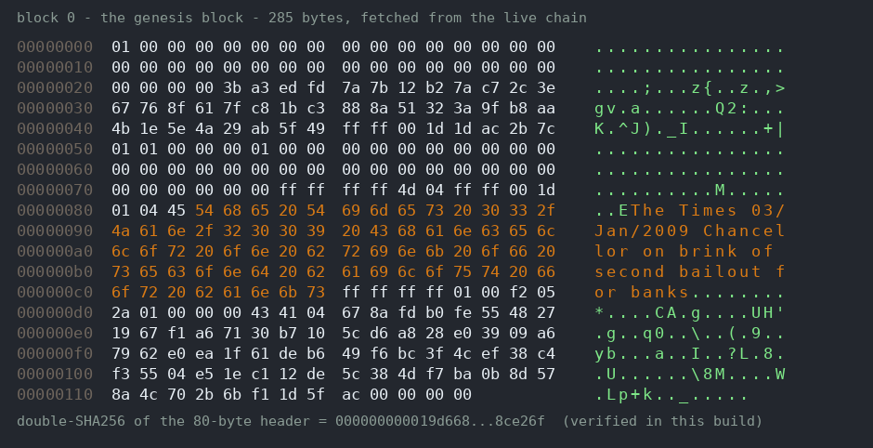
A newspaper headline carved into block zero
₿
Recorded: 3 January 2009
3 January 2009 · block 0 of the Bitcoin chain · Satoshi Nakamoto
On 3 January 2009 Satoshi Nakamoto mined the first Bitcoin block, called block 0.
He typed a headline into the block's script: The Times, 3 January 2009, Chancellor on brink of second bailout for banks.
The headline proves the block was not made earlier, and it records the banking crisis that Bitcoin answers; the next code slide reads those 69 bytes.
Block 0 is a dated receipt and a message at once, and anyone can read it on a block explorer today.
Block 0 hex dump - Yusuf Altunel, CC BY 4.0
READ Genesis block coinbase (tx)
mempool.space
7 / 76
Notes:
Tell this one as a story. Point at the hex dump and at the source link; anyone can open this block today. Ask why a newspaper headline proves a date. A common mistake is to read it as a message to the public; it is a timestamp for the future.

Slide 8
The headline inside block zero
₿
Reading the first block's script as bytes
1
Result: the 77 bytes of block 0's script
raw = bytes.fromhex(COINBASE_HEX)
head, text = raw[:8], raw[8:].decode()
The first block keeps a short script, and the headline sits at its end.
Part of the script | Bytes
Pushes (hex 04ffff00)... | 8
The headline text | 69
Whole script | 77
2
sizes = [len(head), len(text)]
sizes
sizes → [8, 69]
Eight bytes of pushes come first; the rest is the newspaper headline.
It reads: The Times 03/Jan/2009 Chancellor on brink of second bailout for banks.
run under Python 3.14.6 - the chapter library of the page supplies the helper functions
The first block carries its own date: a newspaper headline
8 / 76
Notes:
The code cuts the first block's script into eight bytes of pushes and the text. Point at the result [8, 69] and at the headline in the box beside it. Ask where 77 comes from: eight plus sixty-nine. Students often forget that bytes become text only after decode.

Slide 9

The first person ever paid in bitcoin
₿
Satoshi Nakamoto, and the cryptographer who ran the code
12 January 2009 · block 170 · Satoshi Nakamoto and Hal Finney
Nine days after block 0, Satoshi Nakamoto sent 10 bitcoin to the cryptographer Hal Finney in block 170, the first payment between two people.
Finney had answered the white paper with curiosity and had built the first reusable proof-of-work system years before.
He ran the software and wrote ‘Running bitcoin’; the coins reached him directly, with no bank in between.
The first payment already shows the whole idea: two people, one shared ledger and no bank between them.
Hal Finney, 1972 - Daily News-Post, public domain
READ Satoshi to Finney, block 170 (tx)
mempool.space
9 / 76
Notes:
Two people, one shared ledger, no bank. Point at the photograph of Hal Finney and at block 170 in the link. Ask why the first payment went to a cryptographer. A common mistake is to call Finney the first miner; he ran the software and received the coins.

Slide 10
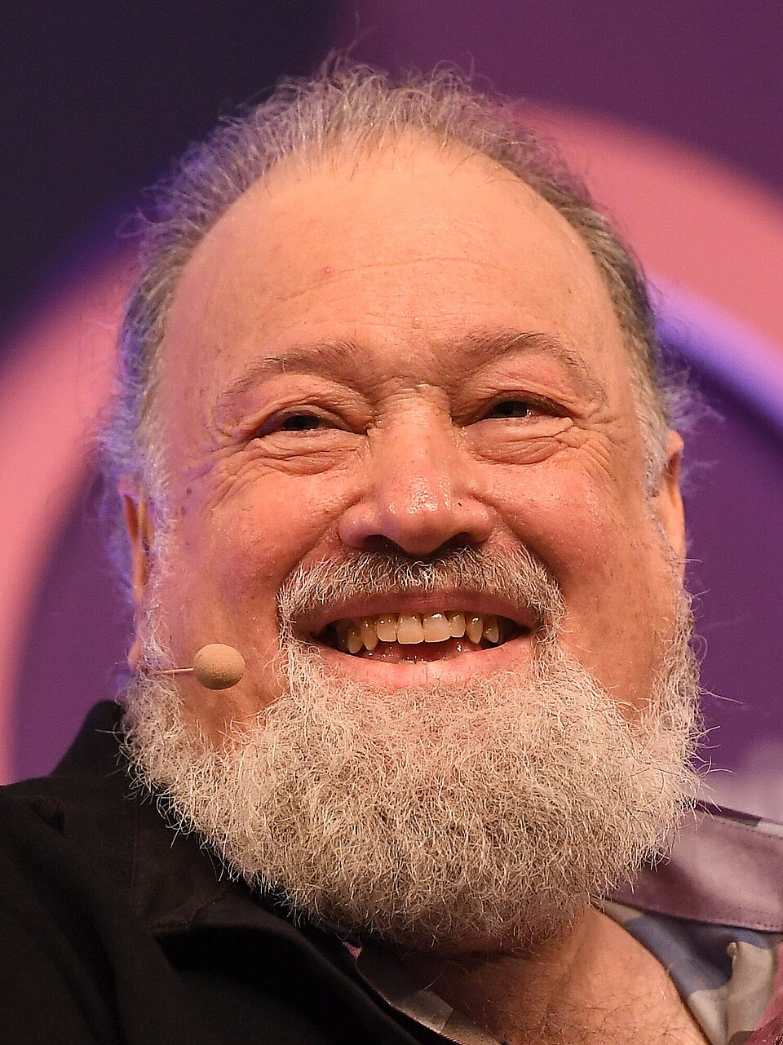
Forty years of failed digital money
₿
Every part existed before Bitcoin combined them
1982 to 2008 · papers and mailing lists · Chaum, Back, Dai and Szabo
Between 1982 and 1998 David Chaum, Adam Back, Wei Dai and Nick Szabo each built a part of digital money.
Their systems failed or stayed unbuilt, because none could agree on one history without a trusted leader.
Satoshi Nakamoto's white paper of 31 October 2008 cites them and adds proof of work as the voting weight of an open network.
Bitcoin was less a new invention than a new combination of four near misses.
David Chaum, 2018 - Harry Murphy, CC BY 2.0
READ Bitcoin white paper (PDF)
bitcoin.org
10 / 76
Notes:
Four names, four parts, forty years. Point at the photograph of David Chaum and ask which part each person built. A common mistake is to say Bitcoin invented digital cash; the white paper cites these systems and adds proof of work.

Slide 11
Four near misses, one combination
₿
Each part existed before Bitcoin joined them
1982
1997
1998
2008
2009
Chaum: ecash
Back: Hashcash
Dai, Szabo: b-money, bit gold
Nakamoto: the whitepaper
The genesis block runs
DigiCash went bankrupt; b-money and bit gold were never built.
Agreement without a leader was the missing piece.
The pieces were old; the combination was new
11 / 76
Notes:
Read the timeline from 1982 to 2009 and stop at each name. Ask what the four near misses had in common. None could agree on one history without a leader. Students often mix up the dates, so point at 1982, 1997, 1998 and 2008.

Slide 12
Money and price
Money is a ledger of who owns what; Bitcoin keeps that ledger in public.
What money was
Units and supply
Price and exchange
Stones, coins, notes and bank balances are all ledgers.
One coin divides into 100 million satoshis; the cap is 21 million.
Markets set the price; exchanges and ATMs convert it.
Think of a scoreboard that everyone agrees to trust.
Think of a market stall whose prices change by the hour.
Think of a cake cut into a hundred million crumbs.
Origins | Money | Network | Wallets | First use | Basics
12 / 76
Notes:
Money is a ledger of who owns what, and Bitcoin keeps that ledger in public. Read the three beats: what money was, units and supply, price and exchange. Ask what a scoreboard and a bank balance have in common. Both work only because everyone trusts the record.

Slide 13
Money and price: key concepts
₿
Each card: the meaning in a few words, then something you already know
floating exchange rate
The price of bitcoin is set by markets and moves with supply and demand.
Finding the Current Price of Bitcoin
Exchanges quote prices; a volume-weighted average gives one fair daily figure.
Think of the price of tomatoes at a stall, which moves with the harvest and the crowd.
Think of reading the board of a stock exchange instead of asking one trader.
currency exchange
A market where buyers and sellers swap bitcoin and local money, with identity checks.
Bitcoin ATM
A machine that takes cash and sends bitcoin to your phone wallet.
Think of the money-changer's booth at an airport.
Think of a vending machine that sells coins instead of snacks.
Say each idea twice: once as the meaning, once as the everyday comparison
13 / 76
Notes:
Four cards: the floating exchange rate, how a fair daily price is found, the currency exchange and the Bitcoin ATM. Ask why the tomato stall is a good comparison for price. Students often think someone sets the price; the next slides show that trades do.

Slide 14
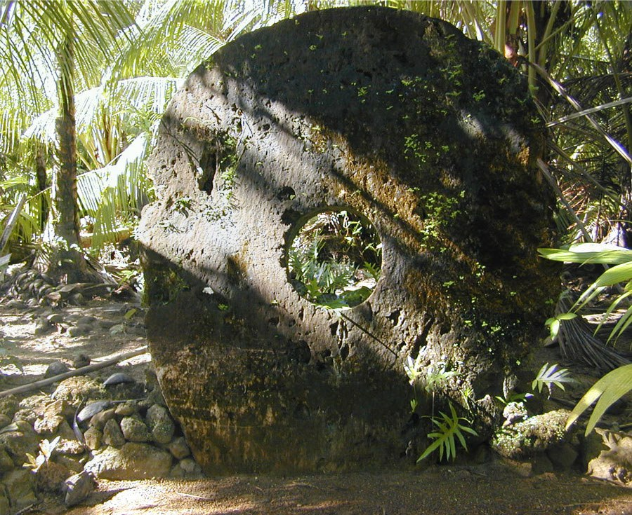
The island where money never moved
₿
Documented in 1903; the free ebook edition came in 2024
1903 · Yap, Micronesia · William Henry Furness III
On the island of Yap, wealth was held in limestone discs called rai, some four metres wide, that never moved when they changed owner.
The anthropologist William Henry Furness III described this after visiting in 1903; a stone that sank at sea was still traded.
What changed was the shared memory of who owned each stone, so the stone worked as a public ledger.
Money is whatever a community agrees to keep a record of: Yap's stones were a ledger long before Bitcoin.
Yap stone money - Eric Guinther, CC BY-SA 3.0
READ Furness: The Island of Stone Money (book)
gutenberg.org
14 / 76
Notes:
On Yap the stones stayed where they were and only the memory of ownership moved. Point at the photograph and ask what the ledger was. The shared memory of the village. A common mistake is to focus on the size of the stones instead of the record.

Slide 15
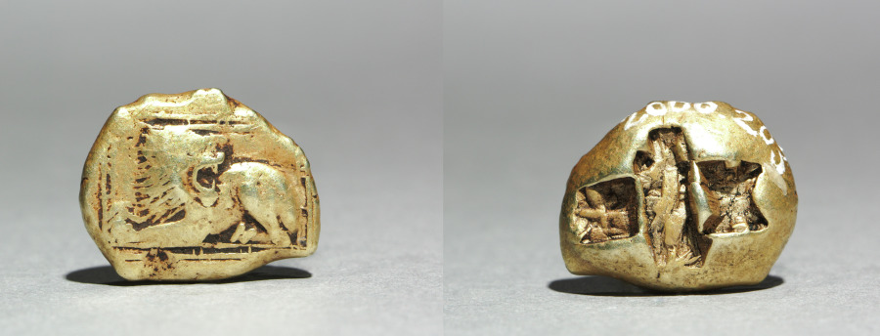
Five thousand years to digital cash
₿
From grain ledgers to pure fiat money, 3000 BCE to 1971
3000 BCE to 15 August 1971 · Mesopotamia to the United States · Richard Nixon
Grain ledgers, Lydian coins, paper notes and bank balances are all ledgers; they differ in who keeps them.
On 15 August 1971 President Richard Nixon cut the dollar's last tie to gold, leaving pure fiat money.
Cards and online banking made money digital as entries in private ledgers; Bitcoin keeps the ledger in public.
Electrum stater, 600-550 BCE - Cleveland Museum of Art, CC0
Money has always been a ledger; Bitcoin keeps it in public.
READ The History of Money (museum exhibit)
money.org
15 / 76
Notes:
Walk the timeline from grain ledgers to 15 August 1971. Point at the coin photograph and the link to the money museum. Ask who keeps the ledger in each age. The common slip is to say fiat money has no ledger; bank balances are one.

Slide 16
Traditional, digital, crypto: side by side
₿
The chapter's one table: same uses, different ledgers
 | Traditional (cash) | Digital money (bank, card, e-money) | Cryptocurrency (bitcoin)
Issued by | A central bank | Commercial banks on a central bank base | No one - issuance is in the protocol
Exists as | Paper and coin in hand | Entries in banks' private ledgers | Entries in one public ledger
Who keeps the ledger | No ledger - possession is the record | Banks and processors | Every node, together
Supply is set by | Monetary policy | Monetary policy and credit | Fixed rules anyone can verify
Settles | Hand to hand, instantly | Through intermediaries, in days | Peer to peer, in about an hour
Same uses, different ledgers: that difference is this course
16 / 76
Notes:
This is the chapter's one table. Read the first column down, then compare the three money kinds across each row. Ask who keeps the ledger in cash, and the answer is nobody; possession is the record. Students often miss that Bitcoin settles in about an hour, not instantly.

Slide 17

The internet got payments - and new gatekeepers
₿
The dot-com boom digitised paying, not cash
8 July 2002 · Palo Alto and San Jose · Levchin, Thiel and Musk
On 8 July 2002 eBay agreed to buy PayPal for 1.5 billion dollars, ending the dot-com race to pay online.
PayPal grew from Confinity (Max Levchin and Peter Thiel, 1998) and X.com (Elon Musk, 1999), which merged in 2000; Beenz and Flooz died in the 2001 crash.
Online payment was solved only as accounts on one company's private ledger; the internet still had no cash.
Paying went digital, but every payment still passed through a gatekeeper who could say no.
PayPal logo - PayPal, public domain
READ PayPal (encyclopedia article)
en.wikipedia.org
17 / 76
Notes:
Tell the PayPal story as a lesson in gatekeepers. Point at the logo and at the names Levchin, Thiel and Musk. Ask what the internet still lacked after 2002, and the answer is cash that needs no company between payer and payee. A common mistake is to think online payment equals digital cash.

Slide 18

When the money in your hand stops working
₿
Ukraine, February 2022: a state turns to an open payment network
26 February 2022 · Kyiv, Ukraine · Mykhailo Fedorov
On 26 February 2022 the government of Ukraine, through Mykhailo Fedorov's ministry of digital transformation, published crypto donation addresses.
With an aid group it raised 54.7 million dollars in about a week, and CNBC reported the total on 3 March 2022.
With war at the capital, ordinary rails were too slow; open digital money kept working where banks, cards or cash stopped.
An open network asks no permission: an address was enough to send help from anywhere.
Fedorov - U.S. Embassy Kyiv, PD
READ CNBC: Ukraine's crypto donations (news)
nbclosangeles.com
18 / 76
Notes:
A war stopped ordinary payments, and an open network kept working. Point at the photograph of Mykhailo Fedorov and the 54.7 million dollars. Ask what the donors needed to send help, and the answer is only an address. Check the CNBC source together; do not repeat figures from memory.

Slide 19
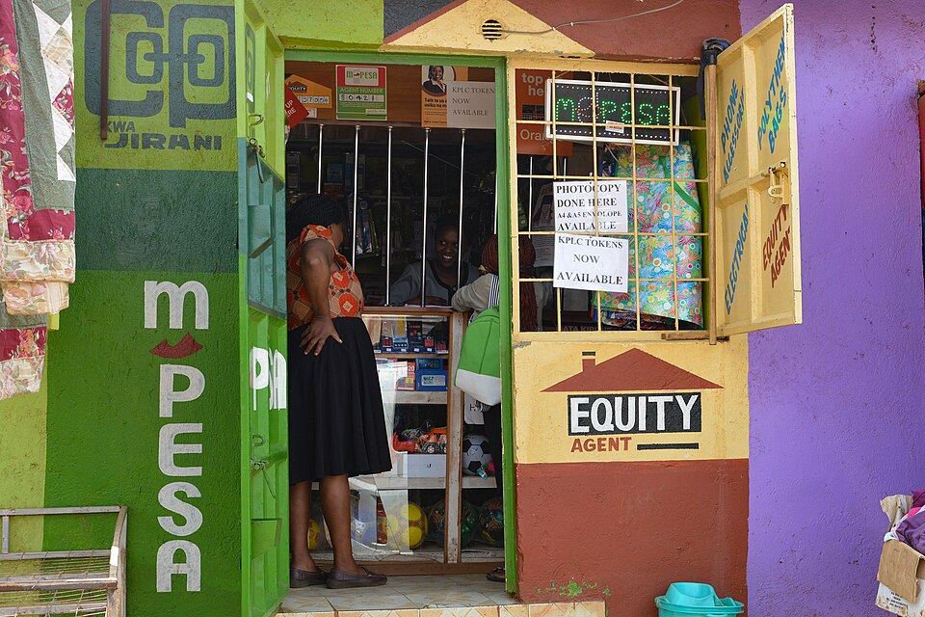
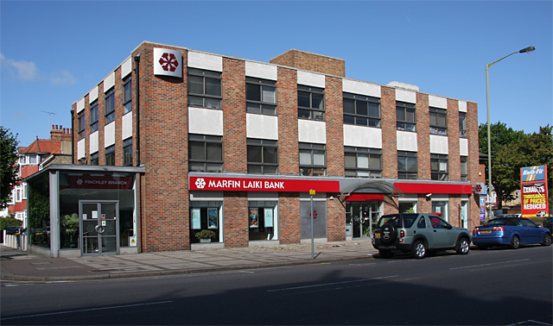
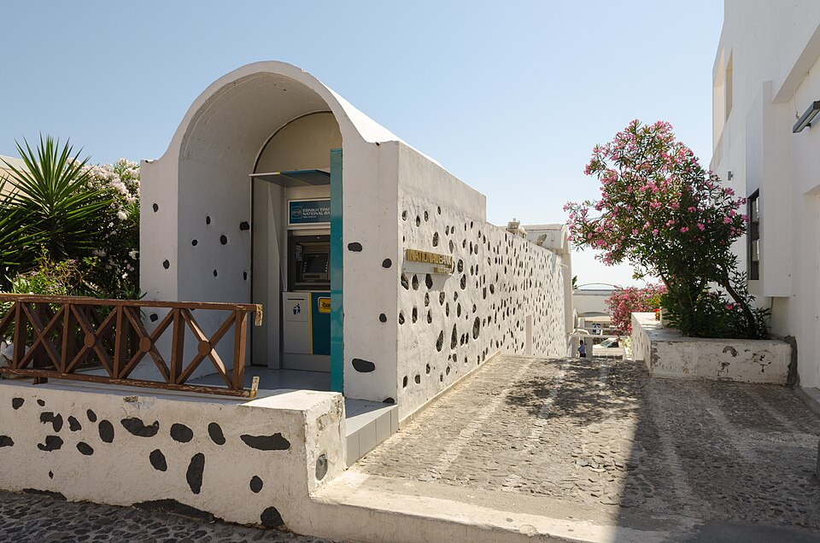
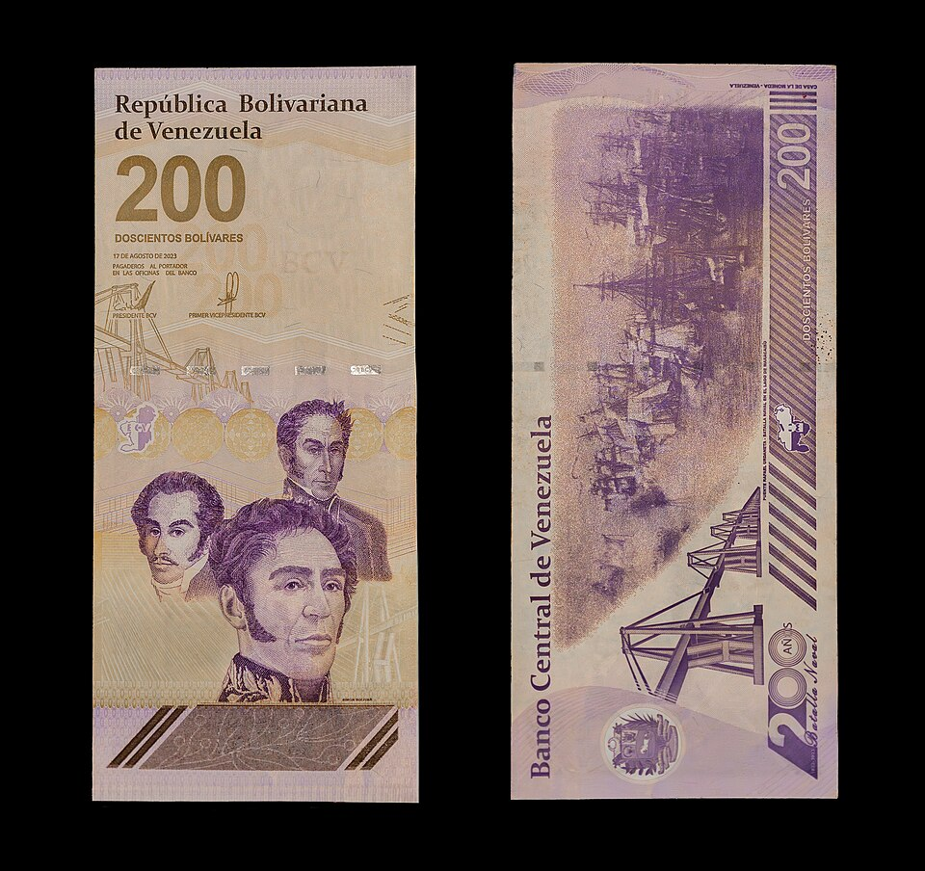

When the money in your hand stops working
₿
Five documented cases, five links; no hypotheticals
Kenya: Fiona Graham / WorldRemit, CC BY-SA 2.0
Cyprus: Martin Addison, CC BY-SA 2.0
Greece: Norbert Nagel, CC BY-SA 3.0
Venezuela: Rjcastillo, CC BY-SA 4.0
Ukraine: U.S. Embassy Kyiv, public domain
Kenya 2007
No banks for most adults - M-Pesa made phones the payment rail
Source: en.wikipedia.org
Cyprus 2013
Banks shut for days; a levy took part of deposits overnight
Source: en.wikipedia.org
Greece 2015
Capital controls: ATM withdrawals capped at 60 euros a day
Source: en.wikipedia.org
Venezuela 2018
Hyperinflation beyond 1,000,000% - wages melted in hours
Source: en.wikipedia.org
Ukraine 2022
State and NGO raised $54.7M in crypto in a week
Source: nbclosangeles.com
Crisis or war, banked or not: the need is documented
19 / 76
Notes:
Five documented cases, each with its own link: Kenya, Cyprus, Greece, Venezuela and Ukraine. Point at one photograph per case. Ask which case is about trust in banks and which about access. A common mistake is to treat these as hypotheticals; every one is sourced.

Slide 20
A bitcoin counted in satoshis
₿
The unit and its smallest piece
1
Result: the same value in three units
from decimal import Decimal
sats = int(Decimal('0.001') * COIN)
A bitcoin is counted in whole satoshis, one hundred million to the coin.
Unit | In satoshis
1 bitcoin | 100,000,000
1 millibitcoin (0.001) | 100,000
1 satoshi | 1
2
units = [COIN, COIN // 1000, 1]
units
units → [100000000, 100000, 1]
Three common amounts, each written as a count of satoshis.
0.001 bitcoin is exactly 100,000 satoshis, so every amount is a whole number.
run under Python 3.14.6 - the chapter library of the page supplies the helper functions
Money here is counting, and the units are exact
20 / 76
Notes:
A bitcoin is counted in whole satoshis, a hundred million to the coin. Point at the result [100000000, 100000, 1] and at the exact conversion of 0.001. Ask why exact whole numbers matter for money. Floating-point decimals would drift; students often type 0.001 as a float.

Slide 21
The subsidy at five block heights
₿
New bitcoin per block, halved every 210,000 blocks
1
Result: subsidy in bitcoin, by halving year
heights = [0, 210000, 420000, 630000, 840000]
subs = [subsidy(h) for h in heights]
The subsidy starts at fifty bitcoin and halves every 210,000 blocks.
2
ratios = [a / b for a, b in zip(subs, subs[1:])]
subs
subs → [50.0, 25.0, 12.5, 6.25, 3.125]
Each era pays exactly half of the era before it.
run under Python 3.14.6 - the chapter library of the page supplies the helper functions
Each era pays half of the one before: 50, 25, 12.5, 6.25, and since April 2024 3.125.
Every halving cuts new issuance in half
21 / 76
Notes:
The subsidy halves every 210,000 blocks. Point at the five heights and at the result 50, 25, 12.5, 6.25, 3.125. Ask what the next value is, and the answer is half of 3.125. Students often think halving happens by date; it happens by block height.

Slide 22
The 21 million cap is a sum
₿
Issuance by era, added up by the code
1
Result: bitcoin issued after each era, in millions
eras = [(50 * COIN >> k) * HALVING for k in range(33)]
Each era issues its subsidy for 210,000 blocks, then the subsidy halves.
2
cap = sum(eras) / COIN
cap
cap → 20999999.9769
Adding every era gives the cap, just under 21 million bitcoin.
run under Python 3.14.6 - the chapter library of the page supplies the helper functions
The total creeps toward 21 million; the cap is 20999999.9769 bitcoin.
Scarcity is arithmetic that every node can re-run
22 / 76
Notes:
The cap is arithmetic, not a promise. Point at the one-line sum over 33 eras and at the result, just under 21 million. Ask why it is not exactly 21 million. Each era drops fractions below one satoshi, so the total ends at 20,999,999.9769.

Slide 23
A central bank's jobs, done by rules
₿
Who issues the money, who settles payments, what keeps its value steady
Job | A central bank and a clearing house | Bitcoin | What changes
Create the money | A board decides how much is issued | The block subsidy halves every 210,000 blocks; the cap is just under 21 million | A rule anyone can read replaces a decision
Settle payments | A clearing house confirms and records each payment | Every node checks every payment; miners settle them in blocks | Many keepers replace one
Hold value steady | Supply is adjusted to the economy | Supply is fixed by rule; the book calls the currency deflationary over the long term | Predictable supply, no discretion
▪ Mining takes over the issuing and clearing work of a central bank, so no central bank is needed for the currency to work.
▪ Deflationary means issuance shrinks and ends: it describes the supply, and it does not promise that the price rises.
▪ Think of a recipe printed on the packet instead of a chef who changes it every day.
Rules every node checks replace three institutions' jobs
23 / 76
Notes:
A central bank decides how much money exists and a clearing house settles payments; Bitcoin does both by rule. Point at the three rows. Ask which institution each row replaces. Deflationary is a tendency of a fixed supply, not a promise of rising prices.

Slide 24
Where a price comes from
₿
Buyers below, sellers above: a trade happens where they meet
Buyers: bitcoin wanted
dollars
Sellers: bitcoin offered
▪ Buyers queue below the market and sellers above it; a trade happens only where a bid reaches an ask.
62,400
0.7
62,300
1.6
▪ Here the best bid is 62,000 and the best ask 62,100, so nothing trades until one side moves.
62,200
2.3
62,100
1.1
no trade yet
▪ The last trade becomes the quoted price, which is why the price floats with the crowd.
1.8
62,000
0.9
61,900
▪ An exchange quotes such a price; a Bitcoin ATM adds a margin. Think of a money-changer's board.
2.1
61,800
1.4
61,700
Toy numbers for illustration, in bitcoin per price level.
A price is the last place a buyer and a seller agreed
24 / 76
Notes:
A price is where a buyer and a seller meet. Point at the gap between the highest bid and the lowest ask in the toy book. Ask what happens when a buyer raises the bid to the ask, and the answer is a trade, and that trade becomes the last price. The numbers are illustrative.

Slide 25
No one sets the price: trades do
₿
A price is a ratio; a day's figure is a weighted average
1
Result: dollars paid per bitcoin
trades = [(0.5, 31000), (0.2, 12600), (1.0, 63100)]
prices = [round(u / b, 2) for b, u in trades]
Trade | Dollars per bitcoin
Trade 1 (0.5 BTC) | 62,000
Trade 2 (0.2 BTC) | 63,000
Trade 3 (1.0 BTC) | 63,100
Day average, by volume | 62,764.71
Three illustrative trades: bitcoin bought, and the dollars paid for it.
2
avg = round(vwap([(b, u / b) for b, u in trades]), 2)
avg
avg → 62764.71
The day's single figure weights each price by its volume.
Each trade sets its own price; the volume-weighted day average is 62,764.71 dollars.
run under Python 3.14.6 - the chapter library of the page supplies the helper functions
Everyone who trades sets the price a little
25 / 76
Notes:
A price is a ratio, and a day's figure is a weighted average. Point at the three trades and the result 62,764.71. Ask why a plain average would mislead. The big trade of one bitcoin should count more than the small one of 0.2.

Slide 26

Two pizzas for ten thousand bitcoin
₿
22 May 2010: the day a price began to exist
22 May 2010 · Jacksonville, Florida · Laszlo Hanyecz
On 22 May 2010 Laszlo Hanyecz paid 10,000 bitcoin for two Papa John's pizzas, the first known commercial purchase in bitcoin.
He had offered the coins on the bitcointalk forum, and the student Jeremy Sturdivant ordered the pizzas for delivery to Jacksonville.
Until then nobody knew what a bitcoin was worth; this purchase is the day a floating price began to exist.
A price is only what two people agree on once; the next slide reprices those coins at six later moments.
Papa John's plaque - Sanjev Rajaram, CC0
READ Guinness: first Bitcoin purchase (record)
guinnessworldrecords.com
26 / 76
Notes:
The first purchase made a price exist. Point at the plaque photograph and the Guinness link. Ask what Hanyecz needed to know before he could set a price, and the answer is nothing yet existed to compare with. A common mistake is to say the pizzas were worth a lot; the point is the first price.

Slide 27
The Pizza Day coins, repriced
₿
10,000 bitcoin at six documented moments
1
Result: value of the 10,000 BTC, in dollars (log axis)
coins = 10000
val = {d: int(coins * p) for d, p in PIZZA.items()}
Ten thousand bitcoin, priced at six documented moments.
2
list(val.values())
The dollar value of the same coins at each moment, from 2010 to 2026.
run under Python 3.14.6 - the chapter library of the page supplies the helper functions
The same coins grew by a factor of 20,831,463, from $41 to $854M.
list(val.values()) → [41, 10000, 10000000, 196000000, 690000000, 854090000]
From 41 dollars to 854 million: price discovery never stopped
27 / 76
Notes:
The same ten thousand coins at six moments, drawn on a log axis. Point at the first bar, 41 dollars, and the last. Ask why a log axis is used. The values span seven orders of magnitude; on a plain axis the early bars would vanish.

Slide 28
The network
No bank sits in the middle: shared rules and shared work do its job.
Peers, not a bank
Work and agreement
Fees and depth
Every node checks the same rules, so none is in charge.
Proof of work makes honest history cheap to check.
Fees pay miners; each new block makes a payment safer.
Think of neighbours who all keep a copy of the land register.
Think of a lock that took a day to make and a second to inspect.
Think of a courier's tip and cement poured over a footprint.
Origins | Money | Network | Wallets | First use | Basics
28 / 76
Notes:
No bank sits in the middle: shared rules and shared work do its job. Read the three beats. Ask what neighbours who all keep a land register have in common with nodes, and the answer is each can check the others. A common mistake is to think a node is a server owned by Bitcoin.

Slide 29
A bank in the middle against peers
₿
Decentralisation is an architecture, not a slogan
Centralised: one ledger-keeper
Bitcoin: every node checks every rule
Bank
Remove any one node and the network still agrees
29 / 76
Notes:
Compare the bank in the middle with peers. Point at the single ledger-keeper on the left and at the ring of nodes on the right. Ask what happens if one node disappears, and the answer is nothing; the network still agrees. Decentralisation here is an architecture, not a slogan.

Slide 30
The network: key concepts (1 of 2)
₿
Each card: the meaning in a few words, then something you already know
proof of work
Adding a block costs real computation, and anyone can check it cheaply.
consensus
Every node applies the same rules, so all agree on one history without a leader.
double-spend
Spending one unit of digital money twice; the network refuses the second try.
Think of a jigsaw puzzle: hard to solve, a glance to see it is done.
Think of neighbours who all keep the same record of who owns which field.
Think of photocopying a banknote and paying with both.
Say each idea twice: once as the meaning, once as the everyday comparison
30 / 76
Notes:
Three cards: proof of work, consensus and the double-spend. Read the jigsaw, the neighbours and the photocopied banknote. Ask why a hard puzzle that is easy to check is useful. Students often think proof of work solves something useful; its value is the cost.

Slide 31
Hard to find, easy to check
₿
A toy proof of work with hexadecimal zeros
1
Result: guesses needed (log axis)
data = b'alice pays bob 1'
tries = [mine(data, z)[0] + 1 for z in (1, 2, 3, 4)]
Search for a number that gives a hash starting with zeros.
2
n, d = mine(data, 4)
check = hashlib.sha256(data + b'%d' % n).hexdigest()
Anyone checks the winner with one hash instead of a long search.
3
tries
tries → [9, 223, 1208, 57247]
The last line shows how many guesses each difficulty took.
run under Python 3.14.6 - the chapter library of the page supplies the helper functions
Each extra zero makes the search about sixteen times longer on average; checking stays one hash.
Finding takes thousands of guesses; checking takes one hash
31 / 76
Notes:
A toy proof of work with hexadecimal zeros. Point at the result [9, 223, 1208, 57247]: each extra zero costs about sixteen times more guesses. Ask how many guesses checking needs, and the answer is one hash. Students often expect the search to be exactly sixteen times longer; it is an average.

Slide 32

Mining pays for honesty
₿
New coin and fees reward the work that secures the chain
Transactions
wait in the mempool
Miners
spend energy on proof-of-work
Block found
~every 10 minutes
Reward
subsidy + fees
The subsidy follows the halving chart
Cheating costs more than it could win
Chapter 12 opens the mechanism
from the owner's 2025 deck
Security is bought with energy and paid in bitcoin
32 / 76
Notes:
Mining pays for honesty. Follow the arrows from transactions waiting in the mempool to miners, a block about every ten minutes, and the reward. Ask why cheating costs more than it could win. Honest blocks pay in bitcoin; a rewrite spends energy for nothing.

Slide 33
Keeping blocks ten minutes apart
₿
Difficulty adjustment, every 2016 blocks
2016 blocks have been found
Compare the time they took with two weeks
Set the next target to hold ten minutes
Blocks came faster than ten minutes
More computing power joined. The next target is harder: more leading zeros are needed, so each search takes longer.
Blocks came slower than ten minutes
Computing power left. The next target is easier, so blocks come faster again.
One step changes the difficulty by at most a factor of four, up or down.
▪ The difficulty is adjusted every 2016 blocks so that, on average, one block is found every ten minutes whatever the total computing power.
▪ In the toy proof of work each extra zero costs about sixteen times more guesses; the real network turns the same dial.
▪ Think of a thermostat: it holds the room at the set temperature whoever lights the fire.
The network turns its own difficulty dial to hold the pace
33 / 76
Notes:
Difficulty adjustment keeps blocks near ten minutes whatever the total computing power. Point at the two cases: blocks too fast, target gets harder; too slow, easier. Ask why it needs 2016 blocks of evidence. One block is luck; two weeks of blocks are a measurement.

Slide 34
Why digital money had to wait
₿
The copy problem: a digital coin is a file
1
Make money digital and it becomes a file
perfect copy
copy 1
> Shop A
₿
2
Files copy perfectly, so coins would too
a coin,
as a file
3
Both copies get spent: the double-spend
₿
Only a trusted central ledger could stop it
copy 2
> Shop B
4
₿
both shops see valid money - the same money
A file can be copied; a coin must not be
34 / 76
Notes:
A digital coin is a file, and files copy perfectly. Walk the three steps down the left, then the picture on the right where one coin reaches two shops. Ask what stopped this before Bitcoin, and the answer is a trusted central ledger. The mistake is to think encryption alone prevents copying.

Slide 35
The double-spend, solved in public
₿
One shared ledger, one agreed order, no referee
1
Every payment is broadcast to every node
pay Bob - seen first
into the block ✓
2
Nodes agree on one order for all payments
Alice's
coin
3
The first spend of a coin enters the block
₿
4
The second is refused by every node
pay Carol - same coin
refused by every node ✗
every node hears both; the shared ledger keeps only one order
Agreement on order is what removes the referee
35 / 76
Notes:
The double-spend is solved in public. Follow the numbered steps: every node hears both payments, they agree on one order, the first enters the block and the second is refused. Ask who plays referee. Nobody; the shared order does it.

Slide 36
A double spend is refused
₿
One shared ledger, one rule, no referee
1
Result: two payments of the same coin
book = Ledger({'c1': 'alice'})
first = book.pay('c1', 'bob')
A shared ledger remembers which coins are spent.
Step | Ledger answer
1. Alice pays Bob | accepted
2. Alice pays Carol | refused
Owner of coin c1 | bob
2
second = book.pay('c1', 'carol')
book.owner
book.owner → {'c1': 'bob'}
Alice offers the same coin again; the rule says no, with no referee.
run under Python 3.14.6 - the chapter library of the page supplies the helper functions
The first spend is recorded; the same coin offered again is refused by the rule alone.
The second spend of a coin is refused everywhere
36 / 76
Notes:
One shared ledger, one rule. Point at the second pay call and at the result {'c1': 'bob'}: Carol never receives the coin. Ask what would happen without the rule, and the answer is both shops would see valid money. Students often expect an error message; the refusal is silent in this toy.

Slide 37
A chain that notices tampering
₿
Each block hashes its text with the block before
1
Result: does each block's link still hold?
blocks = chain(['pay A', 'pay B', 'pay C'])
before = verify(blocks)
Three blocks, each hashing its own text together with the block before.
Block | Before | After the change
Block 1 | holds | holds
Block 2 | holds | broken
Block 3 | holds | not trusted
2
blocks[1]['text'] = 'pay Z'
after = verify(blocks)
after
after → 1
Changing block two breaks its link, so block two and everything after it are no longer trusted.
Change one word in block two; the check stops there.
run under Python 3.14.6 - the chapter library of the page supplies the helper functions
Change one old block and every later link fails
37 / 76
Notes:
Each block hashes its text with the block before. Point at the change to block two and at the result 1. Ask which blocks are no longer trusted, and the answer is block two and everything after it. Students often think only the changed block fails.

Slide 38
A chain of dated blocks
₿
Each block carries a time and the fingerprint of the block before
Block n − 1
Block n
Block n + 1
timestamp: when it was found
timestamp: when it was found
timestamp: when it was found
a list of transactions
a list of transactions
a list of transactions
fingerprint of the block before
fingerprint of the block before
fingerprint of the block before
Edit block n: its fingerprint changes and every later link breaks.
▪ The blockchain is the list of validated blocks, each linking to the one before it back to block 0; the timestamps place the transactions in an agreed order.
▪ A timestamp orders blocks but does not make their content true; the checks of every node do that.
▪ Think of a book whose every page ends with a seal of the page before: tearing one page out shows at the next seal.
Edit one old block and every later link breaks
38 / 76
Notes:
A block holds a time and transactions, and carries the fingerprint of the block before. Point at the arrows that run backwards. Ask what happens when an old block is edited, and the answer is its fingerprint changes and every later link fails. A timestamp orders blocks; it does not make them true.

Slide 39
The network: key concepts (2 of 2)
₿
Each card: the meaning in a few words, then something you already know
confirmation
Each block added after a payment makes the payment harder to reverse.
transaction fee
The amount a sender adds for the miner who puts the payment in a block.
Think of another layer of cement poured over a footprint.
Think of a tip for the courier who picks your parcel for the next van.
Say each idea twice: once as the meaning, once as the everyday comparison
39 / 76
Notes:
Two cards: confirmation and transaction fee. Read the cement comparison and the tip for the courier. Ask why a payment is not final the moment it is seen, and the answer is a later block could still replace it. Common mistake: confusing the fee with the amount paid to the receiver.

Slide 40
Confirmations pile up like layers
₿
Why a payment gets safer with every block built on top
6
confirm.
About an hour
Six confirmations at ten minutes a block is the usual wait for a larger amount.
5
confirm.
4
confirm.
3
confirm.
2
confirm.
1
confirm.
block found
+1 block
+2 blocks
+3 blocks
+4 blocks
+5 blocks
▪ A payment is confirmed once when its block is found; every block built on top adds one more confirmation.
▪ To reverse it, someone must redo that block and every block after it faster than the honest network adds new ones.
▪ Card payments, bank transfers and other electronic payments can be reversed; a Bitcoin transaction practically cannot.
▪ Think of cement poured in layers over a footprint: after enough layers the print is there for good.
Irreversible means ever costlier to reverse
40 / 76
Notes:
Each block built on top adds another confirmation. Point at the staircase and at six confirmations, about an hour. Ask whether a payment is ever one hundred percent final, and the answer is it is only more and more costly to reverse. Irreversible here means practically, not magically.

Slide 41
What the outputs leave over is the fee
₿
A transaction has no fee field; the difference is the fee
1
Result: where the 100,000 satoshis go
inputs = [100000]
outputs = [20000, 75000]
One coin of 100,000 satoshis pays Bob and sends the change back.
2
fee = sum(inputs) - sum(outputs)
share = round(100 * fee / sum(inputs), 1)
fee
fee → 5000
Whatever the outputs do not take goes to the miner as the fee.
run under Python 3.14.6 - the chapter library of the page supplies the helper functions
The fee is 5,000 satoshis, 5.0 percent of the coin; no output carries it.
The fee is the part of the coin nobody was given
41 / 76
Notes:
A transaction has no fee field. Point at the two outputs, 20,000 and 75,000, and at the result 5,000. Ask where a miner finds the fee, and the answer is it is whatever the outputs leave over. A forgotten change output turns into an expensive gift.

Slide 42
Wallets and keys
A wallet holds keys, not coins, like a ring of keys to many safes.
Kinds of wallet
Nodes and clients
Keys and backup
Desktop, mobile, web and hardware wallets differ in risk.
A full node checks everything; a light client trusts others.
Whoever holds the keys controls the coins; a recovery code restores them.
Think of a pocket, a safe and a cloakroom ticket.
Think of an auditor beside a tourist with a map.
Think of a spare key kept in a bank locker.
Origins | Money | Network | Wallets | First use | Basics
42 / 76
Notes:
A wallet holds keys, not coins, like a ring of keys to many safes. Read the three beats. Ask what a pocket, a safe and a cloakroom ticket say about risk. Students often picture coins sitting inside the app; the coins live on the chain.

Slide 43
The wallet branch, mapped
₿
Four questions about any wallet: platform, node, keys, backup
Wallet Platform
Desktop Wallet · Mobile Wallet · Web Wallet · Hardware Signing Device
Node Type
Full Node · Lightweight Client · Third Party API Client · Peer And Client
Wallet
Key Control
Noncustodial Wallet · Custodial Wallet
Backup
Recovery Code · Wallet Metadata
Four questions place any wallet on this map
43 / 76
Notes:
Four questions place any wallet: platform, node type, key control and backup. Point at the four branches. Ask a student to place the phone app they use. Students often mix up node type and key control; they are independent choices.

Slide 44
Wallets and keys: key concepts (1 of 4)
₿
Each card: the meaning in a few words, then something you already know
Getting Started
The first decisions: what a wallet is and which one to choose.
Choosing a Bitcoin Wallet
Pick a wallet by who holds the keys, which device it runs on, and how far you trust it.
Think of choosing a bag before you go shopping.
Think of choosing between a pocket, a home safe and a bank locker.
Types of Bitcoin wallets
Desktop, mobile, web and hardware signing devices, each with its own trade-offs.
desktop wallet
The first kind of wallet, run on Windows, macOS or Linux.
Think of a bicycle, a car and a bus: all travel, with different limits.
Think of the cash register on the shop counter.
Say each idea twice: once as the meaning, once as the everyday comparison
44 / 76
Notes:
Three cards: getting started, choosing a wallet and the types of wallet, plus the desktop wallet. Read the bag, pocket and bicycle comparisons. Ask what makes one kind riskier. Who holds the keys and where the device runs.

Slide 45
Wallets and keys: key concepts (2 of 4)
₿
Each card: the meaning in a few words, then something you already know
mobile wallet
The most common kind of wallet, run on a smartphone.
web wallet
Used through a browser; its data usually sits on someone else's server.
Think of the purse in your pocket.
Think of leaving your coat at a cloakroom.
hardware signing device
A small device that keeps keys inside and signs payments.
third-party API client
A program that asks a remote service for data instead of the Bitcoin network.
Think of a stamp kept in a locked drawer: paper goes in, stamped paper comes out.
Think of asking a travel agent instead of reading the timetable yourself.
Say each idea twice: once as the meaning, once as the everyday comparison
45 / 76
Notes:
Four more kinds: mobile, web, hardware signing device and third-party API client. Ask which one is the cloakroom. The web wallet. A common mistake is to think a hardware wallet stores coins; it keeps keys and signs.

Slide 46
Five kinds of wallet compared
₿
Where the keys live and what can go wrong
Kind | Where the keys live | Main risk | Think of
Desktop wallet | On your computer's disk | Malware on that computer | The cash register on the shop counter
Mobile wallet | On your phone | A lost or stolen phone with no backup | The purse in your pocket
Web wallet | On someone else's server | The host is hacked, fails or freezes you out | Your coat at the cloakroom
Hardware signing device | Inside a small dedicated device | Losing the device with no recovery code | A stamp kept in a locked drawer
Third-party API client | In your client; the facts come from a remote service | The service sees your questions and may be wrong | A travel agent instead of the timetable
▪ Choose by who holds the keys and where the device runs.
The kind of wallet decides who can lose or lock the keys
46 / 76
Notes:
Five kinds of wallet side by side. Read across a row: where the keys live, the main risk, the everyday comparison. Ask which row suits a small daily amount and which a large savings. A common mistake is to think a hardware wallet holds coins.

Slide 47
Wallets and keys: key concepts (3 of 4)
₿
Each card: the meaning in a few words, then something you already know
full node
Software that checks the whole history of transactions by itself.
lightweight client
Keeps your keys but relies on other nodes for most of the data.
Think of an auditor who rereads every page of the ledger.
Think of a tourist who asks locals for directions instead of studying the whole map.
Full node versus Lightweight
Independence and storage on one side, convenience and trust on the other.
Who controls the keys
Whoever holds the private keys controls the coins.
Think of cooking from raw ingredients against buying a ready meal.
Think of whoever holds the house keys controls the house.
Say each idea twice: once as the meaning, once as the everyday comparison
47 / 76
Notes:
Full node, lightweight client, the comparison between them and who controls the keys. Ask who rereads every page of the ledger. The full node. Point at the last card: whoever holds the keys controls the coins.

Slide 48
Full node or lightweight client?
₿
Independence on one side, convenience on the other
Full node
Lightweight client
▪ Downloads every block and checks every rule itself.
▪ Keeps your keys but asks other nodes for most of the data.
▪ Needs the most storage and time.
▪ Needs little storage and starts fast.
▪ Trusts nobody for the facts.
▪ Trusts the nodes it asks, and may reveal which addresses it watches.
Every node is a peer of the others; a lightweight wallet is a client of one or a few of them.
▪ The choice trades independence and storage on one side for convenience and trust on the other.
▪ Think of cooking from raw ingredients against buying a ready meal: you can check the first, and you must trust the second.
Checking for yourself costs storage; asking others costs trust
48 / 76
Notes:
A full node checks every rule itself; a lightweight client trusts the nodes it asks. Point at the trust row. Ask what you give up for convenience, and the answer is independence and some privacy. Students often think a lightweight wallet has no keys; it keeps them.

Slide 49
Your key is your deed
₿
With a house the key opens and the registry proves; in Bitcoin the key does both
your house, your car
your bitcoin
One key opens it. Lose the key, lose access. But the deed, the registry, still names you.
The key IS the deed. Signing with it is the only proof of ownership there is.
Bitcoin's trick: a signature proves you hold the key while the key stays secret
Prove you hold the key; never reveal it
49 / 76
Notes:
With a house the key opens and the registry proves; in Bitcoin the key does both. Point at the two columns and at the word deed. Ask what proof of ownership exists beyond the key, and the answer is none. A signature proves you hold the key while the key stays secret.

Slide 50
Whoever holds the keys holds the coins
₿
The one wallet decision that matters most
Full control
Third-party control
You keep the keys
You sign; nobody can freeze
Backup is your job
A service keeps the keys
Convenient, custodial
You trust their honesty and uptime
desktop
mobile
web
hardware
Custody is the first security decision you make
50 / 76
Notes:
Custody is the first security decision. Compare full control with third-party control and point at the four device icons. Ask who can freeze coins in each column, and the answer is only the service in the right one. Students underestimate that backup becomes their own job.

Slide 51

The exchange that lost everyone's coins
₿
Tokyo, February 2014: balances on a website, keys elsewhere
28 February 2014 · Tokyo, Japan · Mark Karpeles
On 28 February 2014 Mt. Gox of Tokyo, led by Mark Karpeles, filed for bankruptcy at the Tokyo District Court and admitted that about 850,000 bitcoin were gone.
Customers had balances on a website, but the keys, and so the coins, were in someone else's hands all along.
Creditors were still being repaid a decade later.
Not your keys, not your coins: a balance on someone else's website is a promise, not a coin.
Mt. Gox logo - author unknown, public domain
READ Mt.Gox filing statement, TechCrunch (news)
techcrunch.com
51 / 76
Notes:
Tell the Mt. Gox story with the date. Point at the logo and at the Tokyo District Court link. Ask where the keys were, and the answer is in the exchange's hands, not the customers'. A common mistake is to say the bitcoin were hacked on the blockchain; the loss was custody.

Slide 52
Where a wallet gets attacked
₿
Two threats the chapter names, and three habits that blunt them
Phishing
Malware
Three habits that help
A fake site, message or app pretends to be your wallet and asks you for the recovery code.
A harmful program on your device reads the wallet data or swaps the address you paste.
Never type the recovery code into a website. Install wallets from the official page. Check the address on a screen you trust.
A wallet that asks for the recovery code at an unexpected time is a warning sign.
▪ Phishing attacks the person, malware attacks the device; the defence for the first is a habit and for the second a trusted source.
▪ The fake wallet application is the chapter's own example of malware.
▪ Think of a forged letter from your bank for phishing, and of a pickpocket already inside your coat for malware.
No honest wallet asks for the recovery code in a web form
52 / 76
Notes:
Two common attacks: phishing asks you for the secret, malware steals it or changes the address you paste. Point at the three defences. Ask why no honest wallet ever asks for the recovery code in a web form. Anyone who has it owns the coins.

Slide 53
Wallets and keys: key concepts (4 of 4)
₿
Each card: the meaning in a few words, then something you already know
noncustodial wallet
A wallet where only you hold the keys, so only you can spend or lose the coins.
Recovery Codes
Twelve or more words from which all of a wallet's keys can be rebuilt.
Think of a safe in your own home with the only key in your pocket.
Think of a master key in a bank locker that can cut every lost key again.
Say each idea twice: once as the meaning, once as the everyday comparison
53 / 76
Notes:
Two cards: the noncustodial wallet and the recovery code. Read the home safe and the master key in the locker. Ask what twelve words can rebuild, and the answer is every key of the wallet. A common mistake is to photograph the words and store them online.

Slide 54
A recovery phrase becomes a seed
₿
Key stretching repeats a hash, 2048 times in BIP 39
1
Result: the same twelve words, three round counts
words = TEST_PHRASE.split()
rounds = (1, 10, 2048)
The test phrase of BIP 39: eleven times abandon, then about.
Rounds | Seed starts with
1 | 64d8279a
10 | 297e090a
2048 | 5eb00bbd
2
seeds = [stretch(TEST_PHRASE, n)[:8] for n in rounds]
seeds
seeds → ['64d8279a', '297e090a', '5eb00bbd']
Stretching repeats the hash; the wallet uses 2048 rounds.
run under Python 3.14.6 - the chapter library of the page supplies the helper functions
More rounds give an unrelated seed; wallets use 2048, so every guess costs 2048 rounds.
Slow on purpose: every guess costs the full 2048 rounds
54 / 76
Notes:
A recovery phrase is stretched into a seed. Point at the three seeds for 1, 10 and 2048 rounds. Ask why slow is good here, and the answer is every guess of an attacker costs 2048 rounds. Students often think the seed is the phrase itself; it is derived from it.

Slide 55
A first payment
From an empty wallet to a first payment, like a first driving lesson.
Getting bitcoin
Addresses and invoices
Receiving and sending
Buy it, earn it, or use an exchange or an ATM.
An address says where; an invoice adds the amount.
Receiving shows an address; sending signs a transaction.
Think of swapping money at an airport booth.
Think of a mailbox number and a bill with the sum.
Think of giving and taking change at a till.
Origins | Money | Network | Wallets | First use | Basics
55 / 76
Notes:
From an empty wallet to a first payment, like a first driving lesson. Read the three beats. Ask what the first thing to do is, and the answer is write down the recovery code. A common slip is to buy bitcoin before the wallet is backed up.

Slide 56
A first payment: key concepts (1 of 2)
₿
Each card: the meaning in a few words, then something you already know
Quick Start
The chapter's first payment: install a wallet, share an address, receive bitcoin.
Bitcoin Addresses
Receiving addresses: make a fresh one for each payer to protect your privacy.
Think of a first driving lesson in an empty car park.
Think of a new locker number for every delivery.
Bitcoin address
The destination of a payment, derived from your private key and registered nowhere.
invoice
A payment request, often a QR code, that carries an address and an amount.
Think of a postbox anyone may drop money into but only you can empty.
Think of a bill with the account number and the sum printed on it.
Say each idea twice: once as the meaning, once as the everyday comparison
56 / 76
Notes:
Three cards: the quick start, Bitcoin addresses and the invoice. Read the new locker number for each delivery and the bill. Ask why a fresh address for each payer helps. It keeps payments from being linked to one another.

Slide 57
Alice's first bitcoin, step by step
₿
The chapter's running story begins
Install a wallet
keys made on her phone
First address
shared as text or QR
Acquire bitcoin
buy, earn, or exchange
Confirmations
the network accepts it
The wallet writes down a recovery code first
An address is shared; no account is opened anywhere
Each confirmation makes the payment harder to reverse
Four steps from an empty phone to a first payment
57 / 76
Notes:
Alice's first bitcoin in four steps: install, address, acquire, confirm. Point at the recovery code note under step one and at the confirmations note. Ask why no account is opened. An address is derived from a key and registered nowhere.

Slide 58
An address is a hash with a checksum
₿
How the address of the first block is built
1
Result: the address of block 0, in parts
version = bytes([0])
payload = version + bytes.fromhex(GENESIS_HASH160)
Block 0 pays to a 20-byte hash of a public key, behind a version byte.
Part | Bytes | Hex
Version | 1 | 00
Key hash | 20 | 62e907b1...
Checksum | 4 | c29b7d93
Together | 25 | base58: 1A1zP1...
2
check = dsha(payload)[:4]
address = base58(payload + check)
address
address → '1A1zP1eP5QGefi2DMPTfTL5SLmv7DivfNa'
The checksum is the first four bytes of a double hash of the payload.
The 25 bytes are written in Base58 as the 34-character address 1A1zP1eP5QGefi2DMPTfTL5SLmv7DivfNa.
run under Python 3.14.6 - the chapter library of the page supplies the helper functions
A mistyped address is caught by its checksum
58 / 76
Notes:
An address is a hash with a checksum. Point at the four lines: version, payload, checksum, Base58. Ask why a mistyped address is caught, and the answer is the last four bytes check the rest. Students often think the address is the public key; it is a hash of it.

Slide 59
An invoice is a link with an amount
₿
A payment request in the form of BIP 21
1
Result: the fields of one payment link
req = parse_uri(BIP21_URI)
A payment request packs address, amount and label into one line of text.
Field | Value
address | 175tWpb8...245W
amount | 0.00015
label | Bob's Cafe
message | One coffee
2
sats = int(Decimal(req['amount']) * COIN)
sats
sats → 15000
The fields come back by name, and the amount converts to satoshis.
run under Python 3.14.6 - the chapter library of the page supplies the helper functions
0.00015 bitcoin is 15,000 satoshis, the amount the wallet shows the payer.
A QR code is only this text, drawn as dots
59 / 76
Notes:
An invoice is a link with an amount. Point at the parsed fields and at the result 15,000 satoshis. Ask what a QR code adds, and the answer is nothing; it is the same text drawn as dots. Students sometimes forget to convert bitcoin to satoshis exactly.

Slide 60
Why one address per payer
₿
Address reuse lets others link and total your payments
One address for every payer
A fresh address for each payer
Bob
address A
all three payments land here
Bob
address 1
Carol
Carol
address 2
Dan
Dan
address 3
Anyone can link the three payments and add them up.
Each payment stands apart from the others.
▪ Using the same address for several payments lets others link and total them; a new address for each payment protects privacy.
▪ Think of a new locker number for every delivery: the courier never learns what else you receive.
A fresh address for each payment keeps payments apart
60 / 76
Notes:
Reusing an address lets anyone link and total your payments. Point at the left column where three payers all use one address and at the right where each payer gets a fresh one. Ask what an onlooker learns in each case. Fresh addresses keep payments apart.

Slide 61
A first payment: key concepts (2 of 2)
₿
Each card: the meaning in a few words, then something you already know
Receiving Bitcoin
Show an address or an invoice; the payment appears once it is broadcast.
Getting Your First Bitcoin
Buy from a friend, earn it, or use an exchange or an ATM.
Sending and Receiving Bitcoin
Receiving shows an address; sending signs a transaction to someone else's.
Think of handing a customer the payment slip of your shop.
Think of your first foreign money: you can swap for it, earn it or be given it.
Think of giving and taking change at a till.
Say each idea twice: once as the meaning, once as the everyday comparison
61 / 76
Notes:
Three cards: receiving bitcoin, getting your first bitcoin and sending and receiving. Read the payment slip, the foreign money and the till. Ask which way suits a student with no bitcoin. Buying from a friend is the simplest.

Slide 62
Four ways to a first bitcoin
₿
Whom you deal with and what they need from you
Way | Whom you deal with | What they need from you | Think of
Buy from a friend | A person who already has bitcoin | An address to send to, and an agreed price | Swapping banknotes with a travelling friend
Earn it | A customer who pays you in bitcoin | An address, for a product or service you sell | Being paid in foreign money for your work
Bitcoin ATM | A machine and its operator | Cash, often a phone number or an identity check, and a fee | A vending machine that sells coins
Currency exchange | A company | Identity verification and a way to pay; the coins stay in its account until you withdraw | The airport money-changer's booth
▪ Buying from a friend is the least complicated way; every other way adds a company, a fee or an identity check.
▪ A balance at an exchange is not your keys: the Mt. Gox story shows what that can cost.
Buying from a friend is simplest; an exchange adds identity checks
62 / 76
Notes:
Four ways to a first bitcoin: buy from a friend, earn it, use an ATM or use an exchange. Read the third column: what each needs from you. Ask which one is simplest, and the answer is a friend. Note that a balance at an exchange is not your keys; recall Mt. Gox.

Slide 63
Sending: coins in, payment and change out
₿
A wallet spends whole coins and sends the rest back
1
Result: one coin in, three amounts out
coins = [50000, 30000, 80000]
pay, fee = 60000, 1500
The wallet holds three unspent coins; it owes sixty thousand and a fee.
Item | Satoshis
Coin picked | 80,000
Payment | 60,000
Fee | 1,500
Change back | 18,500
2
pick = min(c for c in coins if c >= pay + fee)
change = pick - pay - fee
change
change → 18500
It picks the smallest coin that covers both, and the rest comes back.
A coin is spent whole, like a banknote, and the change returns as a new output.
run under Python 3.14.6 - the chapter library of the page supplies the helper functions
You never cut a coin: you spend it and get change
63 / 76
Notes:
A wallet spends whole coins and returns the change. Point at the three coins and at the result 18,500. Ask why the wallet picks 80,000 and not 50,000, and the answer is that 50,000 does not cover 61,500. A common mistake is to think a coin can be cut.

Slide 64
Foundations
Two old solved problems, joined into one system, like two rivers.
Two old problems
Payments off-chain
What kind of thing
Hashcash made messages cost work; the generals agreed without trust.
Payment channels keep most payments off the public ledger.
Virtual, borderless, decentralized and robust, by design.
Think of a bar tab settled once at closing time.
Think of a public library no single person owns.
Think of two rivers that meet in one channel.
Origins | Money | Network | Wallets | First use | Basics
64 / 76
Notes:
Two old solved problems joined into one system, like two rivers. Read the three beats. Ask which two problems are meant, and the answer is making spam cost work, and agreeing without trust. Students often think Bitcoin solved something nobody had tried.

Slide 65
Two solved problems, one new system
₿
1997 and 1982 meet in 2008
Hashcash (1997)
Byzantine Generals (1982)
Proof-of-work: make sending cost a computation, so flooding costs real resources. Bitcoin turns the same cost into the price of writing history.
How do parties that cannot trust each other agree on one message? Proof-of-work plus the longest valid chain is Bitcoin's practical answer.
Neither idea was new; their combination was
65 / 76
Notes:
Hashcash from 1997 and the Byzantine generals from 1982 meet in 2008. Point at the two boxes. Ask what each contributes, and the answer is a cost for sending, and agreement without a leader. Neither idea was new; their combination was.

Slide 66
From keys to the chain
₿
The pipeline the rest of the course walks
Keys
ch. 4
Addresses
ch. 4
Transactions
ch. 6
Blocks
ch. 11
Mining
ch. 12
Each stage only trusts what it can verify
Every later chapter opens one of these boxes
This pipeline is the course syllabus in one row
66 / 76
Notes:
The pipeline the rest of the course walks: keys, addresses, transactions, blocks, mining. Point at the chapter number under each box. Ask which box this chapter has touched already. Each stage trusts only what it can verify.

Slide 67
Five cryptographic tools in a wallet
₿
Hash, signature, key pair, entropy and keyed hash, each with an example
Hash function
Digital signature
Public-key cryptography
Maps data of any length to a fixed-length fingerprint; any change gives a different result.
A value computed from data and a private key that anyone with the public key can check.
A pair of related keys: what one does, only the other can undo.
'… bob 1' → 9c4a91546667
'… bob 2' → 01054b90feac
message + private key
→ signature
private key → public key
→ address (one way)
Think of: a fingerprint.
Think of: a wax seal only you press.
Think of: a padlock you hand out.
Entropy
Keyed hash
How they fit
A wallet draws entropy, stretches it with a keyed hash into a seed, derives key pairs, signs with the private key, and shows hashes as addresses.
Unpredictability, counted in bits; a wallet needs enough that nobody can guess a key.
A hash with a secret key mixed in, so only the key holder can produce or confirm it.
12 words = 128 bits
2^128 possible phrases
key-one → 850196f921c8
key-two → 8e8af0e253ac
Think of: rolling dice many times.
Think of: a secret ingredient.
Every wallet builds on these five small ideas
67 / 76
Notes:
Five cryptographic tools in one picture. Point at the two real hashes: one changed character gives an unrelated fingerprint. Ask which tool proves who signed, and the answer is the digital signature. Students often mix up a hash, which has no key, with a keyed hash, which does.

Slide 68
Computing words under the chapter
₿
Six everyday terms and where each one appears
Term | What it is | Where it shows up here | Think of
HTTP | The protocol browsers and servers use to exchange web pages | Block explorers and price sites answer your browser with it | Ordering at a counter with fixed phrases
Web browser | A program that fetches and shows web pages | You look up block 0 on mempool.space with one | A window onto a library
Database | Organised storage that is easy to search | A node keeps blocks and coins in one; a wallet keeps labels and history | A filing cabinet with labelled folders
Operating system | System software that runs the hardware and the programs | Desktop and mobile wallets run on top of one | The manager of an office building
Distributed system | Computers that work together over a network without a centre | Bitcoin itself has no central server | A choir without a conductor
Bits and bytes | A byte is eight bits; a hexadecimal digit stands for four bits | A 256-bit hash is 32 bytes or 64 hexadecimal digits | Letters and words
Plain computing ideas carry Bitcoin
68 / 76
Notes:
Everyday computing words under this chapter. Read a row at a time and tie each to where it appeared: explorers in a browser, the node database, a hash of 32 bytes. Ask which term a student is unsure of. Do not skip bits and bytes; later chapters count in them.

Slide 69
How Bitcoin changes without a boss
₿
Open proposals, a reference implementation and open web standards
An idea for a change
A Bitcoin Improvement Proposal: a numbered design document, discussed in public
The reference implementation, open source software, receives the code
Each node operator decides whether to run it
W3C standards
The World Wide Web Consortium publishes open Recommendations.
Decentralized identifier
An identifier you prove control of by key, with no central registry.
Verifiable credential
An issuer's signed claim that a holder can show to a verifier.
▪ Bitcoin has no owner who can order a change: a proposal becomes real only when enough nodes choose to run it.
▪ Bitcoin Core, the descendant of Satoshi Nakamoto's 2009 software, is the reference implementation that proposals first reach.
▪ Think of a town's rules: anyone may propose a bylaw, but it applies only where residents agree to follow it.
Anyone may propose; only the nodes that choose to run a change make it real
69 / 76
Notes:
Bitcoin changes without a boss through open proposals. Follow the flow from idea to BIP to reference implementation to each node's decision. Ask who forces an upgrade, and the answer is nobody; each operator chooses. The W3C row shows the same open habit for identity.

Slide 70
Foundations: key concepts
₿
Each card: the meaning in a few words, then something you already know
offchain technology
Payments that move value without recording each one on the public chain.
Think of a bar tab that is settled once at closing time.
Alice
Bob
Carol
Dave
Alice pays Dave through three channels; the chain is untouched
Say each idea twice: once as the meaning, once as the everyday comparison
70 / 76
Notes:
Offchain technology in one card, with Alice, Bob, Carol and Dave in a picture. Read the bar tab comparison. Ask what the chain sees when Alice pays Dave through three channels, and the answer is nothing. Students often think offchain means unsafe.

Slide 71
Two transactions, any number of payments
₿
A payment channel opens and closes on the chain
1
Result: transactions on the chain, per payment count
payments = [1, 10, 100, 1000]
onchain = payments
Paid on the chain, every payment is one transaction.
Payments | On chain | Channel | Saved
1 | 1 | 2 | -1
10 | 10 | 2 | 8
100 | 100 | 2 | 98
1,000 | 1,000 | 2 | 998
2
saved = [n - 2 for n in payments]
saved
saved → [-1, 8, 98, 998]
A channel records two transactions, one to open and one to close.
run under Python 3.14.6 - the chapter library of the page supplies the helper functions
Opening and closing cost two transactions however many payments follow; a single payment alone does not pay off.
A channel pays off from the third payment on
71 / 76
Notes:
A channel costs two transactions however many payments follow. Point at the result [-1, 8, 98, 998] and at the negative first value. Ask when a channel starts to pay off, and the answer is from the third payment. The first value is negative: one payment alone loses.

Slide 72
A channel in three steps
₿
Open once, pay many times offchain, close once
Open
one transaction on the chain
Pay many times inside the channel
none of these payments reaches the chain
Close
one transaction on the chain
The Lightning Network links channels so that a payment can be routed through several of them
Alice
Bob
Carol
Dave
Alice reaches Dave through three channels; the chain sees nothing of it.
▪ An offchain payment moves value without recording every payment in the public blockchain, which lowers cost and improves privacy.
▪ It also changes what a backup must cover: the state of the channel as well as the keys.
▪ Think of a bar tab that is settled once at closing time.
Two transactions on the chain can carry any number of payments
72 / 76
Notes:
A payment channel costs two on-chain transactions however many payments follow. Follow open, update, close. Ask what the Lightning Network adds, and the answer is channels linked so that any peer can pay any other. Offchain also changes what a backup must cover.

Slide 73
What kind of thing is Bitcoin?
₿
Its stated characteristics, and the architecture behind them
Characteristics - each one a design choice
Virtual
Borderless
Decentralized
Robust
The architecture that delivers them
Peer To Peer Protocol
Public Journal
Consensus Rule Set
Each adjective is engineered, not advertised
73 / 76
Notes:
Bitcoin's stated characteristics and the architecture behind them. Point at virtual, borderless, decentralized and robust, then at the three structures below. Ask which structure delivers which adjective. Each is engineered, not advertised.

Slide 74
The chapter in six lines
₿
One line per part, each provable from its slides
1
Origins: a dated headline sits in block 0, and the first payment went from person to person.
2
Money is a ledger; the cap of 21 million is arithmetic, and the price is discovered by trades.
3
The network has no bank: every node checks every rule, and proof of work makes history costly.
4
A wallet holds keys, not coins; whoever holds the keys holds the coins, and the code restores them.
5
A first payment needs an address or invoice, whole coins, change, and a fee for the miner.
6
Foundations: two old ideas joined, and payment channels that keep many payments off the chain.
If a line feels unproven, its code slide carries the receipt
74 / 76
Notes:
Six lines, one per part. Read each line and point to the slide that proves it. Ask students to say one line in their own words without looking. If a line feels unproven, its code slide carries the receipt.

Slide 75
Where to go from here
₿
Opened on 2026-10-25; every entry is a live link in this file
Read
Community
Bitcoin white paper (PDF)
Nakamoto's nine pages of 31 October 2008 bitcoin.org
Bitcoin Stack Exchange (Q&A site)
Search or ask any technical question; answers are voted
Mastering Bitcoin, ch. 1: Introduction
Chapter text as AsciiDoc source, plain text, free to read
Pizza for bitcoins? (bitcointalk thread)
Laszlo Hanyecz's offer of 10,000 bitcoins, May 2010
Bitcoin Developer Guides (docs)
Guides to blocks, transactions, wallets and the network
Seminal & watch
Explore & markets
Back: Hashcash, a DoS counter-measure (PDF)
Adam Back's proof-of-work paper; Nakamoto Institute copy
Bitcoin Core: download page
Signed releases of the reference client, with checksums
Wei Dai: b-money (text, 1998)
The 1998 proposal Bitcoin cites; Nakamoto Institute copy
mempool.space (block explorer)
Live blocks, transactions and fee rates; look up any txid
But how does bitcoin actually work? (video)
3Blue1Brown draws the ledger, signatures and proof of work
blockstream.info (block explorer)
Look up any block, transaction or address blockstream.info
CoinGecko: Bitcoin price data (API)
Price, market cap and volume of bitcoin, as CoinGecko's own data feed
Read the white paper, then look up block 0 yourself
75 / 76
Notes:
Resources for further reading and watching: the white paper, the book, the developer guides, explorers, the community and the seminal papers. Ask each student to look up block 0 on mempool.space. Every entry is a live link in this file.

Slide 76
What you should now be able to say
And where each claim gets its proof
Where Bitcoin came from
Why supply is capped and price discovered
How a double spend is refused
Who controls the keys; how a payment works
Questions?
76 / 76
Notes:
Close with the six questions from the start and ask who can now answer each. Give a minute for questions. The aim is that every student can say, in one sentence each, where Bitcoin came from, who holds keys and how a double spend is refused.

