Slide 1

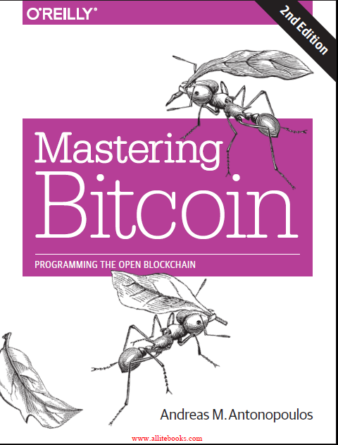
Chapter 1:
Introduction
Course Notes
CSE0469 Blockchain: Special Topics in SW Engineering
Yusuf Altunel
Based on Mastering Bitcoin 2e; Andreas M. Antonopoulos; O’Reilly, 2017

Slide 2
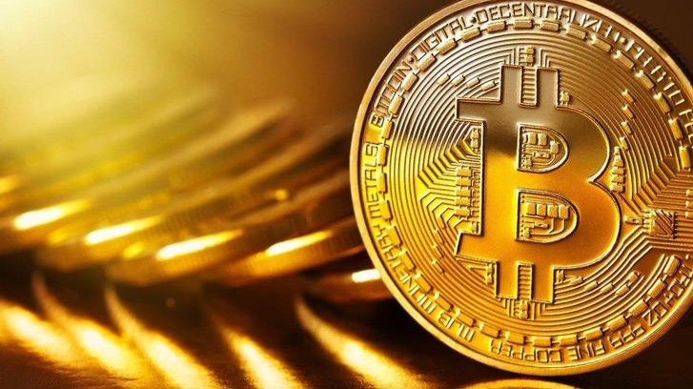
Content
What is Bitcoin?
History of Bitcoin
Bitcoin Uses, Users, and Their Stories
Getting Started

Slide 3
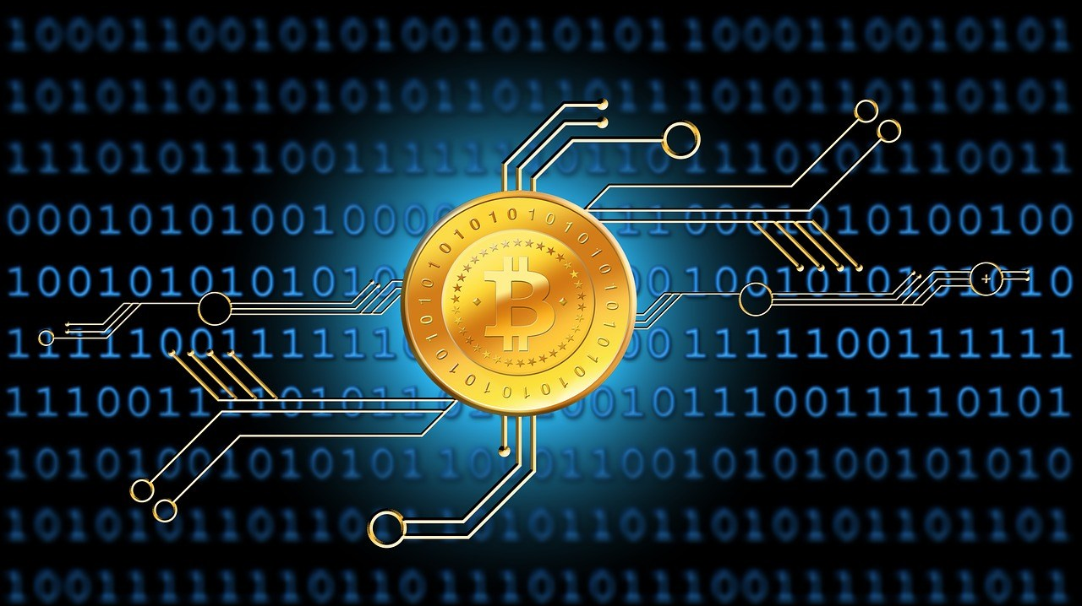
What is Bitcoin
Concept and technologies
form basis of
Units of currency
to store and transmit value
a digital money ecosystem
among participants

Slide 4

What is Bitcoin
Protocol
Bitcoin users communicate with
the internet or transport networks
bitcoin protocol

Slide 5
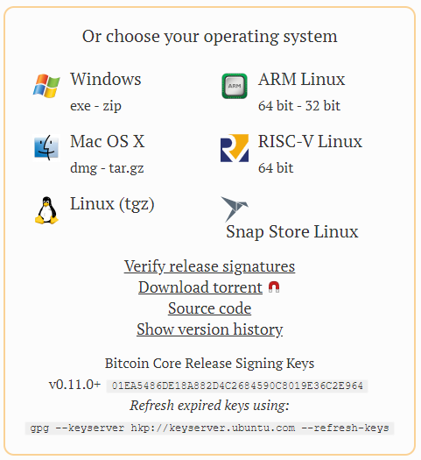
What is Bitcoin
Bitcoin
open source software
Runs on various hardware
available GitHub
Operating systems
laptops
smartphones
MS Windows
LINUX
Mac OS X

Slide 6
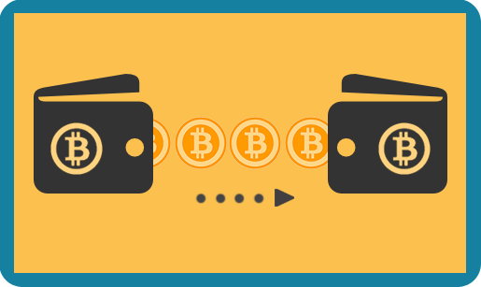
What can be done with Bitcoin?
Transfer Bitcoin
Users can transfer bitcoin over the network
Currency operations
Conventional currency
buy and sell goods
send money to people or organizations
extend credit
Sell & Purchase
Exchange Bitcoin with other currencies

Slide 7

Basic characteristics
Virtual
No physical coins

Slide 8
Basic characteristics
Borderless
Fast, secure & borderless
Bitcoin in a sense is the perfect form of money for the internet because it is fast, secure, and borderless.

Slide 9
Basic characteristics
Distributed
peer-to-peer system
no “central” server or point of control

Slide 10
Basic characteristics
Decentralized
free of any central authority or point of control
avoid a single point of attack or corruption

Slide 11
Basic characteristics
Robust
Not easy to intervent
legitimate governments
Possible actors
criminal elements

Slide 12
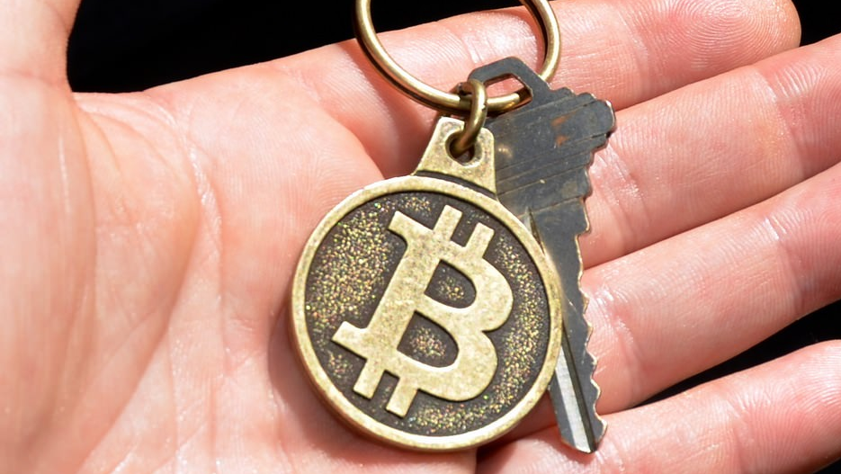
Ownership, Keys & Wallets
Ownership
Keys are the only instruments
to prove the ownership

Slide 13
Ownership, Keys & Wallets
Keys
Signing transactions
Transferring the ownership
users can sign transactions
Spending
Signing
to unlock the value
to a new owner.

Slide 14
Ownership, Keys & Wallets
Digital wallet
Offline wallets
Wallets
Digital wallet
on user’s computer
or smartphone
print
or physical forms
Offline wallet

Slide 15
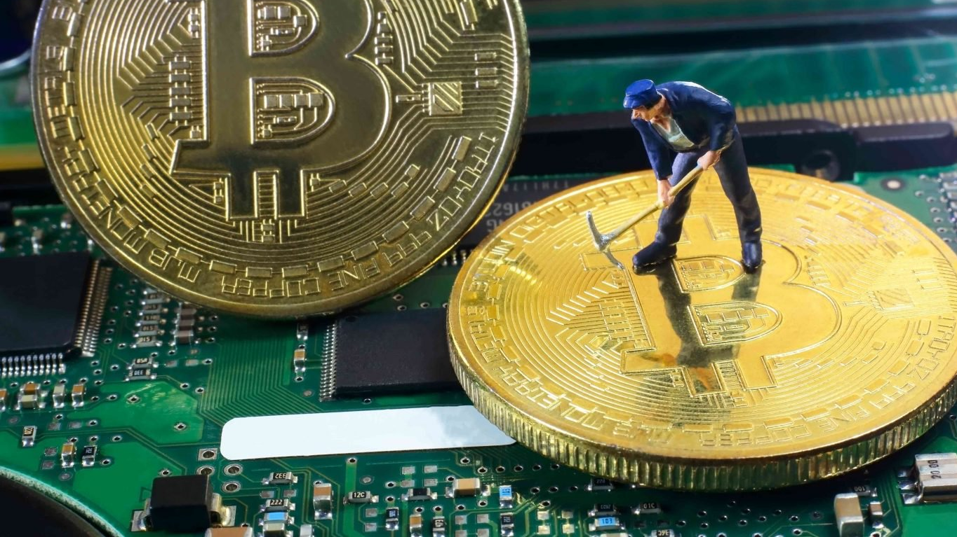
Mining
Mining
competing
processing bitcoin transactions
to find solutions
to a mathematical problem
Coverage
Validation
The transactions
are valid
are genuine

Slide 16
Mining
Involvement
anyone can participate
a device
Requirement
running the full bitcoin protocol stack

Slide 17
Mining
Duration
on average
to validate the transactions
a bitcoin miner is able
10 Minutes
To validate
One block of transaction

Slide 18

Circulation of Bitcoin
Minting
Bitcoin are created
Reward
Miner is rewarded
through mining
with brand new bitcoin

Slide 19
Circulation of Bitcoin
Decentralization
bitcoin mining
clearing functions and need
Decentralizes the currency-issuance
No central banks
for any central bank.

Slide 20
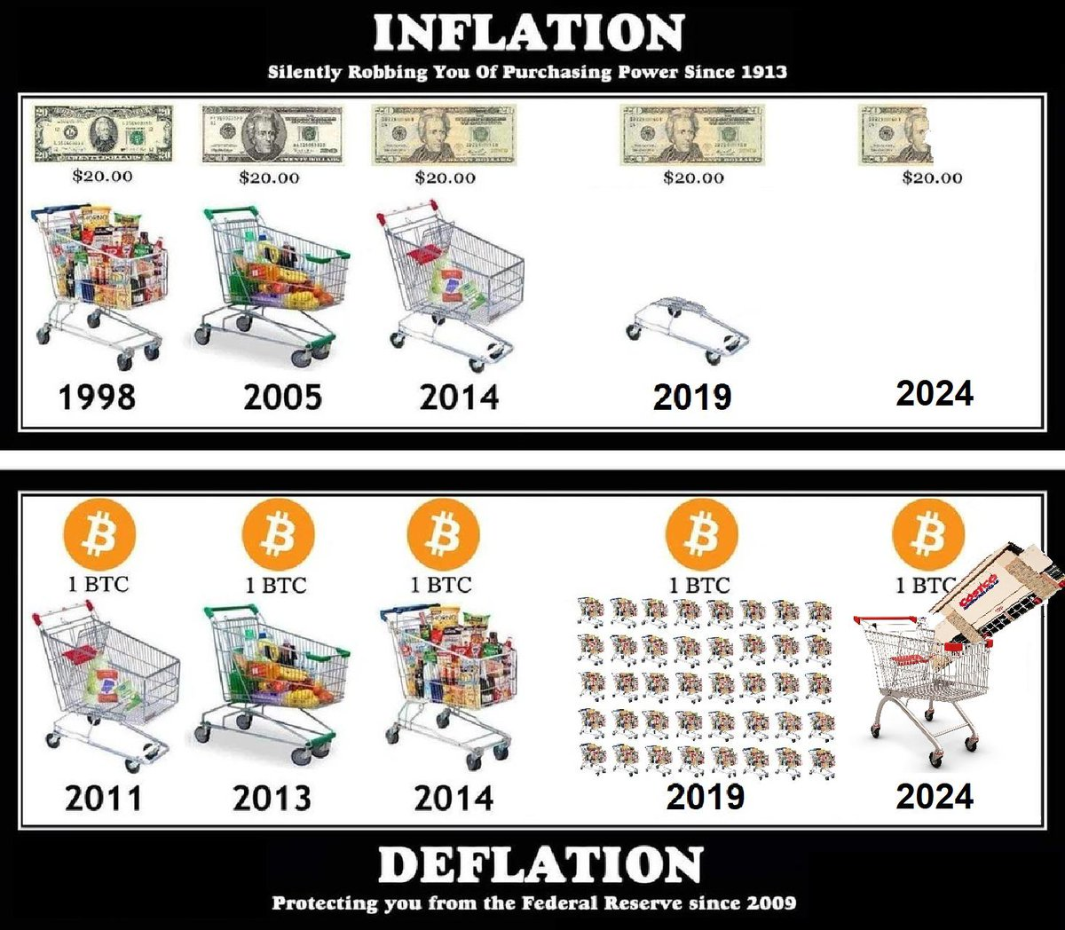
Bitcoin is Deflationary
Notes:
20.02.2021

Slide 21
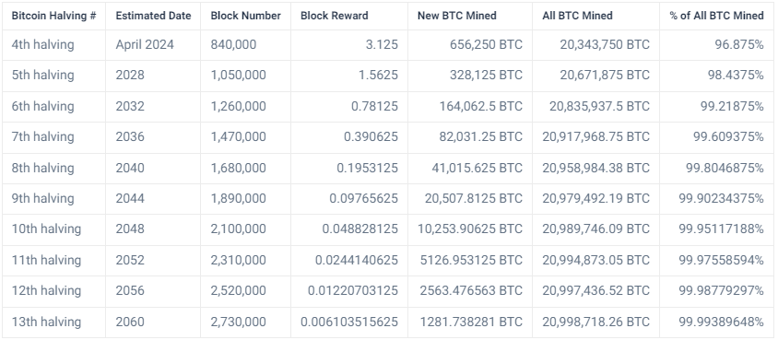
Predictions for Bitcoin Prices
Notes:
https://www.axi.group/en-ae/blog/education/cryptocurrencies/bitcoin-btc-price-predictions

Slide 22
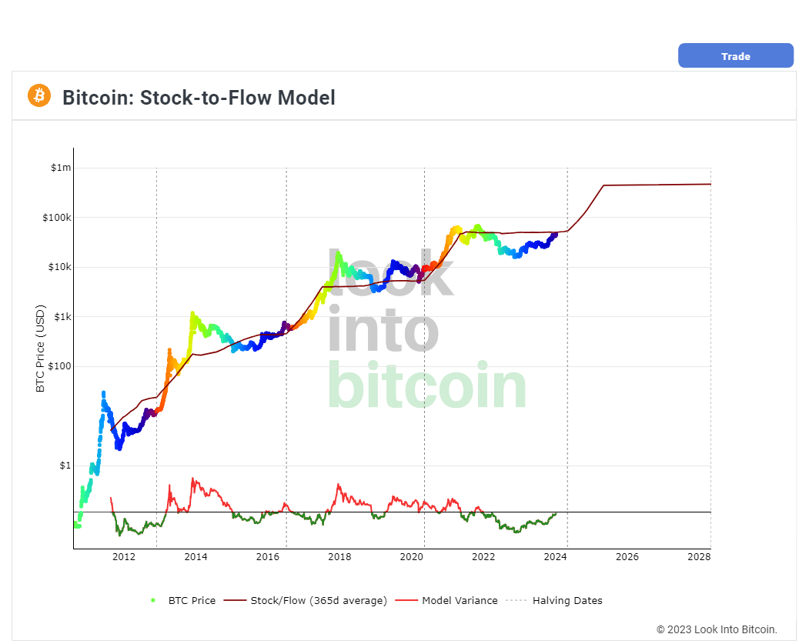
Predictions for Bitcoin Prices
Notes:
https://www.axi.group/en-ae/blog/education/cryptocurrencies/bitcoin-btc-price-predictions

Slide 23
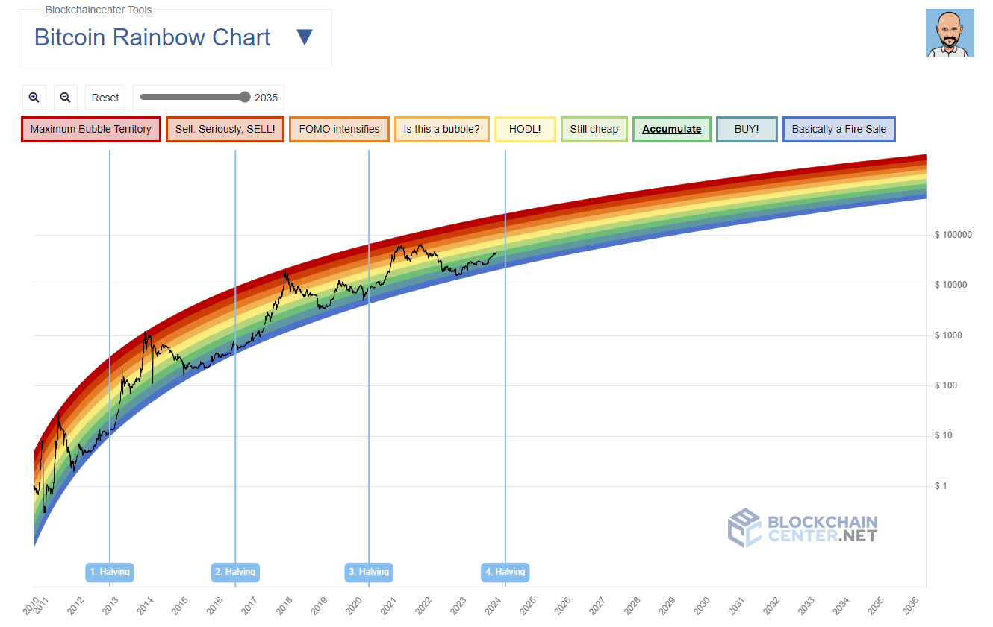
Predictions for Bitcoin Prices
Notes:
https://www.axi.group/en-ae/blog/education/cryptocurrencies/bitcoin-btc-price-predictions

Slide 24
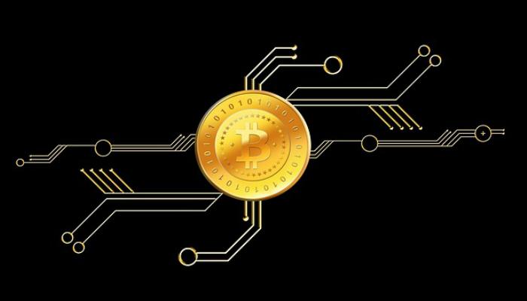
Bitcoin Protocol
Regulation
10 Minutes
The difficulty of the processing task miners must perform
includes built-in algorithms
regulates the mining function across the network
Difficulty
someone succeeds every 10 minutes
regardless of miners and computation power of network
adjusted dynamically

Slide 25
Bitcoin Protocol
4 years period
The protocol halves the rate
21M Coins
the total number of bitcoins
Bitcoin has diminishing rate of issuance
Deflationary
Cannot be inflated by “printing” new money
above and beyond the expected issuance rate
new bitcoins are created
2140
over the long term
to be completed
every 4 years
to be created fixed total
just below 21 million coins
by the year 2140

Slide 26
What is behind the scene?
4 key innovations
1. Bitcoin protocol
2. The blockchain
3. Consensus rules
4. Proof-of-Work algorithm
4 key innovations
A unique and powerful combination
Brought together

Slide 27
What is behind the scene?
1. The bitcoin protocol
A decentralized peer-to-peer network
2. The blockchain
A public transaction ledger
3. Consensus rules
A set of rules for independent transaction validation and currency issuance
4. Proof-of-Work algorithm
A mechanism for reaching global decentralized consensus on the valid blockchain

Slide 28

Bitcoin is
Internet of money
A network
via distributed computation
for propagating value and securing the ownership of digital assets

Slide 29
History of Bitcoin
2008
Bitcoin is invented
publication of a white paper
2009
The bitcoin network started in 2009
Proof-of-Work algorithm (mining) that provides security and resilience for bitcoin has increased in power exponentially
Apr. 2011
Satoshi Nakamoto withdrew from the public
developing the code and network to a group of volunteers
“Bitcoin: A Peerto-Peer Electronic Cash System,” written under the alias of Satoshi Nakamoto
1997
b-money, 1998, by computer scientist Wei Dai
1998
HashCash, 1997, Adam Back

Slide 30
Nakamoto’s Inventions
Early proposals
Nakamoto combined several prior inventions
to create a completely decentralized electronic cash system
b-money, 1998, by computer scientist Wei Dai
Bitcoin combines earlier concepts
HashCash, 1997, Adam Back

Slide 31
Nakotomo’s Inventions
10 Minutes rule
No double-spending
Features
Decentralized
Independent
No authority
Proof of Work
Consensus

Slide 32

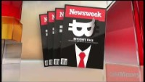

Who is Nakamoto?
Who is behind Bitcoin?
The identity
Still unknown
the person
people
https://www.youtube.com/watch?v=cICWtDj6g0k

Slide 33
Who is Nakamoto?
No control over Bitcoin
transparent mathematical principles
Neither Satoshi Nakamoto nor anyone else
Operation based on
open-source code
consensus among participants
exerts individual control over the bitcoin system

Slide 34
Nakomoto’s Inventions
does not rely on a central authority
currency issuance
No authority
Operations
settlement
validation of transactions

Slide 35
Nakomoto’s Inventions
The key innovation
Distributed validation of transactions
İs the “Proof-of-Work” algorithm
Benefit

Slide 36
Nakomoto’s Inventions
conduct a global “election”
10 Minutes rule
every 10 minutes
Period

Slide 37
Nakomoto’s Inventions
decentralized network
Consensus
arrive at consensus
About the state of transactions

Slide 38
Nakomoto’s Inventions
double-spending problem
was a weakness of digital currency
was addressed
by clearing all transactions
through a central clearinghouse
Notes:
15.02.2020

Slide 39
Getting Started
Choosing a Bitcoin Wallet
1
Quick Start
2
Getting Your First Bitcoin
3
Finding the Current Price of Bitcoin
4
Sending and Receiving Bitcoin
5

Slide 40
Choosing a Bitcoin Wallet: Platform
Desktop wallet
1
Mobile wallet
2
Web wallet
3
Hardware wallet
4
Paper wallet
5

Slide 41
Bitcoin Wallet: Degree of Freedom
Full-node client
Lightweight client
Third-party API client

Slide 42
Full-node client
stores the entire history of bitcoin transactions

Slide 43
Lightweight client
SPV
connects to bitcoin full nodes
stores the user wallet locally and independently
interact directly with the bitcoin network, without an intermediary.
known as a simple-payment-verification client
Connection to Full Nodes
Storage
Direct Interaction
creates,
for access to bitcoin transactions
Transactions
validates
transmits transactions

Slide 44
Third-party API client
Third party API
No direct connection
Wallet storage
All transactions go
interacts with bitcoin
to the bitcoin network directly
The wallet may be stored
Transactions
through a third-party system of
APIs: application programming interfaces
by the user or
by third-party servers
through a third party

Slide 45
Quick Start
Getting Your First Bitcoin
Finding the Current Price of Bitcoin
Sending and Receiving Bitcoin

Slide 46
Wallet
Wallet
A wallet is simply
Bitcoin address
Bitcoin addresses start with a 1 or 3
1Cdid9KFAaatwczBwBttQcwXYCpvK8h7FK.
to unlock the funds within
Usage
Can be shared with other bitcoin users
to send bitcoin directly to your wallet.
a collection of addresses and the keys

Slide 47
Wallet
you can create new addresses
QR code
Private keys
generated by the wallet
Used together with bitcoin addresses
to direct funds to your wallet
to exchange via camera
New Bitcoin Adresses
Easy way to read the address
as often as you like

Slide 48
Getting Your First Bitcoin
No traditional methods applicable
Since account transfers are reversible
As a new user you cannot buy bitcoin instantly with a credit card
You cannot buy bitcoin
No credit card!
with your pay pal or credit card directly

Slide 49
How to get bitcoin?
Sell Product
Find sellers
Buy from Friend
Find a friend who has bitcoin
and buy some from him or her directly
Use a classified service such as localbitcoins.com
to find a seller in your area to buy bitcoin for cash in an in-person transaction
Earn bitcoin by selling a product or service for bitcoin.

Slide 50
How to get bitcoin?
Use Bitcoin ATM
Use a bitcoin ATM in your city if any is available
Use Bitcoin Exchange
Use a bitcoin currency exchange linked to your bank account.
Local exchanges
Many countries now have currency exchanges
offer a market for buyers and sellers
to swap bitcoin with local currency

Slide 51
Finding the Current Price of Bitcoin
Exchange rate
Bitcoin Average
provides a simple view of
CoinCap
A service listing the market capitalization and exchange rates
CME
A reference rate that can be used for institutional and contractual reference
Bitcoin, like most other currencies,
There are hundreds of applications and websites
provided as part of investment data feeds by the CME
https://www.cmegroup.com/trading/cryptocurrency-indices.html
Chicago Mercantile Exchange Bitcoin Reference Rate
that can provide the current market rate.
Example: https://www.coindesk.com/
has a floating exchange rate.
Websites
the volume-weighted-average for each currency.
https://bitcoinaverage.com/
of hundreds of crypto-currencies, including bitcoin
https://coincap.io/

Slide 52
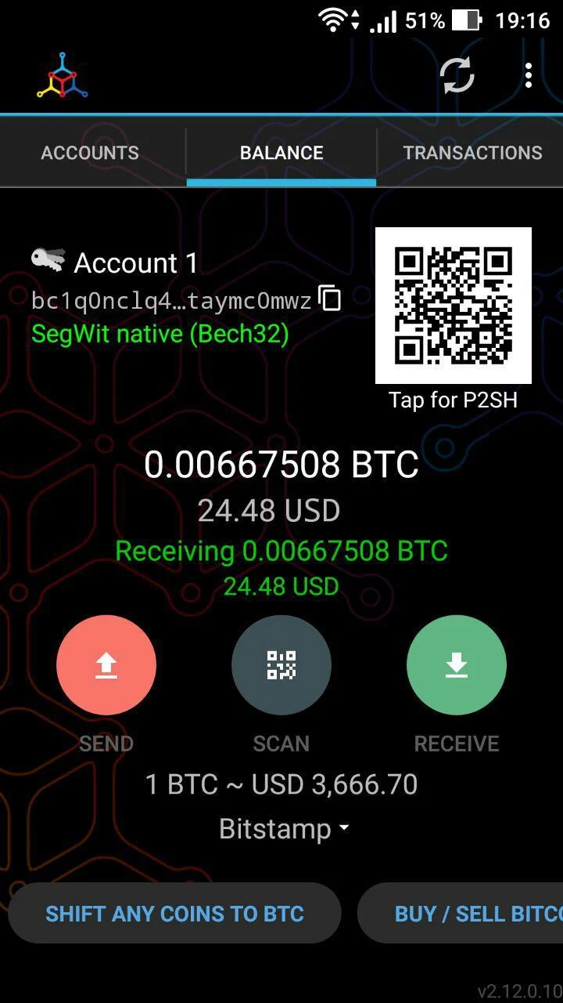
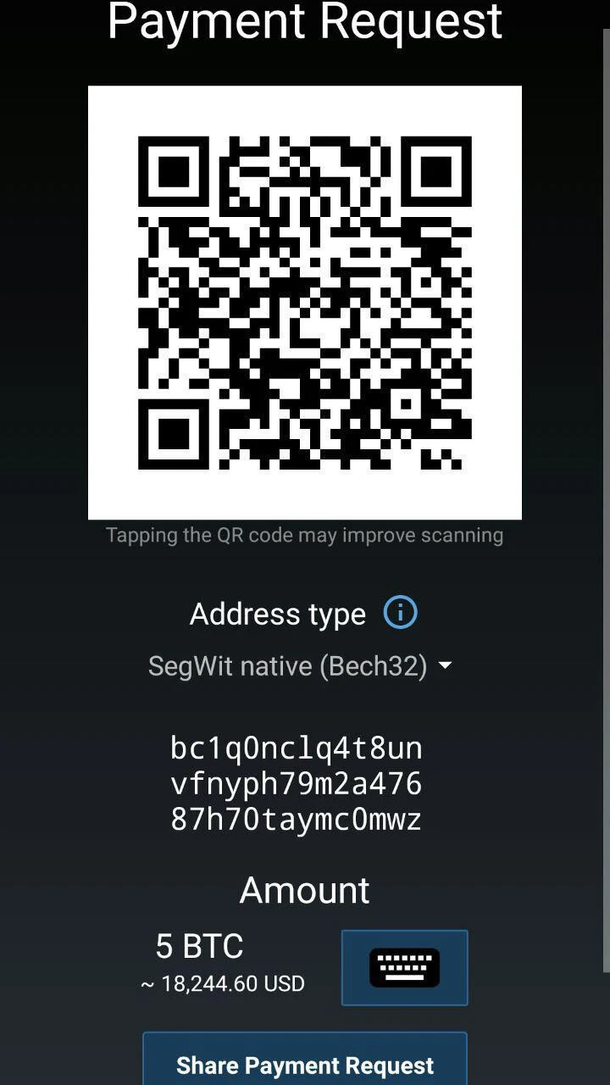
Sending & Receiving Bitcoin
Sending
Exchanging
Receive
Selects Send on his smartphone wallet
Between Alice & Joe
Receiving
QR Code
Tap the QR code icon
scanning the QR code
Enter Amount
Joe enters the amount as $30
to exchange $30 for bitcoin
Bitcoin address is received from QR code
Alice Opens wallet application
Joe opens his wallet application
Mycelium or any other one
An application accepts Bitcoin
Alice’s bitcoin address.
to displays a QR code
displayed on Alice’s smartphone
Exchange rate
Uses live data from exchange markets
1BTC = $30 000
$30 = 1/1000 BTC
Wallet
https://play.google.com/store/apps/details?id=com.mycelium.wallet

Slide 53
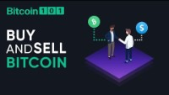
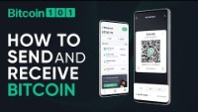

Related Videos
https://www.youtube.com/watch?v=0gNPmLljJ1k
https://www.youtube.com/watch?v=7maNVTM8B1E
https://www.youtube.com/watch?v=fAmdC64KKdM

Slide 54



Discussions
Asses what you got so far!
Noticible issues
Interesting Details
Unclarified issues
What do you think on this chapter?
Do you think the bitcoin inspiring?
What is the most interesting point?
Select and explain a critical issu in this chapter
What are the points need further explanations?

Slide 55
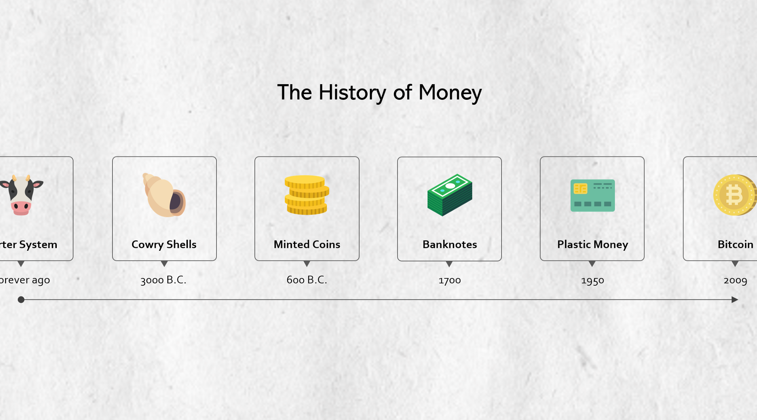





Thank You
y.altunel@iku.edu.tr
Yusuf Altunel, PhD

