Slide 1
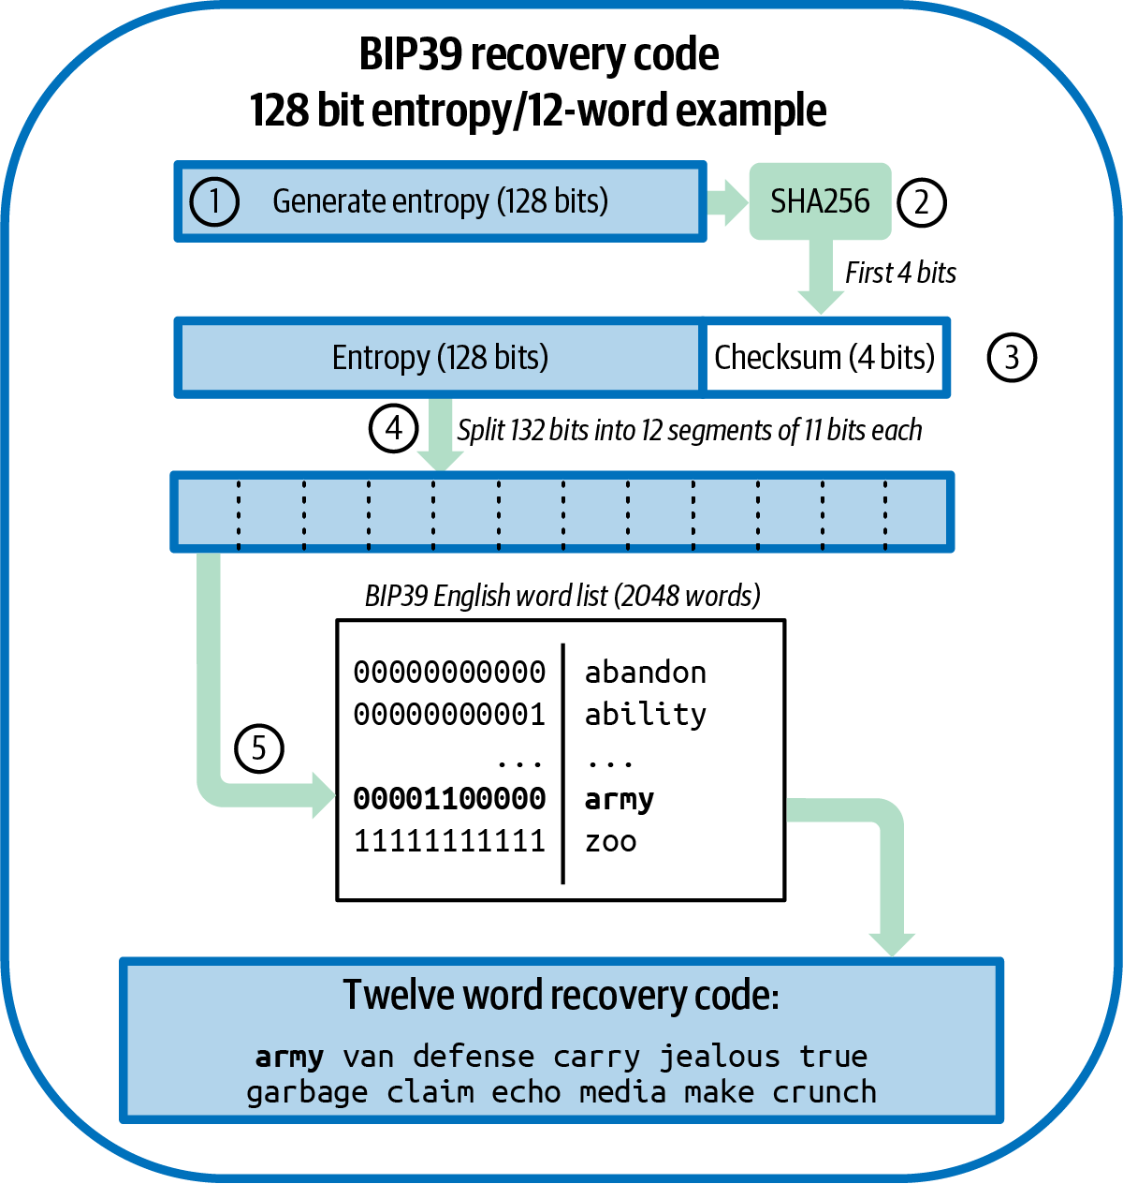
Chapter 5: Wallet Recovery
One seed, twelve words, and every key you will ever need back
SEN0401 Special Topics in Software Engineering: Block Chain - Fall 2026 - Yusuf Altunel, PhD - Istanbul Kultur University
Figure: Mastering Bitcoin 3e, CC BY-SA 4.0
Mastering Bitcoin 3e, chapter 5: Wallet Recovery
1 / 68
Notes:
Welcome to chapter five. A wallet is not a bag of coins but a bag of keys, and keys can be lost. Point at the figure from the book and ask what a person would lose if the keys vanished. By the end, one seed written as twelve words brings every key back.

Slide 2
Today's route
₿
Seven parts; every number is a slide you can jump to
1
Questions, map, story and tools (slides 3-6)
68
2
Part 1: Keys in wallets (slides 7-11)
slides, numbered bottom-right
3
Part 2: Recovery codes (slides 12-18)
4
Part 3: The BIP39 stack (slides 19-30)
27
5
Part 4: The HD wallet (slides 31-42)
code examples, each with its result
6
Part 5: Paths and descriptors (slides 43-52)
7
Part 6: Data that is not keys (slides 53-56)
3
8
Part 7: Deploying and testing (slides 57-65)
true stories with real names, dates and places
9
Summary, resources and questions (slides 66-68)
Seven parts, and at the end a backup you have actually tested.
Mastering Bitcoin 3e, chapter 5: Wallet Recovery
2 / 68
Notes:
Seven parts follow one road, and each part opens with a divider. Point at the three counters and tell students that every code example has a twin on the course page. Ask which part they expect to be hardest. The slide numbers let anyone jump back later.

Slide 3
The questions this chapter answers
₿
Seven questions; each one is answered by a part of the deck
1
What does a Bitcoin wallet actually contain?
2
How does a recovery code turn into a seed?
3
How does one seed make a whole tree of keys?
4
Which recovery code schemes are in use?
5
Which derivation paths does a wallet use?
6
Where does the book differ from the standards?
7
What must you back up, and how do you test it?
If you can answer these seven, chapter 5 is yours.
Mastering Bitcoin 3e, chapter 5: Wallet Recovery
3 / 68
Notes:
Read the seven questions aloud and promise to return to them in the summary. Ask who can already answer the first one. Most students say a wallet holds coins, and the chapter corrects that. The check-yourself slide at the end uses the same questions.

Slide 4
One chapter, eight branches
₿
How many concepts the course page explains in each branch
How to read the deck
Seven parts follow the branches.
Every part opens with a divider.
Code slides show the code, a note beside it, and the result.
Today's spine: keys, codes, the tree, paths, backups.
Mastering Bitcoin 3e, chapter 5: A Wallet Technology Stack in Detail
4 / 68
Notes:
The bars count the concepts the course page explains in each of eight branches. Point at the longest bar and ask what that branch might hold. Every concept also gets an everyday picture later in the deck. The spine of the day is keys, codes, the tree, paths and backups.

Slide 5

Two guesses from 7,002 bitcoin
₿
A true story, with real names, dates and places
In 2011 Stefan Thomas, a programmer and former Ripple technology chief, was paid 7,002 bitcoin and kept the keys on an IronKey USB drive in a safe.
He lost the paper with the password. On 12 January 2021 reporter Nathaniel Popper told the story in the New York Times: eight of ten guesses were already used.
The drive locks forever after ten wrong guesses, and memory was his only backup. A recovery code, tested in advance, is the alternative.
READ NYT via Business Standard (news) business-standard.com
Stefan Thomas, 2015 - Lift Conference, CC BY 2.0
Memory is not a backup; a recovery code you never test is barely one
5 / 68
Notes:
Tell the story slowly. Stefan Thomas was paid 7,002 bitcoin in 2011 and kept the keys on an encrypted drive. Point at the photograph and at the link, and ask what he lacked; a tested backup, not a better memory. Students often blame the drive.

Slide 6
The tools we run today
₿
One small Python library, written for reading
Function | What it does
entropy_to_mnemonic | random bits to recovery words
mnemonic_to_seed | words to a 512-bit seed
master, ckd_priv, ckd_pub | seed to master key, parent to child
keys_at | a key at a path below a code
p2wpkh_address | a public key to a bc1q address
descsum_create | a descriptor checksum
shamir_split, scan_with_gap | split a secret, scan addresses
Name | Sample data
ENT, WORDS | the book's 128 bits and its 12 words
TV | BIP32 test seed
B84 | BIP84 test recovery code
DESC | a descriptor Core made
BOOK_XPUB | the book's extended public key
Same library, same data, every code slide: only the idea changes.
Mastering Bitcoin 3e, chapter 5: Wallet Recovery
6 / 68
Notes:
Every code slide uses the same small library and the same sample data. Point at the table of functions and ask which one turns words into a seed. The library is written for reading and checked against the standards' test vectors. It is not for real money.

Slide 7
Part 1: Keys in wallets
From a bag of keys to one recoverable seed
wallet database
the file where a wallet keeps its keys and notes
How they fit together
1. Seed
2. A rule
3. Key 0
4. Key 1
5. Key 2
independent key generation
every key made alone, so every key needs a backup
deterministic key generation
every key follows from one seed by a rule
seed
the one secret all the keys come from
key tweak
a number added to a key to make a related key
hardware signing device
a small computer that signs and never shows its keys
Mastering Bitcoin 3e, chapter 5: Independent Key Generation
7 / 68
Notes:
Part one asks what a wallet really holds. Point at the six concepts and read each meaning line once. Ask what the picture on the right shows; the answer is one seed and a rule give every key. A common mistake is to think that a wallet stores coins.

Slide 8
What a wallet really holds
₿
A wallet application, its database, and who signs
Wallet application prepares a payment
Wallet database supplies the keys
Signing device signs
Network receives it
Wallet database
Wallet with public keys only
The file where a wallet application keeps its keys and its notes.
It can see funds sent to its keys and show them, but it cannot spend.
External signing
Hardware signing device
One program prepares the transaction; another program or device signs it.
A small computer that holds private keys and signs without revealing them.
Keys are the wallet; everything else can be rebuilt from them.
Mastering Bitcoin 3e, chapter 5: A Wallet Technology Stack in Detail
8 / 68
Notes:
A wallet application prepares a payment, the database supplies keys, a signing device signs, and the network receives it. Point at the four boxes in order. Ask what a wallet with public keys only can still do. It can watch funds but never spend them.

Slide 9
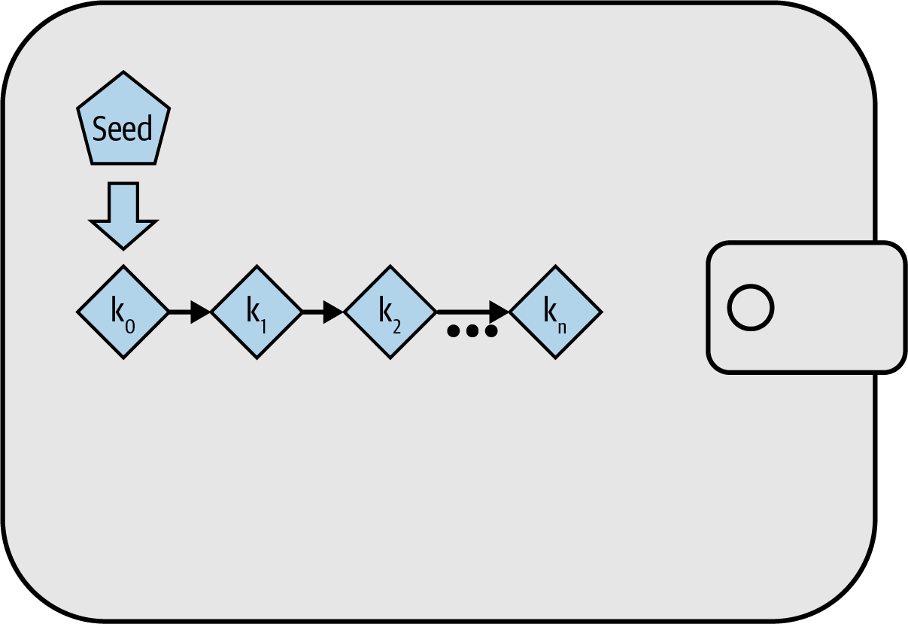
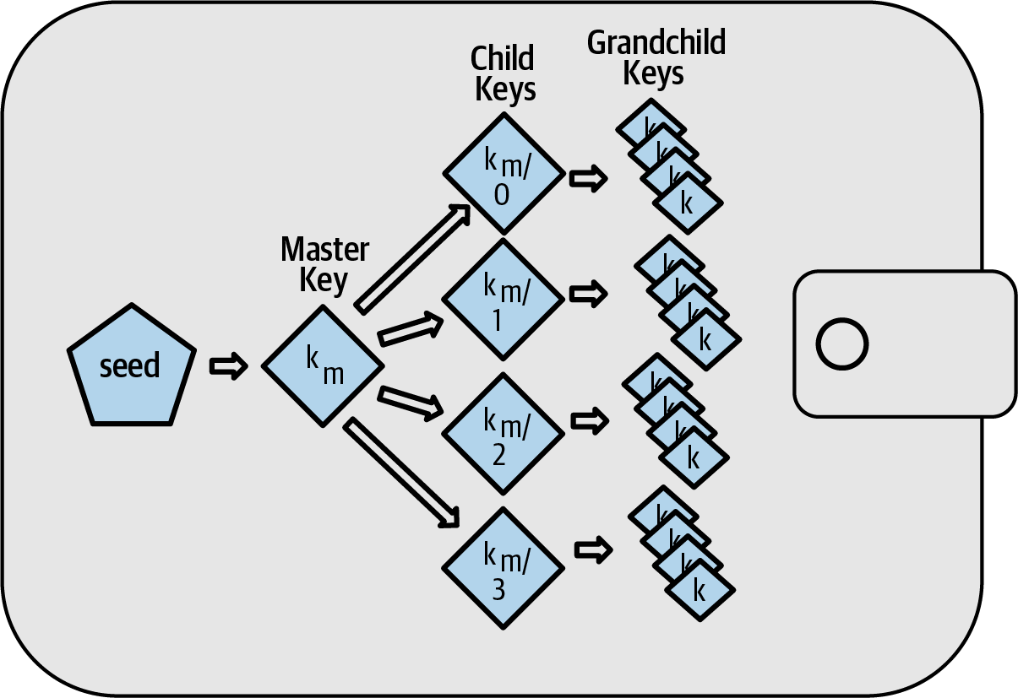
Three ways to make keys
₿
Loose, deterministic, hierarchical
Figure: Mastering Bitcoin 3e, CC BY-SA 4.0
Figure: Mastering Bitcoin 3e, CC BY-SA 4.0
Deterministic: one seed, keys k0 to kn
Hierarchical: a tree of keys below the seed
Independent keys: a backup for each. Seed-based keys: one backup.
Mastering Bitcoin 3e, chapter 5: Hierarchical Deterministic (HD) Key Generation (BIP32)
9 / 68
Notes:
Compare the three pictures from the book. Independent keys need one backup each, deterministic keys need one backup, and a hierarchical wallet adds a tree on top. Point at the keys k0 to kn. Ask how many backups the third wallet needs; the answer is only one, the seed.

Slide 10
Everyday pictures for part 1
₿
A key ring, a recipe and a notary
Concept | In everyday life | In the wallet
wallet database | A key ring in a drawer, with a notebook beside it | The file that stores a wallet's keys and notes
independent key generation | Cutting a new, unrelated key for every door | Each key is made alone, so each needs its own backup
deterministic key generation | A recipe: the same ingredients give the same dish | One seed and a rule always give the same keys
seed | The master recipe card kept in a safe | The one secret every key comes from
key tweak | A copy of a key filed down by a fixed amount | A number added to a key to make a related key
hardware signing device | A notary who stamps letters and never hands over the stamp | A device that signs and never reveals its keys
Wallet Recovery | Getting back into a locked house with a spare key | Chapter 5: how a wallet is restored after a loss
A Wallet Technology Stack in Detail | A workshop manual showing every layer of a machine | The layers: keys, codes, paths, backups
A seed is a recipe: keep the card, and you can cook every key again.
Mastering Bitcoin 3e, chapter 5: A Wallet Technology Stack in Detail
10 / 68
Notes:
Say the everyday picture first and the wallet meaning second. The recipe is the best one, because the ingredients are the seed, the recipe is the rule and the dish is a key. Ask students to invent their own picture for a key tweak. A key filed down by a fixed amount works.

Slide 11
Code 1: Loose keys versus one seed
₿
Deterministic key generation, run
seed = b"my seed"
def key(i):
return hashlib.sha256(seed + bytes([i])).hexdigest()
One secret, and a rule that turns it into key number i.
keys = [key(i)[:8] for i in range(3)]
print(keys)
Ask the rule for keys 0, 1 and 2; show the first eight characters of each.
again = [key(i)[:8] for i in range(3)]
print(keys == again)
Run it again. The same seed gives the same keys, so one backup is enough.
keys == again → True
What the run printed (python 3.14.6)
Same seed, same three keys: one backup is enough.
Key number | First 8 characters
0 | aa74b609
1 | 94af53de
2 | fc092c45
Same keys on a second run | True
1 seed to back up
all keys follow
One seed, one backup, every key.
Mastering Bitcoin 3e, chapter 5: Deterministic Key Generation
11 / 68
Notes:
Run the three boxes from top to bottom. The function key is the rule that turns the seed into key number i. Point at the table and at the True in its last row. Ask why one backup is enough; the answer is the same seed always gives the same keys.

Slide 12
Part 2: Recovery codes
Seeds written down so a human can keep them
recovery code
words or characters that stand for the seed
How they fit together
1. Entropy
2. Recovery code
3. Written on paper
4. Restored later
BIP39
words from a list of 2,048, with a checksum
Electrum v2, Aezeed, Muun
rival schemes with versions, dates or encryption
SLIP39 and codex32
one secret split into shares you can recombine
recovery code passphrase
an extra secret that changes the wallet
brainwallet
words you chose yourself: not a recovery code
Mastering Bitcoin 3e, chapter 5: Seeds and Recovery Codes
12 / 68
Notes:
Part two is about recovery codes, and a code is the seed written for human hands. Point at the six concepts and ask which one is not a recovery code; the brainwallet, because a person chose the words. Students often lump it in with the others.

Slide 13
Six recovery code schemes
₿
What each one adds
Scheme | What it adds | Source
BIP39 recovery code | Words from a list of 2,048, a checksum, an optional passphrase | BIP39 standard
Electrum version 2 recovery code | No global word list; a version number inside the code | Electrum wallet 2.0+
Aezeed cipher seed | Two version numbers and a wallet birthday | lnd wallet
Muun recovery code | A non-word code that decrypts the keys in a separate document | Muun wallet
SLIP39 share set | One seed split into several codes, for example five made, three needed | SLIP-0039
codex32 recovery code | Shares made and checked by hand with paper and a pen | BIP93 (draft)
Same goal, different trade-offs: reliability, privacy, splitting.
Mastering Bitcoin 3e, chapter 5: Seeds and Recovery Codes
13 / 68
Notes:
Walk down the table one scheme at a time and read only the middle column. BIP39 is the common one, Electrum avoids a global word list, Aezeed carries a wallet birthday and SLIP39 splits a seed. Ask which scheme can be made by hand. Codex32.

Slide 14
Why words, and what can go wrong
₿
Memory, imitation and coercion
Memorising a recovery code
Brainwallet
Words make a code easy to remember, yet the book strongly urges writing it down.
Words you chose yourself. A recovery code is random and made by the wallet.
Coercion and physical risk
Wallet birthday
Someone who thinks you remember a code may force you. The book cites over 100 attacks; the 2026 copy of the list has 364 rows.
A date stored in the code, so a restore need not scan the whole blockchain.
Write it down, make it random, and do not depend on memory.
Mastering Bitcoin 3e, chapter 5: Recovery Code Passphrases
14 / 68
Notes:
Four risks sit around a written code. Point at the card about coercion and read the number of attacks aloud. Ask why the book urges writing a code down even though words are easy to remember; the answer is memory fails and people can be forced. A brainwallet is not random.

Slide 15
Everyday pictures for part 2, schemes
₿
Notes, dictionaries and torn maps
Concept | In everyday life | In the wallet
recovery code | A spare-key note you can write by hand | Words that stand for the seed
BIP39 | A shared dictionary of 2,048 numbered words | The most common recovery code scheme
Electrum v2 | A notebook that stamps its own version | No global list; a version inside the code
Aezeed | A sealed letter carrying its own date | Versions and a wallet birthday
Muun | A safe-deposit key opened with a paper from the bank | A code that decrypts a separate document
SLIP39 | A map torn in five: any three pieces show the treasure | Shares of one seed with a threshold
Codex32 | A crossword you can check by hand | Shares and checksums made with paper and a pen
Seven schemes, seven pictures; the torn map is the one to remember.
Mastering Bitcoin 3e, chapter 5: Seeds and Recovery Codes
15 / 68
Notes:
Seven schemes get seven everyday pictures. Point at the torn map for SLIP39, where three of five pieces show the treasure. Ask what two pieces show; the answer is nothing. Students often think two of five give a partial secret, and the picture shows why they do not.

Slide 16
Everyday pictures for part 2, choices
₿
A second lock, a decoy and a date
Concept | In everyday life | In the wallet
recovery code passphrase | A second lock on the safe | An extra secret mixed into the seed
plausible deniability | A decoy purse with a little cash | A wallet that looks genuine and holds little
duress wallet | The purse you hand over under threat | A decoy wallet opened by another passphrase
brainwallet | A password you invented, not a random one | Words you chose yourself: easy to guess
wallet birthday | The date the safe was bought | The creation date stored in the code
Seeds and Recovery Codes | A master recipe written on a card | Writing the seed as words a person can keep
Recovery Code Passphrases | A second lock on the recipe box | Adding a secret word to the recovery code
A passphrase is a second lock: lose it, and the words alone open nothing.
Mastering Bitcoin 3e, chapter 5: Recovery Code Passphrases
16 / 68
Notes:
A passphrase is a second lock on the safe. Point at the decoy purse and ask what plausible deniability protects against; coercion. Ask what happens when the passphrase is lost; the words alone open nothing, which is the usual surprise.

Slide 17
Code 2: Codes check themselves differently
₿
codex32 and Electrum, run
print(codex32_check(C32))
codex32 carries a long checksum that can be checked by hand.
n = next(i for i in range(99999)
if electrum_has_version("seed %d" % i, "100"))
Electrum marks a seed by the first digits of an HMAC. Search for one marked 100.
print(n, electrum_hash("seed %d" % n)[:3])
The search stops at the first match and shows the marker.
n → 5483
What the run printed (python 3.14.6)
codex32 checks by checksum, Electrum by an HMAC prefix.
Scheme | How it checks itself | What the run printed
codex32 | A checksum over the whole string | valid: True
Electrum v2 | Version = the first digits of an HMAC | seed number 5483 starts with 100
BIP39 | Checksum bits taken from SHA-256 | see the checksum slide
Every scheme has its own safety net.
Mastering Bitcoin 3e, chapter 5: Seeds and Recovery Codes
17 / 68
Notes:
Different schemes catch typos in different ways. Point at the first row of the result, codex32 valid True, and at the seed number the search found for Electrum. Ask which scheme can be checked by hand. Students are surprised that Electrum marks a seed by a prefix of an HMAC.

Slide 18
Code 3: Three of five shares recover the secret
₿
SLIP39's idea, run on a small model
secret = 0x1337c0de
shares = shamir_split(secret, 3, 5, [11, 22])
Split a secret into five shares; any three can rebuild it.
print(shamir_combine(shares[:3]) == secret)
print(shamir_combine(shares[1:4]) == secret)
Two different groups of three both recover the secret.
print(shamir_combine(shares[:2]) == secret)
Two shares give a wrong answer and reveal nothing.
shamir_combine(shares[:2]) == secret → False
What the run printed (python 3.14.6)
Any three shares give True; two shares give False.
Shares used | Which ones | Secret recovered?
3 of 5 | shares 1, 2, 3 | True
3 of 5 | shares 2, 3, 4 | True
2 of 5 | shares 1, 2 | False
Any three recover; two learn nothing.
Mastering Bitcoin 3e, chapter 5: Seeds and Recovery Codes
18 / 68
Notes:
Secret sharing splits one secret into five shares. Point at the three rows of the result, where any three shares give True and two give False. Ask what two shares reveal; nothing at all. This is a small model and not SLIP39 itself, which works in a different field.

Slide 19
Part 3: The BIP39 stack
Entropy in, twelve words out, then a seed
entropy
the random bits the code is made from
How they fit together
1. Entropy
2. Checksum added
3. Eleven-bit pieces
4. Words
5. PBKDF2 stretch
6. 512-bit seed
checksum
a few bits that reveal a typo
word list
2,048 numbered words everyone shares
key-stretching function
repeated work that makes guessing slow
PBKDF2 and salt
the stretcher BIP39 uses, and its added string
root seed
the 512-bit result that starts the tree
Mastering Bitcoin 3e, chapter 5: BIP39 Recovery Codes
19 / 68
Notes:
Part three follows BIP39 from random bits to a seed. Point at the six steps in the picture, from entropy to the 512-bit seed. Ask which step makes guessing slow; the answer is the stretch. A common mistake is to think the words themselves are the seed.

Slide 20
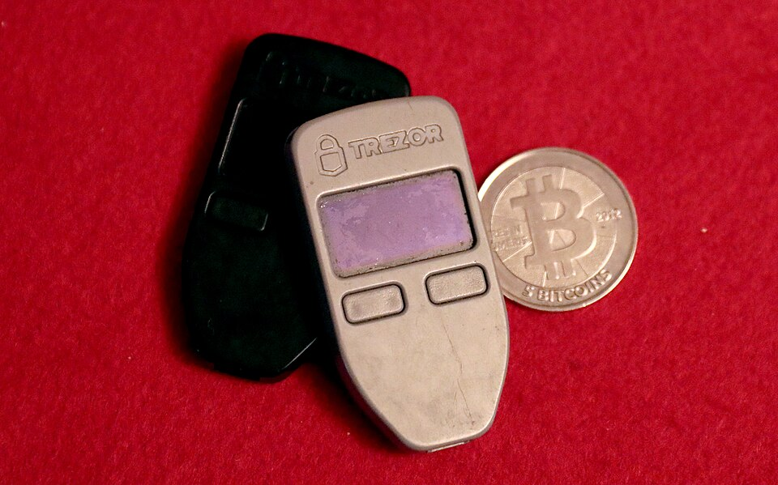
Twelve words between you and 128 bits
₿
A true story, with real names, dates and places
Marek Palatinus and Pavol Rusnak of SatoshiLabs, the makers of Trezor, saw that nobody transcribes 128 raw bits correctly. Aaron Voisine and Sean Bowe joined them.
On 10 September 2013 they published BIP 39 in the public bips repository on GitHub: a way to write entropy as ordinary words.
The recipe is 2,048 words of eleven bits each, a checksum folded in, and key stretching from the words to the seed.
READ BIP 39: Mnemonic code (spec) bips.dev
Trezor One devices - Gage Skidmore, CC BY-SA 3.0
The recovery code is an interface standard between humans and entropy
20 / 68
Notes:
Tell it as a story of people. Marek Palatinus and Pavol Rusnak built the first hardware signing device and saw that nobody copies 128 bits without errors. Point at the photograph and the link to the standard. Ask why words beat bits; the answer is eleven bits fit one word.

Slide 21
Generating a recovery code
₿
Five steps from random bits to words
Entropy: 128 bits
4
1 Generate entropy (128 bits for 12 words)
128 bits of entropy + a 4-bit checksum = 132 bits
2 Hash it with SHA-256
11 bits
word 1
11 bits
word 2
11 bits
word 3
11 bits
word 4
3 Append the first 4 bits as the checksum
11 bits
word 5
11 bits
word 6
11 bits
word 7
11 bits
word 8
4 Split the 132 bits into 12 pieces of 11 bits
11 bits
word 9
11 bits
word 10
11 bits
word 11
11 bits
word 12
5 Look each piece up in the word list of 2,048
Twelve pieces of eleven bits, one word each
12 words x 11 bits = 132 bits = 128 of entropy + 4 of checksum.
Mastering Bitcoin 3e, chapter 5: Generating a recovery code
21 / 68
Notes:
Follow the five steps beside the picture, from entropy and SHA-256 to four checksum bits, twelve pieces of eleven bits and the word list. Point at the 132 bits and ask where the number comes from; 128 plus 4. Students often forget that the checksum is part of the words.

Slide 22
Code 4: A hash function changes half its bits
₿
SHA-256, the tool inside BIP39
a = hashlib.sha256(b"seed A").digest()
b = hashlib.sha256(b"seed B").digest()
Hash two inputs that differ by one letter with SHA-256.
diff = int(a.hex(), 16) ^ int(b.hex(), 16)
print(len(a) * 8, bin(diff).count("1"))
XOR the results and count the bits that differ: about half of the 256 change.
bin(diff).count("1") → 126
What the run printed (python 3.14.6)
Two inputs differ by one letter; the outputs differ in 126 of 256 bits.
A tiny change makes a huge difference.
Mastering Bitcoin 3e, chapter 5: BIP39 Recovery Codes
22 / 68
Notes:
Point at the two bars, 126 bits changed and 130 unchanged. Ask what a good hash does when one letter of the input changes. About half of the output bits flip. Students expect a small change to give a small difference, and the chart shows the opposite.

Slide 23
Code 5: How many words for how much entropy
₿
Code length and security strength
for bits in (128, 160, 192, 224, 256):
ent = bytes(bits // 8)
Five allowed entropy sizes, from 128 to 256 bits.
n = len(entropy_to_mnemonic(ent).split())
print(bits, n)
Turn each into a recovery code and count its words: 12, 15, 18, 21 and 24.
(bits, n) → (256, 24)
What the run printed (python 3.14.6)
128 bits is 12 words; each extra 32 bits adds 3 words.
More bits, more words, more security strength.
Mastering Bitcoin 3e, chapter 5: How Much Entropy Do You Need?
23 / 68
Notes:
Point at the bars climbing in equal steps. 128 bits make 12 words and each extra 32 bits add three words. Ask how many words 256 bits need; the answer is twenty-four. The checksum grows too, by one bit for every 32 bits of entropy.

Slide 24
Code 6: From entropy to twelve words
₿
Eleven-bit segments and the word list
words = entropy_to_mnemonic(bytes.fromhex(ENT))
print(words == WORDS)
The chapter's 128 bits of entropy become its twelve words.
idx = [wordlist().index(w) for w in words.split()]
print(idx)
Each word is a position, 0 to 2047, in the BIP39 list: eleven bits each.
print(format(idx[0], "011b"), words.split()[0])
Position 96 is the eleven bits 00001100000, the word army.
format(idx[0], "011b") → '00001100000'
What the run printed (python 3.14.6)
word | army | van | defense | carry | jealous | true
position | 96 | 1929 | 459 | 279 | 956 | 1866
word | garbage | claim | echo | media | make | crunch
position | 764 | 333 | 559 | 1107 | 1076 | 423
Word number 1 is position 96: the eleven bits 00001100000.
Every word is just an eleven-bit number.
Mastering Bitcoin 3e, chapter 5: Generating a recovery code
24 / 68
Notes:
The chapter's own entropy becomes its own twelve words. Point at the first word, army, and its position 96. Ask why every word is just a number; eleven bits give a position from 0 to 2047 in the list. Students mix up the position with the word.

Slide 25
Code 7: The checksum catches a wrong word
₿
BIP39 checksum
ent, ok = mnemonic_to_entropy(WORDS)
print(ent.hex(), ok)
Decode the code back to entropy and check the last four bits.
bad = WORDS.replace("crunch", "army")
print(mnemonic_to_entropy(bad)[1])
Change the last word. The recomputed checksum no longer matches.
mnemonic_to_entropy(bad)[1] → False
What the run printed (python 3.14.6)
Right code: checksum True. One word changed: False.
Recovery code | Entropy decoded | Checksum ok?
army van ... media make crunch | 0c1e24e5917779d297e14d45f14e1a1a | True
army van ... media make army (last word changed) | not trusted | False
A checksum turns a silent typo into a loud error.
Mastering Bitcoin 3e, chapter 5: Generating a recovery code
25 / 68
Notes:
Decode the code back to entropy and check the last four bits. Point at the two rows and at the True and the False. Ask what the checksum catches; the answer is most typos. It cannot repair them, it only warns, and a silent typo becomes a loud error.

Slide 26
Code 8: Text is normalised before stretching
₿
Text normalisation
s = "caf\u00e9"
n = unicodedata.normalize("NFKD", s)
The same word can be one character or two: e-acute, or e plus an accent.
print(len(s), len(n))
print(mnemonic_to_seed(s) == mnemonic_to_seed(n))
Normalising makes both spellings give the same seed on every device.
mnemonic_to_seed(s) == mnemonic_to_seed(n) → True
What the run printed (python 3.14.6)
Both spellings give one seed after normalising.
Spelling of the word | Characters | Same seed?
as typed: e-acute is one character | 4 | -
after normalising: e plus an accent | 5 | True
Normalise first, so one phrase gives one seed.
Mastering Bitcoin 3e, chapter 5: From recovery code to seed
26 / 68
Notes:
The same word can be stored as one character or as two. Point at the lengths 4 and 5 in the table. Ask why a phone and a laptop could disagree without normalising; the answer is they would build different seeds from the same phrase. Normalising comes before the stretch.

Slide 27
Code 9: PBKDF2 stretches the words with a salt
₿
Key-stretching, salt and the root seed
def stretch(salt, rounds):
d = hashlib.pbkdf2_hmac(
"sha512", WORDS.encode(), salt, rounds)
return d.hex()[:12]
PBKDF2 with HMAC-SHA512 repeats the work many times on the words.
print(stretch(b"mnemonic", 1))
print(stretch(b"mnemonic", 2048))
print(stretch(b"mnemonic1", 2048))
One round, 2048 rounds, and another salt: three unrelated results. BIP39 uses 2048 rounds.
stretch(b"mnemonic", 2048) → '5b56c417303f'
What the run printed (python 3.14.6)
Rounds or salt change, and the result is unrelated.
Rounds | Salt | First 12 hex digits of the result
1 | mnemonic | d4a21305b044
2048 (BIP39) | mnemonic | 5b56c417303f
2048 | mnemonic1 | 6b63963292ef
Slow on purpose: 2048 rounds make every guess costly.
Mastering Bitcoin 3e, chapter 5: From recovery code to seed
27 / 68
Notes:
Point at the three results. One round, 2048 rounds and a changed salt give three unrelated outputs. Ask why BIP39 wants 2048 rounds; the answer is each guess becomes slower for an attacker. A different salt gives a different result, which is the same idea as a passphrase.

Slide 28
Code 10: A passphrase opens a different wallet
₿
Optional passphrase in BIP39
path = "m/84h/0h/0h/0/0"
def addr(pp):
Pick one key path and define a helper that returns its address.
k, c = keys_at(WORDS, path, pp)
return p2wpkh_address(ser_p(ec_mul(k)))
The helper derives the key from the words plus the passphrase.
print(addr(""))
print(addr(PASSPHRASE))
Same twelve words, two passphrases, two different addresses.
addr(PASSPHRASE)[:14] → 'bc1qp2dvcxvj4y'
What the run printed (python 3.14.6)
Two passphrases give two different wallet addresses.
Passphrase | First address of the wallet
(none) | bc1qg0azlj4w2lrq8jssrrz6eprt2fe7f7edm4vpd5
SuperDuperSecret | bc1qp2dvcxvj4y5p5mesfgspljzdvnyzmqy2724n04
A passphrase is a second secret to back up.
Mastering Bitcoin 3e, chapter 5: Optional passphrase in BIP39
28 / 68
Notes:
Same twelve words, two passphrases, two wallets. Point at the two addresses and ask which one holds the funds. Only the one that was funded. This is how a decoy wallet works, and it is also how funds are lost when a passphrase is forgotten.

Slide 29
Everyday pictures for part 3
₿
Shuffling, check digits and kneading
Concept | In everyday life | In the wallet
entropy | A deck shuffled so well nobody can guess it | The random bits a code is made from
checksum | The check digit on a bank card number | Bits that reveal a typo
word list | A numbered dictionary everyone shares | 2,048 words for eleven bits each
key-stretching function | Kneading dough again and again | Repeated hashing that makes guessing slow
PBKDF2 | A kneading machine set to 2,048 turns | The stretcher BIP39 uses with HMAC-SHA512
salt | A pinch of spice that makes each dish unique | A string that separates equal inputs
root seed | The first seed from which the garden grows | The 512-bit seed that starts the tree
Shuffle, tag, name, knead: that is a recovery code.
Mastering Bitcoin 3e, chapter 5: From recovery code to seed
29 / 68
Notes:
Entropy is the shuffled deck, the checksum the check digit and the word list the shared dictionary. Stretching is kneading dough. Ask students which picture they remember best and why. Effort slows an attacker, which is what kneading and stretching have in common.

Slide 30
Everyday pictures for part 3, the book's sections
₿
Padlocks, cards and dough
Concept | In everyday life | In the wallet
BIP39 Recovery Codes | The shared dictionary and its spelling rules | The standard that turns bits into words
Generating a recovery code | Shuffle the deck, then write the card order down | Entropy, checksum, eleven-bit pieces, words
From recovery code to seed | Kneading the written card into dough | Stretching the words into a 512-bit seed
How Much Entropy Do You Need? | How long a padlock combination should be | 128 to 256 bits: 12 to 24 words
Optional passphrase in BIP39 | A second combination on the same padlock | The passphrase mixed into the salt
More entropy is a longer combination; a passphrase is a second lock.
Mastering Bitcoin 3e, chapter 5: BIP39 Recovery Codes
30 / 68
Notes:
Each section of the book gets its own picture. The padlock is the one to keep, because more entropy is a longer combination and a passphrase is a second combination on the same lock. Ask students to pair each section with its picture before you reveal the table.

Slide 31
Part 4: The HD wallet
One seed, a tree of keys
master private key
the first private key of the tree
How they fit together
1. Root seed
2. HMAC-SHA512
3. Master key + chain code
4. Children by index
5. Extended keys
master chain code
the 32 bytes that let the tree keep growing
child key derivation
a new key from a parent, a chain code and an index
hardened derivation
a step only the private parent key can take
extended key
a key and its chain code written as one string
index number
which child: 0 to 2^31-1 normal, then hardened
Mastering Bitcoin 3e, chapter 5: Creating an HD Wallet from the Seed
31 / 68
Notes:
Part four builds the tree of keys. Point at the picture of how the concepts fit. One HMAC of the seed gives the master key and its chain code, and every child comes from a parent, a chain code and an index. Ask what an extended key adds; the answer is the chain code.

Slide 32
One seed, a tree of keys
₿
Every node is a key and a chain code
m/0/0
Nodes are named by their paths
Master
m/0
One HMAC of the seed gives the master key and chain code.
m/0/1
m/1/0
seed
master
key m
Children
m/1
A parent, its chain code and an index make each child.
m/1/1
m/2/0
Every node
m/2
32 bytes of key and 32 bytes of chain code.
m/2/1
From one seed grows a tree that backs up as one secret.
Mastering Bitcoin 3e, chapter 5: Hierarchical Deterministic (HD) Key Generation (BIP32)
32 / 68
Notes:
The picture is the book's tree. Point at the seed, the master key m and the node m/0/1, since every node is a 32-byte key and a 32-byte chain code. Ask why the tree never runs dry; every child brings a fresh chain code. Paths are the names of the nodes.

Slide 33
Code 11: HMAC-SHA512 makes the master key
₿
Master private key and master chain code
h = hmac.new(b"Bitcoin seed", TV, hashlib.sha512)
I = h.digest()
left, right = I[:32], I[32:]
One HMAC-SHA512 of the seed gives 64 bytes, split into two halves.
print(len(I), len(left), len(right))
k, c = master(TV)
The library function master() does the same in one call.
print(k == int.from_bytes(left, "big"), c == right)
print("%064x" % k)
Left half is the master private key, right half the master chain code.
k == int.from_bytes(left, "big") → True
What the run printed (python 3.14.6)
Seed, 16 bytes
Master private key 32 bytes e8f32e723d...
Master chain code 32 bytes
64 bytes in all = 32 + 32; both halves match the library: True True
Half of the HMAC is the key, half the chain code.
Mastering Bitcoin 3e, chapter 5: Creating an HD Wallet from the Seed
33 / 68
Notes:
HMAC-SHA512 gives 64 bytes, and the two halves are the master key and the master chain code. Point at the two halves and at the line that says True True. Ask which half is the key; the answer is the left one. Students often swap the halves.

Slide 34
Code 12: Child keys from a parent and an index
₿
Child key derivation, chain code and index
k, c = master(TV)
for i in range(3):
Start at the master pair and ask for children 0, 1 and 2.
ki, ci = ckd_priv(k, c, i)
print(i, "%064x" % ki, ci.hex())
Each child gets its own key and its own chain code, so the tree can keep growing.
(i, ci.hex()[:12]) → (2, '6da671c6fba4')
What the run printed (python 3.14.6)
Each index gives its own key and its own chain code.
Index | Child private key (first 12 hex digits) | Child chain code (first 12 hex)
0 | 4e2cdcf2f14e | d323f1be5af3
1 | 4df92b81d272 | 8dd96414ff4d
2 | 271614f2ca44 | 6da671c6fba4
Three indexes, three unrelated children.
Mastering Bitcoin 3e, chapter 5: Private child key derivation
34 / 68
Notes:
Ask for children 0, 1 and 2 and look at the table, where each child gets its own key and its own chain code. Point at the two columns. Ask why the chain code is derived too; it lets the tree keep growing. Three indexes give three unrelated children.

Slide 35
Code 13: Hardened and normal children differ
₿
Hardened child key derivation
k, c = master(TV)
normal, _ = ckd_priv(k, c, 0)
Child number 0 is in the normal range, below 2 to the 31.
hard, _ = ckd_priv(k, c, HARD)
print(HARD, normal == hard)
Child number 2147483648 is the first hardened one: a different key.
print(path_indices("m/0h") == [HARD])
In a path, the letter h adds 2 to the power 31 to the index.
normal == hard → False
What the run printed (python 3.14.6)
Index 2147483648 is hardened and gives a different key.
Child index | Kind | Same key as child 0?
0 | normal | -
2147483648 | hardened (first one) | False
the path m/0h | hardened | its index is 2^31: True
The letter h in a path is a security decision.
Mastering Bitcoin 3e, chapter 5: Hardened child key derivation
35 / 68
Notes:
Indexes below 2 to the 31 are normal and from there up they are hardened. Point at 2147483648 in the table. Ask what the letter h in a path means; the answer is it adds 2 to the 31 to the index. A hardened child is a different key from child 0.

Slide 36
Code 14: Why hardened steps protect the parent
₿
Using derived child keys
k, c = master(TV)
K = ec_mul(k)
Take a parent key and its public key K.
kid, _ = ckd_priv(k, c, 5)
back = leak_parent_private_key(K, c, 5, kid)
The extended public key plus ONE normal child private key.
print(back == k)
The parent private key falls out. A hardened step cannot be undone this way.
back == k → True
What the run printed (python 3.14.6)
Parent extended public key
+ one normal child private key
- the hash value
= parent private key
The run printed True: the parent private key was recovered.
Normal child plus xpub exposes the parent; hardening stops it.
Mastering Bitcoin 3e, chapter 5: Using derived child keys
36 / 68
Notes:
Point at the four steps of the leak. The extended public key plus one normal child private key gives the parent private key. Ask why account levels are hardened; the answer is a hardened step cannot be undone this way. The run printed True, which is the bad news.

Slide 37
Code 15: Public keys derived without private keys
₿
Public child key derivation
k, c = master(TV)
K = ec_mul(k)
The parent private key and its public key.
k5, _ = ckd_priv(k, c, 5)
K5, _ = ckd_pub(K, c, 5)
Route one: derive the private child, then its public key. Route two: use only K.
print(ec_mul(k5) == K5)
Both routes give the same public key, so a shop can make addresses without any private key.
ec_mul(k5) == K5 → True
What the run printed (python 3.14.6)
Both routes end at the same public key: True.
Parent private key
Child private key
Child public key
Parent public key
Same child public key: True
Public keys alone can make the shop's addresses.
Mastering Bitcoin 3e, chapter 5: Public Child Key Derivation
37 / 68
Notes:
Two routes end at the same public key. Point at the box that says True. Ask how a web shop can make addresses without any private key; the answer is it derives public children from the parent public key. Students find it surprising that no secret is needed.

Slide 38
Code 16: Extended keys, xprv and xpub
₿
Extended key encoding and key fingerprint
k, c = master(TV)
xprv = serialize_xprv(k, c)
A key plus its chain code, written in Base58Check.
xpub = serialize_xpub(ec_mul(k), c)
print(xprv[:4], len(xprv), xpub[:4], len(xpub))
The same for the public key: xprv and xpub, both 111 characters long.
print(fingerprint(ec_mul(k)).hex())
print(parse_extended(xpub)["depth"])
Four bytes identify the key; the depth says how far down the tree we are.
parse_extended(xpub)["depth"] → 0
What the run printed (python 3.14.6)
Both keys are 111 characters; xprv spends, xpub watches.
Item | Starts with | Length / value
Extended private key | xprv | 111 characters
Extended public key | xpub | 111 characters
Fingerprint of the master key | - | 3442193e
Depth of the master key | - | 0
xprv can spend; xpub can only watch.
Mastering Bitcoin 3e, chapter 5: Extended keys
38 / 68
Notes:
An extended key is a key plus its chain code written in Base58Check. Point at xprv and xpub, both 111 characters long. Ask which of them can spend; the answer is only xprv. The fingerprint names the key and the depth says how far down the tree it sits.

Slide 39
Code 17: 2 to the 31 children, normal and hardened
₿
Index numbers for normal and hardened derivation
print(2**31, HARD, 2**31 - 1)
The book writes 2,147,483,647 for the count; BIP32 counts 2 to the 31 for each kind.
print(len(range(0, HARD)), len(range(HARD, 2 * HARD)))
Indexes 0 to 2^31 - 1 are normal, 2^31 to 2^32 - 1 hardened: equal counts.
len(range(HARD, 2 * HARD)) → 2147483648
What the run printed (python 3.14.6)
The largest normal index is 2147483647; the count is 2147483648.
The book's 2,147,483,647 is the last index, not the count.
Mastering Bitcoin 3e, chapter 5: Index numbers for normal and hardened derivation
39 / 68
Notes:
The book says 2,147,483,647 children and BIP32 says 2 to the 31. Point at the chart, two equal bars. Ask which number is the last index; the answer is 2,147,483,647, one less than the count. Students often treat the last index as the count.

Slide 40
Everyday pictures for part 4, the tree
₿
A family tree with secrets
Concept | In everyday life | In the wallet
master private key | The ancestor's key at the top of the tree | The first private key of the tree
master chain code | The ancestor's secret handshake | The 32 bytes that let children be made
child key derivation | A child born from a parent and a birth number | A new key from parent key, chain code and index
chain code | A family secret passed down each generation | 32 bytes that keep derivation unpredictable
index number | Birth order: first child, second child | 0 to 2^31-1 normal, then hardened
A parent plus a birth number makes a child; the chain code keeps it unpredictable.
Mastering Bitcoin 3e, chapter 5: Creating an HD Wallet from the Seed
40 / 68
Notes:
The family tree fits well. The ancestor holds the master key, each child is born from a parent and a birth number, and the chain code is the family secret. Ask what keeps children unpredictable; the answer is the chain code. Let students extend the picture themselves.

Slide 41
Everyday pictures for part 4, extended keys
₿
Notes stapled to a key
Concept | In everyday life | In the wallet
extended key | A key with its family notes stapled on | A key plus its chain code in one string
extended private key | The archive where every door opens | xprv: it can spend and derive
extended public key | A guest list that greets visitors but opens no doors | xpub: it derives public keys only
hardened derivation | A firewall between parent and children | A step that needs the private parent key
Give out the guest list, never the archive.
Mastering Bitcoin 3e, chapter 5: Extended keys
41 / 68
Notes:
An xprv is the whole archive and an xpub is a guest list that opens no doors. Point at the firewall picture for hardened derivation. Ask what a leaked child must not open; the answer is the parent. Give out the guest list, never the archive.

Slide 42
Everyday pictures for part 4, the book's sections
₿
Family trees, firewalls and shelves
Concept | In everyday life | In the wallet
Hierarchical Deterministic (HD) Key Generation (BIP32) | A family tree grown from one ancestor | One seed, a tree of keys
Creating an HD Wallet from the Seed | Planting the first tree from a seed | Seed to master key and chain code
Private child key derivation | A parent handing a child their own key | A child private key from the parent private key
Using derived child keys | Giving each room its own key, not the master | Hardened children never expose the parent
Extended keys | A key with its family notes stapled on | A key plus a chain code, as xprv or xpub
Public child key derivation | Numbering doors without holding any key | Public keys derived from a public key
Hardened child key derivation | A firewall between parent and child | A step that needs the private parent key
Index numbers for normal and hardened derivation | Two numbered shelves, one ordinary, one locked | 0 to 2^31-1 normal; 2^31 and up hardened
One family tree, with a firewall for hardened children.
Mastering Bitcoin 3e, chapter 5: Creating an HD Wallet from the Seed
42 / 68
Notes:
The family tree is the main picture and the others follow from it. Point at the two shelves, one for normal children and one for hardened ones. Ask which shelf protects the parent; the answer is the hardened one. Students enjoy finding the picture that fits each section.

Slide 43
Part 5: Paths and descriptors
Which key is which, and how to write it down
HD wallet path
numbers from the master key down to one key
How they fit together
1. Recovery code
2. Path m/84h/0h/0h
3. Descriptor text
4. Addresses
BIP43 and BIP44
the first number names the scheme; BIP44 fixes five levels
implicit paths
paths fixed by a standard, so not recorded
explicit paths
paths written down next to the recovery code
output script descriptors
text that names the script and the keys behind it
key origin
the bracket naming a key's parent fingerprint and path
Mastering Bitcoin 3e, chapter 5: Backing Up Key Derivation Paths
43 / 68
Notes:
Part five asks which keys a wallet uses. Point at the four steps, from the recovery code to the addresses. A path names a key, standards fix common paths and a descriptor writes script and path down together. Ask what a wallet needs besides the words; the answer is the path.

Slide 44
Code 18: Reading a key path level by level
₿
HD wallet path, BIP43 and BIP44
path = "m/84h/0h/0h/1/7"
idx = path_indices(path)
A path is a list of child numbers below the master key m.
names = "purpose coin account change index".split()
for n, i in zip(names, idx):
Five levels, as BIP43 and BIP44 define them.
print(n, i, i >= HARD)
Print each number and whether it is hardened: the first three are.
sum(i >= HARD for i in idx) → 3
What the run printed (python 3.14.6)
m
purpose
84h
coin
0h
account
0h
change
1
index
7
Orange levels are hardened: purpose, coin type and account. Change and index are normal.
Purpose, coin, account, change, index.
Mastering Bitcoin 3e, chapter 5: HD wallet key identifier (path)
44 / 68
Notes:
Read the path m/84h/0h/0h/1/7 level by level. Point at the five levels and at the orange ones, which are hardened. Ask which levels are normal; change and index. A common mistake is to forget that the first three levels carry an h.

Slide 45
Code 19: Four standard paths, four address types
₿
Implicit paths and output scripts
def pub(p):
return ser_p(ec_mul(keys_at(B84, p)[0]))
a44 = p2pkh(pub("m/44h/0h/0h/0/0"))
Purpose 44 gives a legacy pay-to-public-key-hash address, and it starts with 1.
s = b"\x00\x14" + hash160(pub("m/49h/0h/0h/0/0"))
a49 = b58check(b"\x05" + hash160(s))
Purpose 49 wraps a segwit script inside a script hash.
a84 = p2wpkh_address(pub("m/84h/0h/0h/0/0"))
q = taproot_output_key(pub("m/86h/0h/0h/0/0"))
a86 = p2tr_address(q)
print(a44, a49, a84, a86, sep="\n")
Purposes 84 and 86 give native segwit and taproot addresses. Print all four.
(a44[0], a86[:4]) → ('1', 'bc1p')
What the run printed (python 3.14.6)
Four purposes give a 1, 3, bc1q and bc1p address.
Purpose | Address type | First address of the BIP84 test code
44 (BIP44) | legacy | 1LqBGSKuX5yYUonjxT5qGfpUsXKYYWeabA
49 (BIP49) | nested segwit | 37VucYSaXLCAsxYyAPfbSi9eh4iEcbShgf
84 (BIP84) | native segwit | bc1qcr8te4kr609gcawutmrza0j4xv80jy8z306fyu
86 (BIP86) | taproot | bc1p5cyxnuxmeuwuvkwfem96lqzszd02n6xdcjrs20cac6yqjjwudpxqkedrcr
One recovery code, four kinds of address.
Mastering Bitcoin 3e, chapter 5: Backing Up Key Derivation Paths
45 / 68
Notes:
The function pub turns a path into a public key. Point at the four rows, where purposes 44, 49, 84 and 86 give four kinds of address from one recovery code. Ask which address starts with bc1p; the taproot one, purpose 86. Students expect one code to give one address.

Slide 46
Code 20: Our address equals the standard's own
₿
Explicit paths and the standard's test vector
k, c = keys_at(B84, "m/84h/0h/0h/0/0")
addr = p2wpkh_address(ser_p(ec_mul(k)))
Derive the first address of the BIP84 test recovery code.
published = "bc1qcr8te4kr609gcawutmrza0j4xv80jy8z306fyu"
print(addr == published)
Compare it with the address printed in BIP84 and derived by Bitcoin Core.
addr == published → True
What the run printed (python 3.14.6)
Our address equals the published one: True.
Source | First address at m/84h/0h/0h/0/0
Our code, in this run | bc1qcr8te4kr609gcawutmrza0j4xv80jy8z306fyu
BIP84 and Bitcoin Core publish | bc1qcr8te4kr609gcawutmrza0j4xv80jy8z306fyu
Equal? | True
Check your code against the published vector.
Mastering Bitcoin 3e, chapter 5: Backing Up Key Derivation Paths
46 / 68
Notes:
To trust a library, compare it with a published answer. Point at the two address rows and at the True, since BIP84 prints the address and Bitcoin Core derives the same one. Ask what you would do if they differed. Stop and find the bug before using any money.

Slide 47
Code 21: A key tweak makes the taproot key
₿
Key tweak and BIP86
k, c = keys_at(B84, "m/86h/0h/0h/0/0")
P = ser_p(ec_mul(k))
This is the internal key of the BIP86 path, before the tweak.
Q = taproot_output_key(P)
print(P[1:].hex()[:12], Q.hex()[:12])
Add a hash-derived number times the generator point: a tweaked output key.
print(p2tr_address(Q))
The address encodes the tweaked key, not the internal one.
Q.hex()[:12] → 'a60869f0dbcf'
What the run printed (python 3.14.6)
The tweak changes the key; the address shows the new one.
Item | Value
Internal key (BIP86 path), first 12 hex | cc8a4bc64d89
Output key after the tweak, first 12 hex | a60869f0dbcf
Taproot address | bc1p5cyxnuxmeuwuvkwfem96lqzszd02n6xdcjrs20cac6yqjjwudpxqkedrcr
Add a number to a key and you get a related key.
Mastering Bitcoin 3e, chapter 5: Backing Up Key Derivation Paths
47 / 68
Notes:
A key tweak adds a number to a key and gives a related key. Point at the two 12-digit prefixes, the internal key and the output key. Ask which one the address encodes; the answer is the tweaked output key. Students expect the internal key.

Slide 48
Implicit and explicit paths
₿
Which paths need writing down?
Implicit path
Explicit path
Fixed by a standard such as BIP44, so the wallet does not record it.
Written down with the recovery code, usually in descriptor notation.
Purpose | Standard | Path in the book | Note
44 | BIP44 | m/44'/0'/0' | legacy scripts
49 | BIP49 | m/49'/1'/0' | coin type 1 is testnet in SLIP-0044
84 | BIP84 | m/84'/0'/0' | native segwit
86 | BIP86 | m/86'/0'/0' | single-key taproot
Know which paths are implicit and write down the rest.
Mastering Bitcoin 3e, chapter 5: Backing Up Key Derivation Paths
48 / 68
Notes:
Implicit paths are fixed by a standard and explicit paths are written down. Point at the last column of the table and ask why BIP49 shows coin type 1; it is the testnet type in SLIP-0044, a known quirk of the book. Write down every path that is not standard.

Slide 49
Code 22: A descriptor with its checksum and origin
₿
Output script descriptors, checksum and key origin
print(descsum_create(DESC)[-8:])
The eight-character checksum that BIP380 appends after the hash sign.
fp, steps = parse_origin(DESC)
print(fp, [s >= HARD for s in steps])
The bracket at the start names the parent fingerprint and the hardened path.
multi = "wsh(multi(2,A,B,C))"
print(descsum_create(multi))
A two-of-three multisignature descriptor gets its own checksum.
descsum_create(multi)[-8:] → 'uhe03042'
What the run printed (python 3.14.6)
The checksum and the key origin are computed from the text.
Part | What the run printed
Checksum of the wpkh descriptor | afwvtk2s
Key origin: fingerprint, hardened steps | 73c5da0a [True, True, True]
A 2-of-3 multisignature descriptor with its checksum | wsh(multi(2,A,B,C))#uhe03042
One line of text can rebuild the wallet's structure.
Mastering Bitcoin 3e, chapter 5: Backing Up Key Derivation Paths
49 / 68
Notes:
A descriptor is text that names the script and the keys. Point at the eight-character checksum and at the key origin in the bracket. Ask what the three True values mean; the answer is the first three steps are hardened. A two-of-three descriptor gets its own checksum.

Slide 50
Multisignature, multipath and miniscript
₿
Three ways descriptors grow
Key A
wsh(multi(2,A,B,C))
Any two sign
Key B
Key C
Multisignature
Multipath descriptor
Miniscript
Spending needs signatures from at least a threshold of the listed keys.
One path step holds a tuple, such as receiving and change, in one descriptor.
A language for a subset of scripts that supports analysis and generic signing.
Descriptors keep the wallet's rules in one line of text.
Mastering Bitcoin 3e, chapter 5: Backing Up Key Derivation Paths
50 / 68
Notes:
Multisignature, multipath and miniscript are three ways descriptors grow. Point at the picture, three keys and any two sign. Ask what a multipath descriptor saves; the answer is writing the receiving and change branches only once. Miniscript lets tools analyse a script.

Slide 51
Everyday pictures for part 5
₿
Street addresses and recipe cards
Concept | In everyday life | In the wallet
HD wallet path | A street address: country, city, street, house | A list of numbers from the master key to one key
BIP43 | A postal rule: the first number picks the scheme | The purpose number below the master key
BIP44 | A house numbering scheme everyone adopted | Five levels: purpose, coin, account, change, index
implicit paths | A standard everyone knows without being told | A path fixed by a standard, not recorded
explicit paths | The address written on the envelope | A path written down with the backup
output script descriptors | A recipe card naming the dish and its ingredients | Text that names the script and the keys
A path is a street address; a descriptor is the whole recipe card.
Mastering Bitcoin 3e, chapter 5: Backing Up Key Derivation Paths
51 / 68
Notes:
A path is a street address and a descriptor is the whole recipe card. Point at BIP43 and BIP44 and ask which postal rule each one is. The first number picks the scheme, and BIP44 fixes the five levels. Students often confuse the two.

Slide 52
Everyday pictures for part 5, the book's sections
₿
Addresses inside a building
Concept | In everyday life | In the wallet
Backing Up Key Derivation Paths | Writing the street address down with the key | Paths or descriptors saved with the code
HD wallet key identifier (path) | The address of one room in a building | m/84h/0h/0h/0/0 names exactly one key
Navigating the HD wallet tree structure | Walking down a family tree by birth order | Levels: purpose, coin, account, change, index
Write the address down with the key, or the key never finds its room.
Mastering Bitcoin 3e, chapter 5: Backing Up Key Derivation Paths
52 / 68
Notes:
A path is the address of one room in a building, and navigating the tree is walking down the floors. Ask what happens if you keep the key but lose its path. The key may be found but never matched to its room. Write the address down with the key.

Slide 53
Part 6: Data that is not keys
A recovery code is not the whole backup
label
a note that names an address or a transaction
How they fit together
1. Keys from the seed
2. Labels
3. Protocol data
4. Encrypted backup
BIP329
a standard file format for exporting labels
Lightning Network
payments off the blockchain, with their own state
static channel backups
a one-time backup that helps recover channel funds
encryption
readable data turned into data only a key holder reads
encrypted wallet backup
the whole database, encrypted by a key from the seed
Mastering Bitcoin 3e, chapter 5: Backing Up Nonkey Data
53 / 68
Notes:
Part six is about what a recovery code does not hold. Point at the four steps and ask which ones the seed cannot rebuild. Labels, protocol data and the full database. Students assume the seed restores everything, and the next slides show why it does not.

Slide 54
Code 23: Labels exported in the BIP329 format
₿
Address label, transaction label, BIP329
a = "bc1qcr8te4kr609gcawutmrza0j4xv80jy8z306fyu"
rows = [dict(type="addr", ref=a, label="rent"),
A label names an address or a transaction.
dict(type="tx", ref="ab" * 32, label="pay")]
for r in rows:
print(json.dumps(r))
BIP329 writes one JSON object per line, so any program can read the backup.
len(rows) → 2
What the run printed (python 3.14.6)
One JSON line per label: an address and a transaction.
type | reference (first 14 characters) | label
addr | bc1qcr8te4kr60... | rent
tx | ababababababab... | pay
Labels are data too: export them.
Mastering Bitcoin 3e, chapter 5: Backing Up Nonkey Data
54 / 68
Notes:
A label names an address or a transaction. Point at the two JSON lines in the table. BIP329 stores one object per line so any program can read it. Ask what you lose if you lose the labels; the answer is your bookkeeping, not your coins.

Slide 55
Channels and encrypted backups
₿
Two answers to data that keys cannot rebuild
Channel opens
Static channel backup saved once
Data is lost
Backup helps close the channel
Wallet database: keys, labels, protocol data
Encrypted with a key from the seed
Stored copy
Restore: seed decrypts it
Static channel backups
Encrypted wallet backup
A one-time backup for the off-chain pool; it cannot guarantee results.
Complete backups made often and automatically, encrypted by a key derived from the seed.
Keys come back from the seed; the rest needs its own copy.
Mastering Bitcoin 3e, chapter 5: Backing Up Nonkey Data
55 / 68
Notes:
Two answers to data that keys cannot rebuild. Point at the first picture, a static channel backup saved once, which helps but cannot guarantee results. The second picture, an encrypted wallet backup, stores everything with a key from the seed. Ask which one is made often.

Slide 56

The 200,000 BTC in a forgotten wallet file
₿
A true story, with real names, dates and places
On 21 March 2014, three weeks after the bankruptcy filing, Mark Karpeles, chief executive of Mt. Gox, said the exchange had found about 200,000 BTC.
Simon Sharwood of The Register reported it. The coins sat in an old-format wallet file that the company believed was empty and had never checked.
A file made by software two generations older still held spendable keys. Wallet files hold keys forever.
READ MtGox finds 200,000 Bitcoin (The Register)
Mt. Gox logo - author unknown, public domain
Wallet files hold keys forever - label, test, and never discard them blindly
56 / 68
Notes:
Tell it as a story. Mark Karpeles said on 21 March 2014 that Mt. Gox had found about 200,000 bitcoin in an old wallet file. Point at the logo and the link to The Register, and ask why nobody had checked. Backups do not expire, and an untested file is not an empty one.

Slide 57
Part 7: Deploying and testing
Keys at work, and a backup you have tested
extended public key deployment
an xpub placed where it makes addresses
How they fit together
1. Extended public key on the shop
2. Customer pays
3. Keys stay cold
4. Restore drill
payment processor
software that turns an xpub into a working shop
gap limit
how many unused addresses in a row a scan checks
cold storage
keys kept where no connected computer can read them
written backup
the recovery code written on a physical medium
testing a backup
a restore drill before you need it
Mastering Bitcoin 3e, chapter 5: Using an Extended Public Key on a Web Store
57 / 68
Notes:
Part seven puts keys to work. A shop holds only an extended public key and cold storage keeps keys offline, as the four steps show. The chapter ends with the habit that matters most, to test the backup before you need it. Ask who has ever tested one.

Slide 58
Code 24: A web shop that holds no private key
₿
Extended public key on a web store
acct = parse_extended(BOOK_XPUB)
K = decompress(acct["key"])
The shop is given only an extended public key.
for i in range(3):
Ki, _ = ckd_pub(K, acct["chain"], i)
For each customer it derives the next public key.
print(i, p2wpkh_address(ser_p(Ki)))
A fresh address per customer, and no private key anywhere on the server.
p2wpkh_address(ser_p(Ki))[:12] → 'bc1qw399x6vy'
What the run printed (python 3.14.6)
Three customers get three different addresses.
Customer | Fresh address made from the xpub
0 | bc1qv32edz2zpvhmmjkd7vq2wcnhacys0pku9vh5jw
1 | bc1qtqvqy3kyl5y6dmvk65p7e966k8ycyhwg9ypw3p
2 | bc1qw399x6vyt7jhurm7h3ylc0uldlqr7wj9clk5ng
Publish the xpub; the keys never touch the internet.
Mastering Bitcoin 3e, chapter 5: Using an Extended Public Key on a Web Store
58 / 68
Notes:
A shop makes a fresh address per customer from an extended public key. Point at the three addresses. The payment processor does this and never sees a private key. Ask what a hacked server could steal; the answer is no coins, only the list of addresses.

Slide 59
Code 25: The gap limit decides how far a scan looks
₿
Mind the Gap
used = {0, 3, 25}
for gap in (5, 10, 20, 30):
A wallet received payments on keys 0, 3 and 25.
found = scan_with_gap(used, gap)
print(gap, len(found))
Scan, stopping after gap unused keys in a row. Gaps below 22 miss key 25.
len(found) → 3
What the run printed (python 3.14.6)
The wallet used keys 0, 3 and 25. Only gap 30 reaches key 25.
A scan that stops too early misses your money.
Mastering Bitcoin 3e, chapter 5: Mind the Gap
59 / 68
Notes:
Point at the chart, where gaps 5, 10 and 20 find two of the three used keys and only gap 30 finds all three. Ask why a small gap loses key 25; the scan stops after too many unused keys in a row. A scan that stops too early misses your money.

Slide 60
Code 26: A digital signature fails if the message changes
₿
Digital signature and the hardware signing device
d = 0x1337
pub = ec_mul(d)
A toy private key and its public key.
z = int(hashlib.sha256(b"pay 1").hexdigest(), 16)
sig = ecdsa_sign(d, z, 4242)
Sign the hash of a message (never choose the nonce yourself in real life).
z2 = int(hashlib.sha256(b"pay 2").hexdigest(), 16)
print(ecdsa_verify(pub, z, sig))
print(ecdsa_verify(pub, z2, sig))
The signature verifies for the signed message and fails for any other.
ecdsa_verify(pub, z2, sig) → False
What the run printed (python 3.14.6)
Verification is True for the signed message only.
Check | Verifies?
The message that was signed | True
Another message with the same signature | False
A signature binds one key to one message.
Mastering Bitcoin 3e, chapter 5: Using an Extended Public Key on a Web Store
60 / 68
Notes:
A signing device signs the hash of a message. Point at the two rows, True for the signed message and False for another one. Ask what a signature binds; the answer is one key to one message. This is a toy version, and you should never choose the nonce yourself in real life.

Slide 61
Cold storage and the hardware signing device
₿
Keep keys where nothing connected can read them
Wallet on a connected computer: watch-only
Unsigned transaction
Signing device offline signs
Signed transaction returns
Cold storage
Hardware signing device
Written backup
Keys created and stored offline; the book advises it for any significant holding.
Signs transactions and never shows the private keys.
The recovery code on paper or metal, stored apart from the device.
Offline keys, a device that signs, and a code on paper.
Mastering Bitcoin 3e, chapter 5: Backing Up Key Derivation Paths
61 / 68
Notes:
Cold storage keeps a reserve offline. Follow the four boxes in the picture, from the unsigned transaction to the signed one. Ask where the private key travels; the answer is nowhere. The written backup of the recovery code is the last line of defence, kept apart from the device.

Slide 62
Code 27: The restore drill, a typo opens another wallet
₿
Testing a backup
def first(words):
k, c = keys_at(words, "m/84h/0h/0h/0/0")
A helper that derives the first address from a recovery code.
return p2wpkh_address(ser_p(ec_mul(k)))
noted = first(B84)
Write down this address when the wallet is created.
print(first(B84) == noted)
print(first(B84.replace("about", "above")) == noted)
Restore from the right code: match. One wrong word: a different, empty wallet.
first(B84.replace("about", "above")) == noted → False
What the run printed (python 3.14.6)
A single wrong word gives a different wallet: False.
Restore from | Same first address as noted?
the right recovery code | True
the code with one word changed | False
Test the restore, not your luck.
Mastering Bitcoin 3e, chapter 5: Wallet Recovery
62 / 68
Notes:
Write down the first address when the wallet is created, then point at the two rows. Restoring from the right code matches, and one wrong word gives a different, empty wallet. Ask why there is no error message; the seed function never judges the words.

Slide 63
What a complete backup holds
₿
The chapter's closing list
Recovery code
Passphrase, if used
Paths or descriptors
Other signers' public keys
Labels and protocol data
Then restore from the backup alone, and check the first address.
Data loss is nobody's fault but cannot be reversed: the holder makes the backups and tests them.
A backup is complete when a restore drill succeeds.
Mastering Bitcoin 3e, chapter 5: Wallet Recovery
63 / 68
Notes:
A complete backup is a list. Read the five items aloud and point at the test step. Ask which item people forget most often; paths and descriptors. A backup is complete only when a restore drill succeeds, not when the list is written.

Slide 64
Everyday pictures for parts 6 and 7
₿
Sticky notes, photocopies and mailboxes
Concept | In everyday life | In the wallet
label | A sticky note on a drawer | Text naming an address or a transaction
BIP329 | A filing format so notes move between programs | One JSON line per label
static channel backups | A photocopy of a contract made once | Helps recover channel funds; no guarantee
gap limit | Checking mailboxes until a set number in a row are empty | How many unused addresses in a row a scan checks
Backing Up Nonkey Data | Photocopying your notes and contracts | Labels and protocol data kept apart from the seed
Mind the Gap | Looking down the street for the next used mailbox | The gap limit of a recovery scan
Using an Extended Public Key on a Web Store | Handing the shop a guest list, not the archive | The xpub makes a fresh address per customer
Notes, copies and mailboxes: each needs its own backup or setting.
Mastering Bitcoin 3e, chapter 5: Mind the Gap
64 / 68
Notes:
Labels are sticky notes and a static channel backup is a photocopy. The gap limit is a patient postman who stops after a set number of empty mailboxes. Ask students which part of the backup each picture reminds them of. None of these live in the seed.

Slide 65
Check yourself
₿
Six questions, then the slides that answer them
Question | Look again at
Why is one seed better than many loose keys? | Code 1
How many words does 256 bits of entropy make? | Code 5
What does the checksum protect against? | Code 7
Why does a passphrase change the wallet? | Code 10
Why are account levels hardened? | Code 14
How do you know a backup works? | Code 27
Answer without looking, then check the code slide.
Mastering Bitcoin 3e, chapter 5: Wallet Recovery
65 / 68
Notes:
Try each question aloud before you look at the slide. If you hesitate, go back to the code slide named on the right. Ask students to pair up and quiz each other. These are the questions the exam will build on, so answer without looking.

Slide 66
The chapter in five lines
₿
One line per part
1
Wallets stopped storing keys and started deriving them: one seed, backed up once.
2
A recovery code is entropy in words: 11 bits a word, checksum included.
3
Words become a 512-bit seed by deliberate slowness; a passphrase forks the wallet.
4
The HD tree gives every purpose a numbered key; hardened steps protect the parent.
5
Beyond keys: paths, labels, channels, and a backup counts only once it is restored.
If a line feels unproven, its part's code slides carry the receipt.
Mastering Bitcoin 3e, chapter 5: Wallet Recovery
66 / 68
Notes:
Five lines carry the chapter. Read one per part and ask students to name its code slide. Wallets derive keys from a seed, a code is entropy in words, a seed is stretched slowly, the tree hands every purpose a key, and a backup counts only once restored.

Slide 67
Where to go from here
₿
Every entry is a live link; the course page holds the same code
Read
Mastering Bitcoin, ch. 5: Wallets
NYT via Business Standard (news)
MtGox finds 200,000 Bitcoin (The Register)
Standards
BIP 39: Mnemonic code
BIP 32: HD wallets
BIP 84: P2WPKH derivation
BIP 380: Output script descriptors
Seminal work
Bitcoin: A Peer-to-Peer Electronic Cash System
Community
Bitcoin Stack Exchange
Bitcoin Optech topics
Tools
Ian Coleman's BIP39 tool (use offline)
BTCPay Server (the book's web store)
Course corpus
SEN0401 course repository
Tutorial
Bitcoin Wiki: Deterministic wallet
Watch
BIP-39 mnemonic words (video, Mobilefish.com)
Twelve words on paper beat every password you have ever memorised.
Mastering Bitcoin 3e, chapter 5: Wallet Recovery
67 / 68
Notes:
These are the places to read, check and ask. Point at the Standards group and the three BIPs first. Use the tools only offline, and never type a real recovery code into a website. The course page holds the same code in the same order as the slides.

Slide 68
What you should now be able to say
₿
And where each claim gets its proof
Why one seed replaced bags of keys
What twelve words carry and how they become a tree
Which path your wallet walks, and who else can walk it
What a tested backup is
Questions?
Mastering Bitcoin 3e, chapter 5: Wallet Recovery
68 / 68
Notes:
Read the four outcomes aloud and ask each student which one they could not yet say. Send them back to the matching part of the deck. A tested backup is the outcome most often skipped. Questions are welcome.

