Slide 1
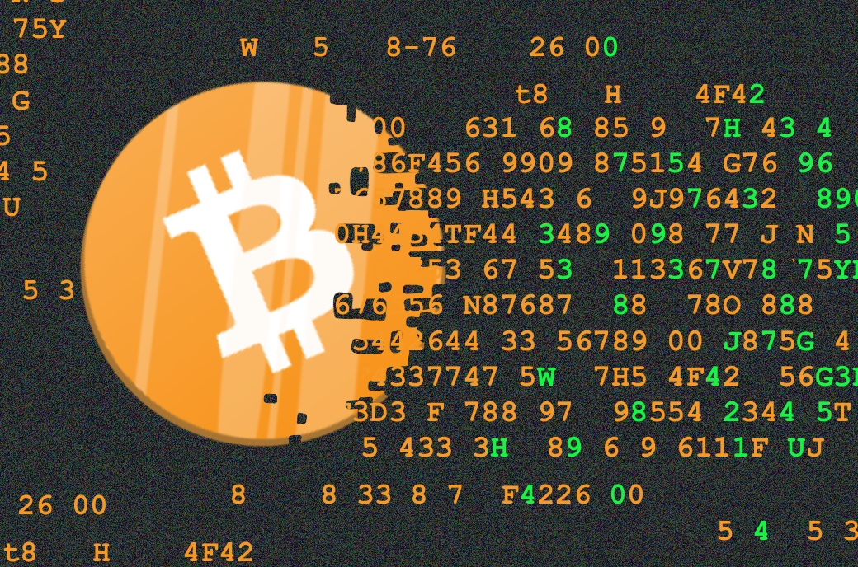
₿
Chapter 3: Bitcoin Core
The reference implementation - download it, verify it, run it, question it
from the owner's 2025 deck
SEN0401 Special Topics in Software Engineering: Block Chain · Fall 2026 · Yusuf Altunel, PhD · İstanbul Kültür University
Notes:
SAY: Chapters 1 and 2 described the system; this chapter hands it to you. By tonight you can be running the same program that wrote the genesis block's successors.
FULL TEXT: course page, chapter 3.

Slide 2
Today's route
₿
Five parts; every number is a slide you can jump to
1
Questions and the chapter map (slides 3-4)
23
slides, numbered bottom-right
2
The node - full, pruned, and the UTXO set (slides 5-7)
3
3
From source to binary - tags, builds, proofs (slides 8-11)
true stories, each with WHO / WHERE / WHEN / READ
4
Running and talking to it - logs, RPC, wallets (slides 12-17)
15
5
The chain as data, summary, and resources (slides 18-23)
live-run examples, shown with their results
Five parts - and by tonight, your own node
2 / 23
Notes:
SAY: Five parts: by the end you can fetch, verify, build, run and query the reference implementation - and every claim on the way arrives with its receipt.
ASK: Who already runs a node? You are today's teaching assistants.
FULL TEXT: course page, chapter 3 - every section.

Slide 3
The questions this chapter answers
₿
Its own competency questions - we return to each
1
Which programs does Bitcoin Core consist of?
2
Which settings and files decide how a node runs?
3
Which numbers does the node report about a transaction and a block?
4
Where do the book's printed outputs differ from the real release 31.1 and the current source?
5
How can a downloaded release and a chosen library be checked before they are trusted?
6
Which terms do the explanations of this chapter rely on?
If you can answer these, chapter 3 is yours
3 / 23
Notes:
SAY: A node is a computer that runs Bitcoin software and takes part in the peer-to-peer network, and this first branch of the chapter is about the most complete kind of node, the full verification node. The chapter opens with the reason such a node exists.
FULL TEXT: course page, chapter 3 - Node.

Slide 4
One chapter, eight branches
₿
The concept map the whole chapter hangs on
Eight branches; the count under each is how many concepts the course page explains for it - today walks the spine.
Node
13 concepts
Build
13 concepts
Operation
19 concepts
Interface
13 concepts
Data
23 concepts
Ecosystem
7 concepts
Semantics
4 concepts
Computing
15 concepts
Eight branches - every slide today lives on this map
4 / 23
Notes:
SAY: A node is a computer that runs Bitcoin software and takes part in the peer-to-peer network, and this first branch of the chapter is about the most complete kind of node, the full verification node. The chapter opens with the reason such a node exists.
FULL TEXT: course page, chapter 3 - Node, Build, Operation, Interface.

Slide 5
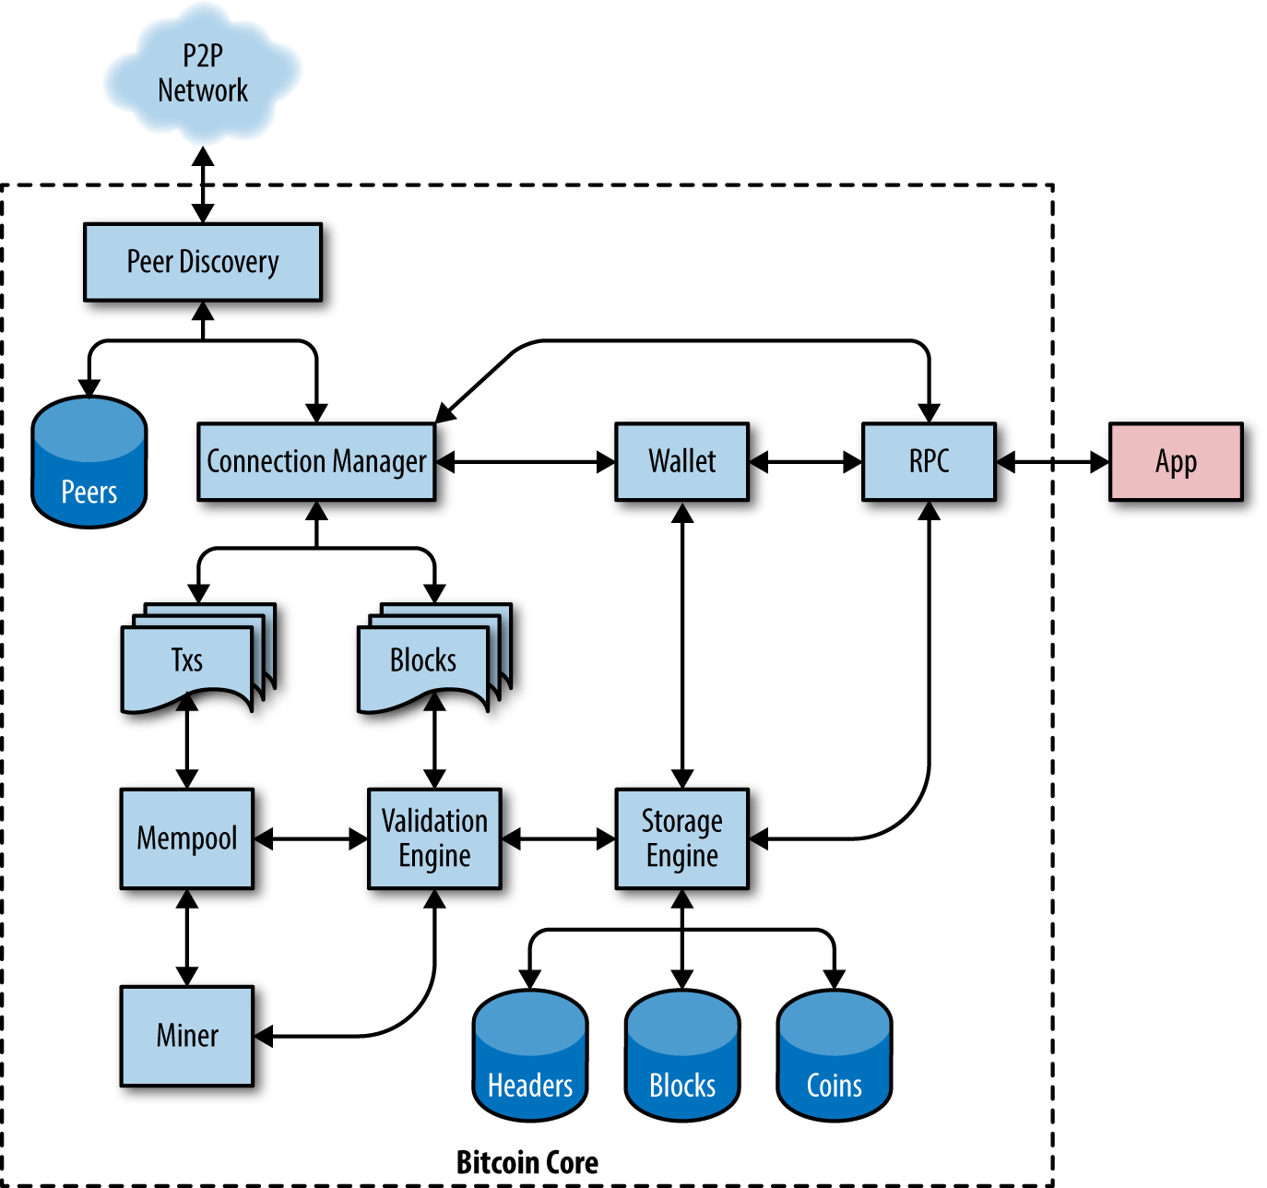
The node
What the reference implementation is, and what it keeps
Full node
Pruned node
Initial download
The UTXO set
Bitcoin Core architecture - Mastering Bitcoin 3e, CC BY-SA
5 / 23
Notes:
SAY: A node is a computer that runs Bitcoin software and takes part in the peer-to-peer network, and this first branch of the chapter is about the most complete kind of node, the full verification node. The chapter opens with the reason such a node exists.
FULL TEXT: course page, chapter 3 - Node.

Slide 6
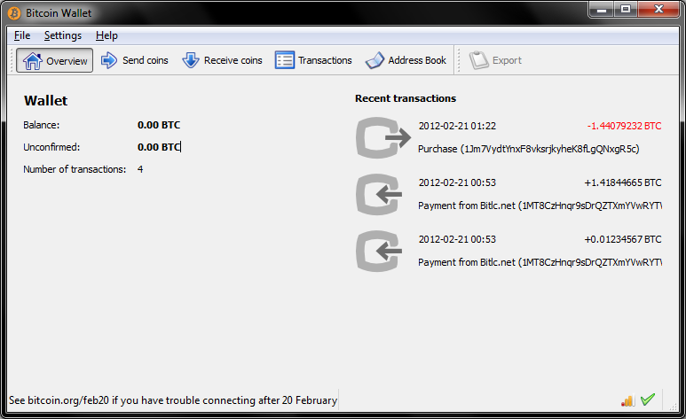
Version 0.1, set in stone
₿
2009-01-09
The Cryptography List
Six days after the genesis block: a runnable Windows program
Friday January 9 2009
'The core design was set in stone' - Satoshi, a year later
Bitcoin v0.1 released
Everything this chapter runs descends from that program
a download on SourceForge
WHO Satoshi Nakamoto, a…
WHERE a Windows build on …
WHEN 2009-…
READ en.wikipe…
The software came first - the program IS the specification
6 / 23
Notes:
STORY (2009-01-09): Six days after the genesis block, Satoshi announced Bitcoin version 0.1 - a Windows program on SourceForge. A year and a half later he wrote the sentence this course keeps returning to: once version 0.1 was released, the core design was set in stone for the rest of its lifetime. Everything this chapter builds, configures and queries descends from that one program, which is why Bitcoin Core is called the reference implementation.
SOURCE: Announcement of 2009-01-09 on the metzdowd.com cryptography list ('Bitcoin v0.1 released'); the 'set in stone' sentence is Satoshi's forum post of 2010-06-17; project history summarized at en.wikipedia.org/wiki/Bitcoin_Core.
IMAGE: the 0.5.2 GUI (MIT licence) - the same program two years on.

Slide 7
One program, many postures
₿
Full, pruned, and the set every posture must keep
Full archive
Pruned
Keeps every block since 2009
Serves history to anyone who asks
Verifies everything, then discards old blocks
550 MB floor - the run checks 5000 >= 550
pruning's floor, checked
IBD: 400 GB at 10 MB/s, in hours
>>> 5000 >= 550
True
>>> 400 * 10 / 1000
4.0
run under Python 3.14.4
run under Python 3.14.4
Same rules, different storage - pruning keeps the checks, drops the history
7 / 23
Notes:
SAY: A pruned node is a full node that deletes old block files after it has verified them, so that it needs far less disk space.
ASK: Which posture still enforces every consensus rule? (both - that is the point)
FULL TEXT: course page, chapter 3 - PrunedNode, InitialDownload.

Slide 8
From source to binary
Trust arithmetic, not downloads
Clone and tags
Reproducible builds
CMake
Tests
8 / 23
Notes:
SAY: The build branch is about turning the text of Bitcoin Core into a program that can run. The book calls this part of the chapter the Bitcoin development environment: the tools, libraries and support software a developer needs for writing Bitcoin applications, which the chapter walks through step by step.
FULL TEXT: course page, chapter 3 - Build.

Slide 9
Clone it, then pick your version by tag
₿
The repository is the publication of record
The chapter corpus itself reads a pinned checkout - commit 05bc2f53 - and the tag list was read live from the public repository on 2026-10-02.
git clone
the whole history
git tag
list the releases
git checkout v...
one exact snapshot
a commit name is 40 hex digits
a tag is just a version, readable
>>> len('05bc2f53ce0cb239c17dbdd6b261bd2db7d2a940')
40
>>> 'v24.0.1'.lstrip('v').split('.')
['24', '0', '1']
run under Python 3.14.4
run under Python 3.14.4
stable today: v31.1
next candidate: v32.0rc3
book's example: v24.0.1
A release is a tag; a tag names one exact snapshot
9 / 23
Notes:
SAY: Git is a distributed version control system, and a repository is the database in which it keeps a project and all of its history. The book calls Git the most widely used distributed version control system and an essential part of the toolkit of every software developer (Antonopoulos and Harding, 2023).
ASK: Why does the course pin a commit instead of saying 'latest'?
FULL TEXT: course page, chapter 3 - GitRepository, ReleaseTag.

Slide 10

Dozens of builders, one identical binary
₿
since 2011; Guix from release 22.0
source at the tag
22.0
Guix builds it, bit for bit
builders compare hashes
first Guix-built release line
signed attestations, public
the project's own icon (MIT)
one hash, many signers - a mismatch would betray itself
The chapter's research re-verified a real release: checksum equal, signatures good, node run
WHO independent Bitcoin Core builders publ…
WHERE the guix.sigs repository beside bitcoi…
WHEN since 2011; Guix…
READ github.com
Verify, don't trust - applied to the software itself
10 / 23
Notes:
STORY (since 2011; Guix from release 22.0): A downloaded binary asks for trust; Bitcoin Core answers with arithmetic. Every release is built reproducibly - first under Gitian, since release 22.0 under Guix - so that anyone compiling the tagged source gets a byte-identical result. Independent builders publish signed hashes of what they produced, side by side, in a public repository. If one build differed, its hash would betray it instantly - the same trick the chapter's Merkle root plays on transactions.
SOURCE: bitcoin-core/guix.sigs on GitHub: per-release folders of builder attestations; Guix build documentation in the pinned source tree, contrib/guix/README.md.

Slide 11
From source to bitcoind
₿
The build branch, compressed to one slide
cmake -B build
configure
compile + link
the toolchain
ctest
the suite must pass
bitcoind
your node
old autotools flag, new CMake flag - one mapping
>>> {'--disable-wallet': '-DENABLE_WALLET=OFF'}['--disable-wallet']
'-DENABLE_WALLET=OFF'
the test the chapter runs: chapter 1's subsidy staircase, as a unit test
run under Python 3.14.4
def subsidy(h):
return 0 if h // 210000 >= 64 else (50 * 10**8) >> (h // 210000)
result = [subsidy(h) for h in (0, 209999, 210000, 630000, 775072)]
result [5000000000, 5000000000, 2500000000, 625000000, 625000000]
program SoftwareTesting, lines 1 to 3 of 3, run under Python 3.14.4
The build system turns audited text into your node
11 / 23
Notes:
SAY: CMake is the build system that Bitcoin Core has used since release 29.0. The manual of CMake explains its role: a buildsystem describes how to build a project's executables and libraries from its source code using a build tool to automate the process, and CMake lets a project describe its buildsystem abstractly in files written in the CMake language, from which it generates a preferred buildsystem for each user (Kitware, 2026).
ASK: Why does the project treat review and tests as the bottleneck?
FULL TEXT: course page, chapter 3 - CMakeBuild, SoftwareTesting.

Slide 12
Running and talking to it
A daemon, a log that explains itself, and one protocol
First run
The daemon
bitcoin-cli
JSON-RPC
12 / 23
Notes:
SAY: Operation is the second large part of the chapter, and it is about what happens after the software has been built or downloaded: how a node is started, how it is configured, how its state is observed, and what kind of wallet comes with it.
FULL TEXT: course page, chapter 3 - Operation.

Slide 13
The log narrates everything the node decides
₿
A real 31.1 startup, captured for this chapter
one line of the captured log, parsed
1
First run creates the data directory and a config
>>> log = 'Starting HTTP server with 16 worker threads'
>>> next(l for l in log.splitlines() if 'worker threads' in l).split()[-3]
'16'
2
The log names every subsystem as it wakes
3
The run reads the real log: 16 worker threads
run under Python 3.14.4
the systemd unit's own flags, extracted from the pinned source tree
>>> text = DAEMON_D1
>>> line = text.split('\nExecStart=')[1].split('ExecStartPre')[0]
>>> [w.split('=')[0] for w in line.split() if w.startswith('-') and not w.startswith('--')]
['-pid', '-conf', '-datadir', '-startupnotify', '-shutdownnotify']
run under Python 3.14.4
When a node misbehaves, the log already wrote the diagnosis
13 / 23
Notes:
SAY: The start-up log is the stream of messages that the node writes while it starts, and afterwards as it runs. With the option that sends the log to the console it appears in the terminal, and otherwise it goes to a file called debug.log in the data directory, as the documentation of the data directory states (Bitcoin Core, 2026).
ASK: Where would you look first when a node misbehaves? (the answer is this slide's title)
FULL TEXT: course page, chapter 3 - StartupLog, Daemon.

Slide 14
The project that outlives its keyholders
₿
2011 and 2014
Satoshi
2009: v0.1
Gavin Andresen
2011: the handoff
W. van der Laan
2014: lead maintainer
many maintainers
today
The faucet builder of chapter 2 is the 2011 keyholder here
Hundreds of contributors; no one has been indispensable since
WHO Satoshi Nakamoto to Gavin Andresen (20…
WHERE the public bitcoin/bitcoin repository
WHEN 2011 and 2014
READ en.wikipedia.org
Maintainers change; the repository and its rules remain
14 / 23
Notes:
STORY (2011 and 2014): Bitcoin Core is the program Satoshi published in January 2009, still developed in public. In 2011 Satoshi handed the project to Gavin Andresen - the faucet builder of chapter 2 - and withdrew. In April 2014 Andresen passed the lead-maintainer role to Wladimir van der Laan to focus on protocol work. Hundreds of contributors and several maintainers later, the repository, its tags and its releases carry on; no single person has been indispensable since.
SOURCE: Repository history of bitcoin/bitcoin (the chapter's pinned checkout is commit 05bc2f53); maintainer handoffs of 2011 and April 2014 as recorded in the project history and summarized at en.wikipedia.org/wiki/Bitcoin_Core.

Slide 15
Talking to the node: bitcoin-cli and JSON-RPC
₿
One protocol under every interface
bitcoin-cli
or any HTTP client
JSON request
method + params
bitcoind
cookie-authenticated
JSON answer
machine-readable
a real request body, built and read back
>>> import json
>>> body = json.dumps({'jsonrpc': '1.0', 'id': 'curltest', 'method': 'getblockchaininfo', 'params': []})
>>> json.loads(body)['method']
'getblockchaininfo'
run under Python 3.14.4
'main'
0
True
chain, from the captured getblockchaininfo
blocks still to verify
initial download complete
Every GUI and every explorer speaks this same protocol
15 / 23
Notes:
SAY: JSON-RPC is a protocol for remote procedure calls whose messages are written in JSON. Its specification describes it as a stateless, light-weight remote procedure call protocol that defines a few data structures and the rules for processing them, independent of the transport, so that the same messages may travel within a process, over sockets or over HTTP (JSON-RPC Working Group, 2013).
ASK: Your phone wallet never shows this - what is it speaking underneath?
FULL TEXT: course page, chapter 3 - JsonRpc, BitcoinCommand.

Slide 16
Wallets are descriptors now
₿
One line states what the wallet watches
Descriptor wallet (today)
Legacy wallet (retired)
A readable expression names keys and script type
Ends in a checksum, like an address does
A bag of loose keys in a binary file
Removed from current Bitcoin Core
the tail of the chapter's descriptor program - the checksum the node itself confirms
symbols = descsum_expand(s[:-9]) + [CHECKSUM_CHARSET.find(x) for x in s[-8:]]
return descsum_polymod(symbols) == 1
def descsum_create(s):
symbols = descsum_expand(s) + [0, 0, 0, 0, 0, 0, 0, 0]
checksum = descsum_polymod(symbols) ^ 1
return s + '#' + ''.join(CHECKSUM_CHARSET[(checksum >> (5 * (7 - i))) & 31] for i in range(8))
result = descsum_create('wpkh(02f9308a019258c31049344f85f89d5229b531c845836f99b08601f113bce036f9)')[-9:]
result '#8zl0zxma'
program OutputDescriptor, lines 34 to 40 of 40, run under Python 3.14.4
A descriptor states, in one line, what the wallet watches
16 / 23
Notes:
SAY: A descriptor wallet is a wallet whose content is a set of output descriptions, each stating one family of scripts that the wallet can receive to and spend from. Bitcoin Core's documentation says that its code internally stores and operates on descriptors to reason about the sets of outputs that belong to the wallet (Bitcoin Core, 2026).
ASK: What does the # suffix buy you when you mistype one character?
FULL TEXT: course page, chapter 3 - DescriptorWallet, LegacyWallet.

Slide 17
Decode a real transaction
₿
The node explains Alice's payment back to us
1
Chapter 2 built Alice's payment; here the real node decodes the real thing
2
Two outputs come back typed: a taproot payment and taproot change
3
Full parse (version, marker, flag, ins, outs, locktime) = (1, 0, 1, 1, 2, 0); flip one witness byte and (wtxid equal, txid equal) = (False, True)
the outputs, as the node reports them
>>> [(o['n'], o['value'], o['scriptPubKey']['type']) for o in json.load(io.StringIO(DECODEDTRANSACTION_D1))['vout']]
[(0, 0.0002, 'witness_v1_taproot'), (1, 0.00075, 'witness_v0_keyhash')]
txid and wtxid, computed from her raw bytes
run under Python 3.14.4
locktime = int.from_bytes(raw[i:i + 4], 'little')
stripped = raw[:4] + raw[6:out_end] + raw[wit_end:]
txid = d(stripped)[::-1].hex()
wtxid = d(raw)[::-1].hex()
result = (txid[:16], wtxid[:16])
result ('466200308696215b', 'f7cdbc7cf8b910d3')
program TransactionIdentifier, lines 44 to 48 of 48, run under Python 3.14.4
The node explains any transaction - Alice's included
17 / 23
Notes:
SAY: A decoded transaction is the structure that results from reading the bytes of a serialized transaction and naming each field. The command decoderawtransaction takes the hexadecimal string and returns a JSON object (Antonopoulos and Harding, 2023).
ASK: Which of the two identifiers survives a witness change, and why does that matter?
FULL TEXT: course page, chapter 3 - DecodedTransaction, TransactionIdentifier.

Slide 18
The chain as data
Headers, roots, and the same node from your own code
The 80-byte header
Merkle root, recomputed
Libraries
Semantics
18 / 23
Notes:
SAY: The data branch is about what a node holds and what the interface shows of it: the transactions that move value, the blocks that gather them into the shared record, and the state of the chain that results.
FULL TEXT: course page, chapter 3 - Data.

Slide 19
The header is 80 bytes of commitment
₿
Block 123,456's root, recomputed from its transactions
the six fields, summed
>>> 4 + 32 + 32 + 4 + 4 + 4
80
80
0e60651a...
bytes that pin the whole block
block 123,456's Merkle root, recomputed
run under Python 3.14.4
the whole program: pair, hash, repeat - against a real block
import hashlib
d = lambda b: hashlib.sha256(hashlib.sha256(b).digest()).digest()
level = [bytes.fromhex(t)[::-1] for t in MERKLEROOT_D1.split()]
while len(level) > 1:
if len(level) % 2: level.append(level[-1])
level = [d(level[i] + level[i + 1]) for i in range(0, len(level), 2)]
result = level[0][::-1].hex()
result '0e60651a9934e8f0decd1c5fde39309e48fca0cd1c84a21ddfde95033762d86c'
program MerkleRoot, lines 1 to 7 of 7, run under Python 3.14.4
Eighty bytes pin megabytes - that is the whole trick
19 / 23
Notes:
SAY: The block header is the summary at the head of every block.
ASK: Chapter 2 drew this tree with toy leaves - what changed here? (nothing but the data)
FULL TEXT: course page, chapter 3 - BlockHeader, MerkleRoot.

Slide 20
The chapter as data, and in one library call
₿
Your scripts and the course page read the same node
1
A wrapper library turns the RPC protocol into one function call
2
And the course page stores what you just learned as triples with provenance - same discipline
the whole program: the request a library builds for you
import json
class Proxy:
def __getattr__(self, name):
return lambda *args: json.dumps({'version': '1.1', 'method': name, 'params': list(args), 'id': 1})
result = Proxy().getblockhash(1000)
result '{"version": "1.1", "method": "getblockhash", "params": [1000], "id": 1}'
program WrapperLibrary, lines 1 to 5 of 5, run under Python 3.14.4
python-bitcoinlib
JSON-RPC
triples
provenance
The course page and your scripts read the same node
20 / 23
Notes:
SAY: The semantics branch connects the chapter to the course's wider theme, the meaning of data. A node answers every request in the JSON text format, a structure of names and values, which a program can read but whose names carry no meaning of their own; the field called height in a block's answer means what the documentation says it means, and nothing in the text states it.
FULL TEXT: course page, chapter 3 - Semantics.

Slide 21
The chapter in five lines
₿
One line per part - each one provable from its slides
1
Bitcoin Core descends from v0.1 of 2009 - the program IS the specification
2
A release is a tag on a public repository; reproducible builds make the binary provable
3
The node narrates itself: a data directory, a config, and a log that explains decisions
4
Everything speaks JSON-RPC underneath - your scripts can too, today
5
80 header bytes commit to the whole chain - the Merkle root we recomputed is the hinge
If a line feels unproven, its part's slides carry the receipt
21 / 23
Notes:
SAY: Five lines, one per part; the agenda names the slides that prove each.
ASK: Which line would you defend first, and with which slide?
FULL TEXT: course page, chapter 3 - every section.

Slide 22
Where to go from here
₿
Checked 2026-10-06; every entry is a live link in this file
Read
Talk to a node
This chapter, free (CC BY-SA) github.com/bitcoinbook/bitcoinbook/blob/develop/ch03_bitcoin-core.adoc
RPC reference, every method developer.bitcoin.org/reference/rpc/
Bitcoin Core's own site and releases bitcoincore.org
Bitcoin Stack Exchange Q&A bitcoin.stackexchange.com
The source, at any tag github.com/bitcoin/bitcoin
History
Verify & build
Bitcoin Core, the project's story en.wikipedia.org/wiki/Bitcoin_Core
Builder attestations (guix.sigs) github.com/bitcoin-core/guix.sigs
Pro Git, free - the tool under it all git-scm.com/book
Build documentation in-tree github.com/bitcoin/bitcoin/tree/master/doc
Clone, verify, build, run - the whole chapter is one evening of commands
22 / 23
Notes:
SAY: Everything here is free. The homework writes itself: clone, checkout the newest tag, build, and bring your log's worker-thread line to class.
ASK: Who will have a pruned node syncing before Friday?
FULL TEXT: course page, chapter 3 - Ecosystem.

Slide 23
What you should now be able to say
And where each claim gets its proof
Where the program comes from, and how to pick a version
Why a verified build beats a trusted download
What the daemon writes, and how to ask it anything
How 80 bytes commit to everything beneath them
Questions?
23 / 23
Notes:
SAY: Four claims, each carried by something you watched run - a log, a request, a recomputed root. Next: the keys and addresses that make ownership work.
FULL TEXT: course page, chapter 3.

